Slide 1
KEK BPM (18K12) Status Report
2013/June/27
Ryo Ichimiya (KEK)
rev. 2.20（+Eng.）

Slide 2
Candidates to get worth position resolution
BPF, ADC input circuit may operate in non-linear region.
Tails of BPF output spectrum exceeds Nyquist window (250-375MHz) and it makes folding noise.
Triple harmonic (900MHz) also may cause folding noise.
Analogue noise from DC-DC converter etc. introduces GND wobble, EMI and so forth.

Slide 3
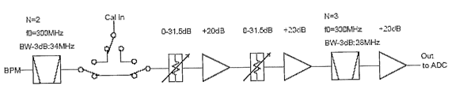

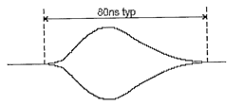
Block diagram
Overview
cal. pulsar(300MHz)
[specifications]
Gain: 32.5dB(confirmed)
Max Output: +12dBm
(2.5Vpp)
Analogue Frontend
1ns
Att.(pre)
0-31.5dB
Att.(post)
0-31.5dB
*These tests presented in this slide have been performed with Pre:8dB, Post:0dB setting. Total BPF gain is +24.5dB(x16.8).

Slide 4
ADC input circuit
250MHz
(fs)
300MHz
250MHz
(fs)
300MHz

Slide 5
22pF -> Snubber circuit
Thanks to Adrew’s suggestion and modification, we have achieved +10dB at ADC input with this snubber circuit than 22pF, which also prevents ADC malfunction.
Snubber circuit
From ADC9467 Datasheet

Slide 6
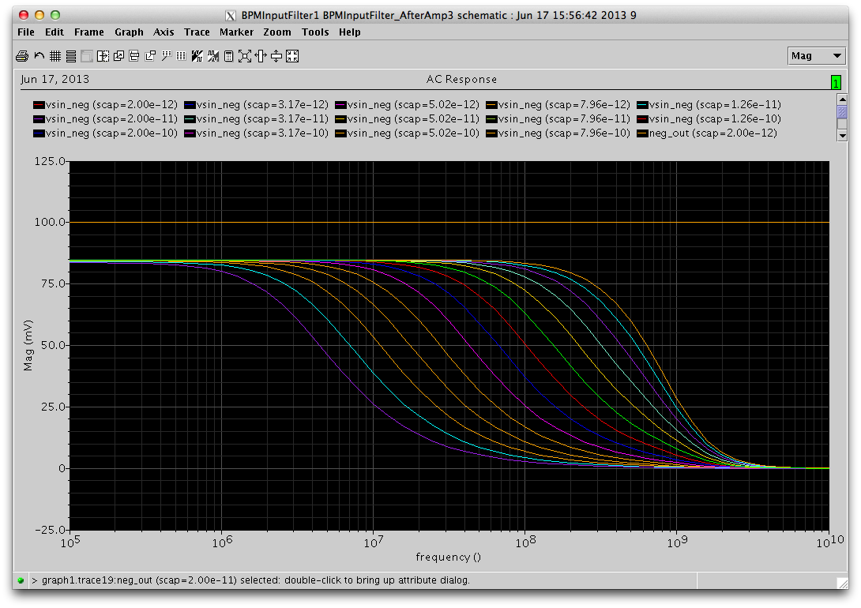
22pF (before modification)
HSPICE simulation
Gain: 1/3 (-10dB) at 300MHz.
Lower capacitance behaves unstable, so cannot reduce its capacitance.
３００MHｚ
２０ｐF

Slide 7
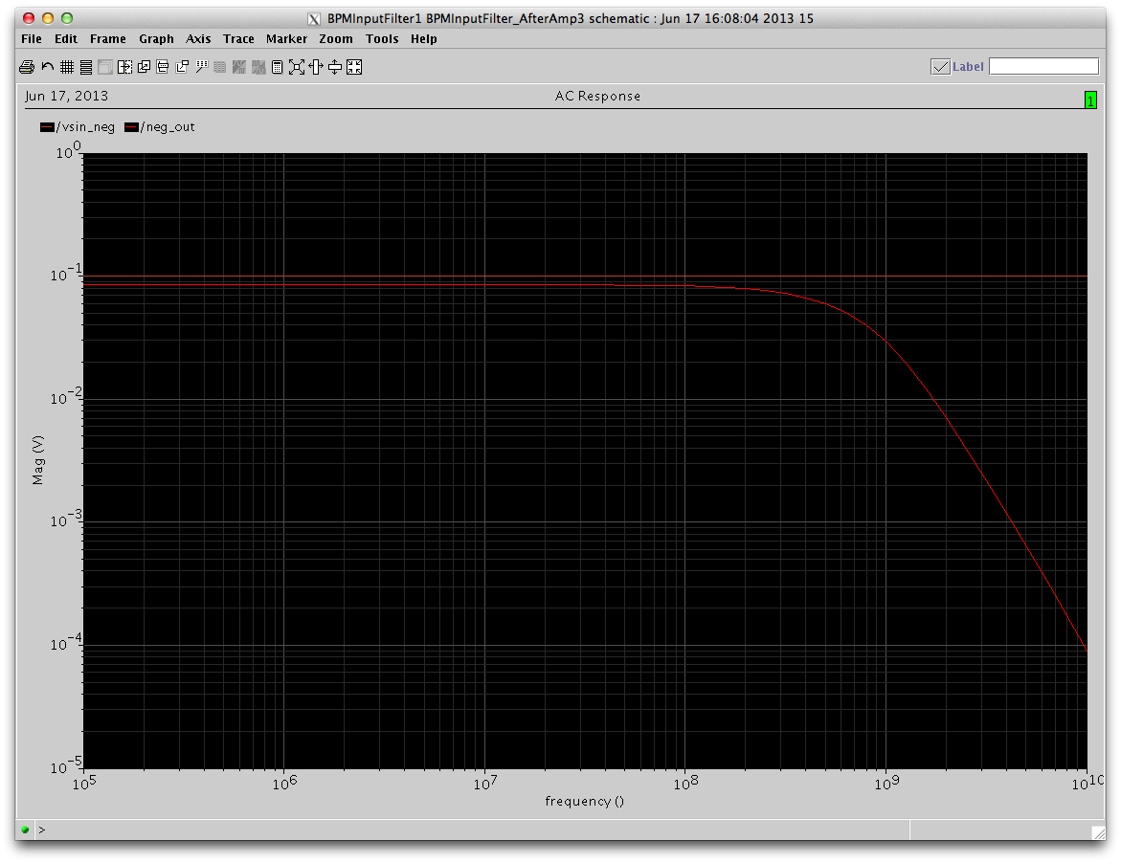
Snubber circuit (after modification)
HSPICE simulation
Almost no gain drop at 300MHz.
Implement on ch1, ch2 on #2 board.
３００MHｚ
Snubber
Circuit

Slide 8
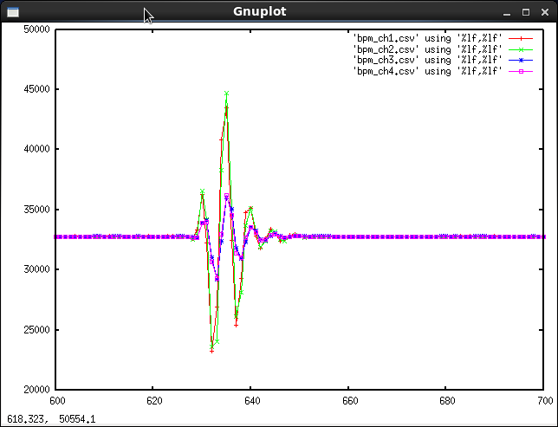
ADC output
Consistent with calculation. x3 gain (+10dB).
Proved it also suppress the ADC malfunction.

Slide 9
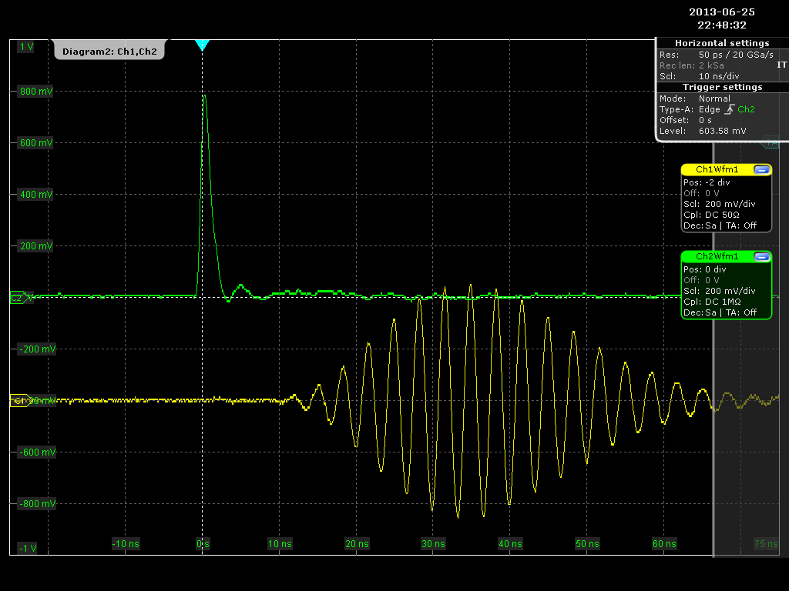
Block diagram of 1kV pulsar test
1:2
BPM
Readout (Pre:8dB
Post:0dB)
１ｋV
Pulsar
40dB
Att.
variable
Att.x2
1:2
1:2
０−７０ｄB
０−１１ｄB
Pulse
Gen.

Slide 10
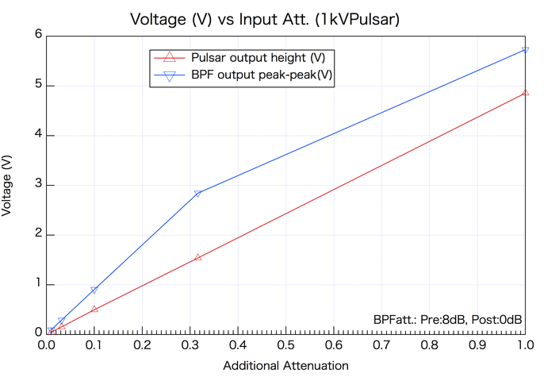
Linearity check (1)
Attenuator output shows good linearity from 40dB to 0dB.
BPF output shows good linearity up to 2.85V(10dB) [Spec.2.5Vpp], but after that it shows non-linear behavior. Also lower part of waveform has distortion.
2.85V(10dB)
4.8V(Att.:0dB)
corresponds to the BPM output at 1nC.
497mV(20dB)
0.1nC
48mV(40dB)
0.01nC

Slide 11
ADC input circuitry
-4dB
IL: -0.4dB
+6dB
ADL5562
Po1dB=4.9Vpp
(1dB compression point)
-> corresponding input level is 2.46Vpp (11.8dBm).
Acceptable input power:
11.8dBm+4dB+0.4dB=16.2dBm (4.08Vpp)

Slide 12
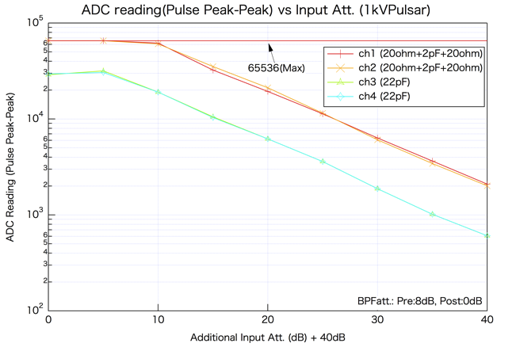
Linearity check (2)
Semi-Log plot of ADC output peak-peak difference v.s. Attenuator setting.
ch1, ch2 has x3 (+10dB) gain with snubber circuit.
Observed ADC over level at 10dB setting for ch1, ch2 at lower limit (ADC reading is 0).
At 0-5dB, ch3 and ch4 have been saturated.
In this setting, >10dB attenuator setting is required to keep linearity.

Slide 13
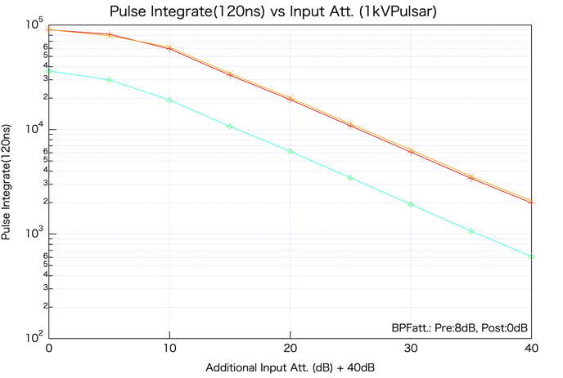
Linearity check (2)
To check it more precisely, integration of ADC reading (same manner to calculate position resolution) v.s. attenuator setting is shown.
Also at lower than 10dB, it seems saturation.

Slide 14
Folding noise at ADC
Tails over the Nyquist window (250MHz - 375MHz) become folding noise.
50MHz
(folded
signal)
Power
(dBm)
300MHz
(signal)
BPF
Spectrum
Folding noise
125
(Nyquist)
250
(fs)
300
375
500
625
Frequency
(MHz)

Slide 15
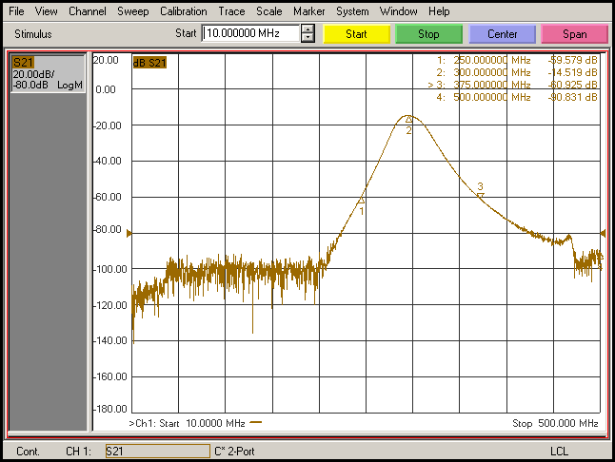
Frequency response of the Band Pass Filter (S21)
250MHz
375MHz
Notes:
Todo: measure the BPF bandwidth

Slide 16
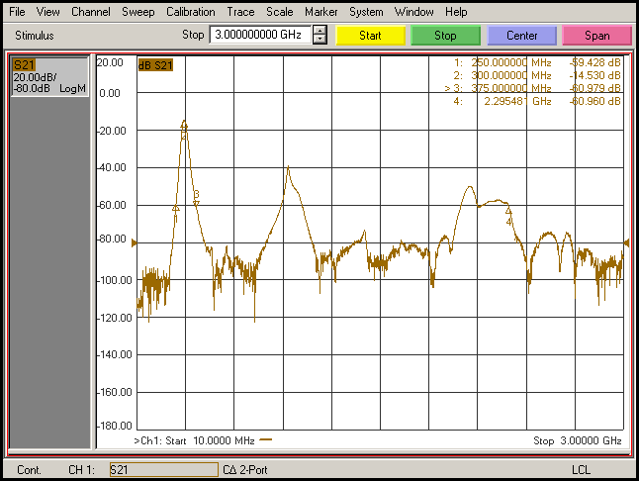
Frequency response of the Band Pass Filter (S21)
300MHz
900MHz

Slide 17
Double Pulse test
To test in more realistic conditions, two bunch signal is emulated by combining 100ns (20m) delayed and 2ns delayed signal. 50 events has been taken with this setting.
Att. Pre:8dB, Post:0dB, 40dB+ Additional: 20dB
Data: ~ryo/vxworks/work/data/2013June19_exPulsar1kV_no2_doubled/
100ns(20m)
1:2
BPM
Readout (Pre:8dB
Post:0dB)
１ｋV
Pulsar
40dB
Att.
Variable
Att.x2
1:2
2ns
1:2
０−７０ｄB
０−１１ｄB
Pulse
Gen.
 | 1st | 2nd
ch1, 2(X) | 12.2um | 13.6um
ch3, 4(Y) | 9.5um

Slide 18
Harmonics (600, 900MHz) reduction with external LPF
When 300MHz CW input, double harmonic (600MHz), triple harmonic (900MHz) were observed at about -15dB down to the fundamental.
When LPF (Mini Circuit VLFX-300) is inserted at BPF output, harmonics have been suppressed to almost the BG level (>53dB suppression). In this setting 100 events data were taken.
Att. Pre:8dB, Post:0dB, 40dB+ Additional: 20dB
Data: ~ryo/vxworks/work/data/2013June20_exPulsar1kV_no1/
 | 1st | 2nd
ch1, 2(X) | 11.9um | 14.4um
ch3, 4(Y) | 9.8um
No significant difference were observed.

Slide 19
Beam Test
As we can get about 10um position resolution constantly with pulsar, we confirmed it with beam signal.
Beam signal were divided to two input signal to emulate ideal (no beam position jitter) beam signal.
20m
1:2
BPM
Readout (Pre:8dB
Post:0dB)
sp34-4-1 (X+)
sp34-4-3 (X-)
1:2
EVR
(3sub)
TTL/NIM

Slide 20
Beam Test (cont’d)
300events data were taken.
@3-2, PFE 5Hz, 0.3nC
Att. Pre:8dB, Post:0dB <= Set this value to keep input <3Vpp.
Data: ~ryo/vxworks/work/data/2013June19_beam_ch12fanout_doubled_ch34_fanout/
 | 1st | 2nd
ch1, 2(X) | 11.9um | 14.4um
ch3, 4(Y) | 9.8um
At previous test (May 29th):
@3-2, PFE 1Hz, 0.5nC
Att. Pre:0dB, Post:0dB single pulse
Data: ~ryo/vxworks/work/data/2013May29_beam_ch12fanout_ch34fanout/
ch1, 2(X) | 53.8um
ch3, 4(Y) | 30.7um
Confirmed that the worse position resolution were caused by input saturation.

Slide 21
Beam test (cont’d)

Slide 22
Beam Test (cont’d)
100 events were taken with 0.45nC.
Att. Pre:8dB, Post:0dB, 40dB+ Additional: 20dB
Data: ~ryo/vxworks/work/data/2013June19_beam_ch12fanout_doubled_ch34_fanout-no2/
Event#59 were rejected from analysis because it contains ADC malfunction.
 | 1st | 2nd
ch1, 2(X) | 5.7um | 8.2um
ch3, 4(Y) | 5.1um
Better position resolution than 0.3nC. Position resolution may be limited by signal source S/N. (i.e. 1kV pulsar might have not a good S/N than high charge beam.)

Slide 23
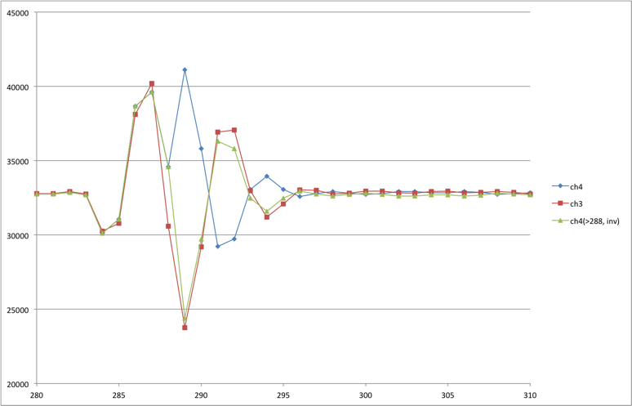
#59 event data
Suddenly waveform sign were inverted after time > 288
Have to check ADC clock delay IC.

