Slide 1

Control System Studio
- CSS -
Overview
Kay Kasemir, Ph.D.
ORNL/SNS
kasemirk@ornl.gov
June 2011 at KEK

Slide 2
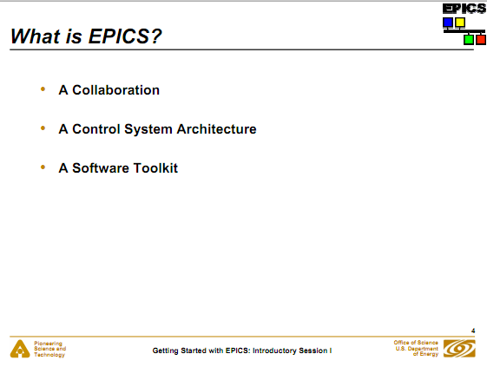

What is CSS ?
Answer: Same as EPICS!
Ned Arnold et al, http://aps.anl.gov/bcda/epicsgettingstarted/introduction/epics_intro_pt1.pdf

Slide 3
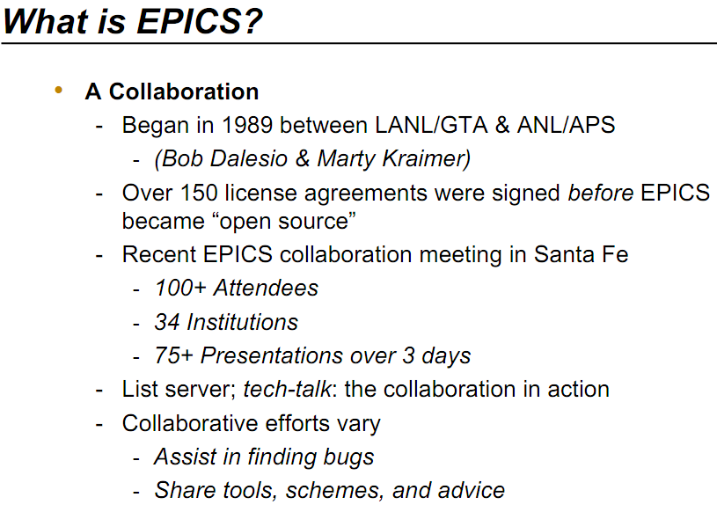

CSS: A Collaboration
Began in 2006 between
DESY and SNS
Joined by CLS, APS, BNL,
, Diamond, …, KEK/J-PARC?
: https://sourceforge.net/apps/trac/cs-studio/wiki
  Wiki, Mailing lists, code repository
Growing presence at EPICS meetings
Benefits from Eclipse community
  EclipseCon 2011: Way over 500 participants from ~30 countries

Slide 4


CSS: A Control System Architecture
  Portable programming environment with very good development tools
  Basic bundling: Java Archive Files (JARs)
Rich Client Platform (RCP)
  Extensible bundling: Plug-Ins, Extension points, Registry
  Framework for GUI with menus, windows, sub-panels, online help, preferences, …

Slide 5
CSS: A Software Toolkit
Library Plug-Ins
  Life data access, Historic Data Access, Control system data types (PV, Sample, …), Logbook , EMail, Authentication, Authorization, …
  Pluggable
    Historic Data: XML-RPC, RDB, …
    Authentication: Kerberos, LDAP, …
Application Plug-Ins
  Strip-Chart: Data Browser
  OPI: SDS, BOY
  Alarms: NAMS, BEAST
  Archive: DESY Archive, BEAUTY
  Utilities: Probe, Clock , PV Tree , Psychiatrist
  List of plugins: http://cs-studio.sourceforge.net/plugins.html

Slide 6



Who uses it, and how?
 |  | NSLS2 | Your Site
Data Browser, Probe, EPICS PV Tree | Data Browser, Probe, EPICS PV Tree | Data Browser, Probe, EPICS PV Tree | Same?
SDS | BOY | BOY | ?
NAMS | BEAST | BEAST | ?
NameSpaceBrowser | PV Util, Rack Util, PV Fields Viewer | Channel Finder | ?
log4j, slf4j | java.util.logging | java.util.logging
Compare to EPICS:
EDD/DM, MEDM, DM2K, EDM
SDDS, Channel Archiver
ALH
IOC Log, CM Log
  See also https://sourceforge.net/apps/trac/cs-studio/wiki/CompareProducts

Slide 7
Confused, yet?
Collaboration?
Architecture?
Toolkit?
So what does it do??

Slide 8


Architecture, Toolkit, Collaboration:
Users don’t care.
What does it look like? What can I do with it?
?
?

Slide 9
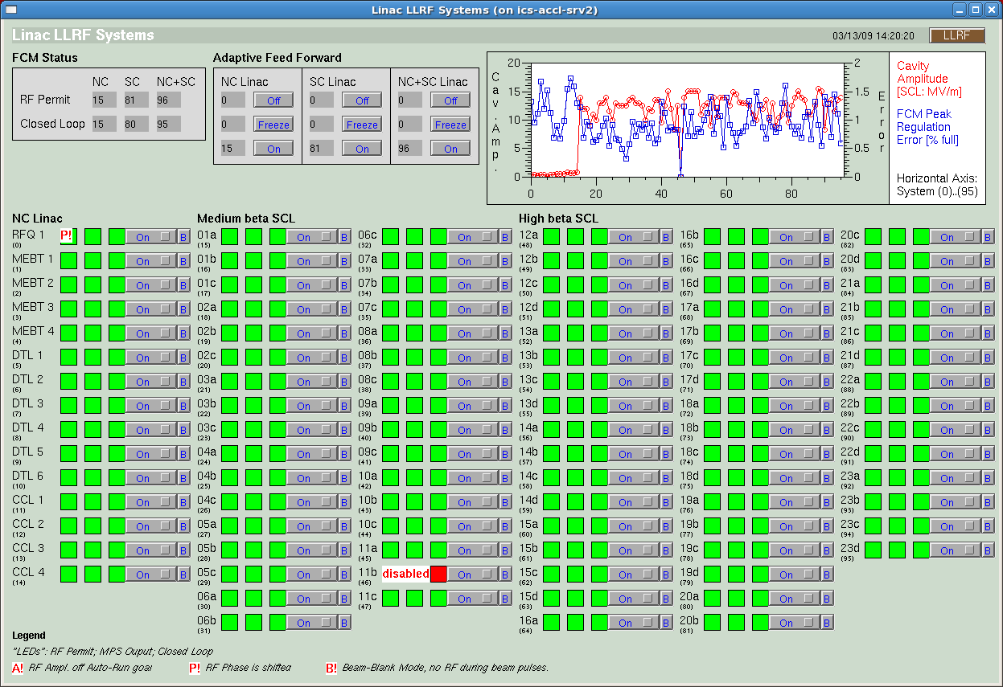
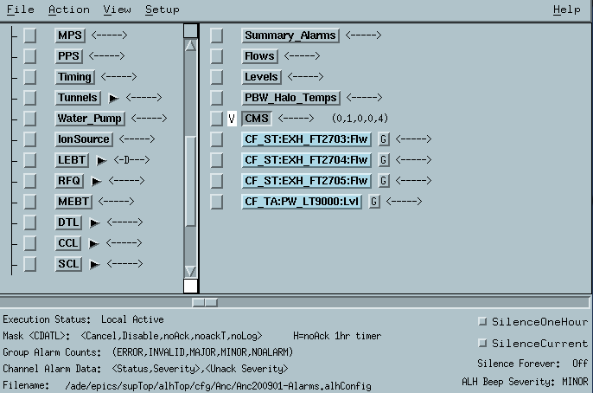
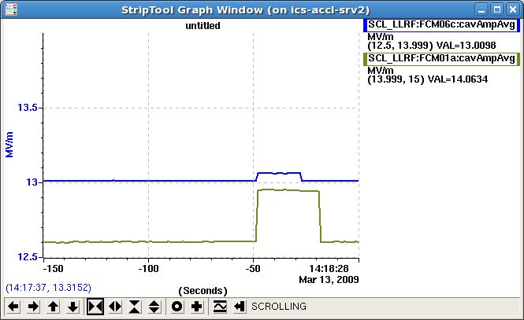
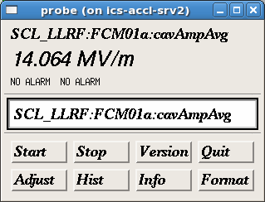
Original EPICS Operator Interface
primarily for Linux/X11
Many disjoint tools
  Inconsistent Look
  Static layout
  Online help?
  Data exchange: at best copy/paste PV names

Slide 10
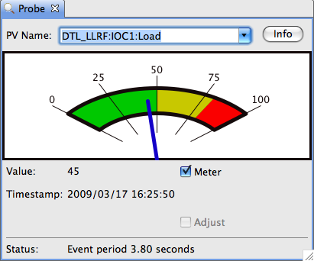
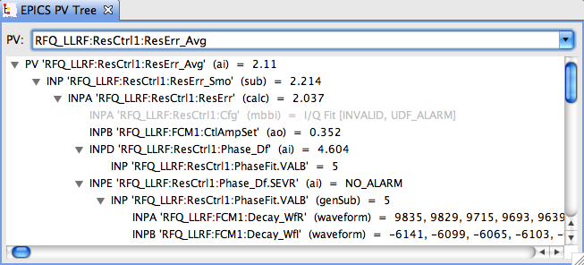
Basic CSS Tools
Probe
  Current value of a PV
EPICS PV Tree
  Trace PV links
  Resize
  Scrollbars
  Drop-downs
  keep previous
  entries

Slide 11
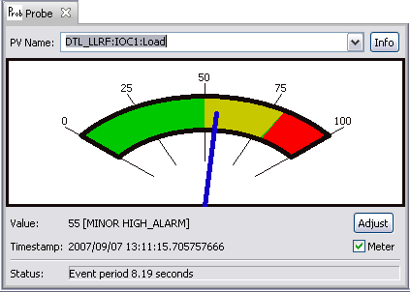
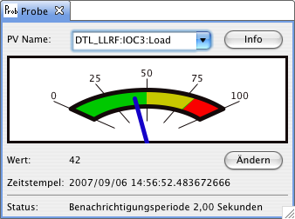
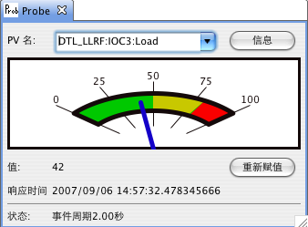
Localization
Eclipse
  IDE helps to localize texts
  Runtime follows
  operating system settings
CSS Translations
  All: (US) English
  Most: German
  Few: French, Chinese
  Could be 日本!

Slide 12
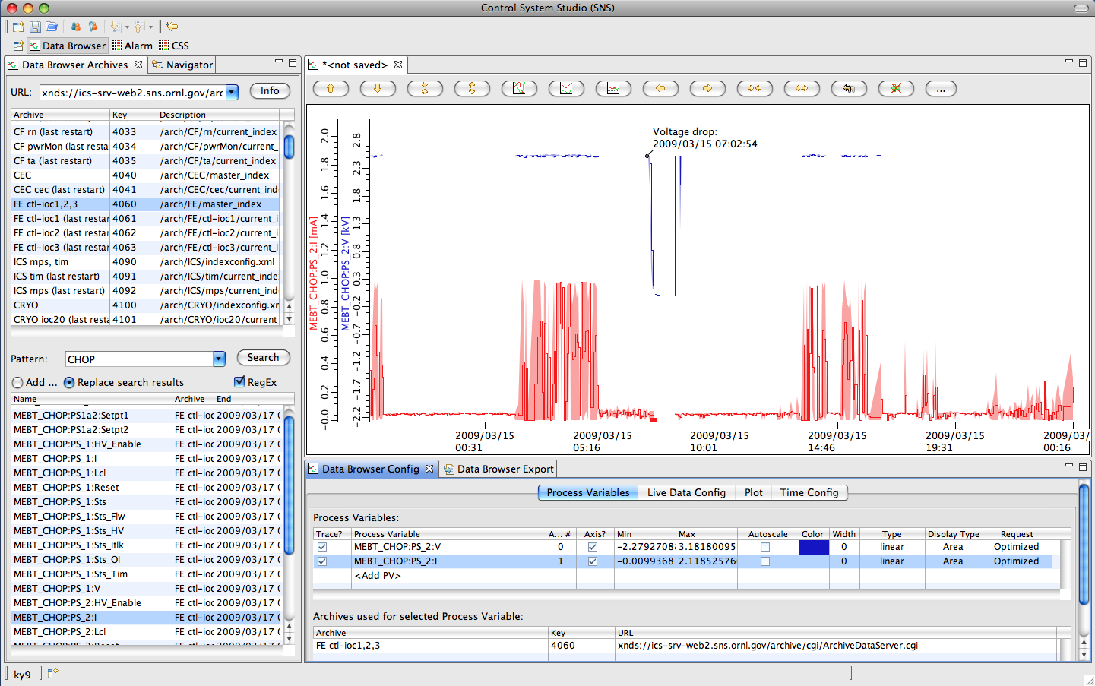
Data Browser
Plot ‘live’ and historic data over time

Slide 13
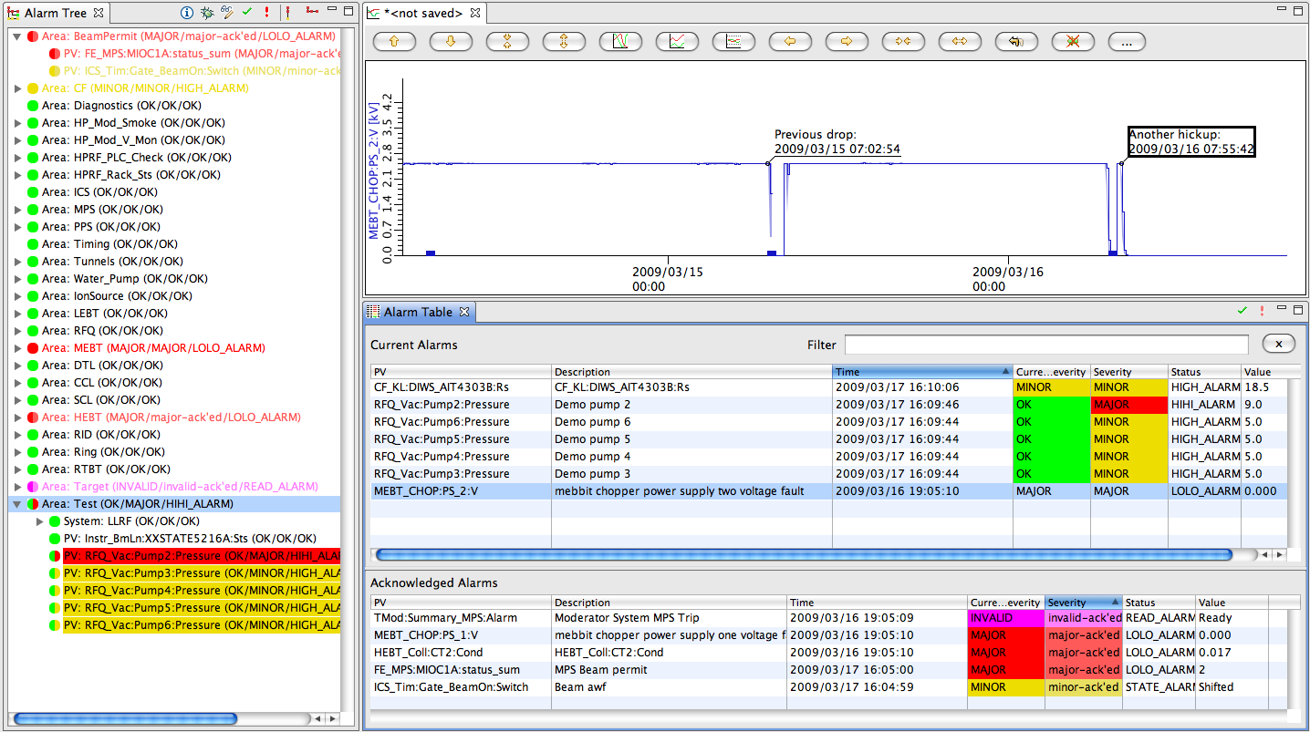
Alarm System (BEAST)
Tabular or Tree view, voice annunciations, …
Select by Name, Description
Acknowledge
Sort by Time,
Severity, …

Slide 14
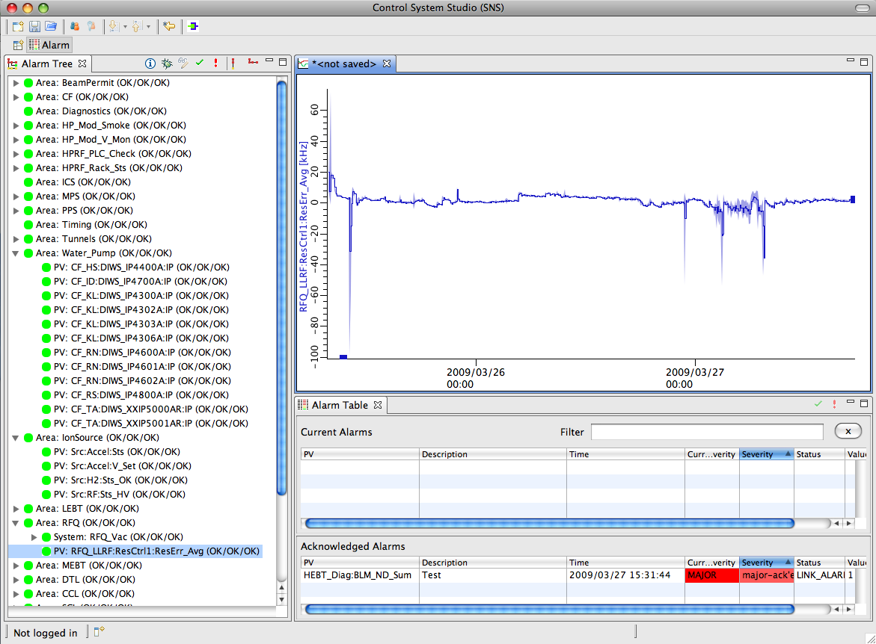
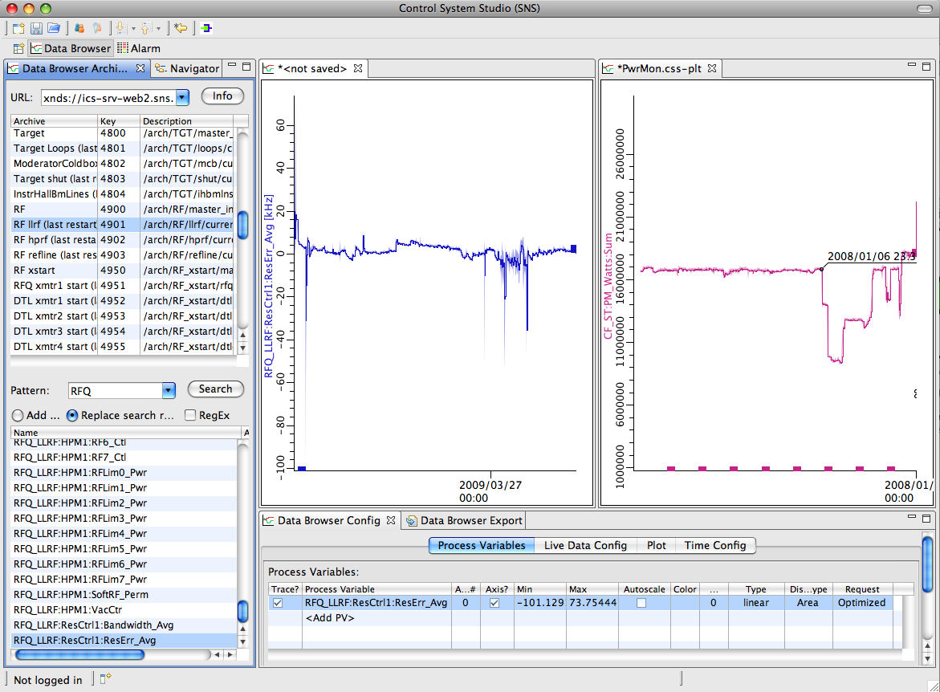
Eclipse Benefit: Flexible Layout
Panels can be closed, reopened, repositioned
Multiple Perspectives
  Name, Save, Restore
Multiple document instances share same configuration panels

Slide 15
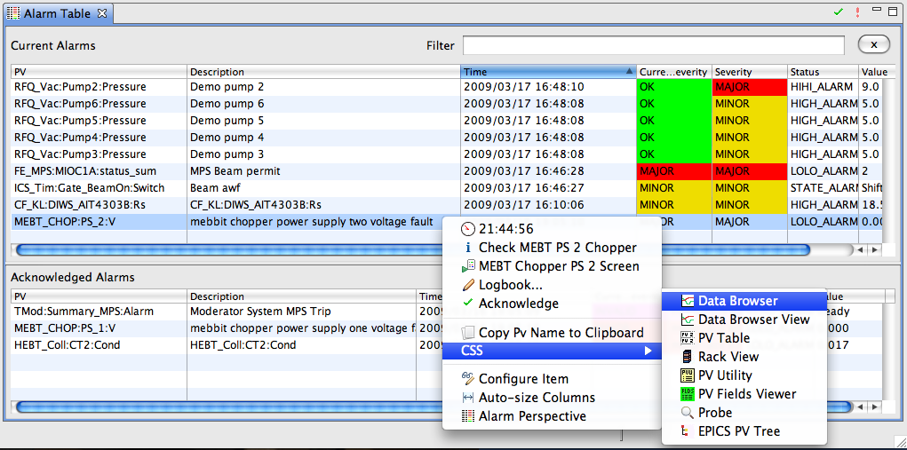
CSS PV Exchange
PVs in any CSS Tool
➔ Context Menu ➔ Select other PV Tools
  Opens other tool with that PVs

Slide 16
Example Work Flow: React to Alarm
Inspect history of PV, annotate
3
2
1

Slide 17
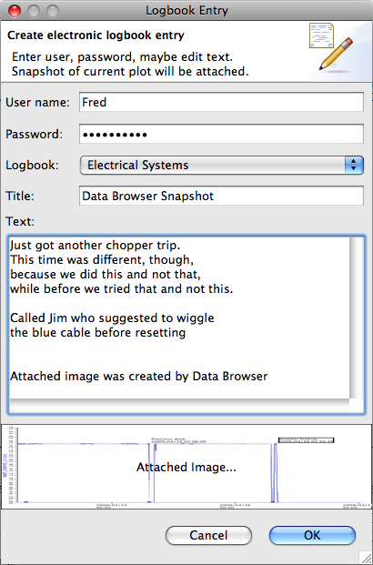
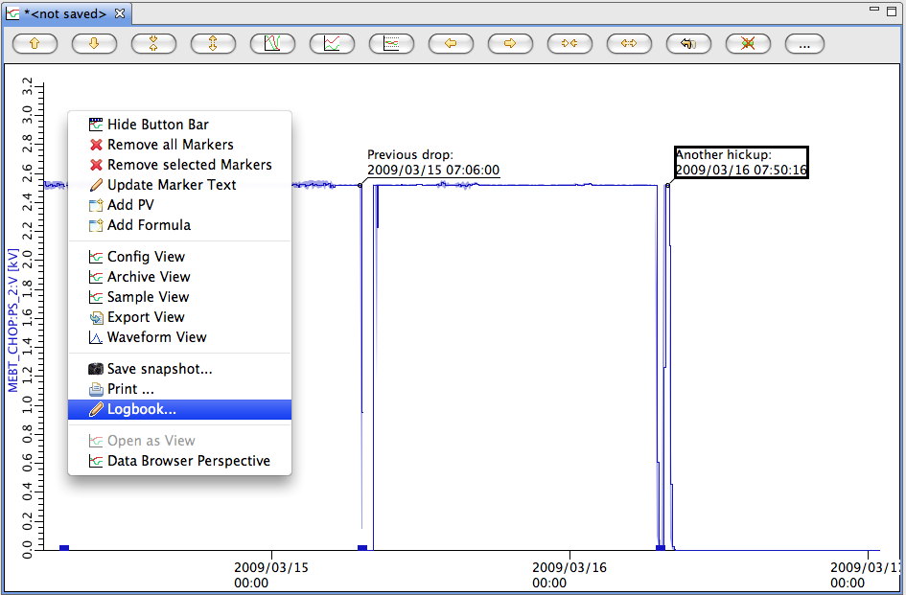
Data Browser ➔ E-Log
After inspecting alarm PV’s history, post commented plot to E-Log

Slide 18
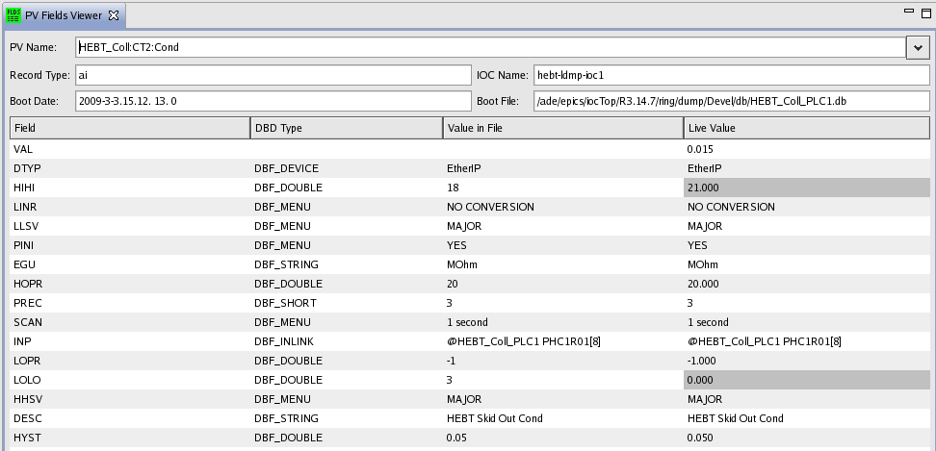
PV Fields Viewer
Detailed configuration info for a PV
@SNS: Info in Oracle, live data from EPICS

Slide 19
PV Fields Viewer: Site-Specific?
Fine, but how would I benefit from an SNS-specific tool?
It’s “Pluggable”!
You can provide the glue code to your EPICS config in RDB, LDAP, text files
PV Fields API
“get info for PV Name”
SNS Implementation
Get info from Oracle
Your Implementation
Get info from …

Slide 20
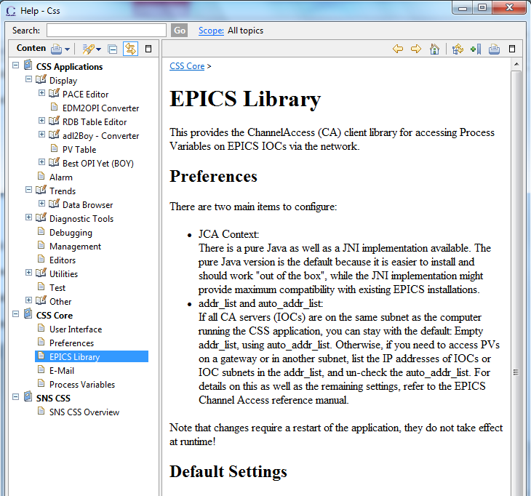
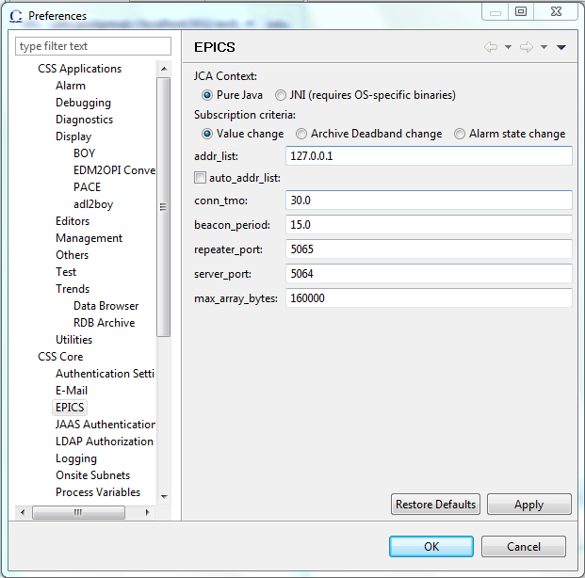
Integrated Help, Preferences
Uniform access to settings, searchable help
  Applications
  Support Libraries
    Logging
    Control System access

Slide 21
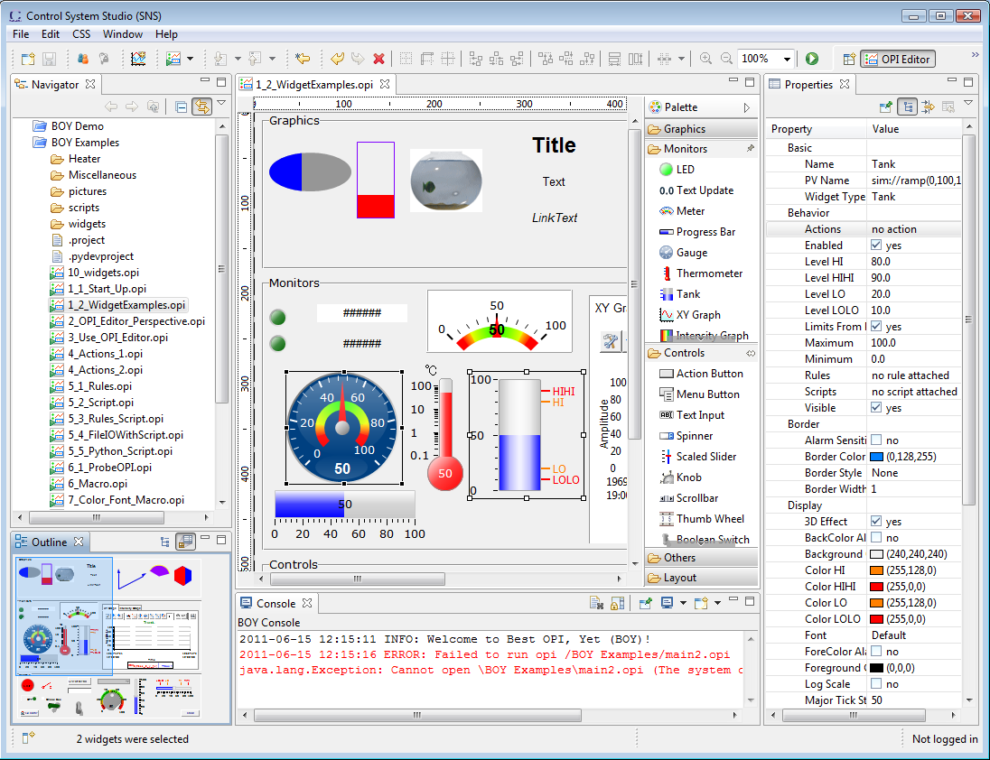
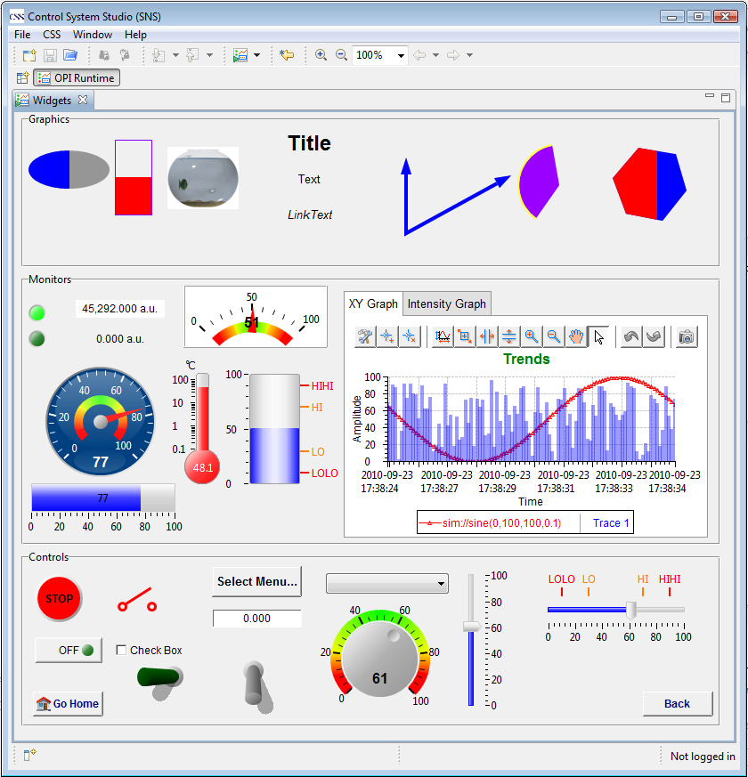
BOY – Best OPI, Yet
Operator Interface Editor Runtime
Similar to EDM, MEDM, SDS, DM2K, but possibly better

Slide 22
OPI Editor

Slide 23
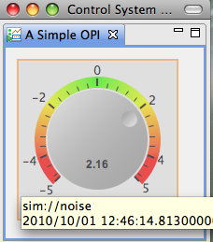
Simple Things are Easy
  Drag a widget, e.g. Knob, from palette to editor
  Enter the PV name in Properties view
  Click the “Run” button to execute!
What you will get
  PV value as text and via knob position
  PV severity reflected in border color
  PV name and value shown in tool-tip
  PV’s display limits set the knob’s default range
  Indicate ‘disconnected’ state via a pink border
  Widget will be greyed-out if read-only

Slide 24
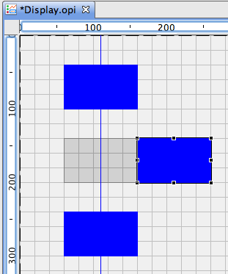
Editing Features
Add Widgets
  Drag & Drop from Palette
  Copy/paste, Ctrl+Drag existing widgets to duplicate
  Snap to grid, guideline, other widgets
  Align, distribute
Select multiple widgets to
  Edit common properties
  Adjust size or move around

Slide 25
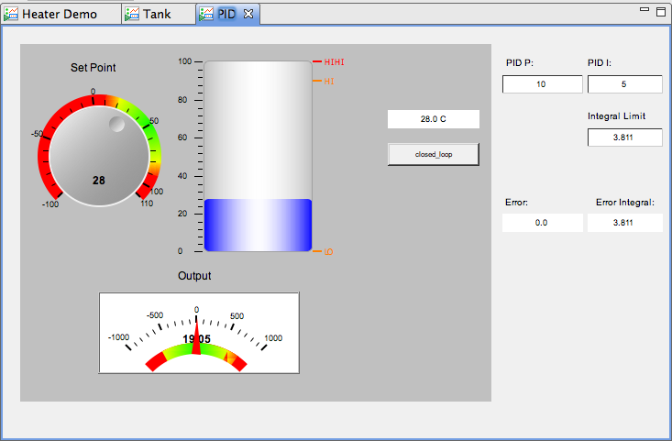
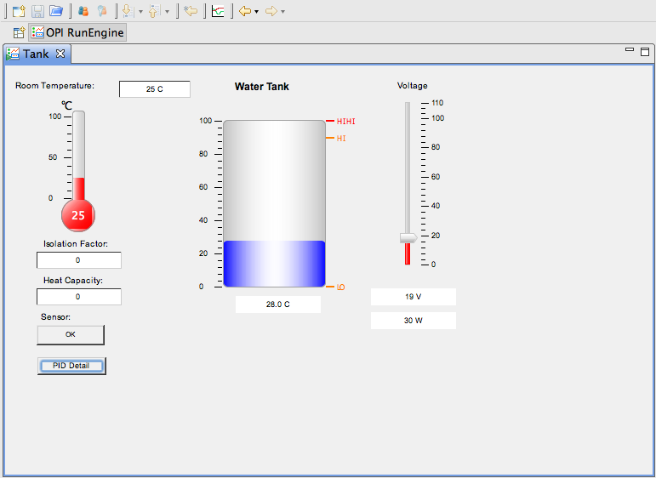
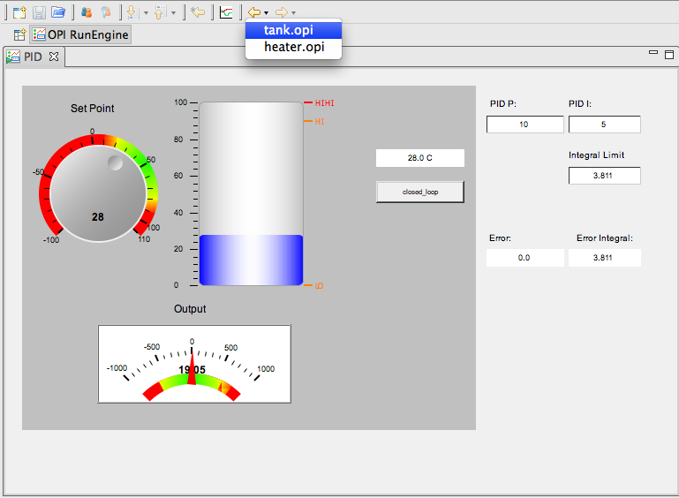
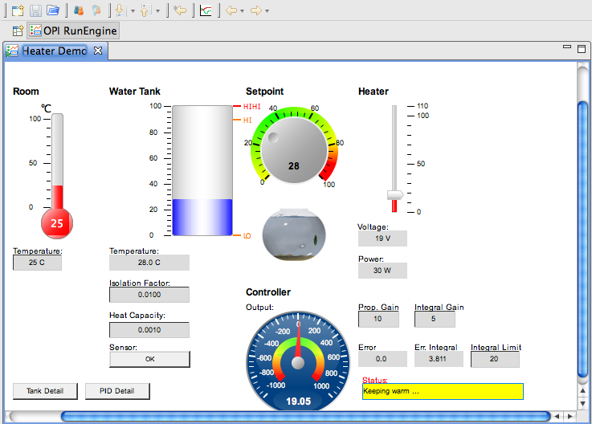
Screen Navigation
Idea: Minimize number of open screens.
Similar to Web Browser links:
  Default: Related displays replace the current display.
  Optional open in ‘tabs’ or new window
  Allow previous/next navigation over display history
Displays in ‘Tabs’

Slide 26
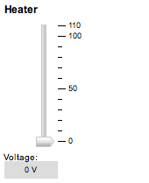
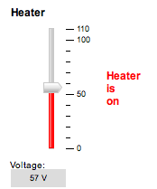
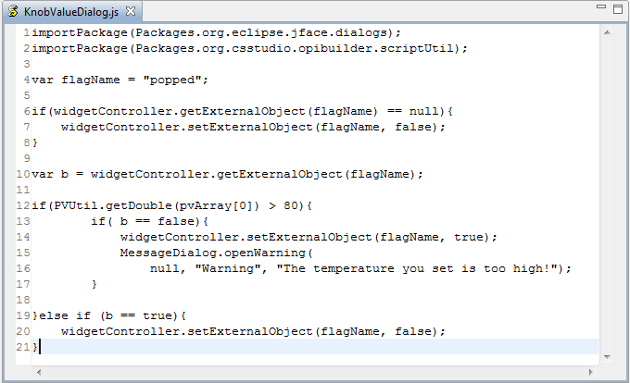
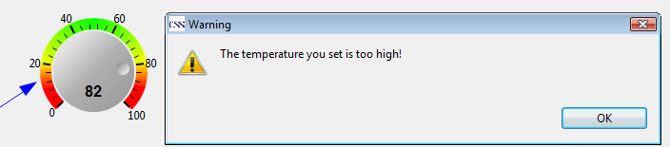
Rules, Scripts
Rules create dynamic displays
  Easy: PV → Widget Property
Scripts can to “anything”
  Read PVs,
  change widget properties,
  open dialog, …
  JavaScript or Phython

Slide 27
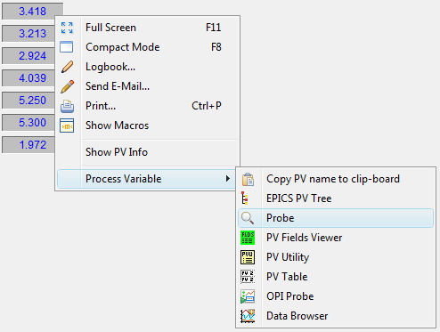
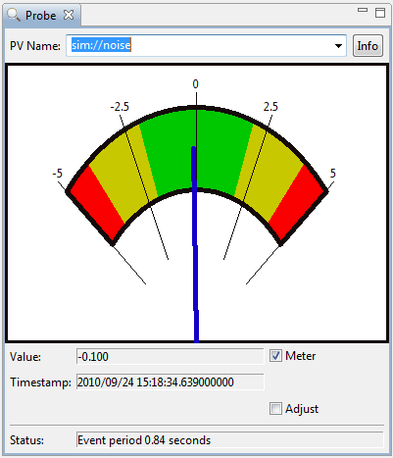
Send PV name to other CSS tools
Use common CSS Process Variable context menu to send PV name to other CSS tools

Slide 28
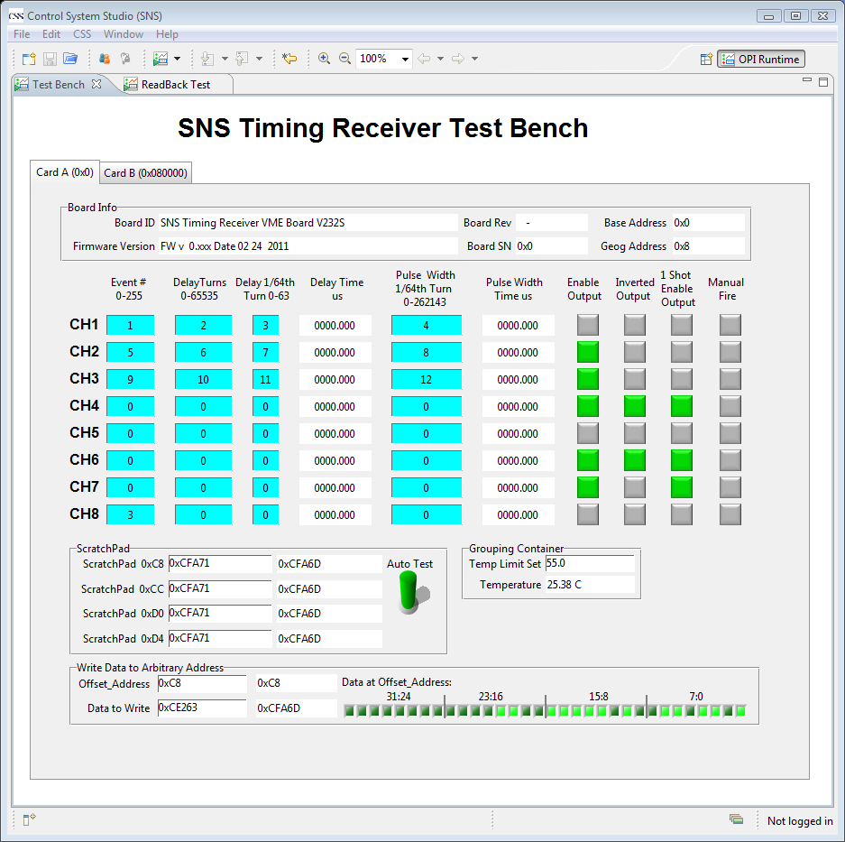
SNS Examples

Slide 29
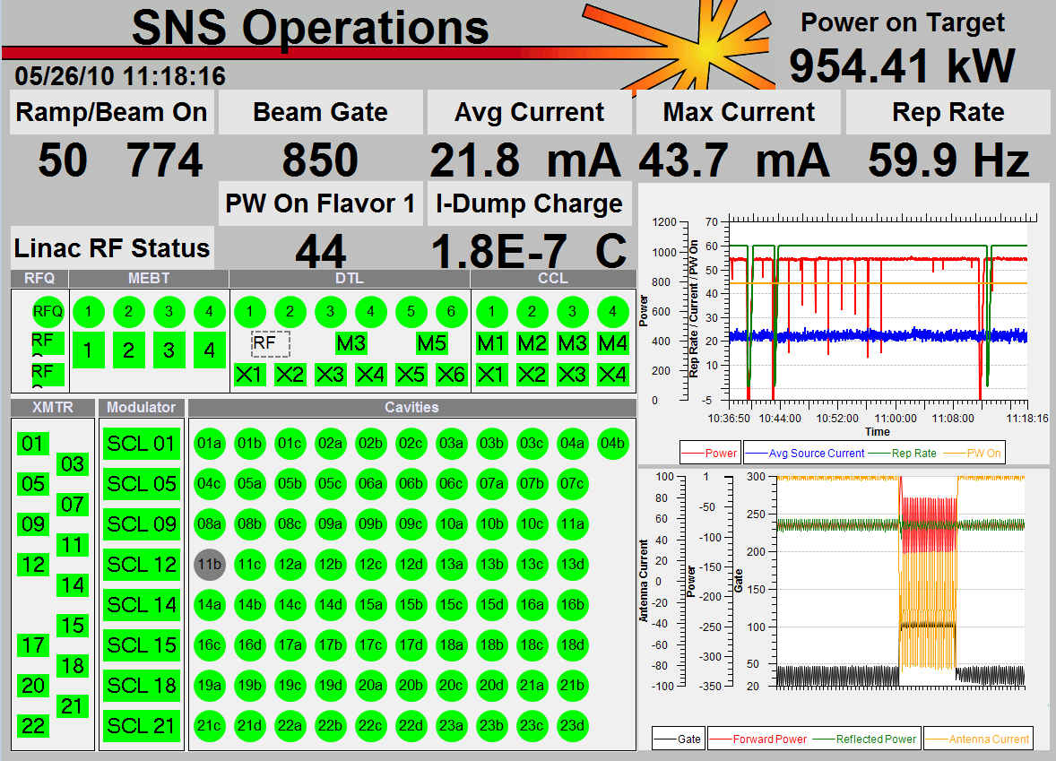
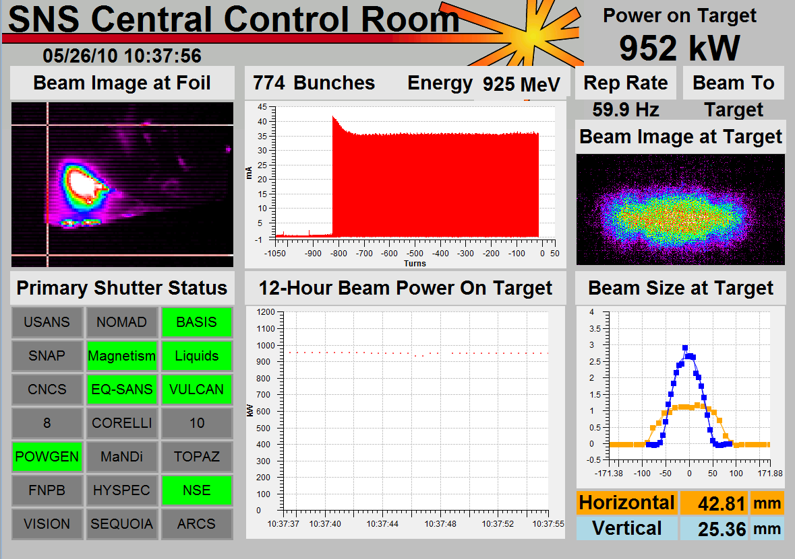
SNS Examples
Top-level displays created by operators
Tim Southern, Nick Luciano

Slide 30
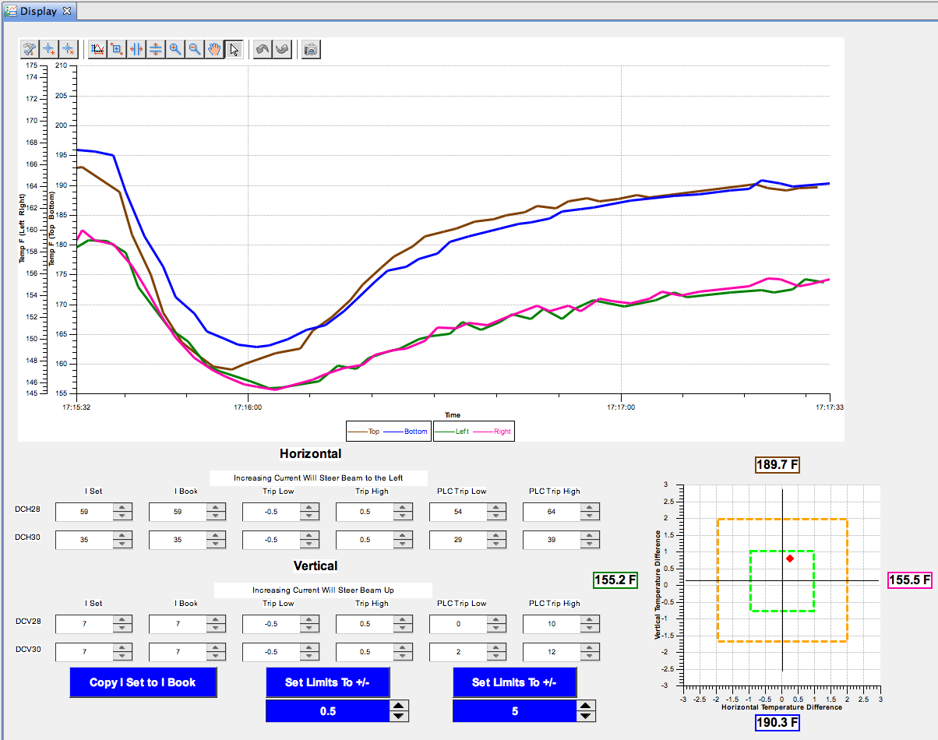
SNS “Steering” Tool
Try to get spot into the green, at least into orange
Tim Southern, Nick Luciano

Slide 31
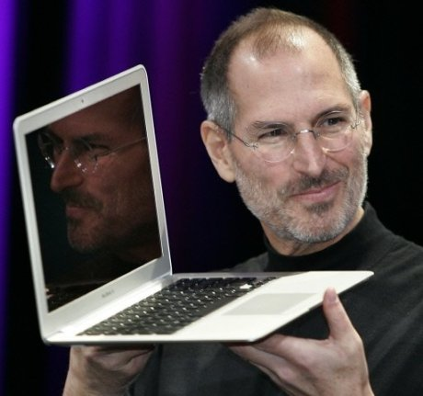
So What is CSS?
Various control-system
tools combined
into
a consistent product
Excellent
for
end-users!
Based on
http://buzzynews.com/wp-content/uploads/2008/01/steve-jobs-presente-le-mac-book-air-lordinateur-portable-le-plus-fin-du-monde.jpg

Slide 32
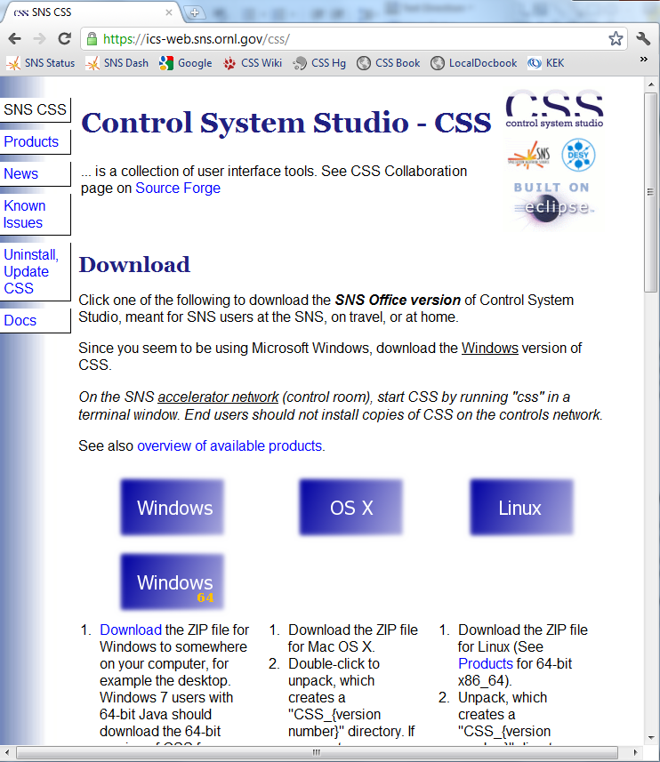
Hardest Part: Starting Site-Specific Setup
Web site:
Initial download

Slide 33
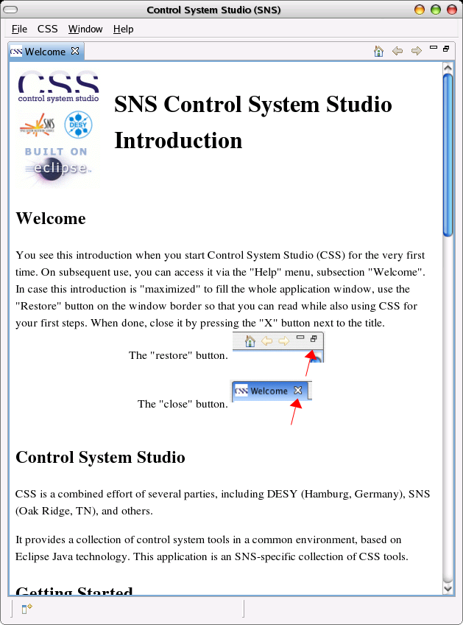
… Site-Specific Setup
Web site
Product: Tools and settings for your users at your site

Slide 34
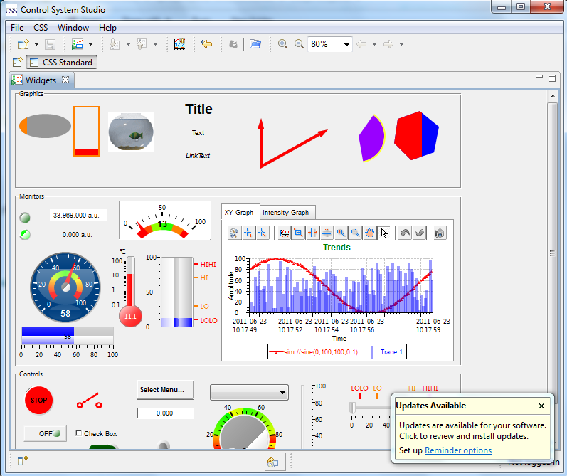
… Site-Specific Setup
Web site
Product for your site
Automated
updates

Slide 35
Need Site-Specific Setup
Web site
Product for your site
Automated updates
Steep Learning Curve for Developers
  … but also many Books, online Tutorials
  Invest to learn it, and you’ll like it

Slide 36



Summary
is:
Collaboration, Architecture, Toolset, Java, Eclipse, RCP, Plug-ins, Localization, Perspectives, Menues, Preferences, Online Help, Probe, Clock, PV Tree, Data Browser, Alarm System, BOY, …
needs:
initial investment in site-specific product
is:
Excellent platform for development of new tools
CSS is Good for the End-User

