Slide 1
DRキッカー・トリガー
2017.1.13

Slide 2
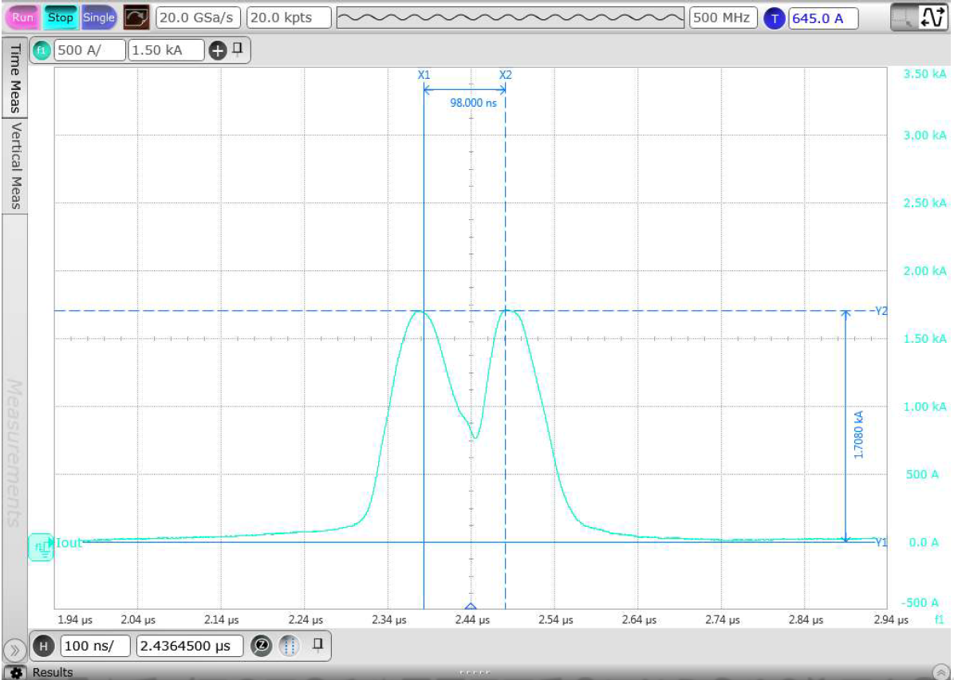
DR Kicker
Lumped type
Double half sine
Kick angle : 2.5mrad/magnet
Current pulse rise time/fall time: <100ns
Timing jitter: < ±1ns
Amplitude stability: <±0.1%

Slide 3
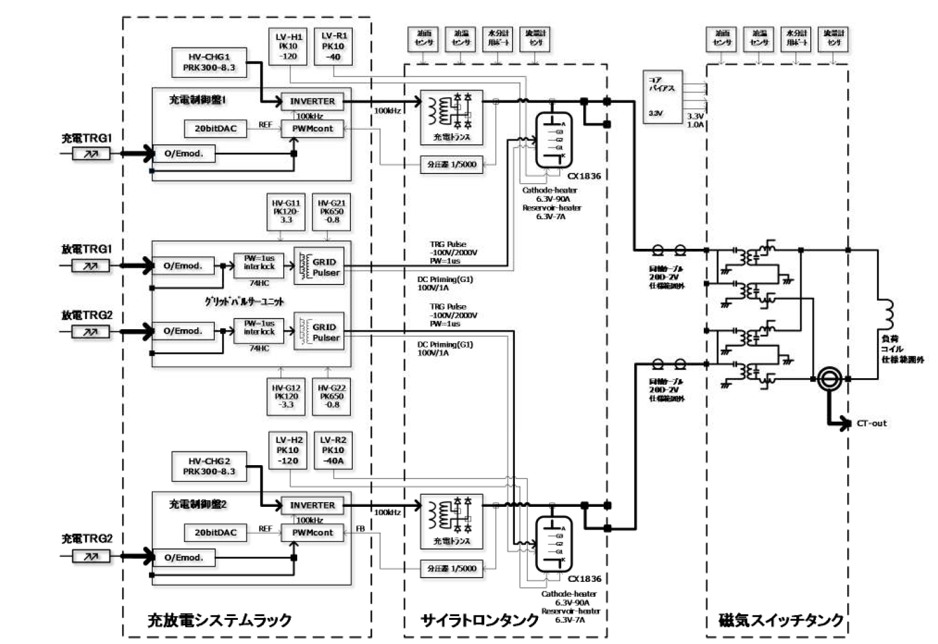
DR Kicker

Slide 4
Trigger仕様
15msec
4 V_{min}
充電TRG1,2
2usec
4 V_{min}
放電TRG1,2
充電電圧

Slide 5
