Slide 1
Upgrade of KEK Electron/Positron Linac for the Both SuperKEKB and Light Sources
Kazuro Furukawa
Injector Linac, KEK
<kazuro.furukawa@kek.jp>

Slide 2
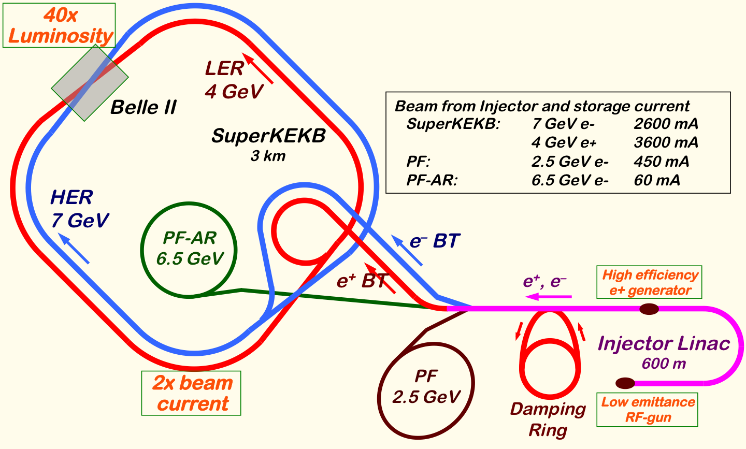
Mission of electron/positron Injector in SuperKEKB
Linac Upgrade Overview
40-times higher Luminosity
  20-times higher collision rate with nano-beam scheme
    → Low-emittance even at first turn → Low-emittance beam from Linac
    → Shorter storage lifetime
  Twice larger storage beam → Higher beam current from Linac
Linac challenges
  Low emittance e-
    with high-charge RF-gun
  Low emittance e+
    with damping ring
  Higher e+ beam current
    with new capture section
  Emittance preservation
    with precise beam control
  4+1 ring simultaneous injection
Notes:
Higher Injection Beam Current
To Meet the larger stored beam current and shorter beam lifetime in the ring
4~8-times larger bunch current for electron and positron
Reconstruction of positron generator, etc
Lower-emittance Injection Beam
To meet nano-beam scheme in the ring
Positron with a damping ring
Electron with a photo-cathode RF gun
Emittance preservation by alignment and beam instrumentation
Quasi-simultaneous injections into 4 storage rings
SuperKEKB e–/e⁺ rings, and light sources of PF and PF-AR
Improvements to beam instrumentation, low-level RF, controls, timing, etc

Slide 3
Required injector beam parameters
Stage | KEKB (2010) |  | Phase-I (2016) |  | SuperKEKB (final)
Item | e+ | e– | e+ | e– | e+ | e–
Energy | 3.5 GeV | 8.0 GeV | 4.0 GeV | 7.0 GeV | 4.0 GeV | 7.0 GeV
Bunch charge | Primary e-10nC → 1 nC | 1 nC | Primary e- 8nC → 0.4 nC | 1 nC | Primary e-10nC → 4 nC | 5 nC
Norm. Emittance (γβε) (μrad) | 2100 | 200 | 2400 | 150 | 100/20 (Hor./Ver.) | 50/20 (Hor./Ver.)
Energy spread | 0.125% | 0.125% | 0.5% | 0.5% | 0.1% | 0.1%
No. of Bunch / Pulse | 2 | 2 | 2 | 2 | 2 | 2
Repetition rate | 50 Hz |  | 25 / 50 Hz |  | 50 Hz
Simultaneous top-up injection | 3 rings (KEKB e–/e+, PF) |  | No top-up |  | 4+1 rings (SuperKEKB e–/e+, DR, PF, PF-AR)

Slide 4
Linac Injector Status
Phase-3 (Collision exp.) should not be delayed
Injector construction was delayed about 2 years because of resource availability
Important equipment was postponed until FY2017
  Most of damping-ring related epuipment
  Many of lower-emittance related equipment
    including 30 pulsed focusing magnets, 36 steering magnets, ~13 girders
Minimum of 5 months required to purchase, fabricate, install and test
Supplemental budget in FY2016 is not enough
  Best effort ! (asuming enough budget in FY2017)
  KEKB construction
    Linac shutdown for 9 months in 1997, after many devices were fabricated in 1996

Slide 5
Possible Rescheduling

Slide 6
Pulsed magnet installation
30 quads and 36 steerings and ~13 girders will be installed at summer 2017
  1 mH, 330 A, 340 V, 1 ms
  Energy recovery to save power (~75%)
  Can change the magnetic field every pulse (50 Hz)
    To support PPM operation or virtual accelerators
Magnets are ready
Power supply tests were OK
Pulsed power supplies and girders will be mass-produced in 2017

Slide 7
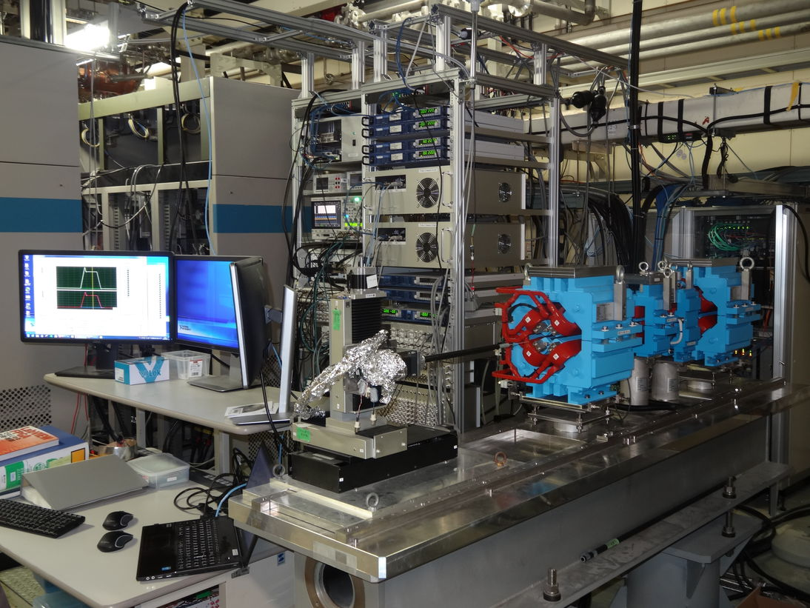
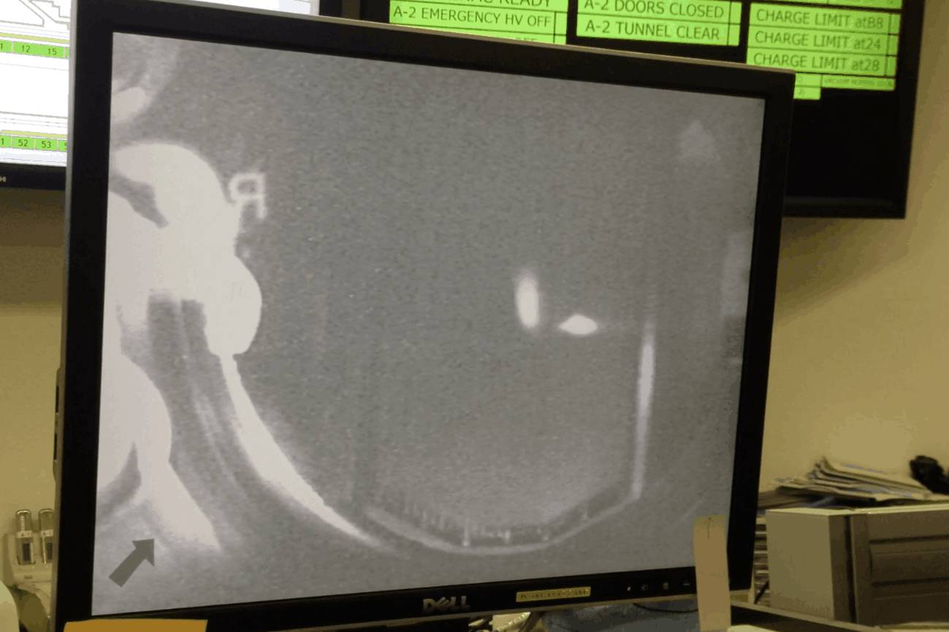
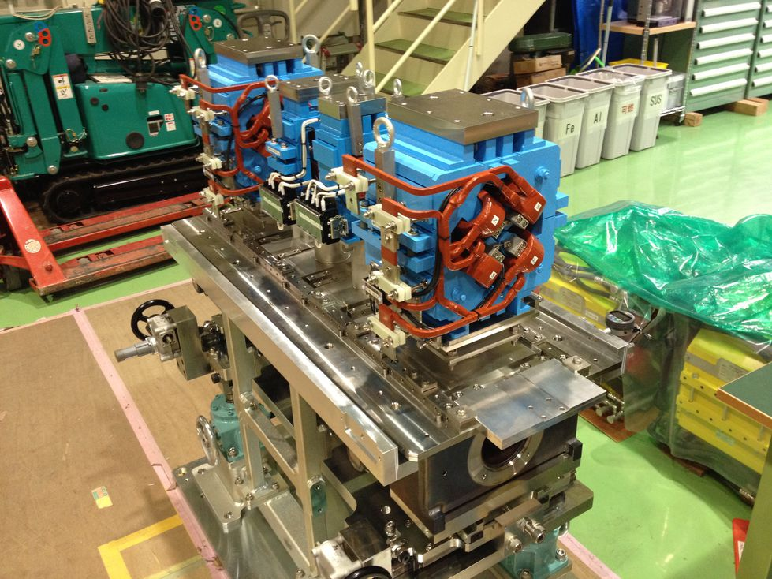
Pulsed magnet development
Pulsed magnet test stand
  Long-term stability was confirmed
Girders were designed
  Waiting for mass-production
  Ready for Phase-3 specification
Successful beam tests
  25-Hz (50-Hz) switching

Slide 8
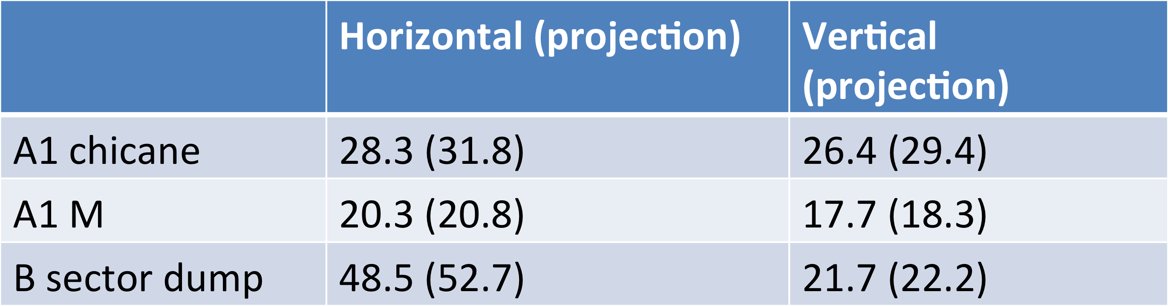
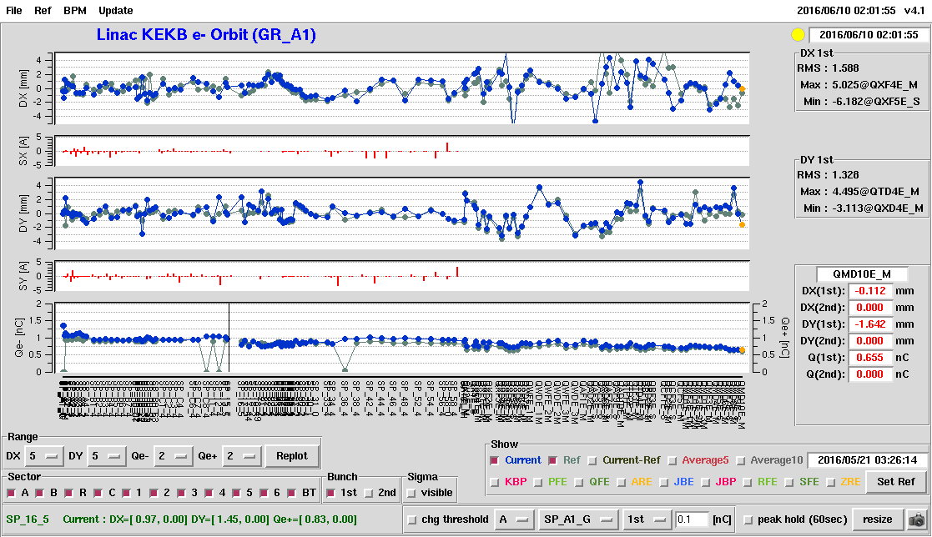
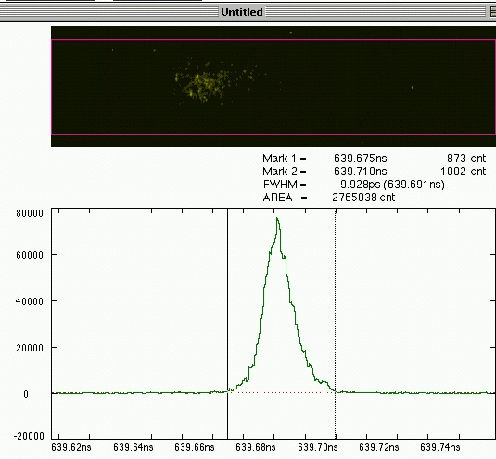
Photo cathode RF gun
Successful HER injection during Phase 1
  For 11 days
  Synch. issues resolved
  Emittance to be improved
Emittance measurement
Bunch profile measurement

Slide 9
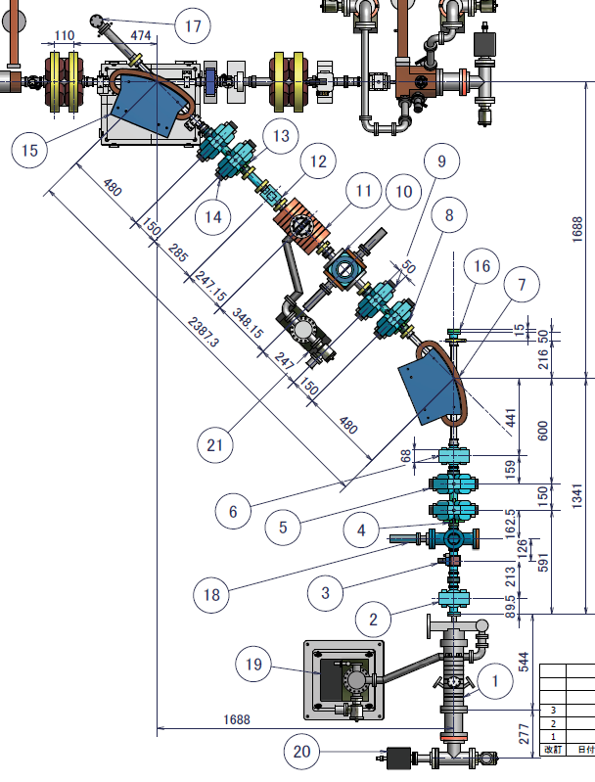
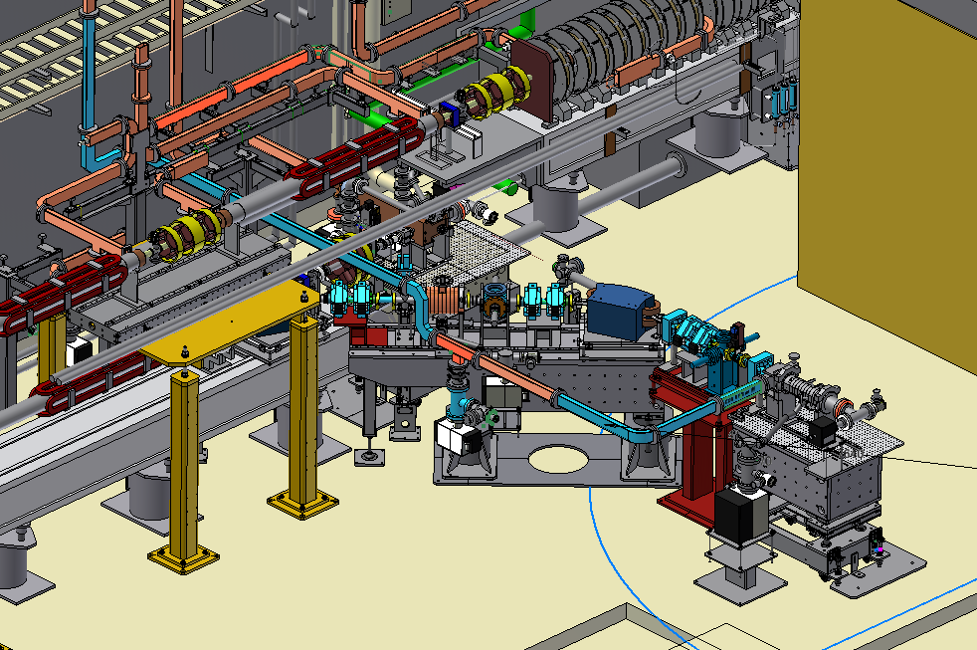
Photo cathode RF gun
Secondary RF gun installation
  Incorporate recommendations from
  review meetings
  Laser, light guides, cavity, etc
  Installed at the beginning of 2017

Slide 10
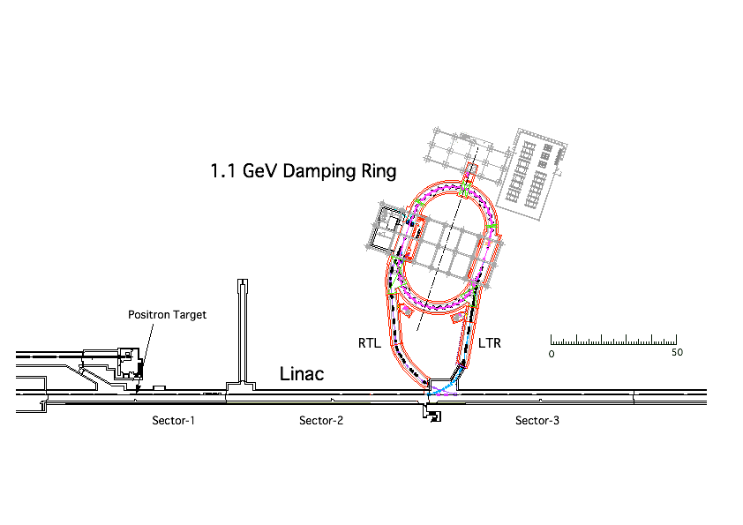
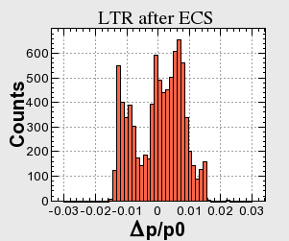
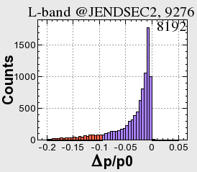
DR layout
Damping Ring System Layout
M. Kikuchi
±1.5%
Energy compression
±5%
Collimators in the arc
20% is cut at tail

Slide 11
Bucket selection in Phase-2 with DR
DR timing
Without DR, simply wait up to 5120 x 96 ns ~ 490 μs
  96 ns : highest common frequency between linac – ring
With DR, in order to select arbitrary bucket in MR, have to wait up to ~4.5 ms, even if a bucket in DR was carefully selected
  Power supply can wait only 2 ms, one of only 2798 buckets in 5120 buckets can be selected, may have to change LLRF condition at latter half of linac every pulse
  Can be a big challenge in LLRF precision
e⁻ Gun
KEKB
ARC
Primary e– (3.5GeV, 10nC)
e⁺ BT (3.5GeV, 0.6nC)
e⁺ Target
96ns
>100ns
e⁺ DR (1.1 GeV, 4nC)
e⁻ Gun
>100ns
SuperKEKB
ARC
96ns
Primary e– (3.5GeV, 10nC)
e⁺ BT (KEKB: 4GeV, 4nC)
e⁺ Target

Slide 12
Subjects to Consider
Have to consider
too many subjects !
Phronesis needed (Greek: Practical wisdom, Ability to understand the Universal Truth)
Nov.
Jan.2018

Slide 13
Injection for Both Experiments of Light-source and B-factory
Proper operation schedule to meet experimental characteristics of those storage rings
Search for common ground with respect for those experiments
Should find and confirm solutions in gradual changes
Improve the machine using virtual accelerator concept, if applicable

Slide 14
Pulse-to-pulse modulation
Event-based
Control System
Four PPM virtual accelerators
for SuperKEKB project
Based on
Dual-tier controls with
EPICS and event-system
Independent parameter sets
for each VA (20ms)
>200 parameters
for equipment controls
many more
for beam instrumentation
maybe with additional PPM VA
of stealth beam
for measurement
Every
20 ms
F.B
e⁻ Gun
F.B
ARC
PF Injection
e– (2.5GeV, 0.2nC)
F.B
e⁻ Gun
Damping ring
SuperKEKB-LER Injection
F.B
ARC
e– (3.5GeV, 10nC)
F.B
e⁺ Target
e⁺ (4GeV, 4nC)
e⁻ Gun
ARC
SuperKEKB-HER Injection
F.B
F.B
e– (7GeV, 5nC)
e⁻ Gun
F.B
ARC
PF-AR Injection
e– (6.5GeV, 5nC)

Slide 15
Summary
Summary
Injection into SuperKEKB is a challenge with higher beam charge and lower emittance
Steady progress towards designed injection beam in steps
  Alignment: almost confident on the required precision (0.1-mm local, 0.3-mm global), need to maintain for longer term
  Positron generator: another license test, need discharge analysis
  RF gun: following recommendations at review meetings
Will install all of remaining equipment at summer 2017
Will balance between final beam quality and progressive operation
Will balance between particle physics and photon science
With some Phronesis we may enjoy beam commissioning

Slide 16
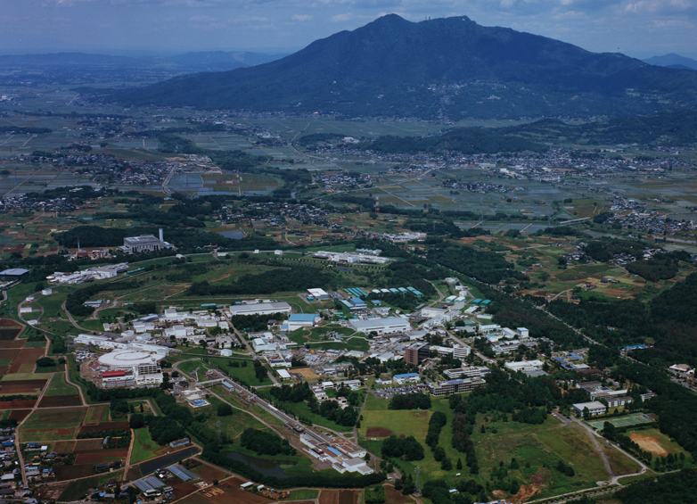
Mt. Tsukuba
Thank you
SuperKEKB
dual rings
PF-AR
PF
600m Injector
Linac
Conference papers at <http://www-linac.kek.jp/linac/>

Slide 18
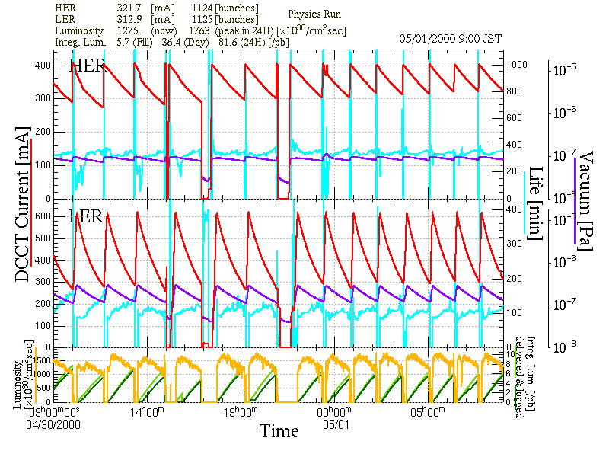

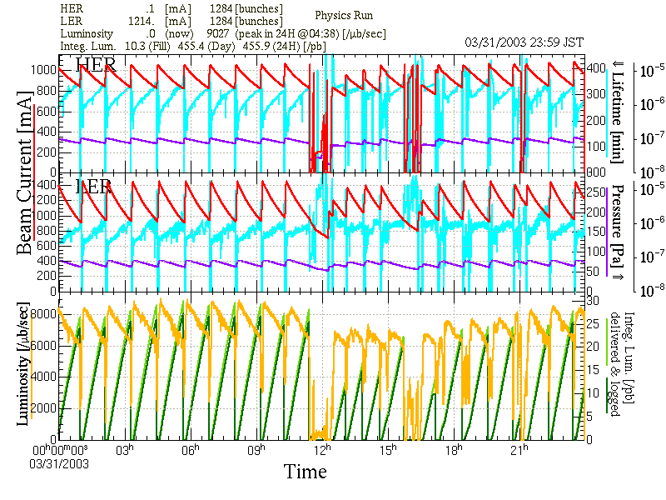
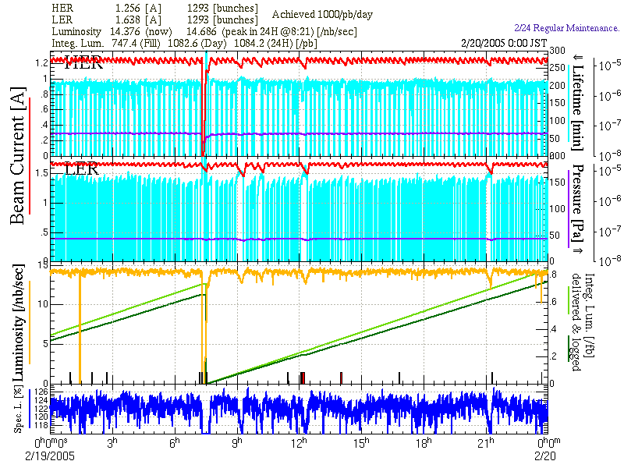
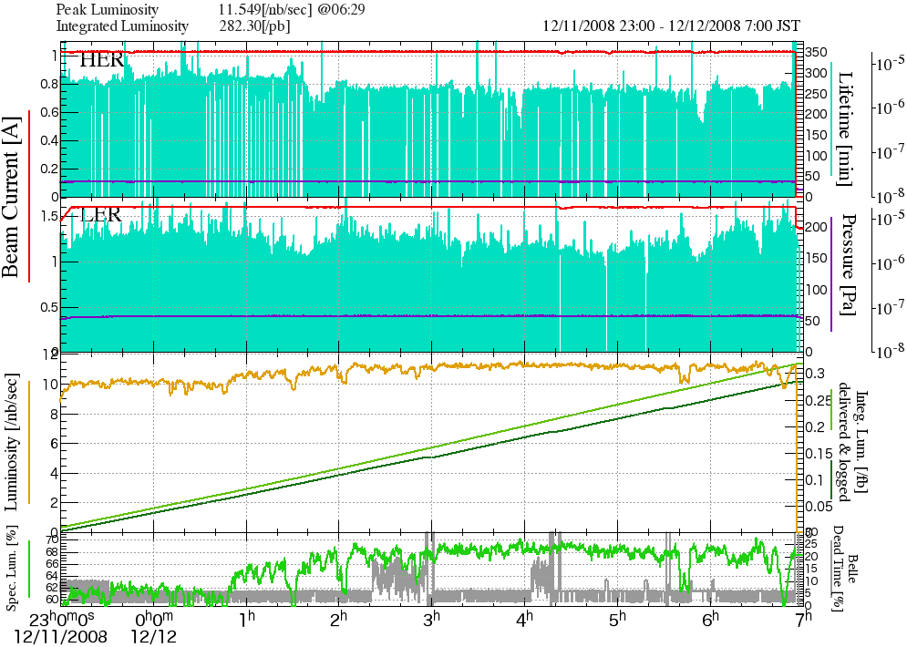
KEKB Operation Improvement (base of SuperKEKB)
Past KEKB
red: beam current (e-, e+)
purple: vacuum (e-, e+)
yellow: luminosity
green: integrated luminosity
Belle/KEK
May.2000
Apr.2003
Dual Bunch e⁺
Feb.2005
Continuous
Injections
Dec.2008
Crab Cavities and
Simultaneous Injection
Keeps world
luminosity record
2.1 x 10³⁴

