Slide 1
Electron / Positron Injector Linac
Kazuro Furukawa
<kazuro.furukawa@kek.jp>
for Injector Linac

Slide 2
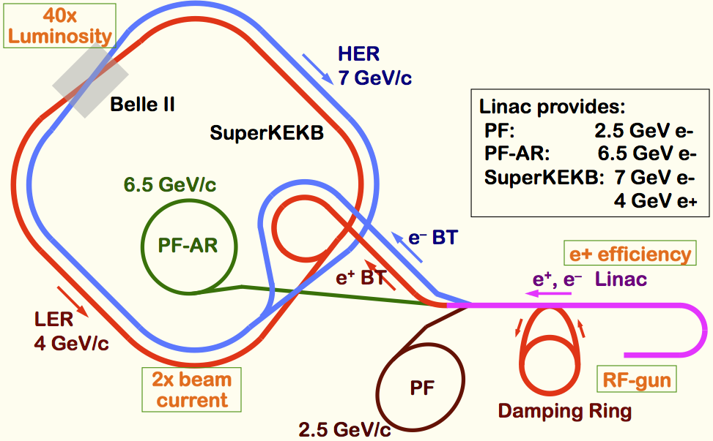
Mission of electron/positron Injector in SuperKEKB
Linac Overview
40-times higher Luminosity
  Twice larger storage beam → Higher beam current at Linac
  20-times higher collision rate with nano-beam scheme
    → Low-emittance even at first turn → Low-emittance beam from Linac
    → Shorter storage lifetime (→ Higher Linac beam current)
Linac challenges
  Low emittance e-
    with high-charge RF-gun
  Low emittance e+
    with damping ring
  Higher e+ beam current
    with new capture section
  Emittance preservation
    with precise beam control
  4+1 ring simultaneous injection
Notes:
Higher Injection Beam Current
To Meet the larger stored beam current and shorter beam lifetime in the ring
4~8-times larger bunch current for electron and positron
Reconstruction of positron generator, etc
Lower-emittance Injection Beam
To meet nano-beam scheme in the ring
Positron with a damping ring
Electron with a photo-cathode RF gun
Emittance preservation by alignment and beam instrumentation
Quasi-simultaneous injections into 4 storage rings
SuperKEKB e–/e⁺ rings, and light sources of PF and PF-AR
Improvements to beam instrumentation, low-level RF, controls, timing, etc

Slide 3
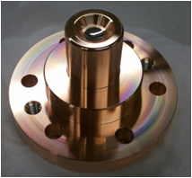
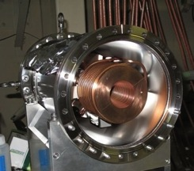
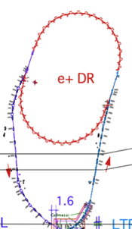
Linac Upgrade for SuperKEKB
Higher Injection Beam Current
  To Meet the larger stored beam current and shorter beam lifetime in the ring
  4~8-times larger bunch current for electron and positron
Lower-emittance Injection Beam
  To meet nano-beam scheme in the ring
  Positron with a damping ring, Electron with a photo-cathode RF gun
  Emittance preservation by alignment and beam instrumentation
Quasi-simultaneous injections into 4 storage rings (PPM)
  SuperKEKB e–/e⁺ rings, and light sources of PF and PF-AR
  Improvements to beam instrumentation, low-level RF, controls, timing, etc
Ir₅Ce
FC
SuperKEKB injector Linac
50 Hz (e+ or e-)
pulse-by-pulse
mode switching
high current
gun
1.1 GeV
Damping Ring
circ. 136 m
PF
low emittance
RF gun
PF-AR
6.5 GeV e-
2.5 GeV e-
0.1nC x 1
Bunch
Compressor
LER
3.5 GeV
10nC x 2 (prim. e-)
5nC x 2 (inj. e-)
Energy-spread
Compression System
S-band
linac
3T
RF gun
4.0 GeV e+ 4nC x 2
ECS
e+ target &
L-band+LAS
capture section
C-band
modules
HER
7.0 GeV e-
5nC x 2

Slide 4
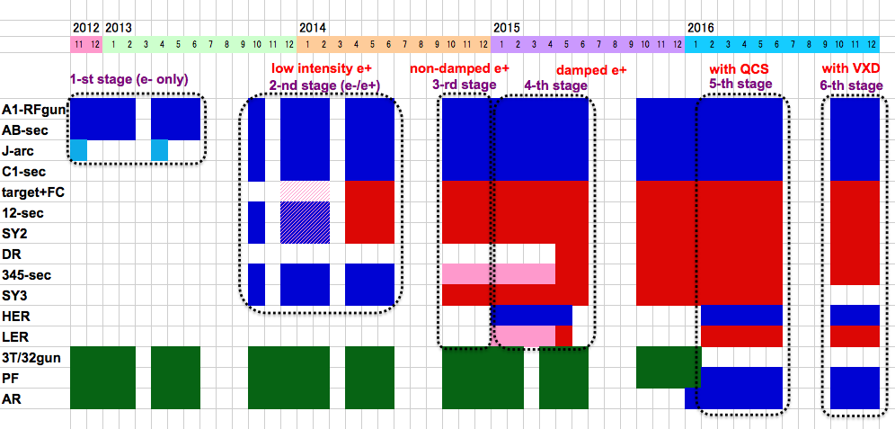
Linac Schedule Overview (to be updated)
RF-Gun e- beam
commissioning
at A,B-sector
Qe- = 5nC
e- commiss.
at A,B,J,C,1
Qe- = 5nC
e+ commiss.
at 1,2 Qe+ = 0.5nC (FC, DCS, Qe- 50%)
e- commiss.
at 1,2,3,4,5 Qe- = 5nC
1 nC
2 nC
4 nC
: Electron
non damped e+ commiss.
at 1,2, 3,4,5 Qe+ = 4nC
e- commiss. pulse-switch
at A→5 Qe- = 5nC
damped e+ commiss.
at 1→5 Qe+ = 4nC
e- commiss.
at A→5 Qe- = 5nC
PF-AR e-
commiss.
: Positron
: Low current electron

Slide 5
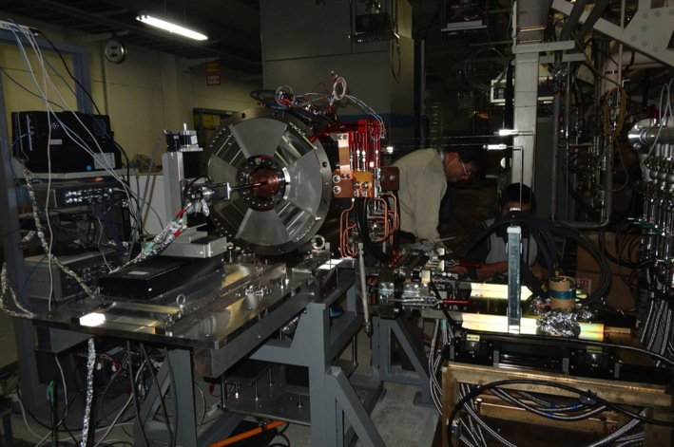
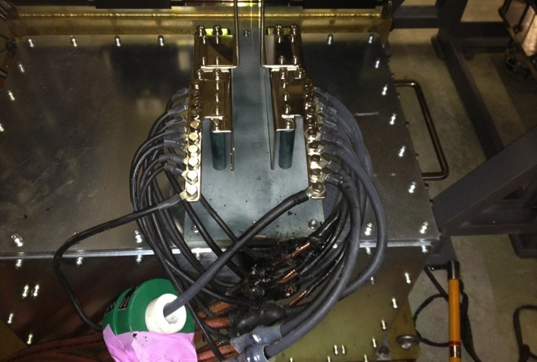
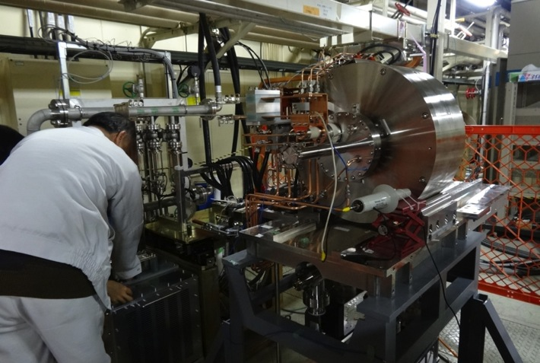
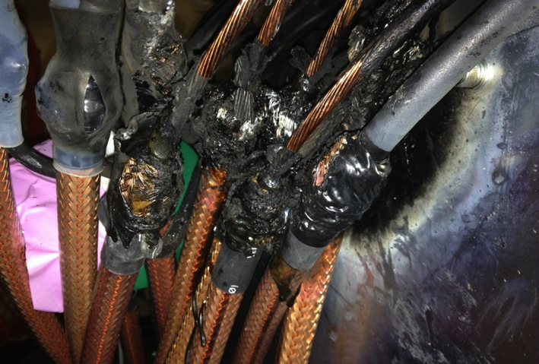
Fire during flux concentrator development
One of small problems – Cables burned by 20cm

Slide 6
SLAC-SuperKEKB Workshop (Injector Linac)
Injector commissioning and issues 30'
  Speaker: Masanori Satoh (KEK)
Photo-cathode RF gun 20'
  Speaker: Takuya Natsui (KEK)
Positron source 30'
  Speaker: Takuya Kamitani (KEK)
Timing synchronization 20'
  Speaker: Hiroshi Kaji (KEK)
Linac alignment 20'
  Speaker: Toshiyasu Higo (KEK)
Beam optics design for simultaneous injection 20'
  Speaker: Takako Miura (KEK)

Slide 7
Questions and Answers
PEDD dependent on beam repetition?
  SLAC study was on single-pulse energy density
    may need further investigation
Fiber loss monitor blackening around target?
  Can be replaced routinely
Diamond loss detector?
  Is worth comparing in the future
Orbit stability tolerance against beam size?
  Pinhole 2mm and beam sigma 0.3mm are possible
  Beam orbit jitter will be studied, as well as for emittance preservation
Rotating target/spoiler?
  Should be studied for the beam current larger
Frequency synchronization btw. linac/ring?
  All SKEKB frequencies are generated from common freq. with ring circumference compensation
Beam charge variation pulse-pulse?
  Can be important
  Technically possible with different event assignment
  Means different injection modes with different orbit stabilization for wakefield
Target quad – pulsed ?
Beam jitter should be small
DR extraction angle jitter
  Offset injection position/angle jitter should be small

Slide 8
Several Workshop around Injector Linac
Technology choice for beam position monitor (BPM)
  Indispensable for emittance preservation
  ~10micron precision (~100micron in KEKB linac), about 100 BPMs, event controls
  Experts from SLAC, Steve Smith and Andrew Young
  Many valuable discussions for filter design, digital signal processing, etc.
  One of the developments was chosen for performance, operation, and budget
Laser and photo-cathode RF gun workshop
  6 presentations, 16 participants
  The same objectives of low emittance and higher stability
  Injector linac is unique on higher beam charge and lower energy spread
  Should exchange technology/information continuously
Accelerator structure processing workshop
  22 participants
  Many discussions on duration (more than a month), and the system
  No baking necessary, longer processing and better monitors, better interlock needed

Slide 9
Improved beam optics design
Pulsed quad addition – Simultaneous injection
FODO → Doublet – Emittance preservation
Orbit correction simulation
Further emittance preservation even with alignment tolerances
Optimization for budget …

Slide 10
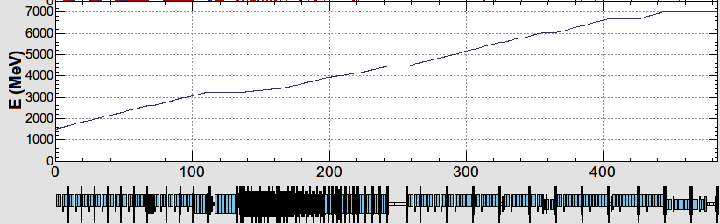
KEK e-/e+ Injector LINAC
B
A
10 nC x 2 (for LER)
5 nC x 2 (for HER)
0.3 nC x 1 (for AR)
0.3 nC x 1 (for PF)
e-/e+ beams are delivered to 4-rings with different current & energy.
Beam acceleration modes must be switched by 50 Hz pulse-by-pulse for top-up injection.
low emittance
RF gun
1.5 GeV e-
1.1 GeV
DR
C
1
2
3
4
5
e+ target
e-:Chicane
HER: 7 GeV e-
5 nC x2
AR: 6.5 GeV e-
4.219 GeV
Decelerate
0.3 nC x1
same energy
e-
LER: 2.5 GeV e+
4 nC x2
e+ target
e+
1.1 GeV
PF: 2.5 GeV e-
0.3 nC x1
1.5 GeV
C
1
2
3
4
5
Beam optics should satisfy the fast beam-mode switching.

Slide 11
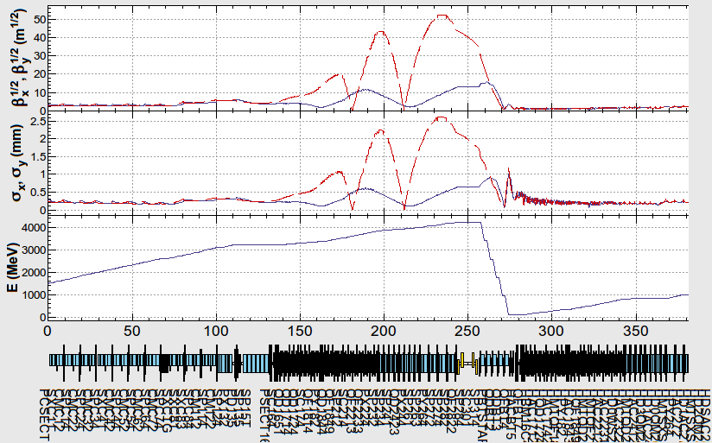
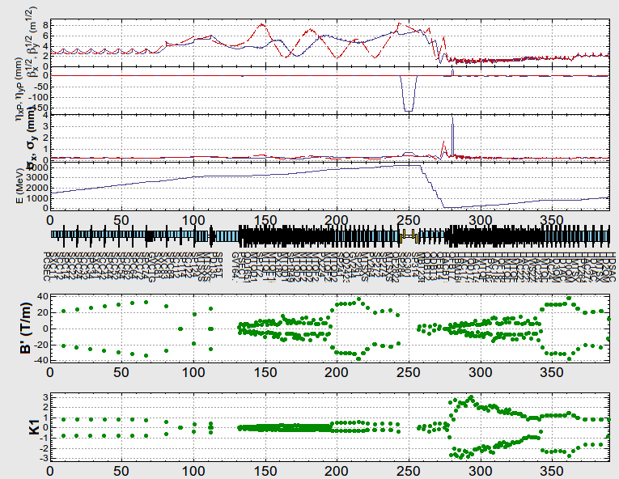
Result of e-p fitting
e-
e+

Slide 12
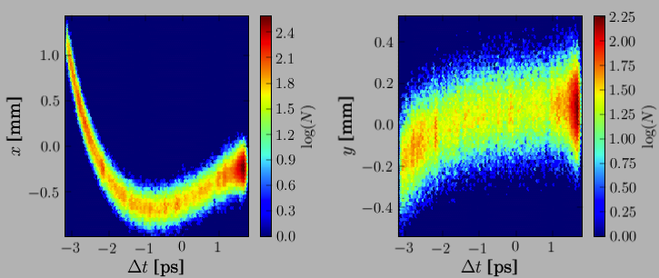
Emittance Preservation
If Device is off center of the beam
  Focusing magnet (quad) kicks the beam bunch
  Accelerating structure (cavity) excites wakefield, to bend the tail
Distorted bunch in banana shape
  Emittance dilution or blow-up
  Depending on the beam optics and the beam charge
Orbit correction is crucial to preserve the emittance
Sugimoto et al.
Beam
Focusing
Magnet
Accelerating
Structure
Transverse distribution in time direction

Slide 13
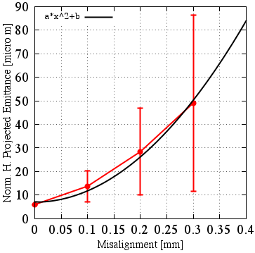
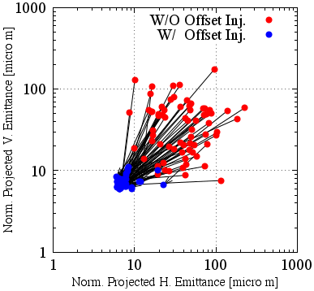
Emittance Dilution
Offset injection may solve the issue
Orbit have to be maintained precisely
Mis-alignment leads to Emittance blow-up
Orbit manipulation compensates it
100 samples
Sugimoto et al.

Slide 14
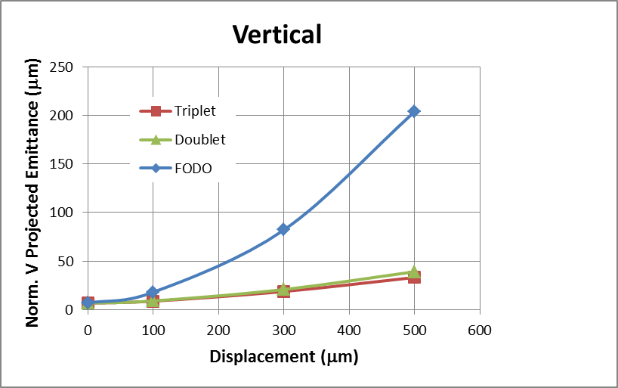
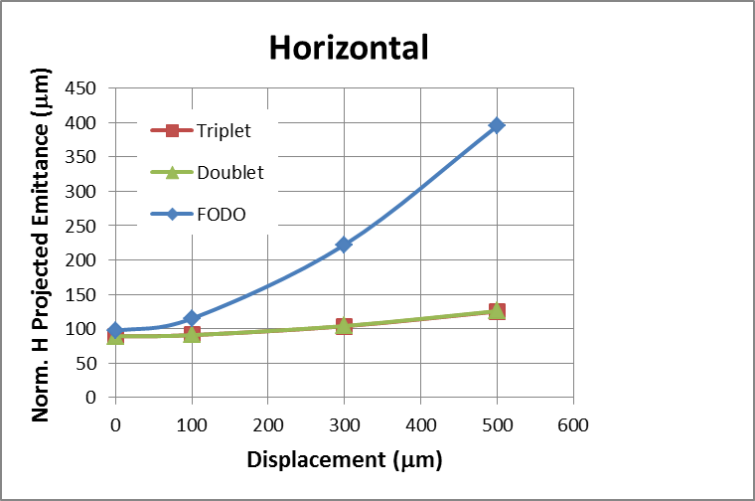
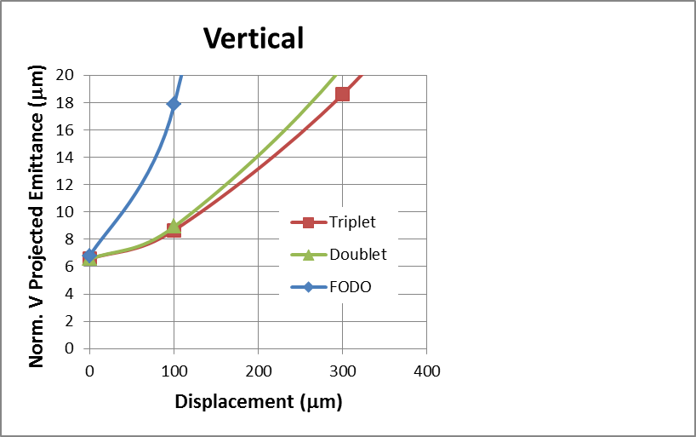
Alignment Error vs. Emittance Growth
<Tracking Condition>
Calculated by H. Sugimoto
Positron is transported from DR outlet to LINAC end.
Alignment error is given in quads and cavities.
The orbit correction is performed by assuming the center of the quads and BPM are exactly the same.
Initial Emittance@Outlet of DR =6.5 μm / 89 μm (Vertical / Horizontal)
Vertical
Horizontal
Zoom
e+ norm. ε at LINAC-end should be less than
20 μm / 100μm ( Ver. / Hor.)
Triplet and doublet give almost same results.
In triplet and doublet, misalignment of 300μm is acceptable.
In FODO lattice, significant emittance growth is seen.

Slide 15
Positron Source
High current positron is required
Positron capturing with flux concentrator (FC) and large aperture s-band structure (LAS)
Deceleration field to reduce satellite bunches
Pinhole beside target for electron beam
Protection system with beam spoilers

Slide 16
Positron beamline under construction
SLED
SLED
KLY
1-5
KLY
1-6
target
+FC
LAS : Large Aperture
S-band structure
LAS 14 MV/m
deceleration & phase slip
& acceleration
LAS 10 MV/m
acceleration
Solenoids
primary e- 3.2 GeV, 10 nC x 2 bunch, 50 Hz
tungsten target
AMD system (5.0 T x 200mm + 0.4 T x 15m)
Flux Concentrator DC solenoids
KLY1 2m LAS x 2 (14 MV/m), aperture 2a = 32 -> 30 mm (typical S-band ~20 mm)
KLY2 2m LAS x 4 (10 MV/m), aperture 2a = 32 -> 30 mm
e+ beam energy at capture section exit : 110 MeV
Deceleration capture
e+ yield: N(e+)/N(e-) = 49 % at 1.1 GeV DR

Slide 17
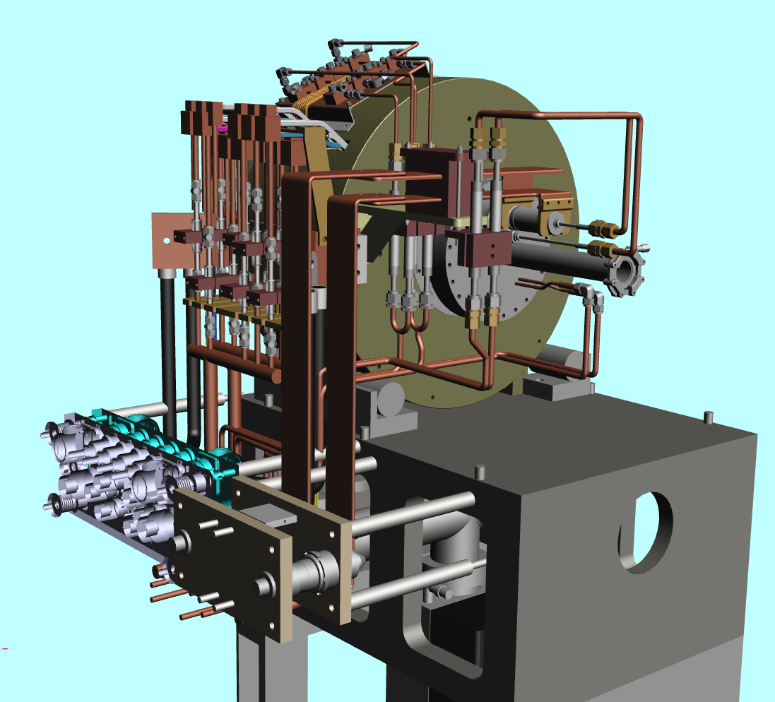
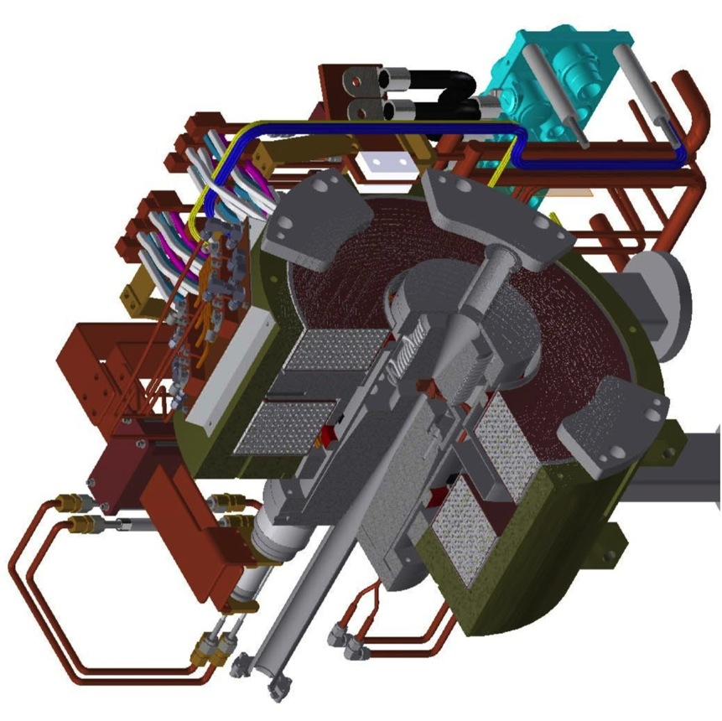
Flux Concentrator Assembly
FC assembly
primary
e- beam
positron
production
Target
quick detachable power & water connection
to minimize worker's radiation dose
Flux
Concentrator
Bridge
Coils
e+ beam

Slide 18
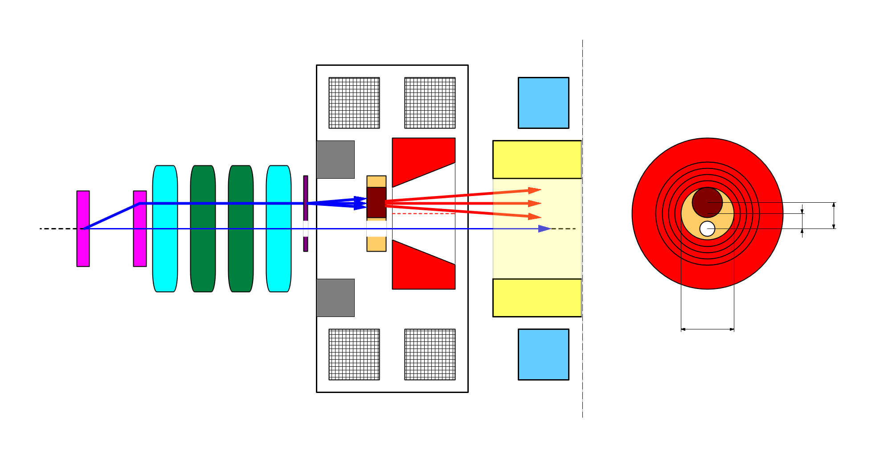
e+/e- beam switching at target
side view
bridge coils
rear view
solenoid
target
diameter
4.0 mm
10 nC
primary e-
DC QM
LAS Accel.
structure
spoiler
target
offset
3.5 mm
target
e+
beam
hole
5 nC injection e-
2.0 mm
FC offset
hole
diameter
2.0 mm
Flux
Concentrator
pulse ST
7.0 mm
FC aperture
pulse QM
Two possible schemes of beam switching by orbit bump
e+ on-axis, e- offset
-> e- emittance growth by solenoid kick induced orbit
e- on-axis, e+ offset
-> e+ yield degradation (50% -> 10%)
we take this scheme.
T.Kamitani

Slide 19
Photo-cathode RF-gun Development
A1 RF-gun (GR_A1) under test
  Big progresses are quasi-traveling wave side-coupled cavity, Ir5Ce photo-cathode, Yb fiber laser
  Longitudinal laser pulse manipulation is necessary for energy-spread and stability management
  Should understand those many new components for real stable operation
  5-nC per bunch was re-confirmed with new configuration
  600-m transport was confirmed (with small charge)

Slide 20
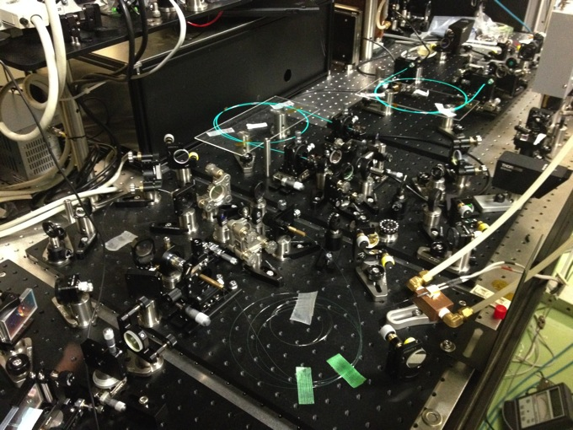
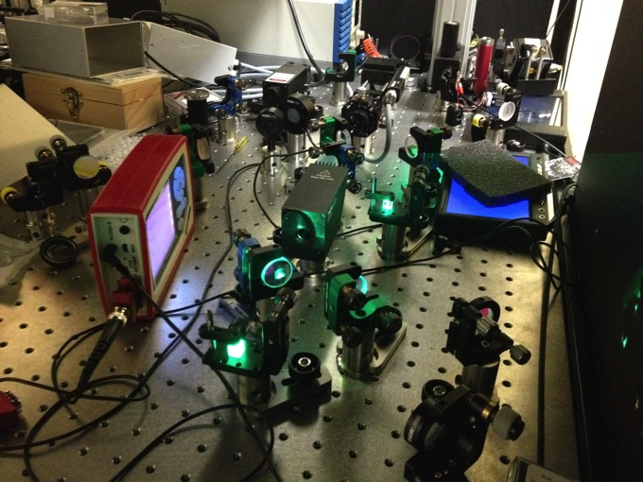
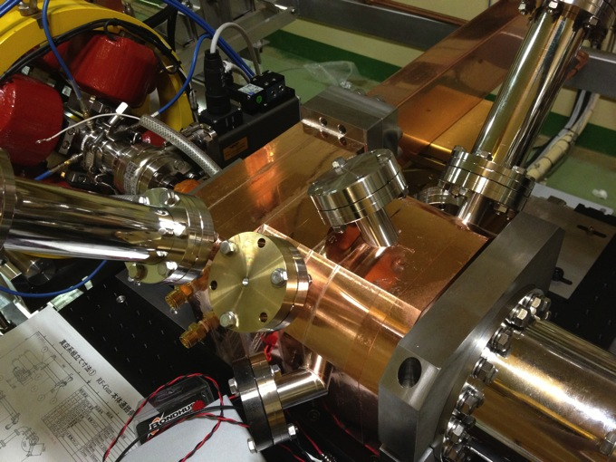
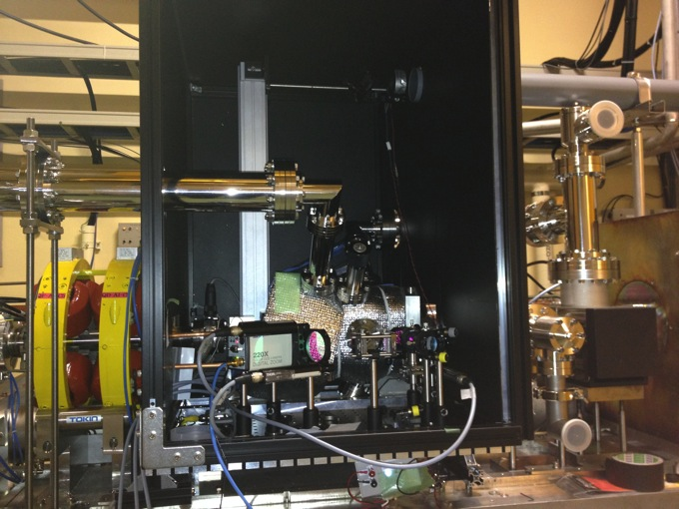

Slide 21
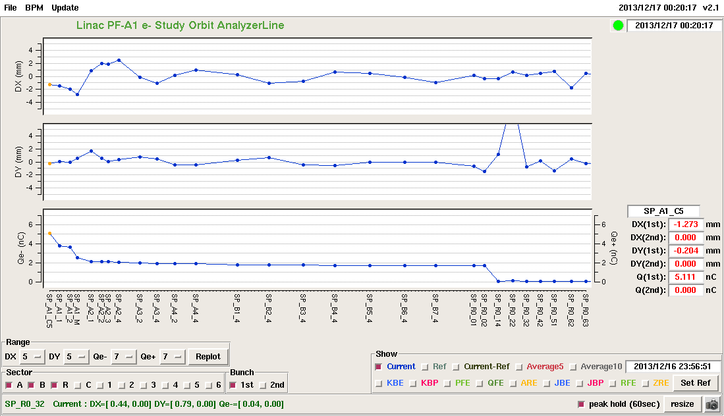
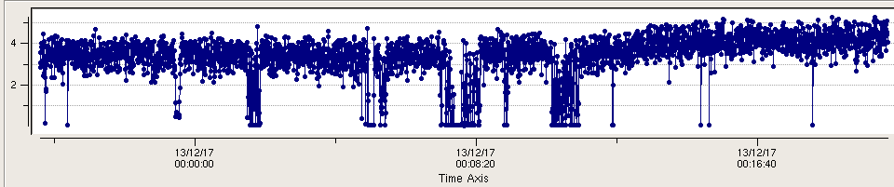
GR_A1 : 5.1 nC / bunch
Vertical position /mm
Charge /nC
Charge Trend / Stability

Slide 22
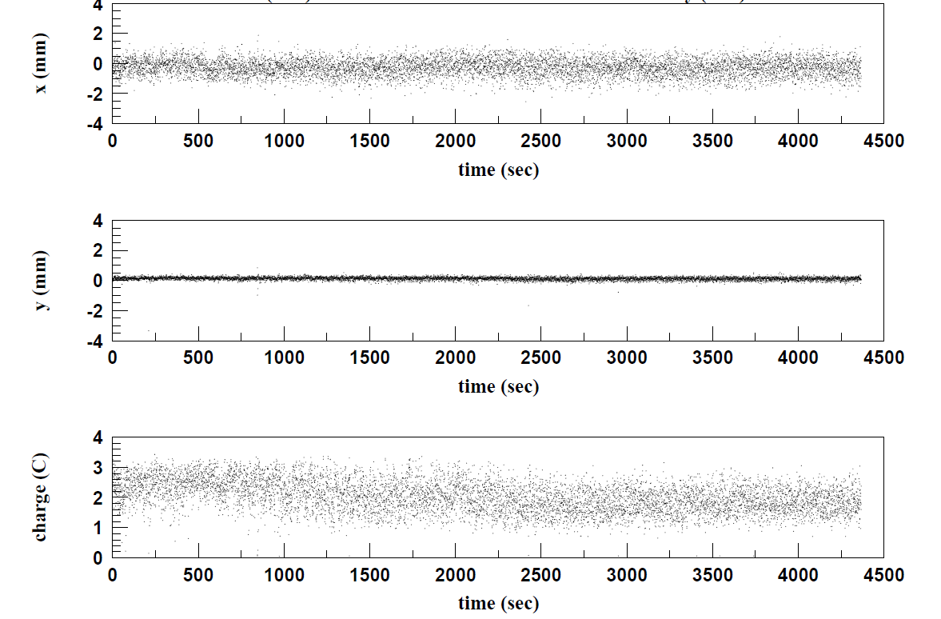
Beam Trend / Stability

Slide 23
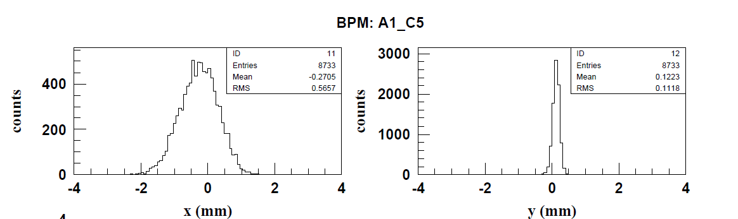
Horizontal / Vertical stability

Slide 24
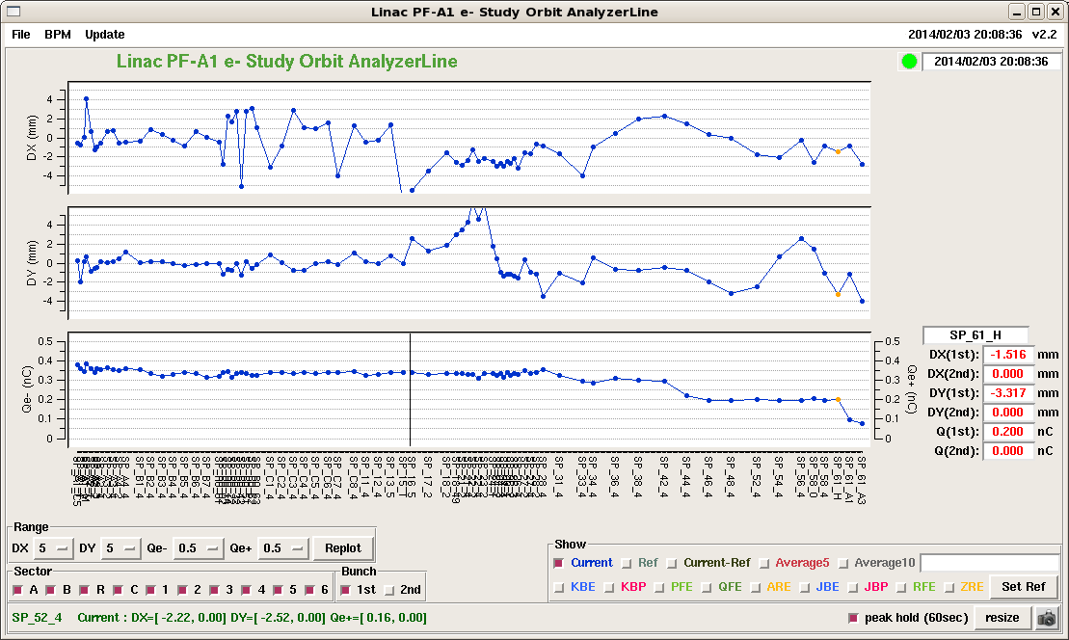
600m beam transport from RF-gun with QTWSC

Slide 25
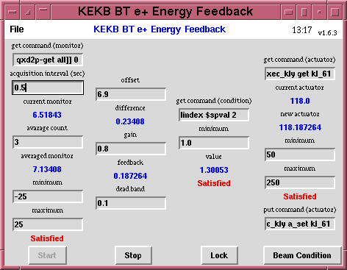
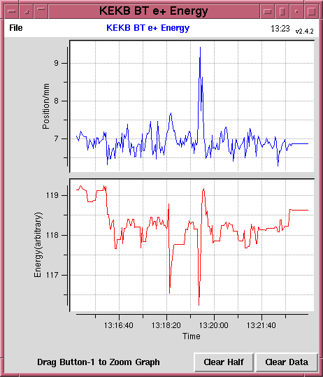
Virtual Accelerator-based Controls
Dual-layer Controls
Multiple closed loops were installed on each PPM VA independently
  Tested at KEKB
e⁻ Gun
e– BT (PF: 2.5GeV, 0.1nC)
ARC
PF Injection
e⁺ Target
Event-based Control System
e⁻ Gun
ARC
KEKB-LER Injection
Primary e– (4GeV, 10nC)
e⁺ BT (KEKB: 3.5GeV, 0.6nC)
e⁺ Target
e⁻ Gun
ARC
KEKB-HER Injection
e⁺ Target
e– BT (KEKB: 8GeV, 1.2nC)

Slide 26
Event-based
Control System
Four PPM VAs at least
for SuperKEKB project
(maybe with
additional PPM VA
for stealth beam)
Every
20 ms
F.B
e⁻ Gun
F.B
ARC
PF Injection
e– (2.5GeV, 0.2nC)
F.B
e⁻ Gun
Damping ring
SuperKEKB-LER Injection
F.B
ARC
e– (3.5GeV, 10nC)
F.B
e⁺ Target
e⁺ (4GeV, 4nC)
e⁻ Gun
ARC
SuperKEKB-HER Injection
F.B
F.B
e– (7GeV, 5nC)
e⁻ Gun
F.B
ARC
PF-AR Injection
e– (6.5GeV, 5nC)

Slide 27
Summary
Steady progress towards first MR injection in 2015
Will make staged improvements before 2017
Will finish disaster recovery in 2014
Will balance between final beam quality and stable and staged operation
Will select optimized route depending on available resources

Slide 28
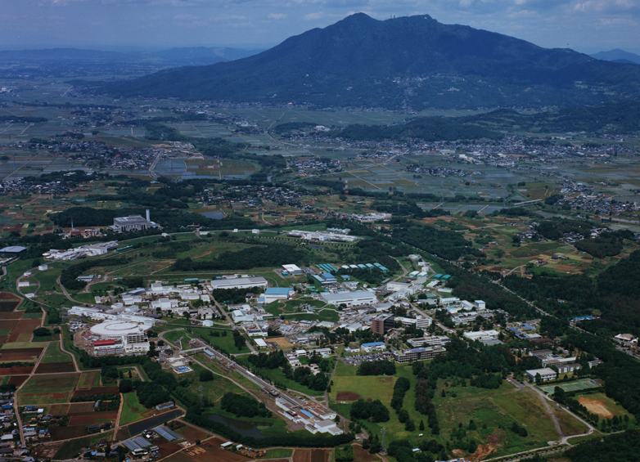
Mt. Tsukuba
Thank you
SuperKEKB
dual rings
PF-AR
PF
Injector
Linac

Slide 30
System Construction
Display and Analysis
EPICS Controls
Multiple
Independent PPM Parameters
Common Parameters
Multiple
Multiple
Event Synchronous Controls
PPM
Virtual Accelerators
Simulation
Virtual Accelerators
Real Accelerator

Slide 31
e- beam
Bunch compression @ J-ARC
Offset injection
@ Sector C-5
BNS damping
@ Sector A-B
High precision monitor
20 mm⋅mrad, 0.08% energy spread, 5 nC, two bunch
Component Alignment
& BBA
Uniform longitudinal beam distribution
e- RF gun
(5 nC)

Slide 32
e+ beam
Damping ring operation
Timing system
/Bucket selection
Large aperture
S-band structure
20 mm⋅mrad, 0.07% energy spread, 4 nC, two bunch
Flux concentrator
Component Alignment
& BBA
e- RF gun
(10 nC)

Slide 33
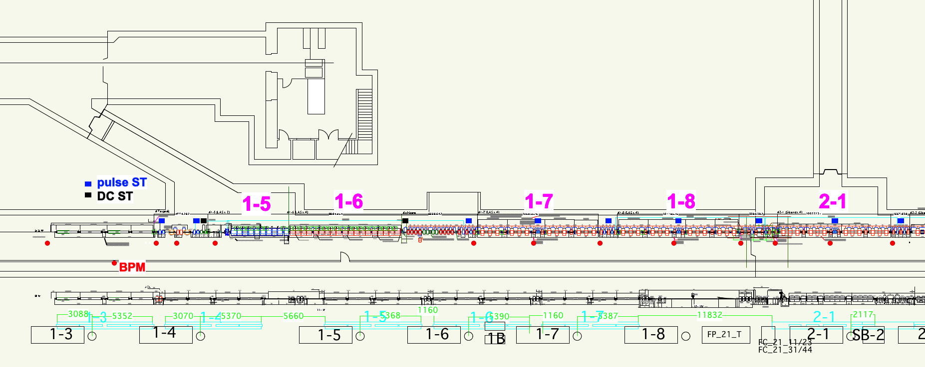
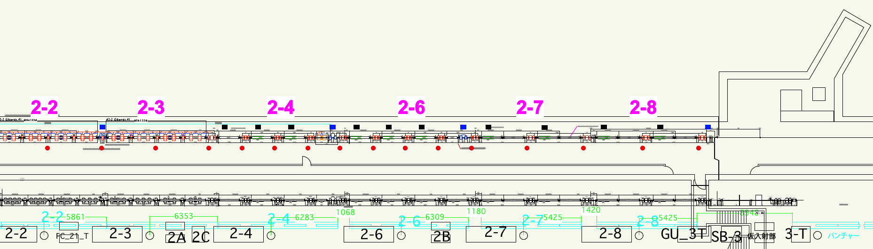
ビームライン詳細
陽電子ター
ゲットから
LTR まで
地下と地上
の摺合わせ
各機器の最
終調整と発
注
matching
section
e+ capture section

Slide 34
まとめ
2 年後の MR 入射コミッショニングに向け、ひとつの Milestone は越えた
震災の影響の懸念をある程度払拭した
SuperKEKB のビーム仕様を満たすための試験の準備が整ってきた
まずは T=0 の 1nC ビームのエミッタンスとエネルギー幅を満足し、さらに大電流ビームのビーム特性達成を目指す
  そのために、機器の安定度向上、ビーム・マイクロ波・タイミング測定、大電流加速、ビーム安定化機構、特にエミッタンス・エネルギー幅制御の確立、などをひとつずつ段階を踏んで進めて行く

Slide 35
BPM 読み出しの技術選択
Beam position monitor (BPM)
  Emittance preservation に重要となる
  ~10μm の要求分解能 (現在の装置は 50~100μm)
Libera と SLAC の技術を基礎とした新規開発
  それぞれ開発・評価中
SLAC の Steve Smith 氏と Andrew Young 氏に Review 依頼
    SLAC – SuperKEKB の協力の枠組み
  Filter 設計、Dual-bunch 信号処理、System 設計に関して詳細な Comment をもらう (may.22-27, jun.15-18.2013.)
  Reviewer は新規開発を選択
詳細設計の改善中
  予算の関係で当初からの全数設置は避けるが、現在のところ、新規開発が性能、価格、運用、保守の全般で有利として、開発中

Slide 36
Laser RF 電子銃 Workshop
ATF, cERL, Linac から計 16 人参加、6+ 件の発表
機構内でも共通技術の交換の可能性がある
低 Emittance はほぼ共通目標であるが、Linac で重要な大電流 + 低エネルギー幅は Unique で、そのための技術交換はあまりなかった
安定度などについて、今後とも情報交換の予定
Web を準備する予定

Slide 37
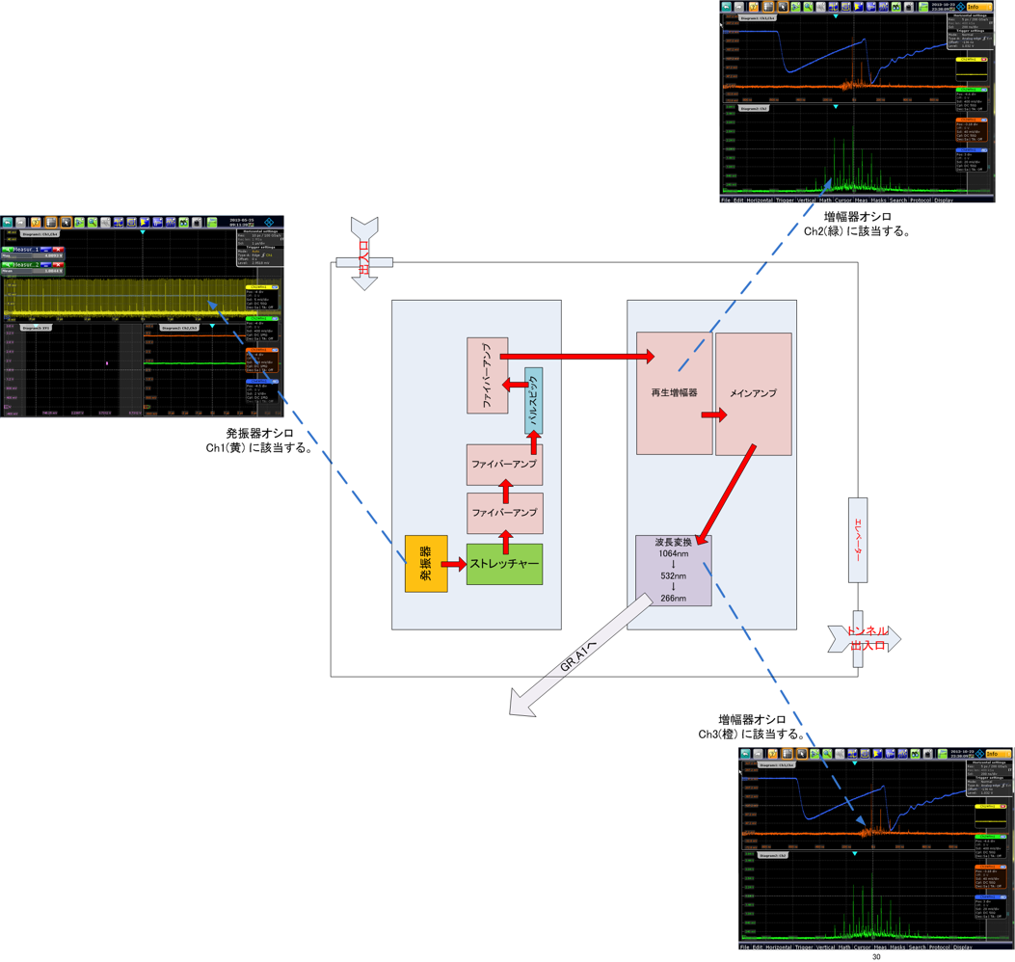
RF Gun GR_A1 Overall Structure
Regenerative Amplifier
Oscillator
Multipass Amplifier

Slide 38
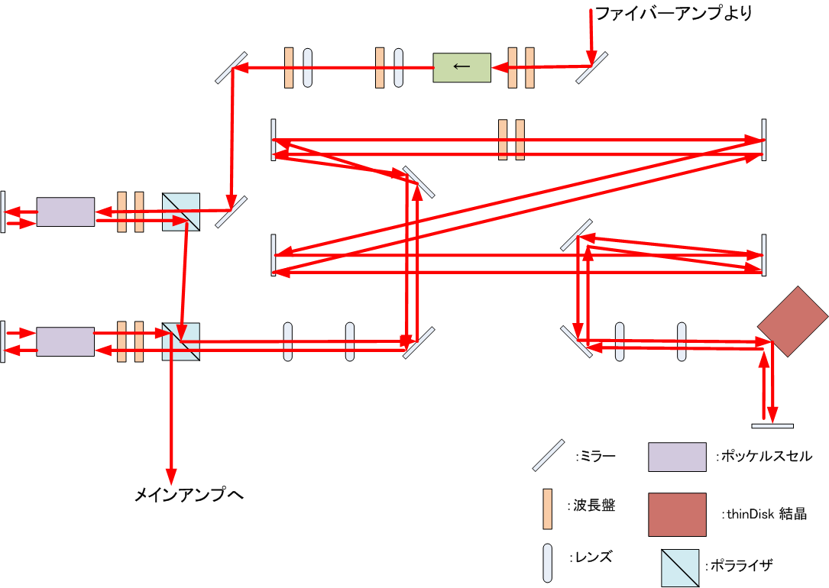
Regenerative Amplifier

Slide 39
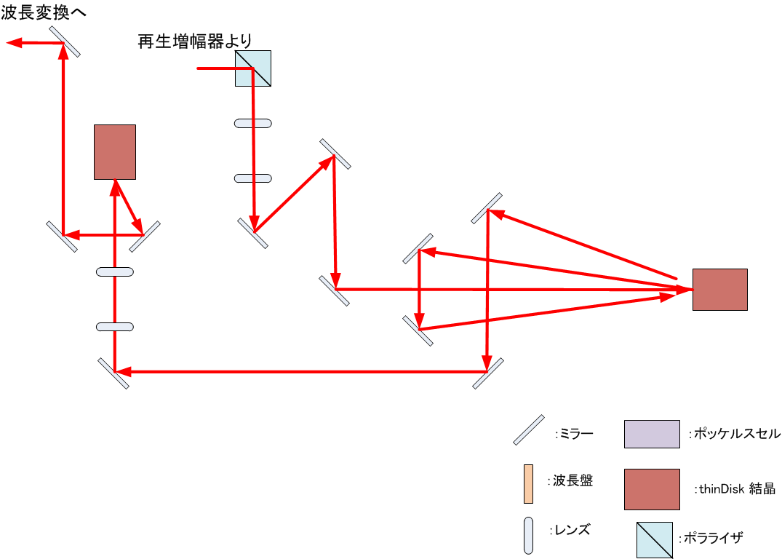
Multipass Amplifier

Slide 40
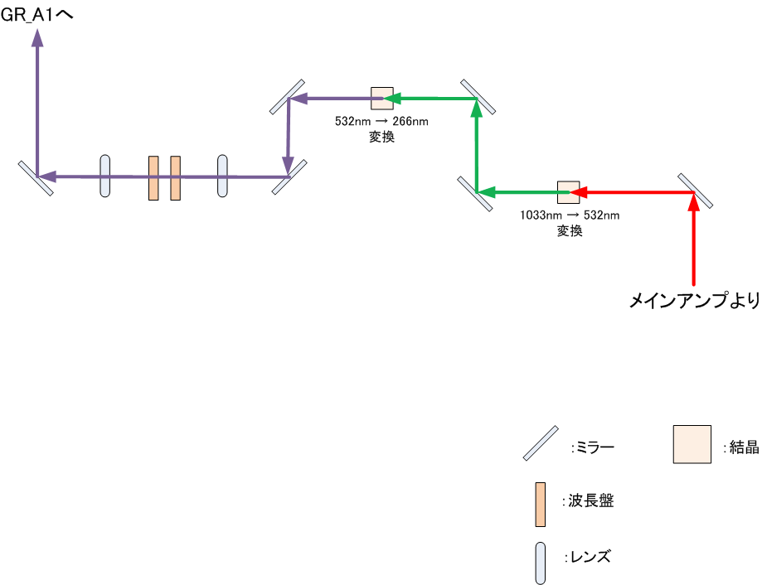
Quadruple Frequency

