Slide 1
Injector Status
[Positron Source Upgrade]
Belle2 GM (2014.06.18)
KEKB injector linac
Takuya Kamitani

Slide 2
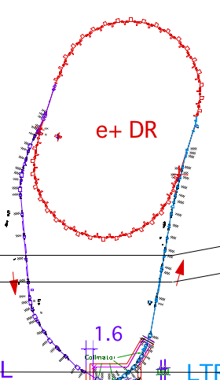
SuperKEKB Injector
SuperKEKB injector
50 Hz (e+ or e-)
pulse-by-pulse
mode switching
low emittance
RF gun
1.1 GeV
Damping Ring
circ. 136 m
PF
2.5 GeV e-
0.1nC x 1
Bunch
Compressor
LER
3.5 GeV
10nC x 2 (prim. e-)
5nC x 2 (inj. e-)
Energy-spread
Compression System
S-band
linac
4.0 GeV e+
4nC x 2
3T
RF gun
HER
ECS
e+ target &
LAS capture section
7.0 GeV e-
5nC x 2
AR
6.5 GeV e-
Key issues in Positron Source Upgrade
Damping ring for lower emittance (2000 -> 92_{[H]}/7_{[V]} μm)
Capture section upgrade for higher intensity (1 -> 4 nC)
  flux concentrator (e+ focusing pulsed solenoid)
  LAS [Large Aperture S-band accelerating structure]

Slide 3
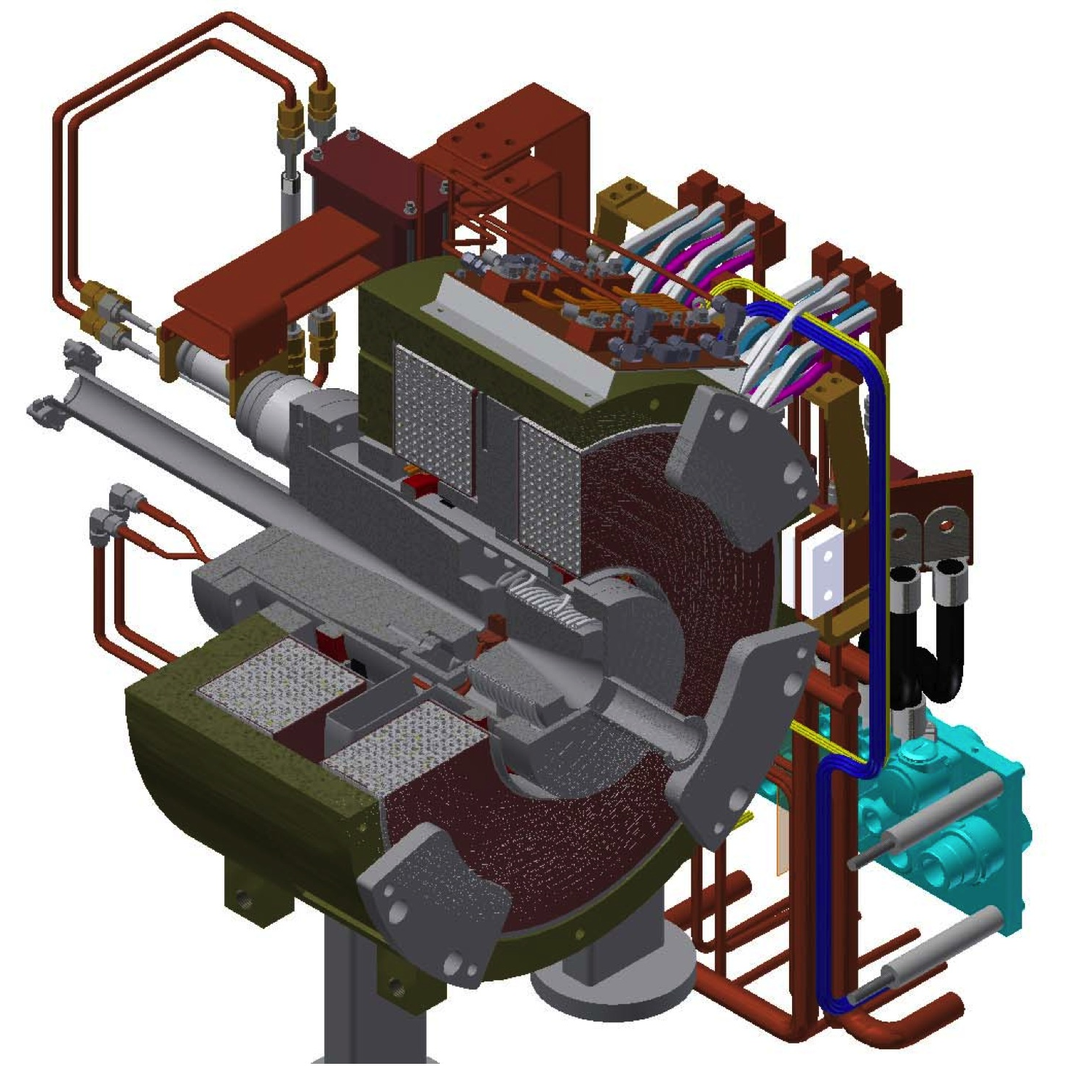
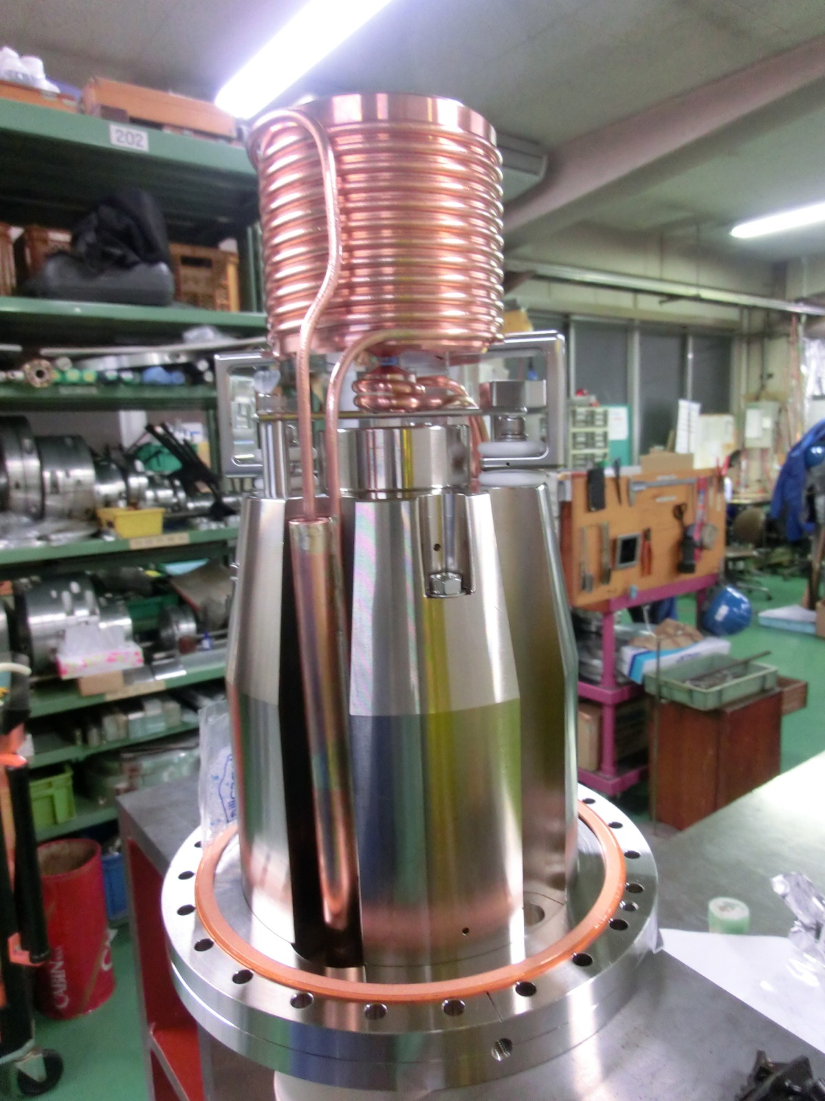
SuperKEKB positron station
flux concentrator
primary
e- beam
target
positron
production
Target
Flux
Concentrator
Bridge
Coils
e+ beam

Slide 4
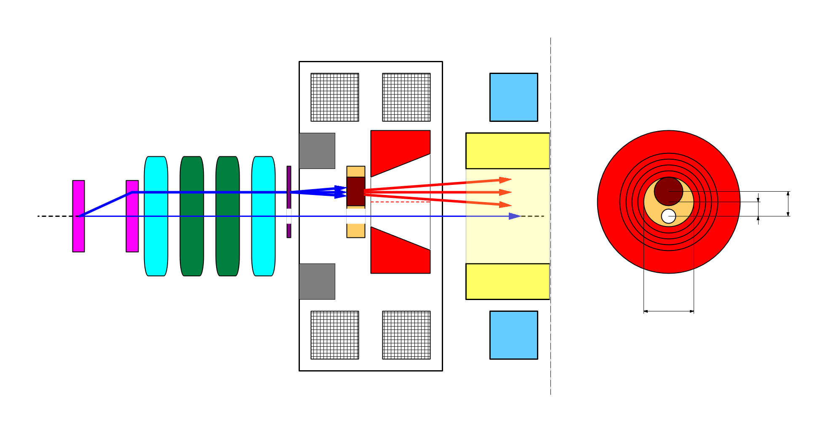
e+/e- beam switching & target hole
side view
bridge coils
rear view
solenoid
target
diameter
4.0 mm
primary e-
DC QM
Accel.
structure
spoiler
target
offset
3.5 mm
target
e+
beam
hole
injection e-
2.0 mm
FC offset
hole
diameter
2.0 mm
Flux
Concentrator
pulse ST
7.0 mm
FC aperture
pulse QM
injection e- beam ON-axis for low emittance preservation
primary e- beam OFF-axis with positron yield degradation

Slide 5
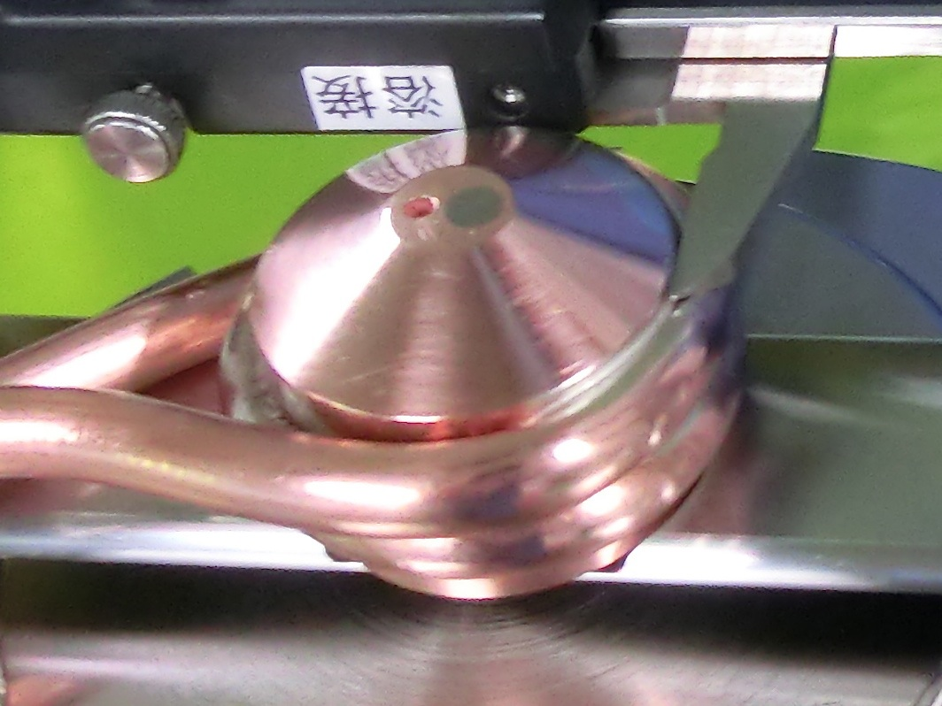
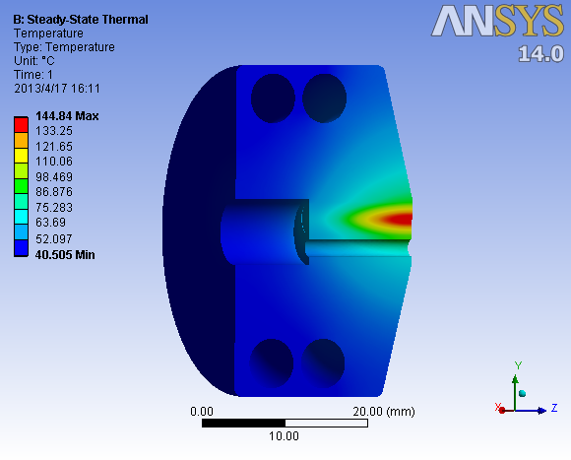
Positron production target
target material selection
  high Z material
  high melting point
  high tensile strength
=> tungsten
14 mm long = 4.0 X₀
4 mm diameter
beam hole for injection e-
beam
hole
tungsten
target
cooling water
pipe
primary
e- beam

Slide 6
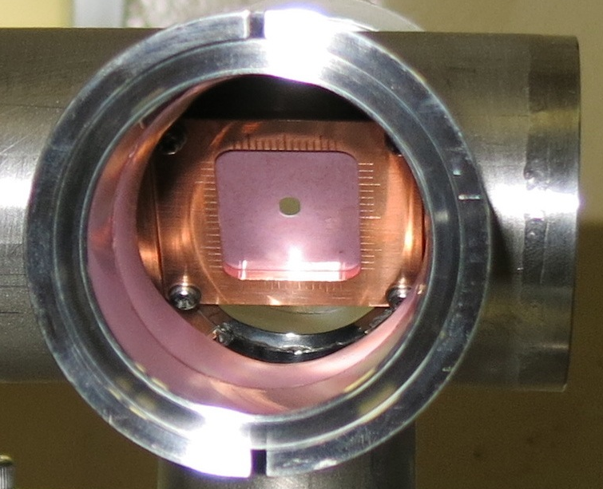
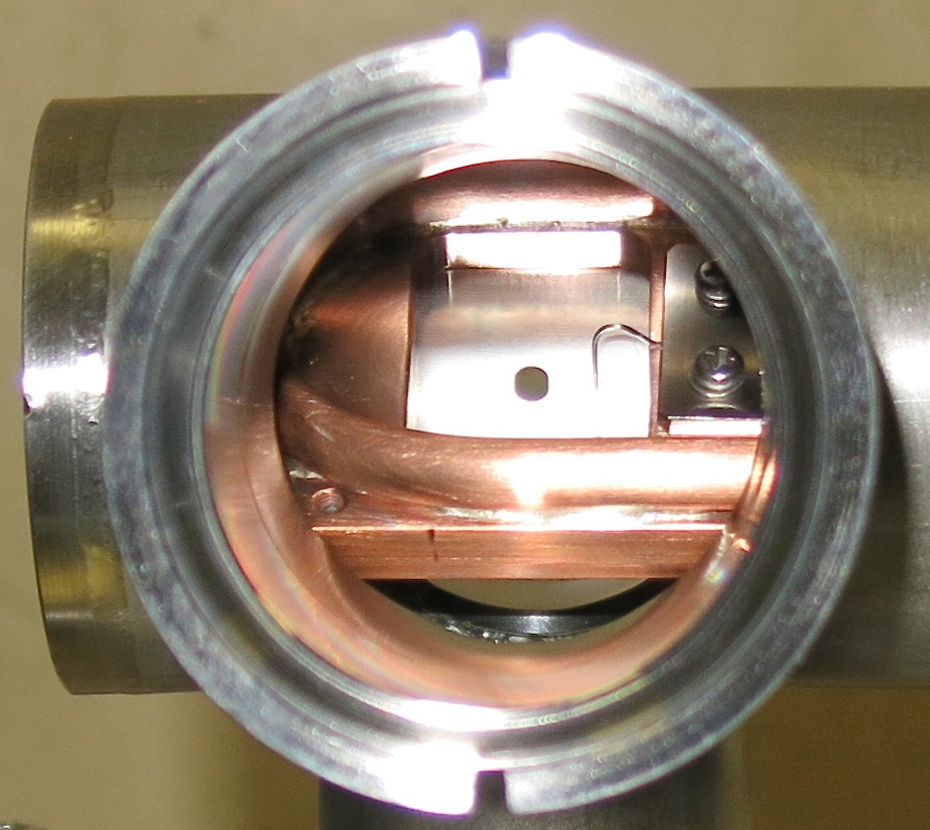
Beam spoiler for target protection
3m distance
beam spoiler to enlarge beam spot on target to be σ_{x ,}σ_{y}> 0.7 mm to avoid target destruction
spot size monitoring screen Al₂O₃
(0.14 mm thick)
+ scattering Al foil (0.25 mm thick)
[total material thickness = 0.05 X₀]
beam hole for injection e-
target
screen & scatterer
e+
primary e-
injection
e- beam
hole
hole
spot size
camera
Front
Rear

Slide 7
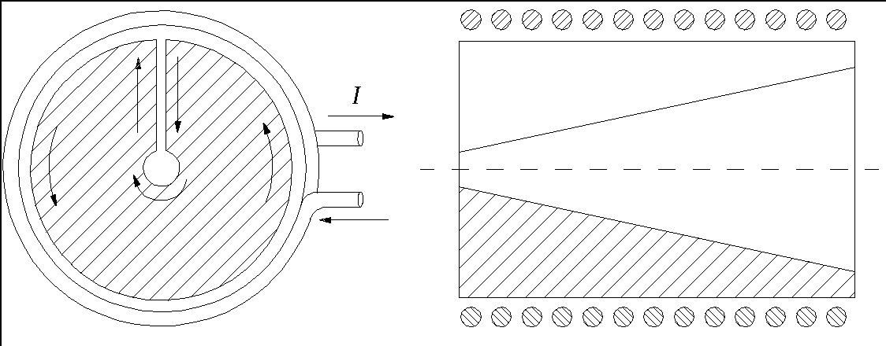
flux concentration concept
primary coil
primary coil
conductor
conductor
primary coil
DC current in primary coil produce uniform solenoidal field
Pulsed current & Conductor with slit
=> eddy current flows inner surface
to generate high magnetic flux density (flux concentration !)
but with non-axial symmetric transverse field !
=> transverse kick to positrons ! beam loss !

Slide 8
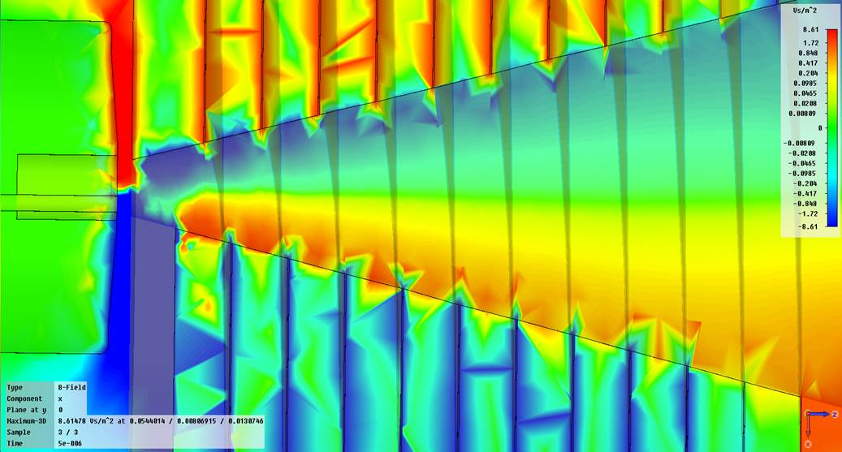
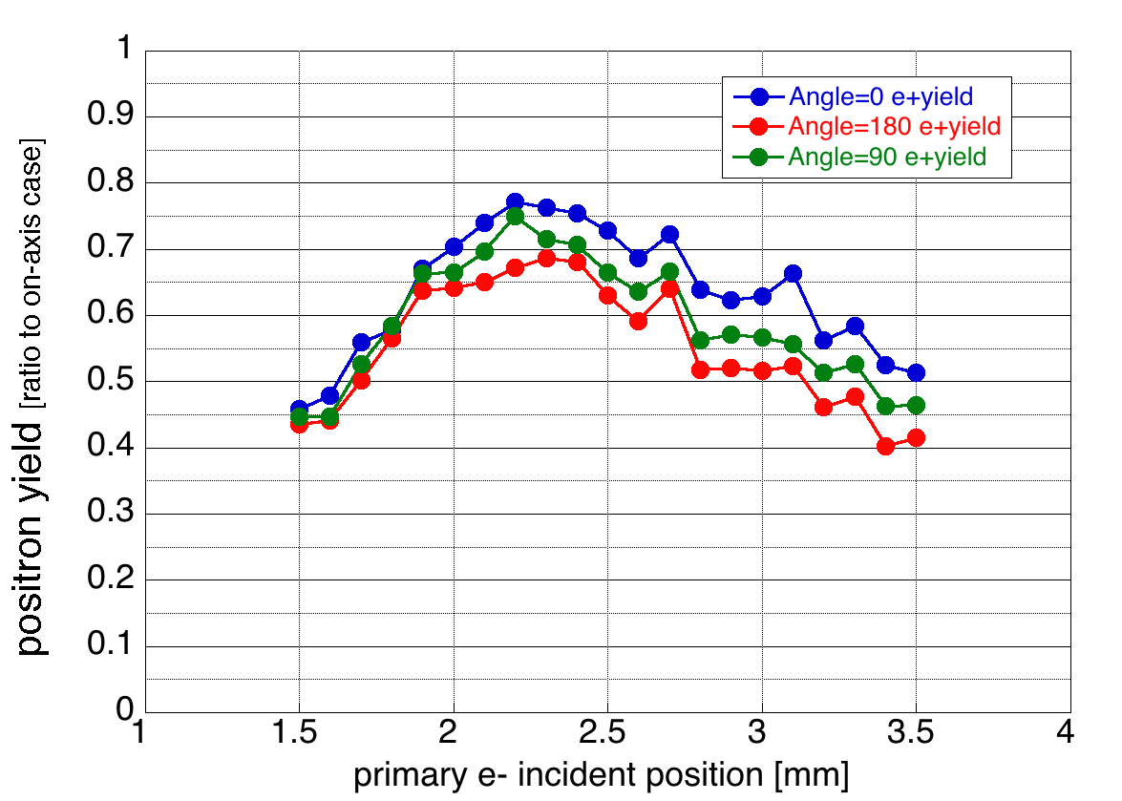
e+ yield degradation by target offset
e+ yield degrades ~50 %
by offset e+ generation
it can be improved to 78 % by
  utilizing transverse kick by proper orientation of FC slit
  e- incident position optimization
FC field map (Bx)
Bx
target
center
position
Bx-max =
0.15 T @ 12 kA

Slide 9
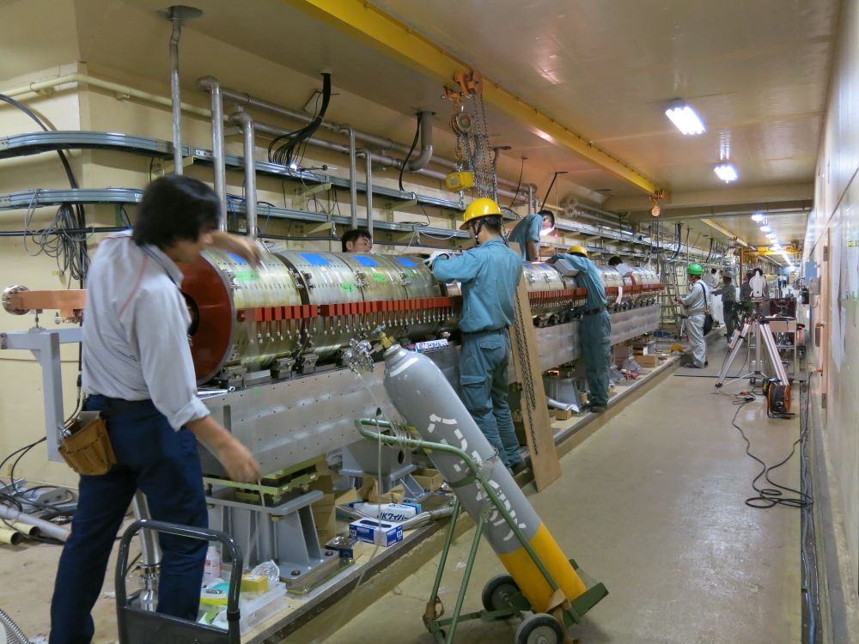
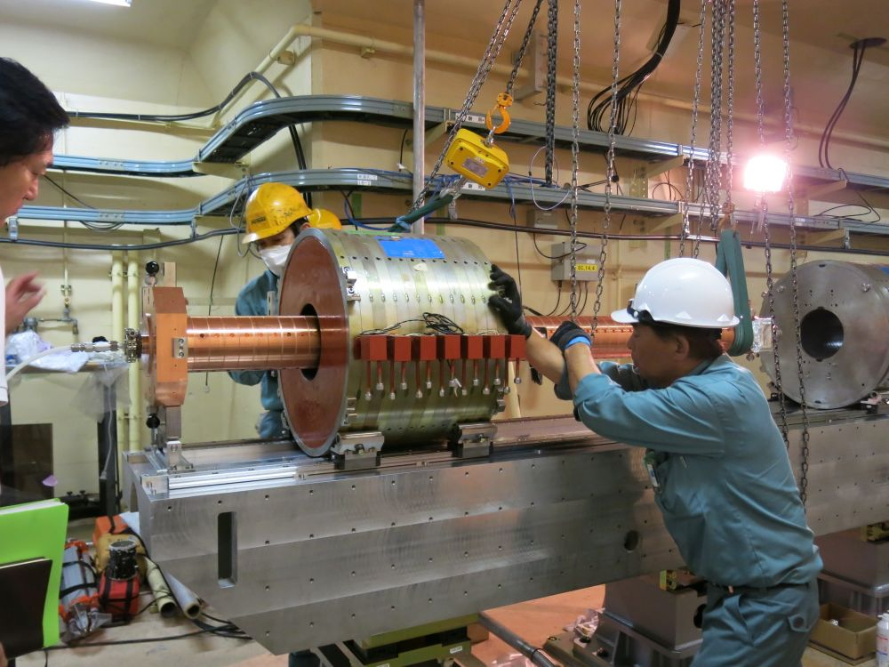
Positron Capture Section
SLED
SLED
KLY
1-5
KLY
1-6
target
+FC
LAS : Large Aperture
S-band structure
LAS 14 MV/m
deceleration & phase slip
& acceleration
LAS 10 MV/m
acceleration
Solenoids
DC solenoid
LAS
accelerating
structure

Slide 10
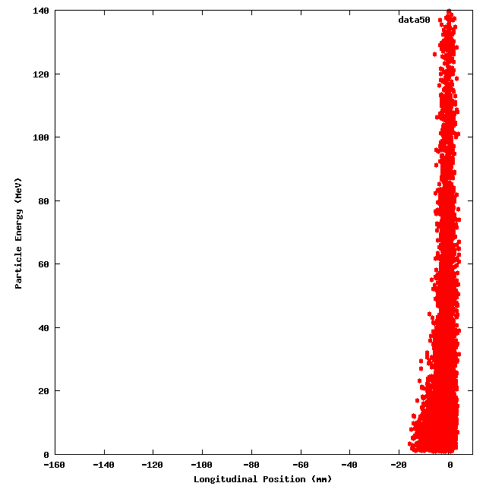
positron capture animation
from target to capture section exit (120 MeV)
Acceleration capture
Deceleration capture
Energy (MeV)
Energy (MeV)
longitudinal position (mm)
longitudinal position (mm)
You are watching longitudinal particle motion
(z-position vs energy) in a moving frame
riding on a microwave !
Positrons with deceleration capture
favored for less halo and satellites !

Slide 11
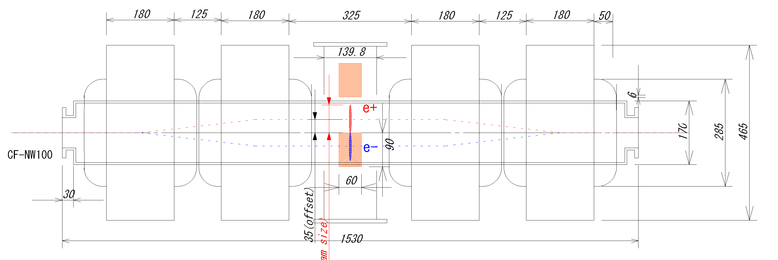
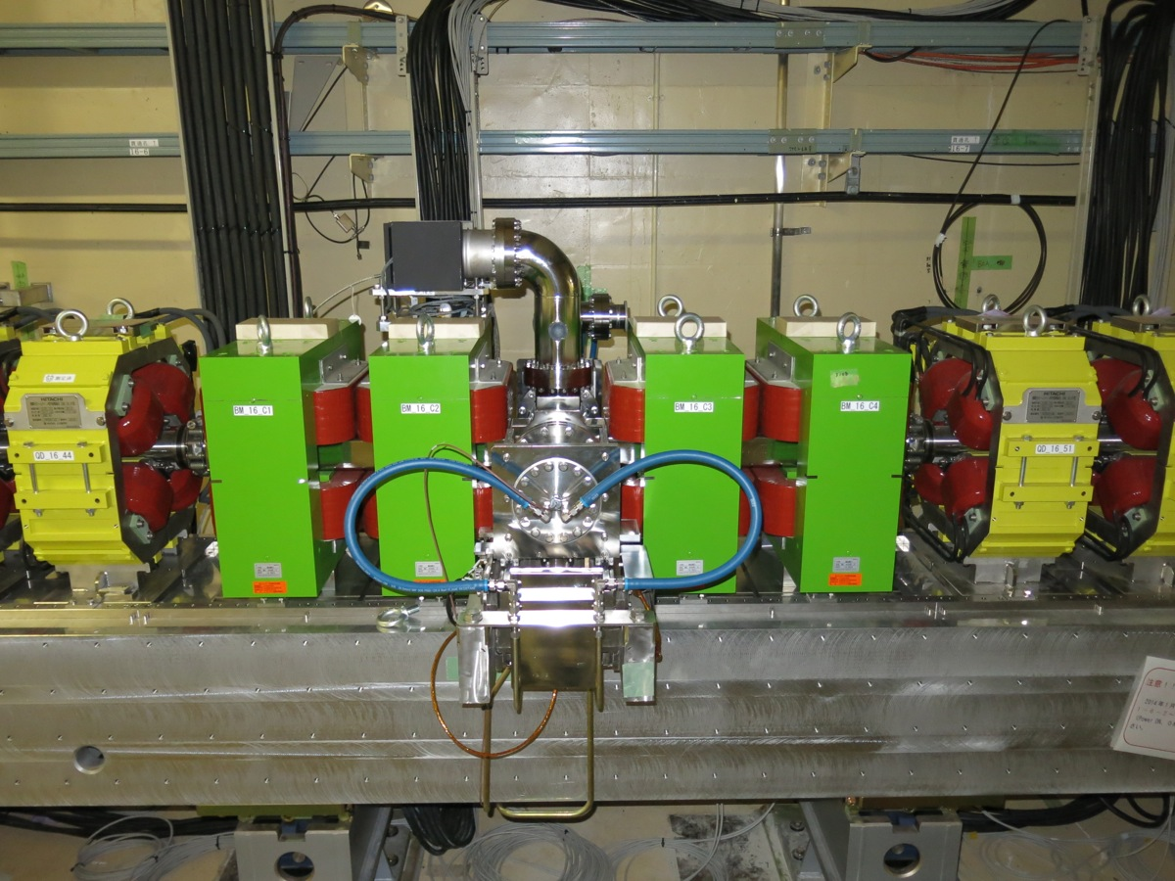
e+/e- separator chicane
e- stopper block
both secondary e+/e- are captured
to avoid disturbance of
beam position monitors
by mixture of e+/e- signals,
only secondary e- are absorbed
pure e+ beam is transmitted

Slide 12
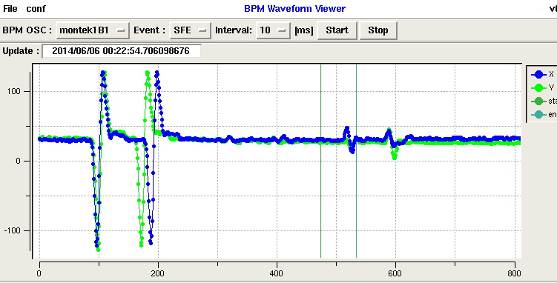
The first positron beam after the upgrade
positron signal !!
BPM: SP_15_T in front of target
negative charged particles (e- beam)
give (-)(+) bipolar signal
BPM: SP_16_5 after e+ capture section
positive charged particles (e+ beam)
give (+)(-) signal

Slide 13
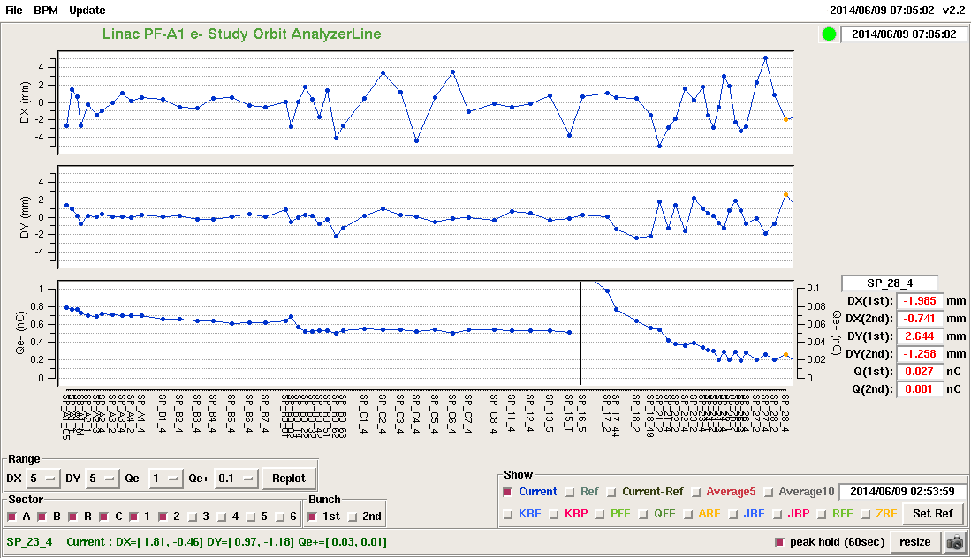
observed positron intensity
orbit-X
[mm]
orbit-Y
[mm]
Primary Electron
intensity at target
Q(e-) = 0.500 nC
Positron intensity
at positron line end
Q(e+) = 0.02 nC
beam
intensity
[nC]
Gun
J-arc
target
Sector-2 end

Slide 14
Summary
Positron source components have been installed
in the beam line
(a target, a beam spoiler, a flux concentrator, bridge coils,
DC solenoids, LAS accelerating structures, e+/e- separator chicane, plenty of quads)
Still in low spec. operation due to various constraints
  design full spec. achieved
  flux concentrator 12 kA 6 kA
  bridge coils 750 A 600 A
  DC solenoids 650 A 370 A
  LAS field gradient 14, 10 MV/m 10, 7 MV/m
We have observed the first positron beam
after the upgrade !
(Q_{e+} = 0.02 nC @sector-2 end for Q_{e-} = 0.5 nC @target)
(Q_{e+} = 4 nC @sector-2 end for Q_{e-} = 10 nC @target)
2014.06.09
x200
x20
SuperKEKB
full spec.

