Slide 1
Injector Linac Energy Margin Answers to injector questions at Moday talk
Kazuro Furukawa
Injector Linac, KEK

Slide 2
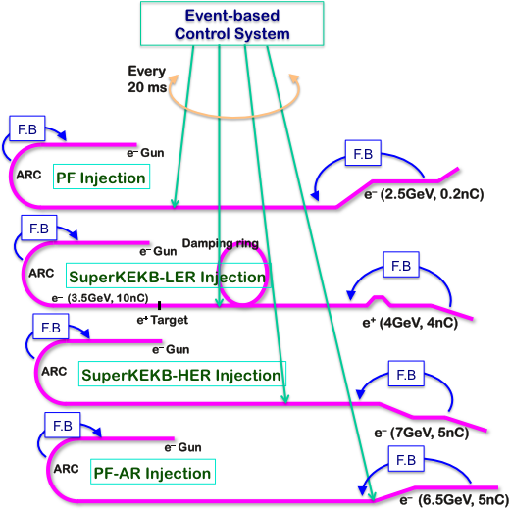
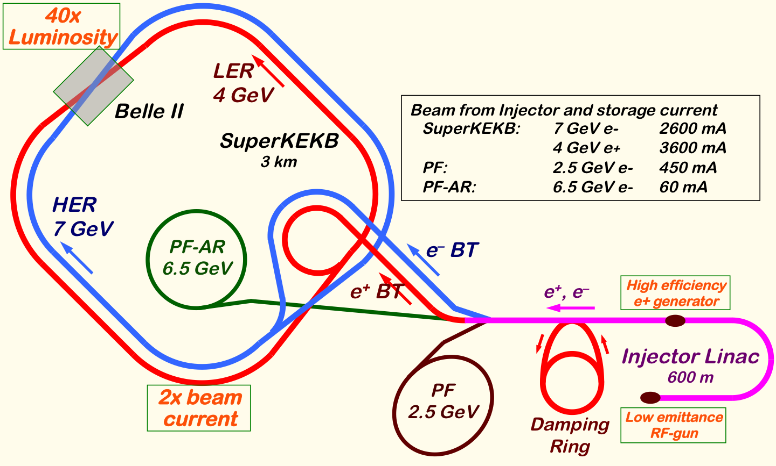
Mission of Electron/positron Injector in SuperKEKB
Linac Mission in FY2016-FY2017
For 40-times higher luminosity in SuperKEKB collider
Low emittance & low energy spread injection beam with 4-5 times more beam current
New high-current photo-cathode RF gun developments
New positron capture section
Damping ring construction
Optimized beam optics and correction
Precise beam orbit control with long-baseline alignment
Simultaneous top-up injection to DR/HER/LER/PF/PFAR
Balanced injection for the both photon science and elementary particle physics experiments
1
The single injector would behave as multiple injectors to multiple storage rings by the concept of virtual accelerator
Notes:
Higher Injection Beam Current
To Meet the larger stored beam current and shorter beam lifetime in the ring
4~8-times larger bunch current for electron and positron
Reconstruction of positron generator, etc
Lower-emittance Injection Beam
To meet nano-beam scheme in the ring
Positron with a damping ring
Electron with a photo-cathode RF gun
Emittance preservation by alignment and beam instrumentation
Quasi-simultaneous injections into 4 storage rings
SuperKEKB e–/e⁺ rings, and light sources of PF and PF-AR
Improvements to beam instrumentation, low-level RF, controls, timing, etc

Slide 3
Linac Energy Margin in Phase II
In Phase II Commissioning
Construction budget is so tight that no backups are prepared for many components (common understanding)
As the acceleration units are indispensable, for Y(4s) in Phase-II at least a single backup/stand-by unit (~150 MeV) is prepared for each of three linac sections
Sections: J-Arc (1.5 GeV), SY2-DR (1.1 GeV e⁺), SY3-Linac-end (7 GeV e– / 4 GeV e⁺)
51 units for acceleration and 9 units for beam manipulation
However, Y(6s) was out of consideration for Phase-II
It may be possible to operate for Y(6s) without backups (J-Arc 1.7 GeV)
Need to reach an understanding with PF / PF-AR for possible interference
Before that, we surely have to establish low emittance beam injection
There are many failure modes of units, typical ones are;
High power klystrons [a few times a year]
Two and a half days to replace a klystron
High power klystron pulse modulators [once or twice a year]
From a shift to several days depending on the failures
Fatal damage in accelerator structures [once in a few years]
Several days to replace a structure
Frequency of the appearance has been increasing
Kamitani et al

Slide 4
Linac Energy Margin in Phase III
In Phase III Commissioning
Unit #13 will be added in Phase-III (+150 MeV)
Securing well-performed accelerator structures in #44, the unit will be converted to high-gradient by adding another klystron (+70 MeV)
On failures, the J-Arc energy may be changed to help other sections depending on the failure mode
If really relevant, DR energy may be changed to help e+ (?)
In the long run, degraded accelerating structures should be refurbished
Kamitani et al
SuperKEKB PF/AR Injector
PF
2.5 GeV
0.2nC x 1
B
A
New RF gun 5 nC
Thermionic gun 10 nC
1.1 GeV
e+ damping ring
J-arc
1.5 GeV
Slow Positron
Primary electron
2.9 GeV, 10nC x 2
New Positron Capture Section
Bunch Compression
Energy Compression
Energy Compression
LER
4.0 GeV
4nC x 2
Bunch Compression
C
1
2
3
4
5
HER
7.0 GeV
5nC x 2
20 um
PF-AR
6.5 GeV
0.2nC x 1

Slide 5
Why Smaller Margin while dropping Energy 8 GeV → 7 GeV
No backup/stand-by before J-Arc in KEKB operation
Optimized for SuperKEKB ring injection reliability with larger beam currents and smaller emittance
A unit was removed to make a room for DR BT
Positron deceleration capturing
Lower acceleration in large aperture structures in the positron capture section
An unit before J-Arc was converted into a stand-by for availability
C-band structures were converted into S-band to help emittance preservation
Degraded accelerating structures after 35 years of operation
Larger beam current with larger beam loading
Kamitani et al

Slide 6
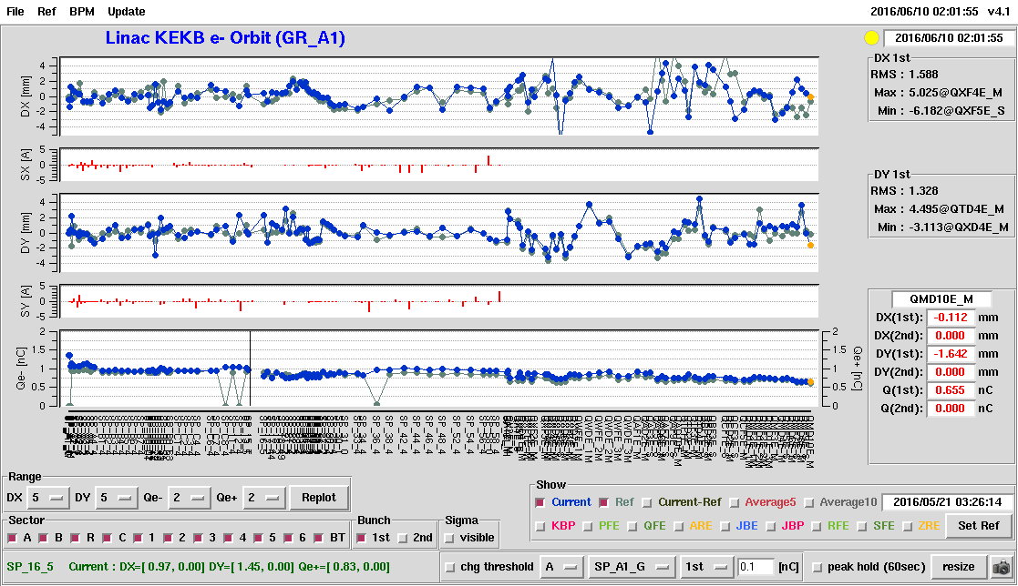
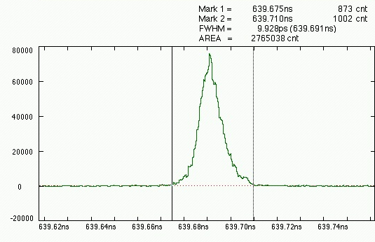
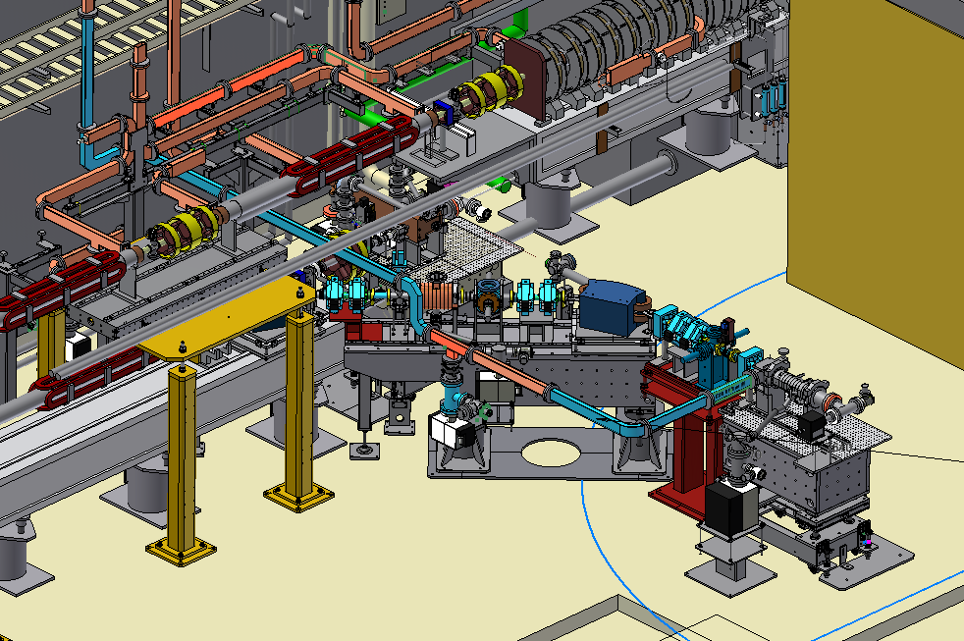
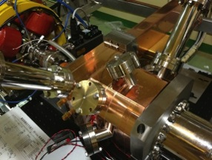
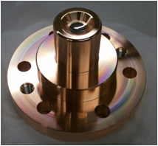
Development of Photo-cathode RF Gun
One of Key Component: Photo Cathode RF Gun
Succeeded in injection during SuperKEKB Phase 1 commissioning for 11 days
Employs Yb-doped-fiber and Yb:YAG laser, Ir5Ce cathode, quasi travelling wave side-coupled cavity
Need stability improvements
Beam instrumentation improvement and comparison with simulation codes underway
Secondary RF gun is being constructed as a backup
Incorporate suggestions by review committee for availability
Beam orbit measurement
Bunch width
Thermionic gun
Primary RF gun
Quasi traveling wave side couple cavity
New secondary RF gun
Ir₅Ce Cathode

Slide 7
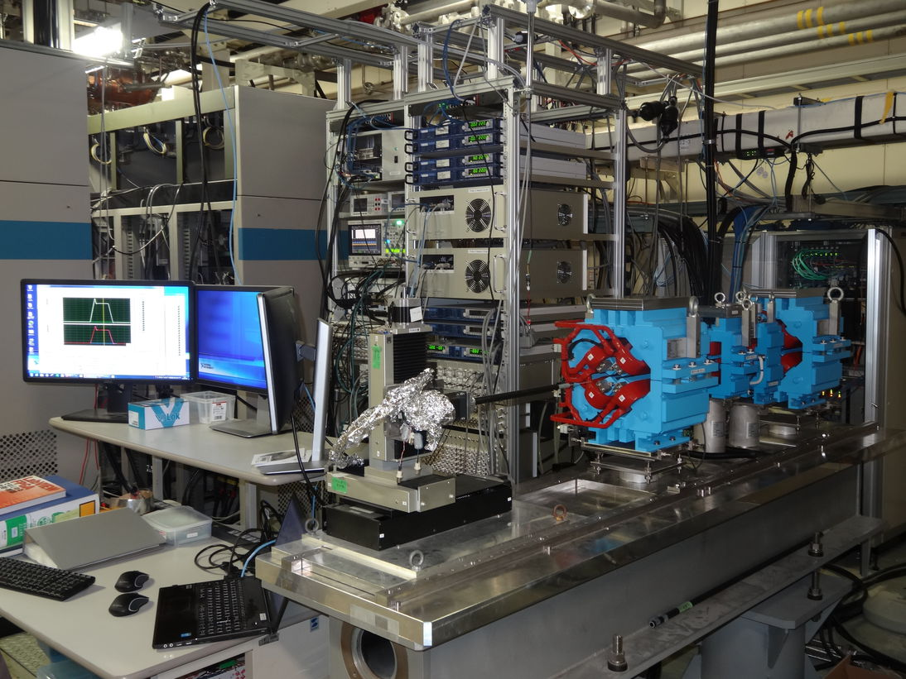
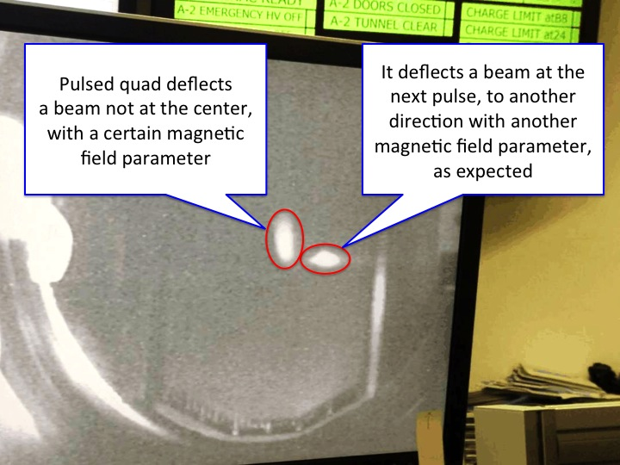
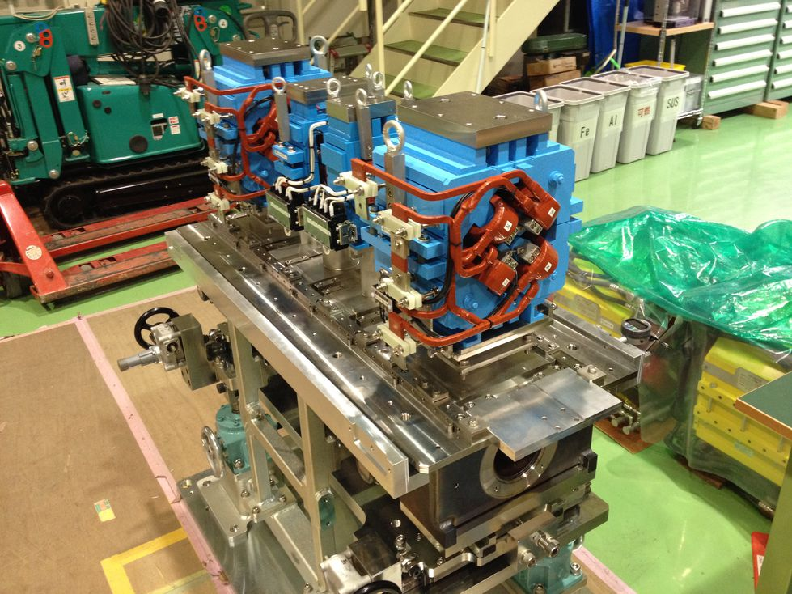
Development and installation of pulsed magnets
One of Key Component: Pulsed Magnets
Pulsed magnet power supplies were postponed to 2017 because of resource availability
30 quads, 36 steerings, 2 bends, 13 girders will be fabricated and installed in 2017
Quads with aggressive design at 1 mH, 330 A, 340 V, 1 ms with energy recovery up to 75%
Essential for SuperKEKB low emittance injection and simultaneous injections
4+1 ring injections with virtual accelerator concept
Risks against schedule and possible backup operation procedure are investigated
Long term tests at a stand
Satisfies specifications
Some more control capability
Synchronous operation in 2017
Beam test with two quads
Successful 25 Hz beam switches
Basic features are completed
Event timing synchronization needed
Girders are tested as well
In-house drawings to save rsc.
0.1mm alignment precision
Ready for Phase-3 upgrade

Slide 8
Possible Rescheduling
Under limited resources rescheduling of fabrication, purchase, tests, installation, commissioning is planned
Because of construction concentration in JFY2017, 5-month shutdown of injector is planned
for KEKB it could allocate 9-month shutdown in 1997, synchronizing with light source upgrade

