Slide 1
Electron/Positron Injector Linac and
SuperKEKB Domestic Review Meeting
Kazuro Furukawa
Injector Linac, KEK

Slide 2
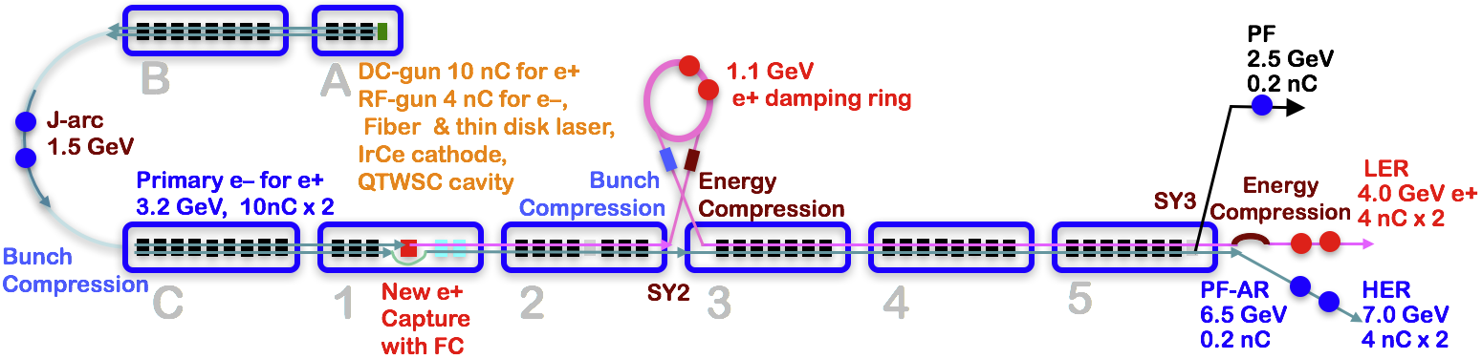
Injector Linac Overview
Injector linac configuration
  Major upgrade items
    Photo-cathode RF-gun for low-emittance e-
    Flux concentrator, LAS structure, solenoids, quads for e+
    Pulsed magnets for adequate beam optics for each beam
    High-precision beam position monitor
    High-precision beamline alignment for low emittance

Slide 3
Required injector beam parameters
Stage | KEKB (final) |  | Phase-I |  | Phase-II |  | SuperKEKB (final)
Beam | e+ | e– | e+ | e– | e+ | e– | e+ | e–
Energy | 3.5 GeV | 8.0 GeV | 4.0 GeV | 7.0 GeV | 4.0 GeV | 7.0 GeV | 4.0 GeV | 7.0 GeV
Stored current | 1.6 A | 1.1 A | 1 A | 1 A | – | – | 3.6 A | 2.6 A
Life time (min.) | 150 | 200 | 100 | 100 | – | – | 6 | 6
Bunch charge (nC) | primary e- 10 → 1 | 1 | primary e- 8 → 0.4 | 1 | 0.5 | 1 | primary e- 10 → 4 | 4
Norm. Emittance (γβε) (μrad) | 1400 | 310 | 1000 | 130 | 200/40 (Hor./Ver.) | 150 | 100/15 (Hor./Ver.) | 40/20 (Hor./Ver.)
Energy spread | 0.125% | 0.125% | 0.5% | 0.5% | 0.16% | 0.1% | 0.16% | 0.07%
Bunch / Pulse | 2 | 2 | 2 | 2 | 2 | 2 | 2 | 2
Repetition rate | 50 Hz |  | 25 / 50 Hz |  | 25 / 50 Hz |  | 50 Hz
Simultaneous top-up injection (PPM) | 3 rings (LER, HER, PF) |  | No top-up |  | Eventually |  | 4+1 rings (LER, HER, DR, PF, PF-AR)

Slide 4
Domestic Accelerator Review

Slide 5
SuperKEKB Domestic Review
The third domestic review meeting
      On September 8th
      Reviewers of Atsushi Enomoto, Katsunobu Oide (chair), Kotaro Satoh, Fujio Naito, Tatsuo Nakada, Junji Haba, Kentaro Harada, Yosuke Honda, Shinichiro Michizono
      <http://accphys.kek.jp/indico/conferenceDisplay.py?confId=122>
  Positron source
  Photo cathode RF gun
  Accelerating structure
  Pulsed magnets
    Two of them received recommendations
  DR timing system
  QCS
  Luminosity tuning
  Electron cloud instability in Phase 1 operation
  Beam background, MDI

Slide 6
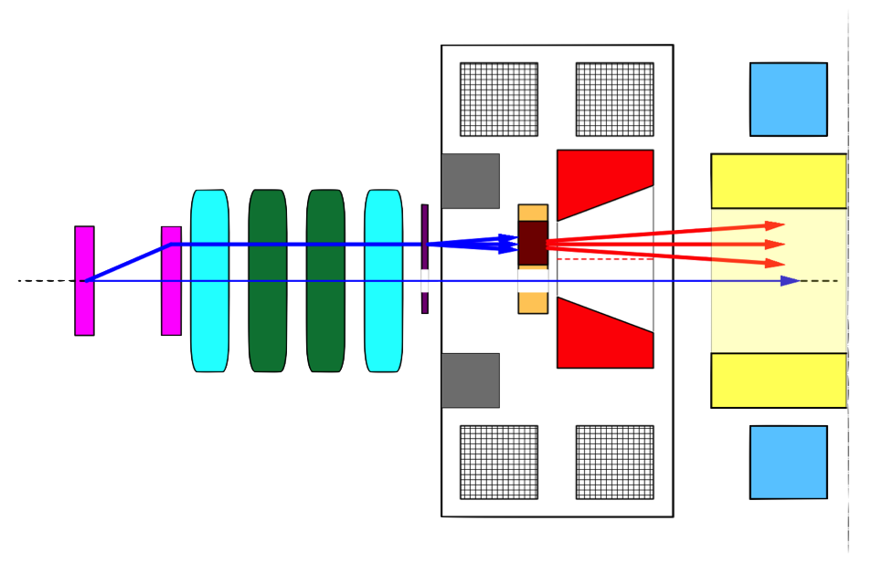
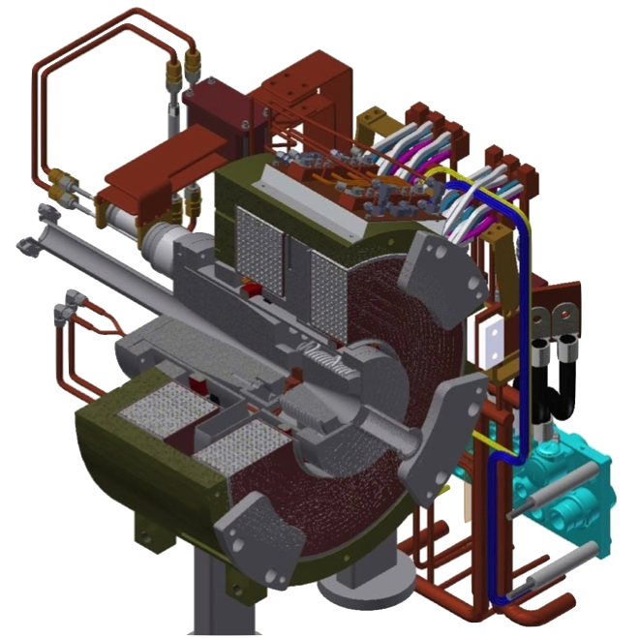
Positron generation for SuperKEKB
Positron Enhancement
Kamitani, Enomoto et al.
bridge coils
solenoid
side view
primary
e- beam
10 nC
primary e-
DC QM
spoiler
LAS Accel.
structure
target
e+
positron
production
Target
beam
hole
5 nC injection e-
Flux
Concentrator
pulsed ST
pulsed QM
Flux
Concentrator
Bridge
Coils
e+ beam
New positron capture section after target with
Flux concentrator (FC) and large-aperture S-band structure (LAS)
Satellite bunch (beam loss) elimination with velocity bunching
Pinhole (2mm) for passing electrons beside target (3.5mm)
Replacement mechanism even under higher radiation
Resolving recent discharge difficulties at maximum field

Slide 7
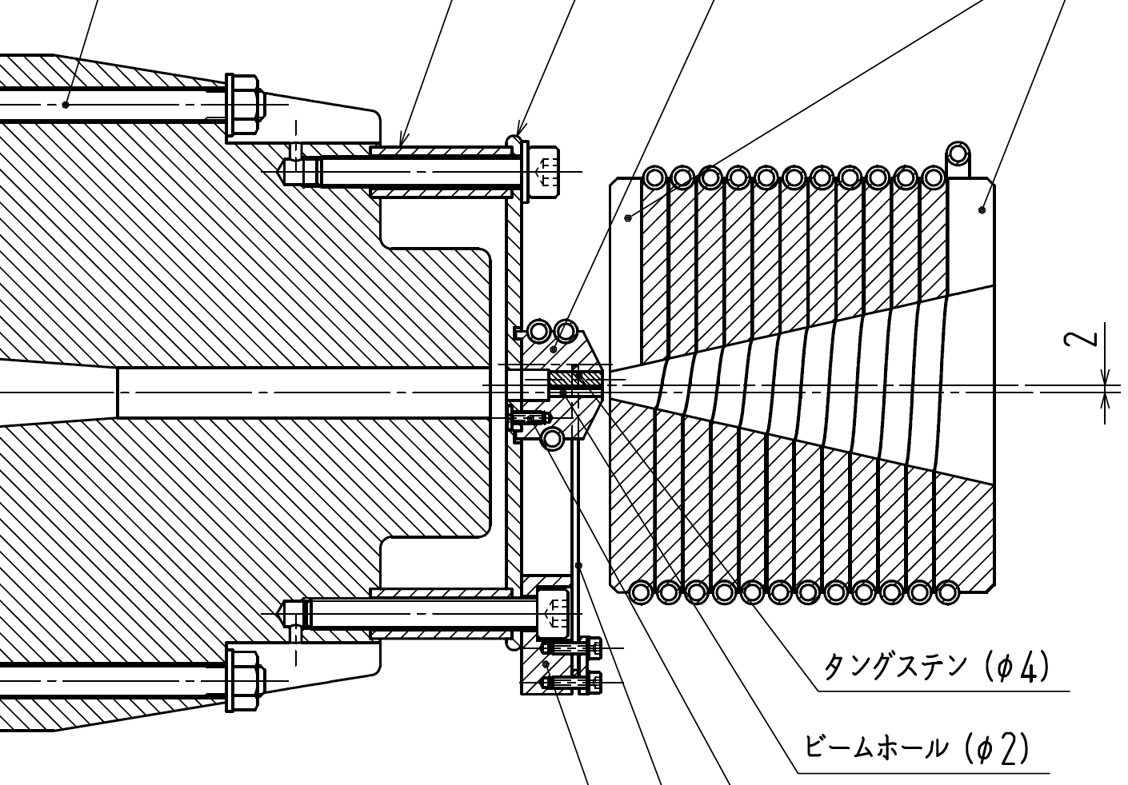
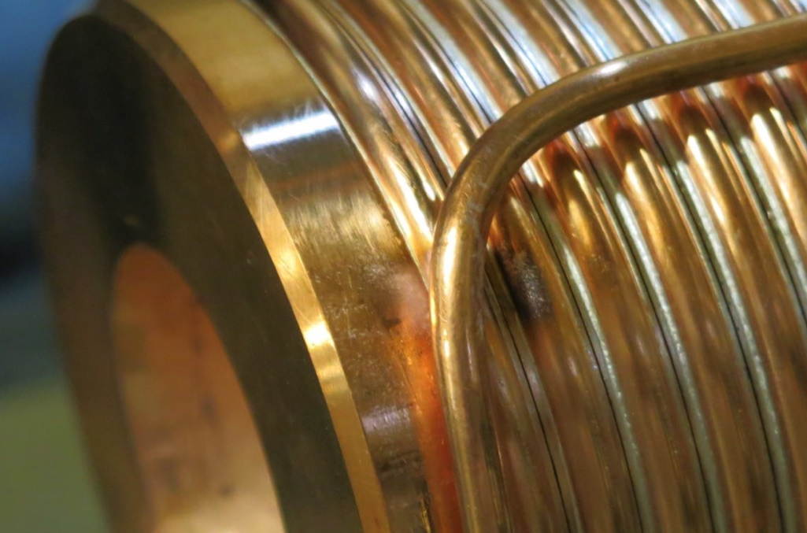
Positron Source status
Breakdown problem in Flux Concentrator during 2017 April operation after beamline installation
(Though we had no problem during test-stand operation at full-spec current.)
No e+ beam operation during April-May run.
Inspection of damaged FC
  cooling down of residual-radiation since May 15
  removal of FC base part from e+ station in June
  visual search for damaged part
  detailed inspection in August
  recovery trial
Re-installation of FC in August for Phase-2
  The operation current will be around half of the nominal. Nevertheless, a sufficient beam for Phase-2 should be available.
Target
Flux
Concentrator
return
yoke

Slide 8
Positron source
Recommendation
  Avoid a fatal destruction by securing the discharge interlock activation within a pulse.
    ——> The interlock system was re-examined, and it is believed that it did work within a pulse. (However, the pulse-to-pulse recording system was not working at the time. It should be made robust in the future.)
Consideration
  FC may provide 20% increase from 6 kA to 12 kA
    Balanced man-power distribution should be necessary

Slide 9
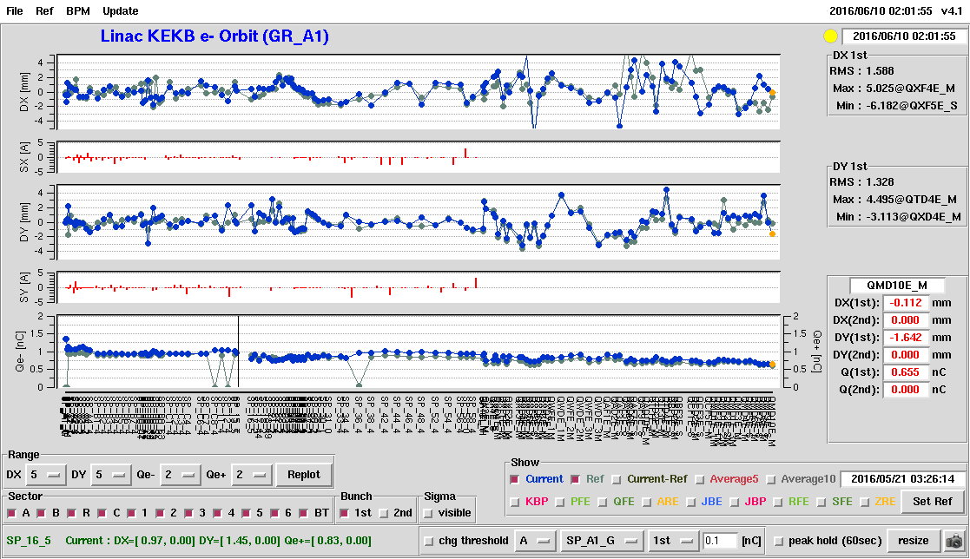
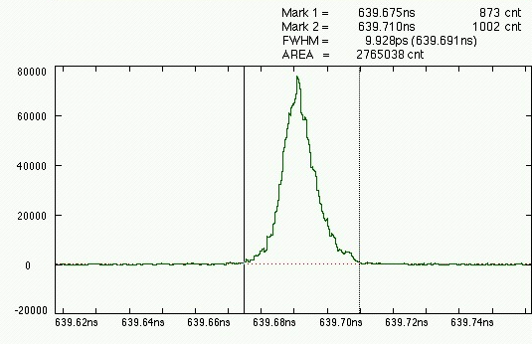
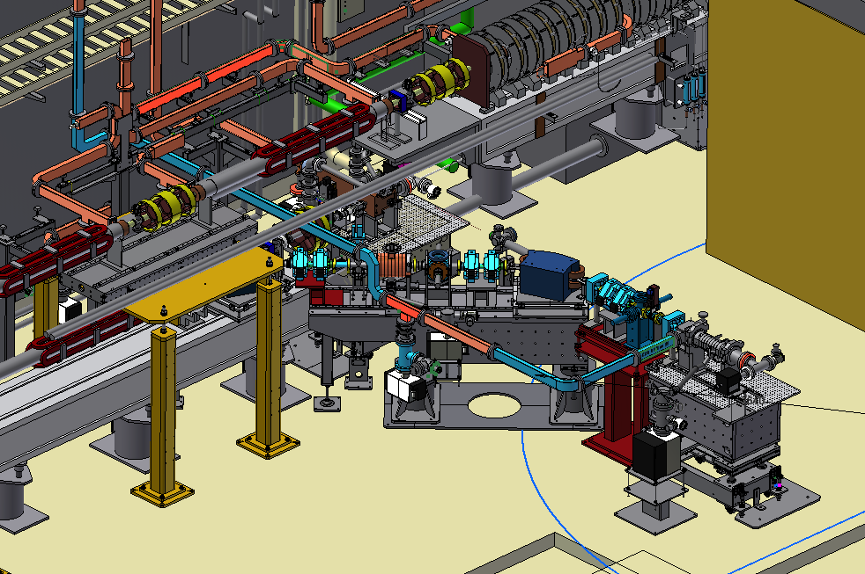
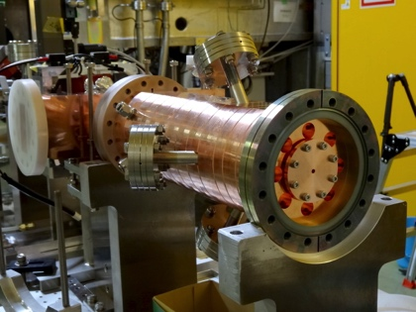
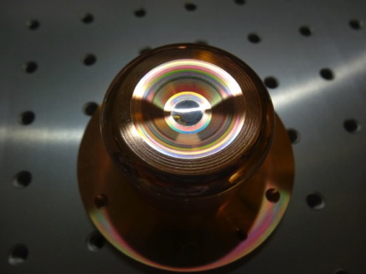
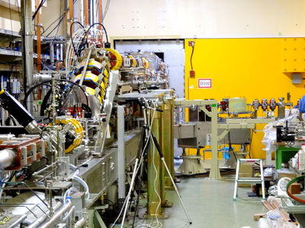
Development of Photo-cathode RF Gun
One of Key Component: Photo Cathode RF Gun
Yoshida et al.
Succeeded in injection during SuperKEKB Phase 1 commissioning for 11 days
Employs Yb-doped-fiber and Nd/Yb:YAG
laser, Ir5Ce cathode, QTWSC or cut disk
cavities
Stability improving
Beam instrumentation
improvements and
comparison with
simulation codes underway
Secondary RF gun is being constructed
as a backup
Incorporate suggestions by review committee
for availability and so on
Bunch width
Beam orbit measurement
Thermionic gun
Primary RF gun
New secondary RF gun
Ir₅Ce
Cathode
Cut disk cavity
Electron Guns

Slide 10
RF gun
Recommendations
  New technologies seem to be introduced too often. Further discussions on available facilities are necessary.
    ==> Weekly meetings are held at the linac open space, in which members from other groups participate. Dr. Yosuke Honda, one of the reviewers, further contributes to the laser discussion weekly.
  Considering whole operation would stop on the gun failure, an existent technology should be employed
    ==> As was recommended in past review meetings, existent technologies were applied for Phase-2. However, we are still open to Phase-3 options.

Slide 11
Injector Linac Issues

Slide 12
Longest shutdown for SuperKEKB
Many major constructions
    for 5 months from May to October 2017
  Removal of a temporary thermionic gun of #3T
  Removal of all quads from 3, 4, 5 sectors
  Installation of 30 pulsed quads and 36 correctors
  Installation of a energy compressor (#DN) at DR LTR
  Installation of a bunch compressor (#DS) at DR RTL
  Finalize the backup RF gun at #AS
  Installation of a streak camera & wire scanners
  Finalize 70 LLRF monitors and LLRF phase shifters
  Installation of the event timing controls for DR

Slide 13
Waveguide fabrication issue
Wrong waveguide fabrication
  found on Sept.19 in LLRF test
    Schematics from KEK and from the maker were correct
  Waveguide flanges need to connect the both vacuum and RF with a help by 2-mm contactor
  with slight taper surface design of 0º22"
  Later, 31 waveguides out of ~100 were found to be wrong
    62 flanges were wrong
    1 waveguide of them is a backup
  Opposite angle was programmed in NC machines
  It can take 5 months to re-fabricate them all

Slide 14
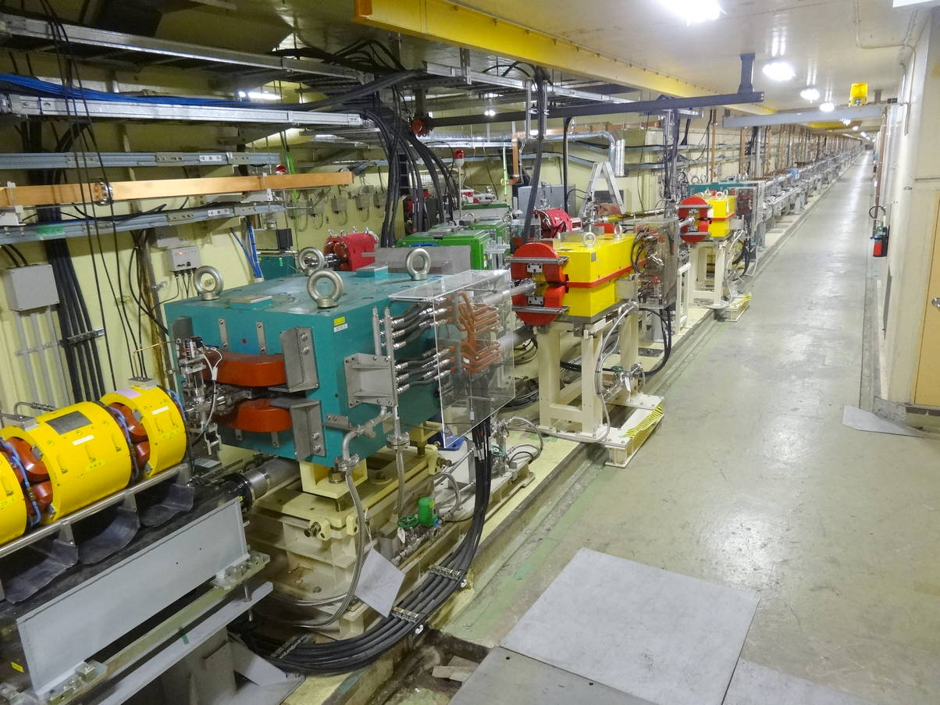
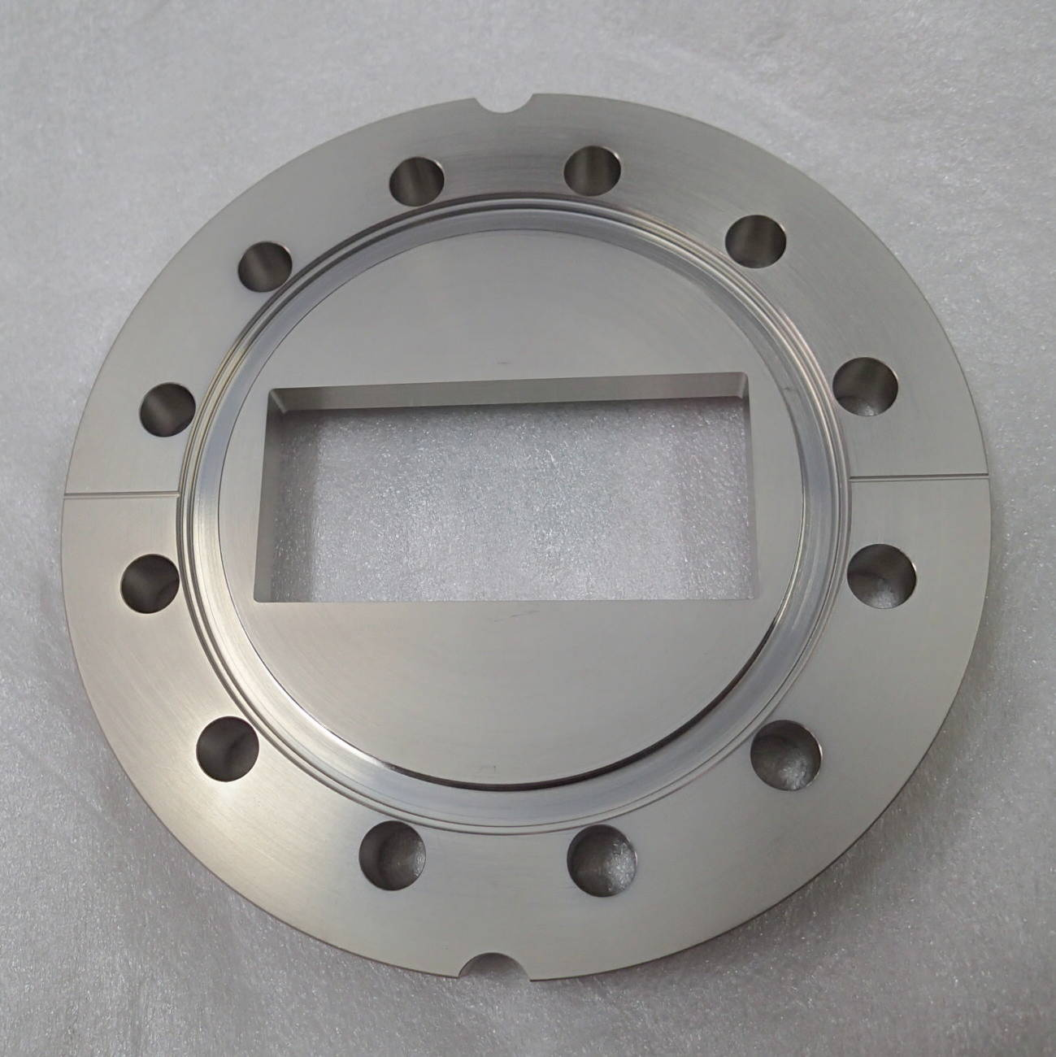
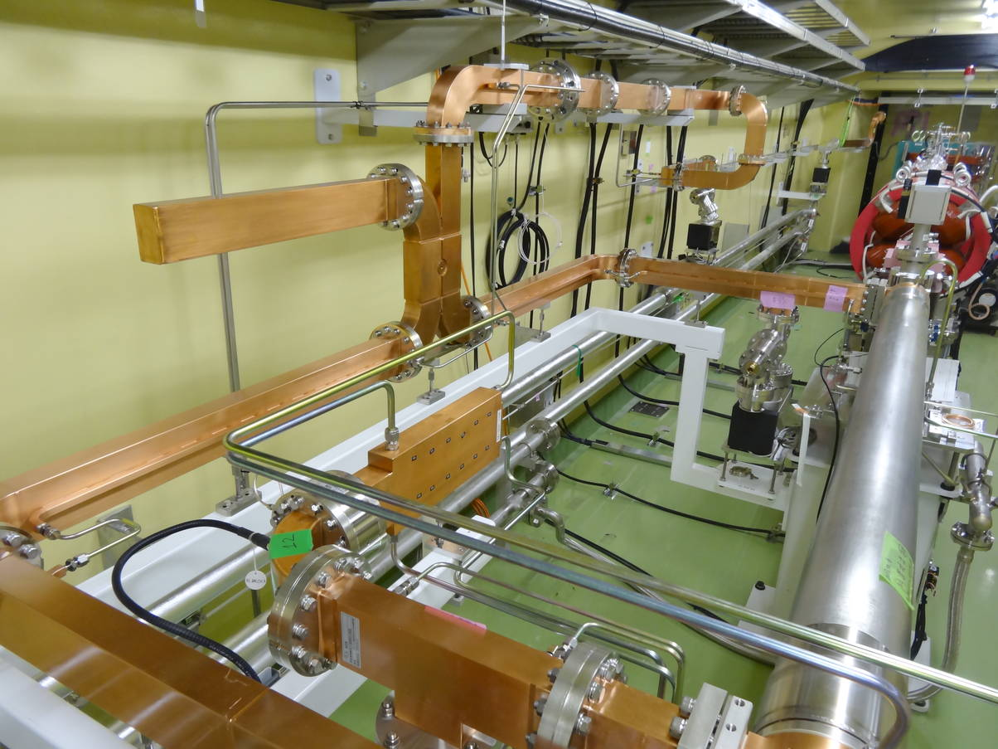
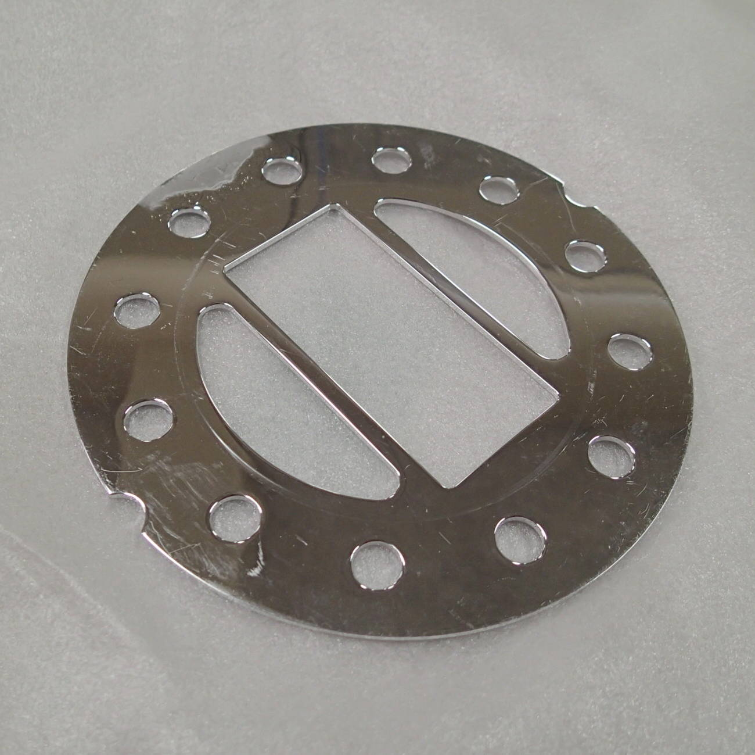
Linac side
Flange
Contactor
DR side

Slide 15
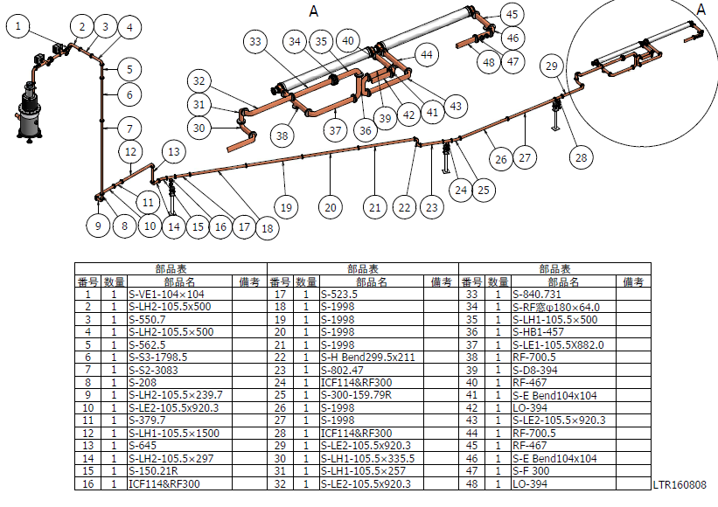
ECS at LTR

Slide 16
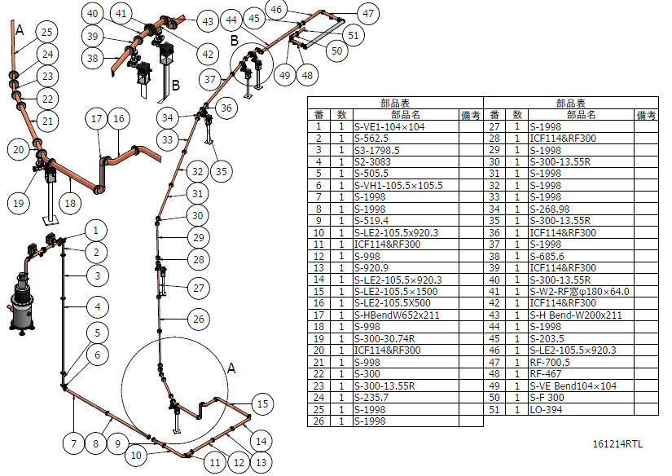
BCS at RTL

Slide 17
Recovery #1
Several countermeasures were examined
  Flange modification, flange replacement, contactor modification, etc.
  Especially, contactor modification possibilities are investigated in detail, but found to be impractical
At first lower-power operation was tested
  On October 2nd
  Nominal operational power and reflection (VSWR) should be 30 MW and 1.05 respectively
  Minimum power for Phase-2 is 8 MW
  A single connection test was performed up to 3 MW with continuous discharges at 1 Hz and VSWR of 1.7
In parallel new fabrications were prepared
  Initial plan suggests the beam availability at the end of January

Slide 18
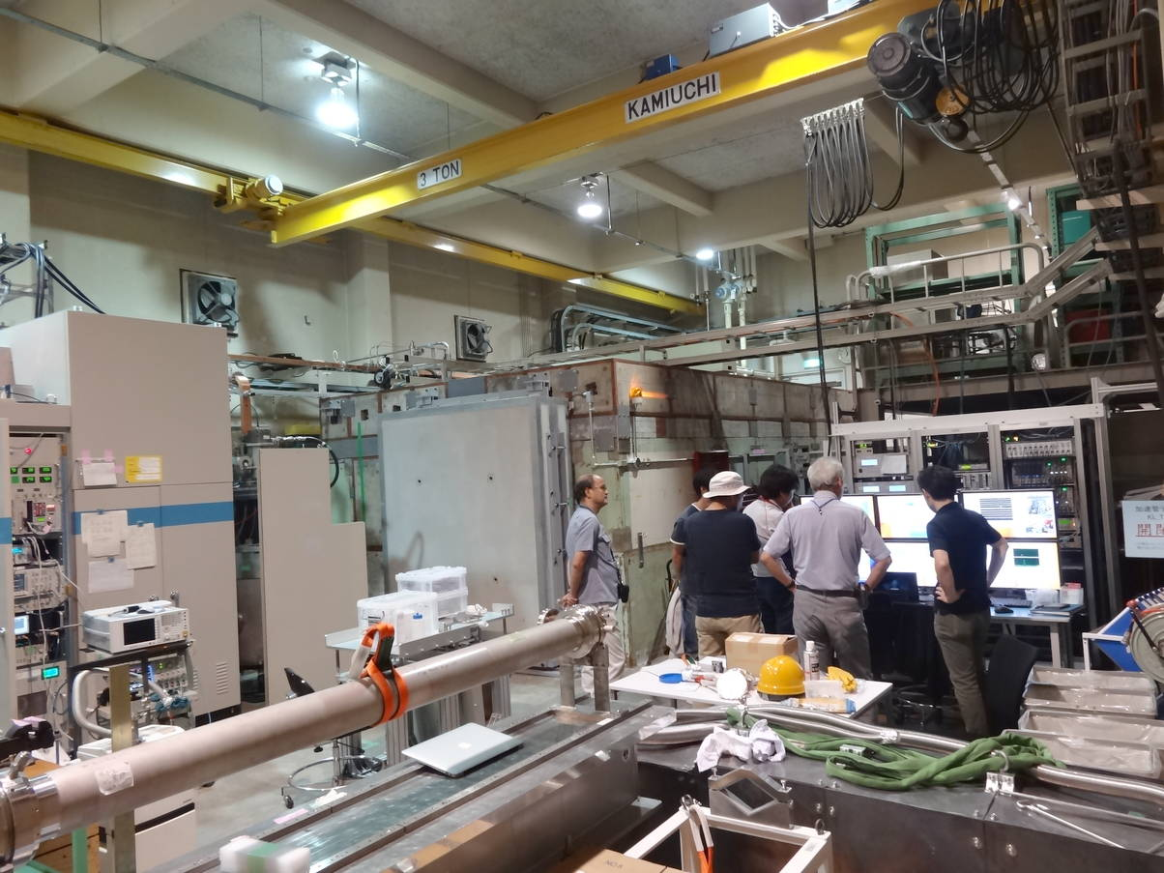
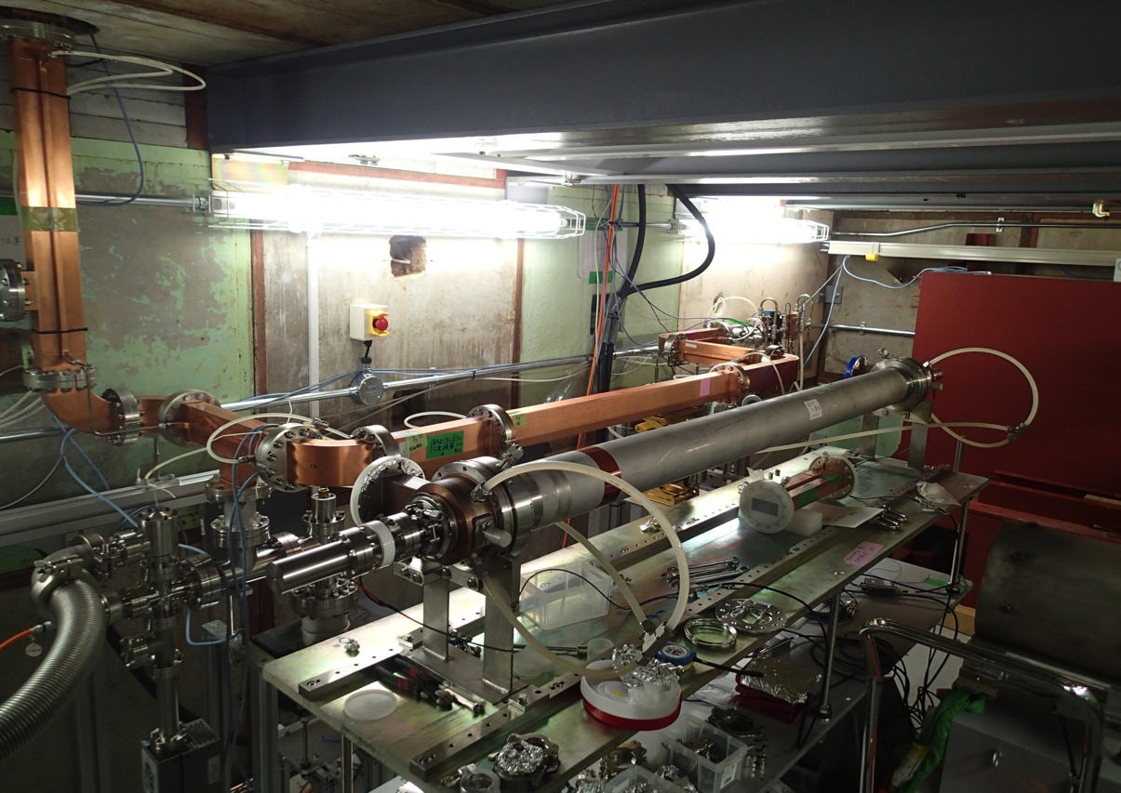
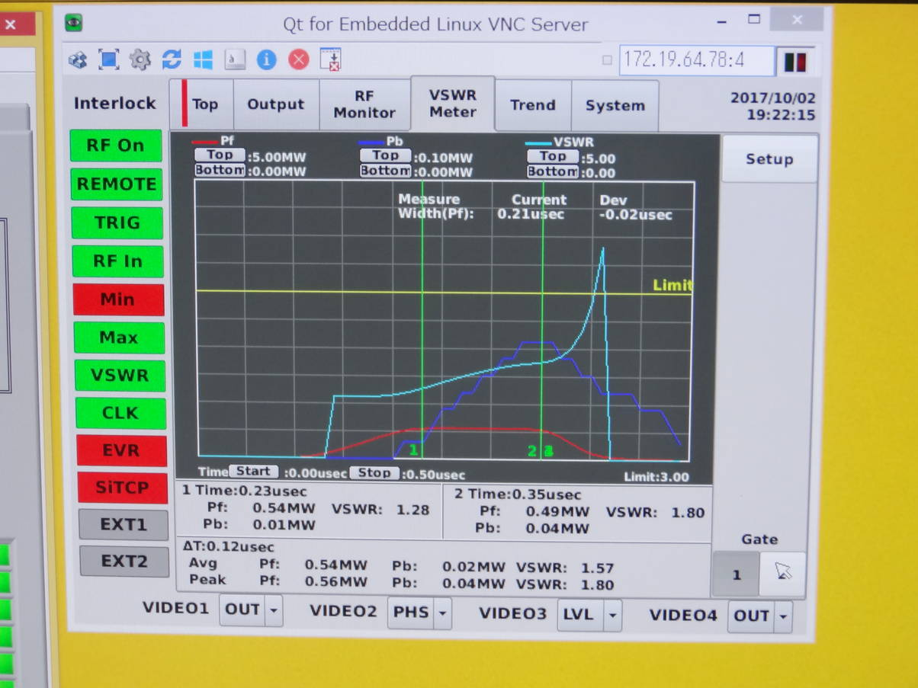
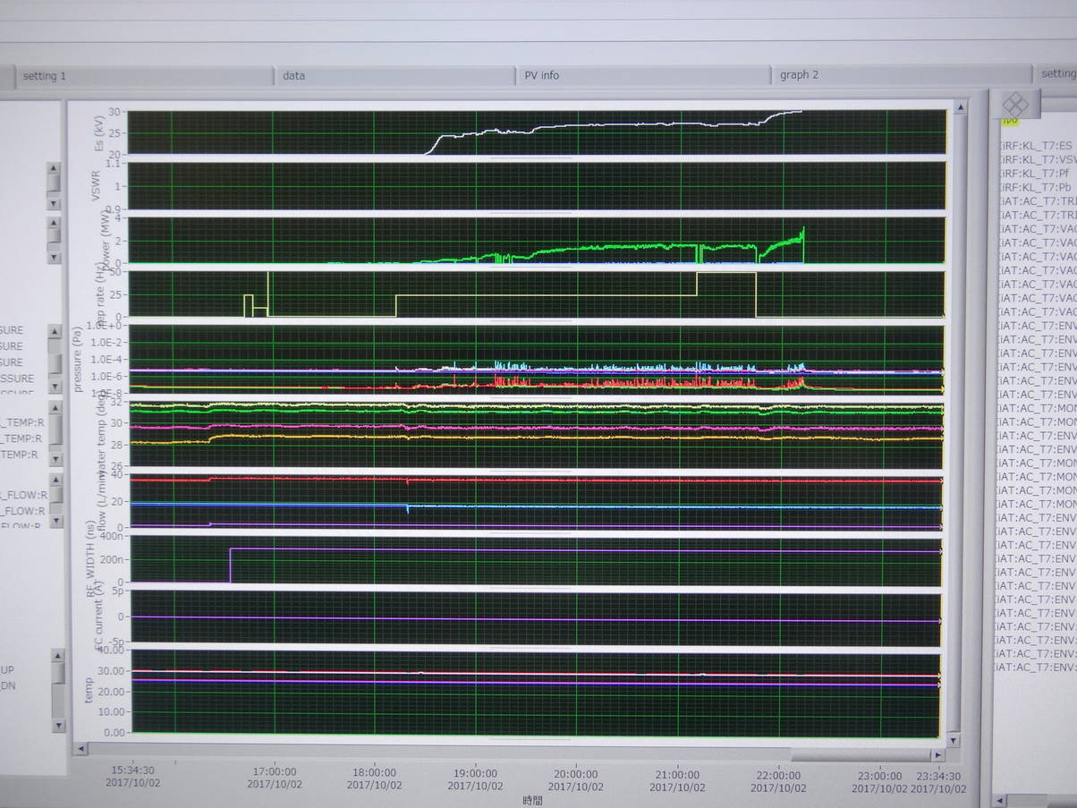
Test stand
Waveguides in cave
Reflection out of range
Forward power
Repetition
Vacuum
Reflection
History strip chart

Slide 19
Recovery #2
Rearrangements and new fabrications of waveguides will be performed
  32 were removed (30 have bad flanges) on Oct.7
  10 (original length) will be fabricated
  4 (new, various lengths) will be fabricated
  20 (old, various lengths) will be reused
  backups will be fabricated in parallel
It was suggested to make system tests within this year
  Zero-power beam delivery may be possible on Dec.20 to the end of LTR
  Almost synchronized with DR construction (?)
  Still barely acceptable with MR Phase-2 operation (?)

Slide 20
Recovery Schedule

Slide 21
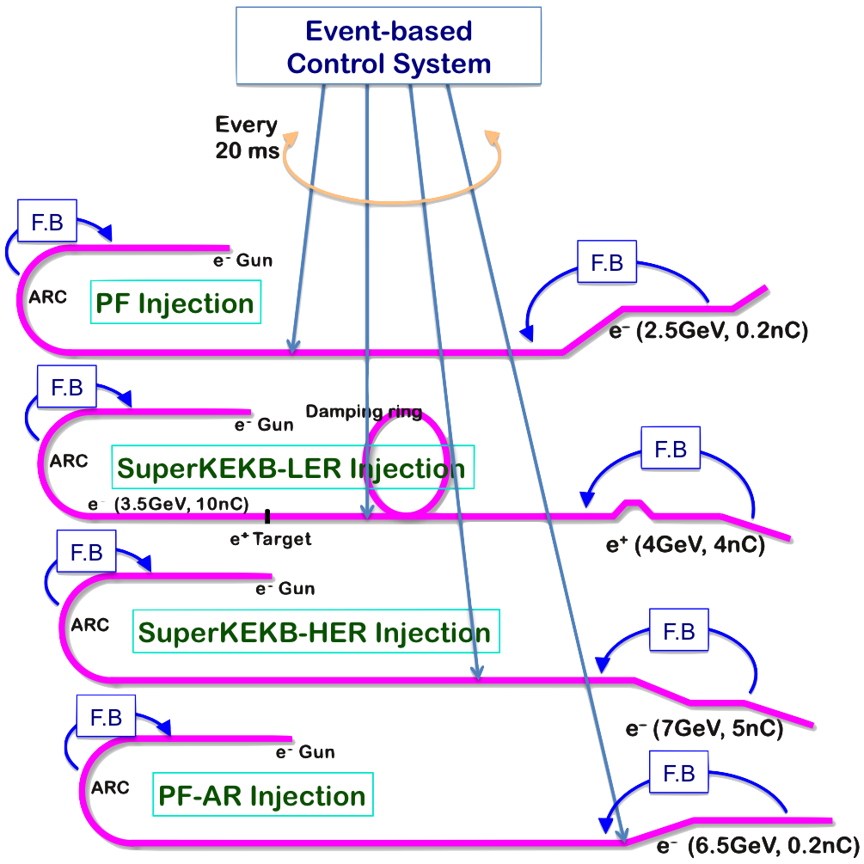
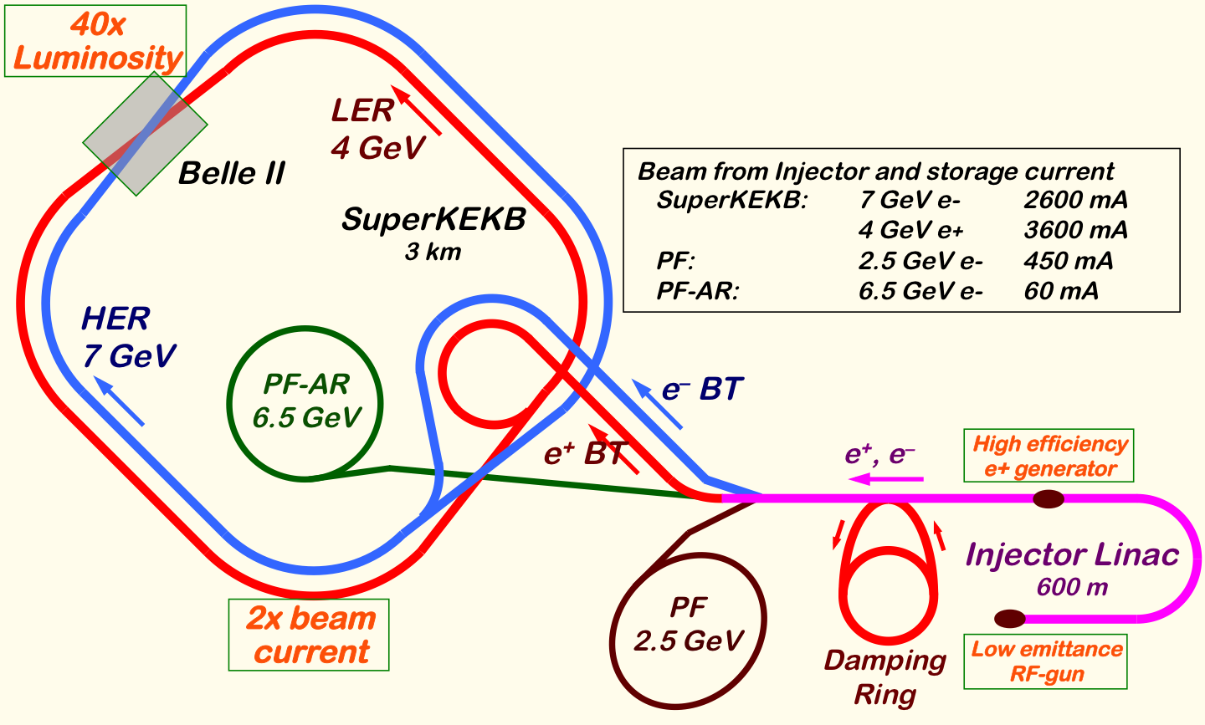
Mission of Electron/positron Injector in SuperKEKB
Injector Linac Mission
  For 40-times higher luminosity in SuperKEKB collider
  Low emittance & low energy spread injection beam with 4-5 times more beam current
    New high-current photo-cathode RF gun
    New positron capture section
    Damping ring construction
    Optimized beam optics and correction
    Precise beam orbit control with long-baseline alignment
    Simultaneous top-up injection to DR/HER/LER/PF/PFAR
  Balanced injection for the both photon science and
  elementary particle physics experiments
The single injector would behave as multiple injectors to multiple storage rings by the concept of virtual accelerator
Notes:
Higher Injection Beam Current
To Meet the larger stored beam current and shorter beam lifetime in the ring
4~8-times larger bunch current for electron and positron
Reconstruction of positron generator, etc
Lower-emittance Injection Beam
To meet nano-beam scheme in the ring
Positron with a damping ring
Electron with a photo-cathode RF gun
Emittance preservation by alignment and beam instrumentation
Quasi-simultaneous injections into 4 storage rings
SuperKEKB e–/e⁺ rings, and light sources of PF and PF-AR
Improvements to beam instrumentation, low-level RF, controls, timing, etc

Slide 22
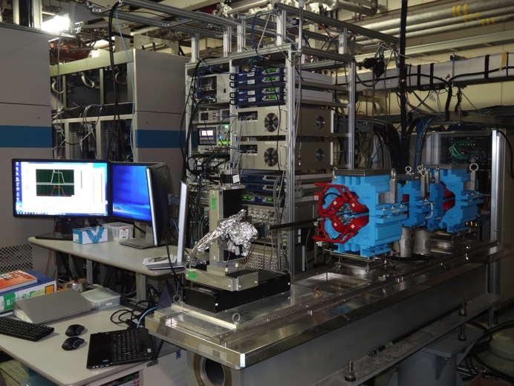
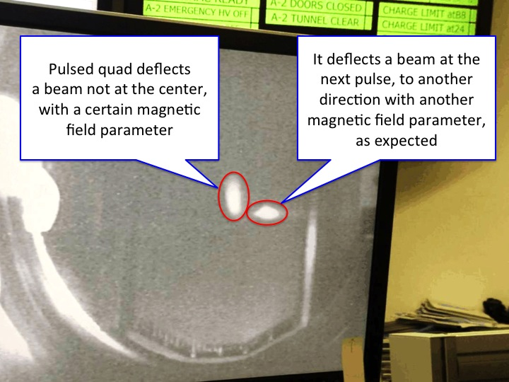
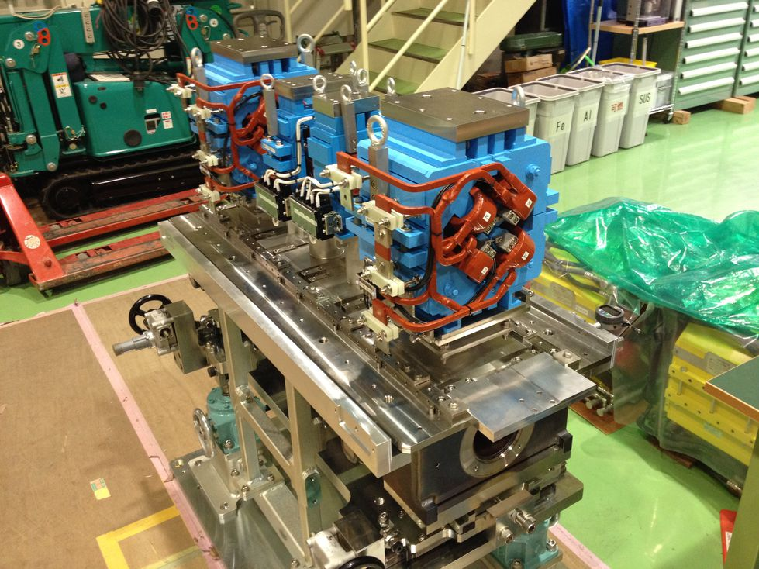
Development and installation of pulsed magnets
One of Key Component: Pulsed Magnets
  Pulsed magnet power supplies are scheduled in FY2017 for resource optimization
  30 quads, 36 steerings, 2 bends, 13 girders are fabricated and installed in 2017
  Quads with advanced design at 1 mH, 330 A, 340 V, 1 ms with energy recovery up to 75%
  Essential for SuperKEKB low emittance injection and simultaneous injections
  4+1 ring injections with virtual accelerator concept
  Risks against schedule and possible backup operation procedure are also investigated
  On going as expected, with long-term test in September for a month
    Long term tests at a stand
    Satisfies specifications
    Some more control capability
    Synchronous operation in 2017
    Beam test with two quads
    Successful 25 Hz beam switches
    Basic features are completed
    Event timing synchronization needed
    Girders are tested as well
    In-house drawings to save rsc.
    0.1mm alignment precision
    Ready for Phase-3 upgrade

Slide 23
Thanks

Slide 25
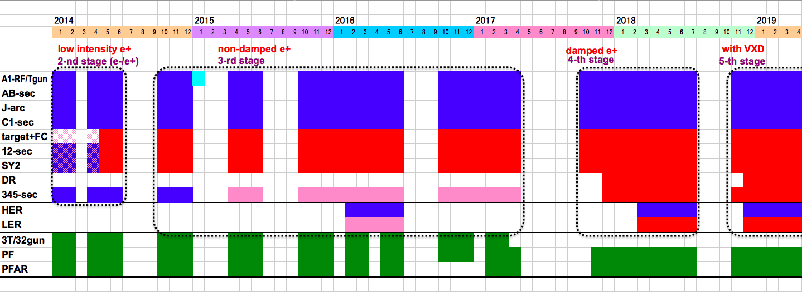
Linac Schedule Overview as of Jun.2017
Schedule
Long (5-month) shutdown for the first time in SuperKEKB project
  9-month shutdown in 1997 during KEKB
  DR construction, resource availability, etc
  Installation of many important components
  during this shutdown
Time →
Location
↓
Beam
Licenses
in steps
Low Emittance Beams
4+1 Ring
Injections
DR
Commiss.
1 nC
Phase1
2 nC
Phase2
4 nC
Phase3
Without Top-up
Direct PF-AR BT
: Electron
: Positron
: Low current electron

Slide 26
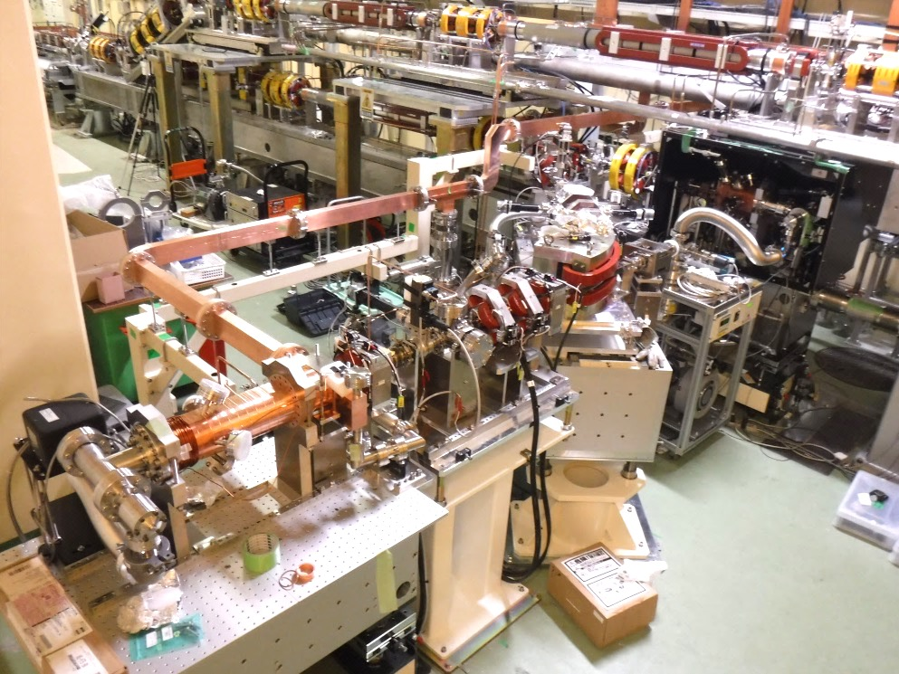
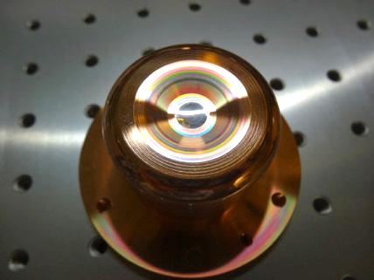
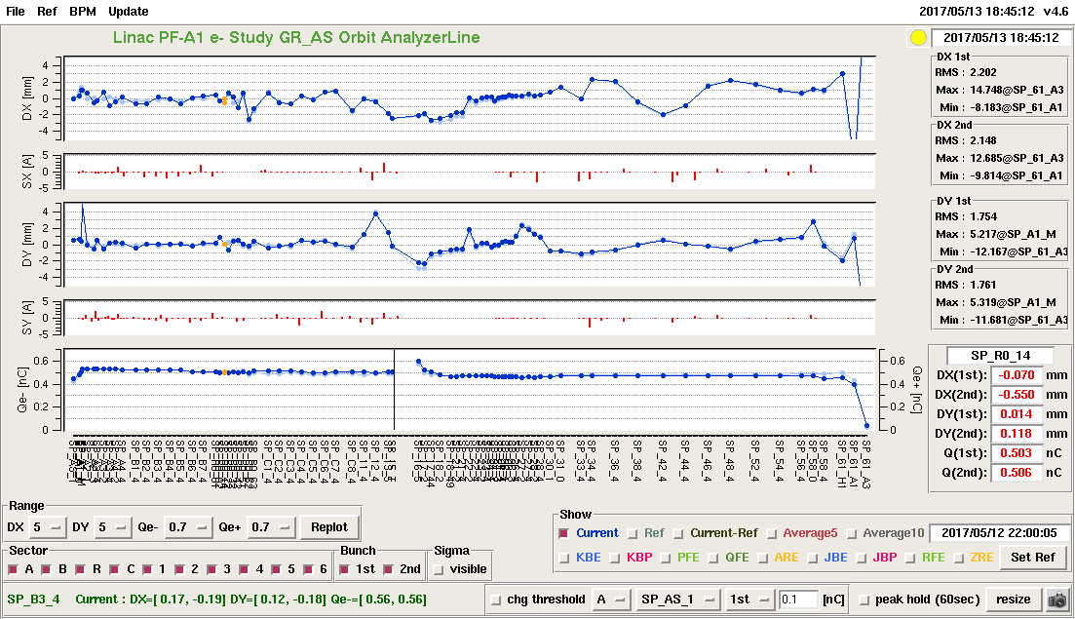
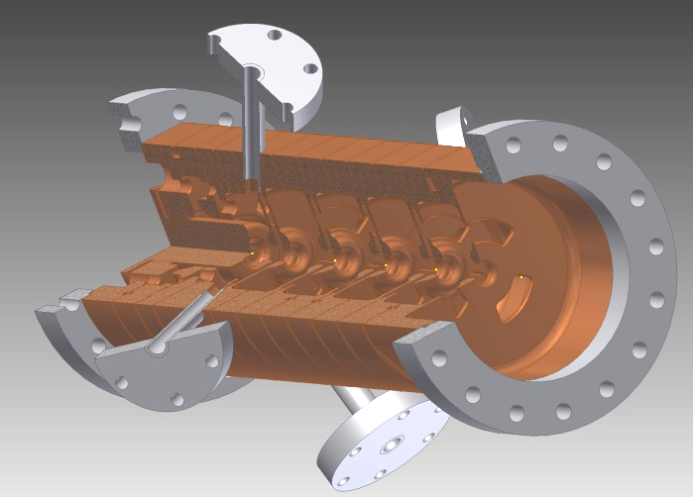
Progress of Photo-cathode RF Gun
Photo-cathode RF Gun
Yoshida et al
Succeeded in injection during SuperKEKB Phase-1 commissioning for 11 days
Employs Yb-doped-fiber and Nd/Yb:YAG
laser, Ir5Ce or Ir2Ce cathode, QTWSC or
cutdisk structures
Secondary RF gun was constructed for
availability with Ir2Ce and cutdisk
Thermionic gun
Primary RF gun
New secondary RF gun
IrCe
Cathode
Cutdisk cavity
Beam orbit measurement

Slide 27
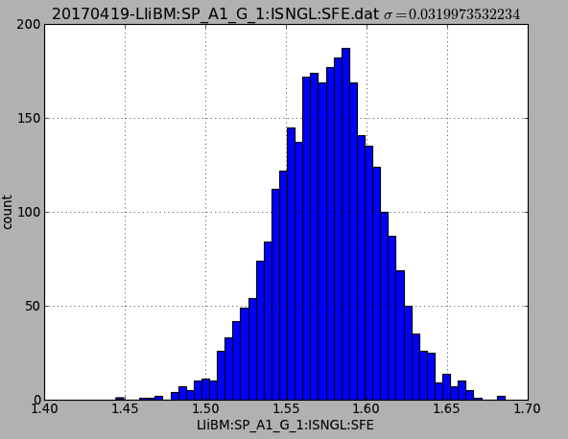
Photo-cathode RF gun: Laser
Yb:Fiber + Nd:YAG multi-pass amplifier
Nd.YAG Φ2mm
×2pass
Nd.YAG Φ4mm
×8pass
1.57 +/-0.032 nC
Fiber Amp
~30 μJ
E.O.
Pockels Cell
Nd.YAG Φ4mm
×4pass
~700 μJ
SHG
FHG
Nd.YAG Φ4mm
2 mJ
1.0 mJ
200 μJ
Beam charge stability
Stable laser system for Phase-II.
  2 nC, 2 bunch stable operation will be expected.
  (2-bunch operation was already demonstrated.)
  Two oscilllator (one will be commercial oscillator).
  Two amplifier lines.
  Spatial filter for one amplifier line.

Slide 28
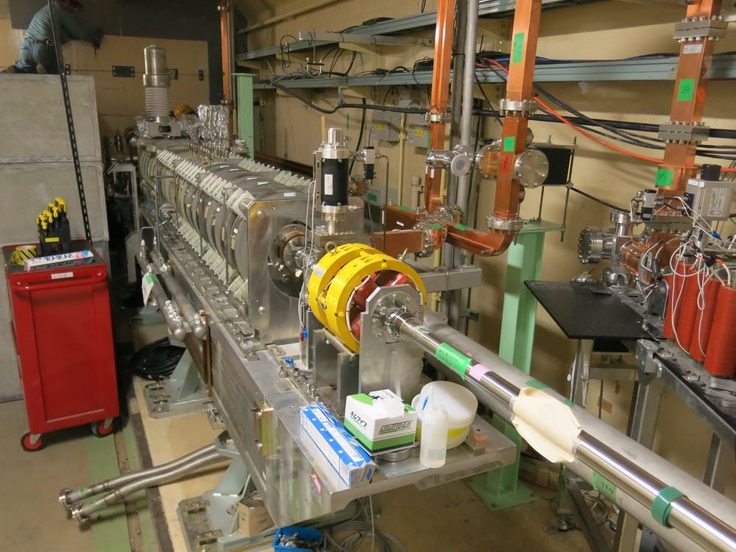
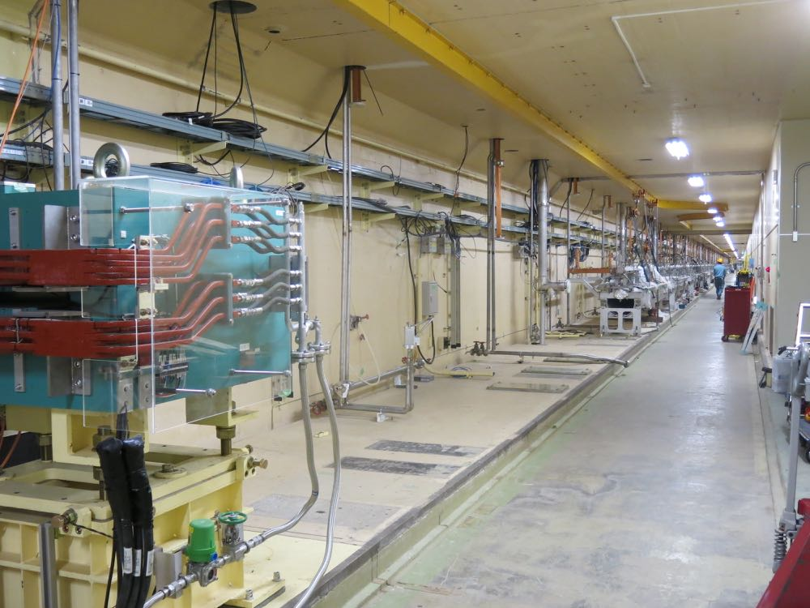
Removal of temporary pre-injector (3T/32RFgun)
KEK e+/e- linac has been divided into two regions by a wall at 3T.
3T/32 pre-injector has been used for PF, AR injection during upgrade construction and initial beam commissioning in linac upstream region.
3T/32 pre-injector is removed in May 2017 for DR commissioning.
a regular accelerator module (3-2) is installed in this region for injection beam energy margin.
AT/A1 pre-injector is used for all the storage rings (HER, LER, PF, AR) after autumn 2017. They share the same fate in case of linac troubles.
PF, AR beam operation from October.
DR commissioning from December 2017.
wall
3T pre-injector
32 pre-injector
After the wall and
3T/32 pre-injector
removal, linac tunnel
is united as one.

Slide 29
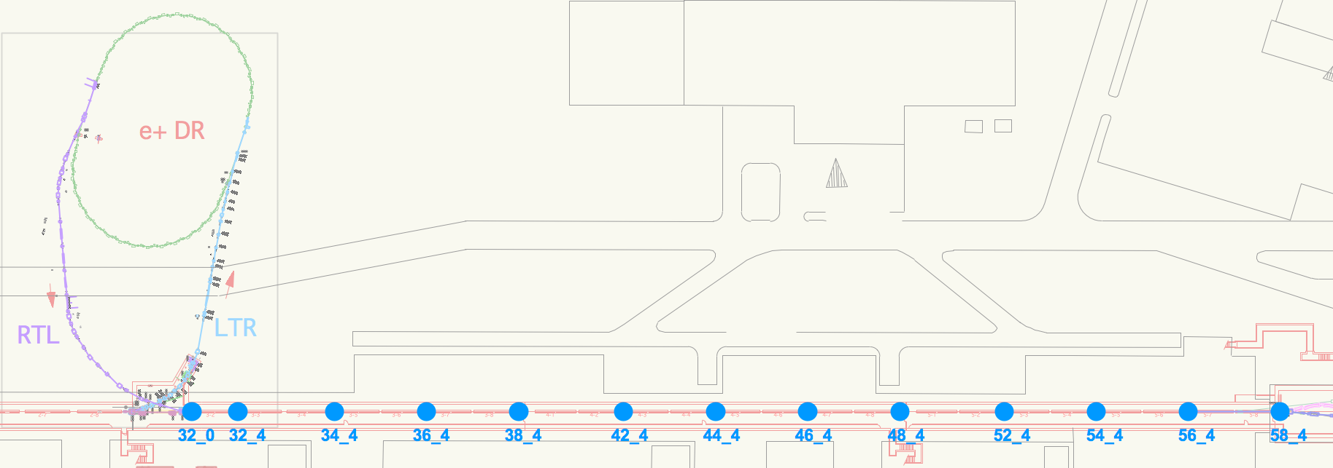
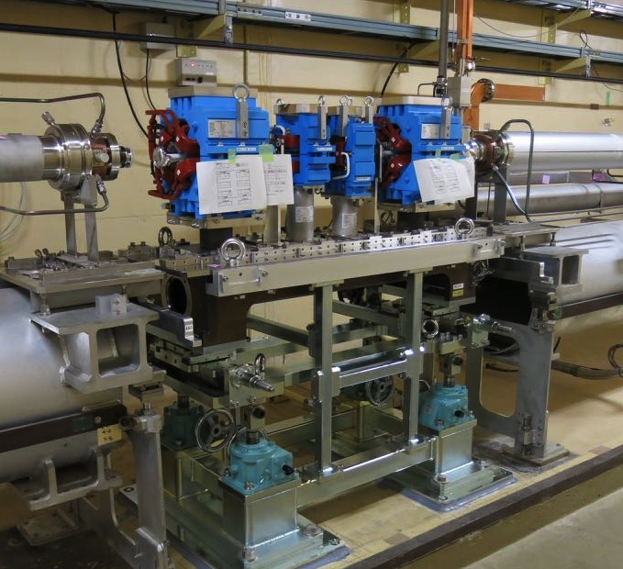
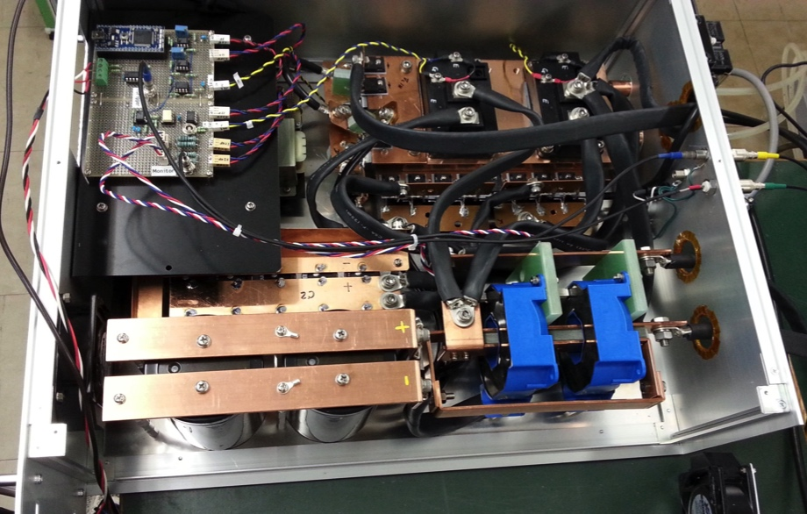
Pulse magnet system
For pulse-by-pulse beam-mode switching and independent optics/orbit tuning,
pulse magnet system is introduced.
All the quads in Sector-3, 4, 5 are replaced by pulse-Qs and pulse-steerings are introduced.
AT/A1 pre-injector merger line bends are replaced from DC to pulse magnets.
Pulse magnets installation completed.
Pulse power supply setting-up on-going.
Test operation of pulse magnet system in September.
Beam commissioning with pulse magnet system start in October 2017.
Pulse magnets (Q+ST+ST+Q)
Pulse current driver

Slide 30
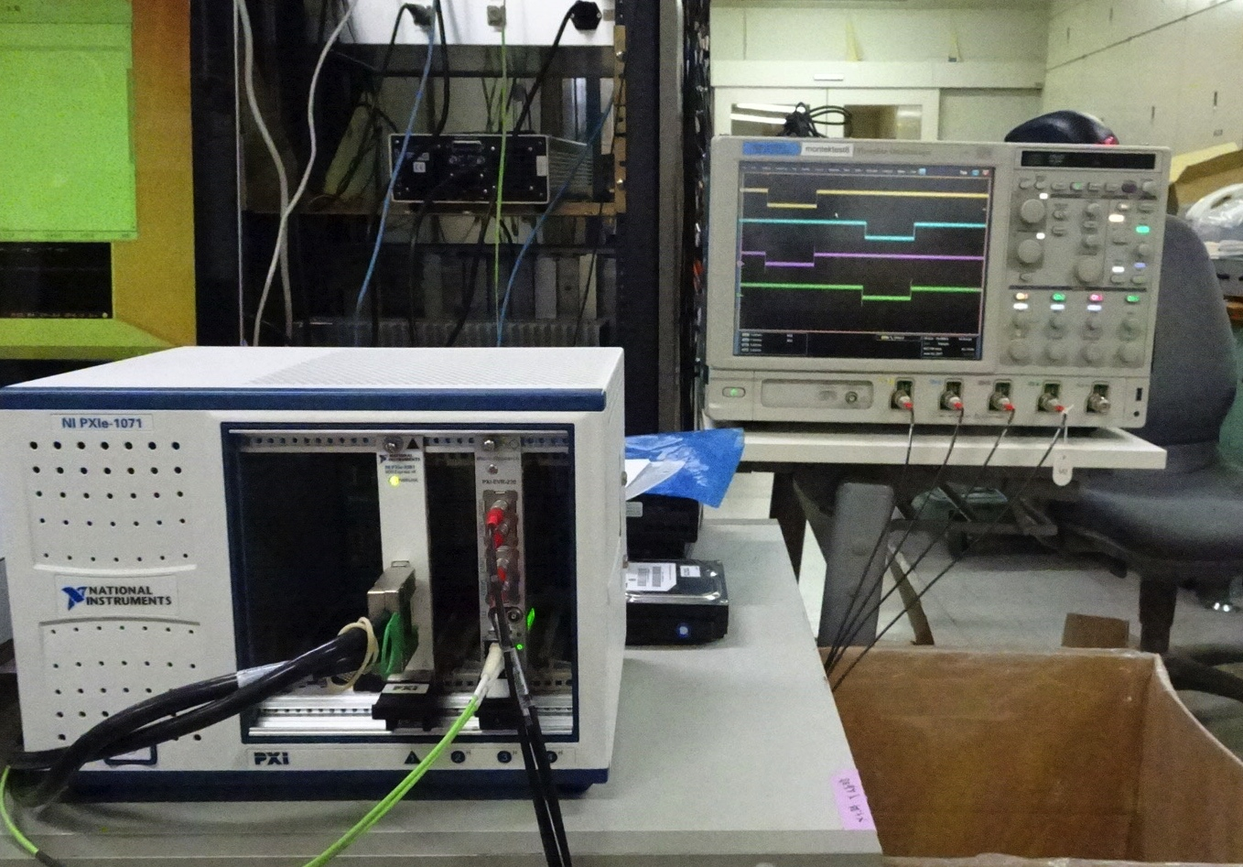
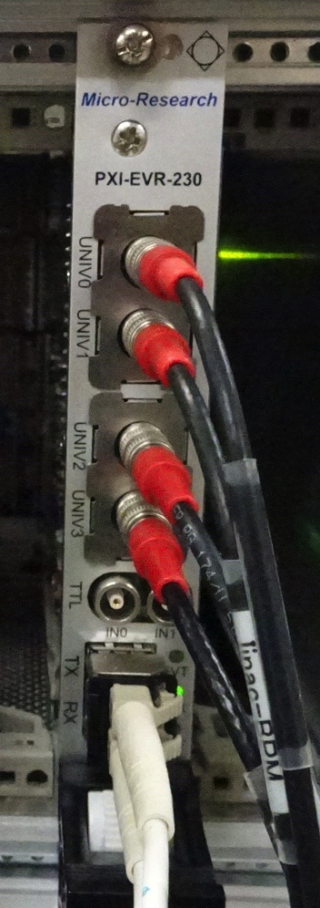
Event timing controls for pulsed quad & steering magnet controls
MRF PXI-EVR-230 was added
Control software is based on:
Windows 8.1 Professional
EPICS base R3.14.12.6 for EVR control
LabView for DAC/ADC control
Satoh, Enomoto et al.
Device driver for cPCI-EVR-300 (Swiss FEL) was modified for our card
Fundamental functions can already work well.
Data buffer functionality is now under implementation.

Slide 31
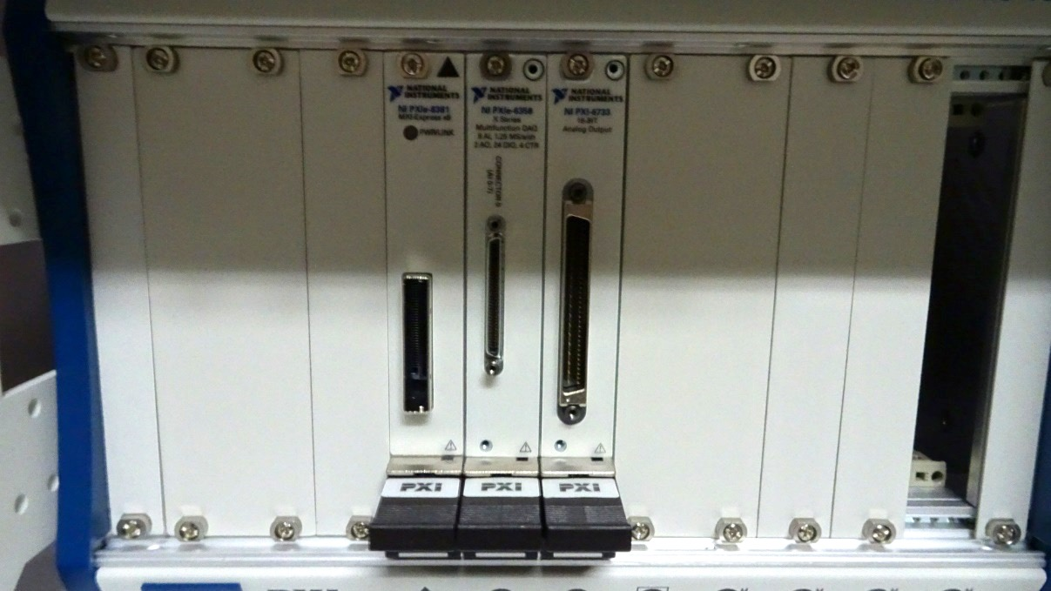
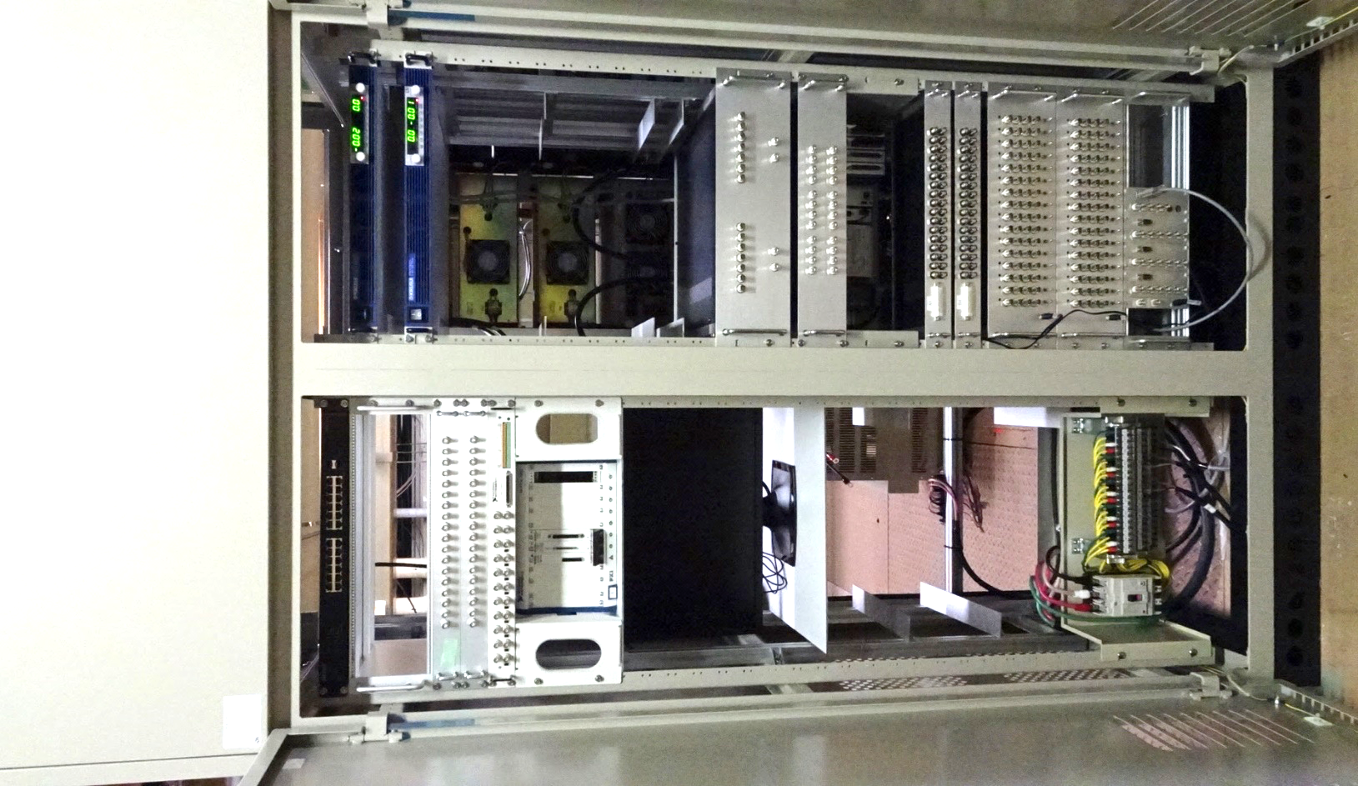
Pulsed magnet rack
Edge switch
DC
Power Supplies
Pulsed magnet driver
PXI chassis
(PXIe-1082)
Remote controller
DAC (PXI-6733)
ADC (PXIe-6356)
PXI-EVR-230
Control
PC
13 racks are newly installed
Small form-factor (4U) power supplies are tested more than 2 months at 50Hz
Interlock signal processing
(CompactRIO based system)

Slide 32
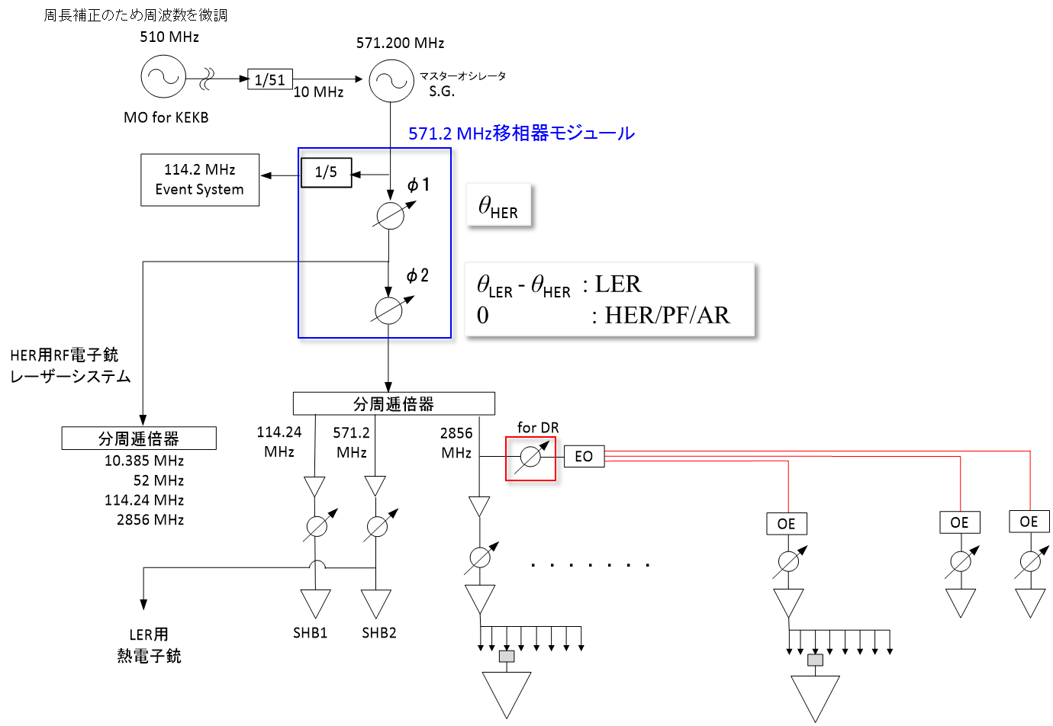
Development of 571.2MHz Master phase shifter
All linac clocks are generated from 571.2 MHz master oscillator
Clock is adjusted every minutes to compensate the ring circumferences, and the phase should be adjusted to meet the lengths of beam transports of electron and positron.
Stabilities of 0.1%rms in amplitude and 0.02 degree rms in phase
φ2 changed at 50 Hz
3,4,5セクター
2856MHz移相器

Slide 33
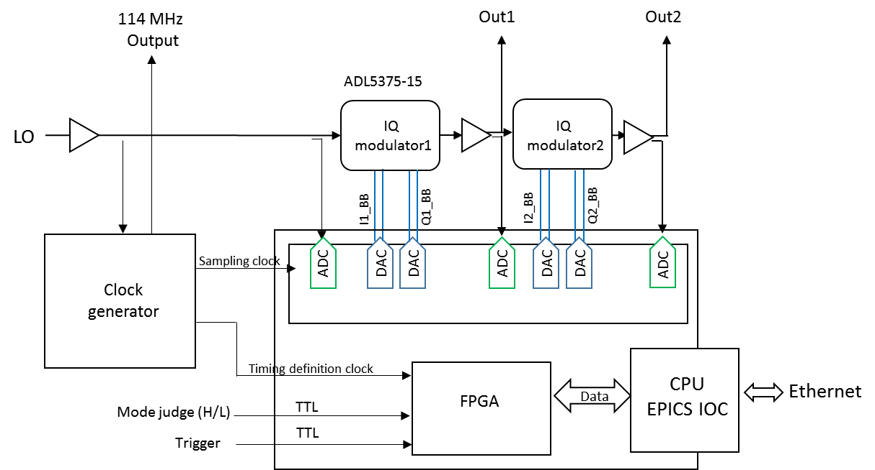
571.2MHz Phase shifter
571.2MHz

Slide 34
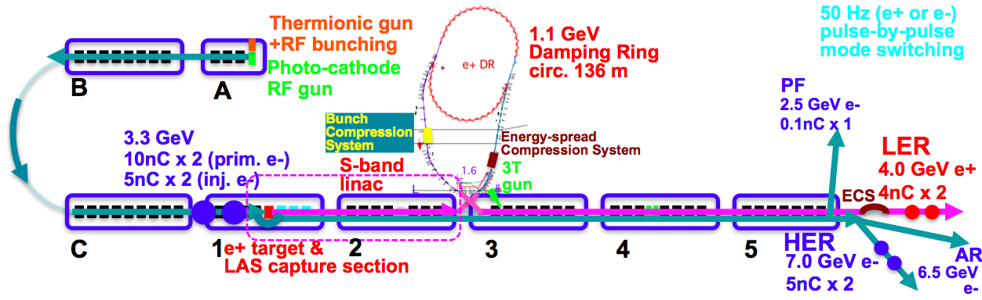
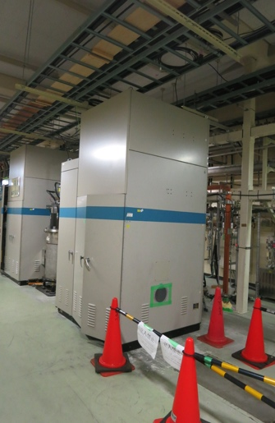
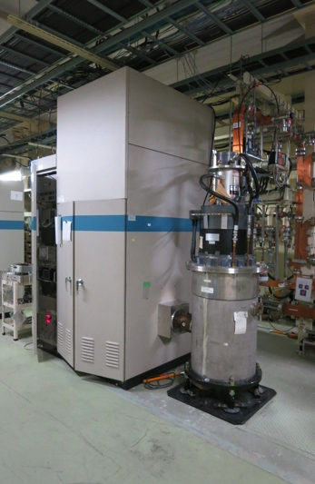
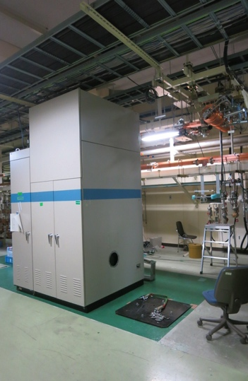
KL_DS, KL_DN , KL_32 Installation
 | ECS | BCS
Voltage required [MV] | 41 | 21.5
# 2m accelerator structure | 2 | 1
Accelerator field [MV/m] | 10.2 | 10.75
Operation power [MW] | 29.0 | 19.0
Pulse width [µs] | 0.8 | 0.8
Rep. rate [Hz] | 50 | 50
KL_DS/BCS
KL_DN/ECS
KL_32

Slide 35
Bucket selection in Phase-2 with DR
Without DR, simply wait up to 5120 x 96 ns ~ 490 μs
  96 ns : highest common frequency between linac – ring
With DR, in order to select arbitrary bucket in MR, have to wait up to ~4.5 ms, even if a bucket in DR was carefully selected
  Power supply can wait only 2 ms, one of only 2798 buckets in 5120 buckets can be selected, may have to change LLRF condition at latter half of linac every pulse
  Can be a big challenge in LLRF precision
e⁻ Gun
KEKB
ARC
Primary e– (3.5GeV, 10nC)
e⁺ BT (3.5GeV, 0.6nC)
e⁺ Target
Kaji et al
96ns
>100ns
e⁺ DR (1.1 GeV, 4nC)
e⁻ Gun
>100ns
SuperKEKB
ARC
96ns
Primary e– (3.5GeV, 10nC)
e⁺ BT (KEKB: 4GeV, 4nC)
e⁺ Target

Slide 36
Linac Schedule Overview as of Jun.2017
New Schedule
RF-Gun e- beam
commissioning
at A,B-sector
e- commiss.
at A,B,J,C,1
e+ commiss.
at 1,2 sector (FC, DCS, Qe- 50%)
e- commiss.
at 1,2,3,4,5 sector
Phase1: high emittance beam for vacuum scrub
Phase2,3: low emittance beam for collision
Time →
Location
↓
Beam
Licenses
in steps
Low Emittance Beams
4+1 Ring
Injections
DR
Commiss.
1 nC
Phase1
2 nC
Phase2
4 nC
Phase3
Without Top-up
Direct PF-AR BT
: Electron
non damped e+ commiss.
at 1,2, 3,4,5 sectors
e- commiss. at A→5 sectors
damped e+ commiss.
at 1→5 Qe+ = 1~4nC
e- commiss.
at A→5 Qe- = 1~5nC
Improved
RF gun
: Positron
: Low current electron

Slide 37
Summary
Summary
We learned a lot during KEKB operation
Phase-2 injection into SuperKEKB is another challenge with higher beam current and lower transverse and longitudinal emittance
Steady progress towards designed injection beam in steps
  Alignment: almost confident on the measurement precision (0.1-mm local, 0.3-mm global), may need mover to maintain it for longer term
  Positron generator: need discharge analysis
  Thermionic gun: stably operated for primary electron for positron generation
  RF gun: following recommendations at review meetings
  Pulsed devices: global and synchronized operation
  New modulators for energy and bunch compressors on DR beamlines
Will balance between final beam quality and progressive operation
Will select optimized route depending on available resources
  Balance with injection operation for light sources, commissioning and development in parallel

