Slide 1
Recent Status of Electron/Positron Injector Linac
Kazuro Furukawa
for Injector Linac, KEK
Many slides from Y. Enomoto and S. Matsumoto

Slide 2
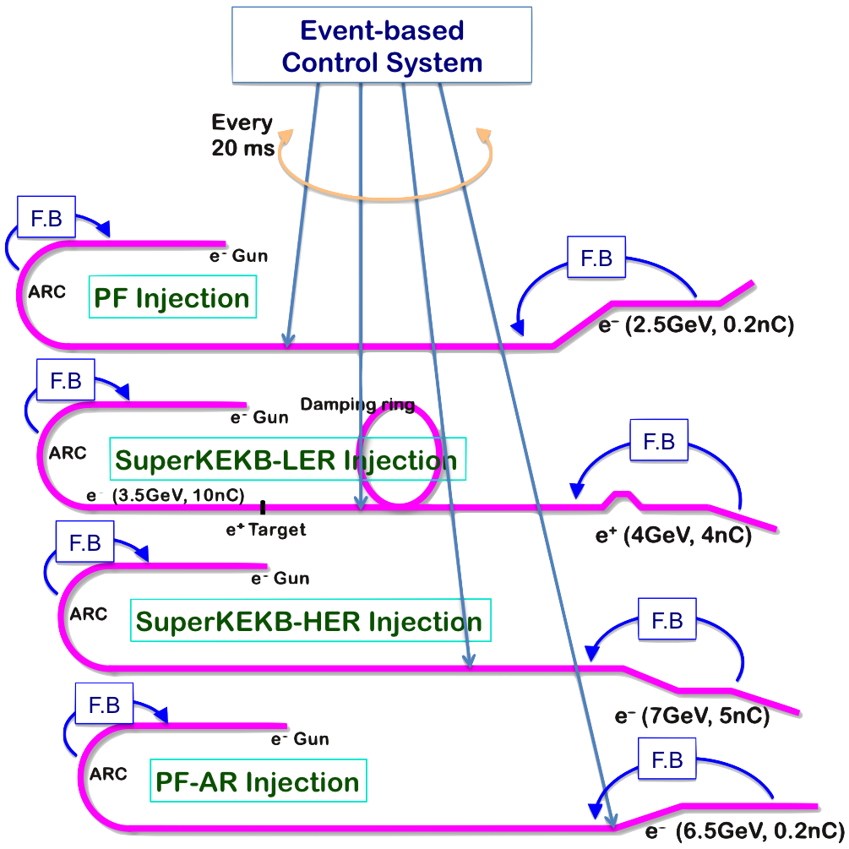
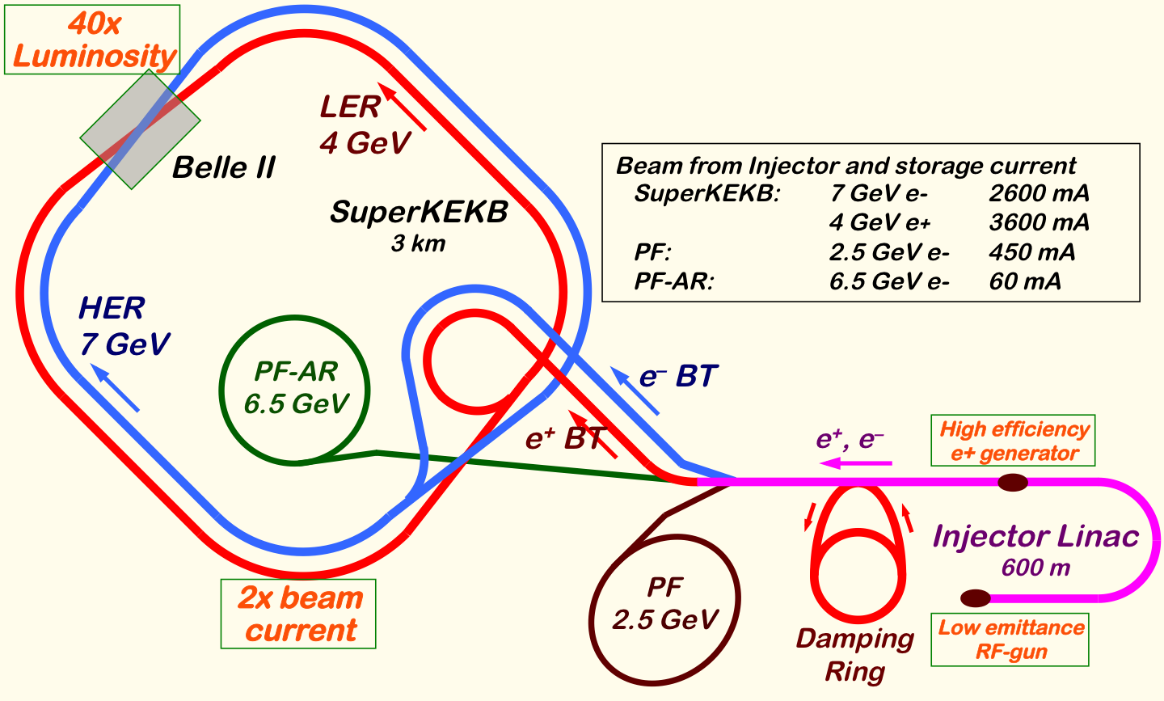
Mission of Electron/positron Injector in SuperKEKB
Injector Linac Mission
For 40-times higher luminosity in SuperKEKB collider
Low emittance & low energy spread injection beam with 4-5 times higher beam current
New high-current photo-cathode RF gun
New positron capture section
Damping ring construction
Optimized beam optics and correction
Precise beam orbit control with long-baseline alignment
Simultaneous top-up injection to DR/HER/LER/PF/PFAR
Balanced injection for the both photon science and elementary particle physics experiments
The single injector would behave as multiple injectors to multiple storage rings by the concept of virtual accelerator
Notes:
Higher Injection Beam Current
To Meet the larger stored beam current and shorter beam lifetime in the ring
4~8-times larger bunch current for electron and positron
Reconstruction of positron generator, etc
Lower-emittance Injection Beam
To meet nano-beam scheme in the ring
Positron with a damping ring
Electron with a photo-cathode RF gun
Emittance preservation by alignment and beam instrumentation
Quasi-simultaneous injections into 4 storage rings
SuperKEKB e–/e⁺ rings, and light sources of PF and PF-AR
Improvements to beam instrumentation, low-level RF, controls, timing, etc

Slide 3
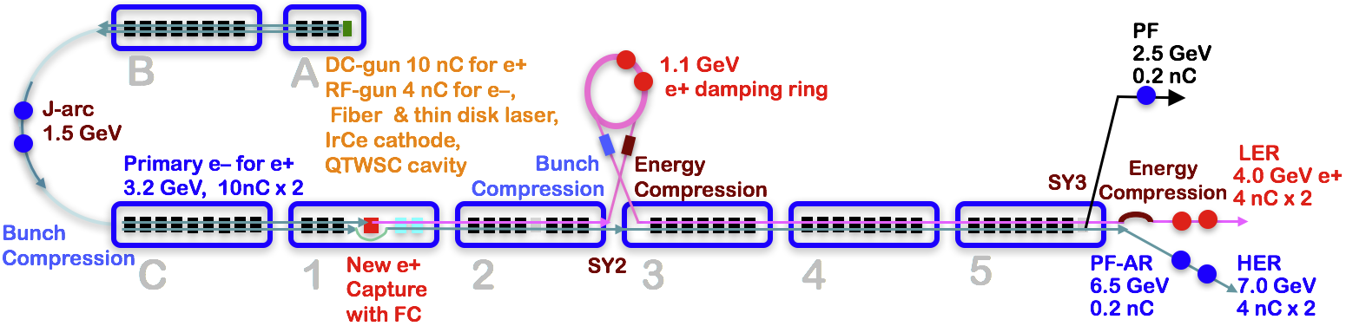
Injector Linac Overview
Injector linac configuration
Major upgrade items
Photo-cathode RF-gun for low-emittance e-
Flux concentrator, LAS structure, solenoids, quads for e+
Pulsed magnets for adequate beam optics for each beam
High-precision beam position monitor
High-precision beamline alignment for low emittance

Slide 4
Required injector beam parameters
Linac Beam Property Requirements
Stage | KEKB (final) |  | Phase-I |  | Phase-II |  | SuperKEKB (final)
Beam | e+ | e– | e+ | e– | e+ | e– | e+ | e–
Energy | 3.5 GeV | 8.0 GeV | 4.0 GeV | 7.0 GeV | 4.0 GeV | 7.0 GeV | 4.0 GeV | 7.0 GeV
Stored current | 1.6 A | 1.1 A | 1 A | 1 A | – | – | 3.6 A | 2.6 A
Life time (min.) | 150 | 200 | 100 | 100 | – | – | 6 | 6
Bunch charge (nC) | primary e- 10 → 1 | 1 | primary e- 8 → 0.4 | 1 | 0.5 | 1 | primary e- 10 → 4 | 4
Norm. Emittance (γβε) (μrad) | 1400 | 310 | 1000 | 130 | 200/40 (Hor./Ver.) | 150 | 100/15 (Hor./Ver.) | 40/20 (Hor./Ver.)
Energy spread | 0.125% | 0.125% | 0.5% | 0.5% | 0.16% | 0.1% | 0.16% | 0.07%
Bunch / Pulse | 2 | 2 | 2 | 2 | 2 | 2 | 2 | 2
Repetition rate | 50 Hz |  | 25 Hz |  | 25 Hz |  | 50 Hz
Simultaneous top-up injection (PPM) | 3 rings (LER, HER, PF) |  | No top-up |  | Eventually |  | 4+1 rings (LER, HER, DR, PF, PF-AR)

Slide 5
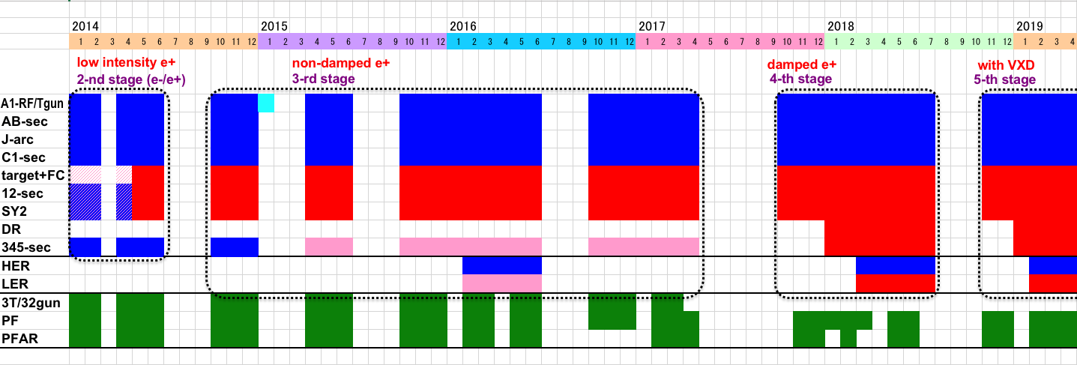
Linac Schedule Overview as of Feb.2018
New Schedule
RF-Gun e- beam
commissioning
at A,B-sector
e- commiss.
at A,B,R,C,1
e+ commiss.
at 1,2 sector (FC, DCS, Qe- 50%)
e- commiss.
at 1,2,3,4,5 sector
Phase1: high emittance beam for vacuum scrub
Phase2,3: low emittance beam for collision
Time →
Location
↓
Beam Licenses in steps
Low Emittance Beams
Low Emittance Injections
4+1 Ring
Injections
DR Commiss.
1 nC
Phase1
1 - 2 nC
Phase2
2 - 4 nC
Phase3
Without Top-up
Direct PF-AR BT
: Electron
non damped e+ commiss.
at 1,2, 3,4,5 sectors
e- commiss. at A→5 sectors
damped e+ commiss.
at 1→5 Qe+ = 1~4nC
e- commiss.
at A→5 Qe- = 1~4nC
Improved RF gun
: Positron
: Low current electron

Slide 6
Newly Installed Pulsed Magnets
KEKB
Common optics was enough
SuperKEKB
Independent beam optics with
26 Quads and 26 Correctors
in Sectors 3 – 5
10 Correctors in Sectors 1 and 2
2 Quads for Positron Target
Positron common optics
with some steering magnets
Independent beam optics
with pulsed magnets
HER (7 GeV)
PF-AR (6.5 GeV)
Beam energy
LER (4 GeV)
PF (2.5 GeV)
A | B | C | 1 | 2 | 3 | 4 | 5
Sector

Slide 7
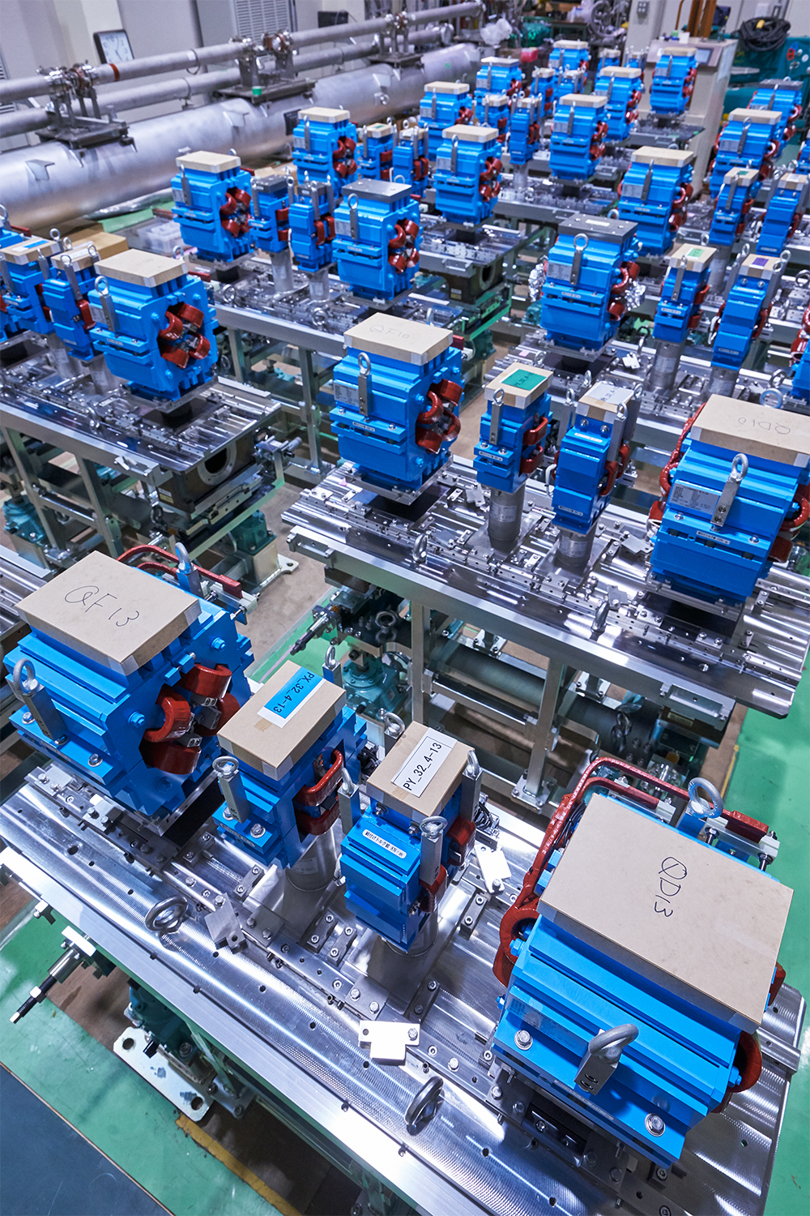
Pulsed Magnet Installation 1
Installation during long shutdown at summer 2017
Not possible before Phase 1 without DR because of the aperture
Replacement for 64 magnets
In 99 days between May and October
All components including magnets, girders, cabling, cooling water, controls, etc.
In parallel with other replacements and installations
2017/3/31 by N.Toge

Slide 8
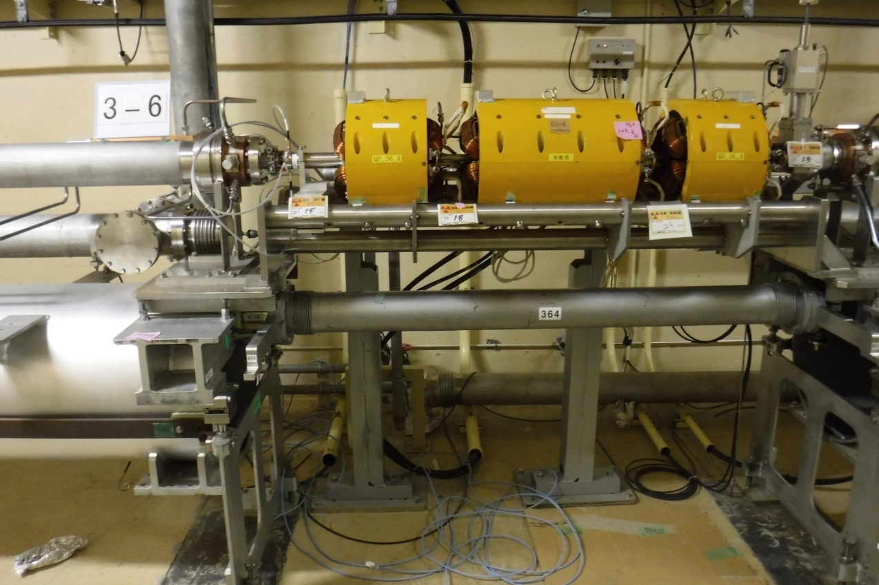
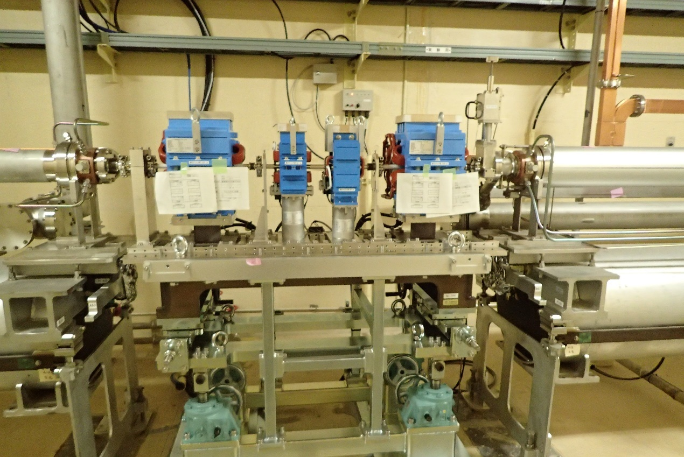
Pulsed Magnet Installation 2
13 New girders
each for 2 quads and 2 correctors
ready for 10 μm alignment to realize low emittance preservation in Phase 3

Slide 9
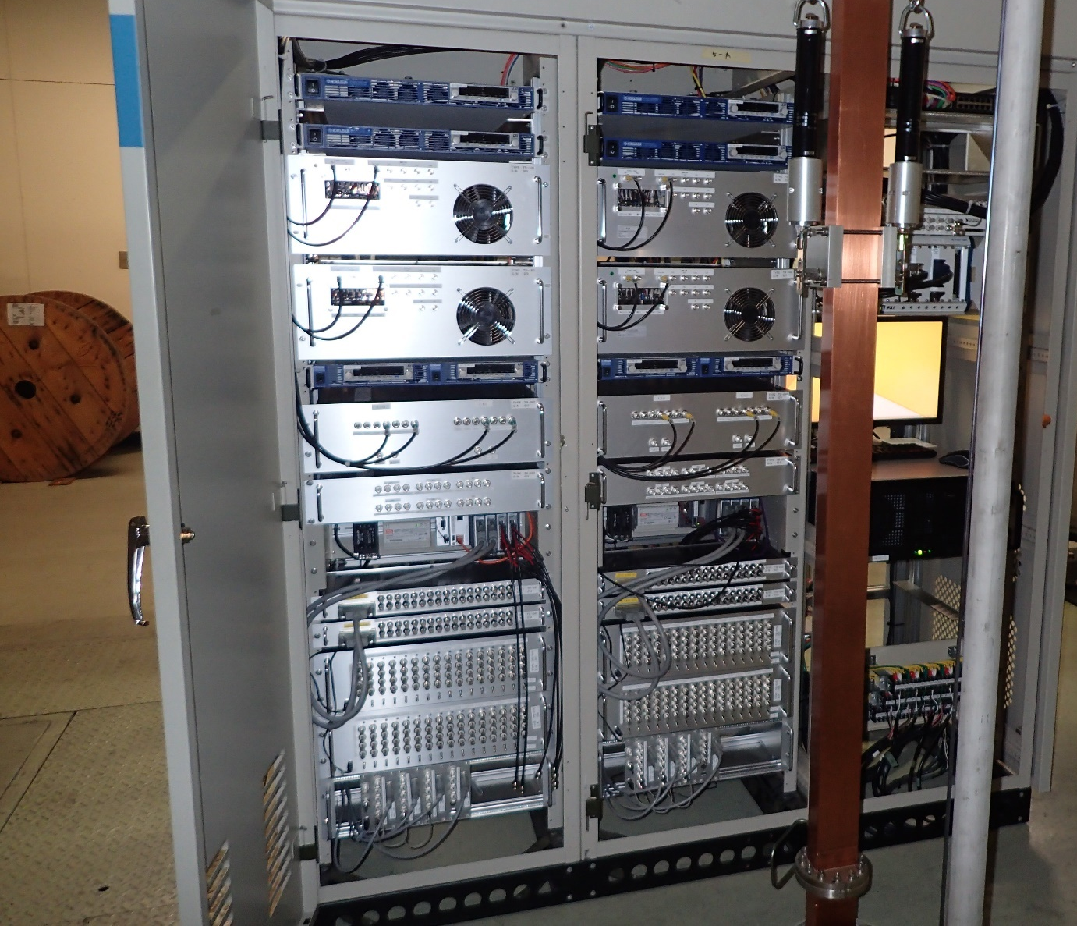
Pulsed Magnet Installation 3
Standard cabinet configuration for pulsed magnets
4 quads and 4 correctors for a half sector
Pulsed power supplies & Interlock system
for 2 quads and 2 correctors
Pulsed power supplies & Interlock system
for 2 quads and 2 correctors
Controls
Girder and magnet replacements before July
Power supply installation and cabling before September
Comprehensive system tests in September for a month

Slide 10
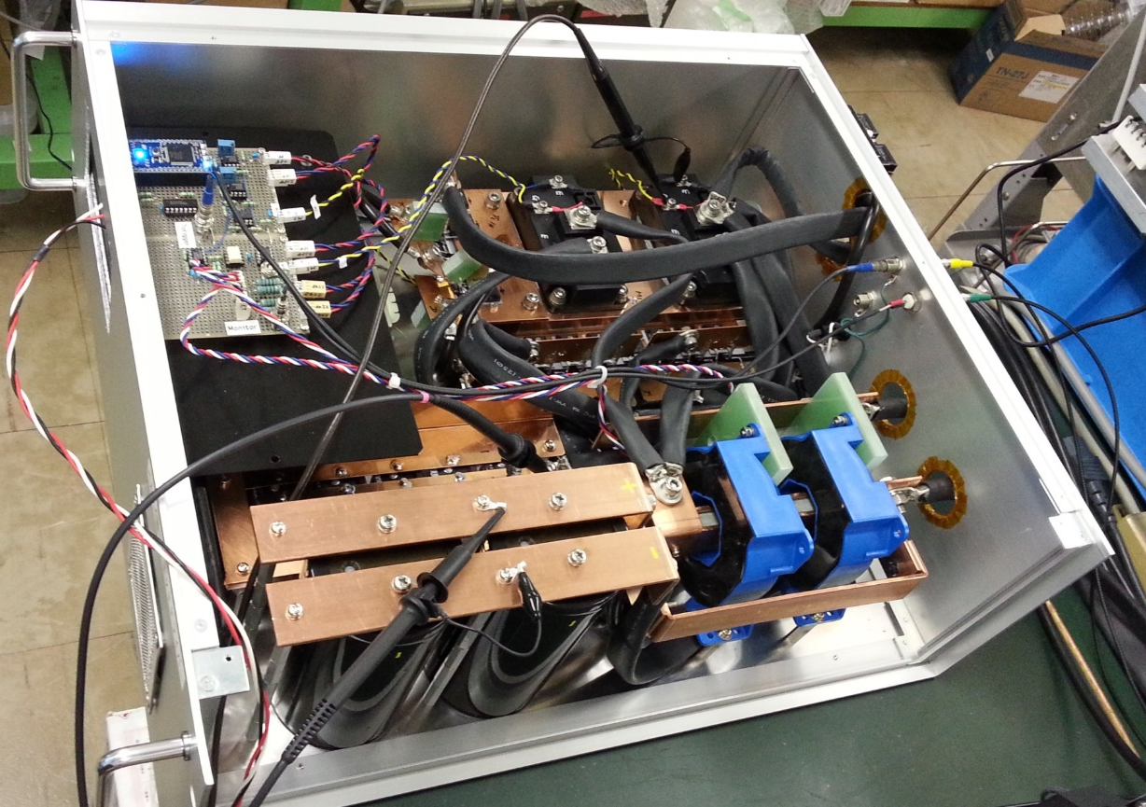
Performance of Quad Power Supply
High performance with energy recovery
Total energy recovery rate of 68.5％ (measured)
No need for additional wall power (only 39kW for all new magnets)
High precision and high stability by analog feedback with IGBT
Stability of 0.01％ for 24 hours
Flexible synchronous controls with global event control system
Independent pulse-by-pulse modulation at 50 Hz
Drives a 1 mH coil at 330 A, 340 V, 1.5 ms risetime

Slide 11
Power Consumption Measurement
Actual power consumption (measured)
Energy stored in coil inductance
Heat loss at Magnet
Heat loss on cables
Total Energy
Energy recovery ratio = 1 - P_{measured} / P_{total} = 68.5 %

Slide 12
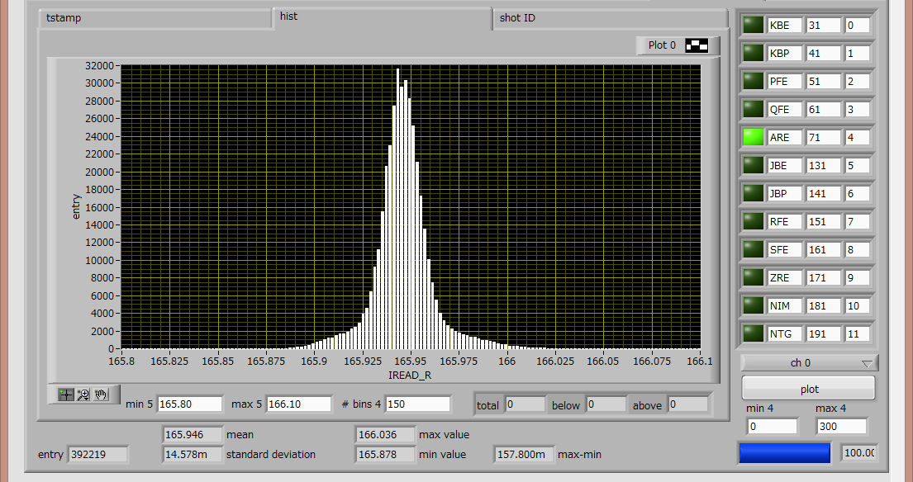
Stability of Quad Power Supply
25 mA / div
0.014578 A / 165.946 A = 0.0107% / 24 hours (for PF_52_4 magnet)

Slide 13
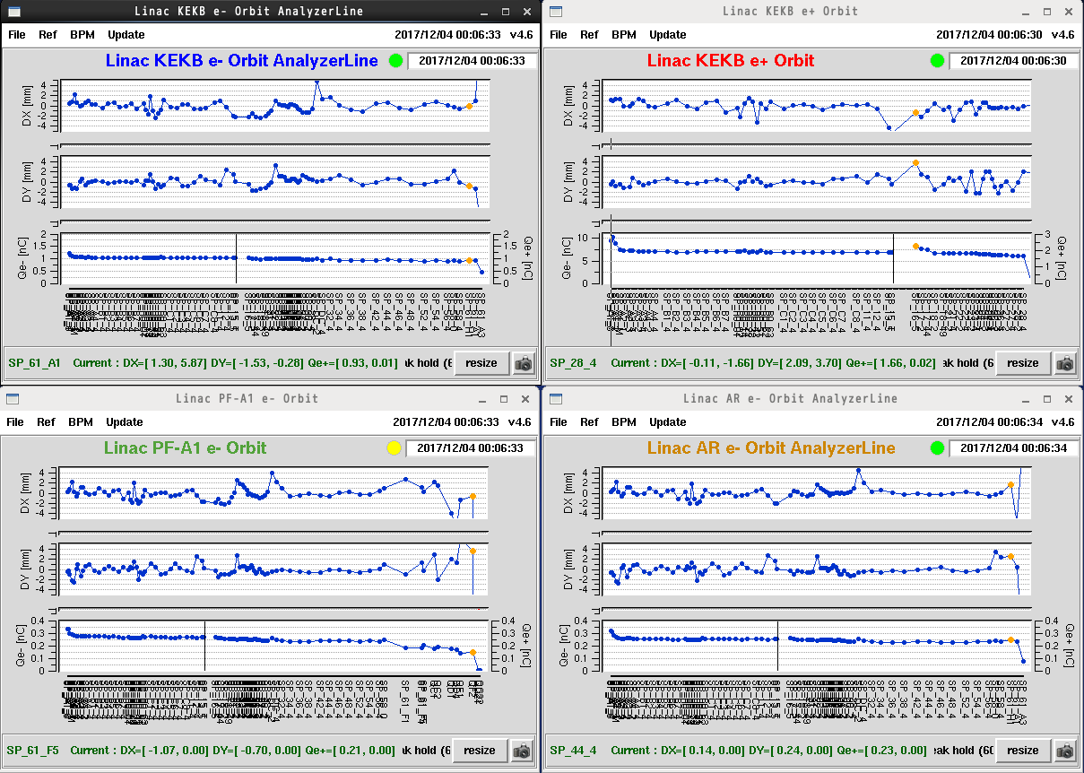
New Pulsed Magnets enabled Simultaneous PF/PF-AR Injections And 2 Test Beam Accelerations

Slide 14
For Phase 3
Pulsed bending magnet addition for switching between RF electron gun / thermal electron gun
Pulsed corrector additions for offset injection (orbit control) to enable lower emittance
40 magnet replacements if budget allows

Slide 15
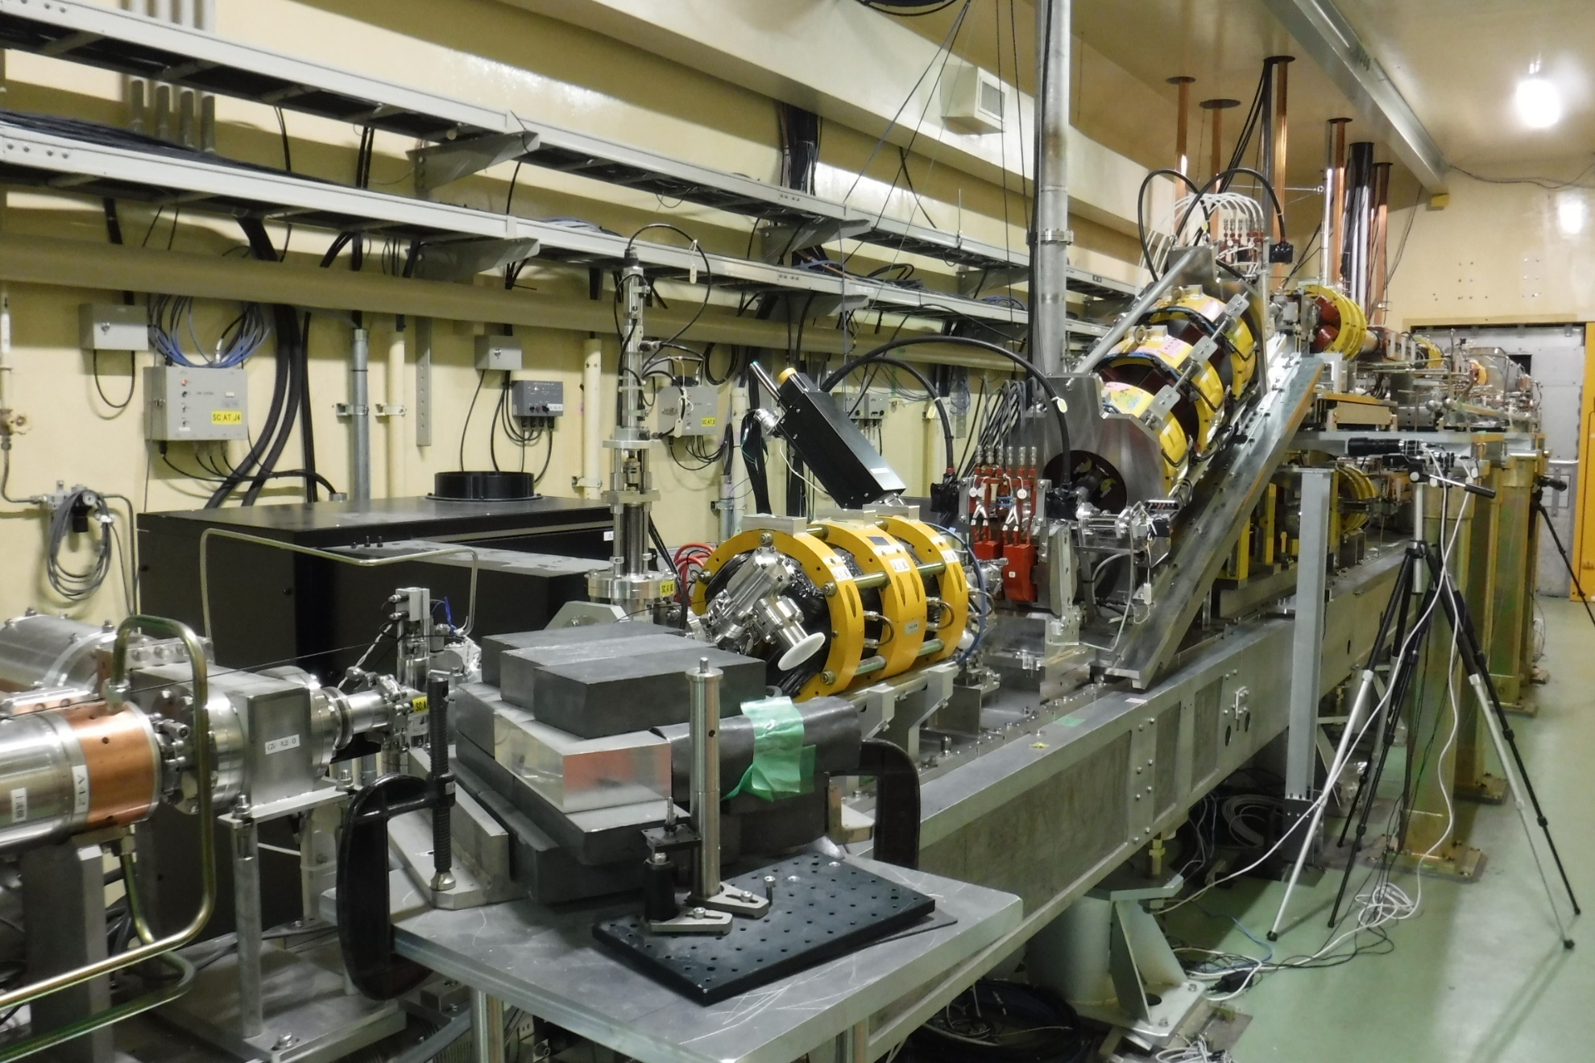
Planning Pulsed Bend for Merger Line
24-degree Merger Bend x2
Thermionic Gun
PF-AR
LER (primary e– for e+）
PF
HER
Photo RF Gun

Slide 16
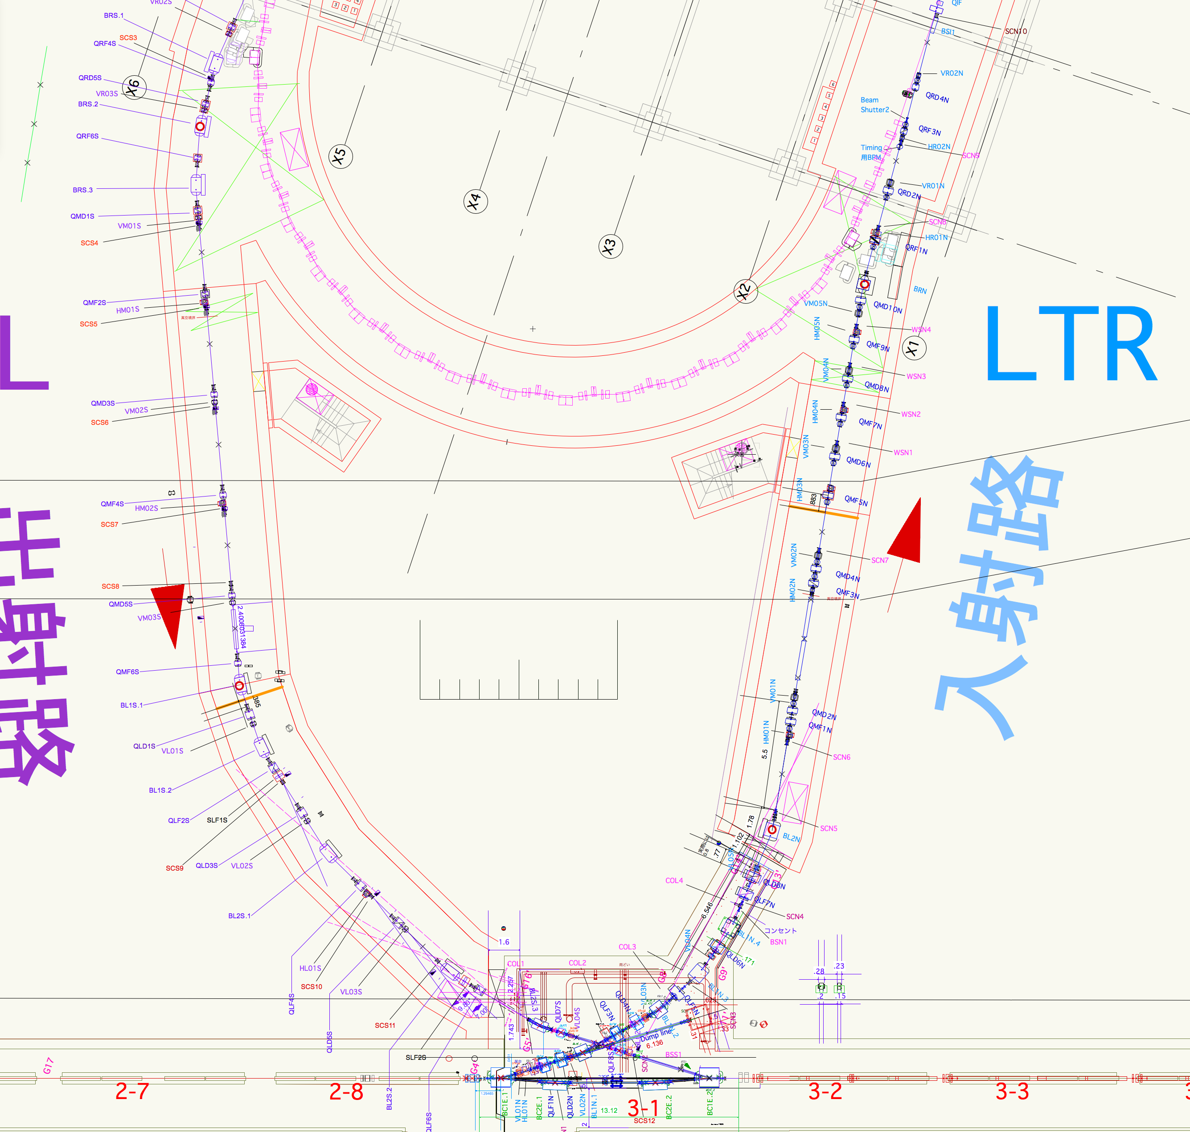

DR LTR / RTL Waveguides
Accelerating structures for energy / bunch compressors on DR LTR / RTL beam lines
45-m waveguides from linac gallery
Fabrication errors of ~150 μm were found (while schematics from KEK and from maker were correct)
DR
RTL
Linac

Slide 17
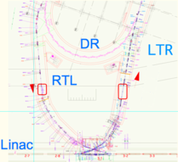
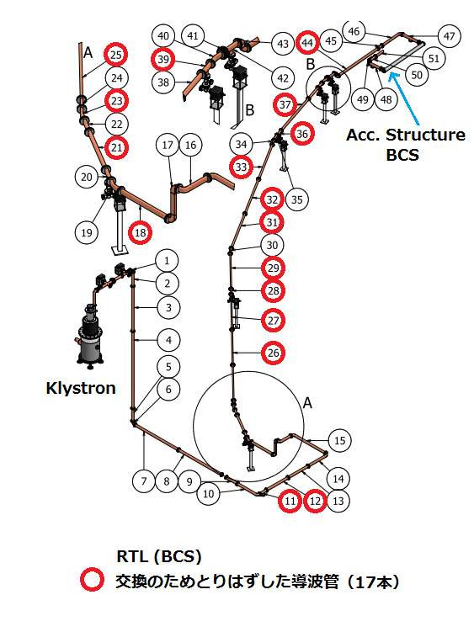
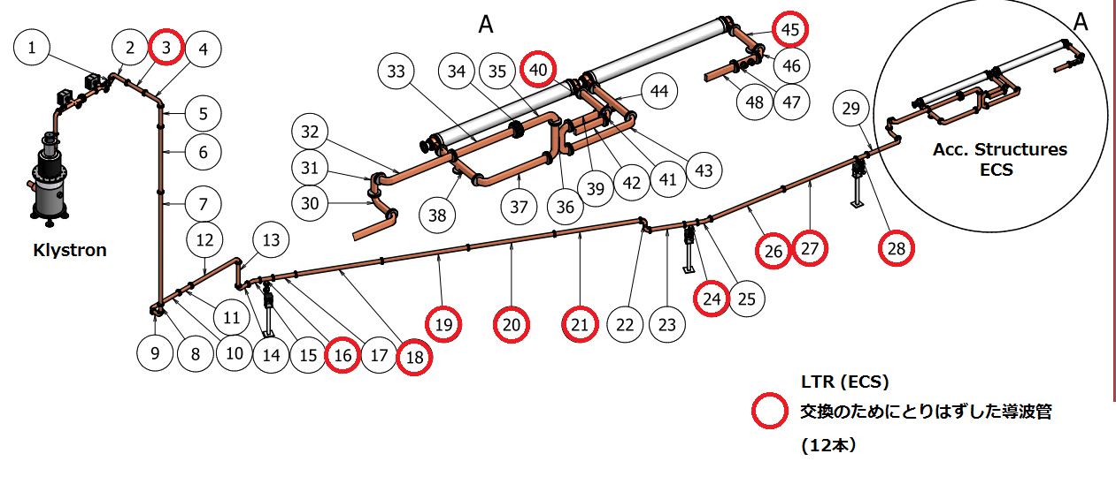
DR LTR / RTL Waveguides
Components with Red circles had to be replaced
Bunch Compressor on RTL
Energy Compressor on LTR

Slide 18
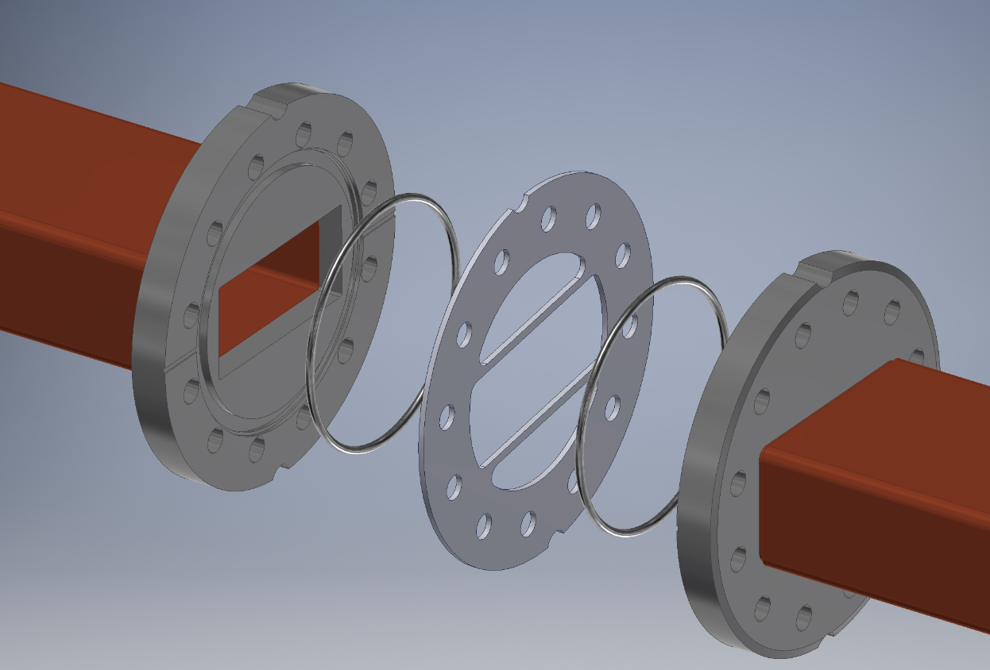
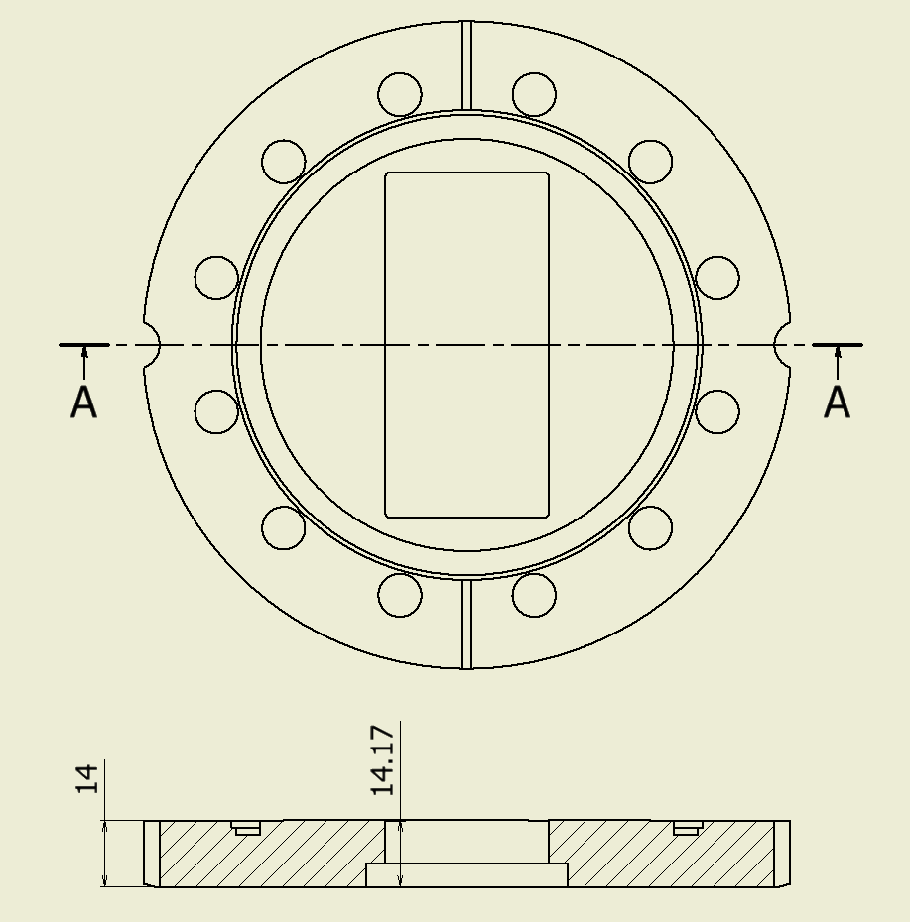
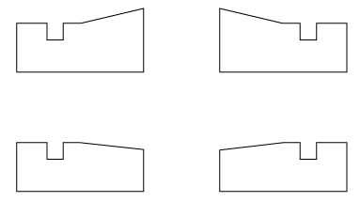
Structure of Waveguide Flange
Metal Seal (Vacuum)
RF Contactor (Electric)
Emphasized figures
Correct
Wrong
only 150 μm difference

Slide 19
Fabrication Error and Recovery
September 2017
A large reflection was observed from the middle of waveguides in the low-power test
Fabrication errors in 58 waveguide flanges were identified
October 2017
High power test was performed at a test stand
Discharge at the gap prevents the power only up to 10% of the nominal power
All 29 wrong waveguides were replaced; some were replaced with the ones with different length, others were newly fabricated

Slide 20
Fabrication Recovery
Early October 2017
Removal of all erroneous waveguides from the tunnel
Till November 2017
Fabrication, preparation and test of replacement waveguides
Late November – early December 2017
Re-installation in between linac operation
December 17 and 24, 2017
High-power verification of whole system in between DR construction
January 2018
Intermittent RF conditioning in between DR construction
Reached nominal power for Phase 2 and 3 operation
Confirmed the designed energy compression of one third on LTR

Slide 21
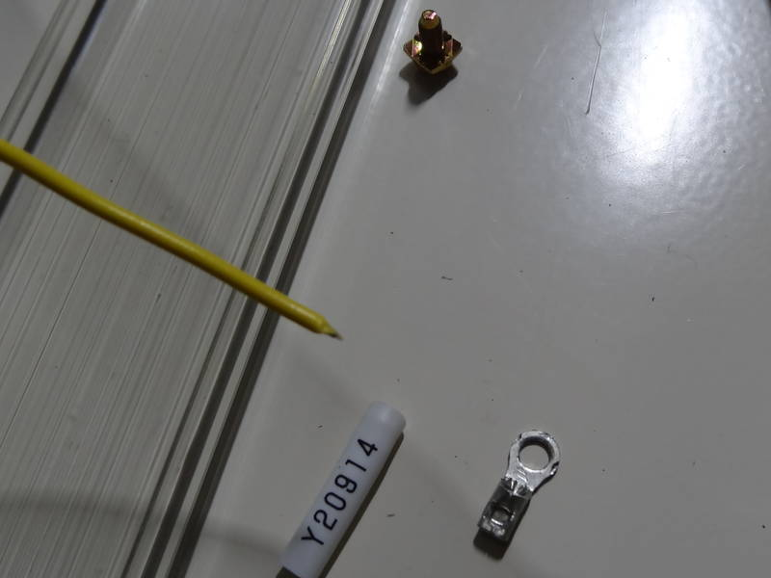
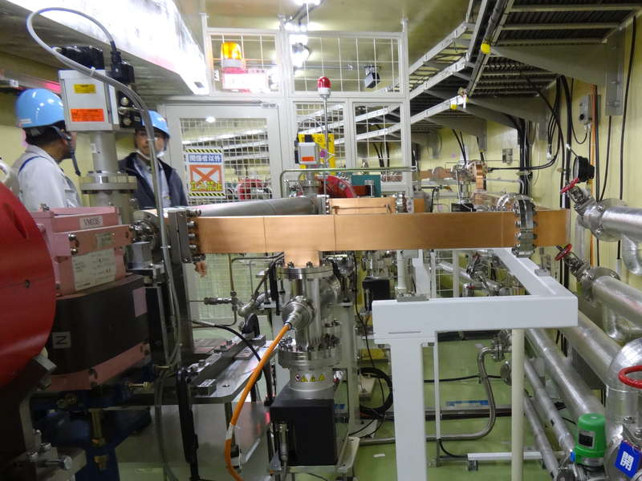
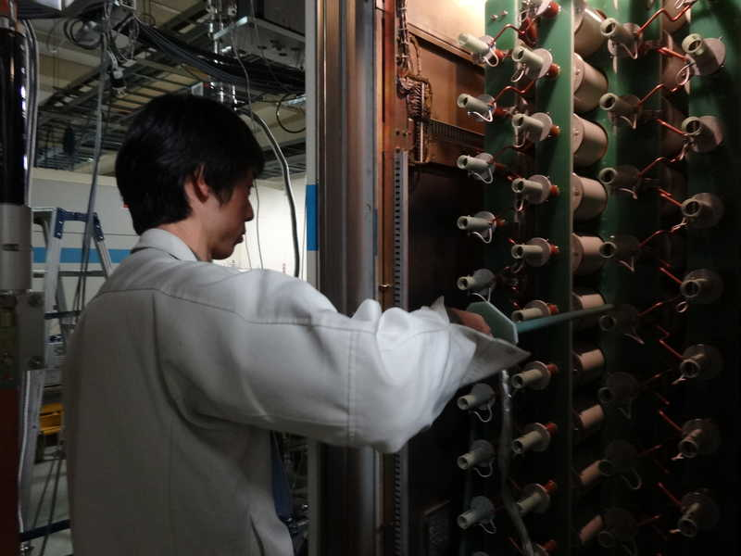
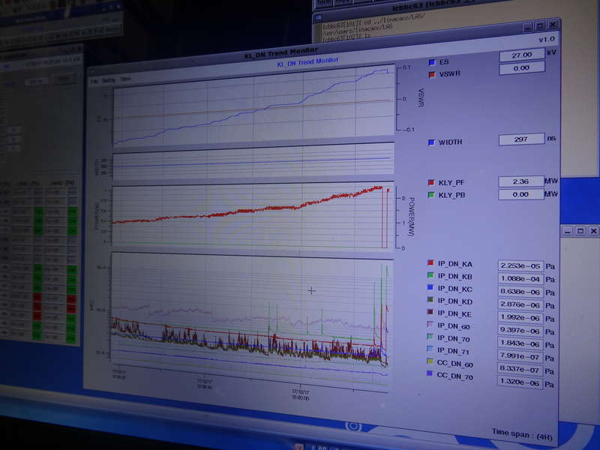
LTR/ECS – RTL/BCS Waveguide Conditioning

Slide 22
Summary
New Pulsed Magnets
Successful fabrication and installation of home-grown low-cost pulsed magnet system during 2017 summer shutdown
1-month test was performed as scheduled
Experienced no large troubles so far and enabled stable simultaneous accelerations with different energy beams
Erroneous Waveguides
Replacements of 29 waveguides were performed successfully even during light source operation and SuperKEKB commissioning /construction
Achieved the designed energy compression without any harmful impact against DR commissioning
Injector is ready for Phase-2 commissioning

Slide 23
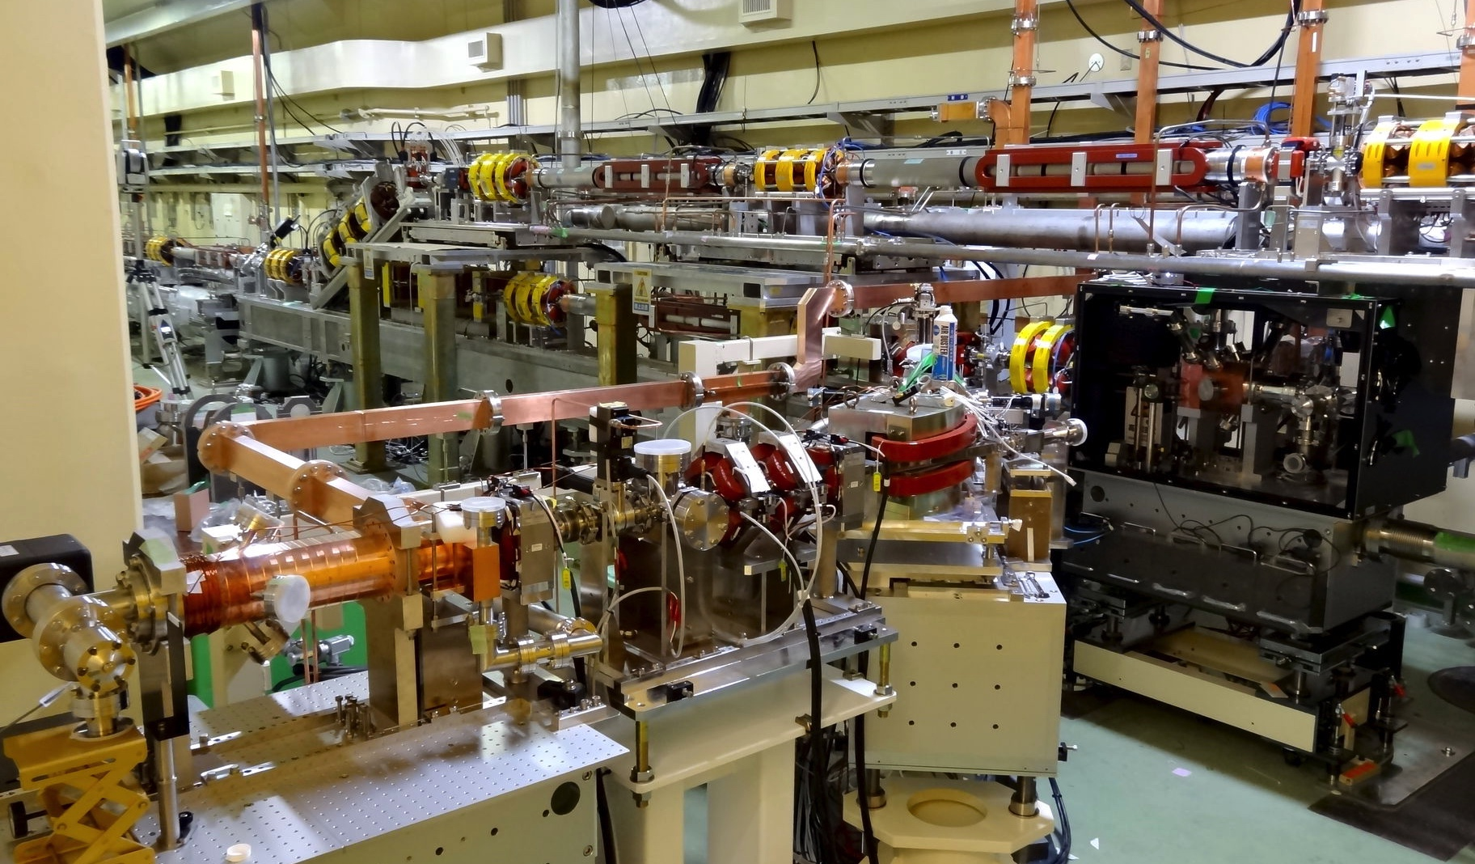
Thank you

