Slide 1
Injector Linac
< kazuro.furukawa @ kek.jp >
Kazuro Furukawa
for Injector Linac Groups
Many slides from M. Satoh and N. Iida
<http://www-linac.kek.jp/linac/>
< kazuro.furukawa @ kek.jp >

Slide 2
Contents
Injector status
Overview
Beam sources
Accelerator components
Structures, pulsed magnet, monitors, operation tools
Injection management
Anomalous injection beam
Beam controls
Especially positron beam emittance improvements
Background spikes
Mystery
Summary

Slide 3
Overview

Slide 4
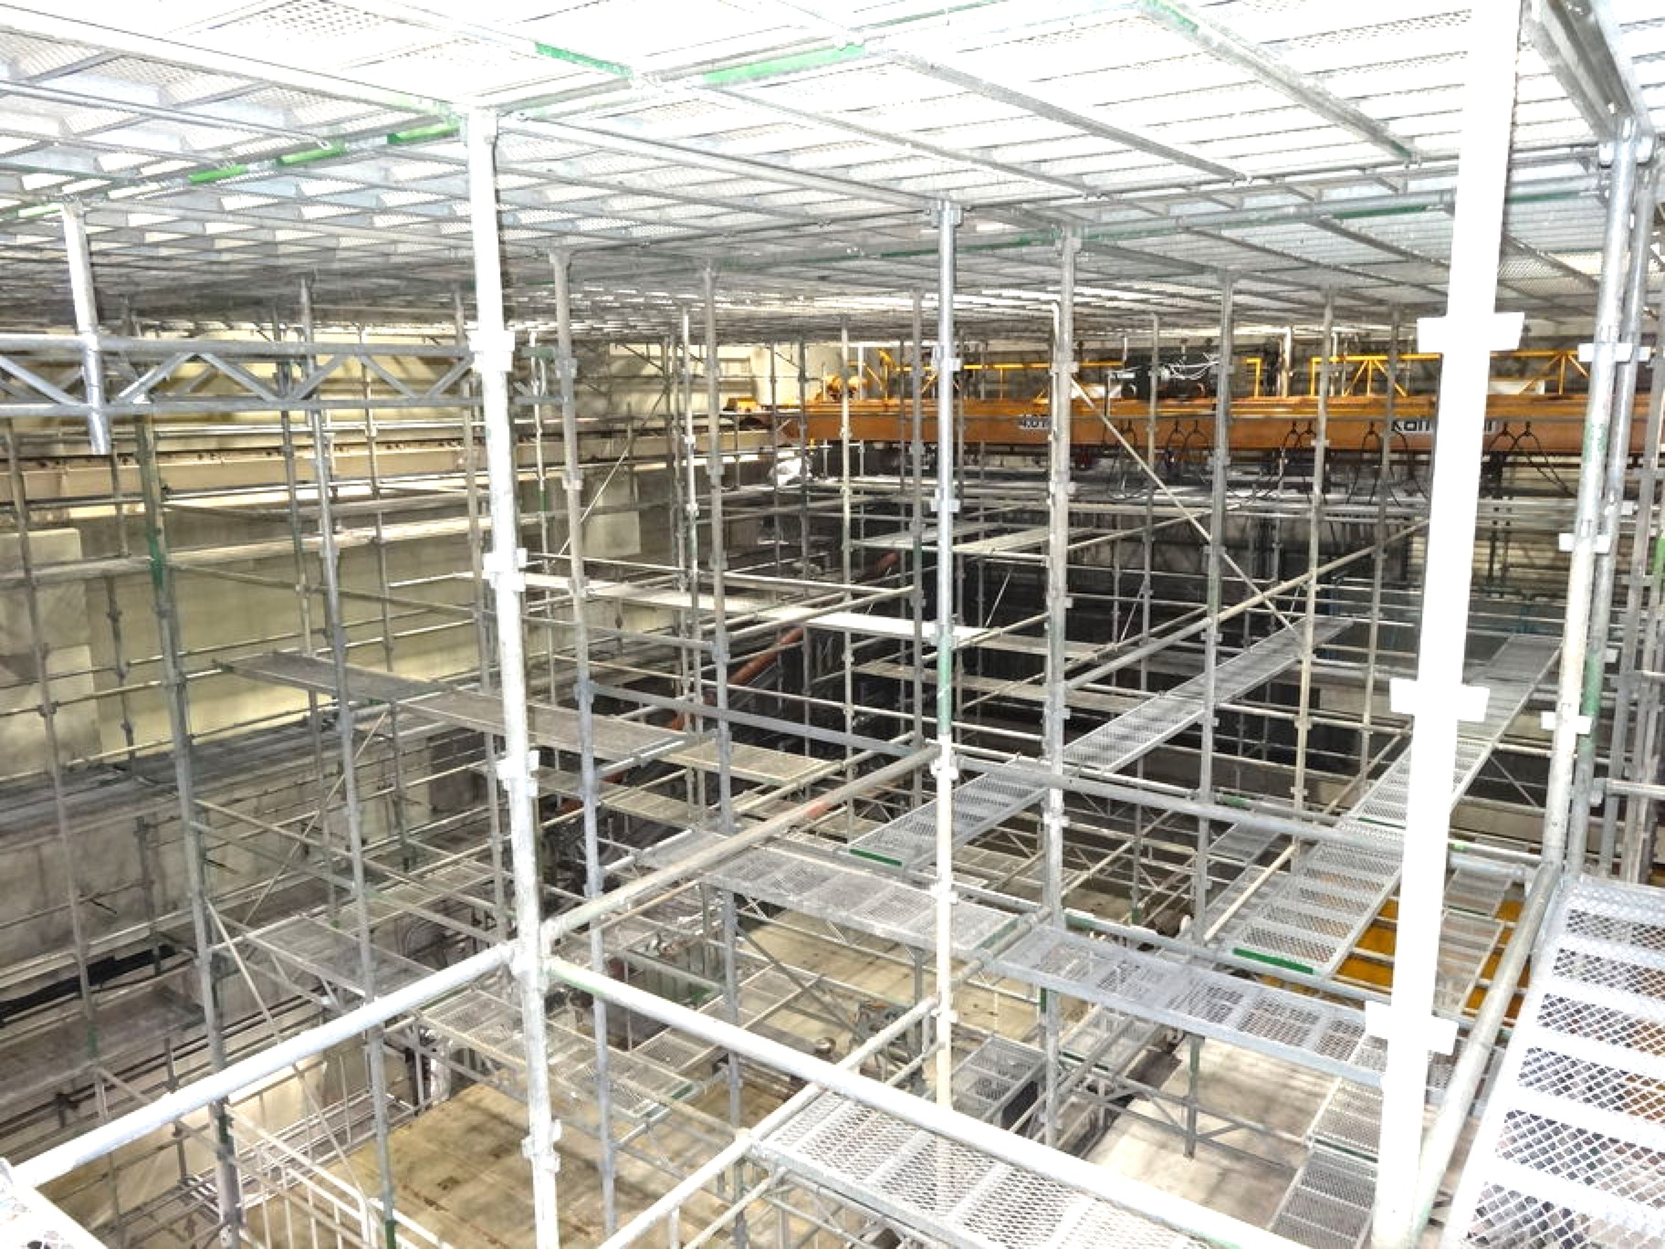
Fire Recovery
Fire at acc. structure assembly room on Apr.3
Southern part of the injector was much damaged as well as the assembly room
Interim injector recovery by Apr.26
Full injector recovery during summer shutdown
The assembly room cleaned up
Restoration in April
S-band structure tests and RF conditioning soon
Scaffold to clean up walls and ceiling
at acc. structure assembly room

Slide 5
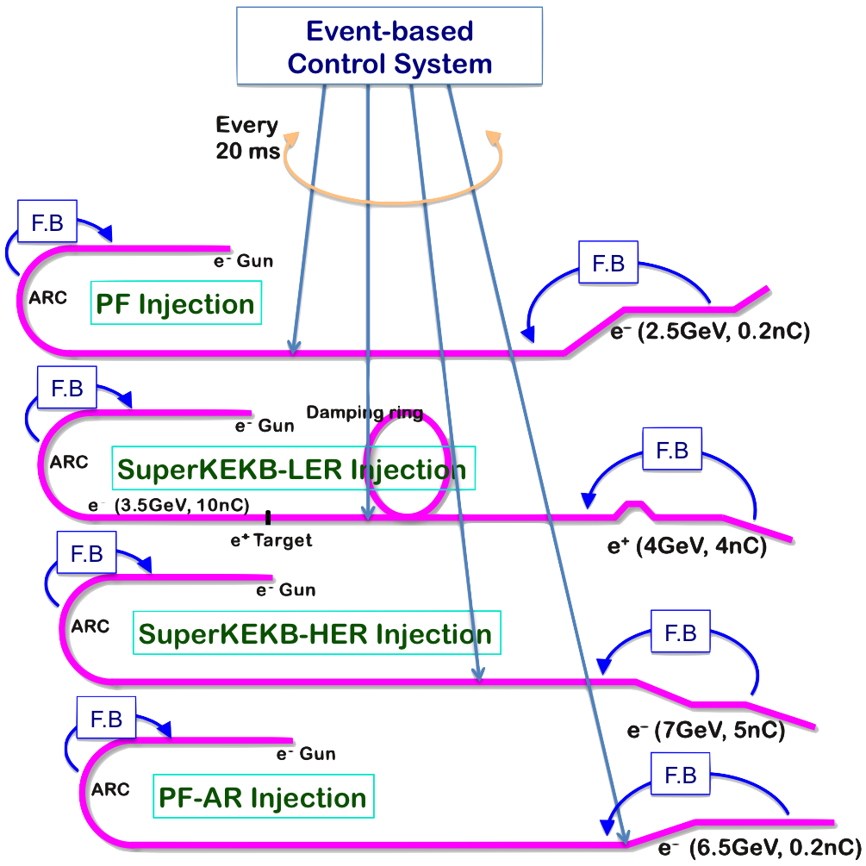
Mission of Electron/positron Injector in SuperKEKB
Injector Linac Mission
Low emittance & low energy spread injection beams with 4 times higher beam current
New high-current photo-cathode RF gun
New positron capture section
Positron damping ring injection/extraction
Optimized beam optics and correction
Precise beam orbit control with long-baseline alignment
Simultaneous top-up injection to DR/HER/LER/PF/PFAR
Balanced injection for the both photon science and elementary particle physics experiments
The single injector would behave as multiple injectors to multiple storage rings by the concept of virtual accelerator
Notes:
Higher Injection Beam Current
To Meet the larger stored beam current and shorter beam lifetime in the ring
4~8-times larger bunch current for electron and positron
Reconstruction of positron generator, etc
Lower-emittance Injection Beam
To meet nano-beam scheme in the ring
Positron with a damping ring
Electron with a photo-cathode RF gun
Emittance preservation by alignment and beam instrumentation
Quasi-simultaneous injections into 4 storage rings
SuperKEKB e–/e⁺ rings, and light sources of PF and PF-AR
Improvements to beam instrumentation, low-level RF, controls, timing, etc

Slide 6
Linac Beam Parameters at KEKB/SuperKEKB
Linac Beam Property Requirements
Stage | KEKB (final) |  | Phase-I |  | Phase-II |  | Phase-III (interim) |  | Phase-III (final)
Beam | e+ | e– | e+ | e– | e+ | e– | e+ | e– | e+ | e–
Energy | 3.5 GeV | 8.0 GeV | 4.0 GeV | 7.0 GeV | 4.0 GeV | 7.0 GeV | 4.0 GeV | 7.0 GeV | 4.0 GeV | 7.0 GeV
Stored current | 1.6 A | 1.1 A | 1.0 A | 1.0 A | – | – | 1.8 A | 1.3 A | 3.6 A | 2.6 A
Life time (min.) | 150 | 200 | 100 | 100 | – | – | – | – | 6 | 6
 | primary e- 10 |  | primary e- 8 | 1 | 0.5 | 1 | 2 | 2 | primary e- 10 | 4
Bunch charge (nC) | → 1 | 1 | → 0.4 |  |  |  |  |  | → 4
Norm. Emittance | 1400 | 310 | 1000 | 130 | 200/40 | 150 | 150/30 | 100/40 | 100/15 | 40/20
(γβε) (mrad) |  |  |  |  | (Hor./Ver.) |  | (Hor./Ver.) | (Hor./Ver.) | (Hor./Ver.) | (Hor./Ver.)
Energy spread | 0.13% | 0.13% | 0.50% | 0.50% | 0.16% | 0.10% | 0.16% | 0.10% | 0.16% | 0.07%
Bunch / Pulse | 2 | 2 | 2 | 2 | 2 | 2 | 2 | 2 | 2 | 2
Repetition rate | 50 Hz |  | 25 Hz |  | 25 Hz |  | 50 Hz |  | 50 Hz
Simultaneous top-up injection (PPM) | 3 rings (LER, HER, PF) |  | No top-up |  | Partially |  | 4+1 rings (LER, HER, DR, PF, PF-AR) |  | 4+1 rings (LER, HER, DR, PF, PF-AR)
Limited improvements for operational electricity budget

Slide 7
Simultaneous 4 + 1 Ring Top-up Injection
HER
Realized for the first time
SuperKEKB HER 7 GeV e–
SuperKEKB DR and LER 4 GeV e+
Photon Factory 2.5 GeV e–
PF-AR 5.0 / 6.5 GeV e–
4 beams are modulated at 20-ms PPM (pulse-to-pulse modulation)
More than 200 pulsed devices were constructed for SuperKEKB, as well as many beam and RF monitors
Injection noise (background) were well studied by Belle II and MDI group
LER
PF
PF-AR

Slide 8
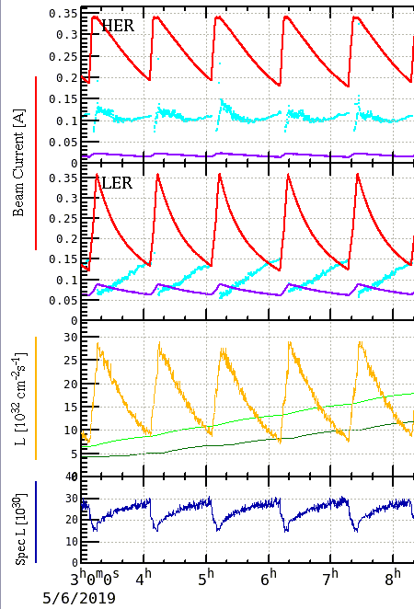
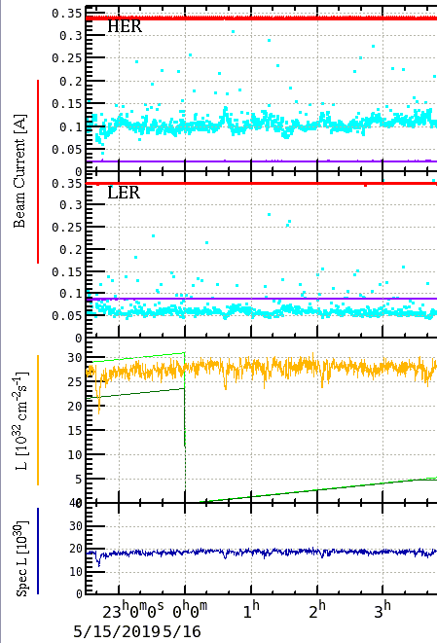
Simultaneous Top-up Injections
SuperKEKB integrated luminosity improvement
17.5 /pb in 5.15 hr
(5 fills)
on May.6
41.6 /pb in 5.15 hr
(top-up)
on May.16
237% improvement

Slide 9
Beam Sources

Slide 10
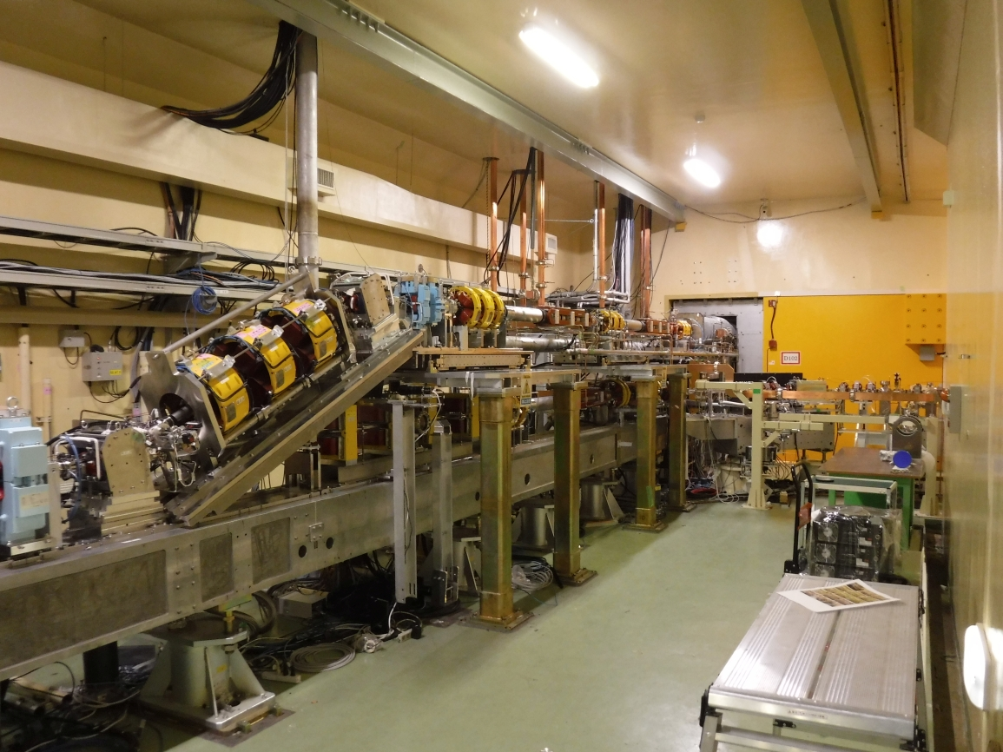
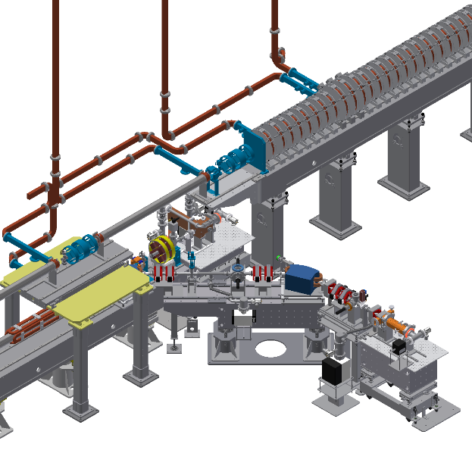
Pulse to pulse switching: rf e- gun/thermionic e- gun
Thermionic DC e- gun (GU_AT)
w/ 2 subharmonic bunchers and 2 bunchers
・e+ production e-: 10 nC (for LER injection)
・PF injection: 0.3 nC
・PF-AR injection: 0.3 nC
RF e- gun
（GR_A1 for HER injection）
Pulsed bend rep. up to 25 Hz (LER + PF + PF-AR)
(magnet coil and chamber heating issue)
It will be replaced by new one in summer shutdown 2020 for full 50 Hz operation.
Notes:
入射部では24度垂直偏向パルスベンドを用いて，熱電子銃，RF電子銃を切り替えて運転している．
熱電子銃は，陽電子生成用10 nC電子ビーム，PF,PF-AR入射用 0.3 nCビームを生成している．
RF電子銃は，HER入射用低エミッタンス電子ビームを生成している．（レーザー両打ち，IrCeカソード）電子銃からは，最大2～3 nC出る．

Slide 11
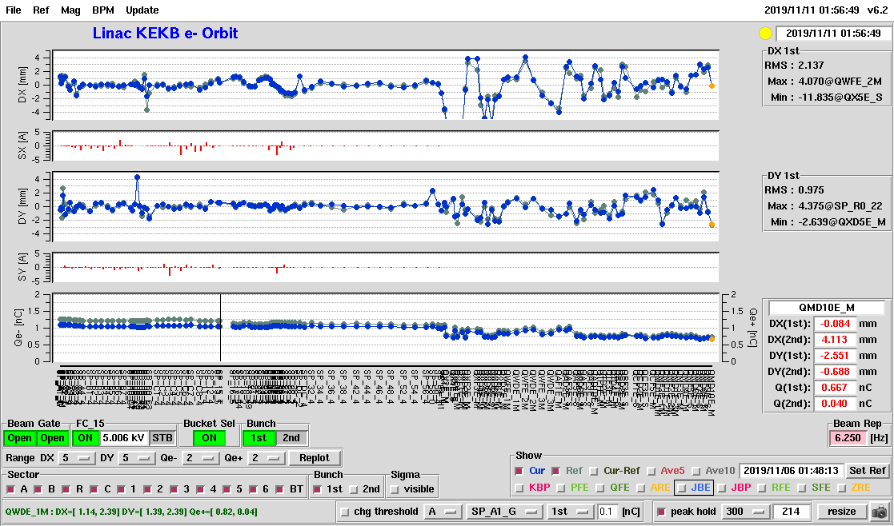
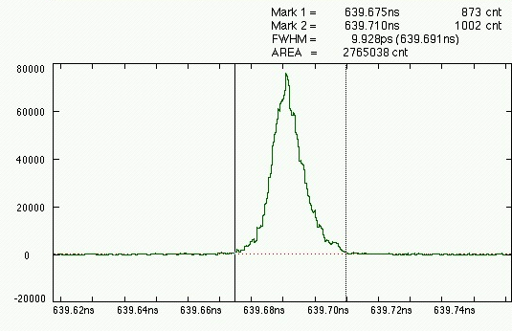
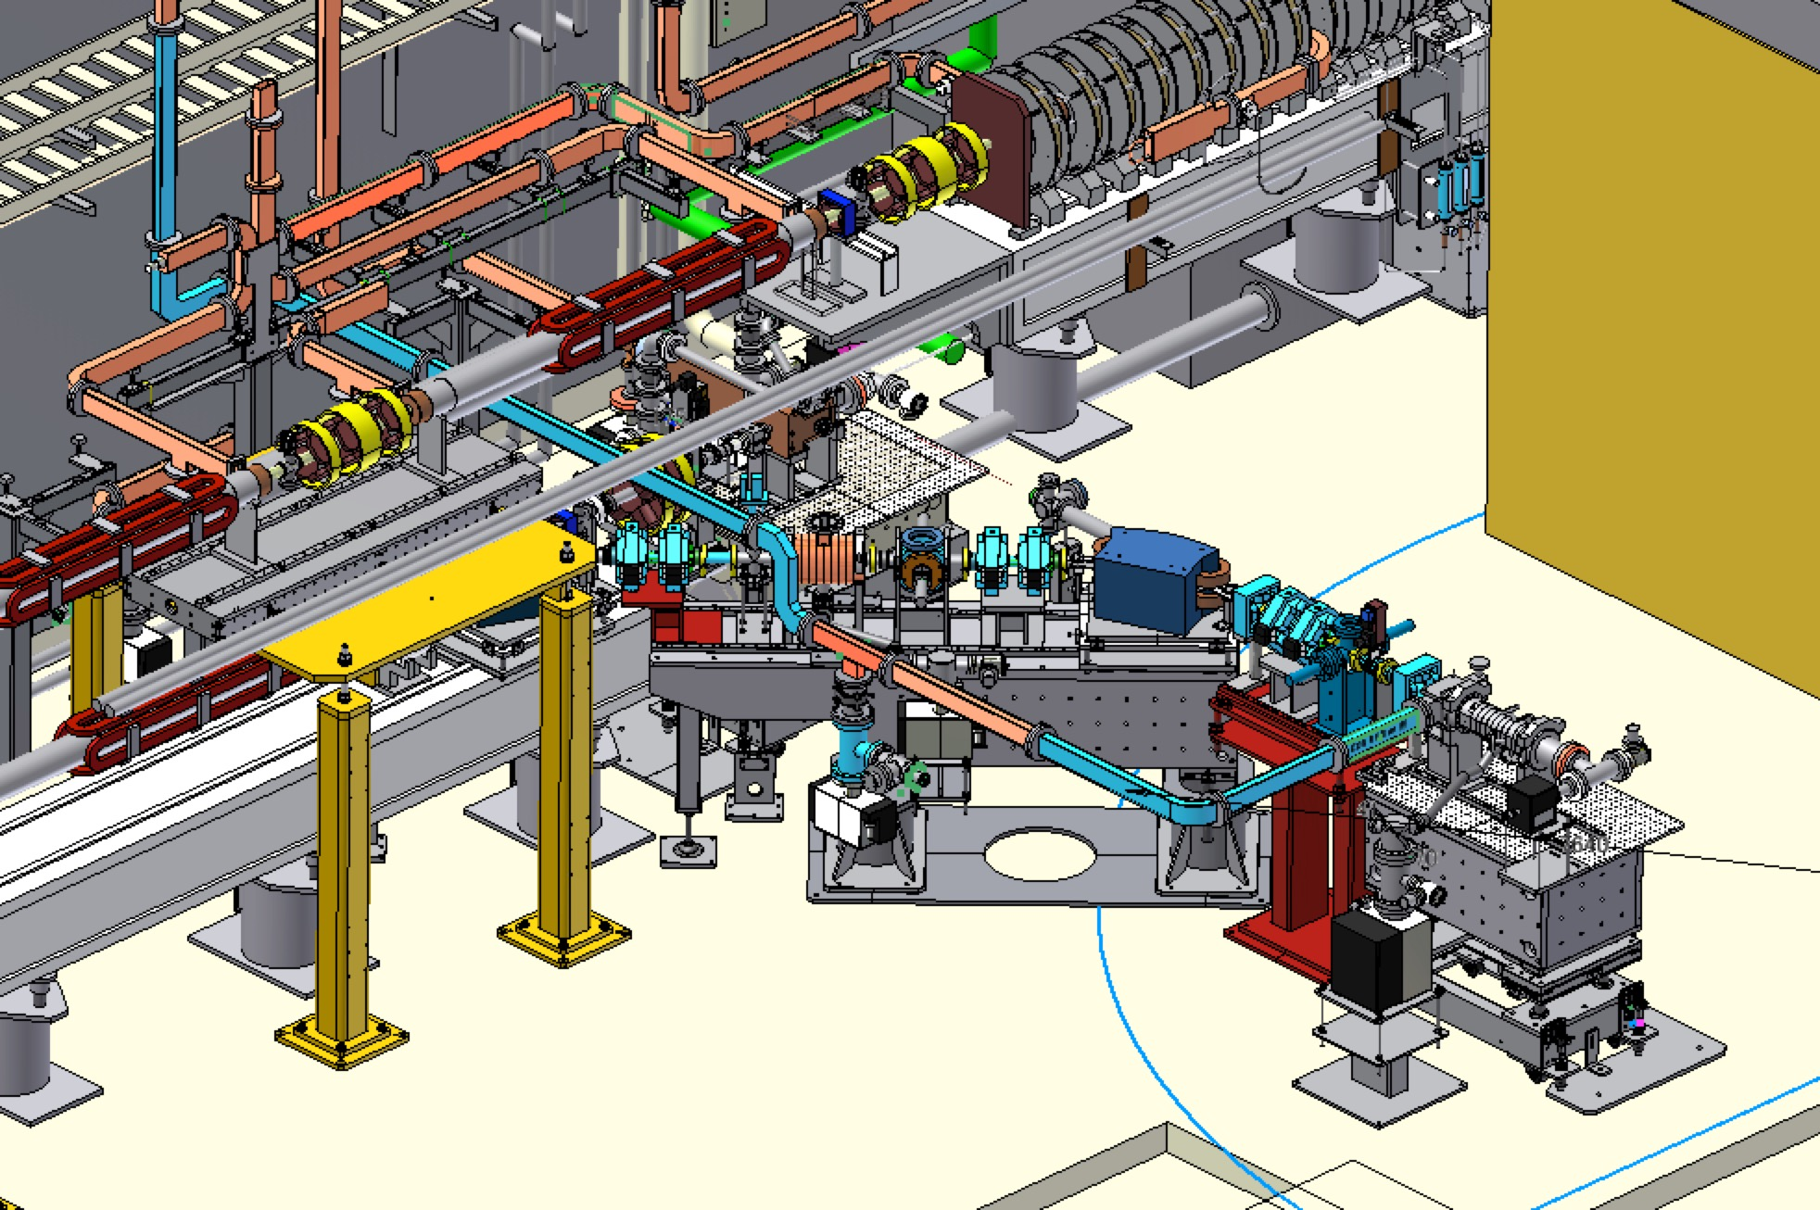
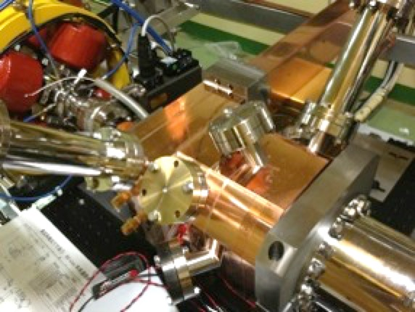
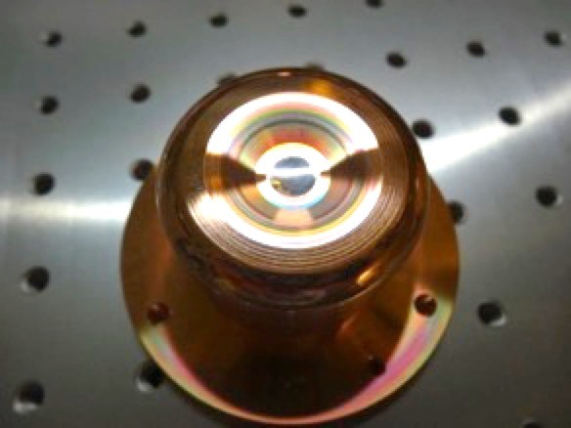
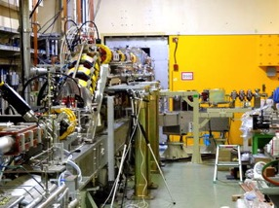
Development of Photo-cathode RF Gun
One of Key Component: Photo Cathode RF Gun
M.Yoshida et al.
Successfully deployed for injection into SuperKEKB HER
Employs Yb-doped-fiber and Nd/Yb:YAG laser, IrCe cathode, QTWSC or cut disk cavities
Stability improving
Beam instrumentation improvements and comparison with simulation codes
Secondary RF gun was constructed as a backup (under tuning)
Incorporate suggestions by review committee for availability
Bunch length
Beam orbit measurement
Thermionic gun
Primary RF gun
Quasi traveling wave side couple cavity
Secondary RF gun
IrCe Cathode
Cut disk cavity
Electron Guns

Slide 12
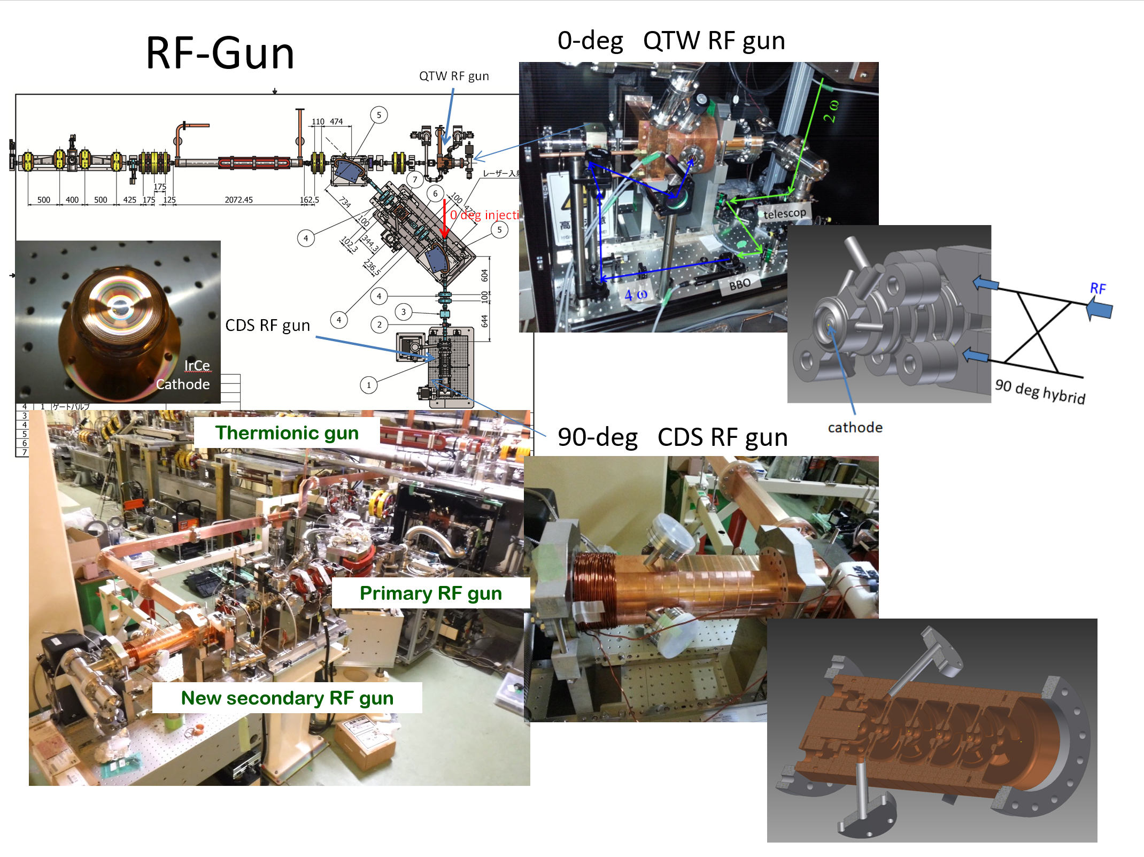
RF e- gun
Low emittance
RF gun
QTW RF gun or operation (0 deg. Line)
Photocathode
(metal composite: IrCe)
CDS RF gun
for backup (90 deg. Line)
e- source
M. Yoshida, SuperKEKB review, Mar. 14th, 2018

Slide 13
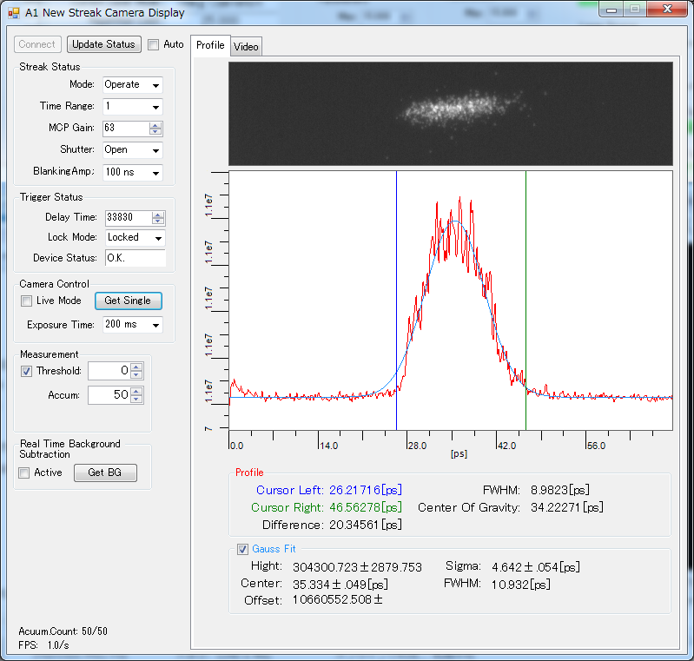
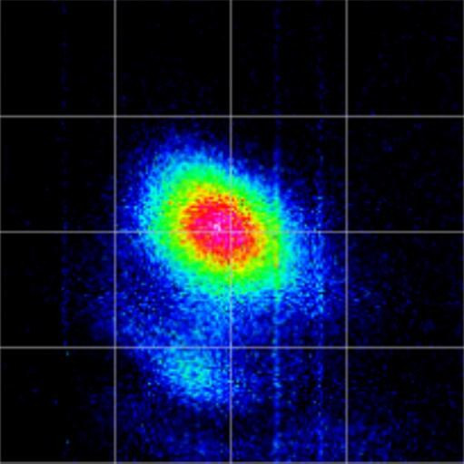
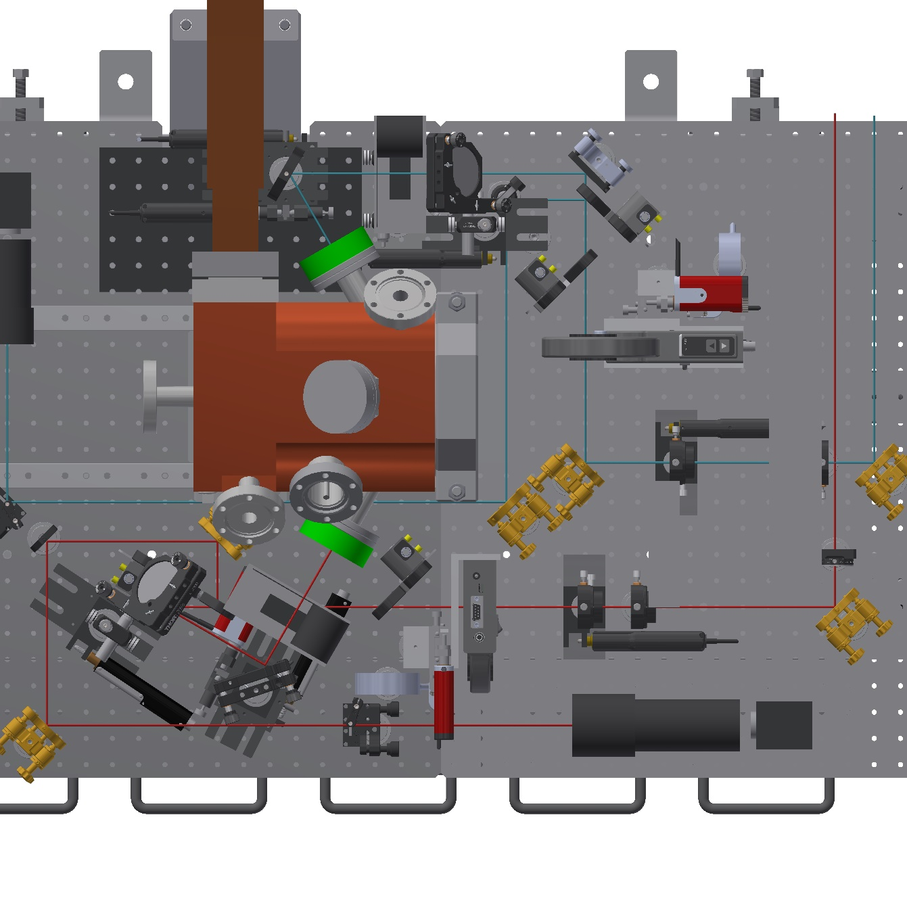
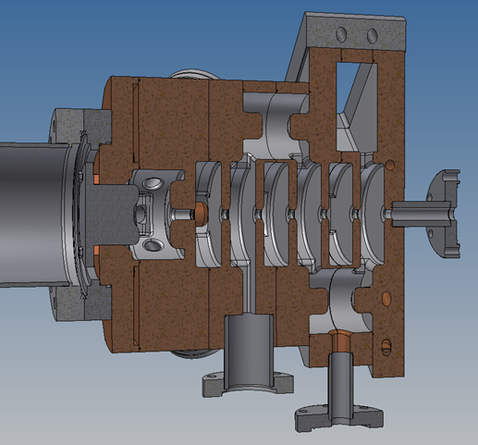
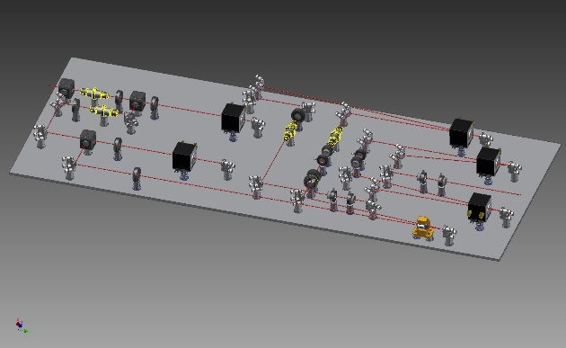
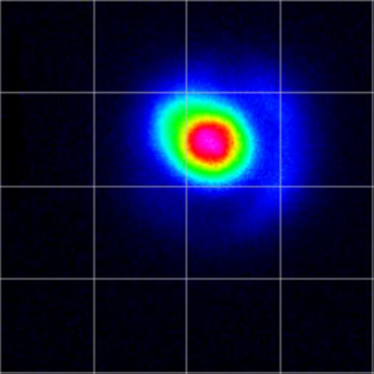
Hybrid laser system for rf gun
Three Oscillators (two of them are backup)
Yb doped fiber and Neodymium (Nd) doped laser crystal
1st laser
UV laser beam profile
2nd laser
1st + 2nd laser line:
laser line:
e- beam bunch length
10.93 ps (FWHM) at A1 streak camera
(‘19/11/20)
UV laser beam profile
R. Zhan, SuperKEKB review, 2019
Optics layout in the tunnel
e- source

Slide 14
HER injection beam (RF e- gun) status
HER injection has been done with only RF gun since the beginning of Phase III (Mar. 11th, 2019)
Laser system has no significant fault
In summer shutdown 2019, photocathode (Ir7Ce2) was replaced by new one (Ir2Ce) aiming at better quantum efficiency (Qe)
Discharge, frequent VSWR, gradual decrease of bunch charge
In this winter shutdown,
After applying heat and laser cleaning of cathode, bunch charge was not stable.
Finally, photocathode was replaced by previous one (Ir7Ce2) toward next run. Now, under rf conditioning.

Slide 15
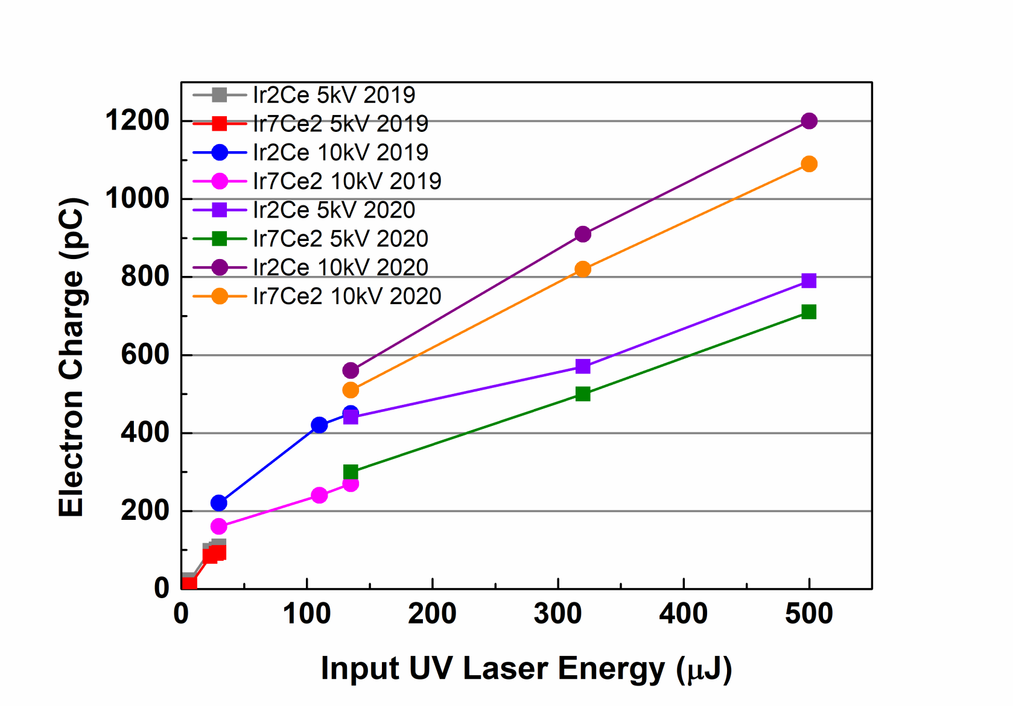
Qe of photocathode (Ir7Ce2, Ir2Ce)
M. Yoshida
e- source
15

Slide 16
Ir7Ce2
2019
16
e- source

Slide 17
Ir2Ce
discharge
VSWR
discharge
VSWR
VSWR
VSWR
VSWR
2019
e- source

Slide 18
Ir7Ce2
One day
2020
e- source

Slide 19
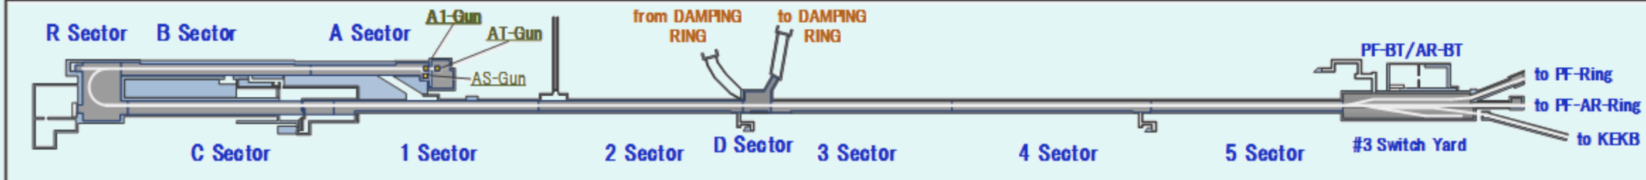
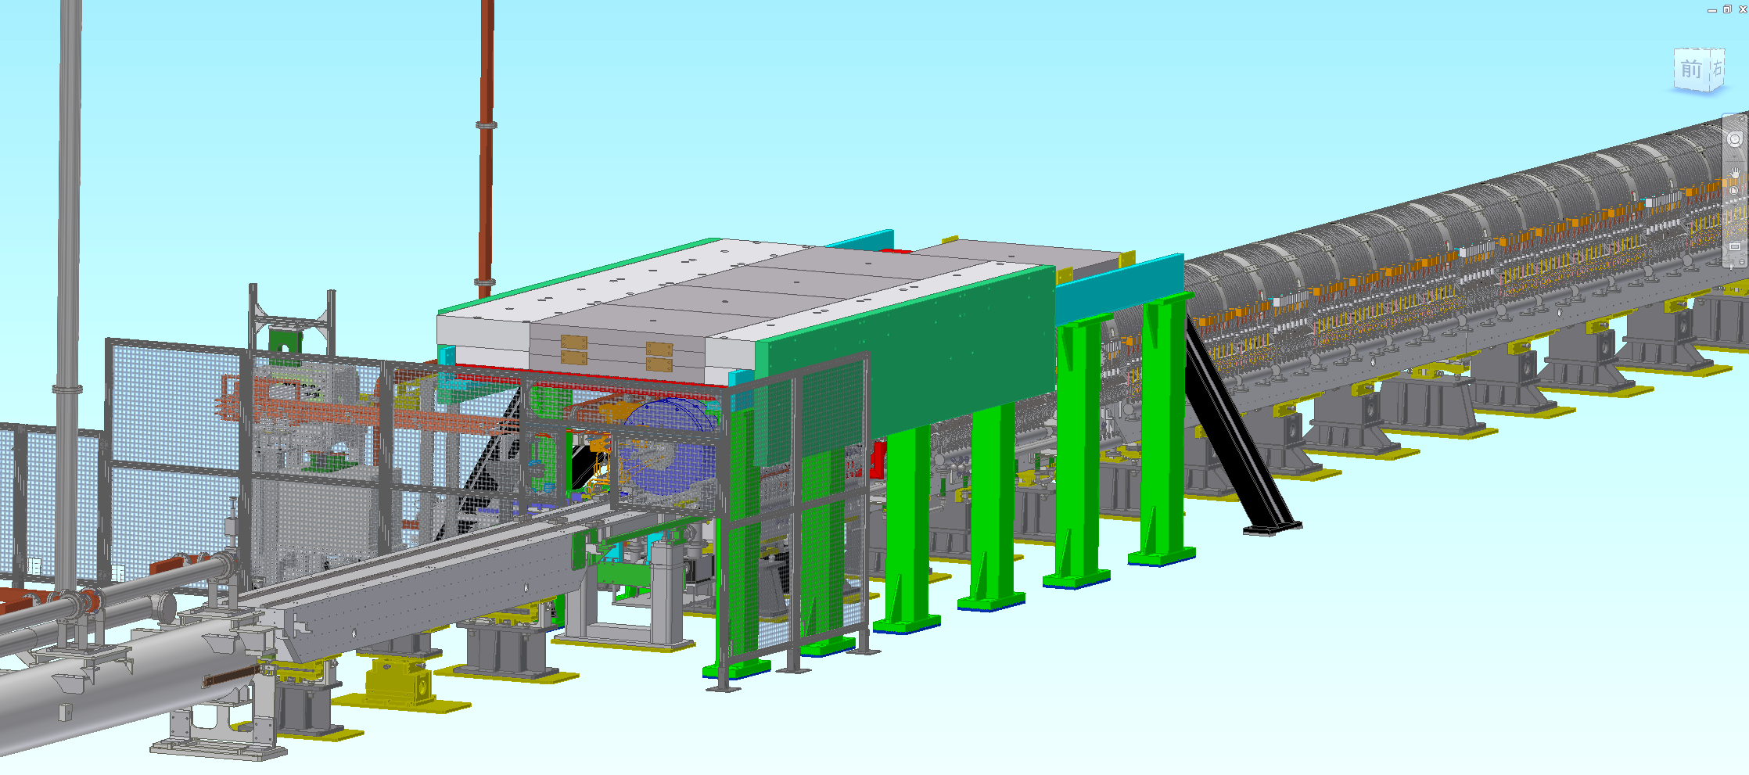
e+ source setup 1
Positron target and capture section
DC solenoid
Large aperture S-band acc. Structures (x10)
W target + flux concentrator (FC)
e+ source
Y. Enomoto, SuperKEKB review, 2019

Slide 20
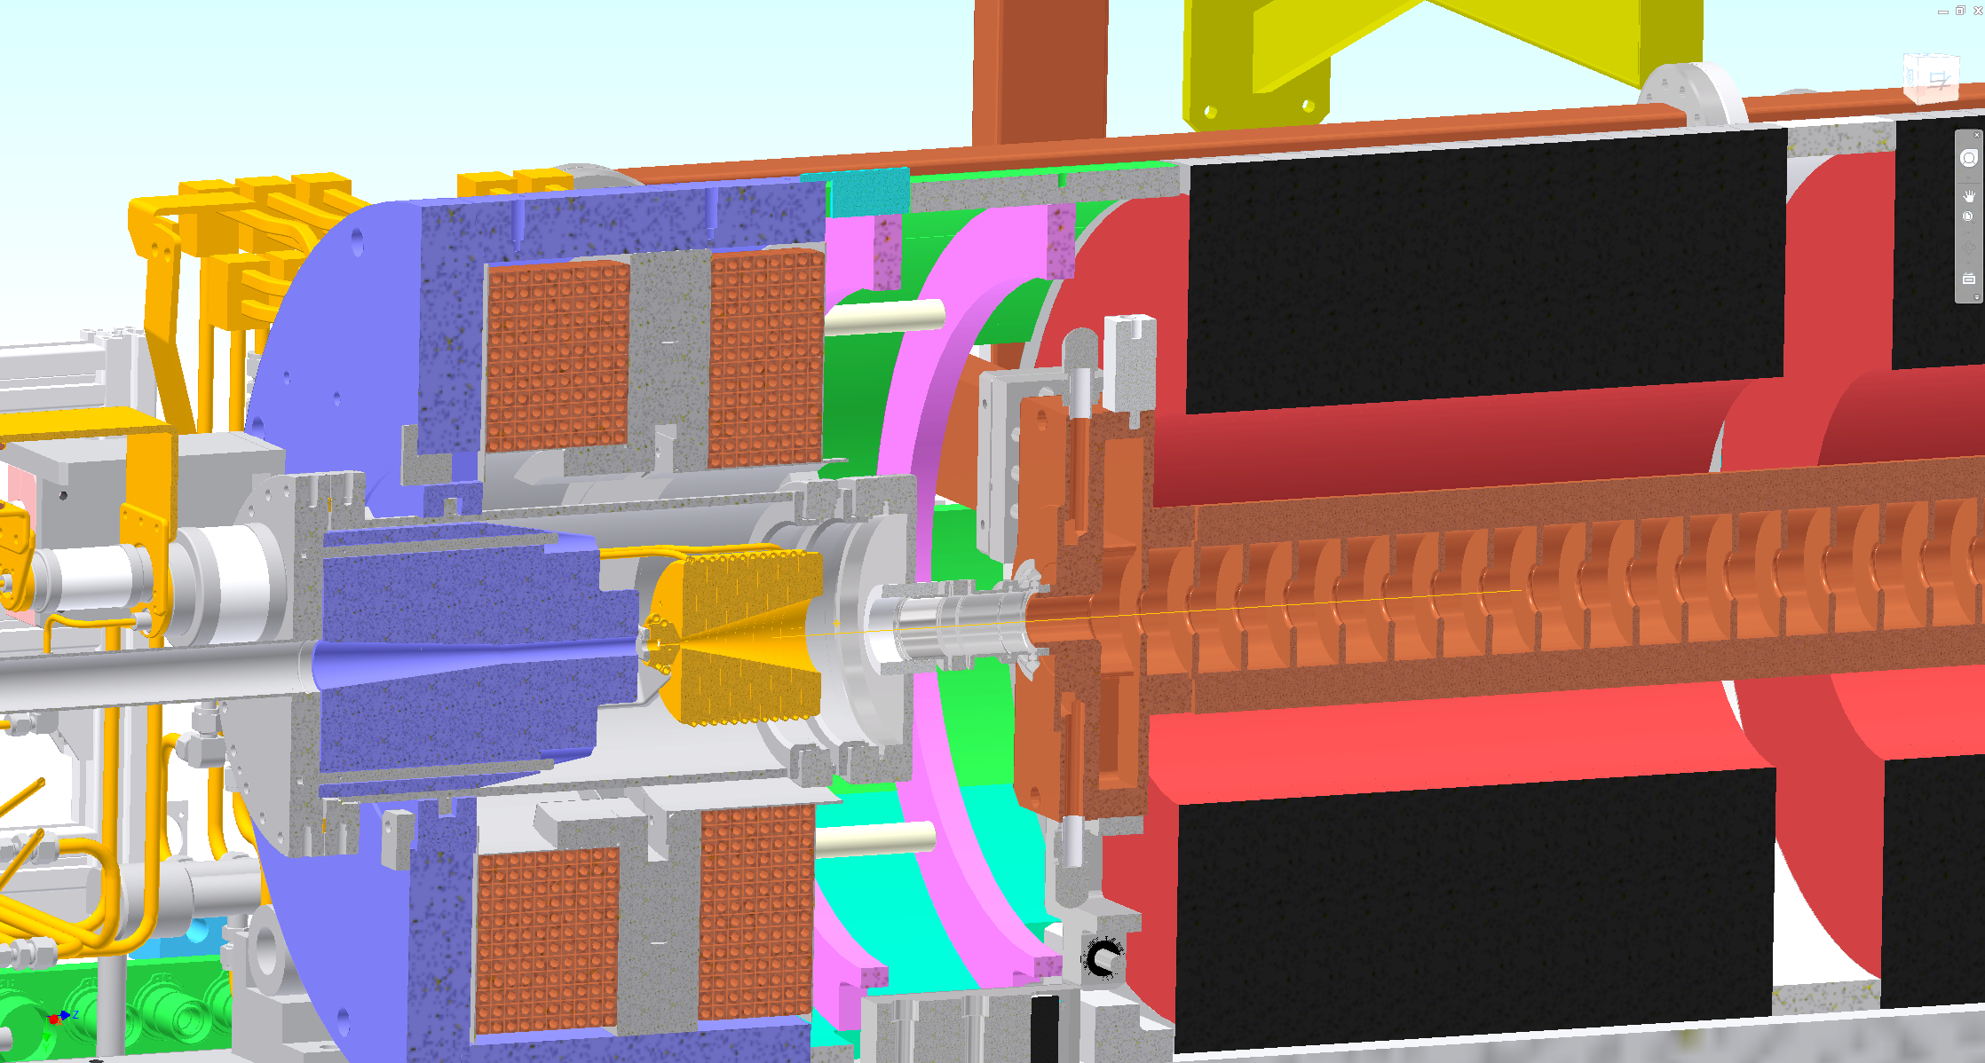
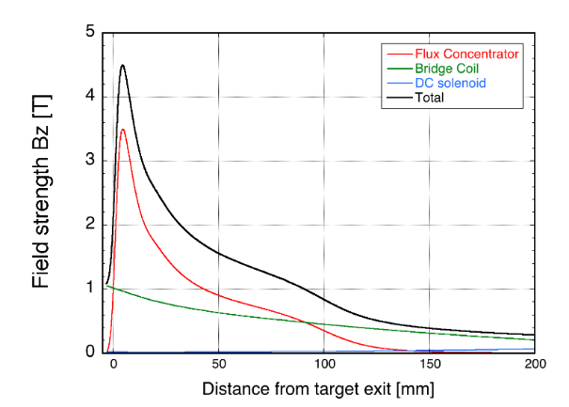
e+ source setup 2
FC head + BC + target = FC assembly
BC (bridge coil)
LAS (large aperture S-band)
target
FC(flux concentrator) head
solenoid
e+ source
Y. Enomoto, SuperKEKB review, 2019

Slide 21
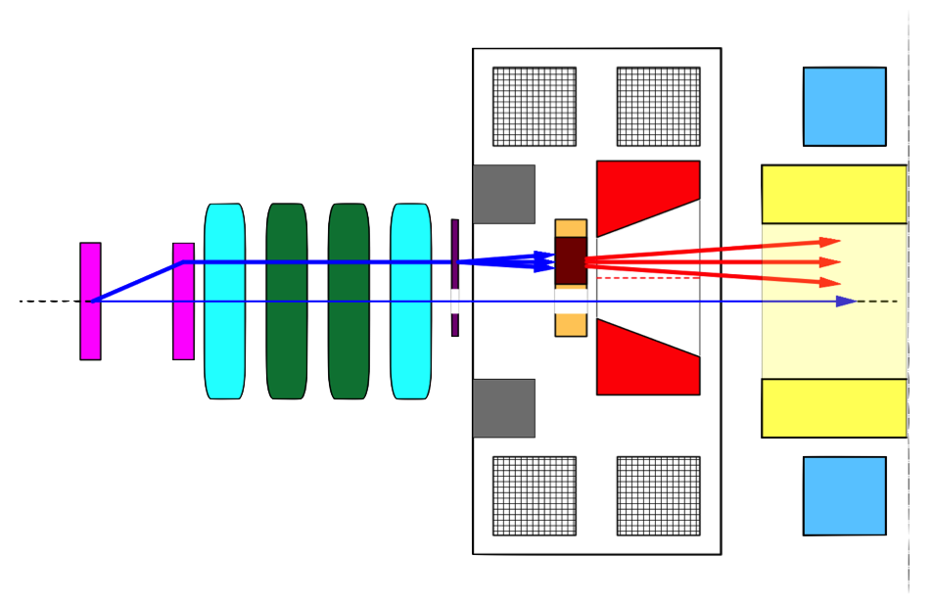
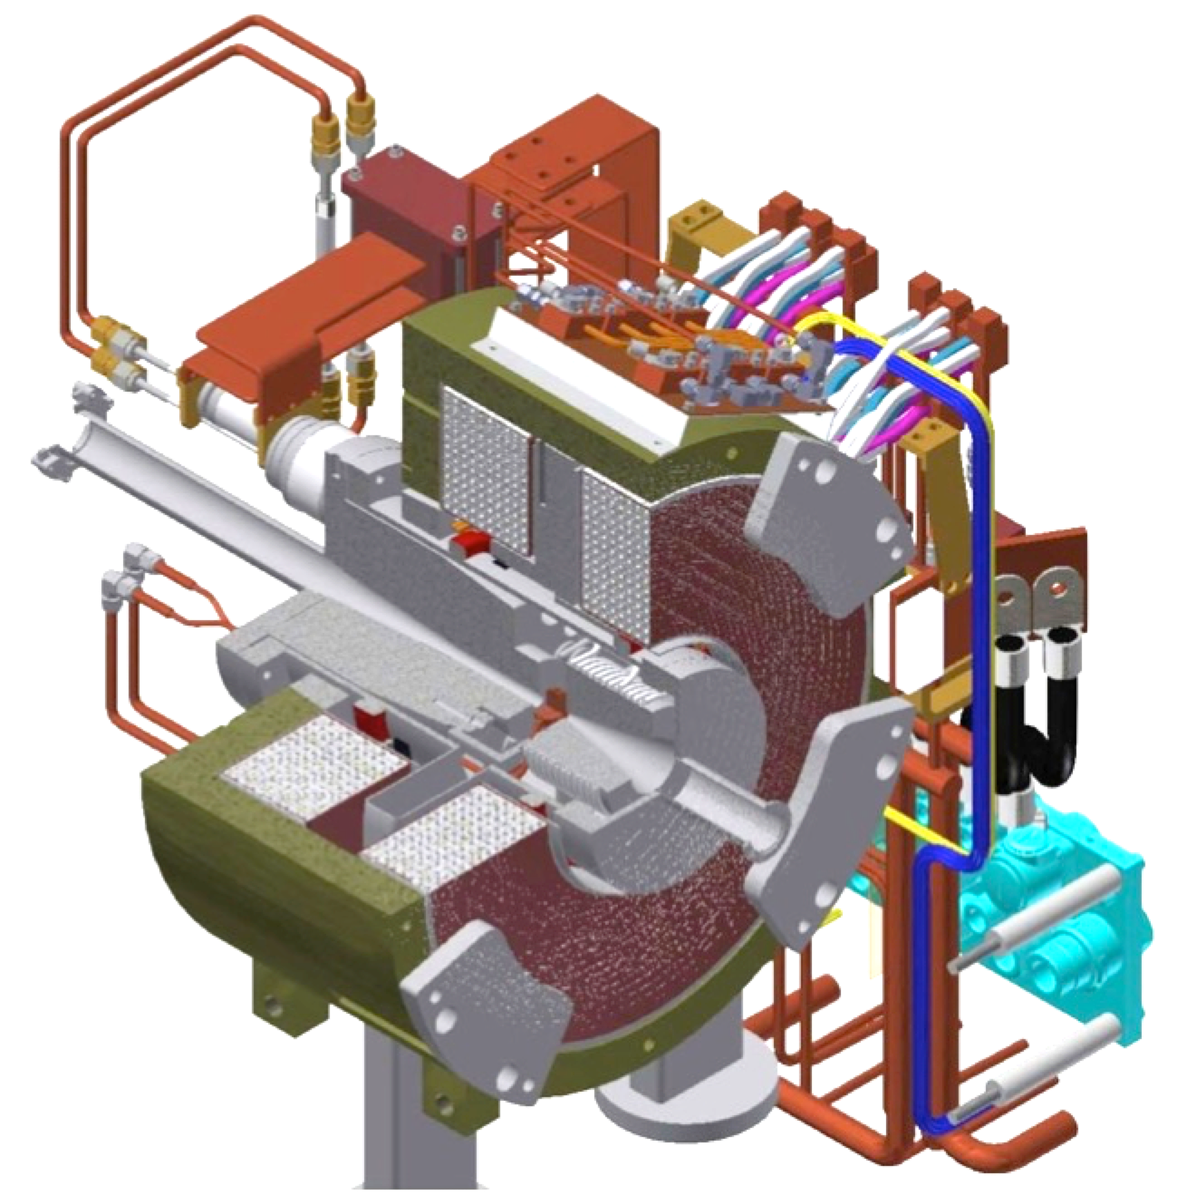
Positron generation for SuperKEKB
Positron Enhancement
Y.Enomoto et al.
bridge coils
solenoid
top view
primary
e- beam
10 nC
primary e-
DC quad
spoiler
LAS Accel.
structure
target
e+
positron
production
Target
beam
hole
4 nC injection e-
Flux
Concentrator
pulsed ST
pulsed quad
Flux
Concentrator
Bridge
Coils
e+ beam
New positron capture section after target with Flux concentrator (FC) and large-aperture S-band structure (LAS)
Satellite bunch (beam loss) elimination with velocity bunching
Pinhole (2mm) for passing low-emittance electrons beside target (3.5mm)
Matching the beam optics for the damping ring injection

Slide 22
e+ beam history in 2019
Primary
e- beam
e+ beam
2019
e+ source
22

Slide 23
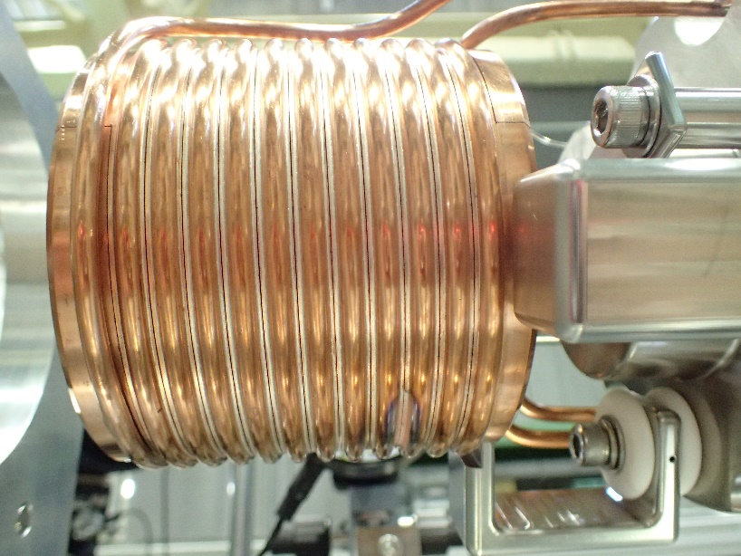
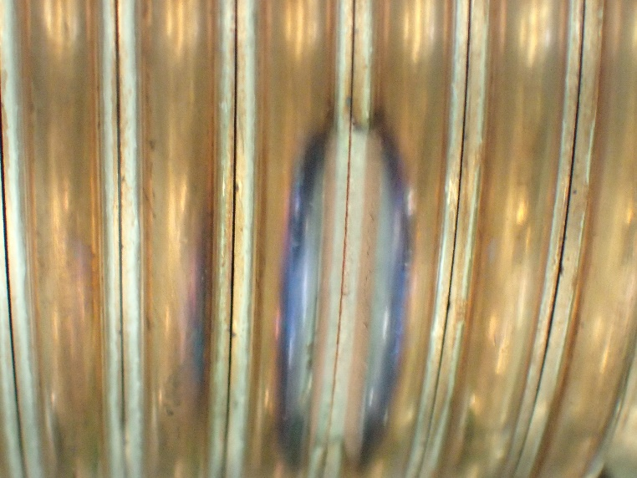
After large discharge…
After large discharge
Slit gap got narrow.
Not possible to apply high voltage unless the gap will be expanded.
Y. Enomoto, SuperKEKB review, 2019
e+ source

Slide 24
LER injection beam status
Bunch charge
Stable and enough bunch charge in this stage
Primary e-: 11 nC (from gun), 9 nC (on W target), e+ : 1.2 nC (linac end), 0.8 nC (BT)
Flux concentrator (FC)
Previous FC was damaged by large discharge during PhaseII. It was removed in Sept. 2018.
Current FC was installed in Jan. 2019.
2 ～ 3 kA operation current (design 12 kA) for stable operation. no significant fault.
New FC made of Cu-alloy (NC50: Cu-Si-Ni) has been tested w/o fault (～ 12 kA).
New FC will be installed in summer shutdown of 2020 for aiming at design operation current.
Requirements for material of the FC head are
Good brazing characteristic
High yield strength even after brazing
High electric and thermal conductivity
e+ source

Slide 25
Accelerator Components

Slide 26
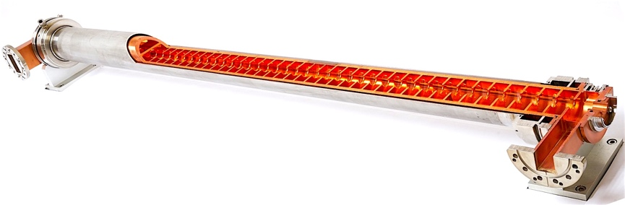
Accelerator Structure
Approx. 230 accelerator structures employed
Many aged (40 years-old) structures are degraded
Risk of 7 GeV / 4 GeV acceleration for Y(4S)
Cannot reach Y(6S)
As a 4-5 year plan, structures are being fabricated since the last year
First tests will be performed at the assembly room
Possibly, a couple of structures would be installed during summer

Slide 27
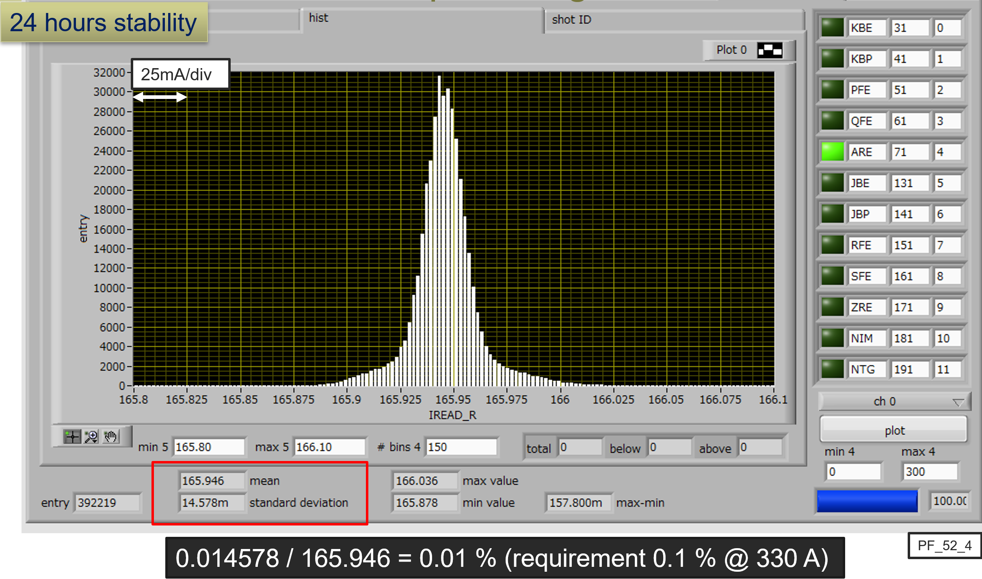
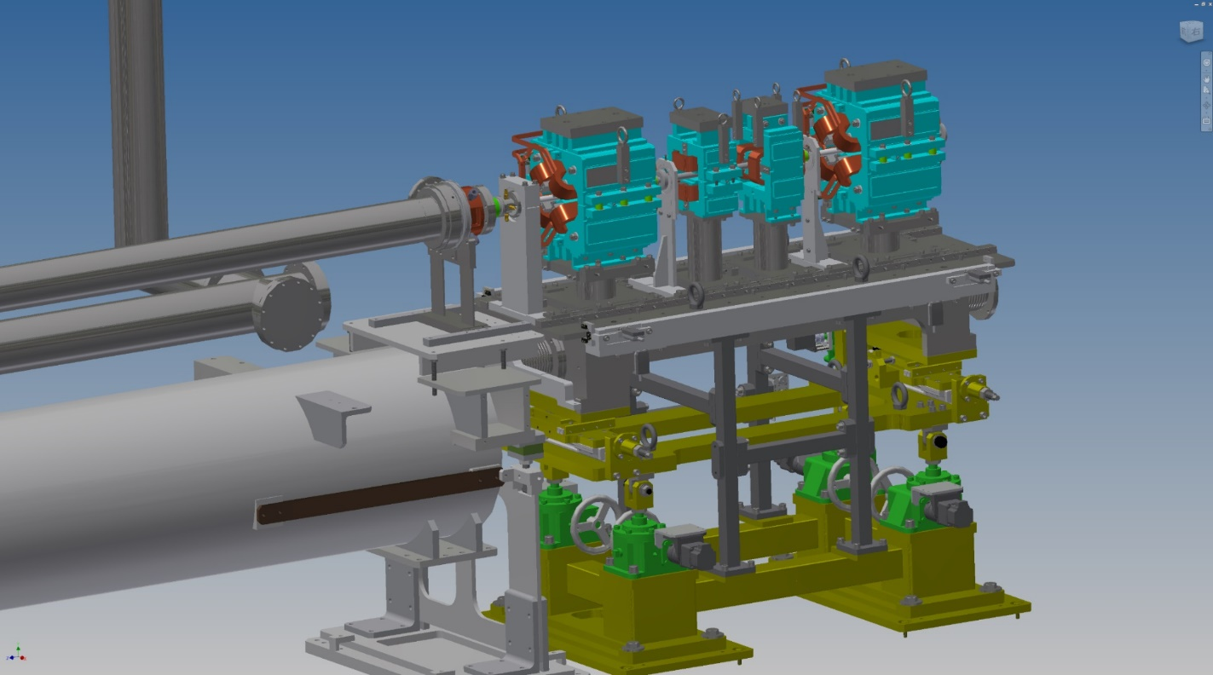
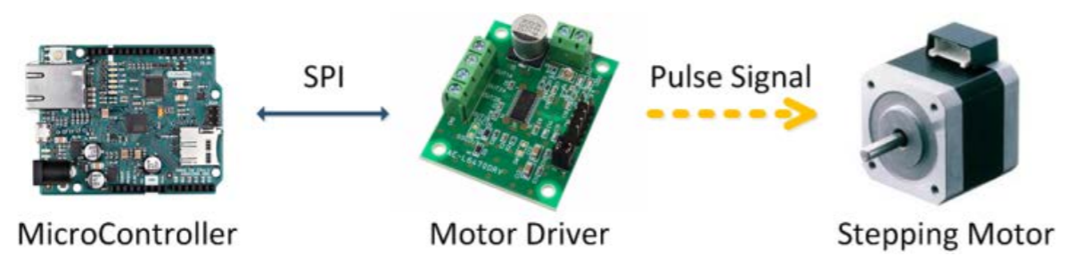
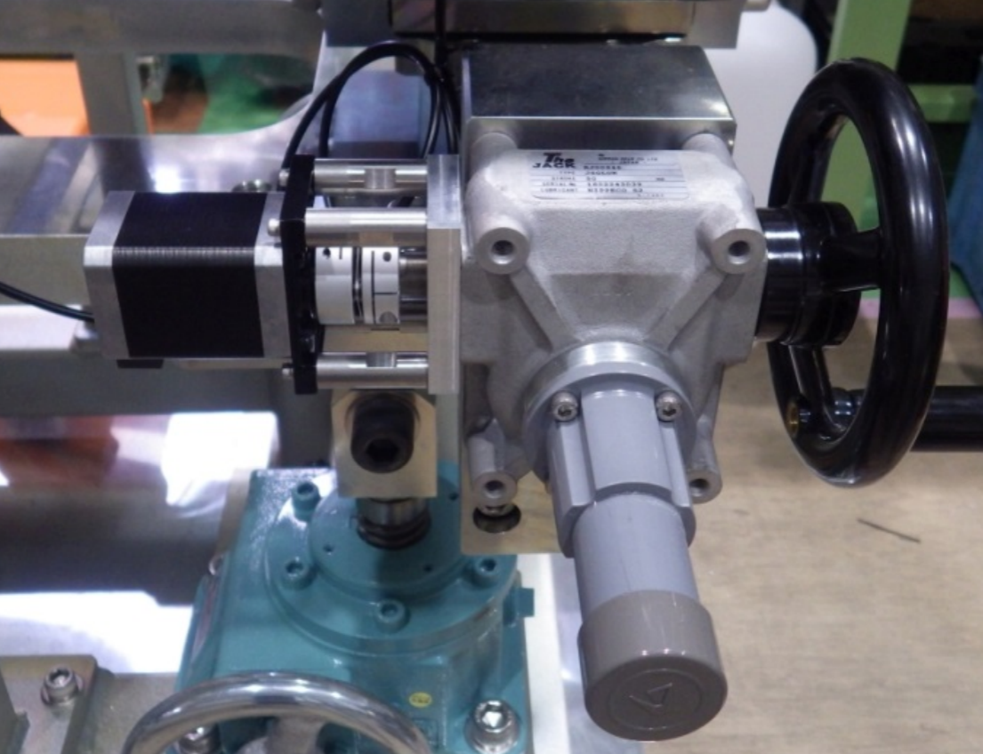
Pulsed magnet system
Pulsed quads (x 28) (w/ ceramic duct) and steering (x 36) were installed at Sector3 to Sector5 in 2017 (on movable girder).
Pulsed bend, additional quad and steering were installed in 2018 summer and winter shutdown.
PXIe based control system (Windows 8.1, LabVIEW, EPICS) have worked fine w/o any serious trouble.
Power supply stability: 0.01% (24 hours)
Pulsed magnet
BPM
Movable girder for pulsed magnet
(remote controllable, 10 μm step)
Subsystems

Slide 28
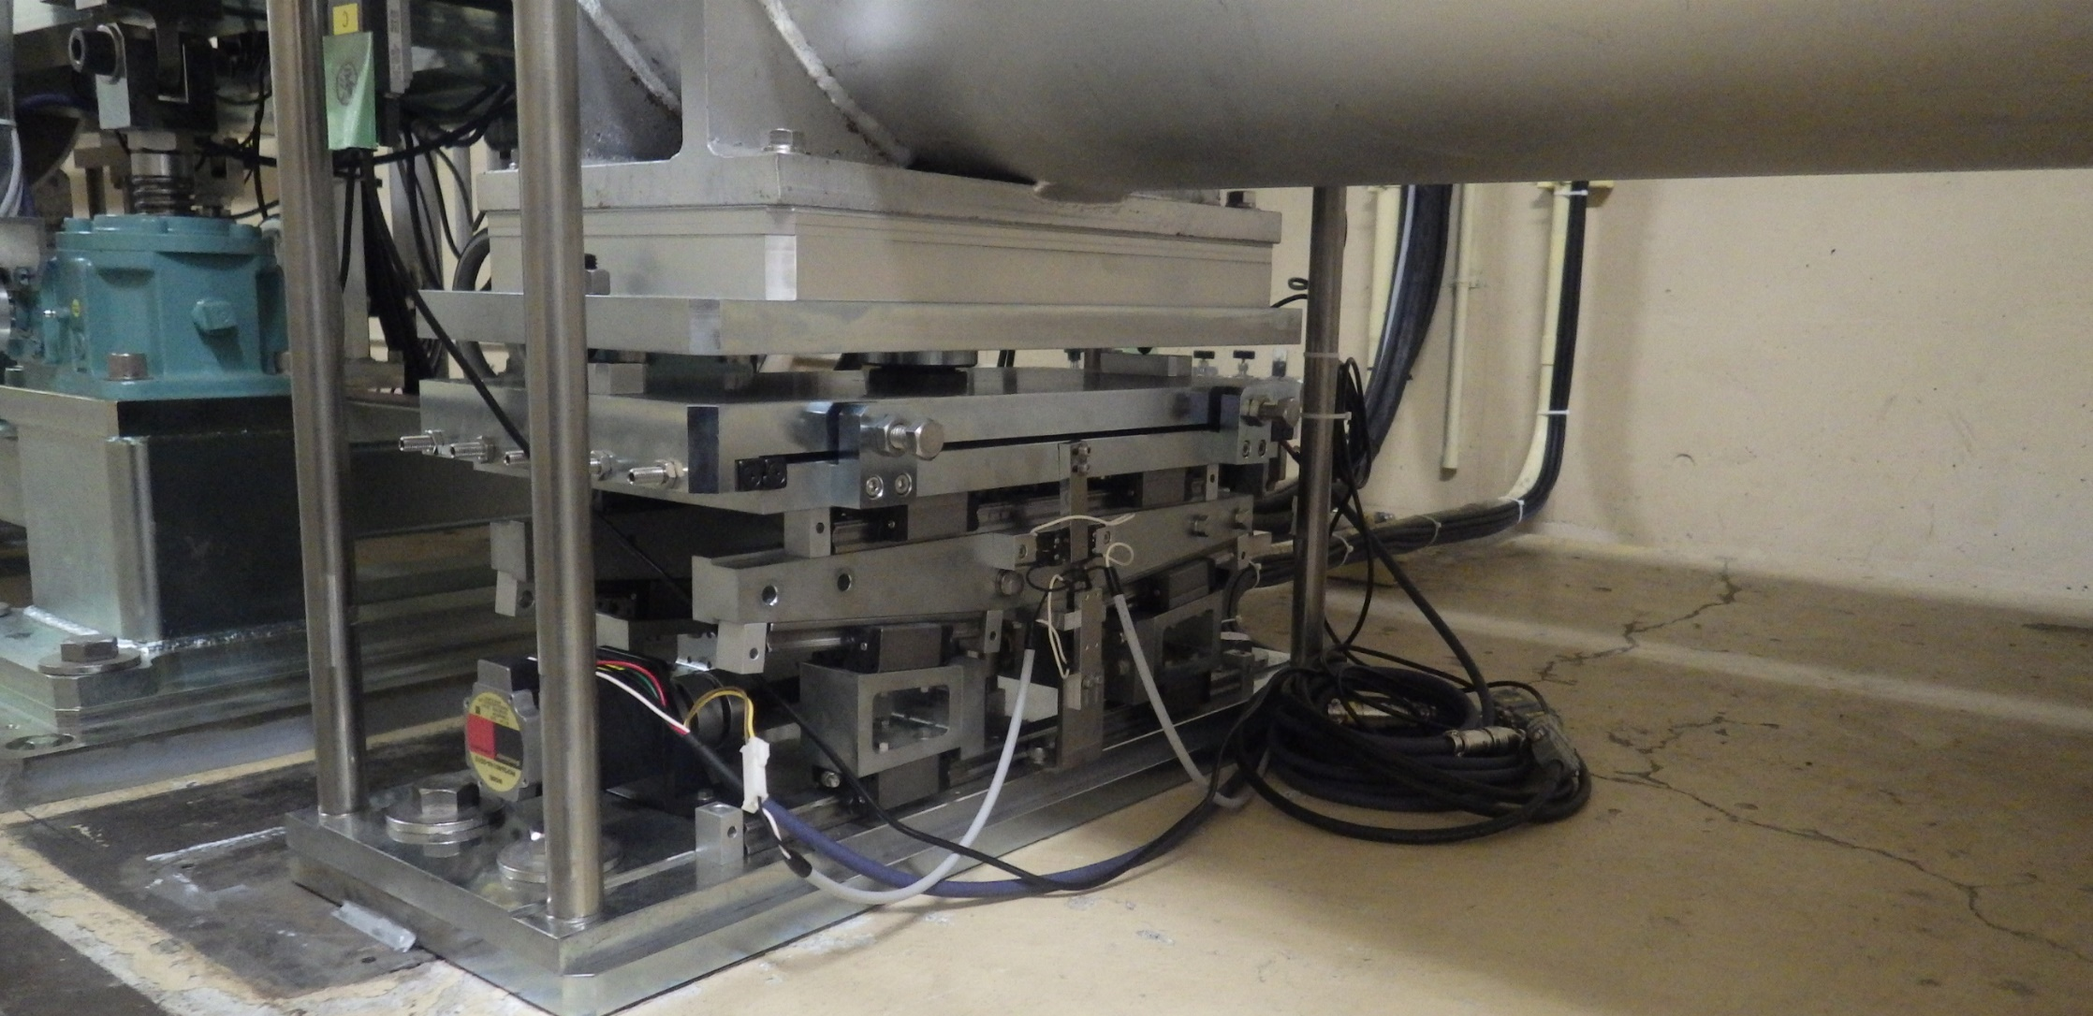
Movable girder for accelerating structure
Six movable girders have been installed in Sector3 (in summer shutdown of 2019).
Four 2-m-long accelerating structures are mounted on one girder.
It could help to suppress emittance growth due to misalignment.
subsystems

Slide 29
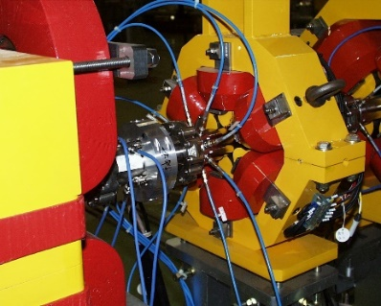
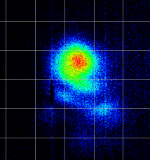
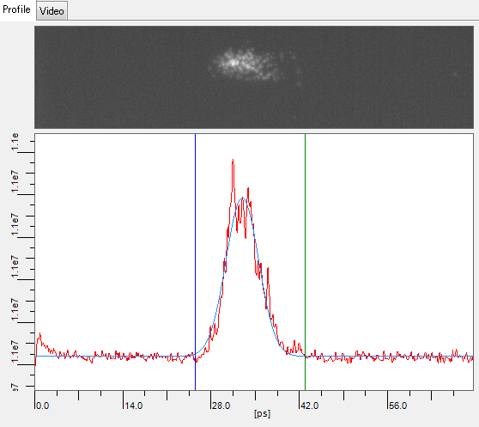
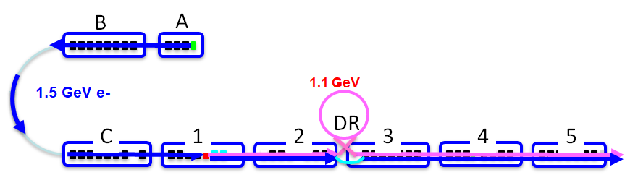
Monitors (1)
Beam position monitor (x 103)
Four strip line electrodes (x 97)
Measurement precision ~ 10 μm
Eight strip line electrodes (x 6) (J-ARC, LTR x2, PF BT, HER BT, LER BT)
Profile monitor (x 104)
Al2O3/CrO3 (AF995R, Demarquest Co.). (t: 1 mm, 0.1 mm), YAG:Ce (t: 0.1 mm)
Wire scanner (WS) (x 6)
SectorA, B, C, 2, 3, 5
Streak camera (ST) (x 2)
SectorA, C, 3
RF monitors for klystron, SLED, acc. structure
ST
WS
WS
WS
WS
WS
WS
ST
ST

Slide 30
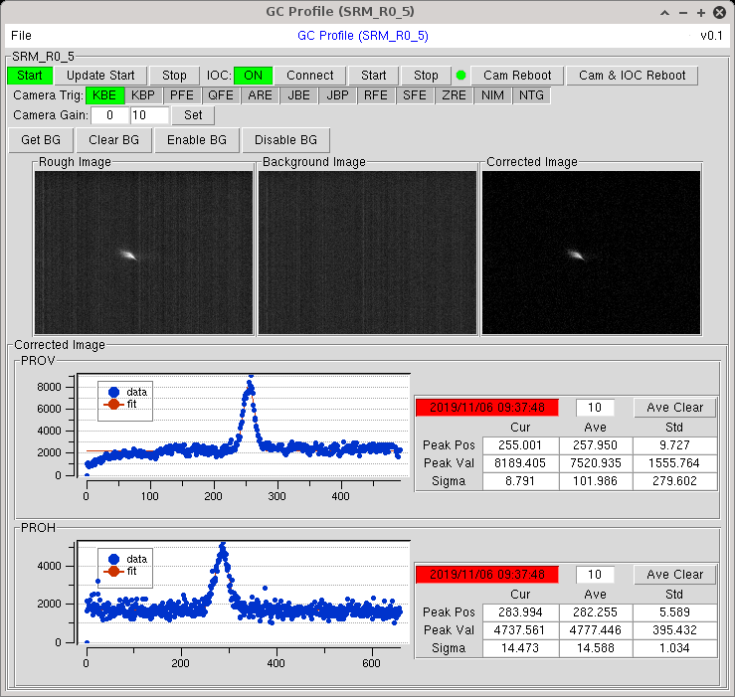
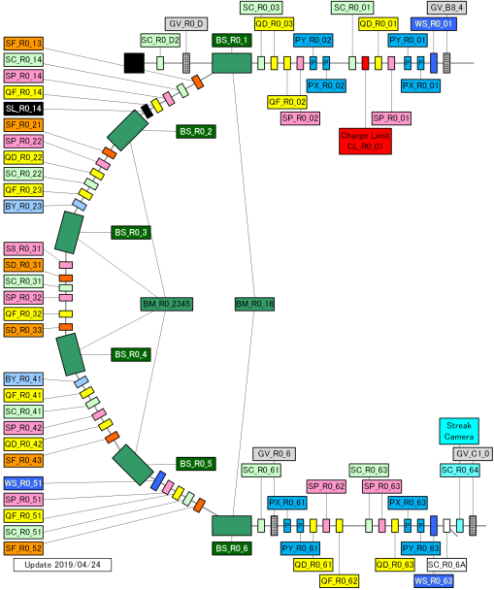
Monitors (2)
SR monitor was installed and tested in early stage of KEKB era (J-ARC and ECS at SY3). Then, they have been obsoleted. SR monitor at J-ARC has been renovated in summer shutdown of 2019.
Nondestructive beam profile monitor w/ triggered camera, and it could be utilized for energy spread feedback (together w/ 8 electrodes BPM).
Additional high resolution profile monitors: C2 (OTR), 58 (YAG)
Background measurement and calibration
8 electrodes BPM
Fitting results
SR monitor
subsystems

Slide 31
Injection Management

Slide 32
Injection BG tuning
+ Stability
No drift
No jitter
+ Injection beam
+ Injection tuning
Emittance
Orbit
Charge
Energy
Energy spread
Bunching
Laser
…
Septum angle
Vertical angle
Energy
Injection phase
kicker height
…
No
BG
Optics correction
(beta, X-Y coupling, dispersion)
Tune
iBumpFB target
IP Knobs
Collimator
Luminosity
…
+ Ring condition

Slide 33
Injection efficiency and background
Injection tuning for squeezing βy*
Open collimators in the MR
Squeeze βy* -> Optics correction
Injection tuning using Turn-by-turn BPMs
Close collimators in the MR
 | LER | HER
Injection efficiency | ・The emittance and energy spread of the injection beam are now good enough for βy*=1.0mm. | Depends on the vertical emittance and the energy spread of the injection beam
Background | ・Mainly comes from stored beam caused by vacuum condition. ・Low enough from injection usually. ・”Spike” and “Duration of injection BG” are most serious problems. | Mainly comes during Injection. Stability of e- beam should be resolved.

Slide 34
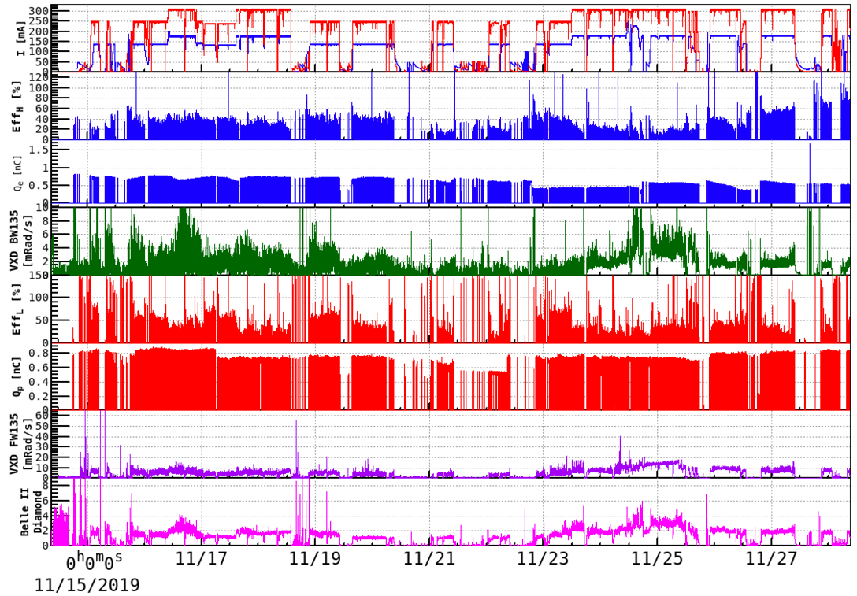
Injection efficiency and background
HER
Phase3.2
2019c(Autumn)
βy*=1.2mm
βy*=1.0mm
Total current
HER, LER
The injection efficiency gradually increased.
Inj. eff. (HER)
Charge for HER
unstable !
The background decreased.
VXD-BW signal
Inj. eff. (LER)
Charge for HER
VXD-FW signal
Belle II
Diamond signal
ZOOM

Slide 35
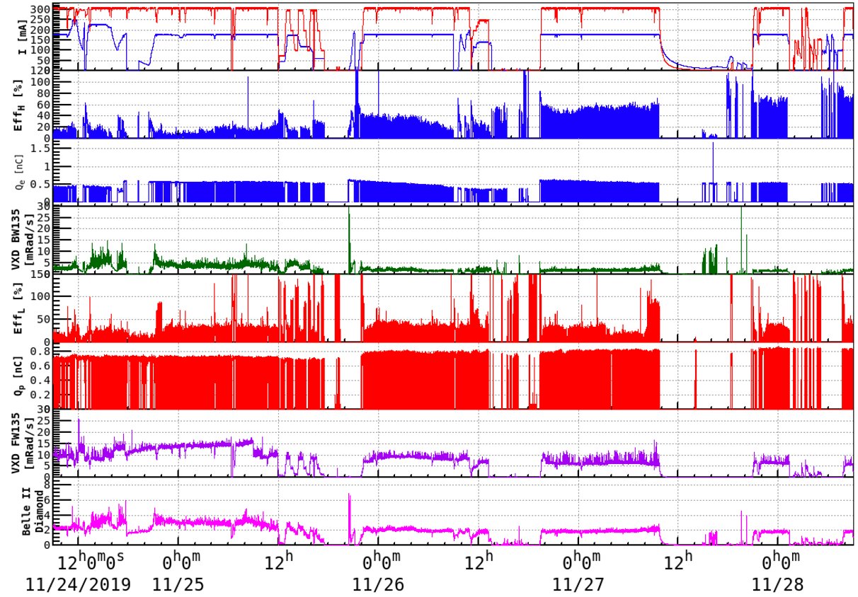
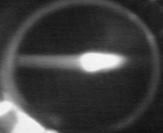
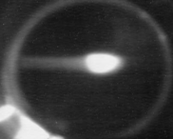
Injection efficiency and background
The injection efficiency increased as emittance decreased by tuning day by day.
Phase3.2
2019c(Autumn)
These efficiencies are calculated at the low current beam in the HER.
→ The effect of Touschek lifetime can be neglected.
βy*=1.0mm
γεy=144±24μm: 40%
γεy=105±14μm: 55%
γεy=83±23μm: 75%
γεy=66±13μm: 100%
Energy spread became better

Slide 36
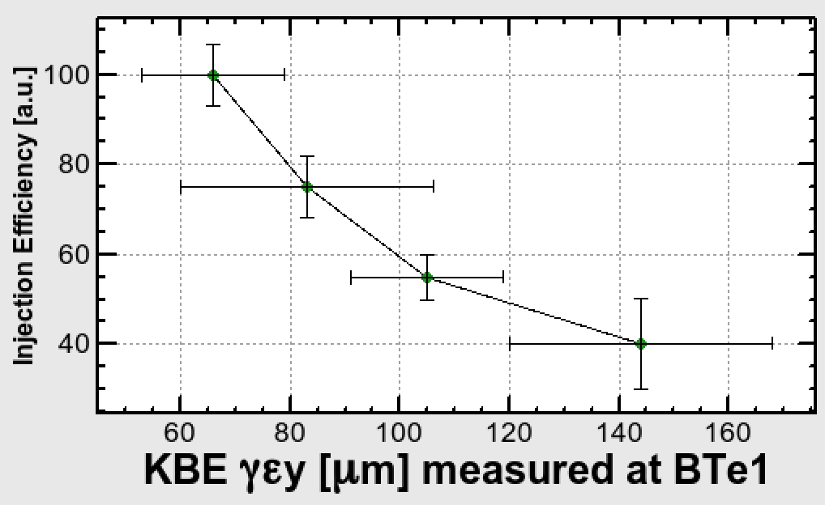
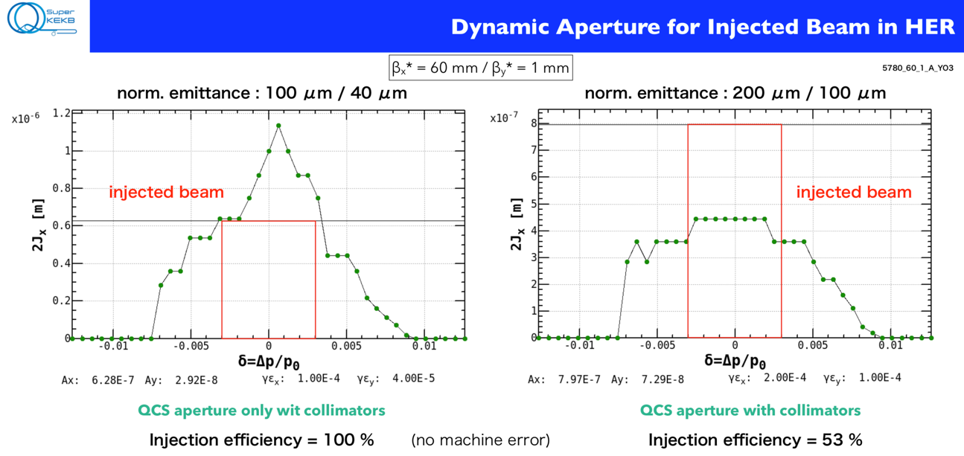
Vertical emittance vs. HER Injection efficiency
Injection efficiency and background
Y. Ohnishi

Slide 37
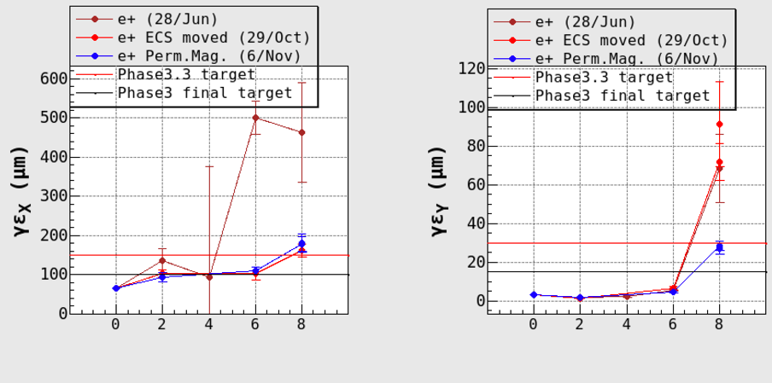
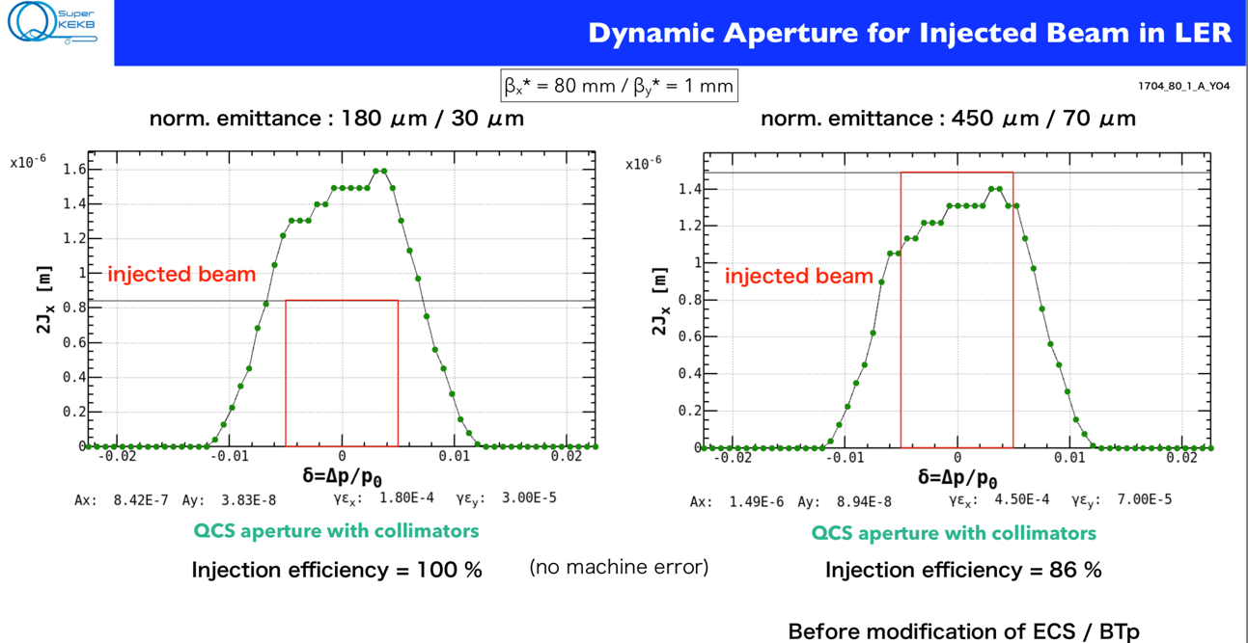
・LER
γεx
[μm]
γεy
[μm]
DR 3 5 BT1 BT2
DR 3 5 BT1 BT2
Y. Ohnishi
Reducing emittance is in time for βy*=1mm
(6/Nov/2019)
(28/Jun/2019)

Slide 38
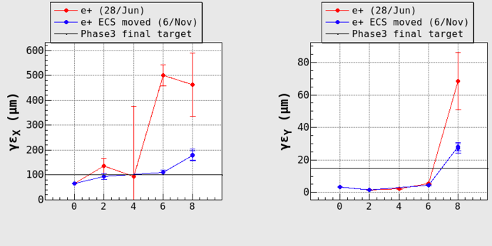
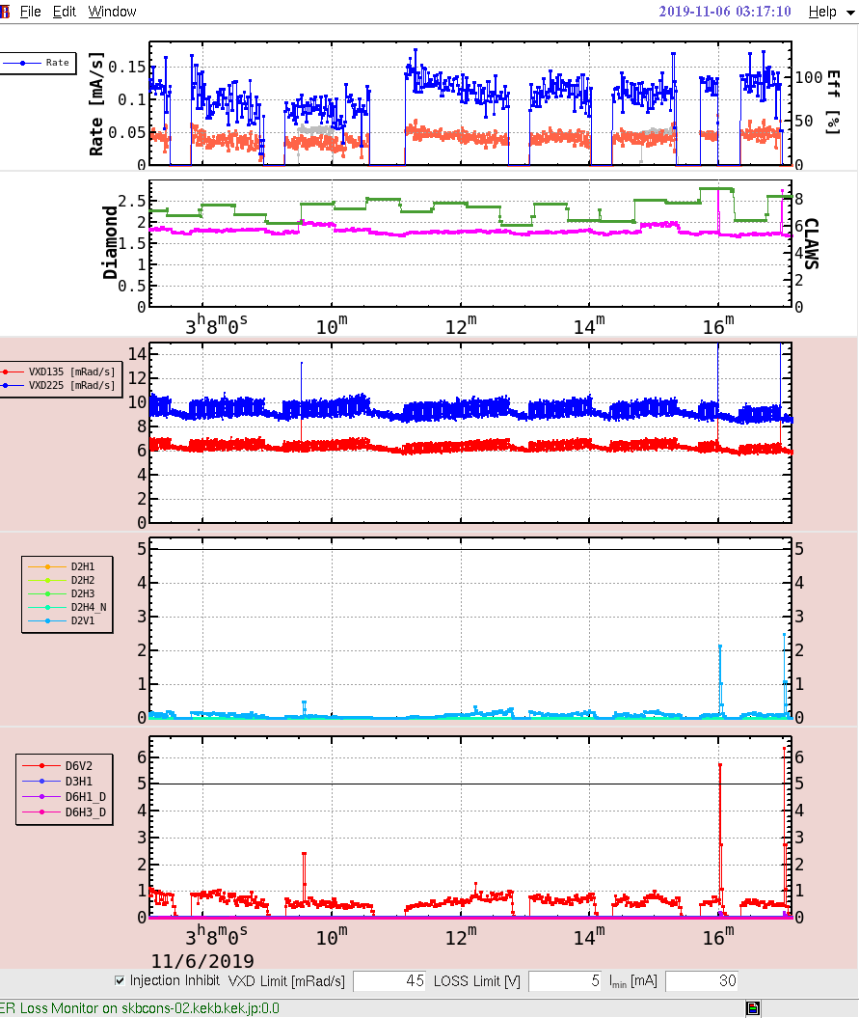

When the vertical emittance was improved
Injection efficiency and background
LER
γεx
[μm]
γεy
[μm]
DR 3 5 BT1 BT2
DR 3 5 BT1 BT2
6.Nov.2019 3:17
6.Nov.2019 18:50
BGs from Vertex detectors
BG due to injection became smaller.
Signals from Loss monitors in the LER

Slide 39
Beam Controls

Slide 40


Feedback loops
Energy feedback (J-ARC, LTR, ECS, BT) loops work fine.
Energy stability at BT line < 0.025%
Orbit feedback at some locations.
Large drift (～ 1 mm) can be corrected
within ~ 0.1 mm w/ feedback.
Energy @ BT
Energy FB
Orbit FB

Slide 41
2. Improvements of emittance growth
Residual dispersion
Dispersion correction
Residual dispersion at the acceleration for compression system
Abnormal skew magnetic field from bends
Emittance growth caused by jitters
Other sources
Wake field in the LINAC
Radiation excitation in the e- BT line

Slide 42





Residual Dispersion Function Correction
Y. Seimiya et al.
Design
Large residual dispersion function was generated at the 180-degree J–ARC, that caused beam instability.
Dispersion correction by tuning the magnetic field of quadrupole magnets made residual dispersion function small enough.
Measured
Measured
After
Before
Dispersion correction

Slide 43






Phase Space Jitter Reduction
Before dispersion correction
After dispersion correction
J-ARC e+ target
J-ARC e+ target
1nC
First figure shows the standard deviation of beam position. Second figure shows emittance growth induced by beam jitter.
Linac end:
28 μm
7 μm
Linac end:
1.8 μm
0.9 μm
Beam phase space jitter is reduced by dispersion correction.
Small emittance growth still occurred from after the target after the correction.
We should understand the source of the beam jitter to prepare for the high charged beam and for accidental jitter source which may occur at upstream.

Slide 44
Beam emittance example (~1 nC) w/ multiple wire scanners
Final target
e-: εx/εy 40/20 μm
e+: εx/εy 100/15 μm
Interim target
e- emittance growth
e-: εx/εy 100/40 μm
e+: εx/εy 180/30 μm
B
A
e+: εx/εy ～100/2 μm
e+: εx/εy ～100/6 μm
1.5 GeV e-
1.1 GeV
BT
#1 straight
DR
C
1
2
3
4
5
e+: εx,y ～ 2500 μm (before DR)
e-: εx,y ～20 μm
e-: εx,y ～ 50～80 μm
e-: εx,y ～ 50～80 μm
e-: εx,y ～10~20 μm
Emittance
Notes:
1 nCでのエミッタンス測定の典型的な例（4台のワイヤースキャナで測定）
Phase3の最終目標は，4 nCで中央下にある値．
1nCであるが，陽電子は，概ね最終目標エミッタンスを満たしている．
電子も1nCであるが，入射器内（5セクタ）では水平方向は50 um程度の場合もある．C～5セクタでのエミッタンス増大は，アライメントの改善と加速管架台ムーバーの導入で改善を図る予定である．
Phase2の時には，BTでエミッタンス増大が見られる（入射器5セクタの2～3倍のエミッタンスになる．100 um が300 um以上になる）問題があったが，BTワイヤスキャナのワイヤ径を200 umから60 umに変更し，データ収集系をCAMACから入射器と同じVMEベースのものに変更したところ，そのような増大が見られなくなった．（詳しい原因は不明ですが，測定系に問題があったと思われます．）

Slide 45


Layout of LINAC, BT, Injection to MR
e+ beam injects into LER via DR:
The injection BG is not affected very much by the condition upstream the DR.
e- beam directly injects into HER:
The injeciton BG is directly affected by the condition of RF-gun LINAC and BT.
Injection Points
LINAC
BT1
Damping Ring (DR)
for positron
Beam Transport line (BT)
HER
primary e- for e+: Therminic Gun
Arc4
e- : RF Gun
ECS
for e+
BT2
SectorB
SectorA
BCS
ECS
Jarc
Sector1
Sector2
Sector3
Sector4
Sector5
Arc2-3
SectorC
LER
e+ target
green: Emittance measured with wire scanners
ECS: Energy Compression System
BT1
Arc1
Arc0
Notes:
The contents of my talk is like these.
First, let me talk about the DR complex shortly.

Slide 46


Layout of LINAC, BT, Injection to MR
LINAC
e- beam directly injects into HER
Damping Ring (DR)
for positron
HER
Injection
Points
primary e- for e+: Therminic Gun
e- : RF Gun
e+ beam injects into LER via DR.
SectorB
SectorA
Jarc
SectorC
Sector1
Sector2
Sector3
Sector4
Sector5
LER
e+ target
Beam Transport line (BT)
MR
Diamond detectors at VXD in Phase3
Many loss monitors are around the MR.
Belle2
HER:
VXD(Diamond) BW135
LER:
VXD(Diamond) FW135
Most sensitive to the BG on Belle2.
LINAC
The signals from the Diamonds and the loss monitors are carefully monitored to keep the BG low.
Some aborts are avoided by stopping injection when the signals are high.
Notes:
The contents of my talk is like these.
First, let me talk about the DR complex shortly.

Slide 47


Measured Emittance
Phase3.3 | e+ | e-
γεx [μm] | 150 | 100
γεy [μm] | 30 | 40
σδ [%] | 0.16(1σ) | 0.1(1σ)
e+ beam (Phase3.2(6.Nov.2019))
γεx
[μm]
γεy
[μm]
DR → Sector 3、
BT1 → BT2、
Emittances increase
→Need study
DR 3 5 BT1 BT2
DR 3 5 BT1 BT2
e- beam (Phase3.2(4.Dec.2019))
C→Sector 3、
BT1→BT2、
Emittances increase
→Need study
γεx
[μm]
γεy
[μm]
B C ３ 5 BT1 BT2
B C ３ 5 BT1 BT2

Slide 48



A) Residual dispersion
Improvements of emittance growth
Dispersion correction
for Example,
Y. Seimiya
J-ARC
Large residual dispersion had been observed at the Jarc before dispersion correction.
By tuning the strength of quadrupole magnets, residual dispersion became small.
Design
m
Thermionic gun
Measured
Before
Measured
After
Dispersion
correction
m
m
Δγβε_{x} = -47 μm
RMS Δη_{x} = 0.43 m
γβε_{x} = 187 ± 27 μm
RMS Δη_{x} = 0.02 m
γβε_{x} = 140 ± 33 μm
(Emittance at the end of LINAC)

Slide 49


A) Residual Dispersion in the BT line
Improvements of emittance growth
Y. Seimiya
Dispersion function correction
The dispersion functions have been corrected for each BT ARC one by one.
Non-negligible residual dispersion is still observed
Straight line
(BT1)
Straight line
(BT2)
Straight line
(BT1)
Straight line
(BT2)
BT for e-
BT for e+

Slide 50







Improvements of emittance growth
Residual dispersion at the acceleration structure for a compression system
When the beam with finite dispersion function is accelerated by RF cavity, ηδ converts to betatron oscillation and causes emittance growth.
ECS: Chicane+Acc
M. Kikuchi
Measured dispersion from ECS at the end of LINAC.
The dispersion is leak at the ECS cavity.
If the cavity has non-zero dispersion, a beam, gaining its energy depending on z, has net growth in the projected-emittance.
This is an analogue of the synchro-beta excitation at the cavity with non-zero dispersion in the ring.
Simulation result:

Slide 51


Improvements of emittance growth
Residual dispersion at the acceleration structure for a compression system (cont’d)
The bending magnets used in ECS/SY3 have quadrupole components.
The beam feels B’ field passing through the design orbit in the bends, which makes dispersion leakage.
By moving the bends about 10mm, the beam pass the area of small B’.
This can explain the measured dispersion leak
T. Mori
Magnetic field measurement
T. Kamitani, H. Kakihara, T. Oogoe
design orbit
~10 mm
-10mm
Bends were moved during sumer
BL along the horizontal direction

Slide 52



Improvements of emittance growth
ηx = 0.50 m @Acc.
ηx = 0.15 m @Acc.
ECS
ECS
Y. Seimiya
DIfference from design dispersion
The horizontal dispersion has been improved by moving ECS bends.
1nC
γεx
[μm]
γεy
[μm]
LERの要求値
DR 3 5 BT1 BT2
DR 3 5 BT1 BT2
Still a large vertical emittance remained

Slide 53
2. Improvements of emittance growth
Residual dispersion
Dispersion correction
Residual dispersion at the acceleration for compression system
Abnormal skew magnetic field from bends
Emittance growth caused by jitters
Other sources
Wake field in the LINAC
Radiation excitation in the e- BT line

Slide 54
B) Abnormal skew magnetic field from bends
Improvements of emittance growth
BT1
LINAC
e+
Slope1
Y. Seimiya
BTpositron
３rd Arc
LER
ηx
dispersions
(Measured)
BT2
e+
ηy
Slope2
dispersions
(Measured-Design)
Δηx
Δηy

Slide 55



Simulation
Improvements of emittance growth
Since the energy of the e+ beam increased to 4 GeV from 3.5GeV of the old KEKB, the gap of bend narrowed asymmetry, which created an abnormal skew component in the bend.
However, this can only explain about one third of the measured skew quad component of the beam.
Anyway, try to correct.
M. Kikuchi
It is considered that the vertical dispersion could be corrected with the skew quads with permanent magnets.
e+ beam
~1 kgauss
Measured vertical dispersion before SkewQ
Calculated vertical dispersion by the skew quads which are installed.
Good agreement !

Slide 56


2. Improvements of emittance growth

Slide 57



Improvements of emittance growth
11 of 16 Skew Quads with permanent magnets were installed.

Slide 58


Measured Dispersion
Improvements of emittance growth
Y. Seimiya
① Before installation of skew quads
② After installation of skew quads
γεx
[μm]
γεy
[μm]
DR 3 5 BT1 BT2
DR 3 5 BT1 BT2
Remaining SkewQuads will further improve the vertical emittance.

Slide 59
2. Improvements of emittance growth
Residual dispersion
Dispersion correction
Residual dispersion at the acceleration for compression system
Abnormal skew magnetic field from bends
Emittance growth caused by jitters
Jitter emittance from energy jitter
Jitter from hardware components
Other sources
Wake field in the LINAC
Radiation excitation in the e- BT line

Slide 60



C) Emittance growth caused by Jitter (Jitter emittance)
2. Improvements of emittance growth
We focus on dispersion which convert to orbit jitter through energy jitter.
By dispersion correction, jitter emittance become less than 1 μm.
J-ARC
e+ target
e+ target
Y. Seimiya
e- beam
J-ARC
Before
After
Measured
Dispersion
Linac end:
28/7 μm
(Hor./Ver.)
Dispersion
Correction
Linac end:
γβε_{j} < 1 μm
Measured
Jitter emittance

Slide 61






C) Emittance growth caused by Jitter
2. Improvements of emittance growth
Y. Seimiya
Electron beam straightly pass through the positron generation target hole, whose diameter is 2 mm.
We suspected wakefield effect as a orbit jitter source.
e-
e+
14 mm
e-
φ2 mm
wake potential induced by target hole (simulation)
Color differences show differences of distance between center of hole and beam position.
From the beam position before and after target, amplification factor are derived.
Comparison of orbit jitter
Target IN
Target OUT
Growth factor〜20
LINAC end
Growth factor of beam phase space jitter:
< 0.1@1nC << Measured growth factor
Wakefield effect of target hole is negligibly small.

Slide 62




C) Emittance growth caused by Jitter
2. Improvements of emittance growth
Remain orbit jitter can be explained by β function.
Using Twiss parameters measured by WS at sector C, β function near target is derived.
β function is highly correlated with orbit jitter.
We conclude that large orbit jitter sources are mainly both residual dispersion and β function.
Y. Seimiya
e+ Target

Slide 63







Other Sources of Jitter
2. Improvements of emittance growth
Y. Seimiya
following items were sometimes sources of jitter. Pulsed magnet and RF phase jitter was almost resolved by person in charge.
To identify the jitter source, monitoring beam jitter is important.
Binarization of Pulsed magnet
Three valued RF phase
Large RF phase jitter cause orbit jitter.
x’ [mrad]
x [mm]
Slope of RF phase
Degree@KL_B3
Degree@KL_C8
Δp/p=0.042%
Δp/p=0.027%
Near zero cross phase
Near crest phase
If RF phase is near zero cross, energy jitter is enlarged by the slope of phase.

Slide 64
2. Improvements of emittance growth
Residual dispersion
Dispersion correction
Residual dispersion at the acceleration for compression system
Abnormal skew magnetic field from bends
Emittance growth caused by jitters
Other sources
Wake field in the LINAC
Radiation excitation in the e- BT line

Slide 65


Wakefield in Acceleration Structure
Y. Seimiya
Using a steering magnet, we searched an orbit so as to minimize emittance.
Emittance highly depends on beam charge and orbit.
Wake free steering will be performed using RF gun in the next run.
Thermionic gun
1nC
4nC
Notes:
昔のnC変えた時の図を貼る

Slide 66



Emittance growth induced by radiation excitation in BTe
Y. Seimiya
Theoretical emittance growth induced by radiation excitation:
∝ γ⁵, 1/ρ³
BT2
BT2
Particle tracking simulation was performed from the end of LINAC to the end of BT.
Simulation | Initial particles | With Radiation | Phase-III final requirement
e- (7 GeV) γβε_{x} [μm] | 20 | 65 | 40
e+ (4 GeV) γβε_{x} [μm] | 64 | 74 | 100
BT1
-> The maximum emittance can be relaxed.
Now in re-considering
M. Kikuchi
Simulation Result
Radiation excitation has little dependence on initial emittance.
By the radiation excitation, emittance growth of e-/e+ beam is about 48/10 μm.
The beam size at the injection septum is 0.31 mm, assuming βx = 20 m. The required injection aperture is still dominated by the septum width of 2.5 mm. Although the emittance growth due to synchrotron radiation is very big, it plays only a minor role on the injection aperture itself.
γεx = 65 μm
e- beam
γεx = 20 μm
Notes:
Last item is emittance growth induced by radiation excitation in BT for e-.
Theoretical emittance growth induced by radiation excitation is described this equation
and depend on Lorenz gamma to the fifth and inverse of curvature radius to the third.
Particle tracking was performed from the end of LINAC to the end of BT by Ms. Iida.
Initial horizontal emittance of e- and e+ beam have 20 and 64 μm, respectively.
These emittances are increased by radiation excitation and reach 68 and 74 micron.
Especially, electron beam emittance at the end of BT is larger than Phase-III requirement.
Even if the emittance preservation is perfect in the LINAC, emittance growth by radiation excitation
is larger than Phase-III final requirement for the e- beam.
We seek a solution of this problem now.
One possible way is that other tunnel (AR line) is used as electron beam line,
which has smaller ρ than that of current beam line.

Slide 67
3. Feedback systems
for stability,
are working now.
Orbit feedback
In front of,
Jarc, e+ target, Branch to DR, BT, Injection
Energy feedback
In front of ,
Jarc, Branch to DR, BT
RF phase
Master Oscillator feedback between LINAC and MR
RF phase(partly prepared)
We need more
Energy spread feedback (using OctoPos-BPM)
lazer position on the cathode(preparing)
…

Slide 68
Beam abort caused by abnormal injection beam
Abnormal energy beam
Spike and injection beam

Slide 69


Beam abort caused by abnormal injection beam
A) Lower or Higher energy injection beam
Operation log for SuperKEKB
Energy jump
Additonal information from LINAC

Slide 70


Fast beam position monitor(BPM) in LINAC
Beam abort caused by abnormal injection beam
Injection beam just before abort can be monitored by,
Y. Seimiya, F. Miyahara
1.Jun.2019 19:56
LER D6V2 LM abort
1.Jun.2019 21:19
LER D6V2 LM abort
Beam energy was 50 MeV lower.
No energy deviation
Orbit deviation
Dispersive point
Straight line
Dispersive point
Straight line
One station for the power supplies(PS) was set to 0 [A] due to a trigger missing of the PS.
The klystron 51 was down at the time.
The estimation was -46.5 MeV which is consistent with the beam position.

Slide 71




Simulations
Beam abort caused by abnormal injection beam
In the both cases, the beams had been injected into the LER.
Y. Seimiya
1.Jun.2019 19:56
1.Jun.2019 21:19
BT line
BT line
The collimators(CHP, CVP) in the BT could cut the beams with the abnormal orbits.
The lower energy beam(δ=-1%) can not be cut in the BT(Energy aperture is ±0.5%) due to the Energy Compression System(ECS) at the end of the LINAC. We have to install one more collimator, which is under planning.
In HER, the collimator for protecting the lower energy beam will be also prepared in this summer.

Slide 72







Lower energy beam through the ECS
Beam abort caused by abnormal injection beam
The longitudinal phase space
R56=0.9
Exit of ECS acc. structure
LINAC end
Exit of the chicane
ΔE=０
δ
dz
ΔE=-50MeV
(δ=-1.25%)
BT
LER
Since the ECS restores the beam energy, the beam can inject while being shifted in the time direction, which could cause a LER abort.

Slide 73



LER Abort caused by injection beam with higher energy
4. Beam abort caused by abnormal injection beam
Phase and HV of KL_51 abnormally changed,
which made 1％ higher beam energy.
It also could inject into LER via ECS.
25.Nov.2019 16:14

Slide 74
B) Spike and Injection beam
4. Beam abort caused by abnormal injection beam
Still mystery
Injection beams sometimes have some correlation.
more detailed investigation is needed.
Tunes in LER are also related.
In smaller βy*, the spikes increased.

Slide 75





Spike and Injection beam
4. Beam abort caused by abnormal injection beam
2019-6-30, βy*=2mm
Many spikes were observed.
Injection beam were not the cause in these 4 samples.
18:03
18:16
18:21
18:24

Slide 76




2019-11-04 , βy*=1mm
Beam abort caused by abnormal injection beam
Many spikes are observed.
Only one seems to be related to the LINAC orbit.

Slide 77




2019-11-05 , βy*=1mm
4. Beam abort caused by abnormal injection beam
… A few spikes look like to be caused by Injection.
More detail check is needed.

Slide 78

5. 2 bunch Injection trial at the last 2 days of autumn run
The charges of injection were not enough for single bunch especially for HER.
2 bunch injections were tried for both rings.
Total current
HER, LER
Inj. eff. (HER)
Charge for HER
VXD-BW signal
Inj. eff. (LER)
Charge for HER
VXD-FW signal
Belle II
Diamond signal
The BG was high, so we switched back to the single bunch, but it wasn’t only due to 2bunch.
→ After that, BG was improved by LER X-Y coupling correction

Slide 79
5. 2 bunch Injection
LER 2 bunch
Detail tunings for 2 bunch operation are scheduled in the next February.
BT1ｐ | #1 / 2 bunch op. | #1 / 1 bunch op.
γεx [μm] | 198.6±10.7 | 168.0±25.5
γεy [μm] | 12.4±2.4 | 12.6±1.5
1+2 bunch @11.5Hz
1 bunch @11.5Hz

Slide 80
Summary
Fire recovery, simultaneous top-up injections, RF-gun deployment, went well
Beam sources and other subsystems are gradually upgraded
Beam controls are being improved based on injection observations
Further beam studies are indispensable balancing the resources and requirements in SuperKEKB complex

Slide 81

Mt. Tsukuba
Thank you
SuperKEKB
dual rings
PF-AR
PF
Linac

Slide 83
Summary and plan
Beam operation status
Achievement of stable simultaneous top up injection to 4 storage rings (HER, LER, PF, and PF-AR) w/ thermionic gun, rf gun, pulsed magnets.
Energy feedback, orbit feedback loops, dispersion correction, and other operation tools are working fine.
Pulsed magnets work fine. Pulsed bends will be replaced by new ones to solve heating issues (50 Hz operation) in summer of 2020.
e- beam
HER injection has been done w/ only rf gun from Phase III day 1.
Laser system has no significant fault.
Photocathode: Ir7Ce2 => Ir2Ce (summer of 2019) for higher Qe, however, bunch charge gradually decreased.
In this winter shutdown: back to Ir7Ce2 photocathode
Better vacuum for rf gun improvement in summer of 2020.

Slide 84
Summary and plan (cont’d)
e+ beam
Flux concentrator has no significant fault.
New flux concentrator will be installed for higher e+ bunch charge.
Injection background, emittance issues
Iida san’s talk
e+ beam emittance growth in BT was much improved in the 2019 autumn run. (ECS magnets at linac end were realigned in summer of 2019)
Low emittance beam w/ high bunch charge
e- beam emittance growth in Sector2: Steering magnets and BPMs will be installed in e+ capture section (solenoid section).
Alignment, movable girder of acc. structure and pulsed magnets.
Precise orbit control, wake field free steering, other beam handling methods.
Reproducibility of emittance and other beam quality

Slide 85
6. Summary and Future plan
Emittance
e- beam
The emittance just after the RF gun is OK.
Investigate emittance growth in the LINAC and BT
e+ beam
Almost done for Phase3.3.
Further studies will be done for the final emittance and charge.
Stability
e- beam
To be resoled. -> Satoh-san’s talk
( e- damping ring ? )
e+ beam
Very stable thanks to the DR.
Additional collimators will be installed for cut the abnormal energy beams.
Monitors
Orbit feedback
Higher accuracy BPMs synchronized with LINAC shot by shot events in BT will be prepared in a near future.
Energy spread monitor
For energy spread feedback, non-destructive beam profile monitors (OctoPos BPM) will be available soon.
Digitization of energy spread with OTR, etc, will be prepared.
Bunching
Diagnostic lines are under consideration.

Slide 86
Backup slides

Slide 87



1. Injection efficiency and background
HER
QCS Quench &
e- beam Tuning
Phase3.1
2019b(Spring)
before tuning
M. Yoshida
after
tuning
VDX BW135
became
“Super clean”.
Energy spread
Energy spread
γεx=147μm
γεy=262μm
γεx=99μm
γεy=68μm

Slide 88
(1) Injection beam
I. Injection background
TBI: To be introduced
Improvements for stabilizing the injection beam
 | Tool | Place | Achievement | Feedback | Talk
Energy | (A) Energy feedback | Jarc, DR, BT | ◯
Energy spread | (B) Sub Hermonic Buncher 1 (SHB1) for LER beam | Thermionic Gun | ◯ | ー
 | SHB2 |  | TBI | ー
 | RF Phase monitor | LINAC | ◯ | TBI | T. Miura
 | RF Induced wave monitor | LINAC | △ | ー
 | OctoPos BPM monitor | Jarc | ◯ | TBI | F. Miyahara
 |  | BT | △ | TBI
 | (C) Temperature control | LINAC | △
Orbit | Orbit feedback | LINAC | ◯ |  | Y. Seimiya
 |  | End of BT | ◯
Orbit jitter | (D) Pulsed magnet PS | Sector 3-5 | △ | ー | Y. Seimiya
Energy jitter | (D) Energy knob phase | Sector B, 2, 5 | TBI | ー
 | (D) RF phase | LINAC | △ | ー | T. Miura
Injection phase | FB of Master oscillator | LINAC and MR | ◯
Emittance | (E) e- RF gun | RF Gun | △(Stability) | TBI | R. Zhang
 | e+ DR | DR | ◯ | ー
 | (E) Wire scanner | LINAC, BT | ◯ | ー | Y. Seimiya
 |  | End of BT | △ | ー | T. Mori
A
B
C
D
E

Slide 89



(A) Energy Stabilizer (Energy FB)
I. Injection background
T. Kudo,
M. Kikuchi
Phase2
Jarc
BT
FB ON
±0.03%
Target
FB ON
Beam energy
( monitored)
Energy knob
The injection energies have been stabilized within ±0.03%(p-p) by the energy feedback.
Diamond
became small
Diamond Dose
Beam Energy
Energy FB did not work well.
±0.1%
±0.05%
CLAWS

Slide 90





(B)Phase fluctuation of SHB1
I. Injection background
The fluctuation of SHB depends on the charge from the thermionic gun.
green：SHB1 Phase
red: SHB2 Amplitude
T. Miura
After worked, SHB1 becomes stable.
SHB2 is still moving.
The long electric cable for 114MHz oscillation replaced to an optical fiber.
2deg.
SHB1 PF
SHB2 PF
2deg.
SHB1 primary e⁻
SHB2 primary e⁻
The diunal diference due to the phase change almost disappeared.
2deg.
2deg.
Tuning
May/13/2019
9:00
2.5days
2.5days
SHB1
SHB2

Slide 91

(D) Beam jitter (cause and remedy)
I. Injection background
Progress of LINAC in autumn, 2018
Orbit stabilization
Binarization from the Pulsed Magnets
The power supplies will be repaired in this summer.
Binarization from the RF Phase
Connector or Cable Problems
Large variation of RF phase near the zero cross
Use the energy knob closer to the top of the RF wave
Beam energy stabilization
18:00
Before tightening the cable
20:00
After
T. Miura, T. Matsumoto
Std=0.28°
Std=0.15°
1.5°
0.8°
Before
After
The cables are exchanged to soft ones.

Slide 92

C) Beam Jitter caused by hardware equipments
2. Improvements of emittance growth
In 2018, large orbit jitter was measured (1000 shots).
Emittance estimated from beam jitter, called jitter emittance, was not negligible.
1nC
J-ARC
e+ target
Orbit jitter (RMS)
Emittance growth converted from beam jitter
Linac end:
28/7 μm
(Hor./Ver.)
Design beta function
m
B_{jmag} (≧1) express amount of mismatching between beam optics and the jitter optics.
LINAC end
Notes:
\epsilon_{eff} &= \sqrt{ \epsilon_{0}^2 + \epsilon_j^2 + 2\epsilon_{0}\epsilon_jB_{jmag}} \\
& \ge \epsilon_{0} + \epsilon_j

Slide 93
4. 2 bunch Injection
LER:1bunch
HER:2bunch
LER
HER
Total current
Inj. Rate
Charge at BT
Injection
efficiency
Rep.rate
LER:1bunch
HER:2bunch

Slide 94
Thank you

