Slide 1
Injector progress and
Stable injection
Feb. 4, 2019
32nd B2GM
N. Iida
for SuperKEKB LINAC group

Slide 2
Contents
0. Introduction
Injection background (BG) during Phase 2
Progress of LINAC study for autumn, 2018
  Mainly about the study related to BG
Injection beam for the beginning of Phase 3
Summary

Slide 3
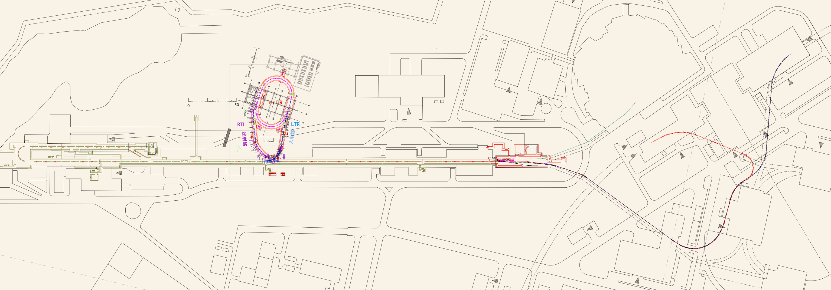

LINAC Layout
0. Introduction
Request of injection beam from SuperKEKB
 | Phase 2 | Phase3 Goal
 | 2018 | 2019〜202?
 |  | e+ | e-
γεx [μm] | < 200 | < 100 | < 40
γεy [μm] | < 40 | < 15 | < 20
σδ [%] | 0.16 | 0.16 | 0.07
Charge [nC] | 1.5 | 4.0 | 4.0
The goal emittances and charges are gradually improved as βy* is squeezed.
We are here
7GeV
SuperKEKB-HER
DR
1.1GeV
e-
e- Guns
RTL
LTR
SectorB
SectorA
Jarc
e+
SectorC
Sector1
Sector2
Sector3
Sector4
Sector5
Beam Transport lines
(BT)
SuperKEKB-LER
e+ Target＋
Flux Concentrator (FC)
4GeV

Slide 4
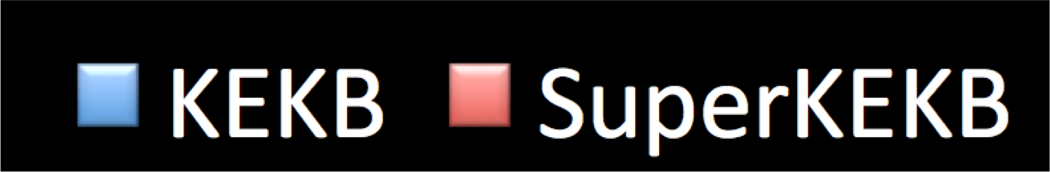














Injection Beam at KEKB and SuperKEKB
0. Introduction
Comparison between the achievement at KEKB and requirement at SuperKEKB Phase 3 goal
  Much smaller emittance even with 3 times higher beam charge.
  Still a big challenge that must be resolved.
Electron beam for the HER
5
4
3
2
1
0
3 times
400
300
200
100
0
1/7
400
300
200
100
0
1/15
0.08
0.06
0.04
0.02
0
1.3 times
Norm. Hor.
Emit. (μm)
Norm. Ver.
Emit. (μm)
Charge (nC)
σδ(%)

Slide 5
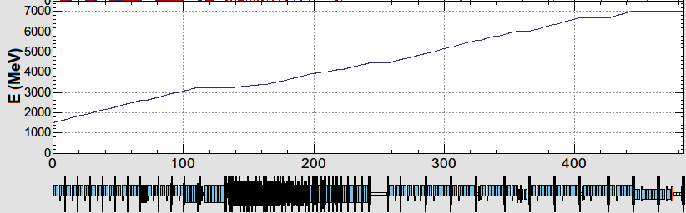
Simultaneous Injection
LINAC Beam
0. Introduction
Ring | Energy [GeV] | Charge/bunch [nC] | # of Bunch | Rep. Rate [Hz]
LER | 4 | 4 | 2 | 50
HER | 7 | 4 | 2 | 50
PF-AR | 6.5 | 0.3 | 1 | 25
PF | 2.5 | 0.3 | 1 | 25
B
A
Achievement:
Beam injection with pulse-to-pulse variable charge and energy
Device parameters change at 50 Hz (20 ms)
Pulsed magnets commissioned at 3-5 sectors (2017 autumn), and many more have been installed also in this winter.
1.5 GeV e-
1.1 GeV
DR
C
1
2
3
4
5
Positron
Target
DC Magnets
Pulsed Magnets
HER: 7 GeV e-
4.219 GeV
PF-AR: 6.5 GeV e-
the same energy
e-
variable energy pulse-to-pulse
LER: 4 GeV e+
1.1 GeV
deceleration
positron target
e+
PF: 2.5 GeV e-
1.5 GeV
Sector#
C
1
2
3
4
5

Slide 6
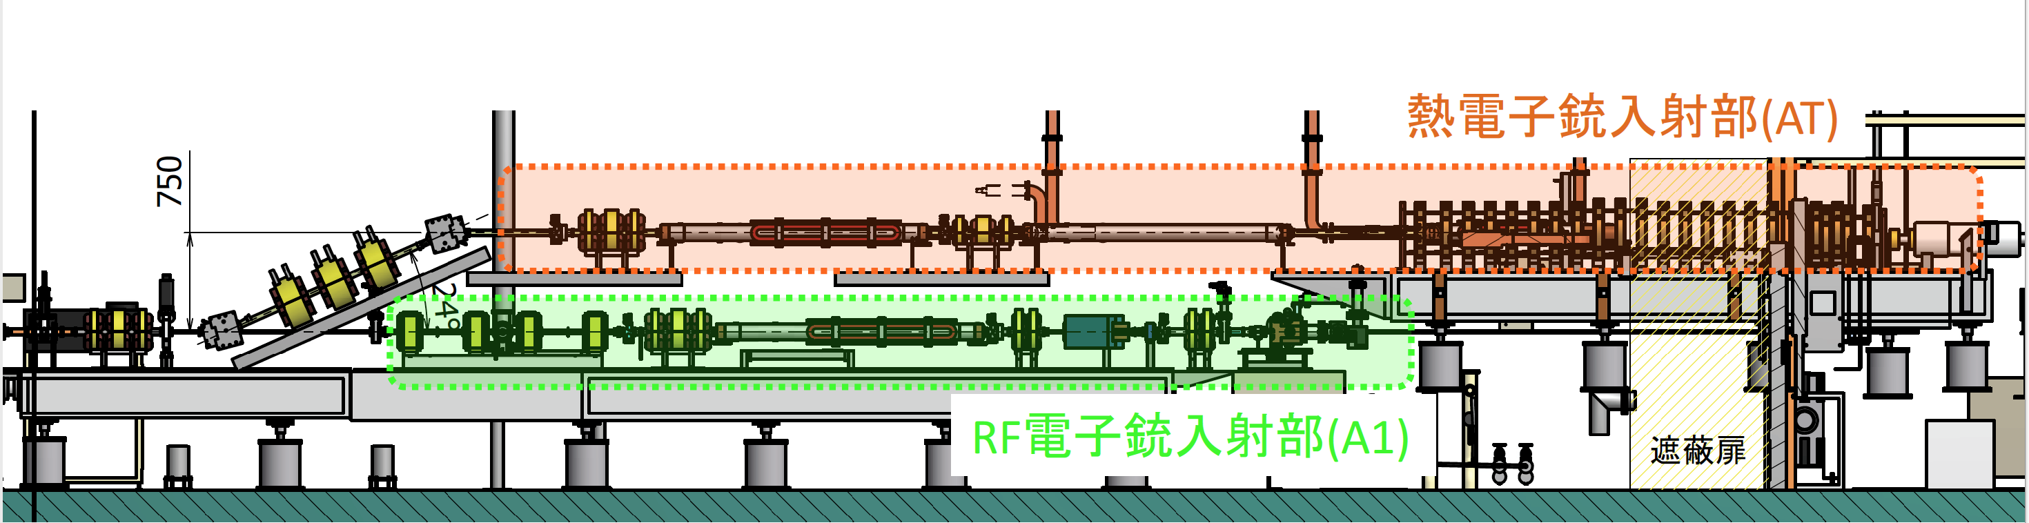
Merger Line (Sector A)
0. Introduction
T. Kamitani
Thermal Gun
Bunching Section
24 degree Merger line
LER
PF
PF-AR
RF Gun
HER
Thermal gun
  LER, PF, PF-AR (, HER)
  Thermal gun
  SHB1(114MHz)
  SHB2(571MHz)
  Pre-buncher
  Buncher
  Accelerating Structure(2mx2)
24 degree Merger Line
  The beam of the thermionic gun joins at the merger line.
RF gun
  HER
  0-deg QTW RF gun
  90-deg CDS RF gun
  Bunch Compress System(BCS)
  Accelerating Structure(2mx1)

Slide 7
Contents
0. Introduction
Injection background(BG) during Phase 2
Progress of LINAC study for autumn, 2018
  Mainly about the study related to BG
Injection beam for the beginning of Phase 3
Summary

Slide 8
１．Injection BG in Phase 2
1. Injection BG in Phase 2
Background TF Report (2018105) for B2GM
Tuning of collimator in the MR has been very useful for suppressing the BG.
A stable beam is very important to reduce the BG;
  Beam energy (Energy FB)
  Energy spread
  Energy jitter
  Orbit in LINAC, BT
  Optics, Emittance
Tools to be prepared;
  LINAC orbit FB (Phase 3)
    Now preparing
  RF phase/voltage monitor
  Energy spread monitor
Beam Energy
Energy Spread
These will be talked
the next topic
Energy Jitter

Slide 9
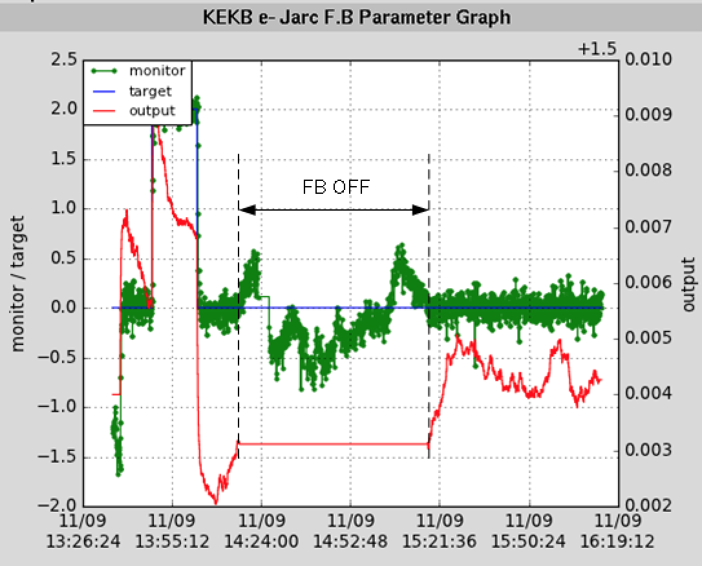
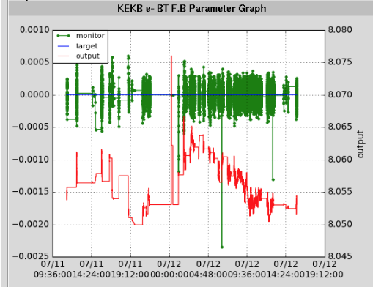
A) Energy Stabilizer (Energy FB)
1. Injection BG in Phase 2
Jarc
BT
FB ON
±0.03%
Target
FB ON
Beam energy
( monitored)
Energy knob
The injection energies have been stabilized within ±0.03% by the energy feedback.

Slide 10
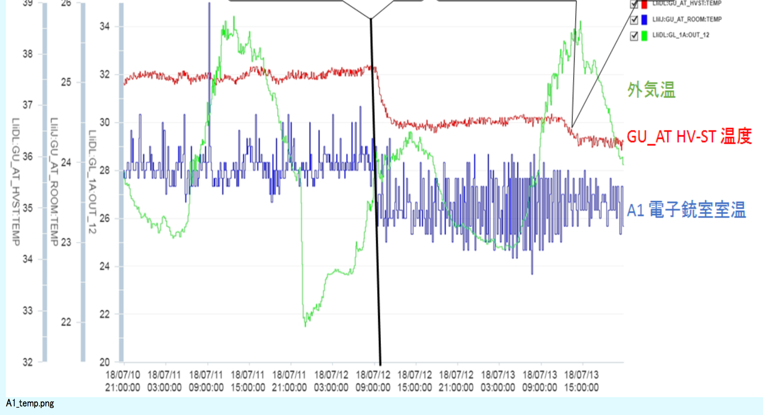
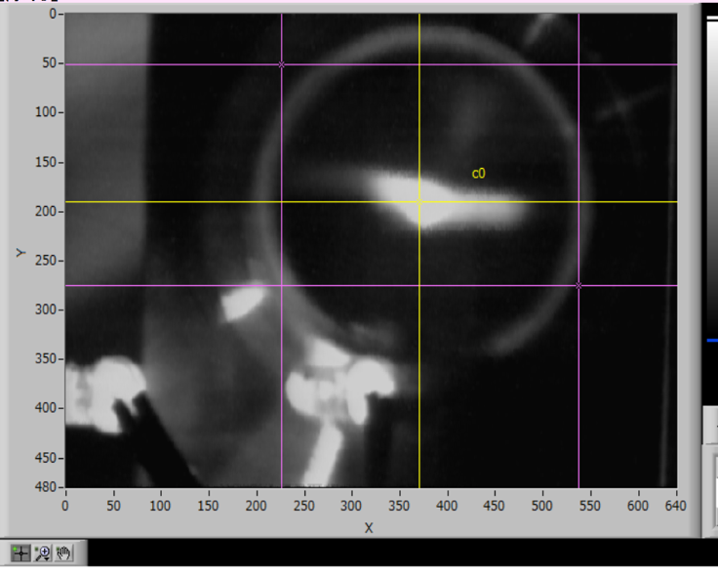
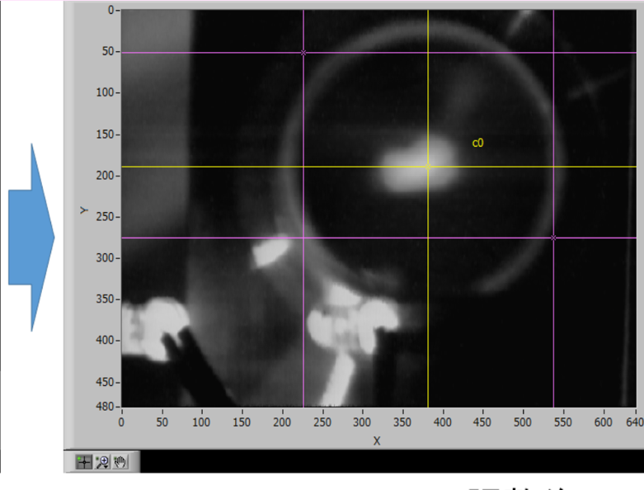
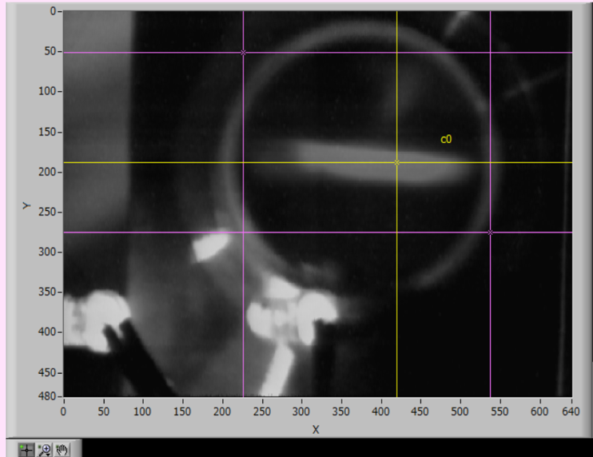
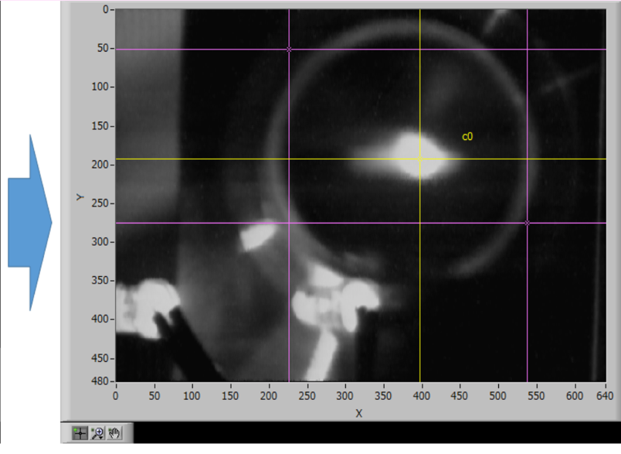
B) Energy spread
1. Injection BG in Phase 2
Arc section in Beam Transport line (BT)
Temperature
of atmosphere
Before tuning
After tuning
Temperature
in HV station of the thermal gun
7/13 20:00
Room temperature
of the thermal gun
Energy spread
Energy spread was widened.
7/13 20:43
Energy spread is very sensitive to the RF phase.
RF Phase drifts due to temperature change.
→ RF phase/voltage monitors are necessary.
The energy spread can be monitored only by destructive screen monitors. → A nondestructive monitors are necessary.

Slide 11
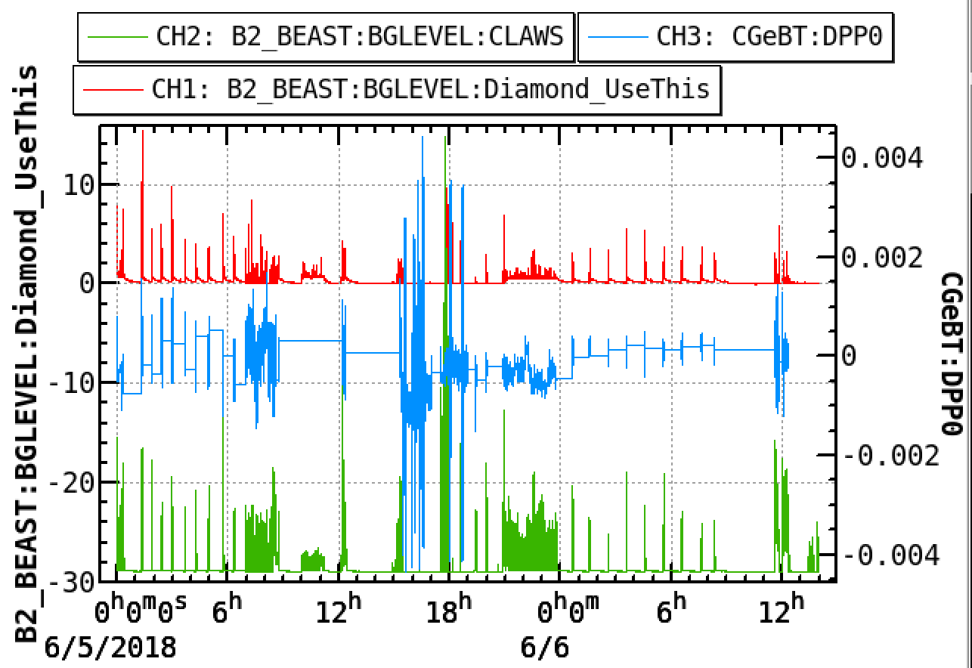
C) Energy jitter
1. Injection BG in Phase 2
B2GM_Background TF_2018105_Iida
After suppressing the energy jitter,
the signal from Diamond detector was reduced.
Diamond became small
±0.1%
Energy Jitter
Energy FB did not work well.
±0.05%
CLAWS
Beam background is sensitive to the energy jitter.

Slide 12
Contents
0. Introduction
Injection background(BG) during Phase 2
Progress of LINAC study for autumn, 2018
  Mainly about the study related to BG
Injection beam for the beginning of Phase 3
Summary

Slide 13
LINAC Beam Studies (Oct.-Dec., 2018)
RF Gun (M. Yoshida, X. Zhou, R. Zhang )
Thermionic Gun
  Tuning of Buncher (T. Natsui)
  Q-Scan、10nC（T. Natsui and Y. Seimiya）
24 degree Line
  Measurement and Correction of Dispersion（Y. Seimiya）
  Measurement of Response and Aperture (Y. Seimiya)
  Consistency Measurement of BPM (F. Miyahara)
Jarc
  Measurement and Correction of Dispersion（Y. Seimiya）
  Bunch Compress（M. Yoshida)
  OctoPos BPM (F. Miyahara)
Measurement of Beam Position Jitter and Fluctuation (Y. Seimiya)
  Binarization from Pulsed Magnet (T. Natsuim Y. Enomoto, M. Satoh, I. Satake)
  Monitors of RF Phase and RF Induced wave
Monitors of RF Phase and RF Induced wave (T. Miura, et al.)
Primary side power fluctuation (T. Miura, T. Natsui)
Investigation around Dummy Target (Y. Enomoto, H. Sugimura, T. Kamitani, Y. Ohnishi, Y. Funakoshi, N. Iida)
  Beam Based Aligment ( Ballistic Orbit、QuadBPM )
Investigation of Solenoid magnet after Positron Target (T. Kamitani, Y. Ohnishi)
Measurement of RF Energy Gain (T. Kamitani, Y. Ohnishi, T. Natsui, Y. Seimiya, M. Satoh)
SY2 (N. Iida, H. Koiso)
  Measurement of Dispersion
Sector 3-5
  Offset Injection (Y. Seimiya, N. Iida, T. Mimashi, T. Kawamoto, K. Yokoyama)
  Fudge Factor Measurement of Quad (Y. Seimiya, M. Satoh )
  QuadBPM (H. Sugimura), Mover Alignment (Y. Enomoto, T. Kamitani)
Coexistence with PF and PF-AR
… Studies especially related to the BG:
Core subjects

Slide 14

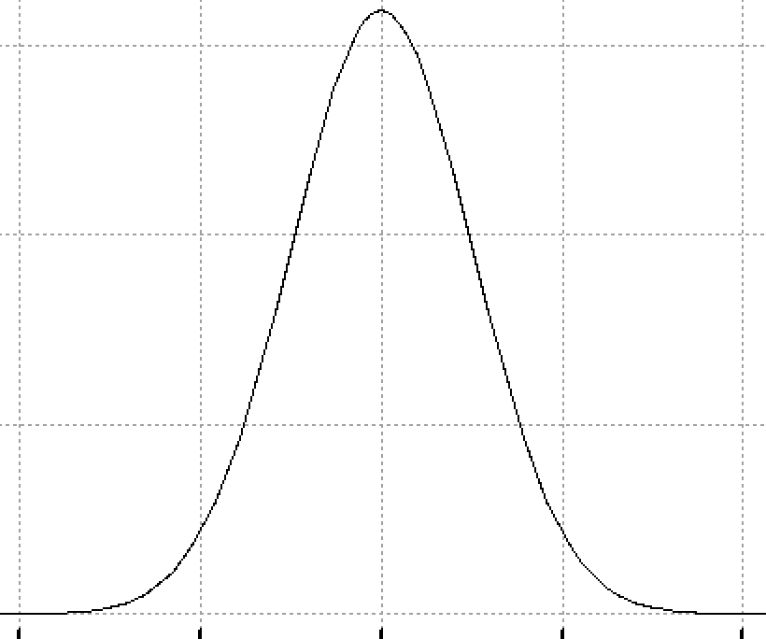
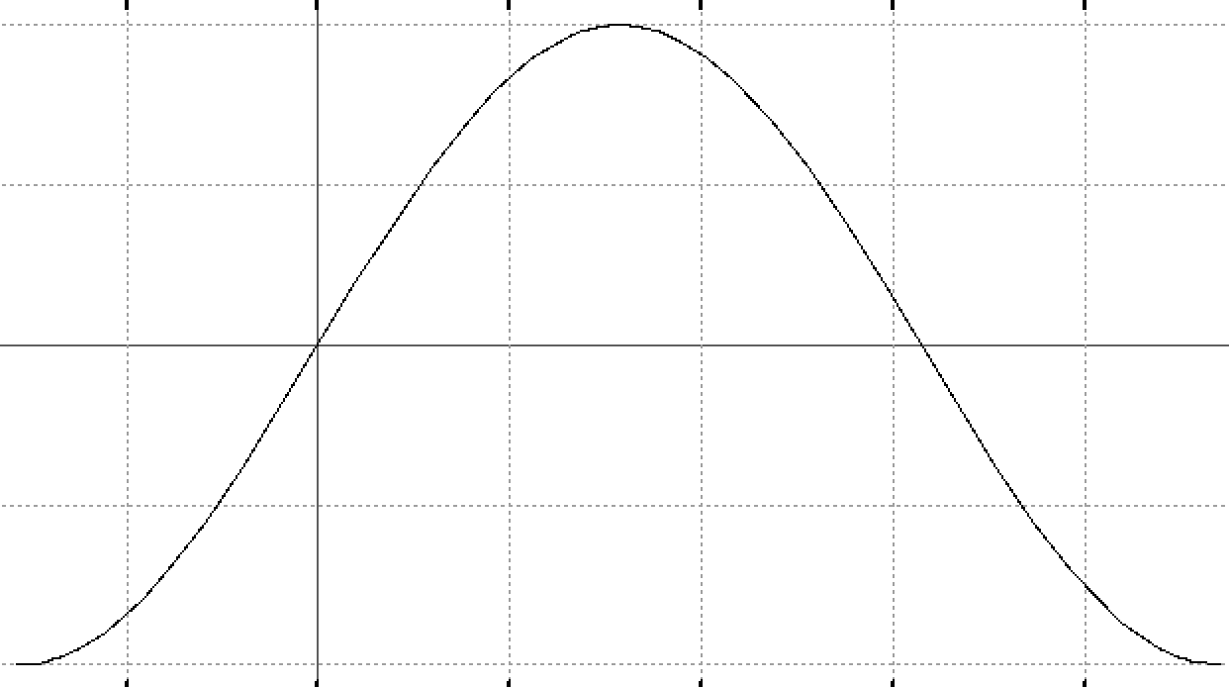
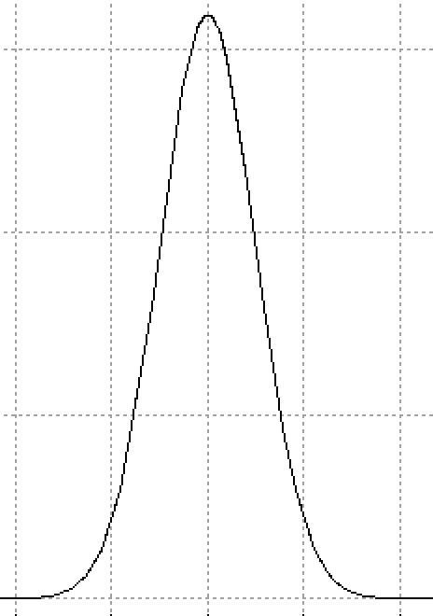

2. Progress of LINAC in autumn, 2018 related to the BG
2. Progress of LINAC in autumn, 2018
ΔE/E
Energy spread, jitter: broad
Jitter of beam position
Beam energy stabilization
  RF phase/voltage monitor
  RF Stabilization
Energy spread monitor
  “OctoPos”:
  Eight electrode BPM
Tuning of the bunching
σ_{δ}
RF voltage
Z
ΔE/E
Energy spread, jitter: narrow
σ_{δ}
RF voltage
Z

Slide 15
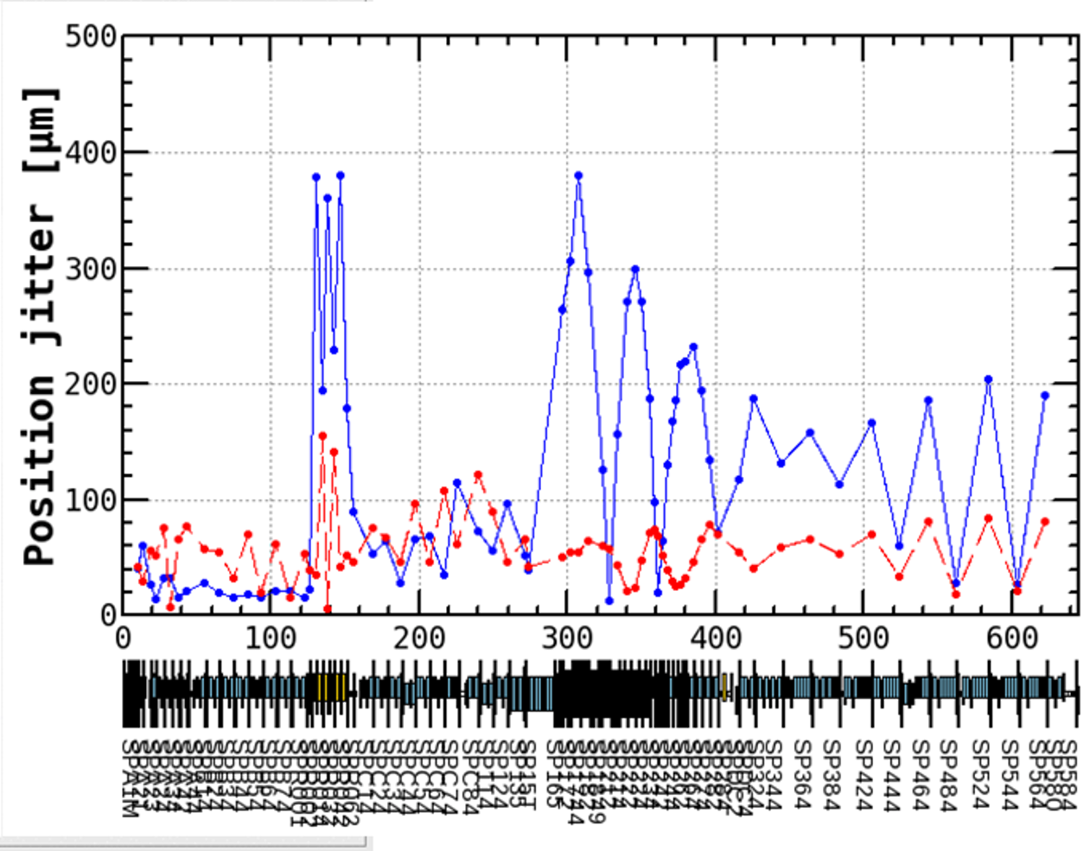
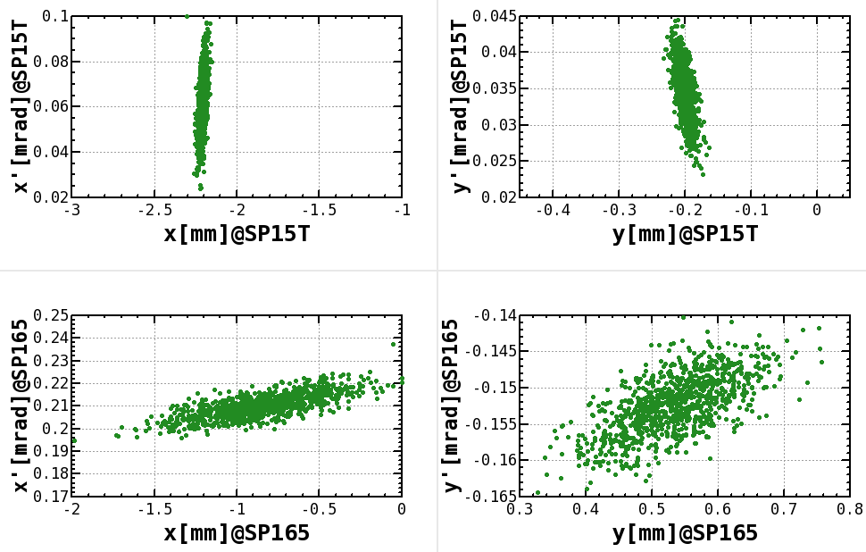
(A) Jitter of beam position
2. Progress of LINAC in autumn, 2018
Y. Seimiya
A hole in the positron target for HER e- beam： φ2 mm．
  Possibly the small hole could have caused the position jitter ?
e+ target
There is a problem of the beam position jitter after the positron target.
J-ARC
ηx ~ 0.8 (m)
Horizontal
Vertical
Horizontal
Vertical
Phase space plot at BPM before target.
Sector
C
Sector
5
Phase space plot at BPM after target.

Slide 16
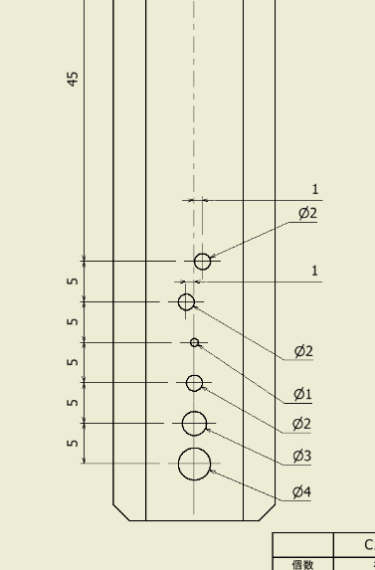
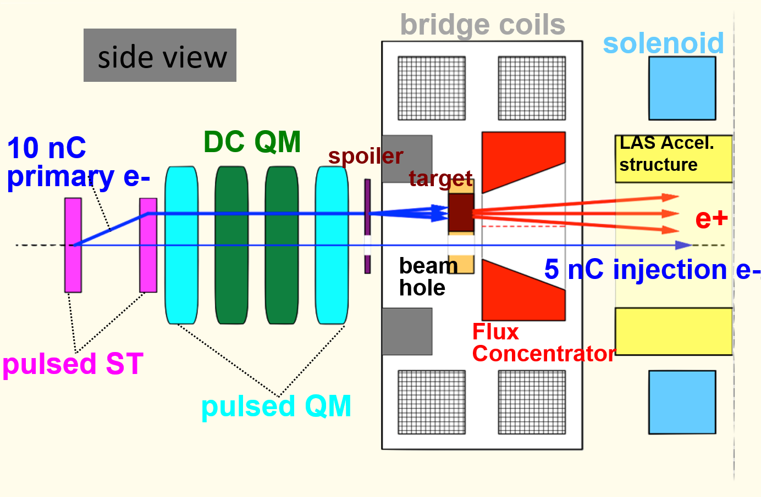
Jitter of Beam Position
2. Progress of LINAC in autumn, 2018
Y. Enomoto
A hole in the positron target for HER e- beam： φ2 mm．
  Possibly the small holes could have caused the position jitter ?
LINAC Study in Autumn, 2018
  A movable dummy target was installed instead of the positron target.
  Beam studies were done with in/out the dummy target.
The positron target was re-installed now.
plan view
for LER
for HER

Slide 17
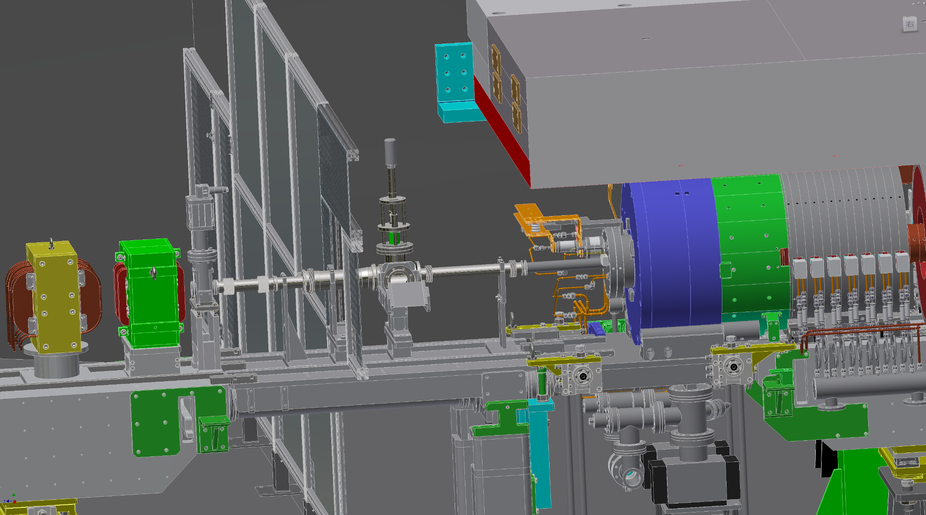
Removed the Flux Concentrator (FC)
2. Progress of LINAC in autumn, 2018
SC_15_T
GV_15_T
BY_13_5
PY_13_5
SP_15_T
Y. Enomoto
(LCG meeting, ‘18/7/2)

Slide 18
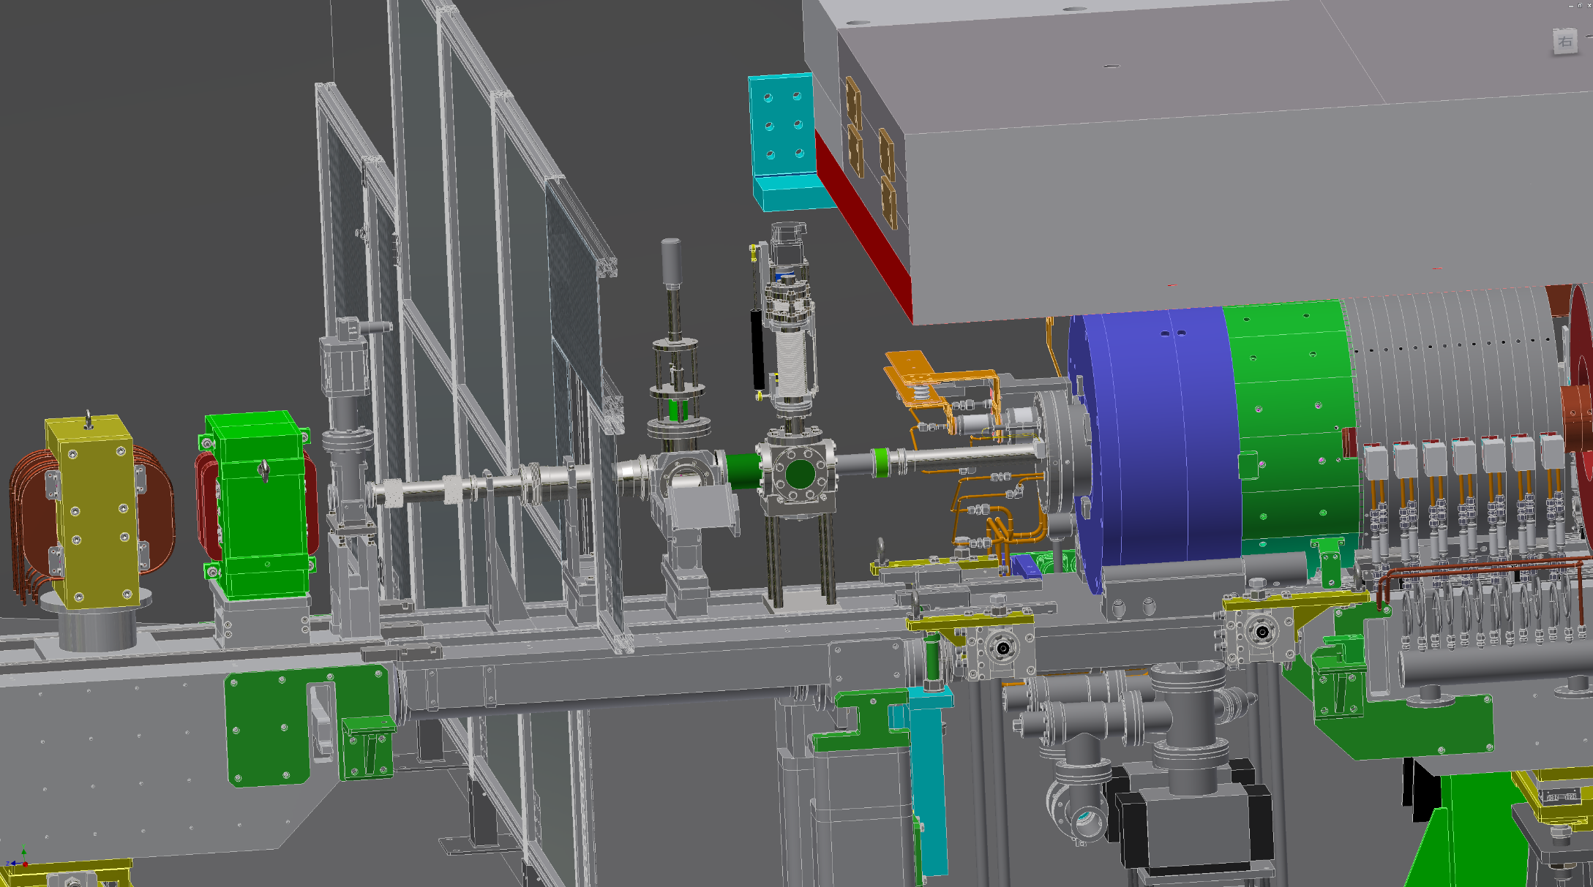
Installed a dummy target block
2. Progress of LINAC in autumn, 2018
SC_15_T
GV_15_T
BY_13_5
PY_13_5
SP_15_T
Y. Enomoto
(LCG meeting, ‘18/7/2)

Slide 19
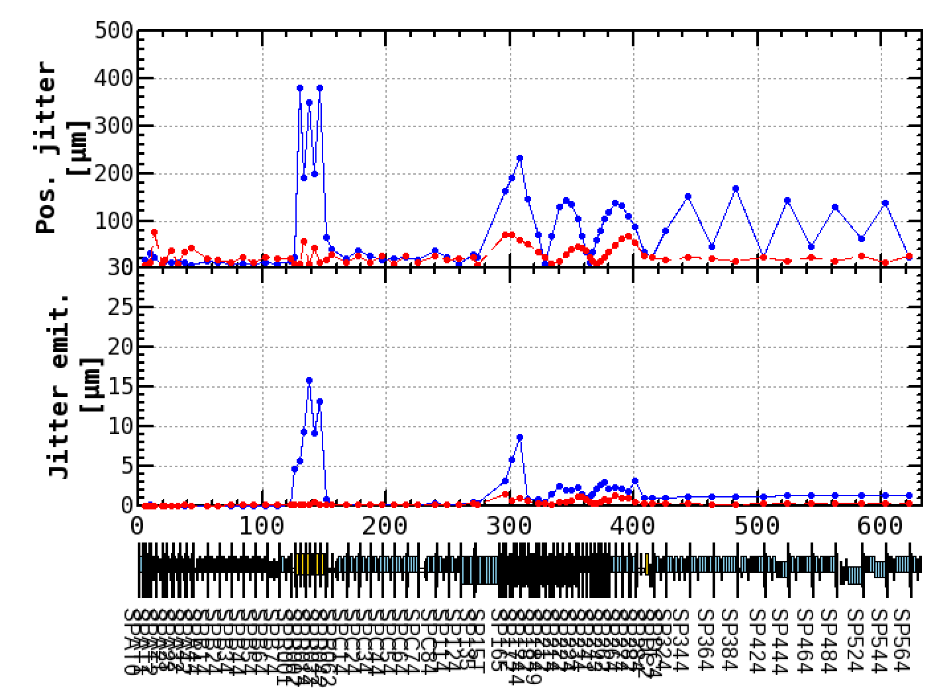
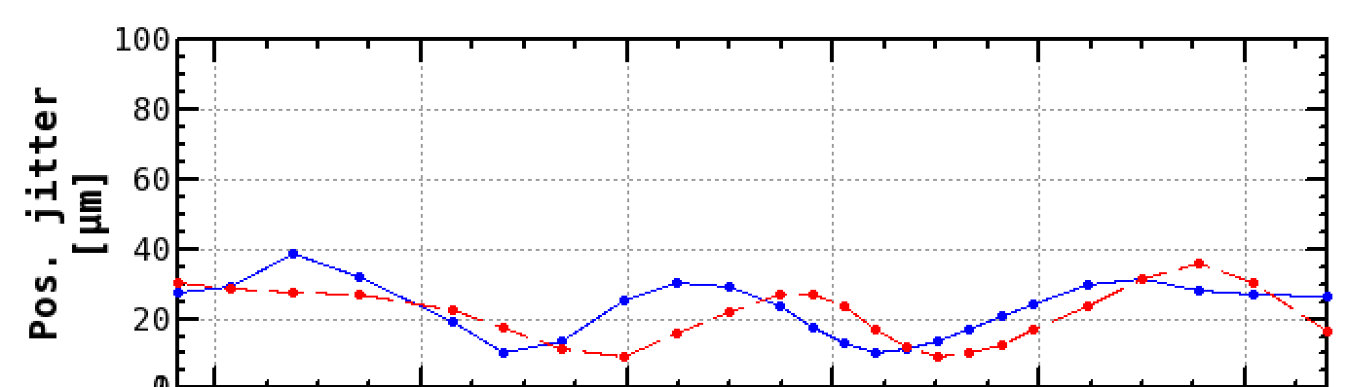
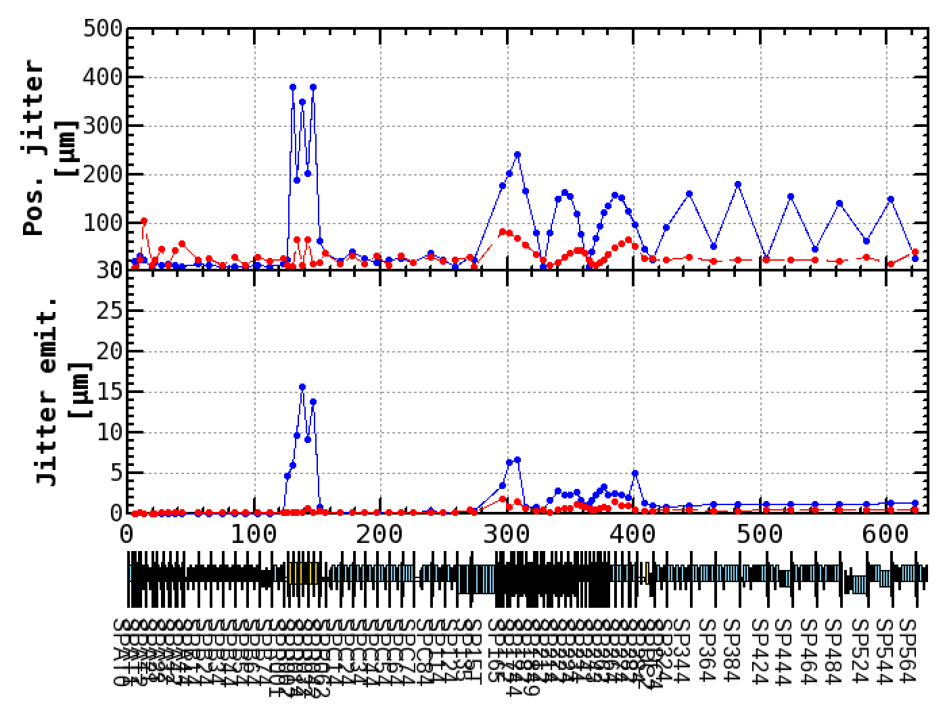
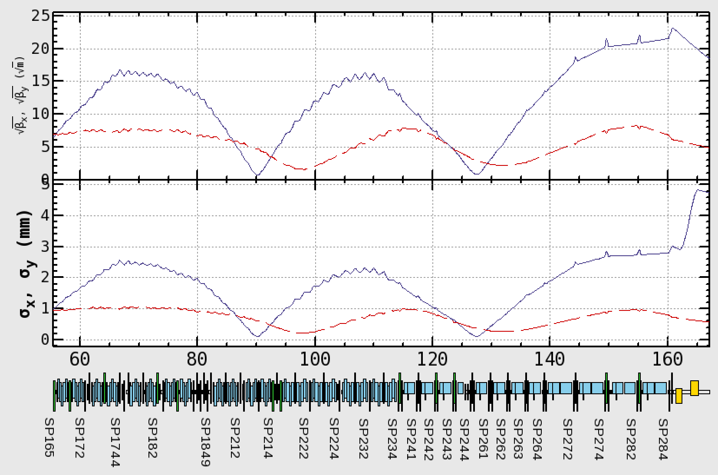
Jitter Emittance
2. Progress of LINAC in autumn, 2018
The result is;
The growth of the jitter emittance has been nothing to do with the small hole.
Strong correlation between orbit jitter and beta function.
The beta function after the target is large to squeeze the beam sizes to pass through the hole, which causes the large orbit jitter.
With Target hole(φ2mm)
Position jitters x, y [μm]
Although the jitter emittances are still increased as shown in the jitter emittance plots, it is known that this jitter becomes smaller when Jarc's dispersion leakage is reduced.
They are small enough at the end of LINAC.
√βx, √βy
No Target hole

Slide 20
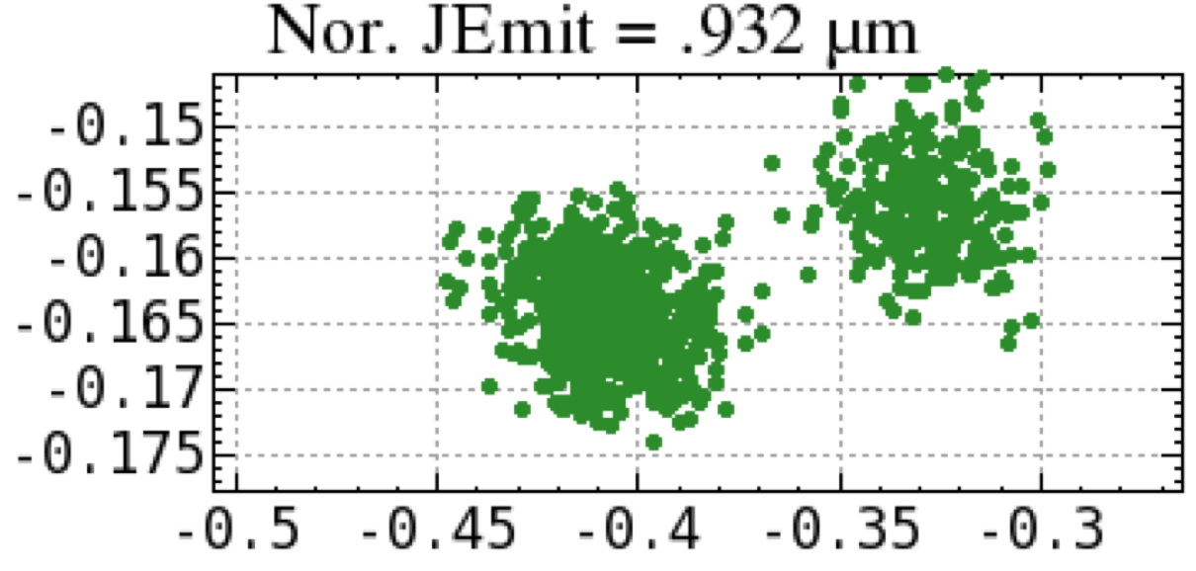
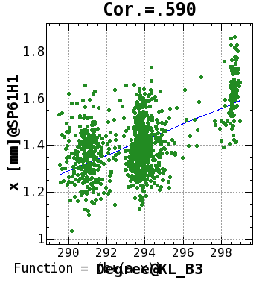
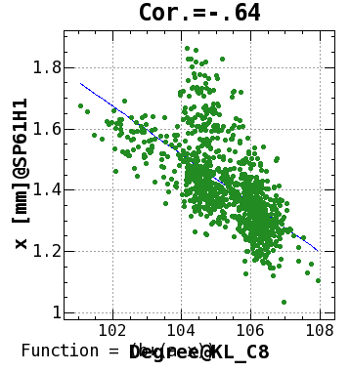
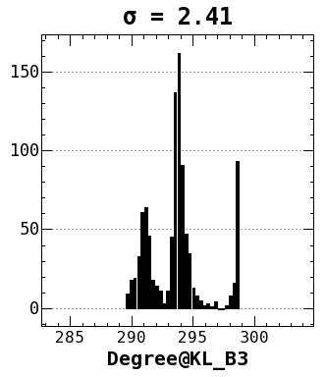
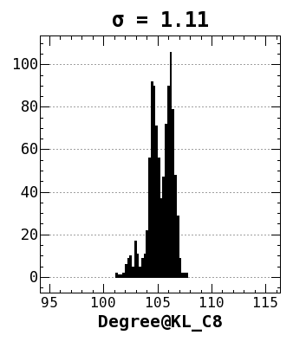
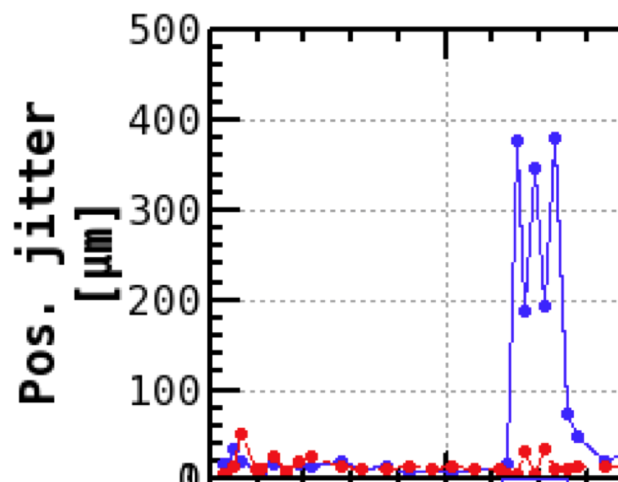
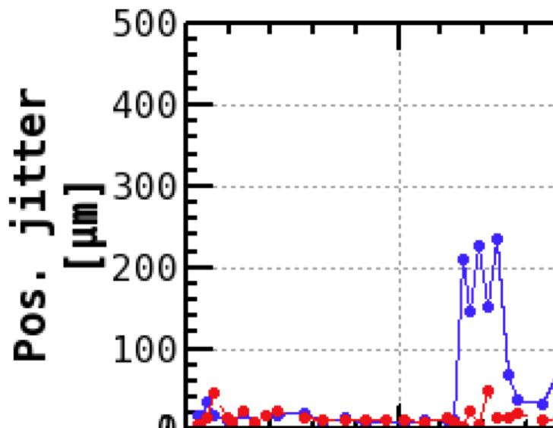
Beam Jitter Sources
2. Progress of LINAC in autumn, 2018
Y. Seimiya
Causes of several beam fluctuations were revealed by BPMs and the new RF monitors.
①
Binarization from the Pulsed Magnets
(at the straight section)
②
Binarization from the RF Phase
(at the dispersive section)
x’ [mrad]
x [mm]
Beam energy (arb. unit)
③
Large variation of Energy gain
near zero cross of RF phase
Degree@KL_B3
Degree@KL_C8
Δp/p=0.042%
Δp/p=0.027%
near zero cross
near peak
RF phase monitor

Slide 21
Beam jitter (cause and remedy)
2. Progress of LINAC in autumn, 2018
Binarization from the Pulsed Magnets
  Currently under investigation
Binarization from the RF Phase
  Connector or Cable Problems
Large variation of RF phase near the zero cross
  Use the energy knob closer to the top of the RF wave
(B) Beam energy stabilization
T. Miura, T. Matsumoto
18:00
Before tightening the cable
20:00
After
Std=0.28°
Std=0.15°
1.5°
0.8°

Slide 22
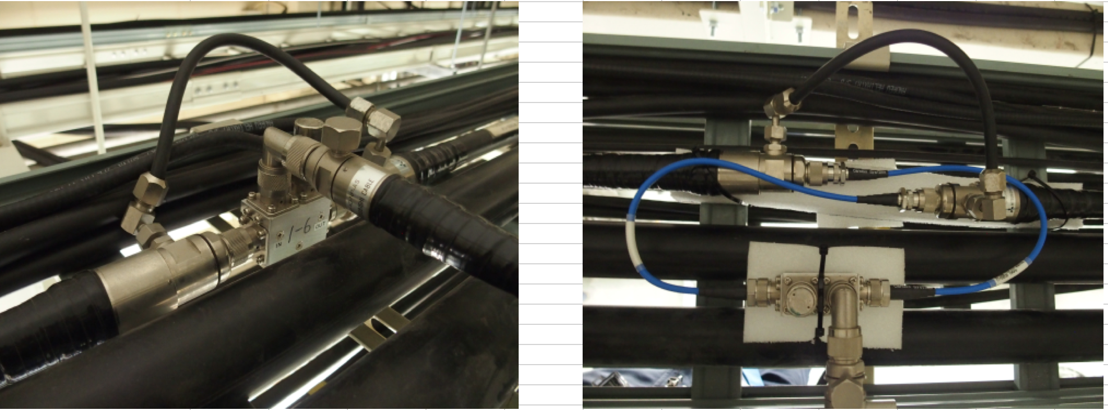
Cable re-connection
Before
After
In the cable connection before work, since the cable was hard and thick, a force was applied to the connecting part, causing poor contact between the cables.
By holding a soft cable in between, the cables felt less stress any more.
In this winter shut down, some other connectors were re-connected.

Slide 23
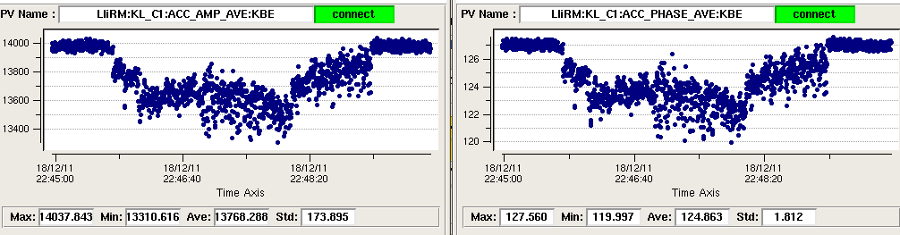
Other voltage fluctuation of klystron power supply
2. Progress of LINAC in autumn, 2018
(B) Beam energy stabilization
C1: RF voltage
C1: RF Phase
5%
7deg
RF voltage / phase variation
Sometimes the AC line voltage for klystron power supply drops.
Klystron output power is stabilized by
Induced Voltage Regulator (IVR) at the sudden change of AC line voltage.
In Phase 2, IVR stabilization had been done once an hour.
It is planed to establish the IVR feedback in Phase 3.

Slide 24
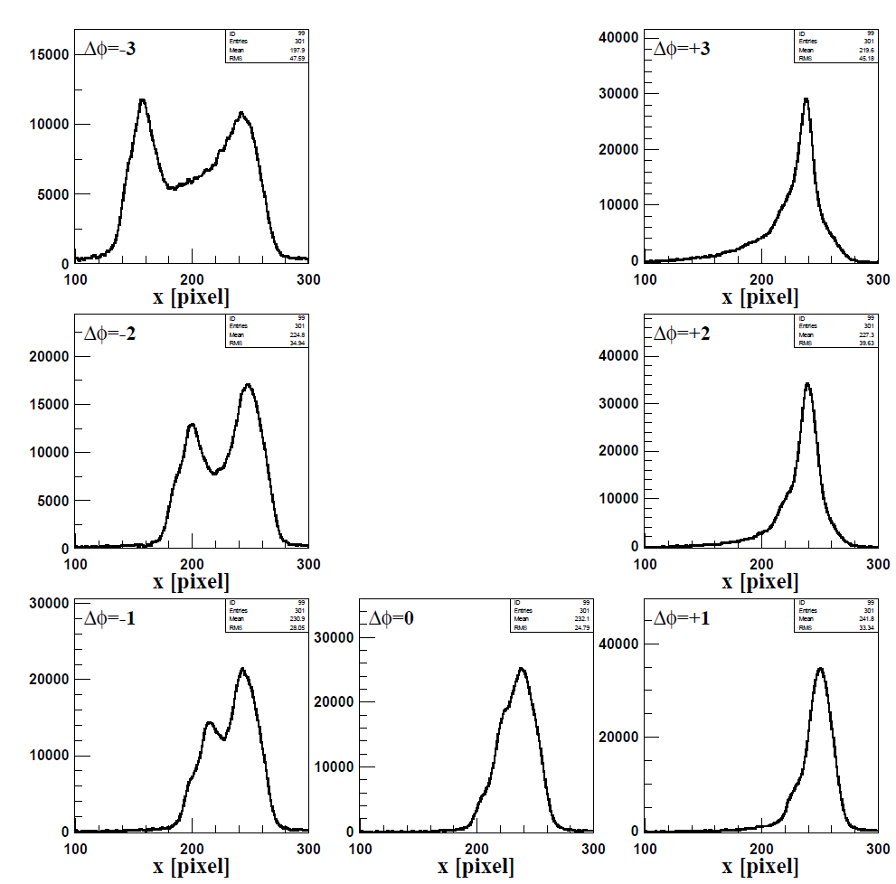
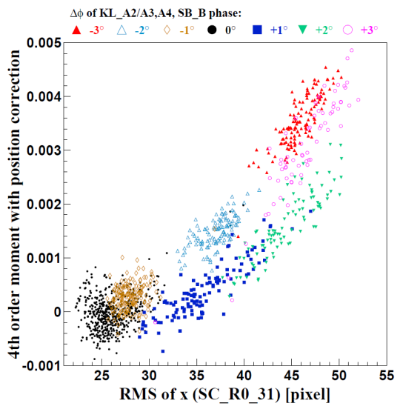
（C) Nondestructive Energy Spread Monitor：
“OctoPos”, eight electrode BPM in Jarc
2. Progress of LINAC in autumn, 2018
F. Miyahara
Second moment and horizontal profile
①
⑦
σx monitored with
OctoPos BPM
②
⑥
σx monitored with
screen monitor
③
⑤
④
The beam spread can be measured from the second moment.
Although the profile with two peaks ② can not be recognized from ⑥ only with the second moment, it is important to keep the energy spread to ③ or ④.
We would like to use this monitor in Phase 3.
There are two more OctoPos in the BT.

Slide 25
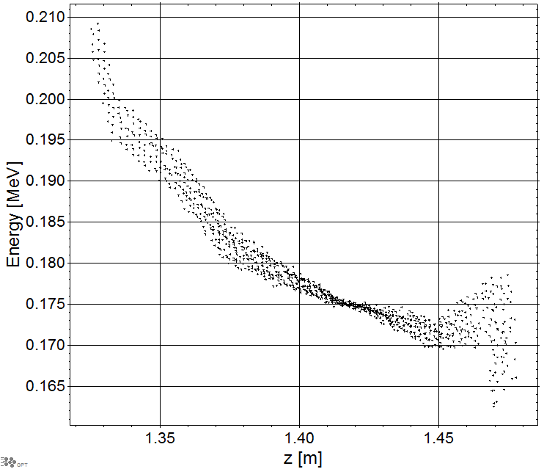
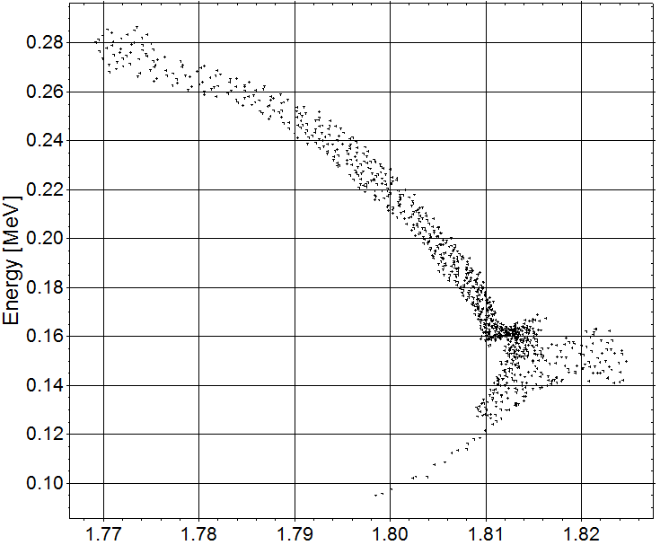
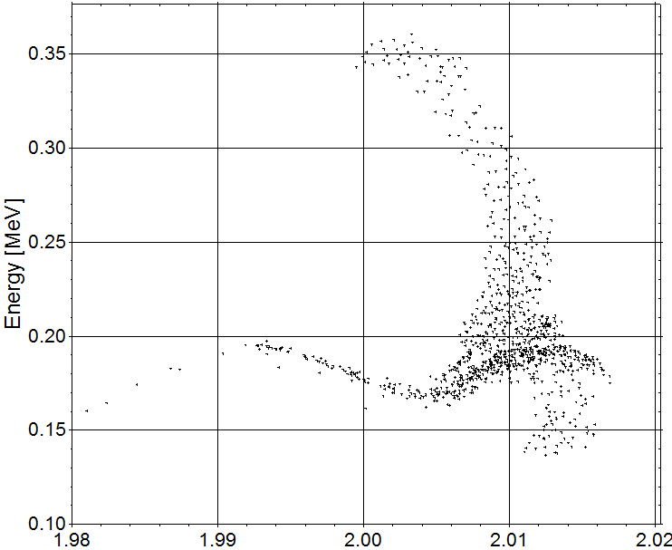
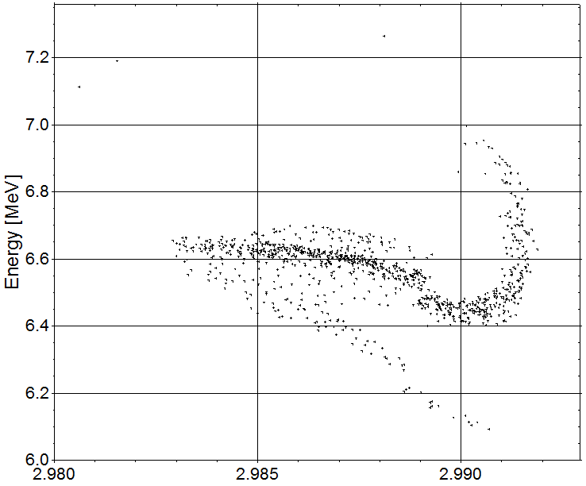
(D) Bunching after the thermal gun (Simulation)
2. Progress of LINAC in autumn, 2018
T. Natsui
The beam dynamics in the bunching section is simulated with the GPT code.
Bunch length
optimized value: σ=7.6 psec

Slide 26
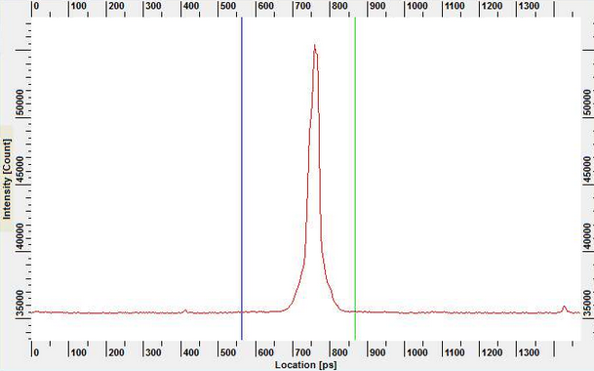
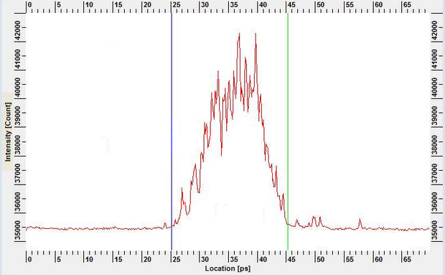
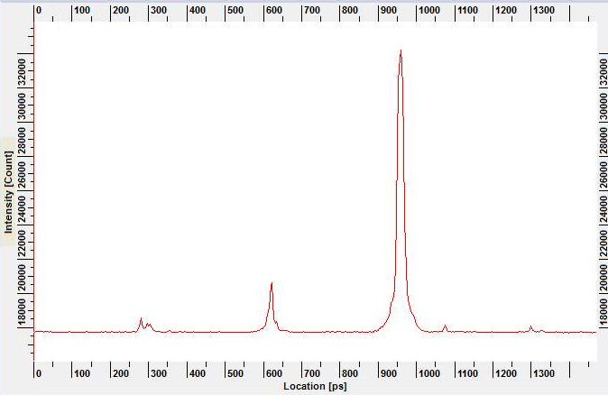
(D) Bunching after the thermal gun (Beam study)
2. Progress of LINAC in autumn, 2018
T. Natsui
Oct. 29 Tuning with 10 nC-beam
Monitored bunch length with a streak camera
SHB1 : 9.4 kW, SHB2 : 3.2 kW
The bunch length is short enough.
20 psec
No satellite bunch around the beam
Nov. 22
After 3weeks
The satellite bunches appeared, while the phases of the bunchers were not changed．
By the RF phase drift？
Some satellite bunches were observed.
We would like to monitor the phase drift of the SHB which can affect the BG due to the satellite.

Slide 27
Contents
3. Injection beam for the beginning of Phase 3
0. Introduction
Injection background(BG) during Phase 2
Progress of LINAC study for autumn, 2018
  Mainly about the study related to BG
Injection beam for the beginning of Phase 3
Summary

Slide 28
3. Injection Beam for the beginning of Phase 3
3. Injection beam for the beginning of Phase 3
Charge and Repetition Rate (Max.)
  LINAC RF: 50Hz
  HER : 2nC, 25Hz, 2 bunches
  LER : 2nC, 23Hz=25Hz-2Hz(PF+AR), 2 bunches
  They are enough for the top-up injection.
Emittance Preservation
  The big issue for the BG.

Slide 29
Merger Line (Sector A)
3. Injection beam for the beginning of Phase 3
T. Kamitani
Pulsed bends
Thermal Gun
24 degree merger line
LER
PF
PF-AR
HER
RF Gun
Thermal gun
  LER, PF, PF-AR (, HER)
  Thermal gun
  SHB1(114MHz)
  SHB2(571MHz)
  Pre-buncher
  Buncher
  Accelerating Structure(2mx2)
24 degree Merger Line
  The pulsed bends for 25 Hz are available now.
  50 Hz operation will be ready in 2020 summer.
RF gun
  HER
  0-deg QTW RF gun
  90-deg CDS RF gun
  Bunch Compress System(BCS)
  Accelerating Structure(2mx1)

Slide 30
Lifetime and injection rate
3. Injection beam for the beginning of Phase 3
Example : Phase 3-3ex Parameter
Assumed from the lifetime of Phase 2
 | LER
Life time [sec.] | 600 | N_{b}=1578, I_{tot}=2.0A
Loss Rate [mA/sec] | 3.0
frev=100kHz
Q_{BTend}=1.0nC
f_{rep}=25Hz
n_{bunch}=2
eff_{inj}=70%
Even if such a low charge injection, the total beam current can be kept
with 25Hz injection.

Slide 31
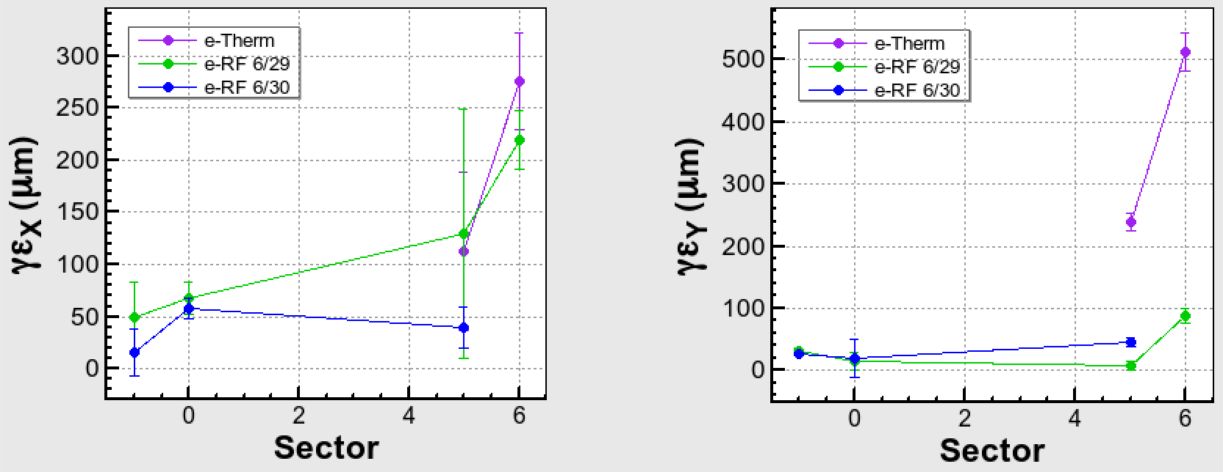
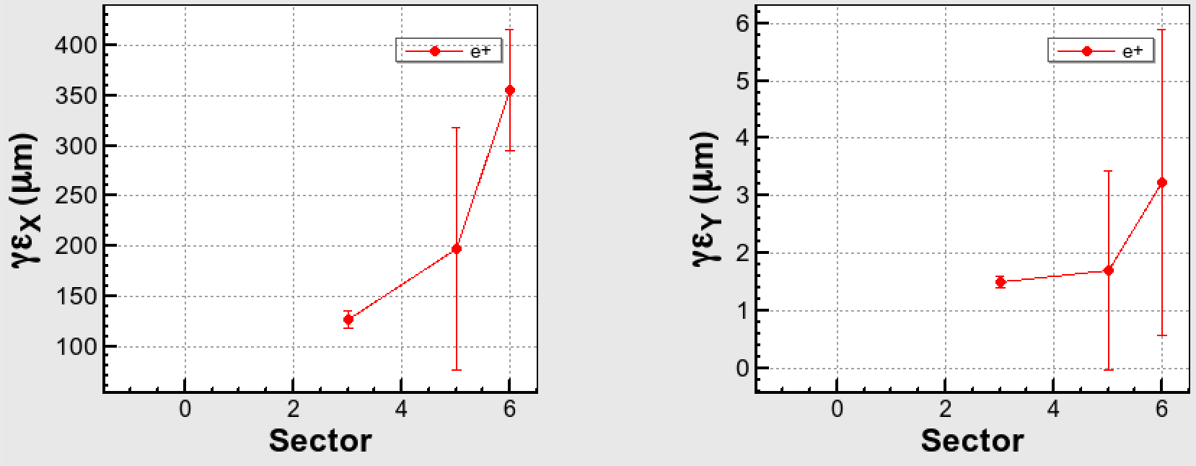
Emittance blowup in Phase 2
3. Injection beam for the beginning of Phase 3
Final Request from MR
Phase2 ----------
Phase3 ----------
X
Y
There is no question that the emittance blowup affects the BG.
1.2nC
e-
Measurement at the upstream of BT
B C
5 BT
B C
5 BT
40 ----
15 ----
0.7nC
e+
DR designed value
B C
5 BT
B C
5 BT
More beam studies at BT will be needed.

Slide 32
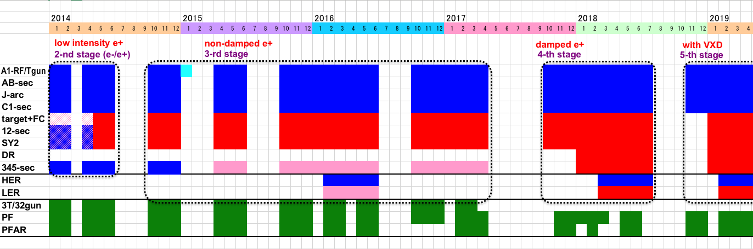

Linac Schedule Overview as of Jun.2018
Schedule
There is no future schedule for a big modification now.
RF-Gun e- beam
commissioning
at A,B-sector
e- commiss.
at A,B,R,C,1
e+ commiss.
at 1,2 sector (FC, DCS, Qe- 50%)
e- commiss.
at 1,2,3,4,5 sector
Phase1: high emittance beam for vacuum scrub
Phase2,3: low emittance beam for collision
Time →
Summer
2020
Location
↓
Beam
Licenses
in steps
Low Emittance Beams
Low Emittance Injections
4+1 Ring
Injections
24 degree line
ready for
50Hz operation
DR
Commiss.
1 nC
Phase1
1 - 2 nC
Phase2
1 - 4 nC
Phase3
Without Top-up
Direct PF-AR BT
: Electron
non damped e+ commiss.
at 1,2, 3,4,5 sectors
e- commiss. at A→5 sectors
damped e+ commiss.
at 1→5 Qe+ = 1~4nC
e- commiss.
at A→5 Qe- = 1~4nC
Improved
RF gun
: Positron
: Low current electron

Slide 33
4. Summary
Injection background(BG) during Phase 2
  The deviations of the injection beam mainly related beam energy could be the BG source.
Progress of LINAC study for autumn, 2018
  The voltage and phase monitors of RF, OctoPos BPM are powerful tools.
  In Phase 3, we would like to use them to test and operate feedback tools.
Injection beam for the beginning of Phase 3
  The charge and repetition rate are enough for Phase 3-3ex.
  The studies for the emittance preservation are needed in LINAC and the BT.
  More studies for LINAC including BT are indispensable !

Slide 34
Backup

Slide 35
Life and minimum injection
Example 1:
 | LER
Life time [sec.] | 1200 | N_{b}=1578, I_{tot}=1A
Loss Rate [mA/sec] | 0.83
frev=100k
Q_{BTend}=1.0nC
f_{rep}=25Hz
n_{bunch}=1
eff_{inj}=70%
Even if such a low charge injection, the total beam current can be kept
with 25Hz injection.

Slide 36
Lifetime and injection rate
3. Injection beam for the beginning of Phase 3
Example :
Phase 3-3 Parameter
 | LER
Life time [sec.] | 670 | N_{b}=1578, I_{tot}=1.8A
Loss Rate [mA/sec] | 2.6
frev=100k
Q_{BTend}=1.0nC
f_{rep}=25Hz
n_{bunch}=2
eff_{inj}=70%
Even if such a low charge injection, the total beam current can be kept
with 25Hz injection.

