Slide 1
Injector Linac Status
Masanori Satoh
(Accelerator Laboratory, KEK)
for Linac Commissioning Group
The 30th B2GM, June 18-22, 2018

Slide 2
Contents
Injector Overview
Progress in Phase II
Towards Phase III
Schedule: Oct. 2018 -
Summary

Slide 3
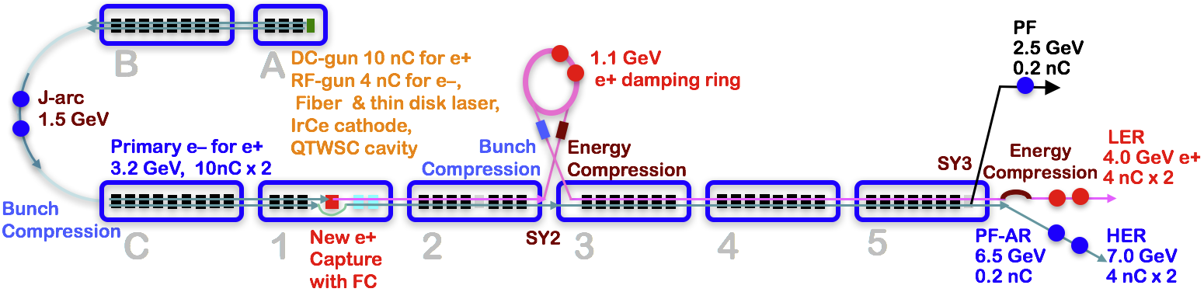
Injector overview
Injector for light sources (PF, PF-AR)3 times daily injection and SuperKEKB
up to 25 Hz beam repetition rate in Phase II (to save electricity)
50 Hz operation in Phase III
Thermionic e- gun for light source injection and 10 nC beam generation (e+ production)
Photocathode rf gun for low emittance e- beam
Flux concentrator, LAS (large aperture S-band) structure, solenoids for e+ beam capture system
DR (damping ring) for low emittance e+ beam

Slide 4
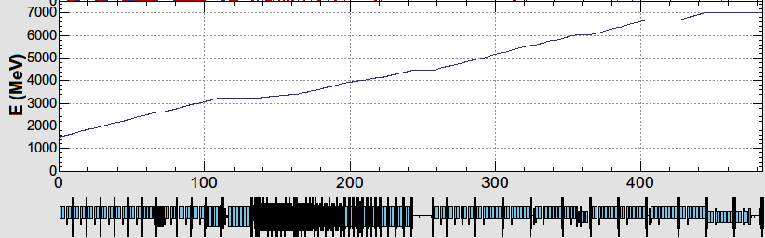
Energy profile for light source and SuperKEKB injection
B
A
Low emittance RF e- gun
Thermionic DC e- gun for positron production and light source injection
e-/e+ beams are delivered to 4-rings with different bunch charge and energy.
Beam acceleration modes must be switched by 50 Hz pulse-by-pulse for top-up injection.
Compatible settings for e-/e+ beams (DC Quad)
Pulsed Quad and steering for pulse-by-pulse switching
1.5 GeV e-
1.1 GeV
DR
C
1
2
3
4
5
e+ target
e-:Chicane
HER: 7 GeV e-
PF-AR: 6.5 GeV e-
4.219 GeV
Decelerate
same energy
e-
LER: 4 GeV e+
e+ target
e+
1.1 GeV
PF: 2.5 GeV e-
1.5 GeV
C
1
2
3
4
5

Slide 5
Progress in Phase II
Monitors
High measurement precision readout (< 10 μm) and synchronized measurement for 100 beam position monitors (BPMs)
All data is stored together with shot id. Similar framework will be applied to pulsed magnet power supply and rf monitor data for the correlation analysis soon.
Wire scanner at SectorB, SectorC, Sector2, Sector3, and Sector5
Streak camera at Laser hut/SectorA, SectorC, and Sector3
RF phase/amplitude monitors for klystron, SLED, acc. structure
Timing system for DR injection and extraction system
Stable operation of pulsed quads and steering magnets
Simultaneous beam injection via thermionic e- gun
RF e- gun injection to HER (June 16th -)
Beam energy stabilization

Slide 6
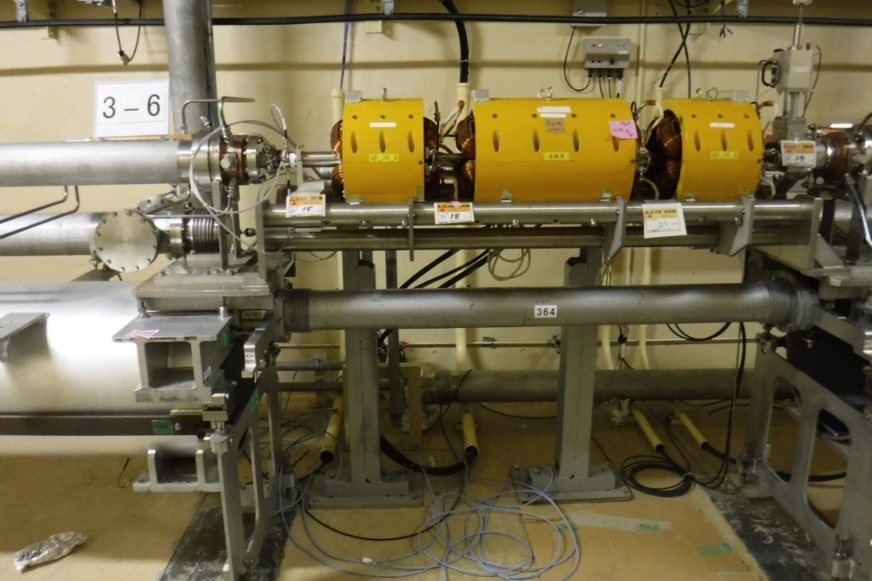
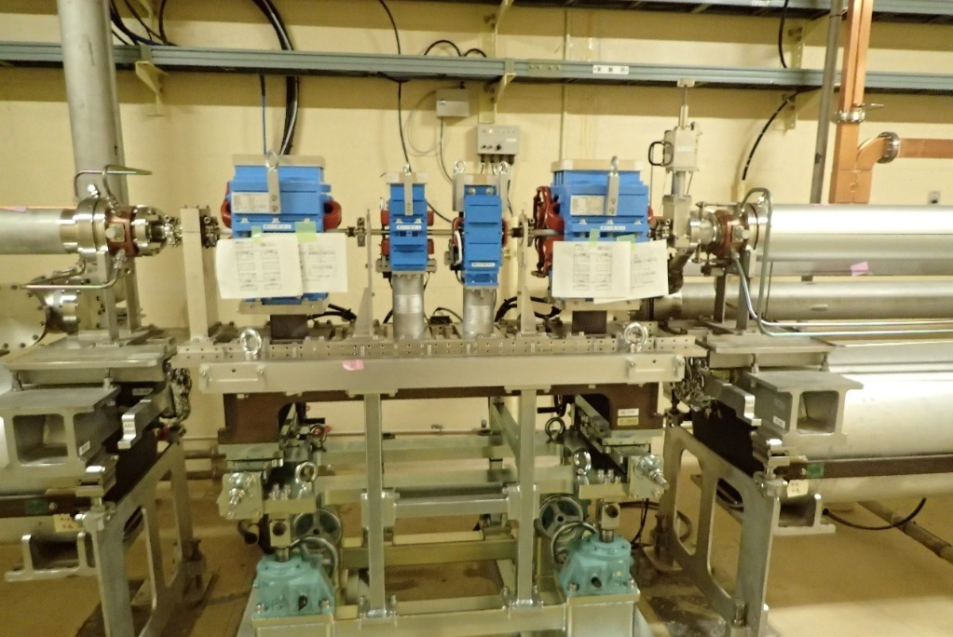
Pulsed magnet
DC quad (triplet)
Pulsed quad
Pulsed steering
Pulsed quads (x28) (w/ ceramic duct) and steering magnets (x 36) on new girder (Sep. 2017 - ) at Sector3 to Sector5
Power supply stability ～ 0.01% (24 hours)
PXI bus based local controller and cRIO
Remote controllable mover will be ready in this summer.

Slide 7
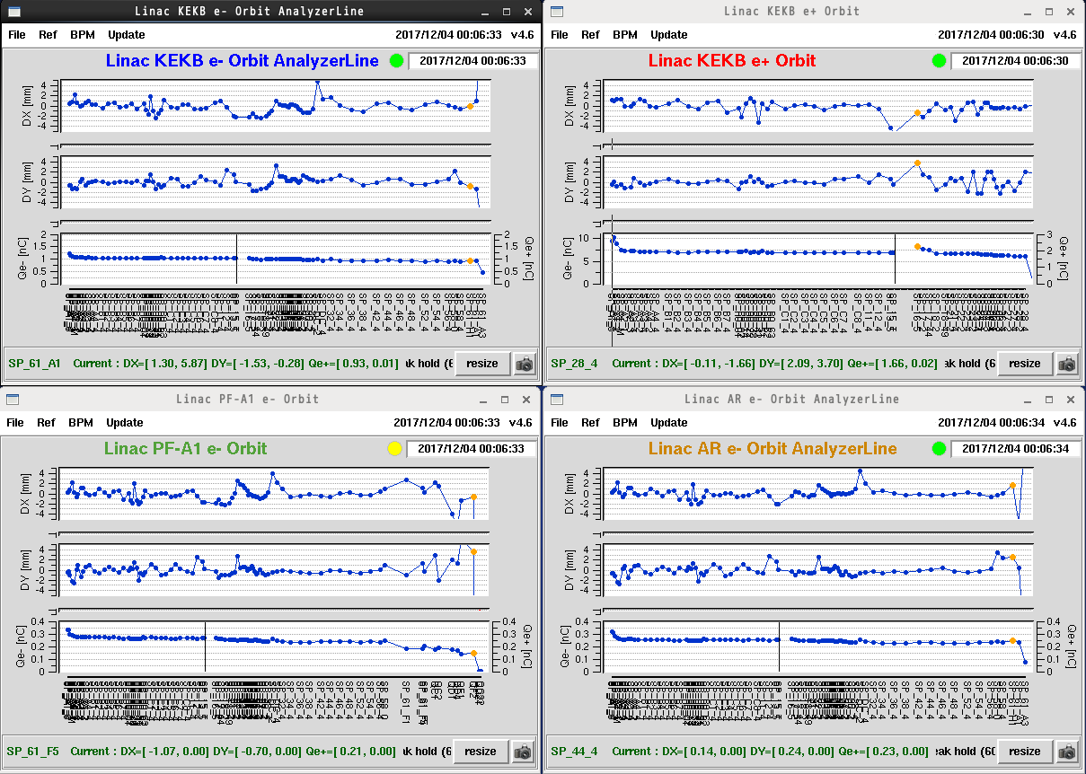
Simultaneous beam operation w/ thermionic e- source
Hor. orbit
Ver. orbit
Bunch charge
Stable operation w/o significant trouble
Hor. orbit
Ver. orbit
Bunch charge

Slide 8
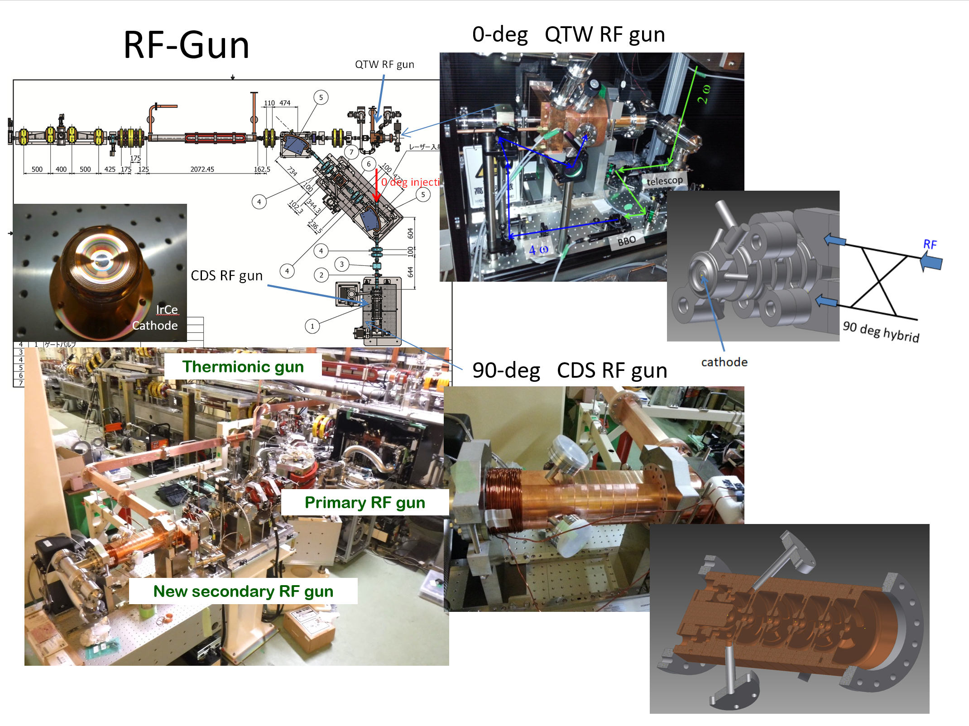
RF e- gun
M. Yoshida, SuperKEKB review, Mar. 14th, 2018

Slide 9
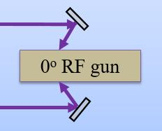
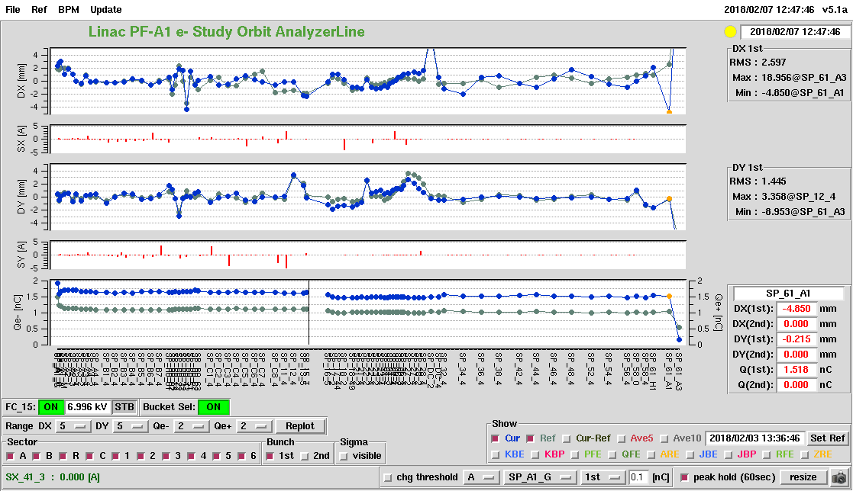
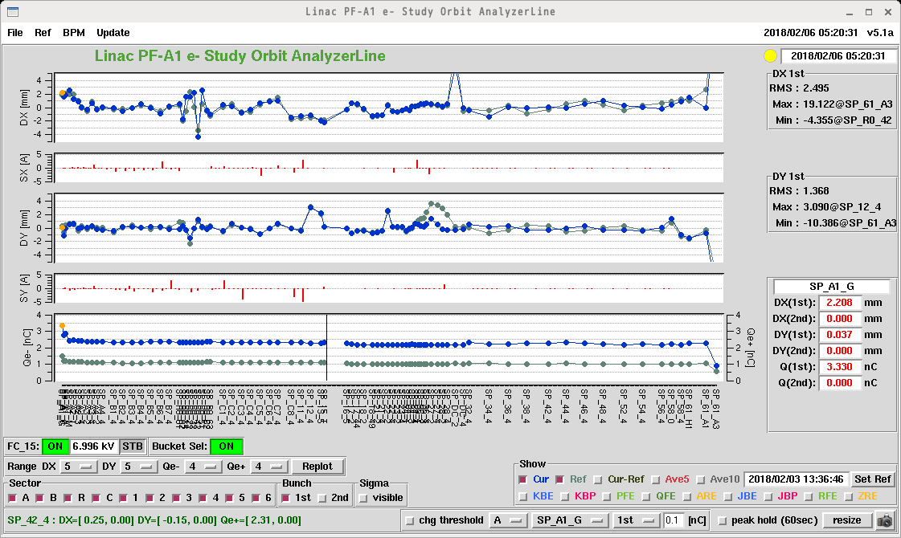
e- beam from photocathode rf gun
2nd laser only
X (mm)
y (mm)
Q (nC)
1.5 nC
Redundant Yb:Fiber + Nd:YAG Hybrid Laser System
Three oscillators
Bunch charge
3.6 nC @ first BPM
2.4 nC @ Linac end
(Phase II requirement: 1 nC)
1st and 2nd laser together
X (mm)
y (mm)
Q (nC)
2.4 nC
3.6 nC

Slide 10
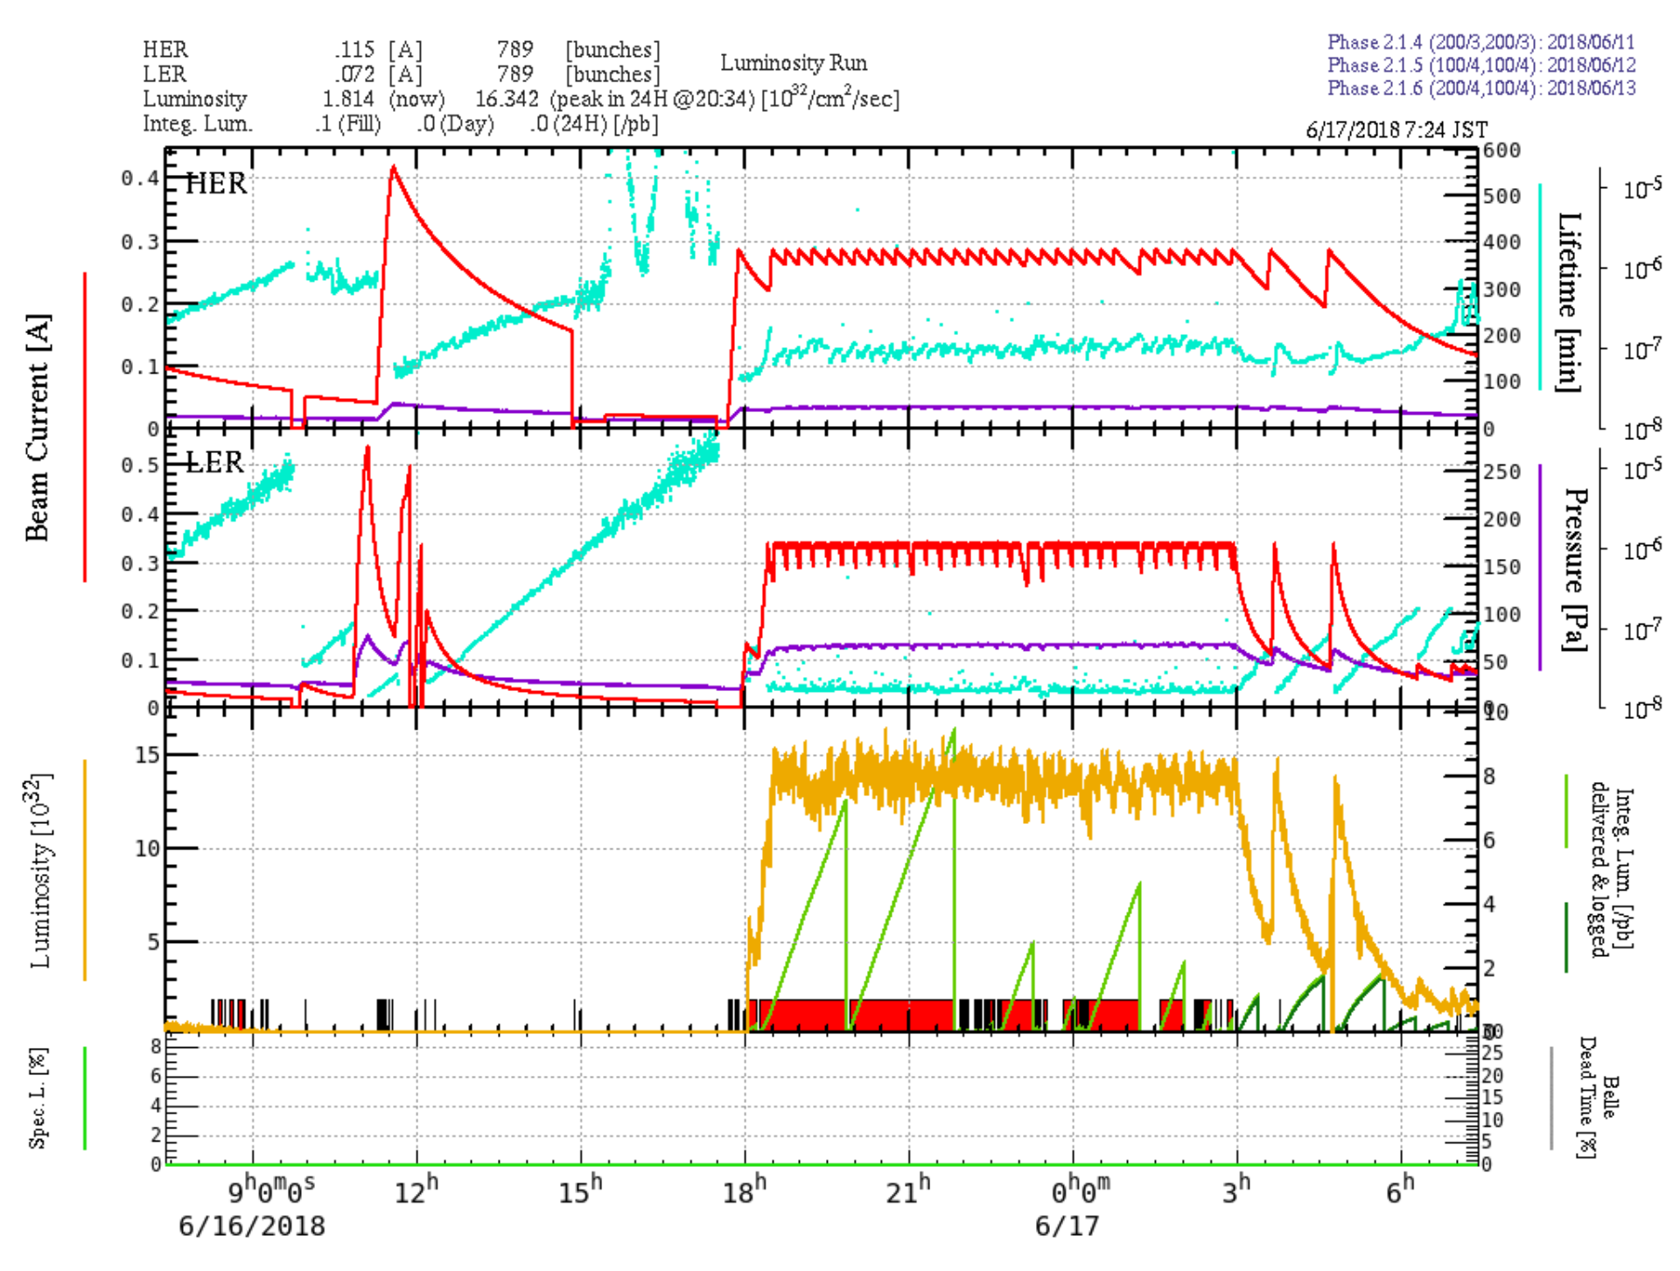
rf e- gun injection to HER
rf e- gun
thermionic e- gun

Slide 11
Emittance and bunch charge status
 | LER injection e+ beam |  | HER injection e- beam
 | Goal | Current status | Goal | Current status
Normalized emittance (Hor./Ver.) (mm∙mrad) | 200/40 (w/ DR) | 192 ± 22.4 / 2.01 ± 0.363 @ Sector3 185 ± 28.4 / 1.72 ± 0.704 @ Sector5 | 150/150 | rf e- gun 23.411 ± 1.867/18.593 ± 9.372 @ SectorB 25.048 ± 18.128/37.960 ± 9.807 @ SectorC 49.258 ± 61.683/51.167 ± 38.077 @ Sector5 Thermionic e- gun e.g.) 250/100 @ Sector5
Bunch charge (nC) | 0.5 | 1.4 (w/ flux concentrator) @ Sector5 | 1.0 | 1.0 (thermionic e- gun) @ Sector5 1.0 ~ 3.0 (rf e- gun) @ Sector5
Phase II parameters are almost achieved.
Horizontal emittance of e+ beam and e- emittance at BT are large.

Slide 12
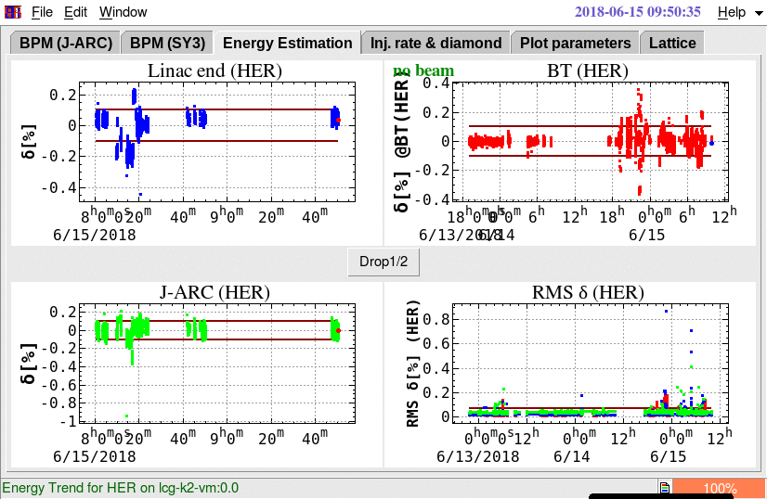
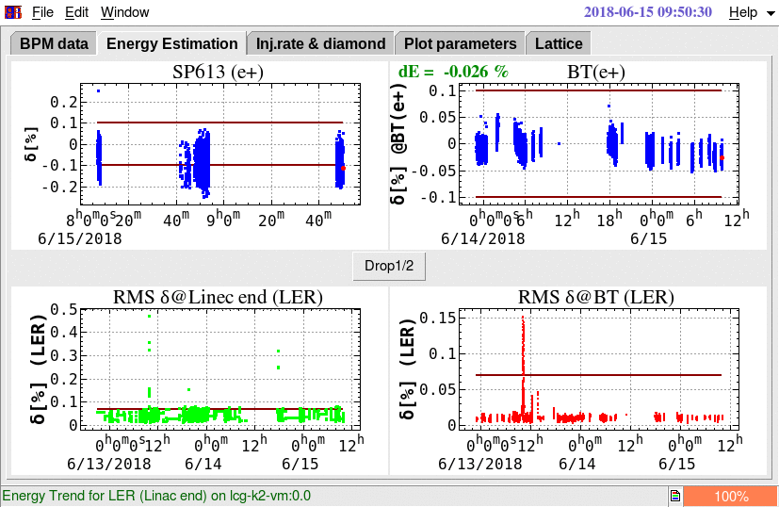
Energy feedback,etc
Energy feedback at J-ARC, Sector2, Sector5 for each beam operation mode (HER, LER, light source injection beam)
Energy fluctuation at BT: < ± 0.1%
When klystron down at Linac:
Beam gate close => waiting for recovery of klystron ( 8 s ) => beam gate open
Energy stability of e- beam
Energy stability of e+ beam

Slide 13
Towards Phase III
Investigation of
e- beam emittance growth at BT.
large horizontal emittance of e+ beam
Large misalignment at Sector2 (~ 2 mm)
will be fixed in this summer shutdown
Simultaneous top up for HER, LER, PF, PF-AR by using rf e- gun and thermionic e- gun
Fast switching (50 Hz): rf e- gun and thermionic e- gun
Beam position jitter issue

Slide 14
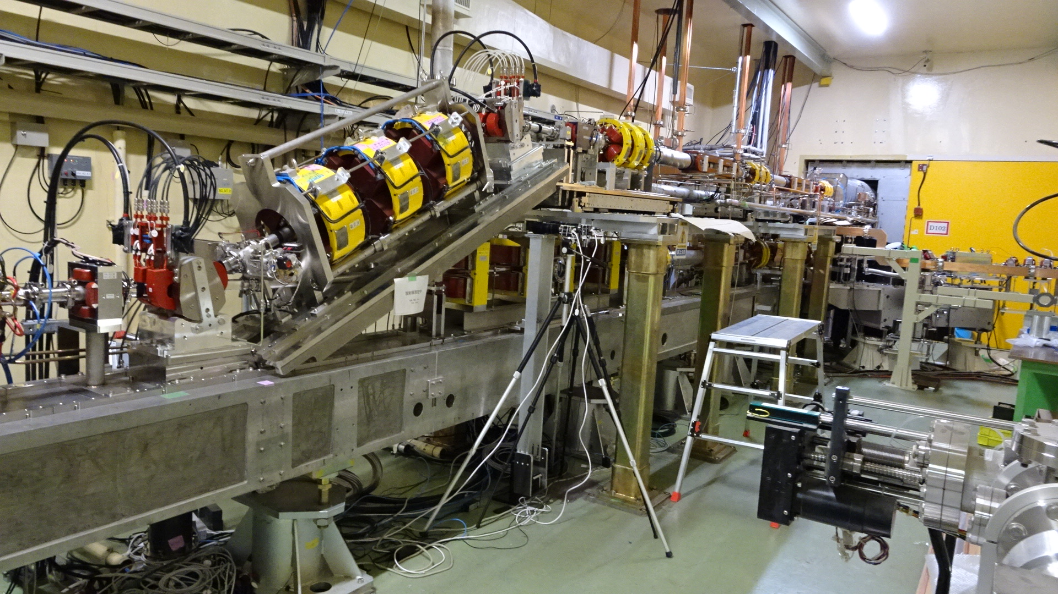
Pulse to pulse switching: rf e- gun/thermionic e- gun
Thermionic DC e- gun
(GU_AT)
・e+ production e-: 10 nC
・e- study/HER injection: 1 nC
・PF injection: 0.3 nC
・PF-AR injection: 0.3 nC
BM_AT_J1
RF e- gun
（GR_A1 for HER injection）
BM_AT_J5
24 deg. junction line
DC bend will be replace by pulsed bend
in summer shutdown

Slide 15
Required injector parameters
Stage | KEKB (final) |  | Phase-I |  | Phase-II |  | SuperKEKB (final)
Beam | e+ | e– | e+ | e– | e+ | e– | e+ | e–
Energy | 3.5 GeV | 8.0 GeV | 4.0 GeV | 7.0 GeV | 4.0 GeV | 7.0 GeV | 4.0 GeV | 7.0 GeV
Stored current | 1.6 A | 1.1 A | 1 A | 1 A | – | – | 3.6 A | 2.6 A
Life time (min.) | 150 | 200 | 100 | 100 | – | – | 6 | 6
Bunch charge (nC) | primary e- 10 → 1 | 1 | primary e- 8 → 0.4 | 1 | 0.5 | 1 | primary e- 10 → 4 | 4
Norm. Emittance (γβε) (μrad) | 1400 | 310 | 1000 | 130 | 200/40 (Hor./Ver.) | 150 | 100/15 (Hor./Ver.) | 40/20 (Hor./Ver.)
Energy spread | 0.125% | 0.125% | 0.5% | 0.5% | 0.16% | 0.1% | 0.16% | 0.07%
Bunch / Pulse | 2 | 2 | 2 | 2 | 2 | 2 | 2 | 2
Repetition rate | 50 Hz |  | 25 Hz |  | 25 Hz |  | 50 Hz
Simultaneous top-up injection | 3 rings (LER, HER, PF) |  | No top-up |  | Eventually |  | 4+1 rings (LER, HER, DR, PF, PF-AR)

Slide 16
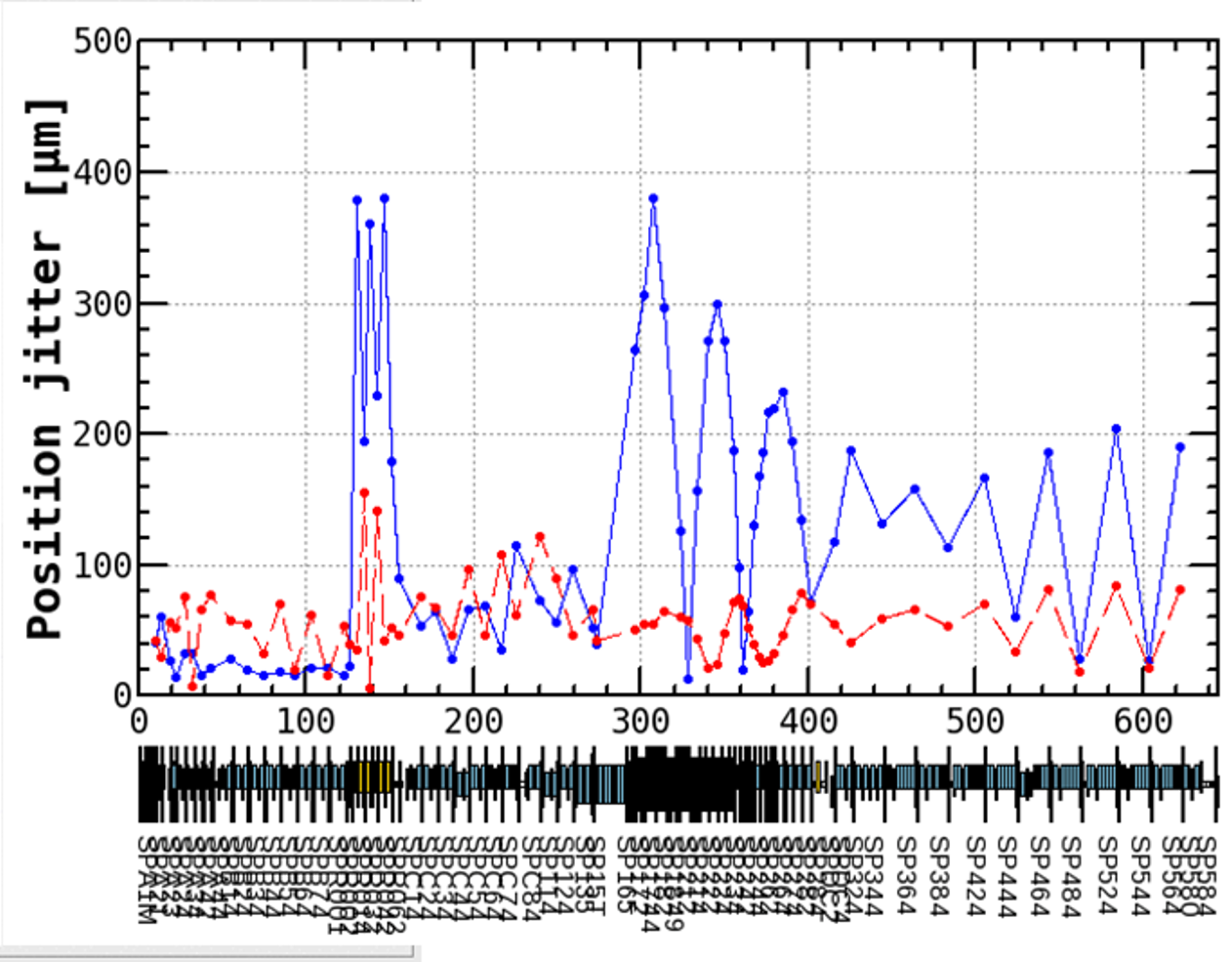
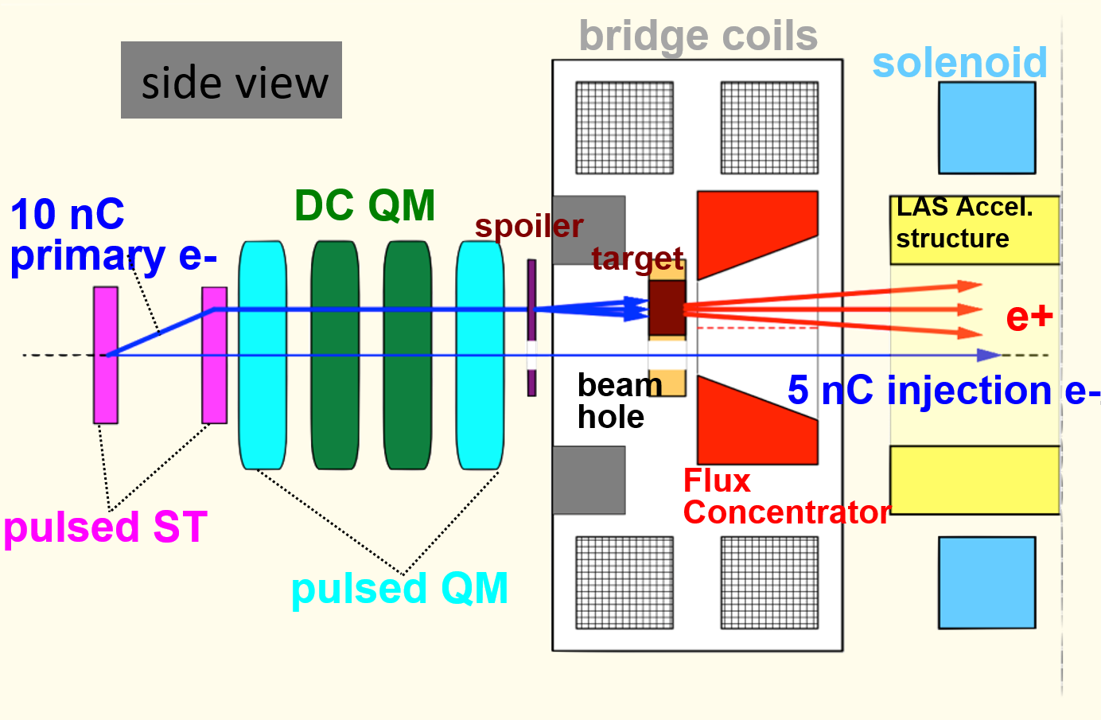
Beam position jitter issue
e+ target w/ small beam hole for e- beam (φ2 mm)
Small beam hole could cause the beam position jitter.
Machine study plan:
Remove e+ target in this summer shut down and install test dummy target w/ small hole of various diameter.
e+ target will be back in winter shutdown for Phase III
J-ARC
ηx ~ 0.8 (m)
e+ target
Horizontal
Vertical

Slide 17
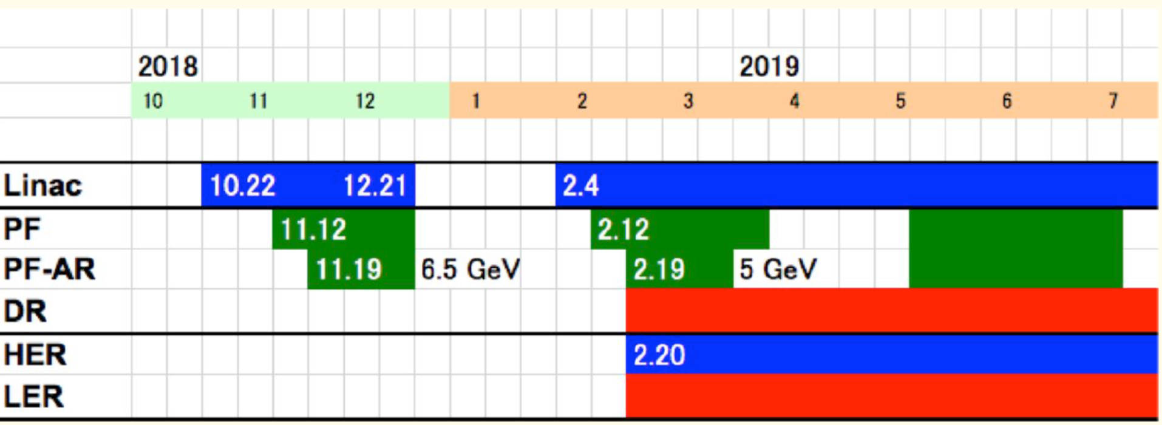
Schedule: Oct. 2018 -
Pulsed bend (thermionic/rf gun merger line), some pulsed quads and steering installation in this summer shutdown
Flux concentrator reinstallation during winter shutdown
50 Hz operation (will be tested in Dec. ‘18)

Slide 18
Summary
Success of simultaneous injection to PF, PF-AR, HER, and LER from thermionic e- gun.
Timing system for DR, pulsed quads and steering magnets work well.
Success of HER injection via rf e- gun
Required parameters for Phase II are almost achieved. e- emittance at BT and horizontal emittance of e+ after DR should be improved.
Towards Phase III
Simultaneous top up injection with thermionic/RF e- gun
Pulsed bends and quads installation (in this summer shutdown)
High bunch charge and low emittance preservation
Beam line alignment (in this summer shutdown)
Beam jitter study w/o e+ target (in Oct. – Dec., 2018)
Beam orbit control study (in Oct. – Dec., 2018)

