Slide 1
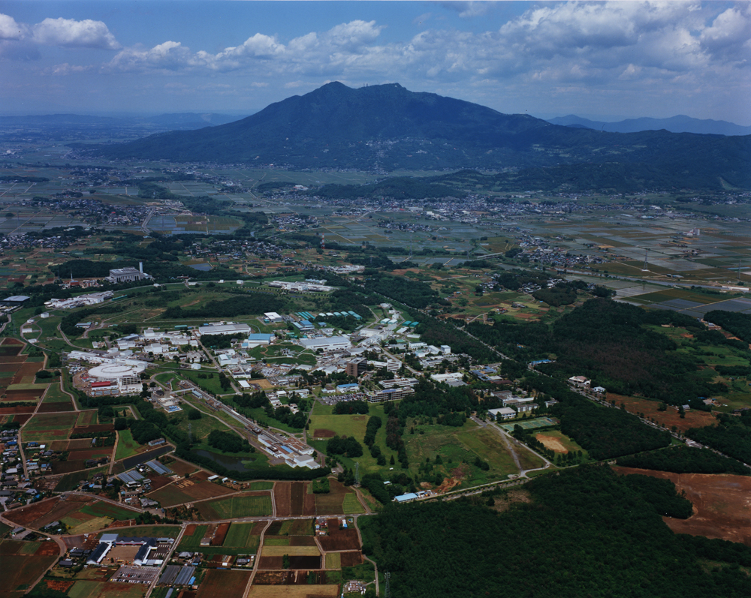
Issues in SuperKEKB Phase 2 Operation
Y. Funakoshi for the SuperKEKB commissioning team
Accelerator Laboratory, KEK
2018.10.15@B2GM

Slide 2
Contents
Missions of Phase 2 and achievements
QCS quench issue
High current issues
Detector beam background

Slide 3
Missions of Phase 2
Peak luminosity 1 x 10³⁴ cm⁻² s⁻¹ (Validation of “nano beam scheme”)
Squeezing β_{y}*
Ohnishi’s talk
Specific luminosity (beam-beam parameter)
Ohnishi’s talk
Increasing beam currents
This talk
Beam background issues
Iida’s talk in BEAST session this afternoon, This talk
QCS quench issue
This talk
Tuning and Study of Injector Linac
Furukawa’s talk

Slide 4
QCS quench issues

Slide 5
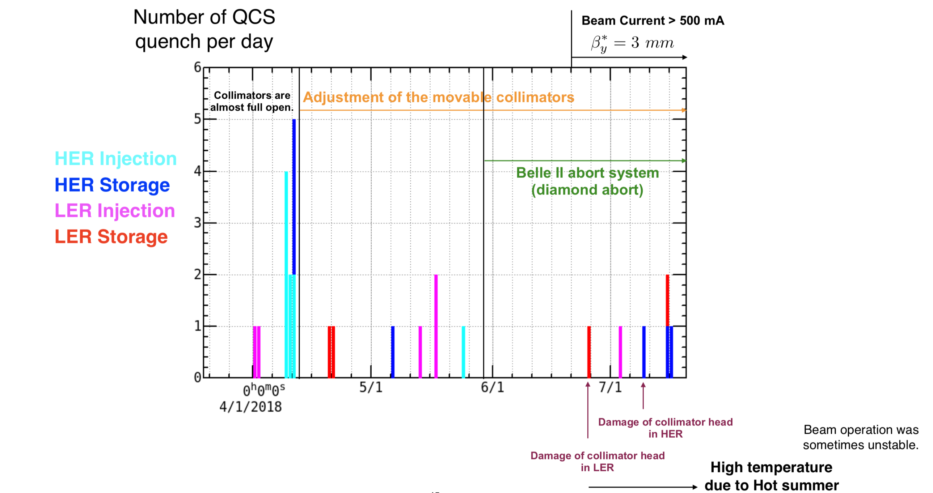
Frequency of QCS quenches
Y. Ohnishi

Slide 6
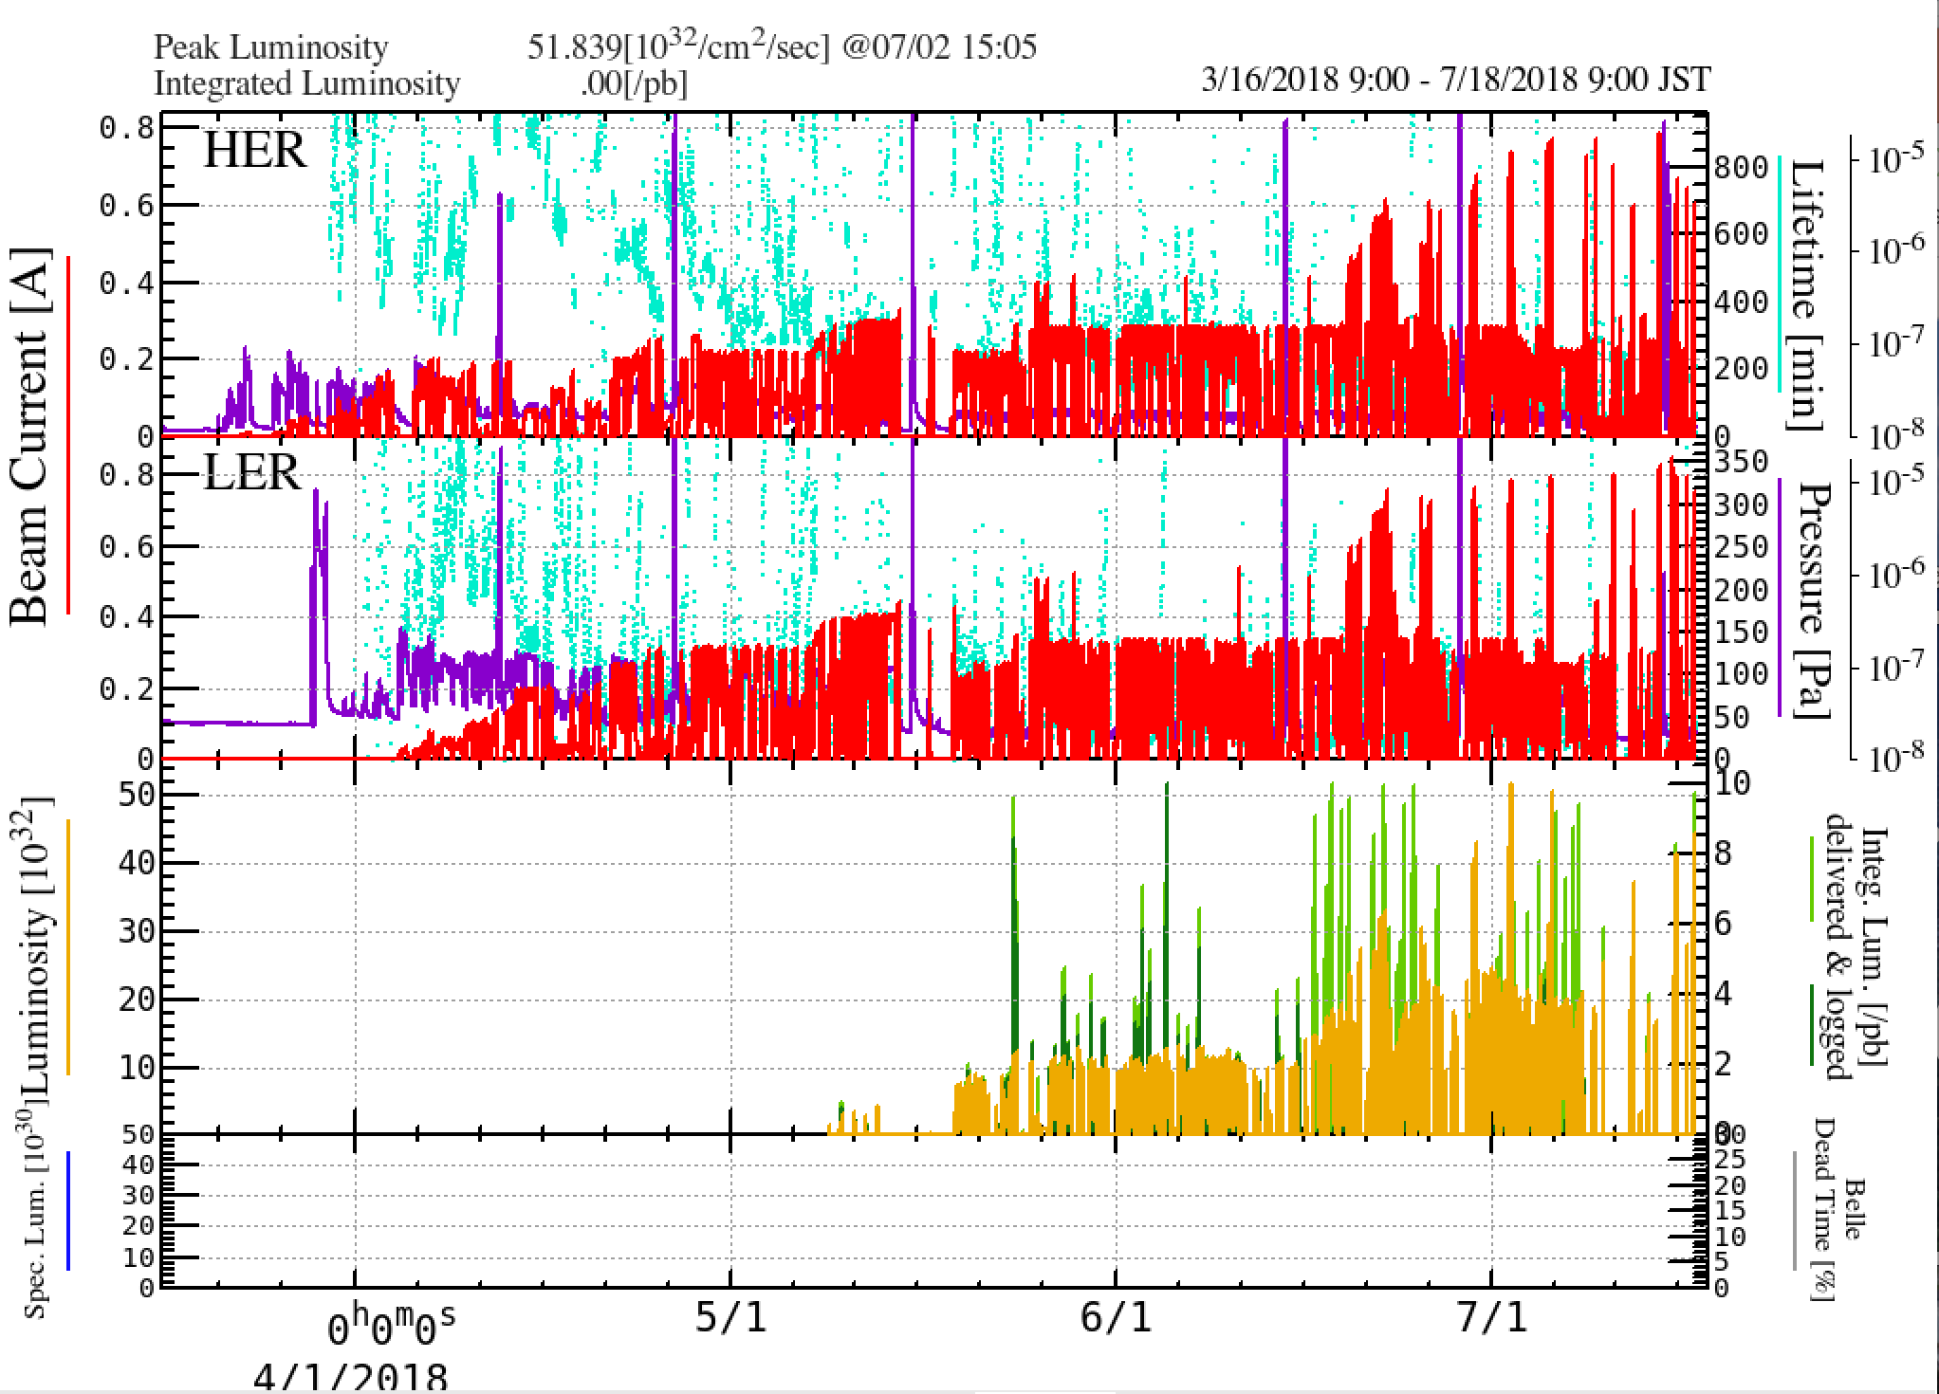
History of SuperKEKB Phase 2
2018/7/23 Monday Meeting
β_{y}*= 80mm
β_{y}*= 8mm
6mm
β_{y}*= 4mm
β_{y}*= 3mm
5.55 x 10³³/cm²/s (βy*3mm, LER: 800mA, HER: 780mA, 1576 bunches/beam July 5th)
2.29 x 10³³/cm²/s (βy*3mm, LER: 270mA, HER: 225mA, 394 bunches/beam July 3rd)

Slide 7
List of QCS quenches (from QCS group)
38coils quenches, 26 events
Date | Time | Quenched Magnet | Beam Line |  | Causes | Injection/strorage
2018/4/1 | 20:55 | QC1LP | LER |  | Injection Kicer K1, K2 balance | Injection
2018/4/2 | 19:29 | QC1LP | LER |  | Injection Kicer K1, K2 balance (EVR module) | Injection
2018/4/9 | 17:31 | QC1LE-a1 | HER |  | Trial of βy*=2.4mm | Injection
2018/4/9 | 20:06 | QC1LE-a1 | HER |  | Trial of βy*=2.4mm | Injection
2018/4/9 | 20:53 | QC1LE-a1 | HER |  | Trial of βy*=2.4mm | Injection
2018/4/9 | 21:40 | QC1LE-a1 | HER |  | Trial of βy*=2.4mm | Injection
2018/4/10 | 17:44 | QC1LE-a1 | HER |  | Trial of βy*=2.4mm (BT V steering tuning中) | Injection
2018/4/10 | 21:56 | QC1RE-b1 | HER |  | Trial of βy*=8mm | Injection
2018/4/11 | 14:21 | QC1RE-b1 | HER |  | Trial of βy*=8mm | Injection
2018/4/11 | 15:25 | Cancel-Mag-b3 | HER |  | Trial of βy*=8mm | Injection
2018/4/11 | 18:45 | QC1RE-b1 | HER |  | Trial of βy*=8mm tune changer | Storage? (10mA)
2018/4/11 | 20:23 | QC1RE-b1 | HER |  | Trial of βy*=8mm local bump in downstream of IP | Storage (5mA)
2018/4/11 | 21:15 | QC1RE-b1 | HER |  | Trial of βy*=8mm local bump in downstream of IP | Storage (10mA)
2018/4/20 | 14:33 | QC1RP | LER | Single event | RF Phase scan Mis-operation (big Phase jump) | Storage (48mA)
 | 14:33 | QC1LP | LER
 | 14:33 | QC1RP-b1 | LER
2018/4/21 | 0:21:49 | QC1LP | LER | single event | unknown (after end of RF phase scan) | Storage (18mA)
 | 0:21:51 | QC1RP | LER
 | 0:22:13 | QC1RP-b1 | LER
2018/5/6 | 11:28 | QC1LE-b1 | HER |  | Waist knob test (locally large orbit or beta-beat) | Storage (35mA)
2018/5/13 | 2:45 | QC1RP-b1 | LER |  | Beam injection with ECK=-2 | Injection
2018/5/17 | 2:09 | QC1RP-b1 | LER |  | βy*=6mm K2-3 malfunction? | Injection
2018/5/17 | 4:06 | QC1RP-b1 | LER |  | βy*=6mm K2-3 malfunction? | Injection
2018/5/24 | 17:17 | QCSL-Can-b3 | HER |  | Trial of βy*=4mm, v-collimators not enough | Injection
Narrower collimator setting to prevent QCS quench
May 28th Belle abort using diamond sensor was introduced.

Slide 8
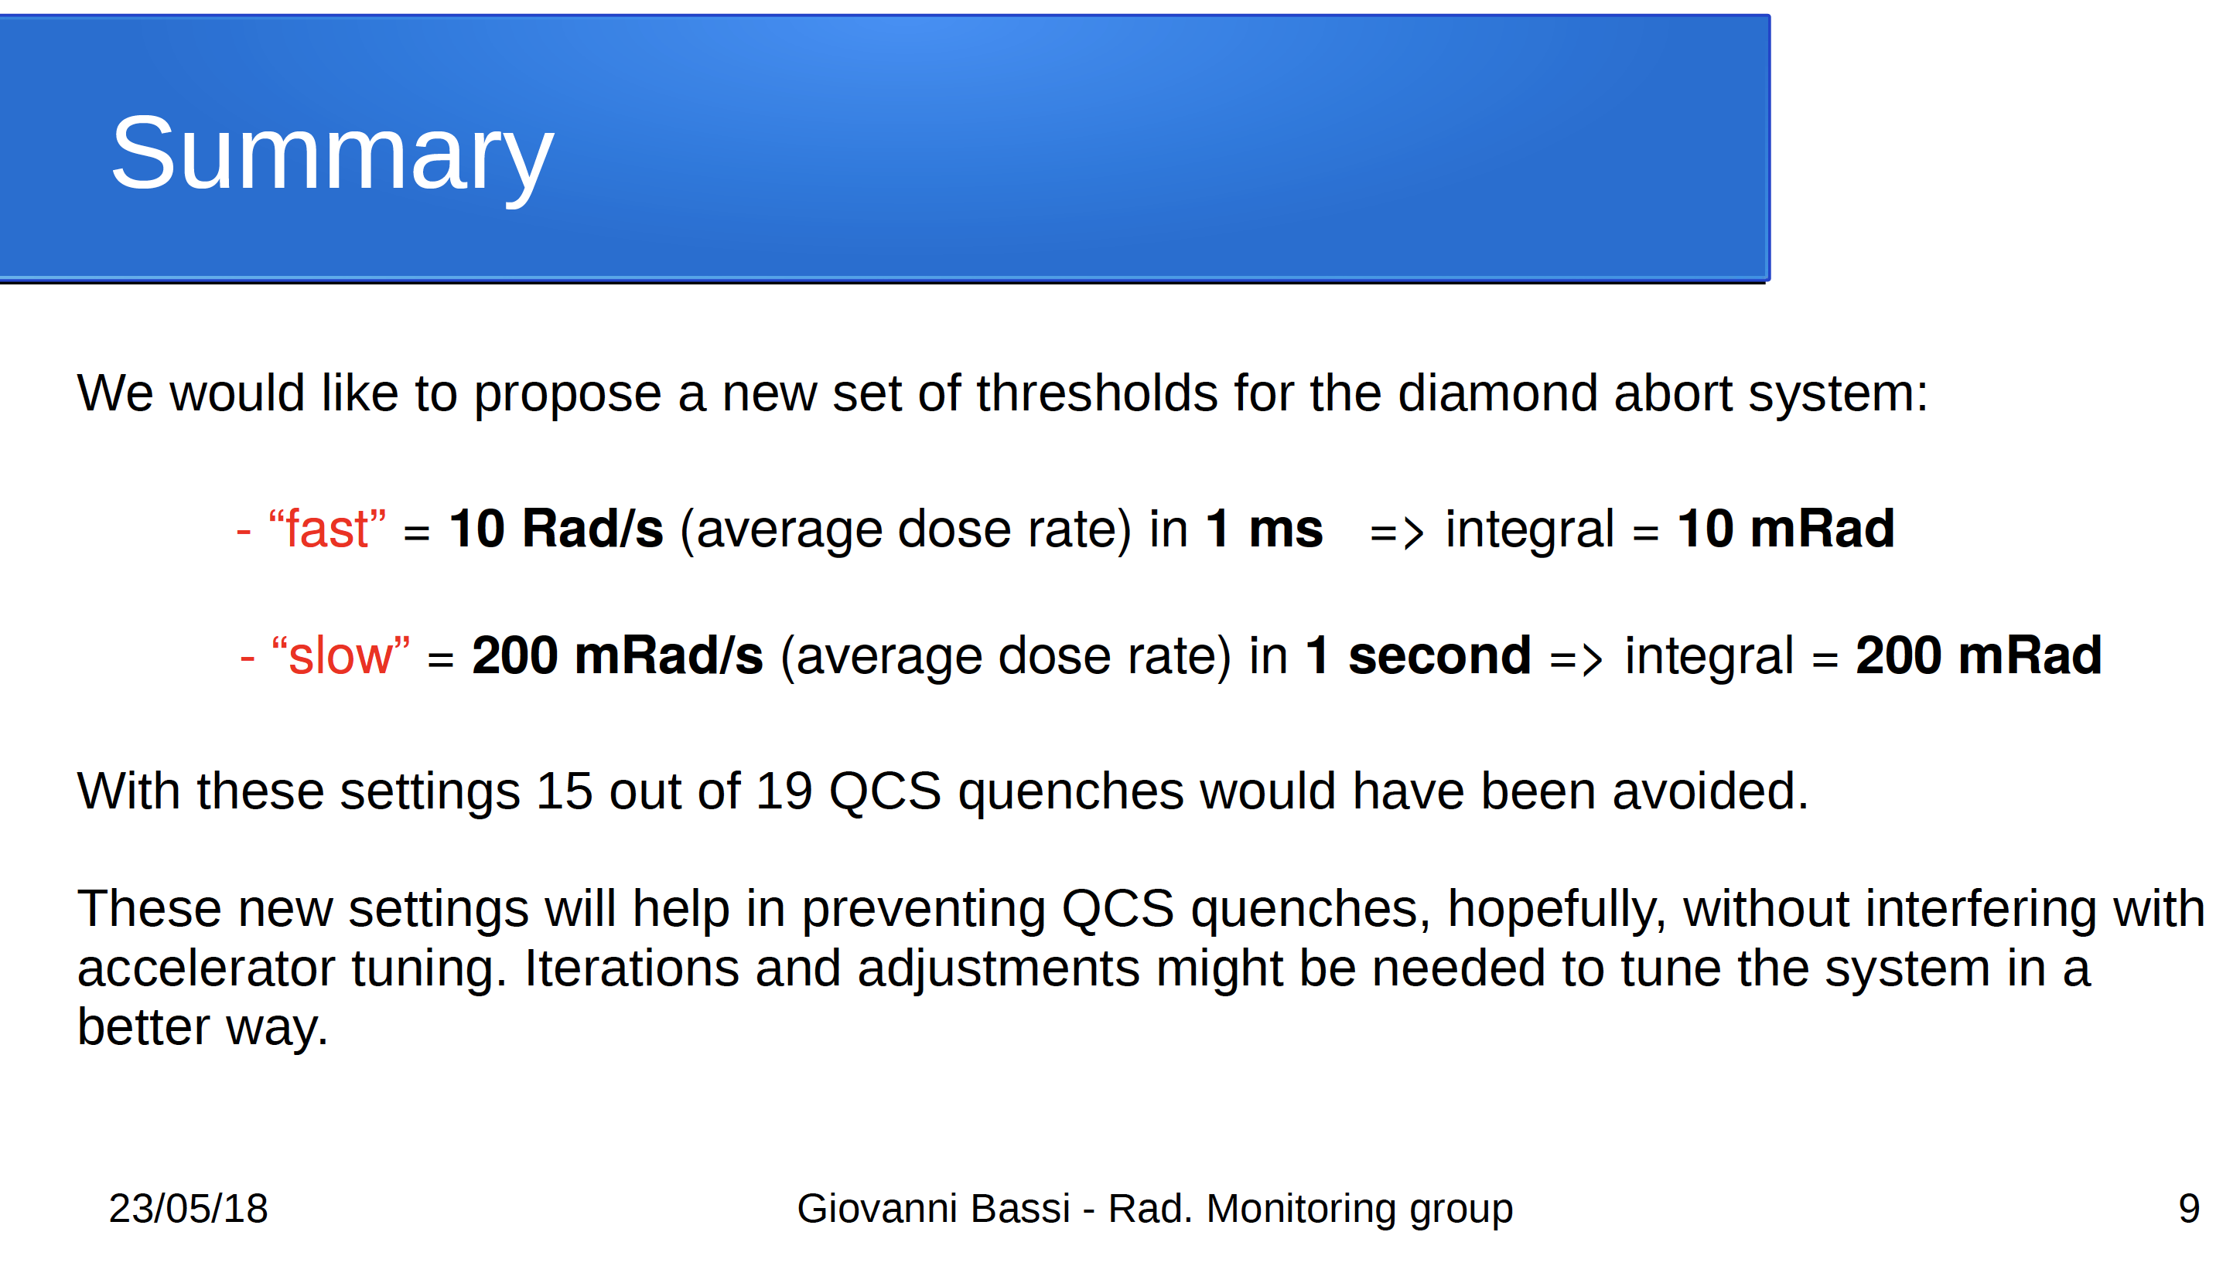
Belle 2 beam abort based on diamond sensors

Slide 9
List of QCS quenches (from QCS group)
38coils quenches, 26 events
Date | Time | Quenched Magnet | Beam Line |  | Causes | Injection/storage
2018/6/25 | 11:20 | QC1RP | LER |  | D02V1 collimator was damaged. At this moment, a big beam loss (~100mA) was induced. A vacuum burst was observed. | Storage (728mA)
 |  | QC1RP-b1
 |  | QC1LP
2018/7/3 | 5:14 | QC1RP-b1 | LER |  | Continuous bad injection? | Injection
2018/7/9 | 11:20 | QC1LE | HER |  | D01V1 collimator was damaged. At this moment, a big beam loss (~100mA) was induced. A vacuum burst was observed. | Storage(766mA)
 |  | QC1LE-b1
 |  | QCSL Cancel
2018/7/15 | 22:32 | QC1RP | LER |  | LER QCS quench happened first due to longitudinal instability. A vacuum burst was observed. LER QCS quench induced HER beam loss and HER QCS quench. | Storage (LER: 793mA)
 |  | QC1LE | HER
 |  | QC1LE-b1
 |  | QCSL Cancel
2018/7/16 | 17:53 | QC1LE-b1 | HER |  | A vacuum burst at D02H collimator was observed. | Storage (HER: 670mA)
 |  | QCS Cancel
5 quenches happened after June 25th.
4 of them were induced stored beam accompanied with vacuum burst.
In 2 cases, beam hit vertical collimators and gave some damages.
The reason why beams hit collimators has not been understood.
No beam orbit change, no beam oscillation.
We suspect the dust trapping effect.

Slide 10
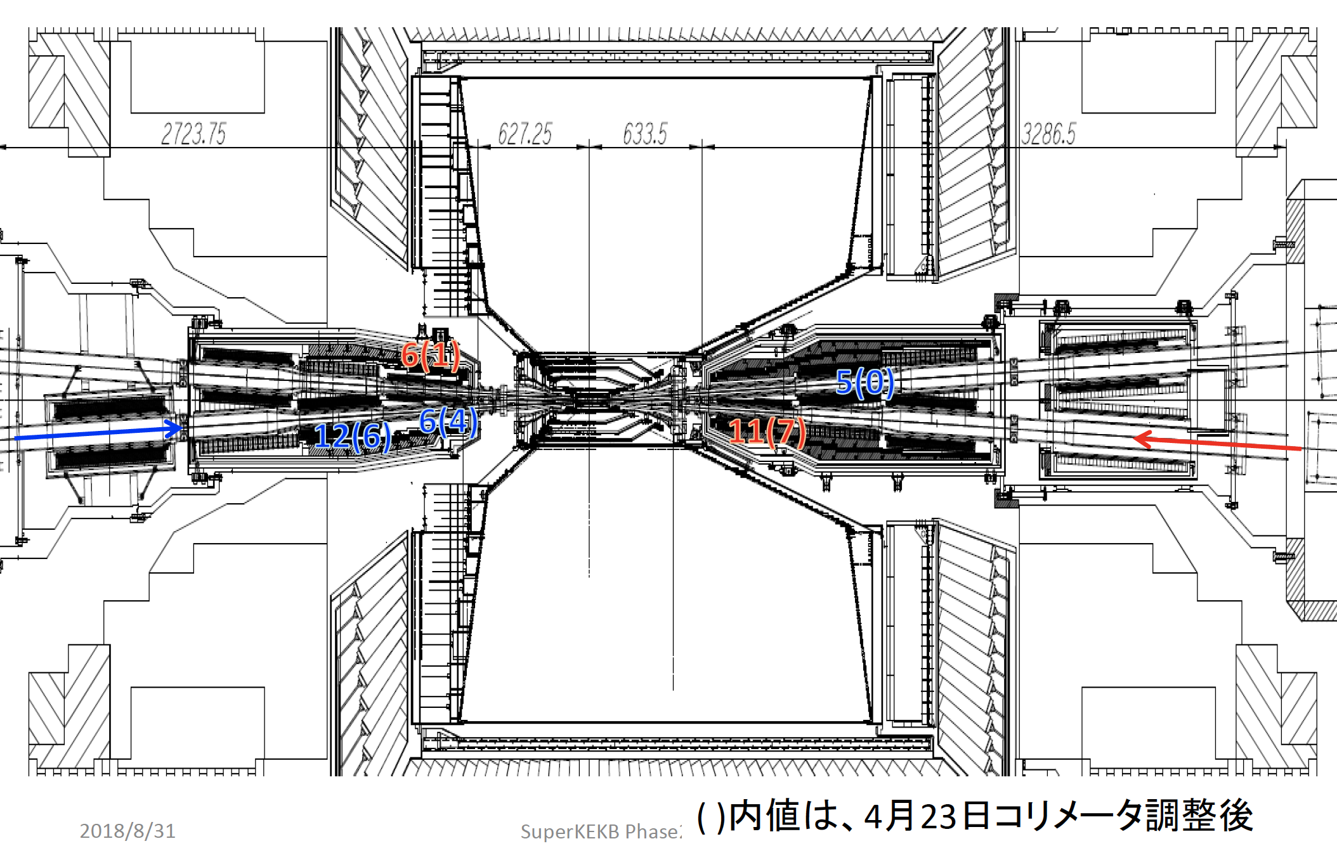
Locations of QCS quenches

Slide 11
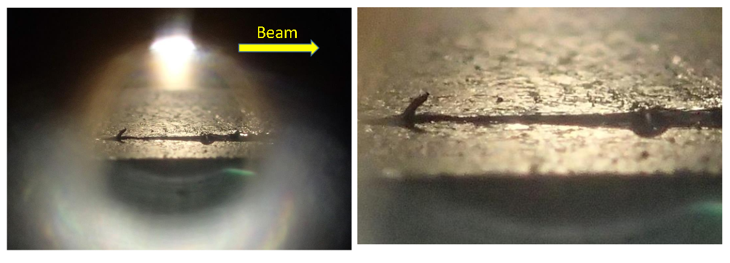
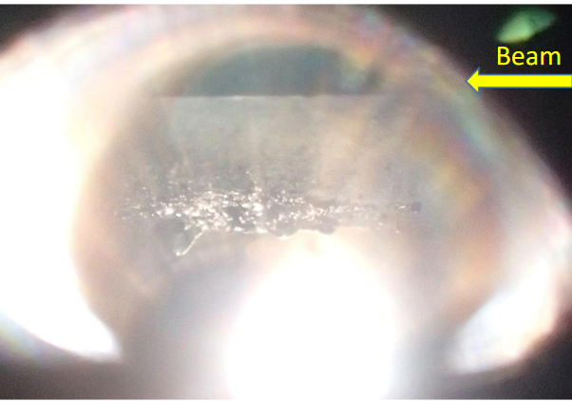
Damage of collimator (LER D02V1)
Bottom
Beam hit bottom of collimator.
Sputtered material (W) stuck to top?
Top
S. Terui

Slide 12
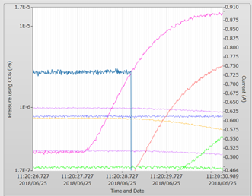
Vacuum burst when collimator was damaged
Beam Current
Vacuum paressure

Slide 13
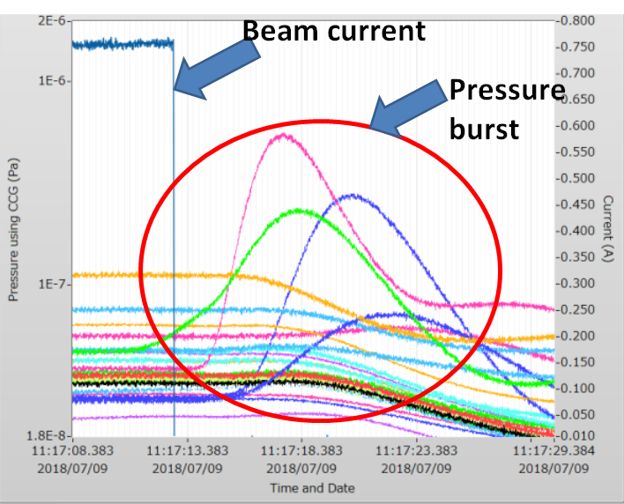
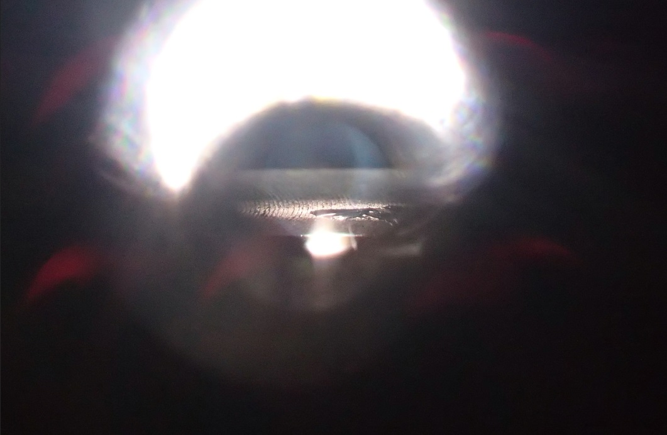
Damage of collimator (HER D01V1)

Slide 14
Summary of QCS quench in Phase 2
During Phase 2, QCS quenches happened 26 times. Once QCS quench happens, it takes about 1.5~2 hours for recovery.
Initial quenches in Phase 2 were mainly induced by injecting beams.
The quenches were almost prevented by setting movable collimators properly and introducing the Belle 2 abort using diamond sensors.
We felt that we had overcome the quenches, since we had no quenches for about a month after the quench on May 24th.
However, on June 25th, the quench happened again by a stored LER beam and 4 quenches followed in July.
The reasons for the QCS quenches have not been understood well. I suspect the dust events may have something to do with the quenches.

Slide 15
To do list for QCS quench
Install more collimators before Phase 3
1 vertical collimator (LER)
3 horizontal collimators (LER), 1 horizontal collimator (HER)
Understanding of mechanism of QCS quench
Ohuchi-san’s simple calculation: If ~8000 electrons (7GeV) lose their entire energy at a small part of a coil, QCS quench can happen.
Simulation on the more precise locations of particle loss near QCS.
Collimator chip scattering, dust trapping…
Simulation on the effect of continuous particle loss due to some processes (ex. Radiative Bhabha process).
More experiences in early stage of Phase 3
A task force on the QCS quench issues has been established.
W shields near QCS? (2019?)
Simulation works are in progress.
Modification of QCS magnet system?

Slide 16
IR
e-
e+
HER
HERコリメータ
D01 H3, H4, 5
D01 V1
LERコリメータ
D02 H1, H2, H3, H4
D02 V1
LER
TSUKUBA
HERコリメータ
D12 H1, H2, H3, H4
D12 V1, V2, V3, V4
LERコリメータ
D03 H1
SuperKEKB Main Ring
SC
ARES
WIGGLER
WIGGLER
NIKKO
OHO
SC
: Horizontal Collimator (KEKB type)
: Vertical Collimator (KEKB type)
: Horizontal Collimator (SuperKEKB type)
: Vertical Collimator (SuperKEKB type)
: Horizontal Collimator (SuperKEKB type)
: Vertical Collimator (SuperKEKB type)
: Horizontal Collimator (SuperKEKB type)
: Vertical Collimator (SuperKEKB type)
WIGGLER
Phase-III
Phase-II
Phase-I
ARES
HERコリメータ
D09 H1, H2, H3, H4
D09 V1, V2, V3, V4
FUJI
LERコリメータ
D06 H1, H3
D06 V2
e-
e+
ARES
ARES

Slide 17
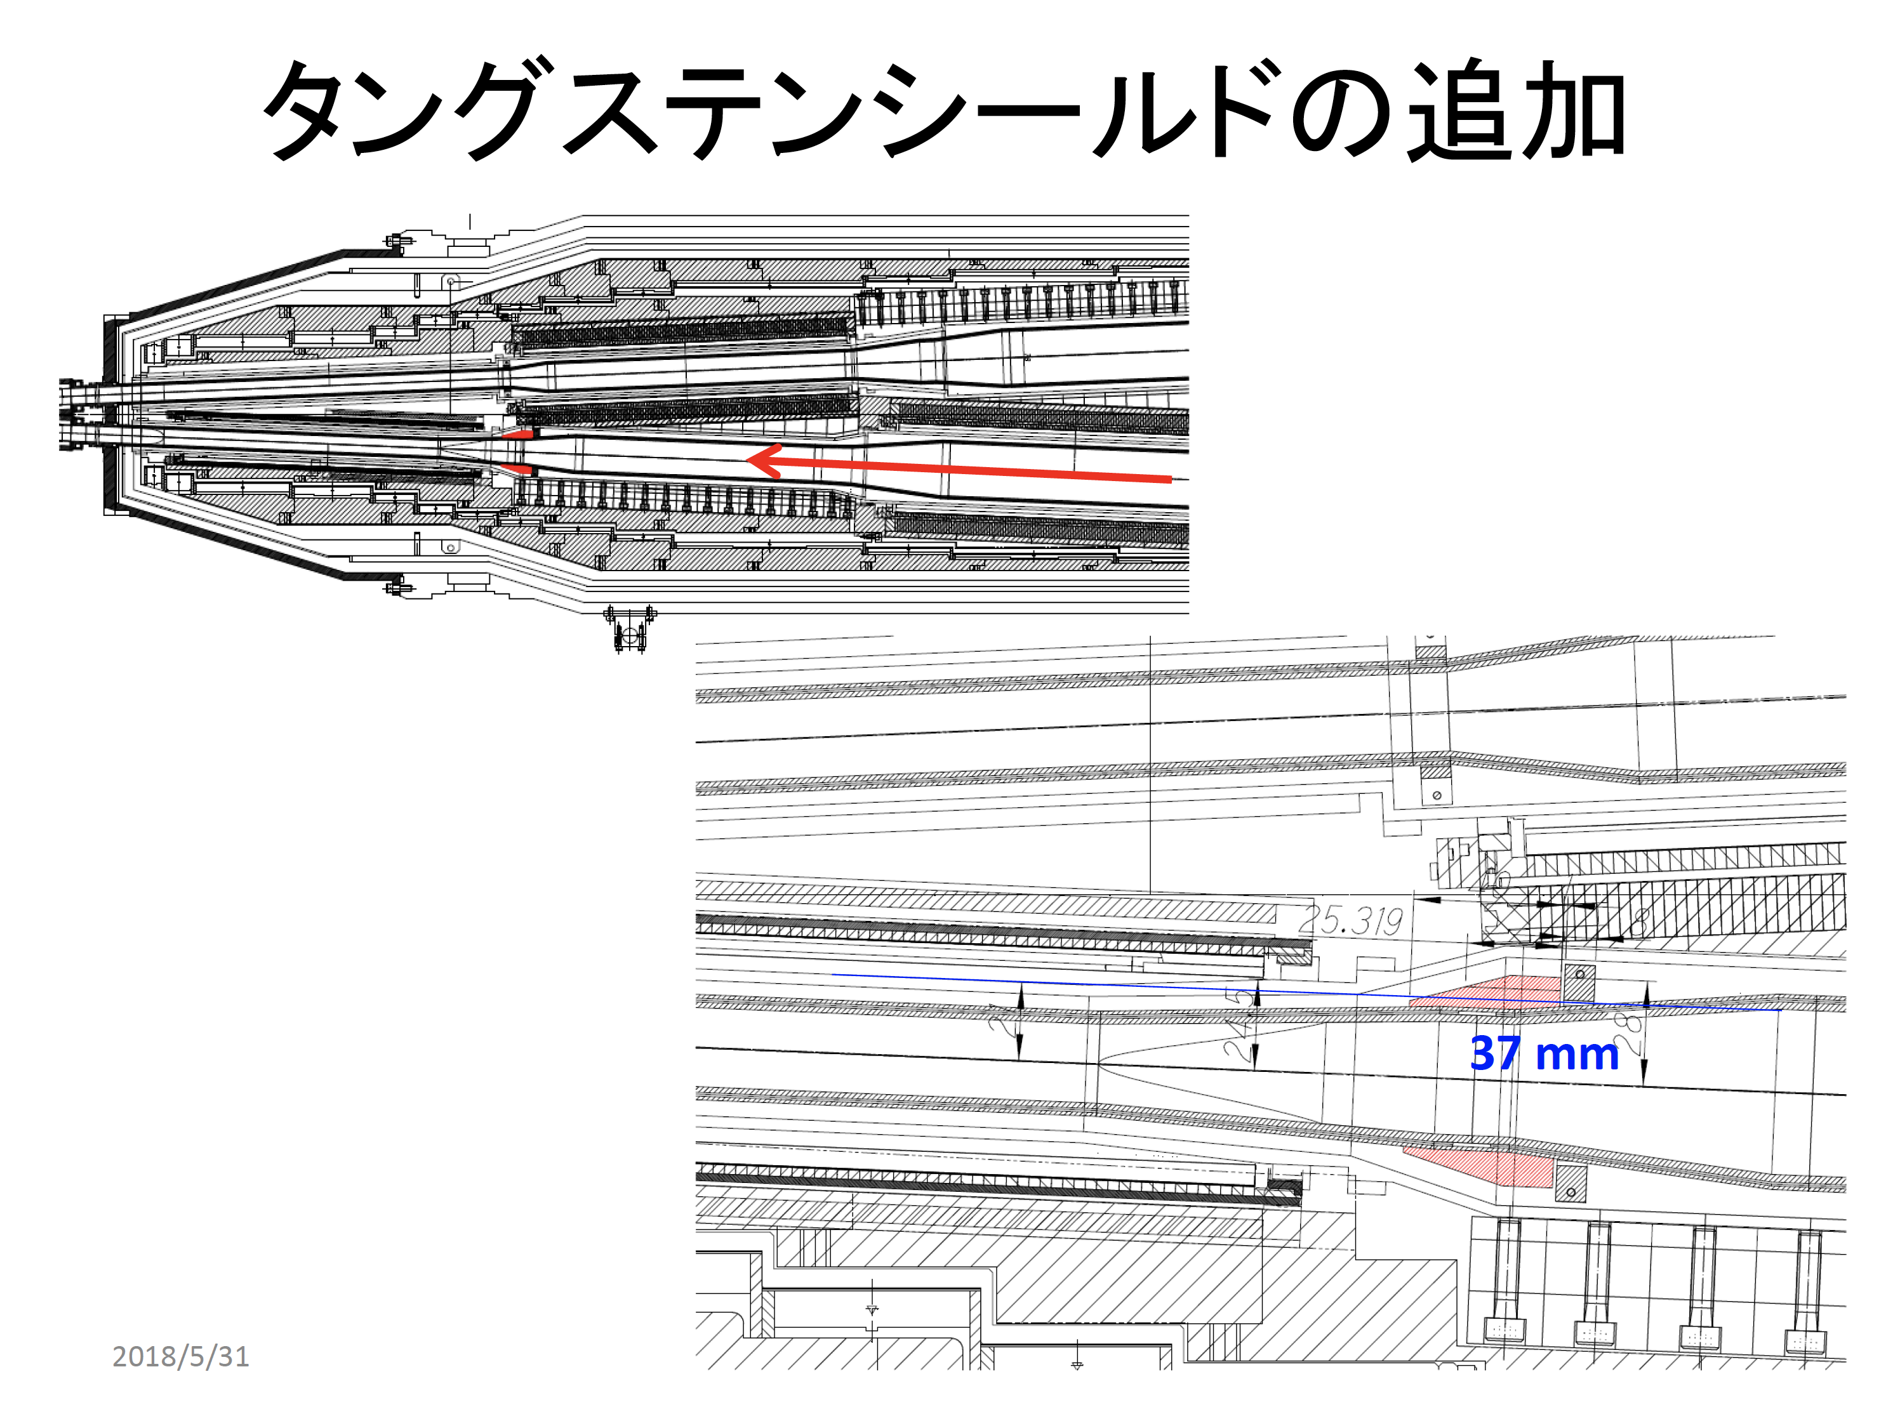
Additional tungsten(W) shield?

Slide 18
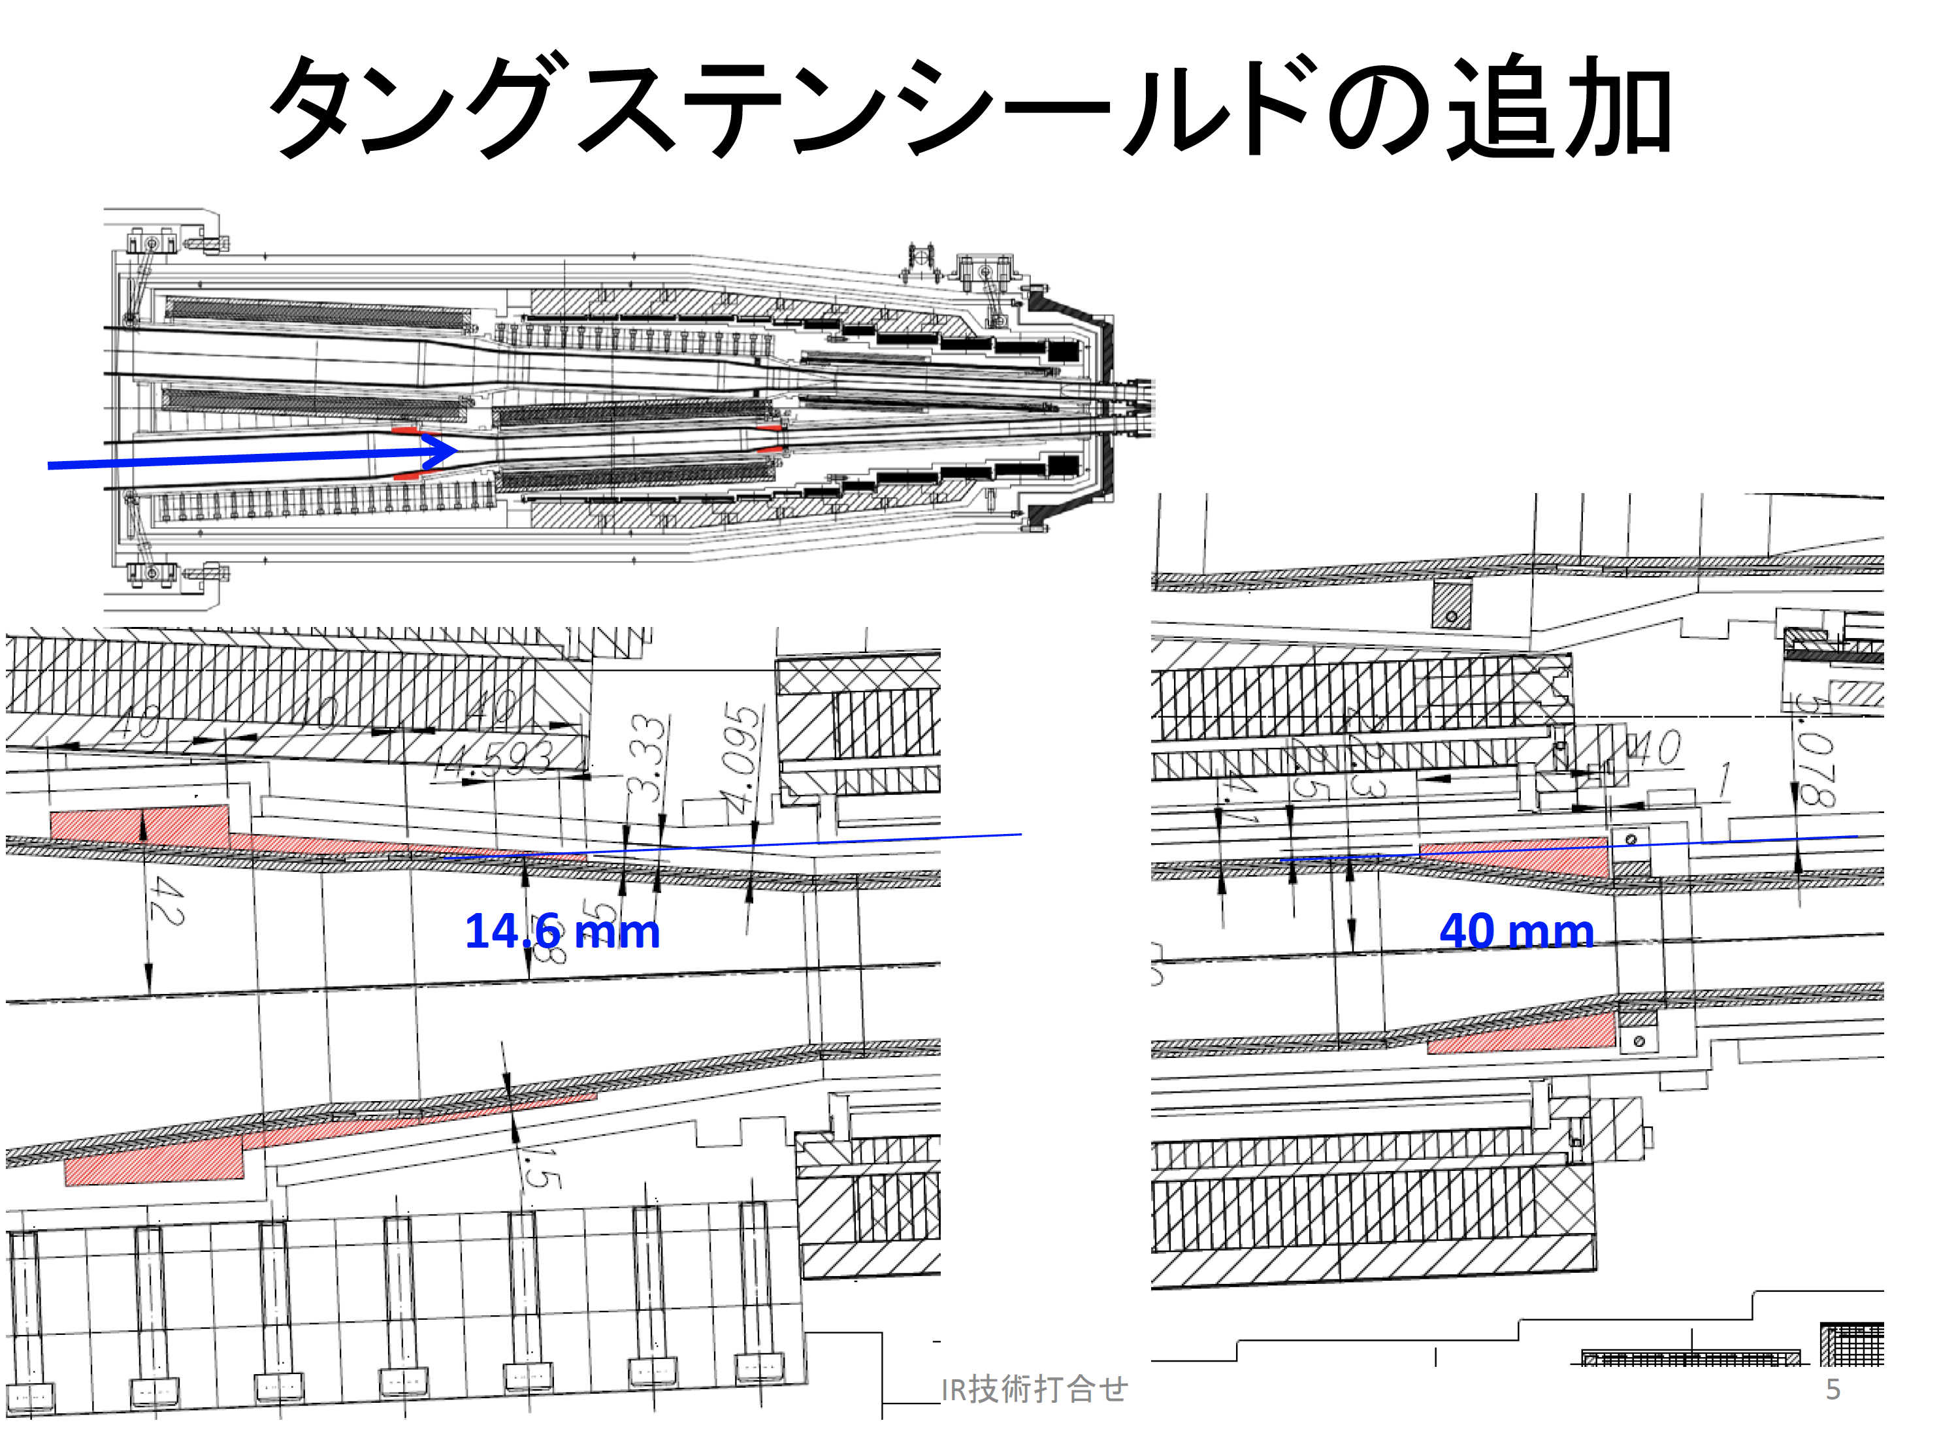
Additional tungsten(W) shield?

Slide 19
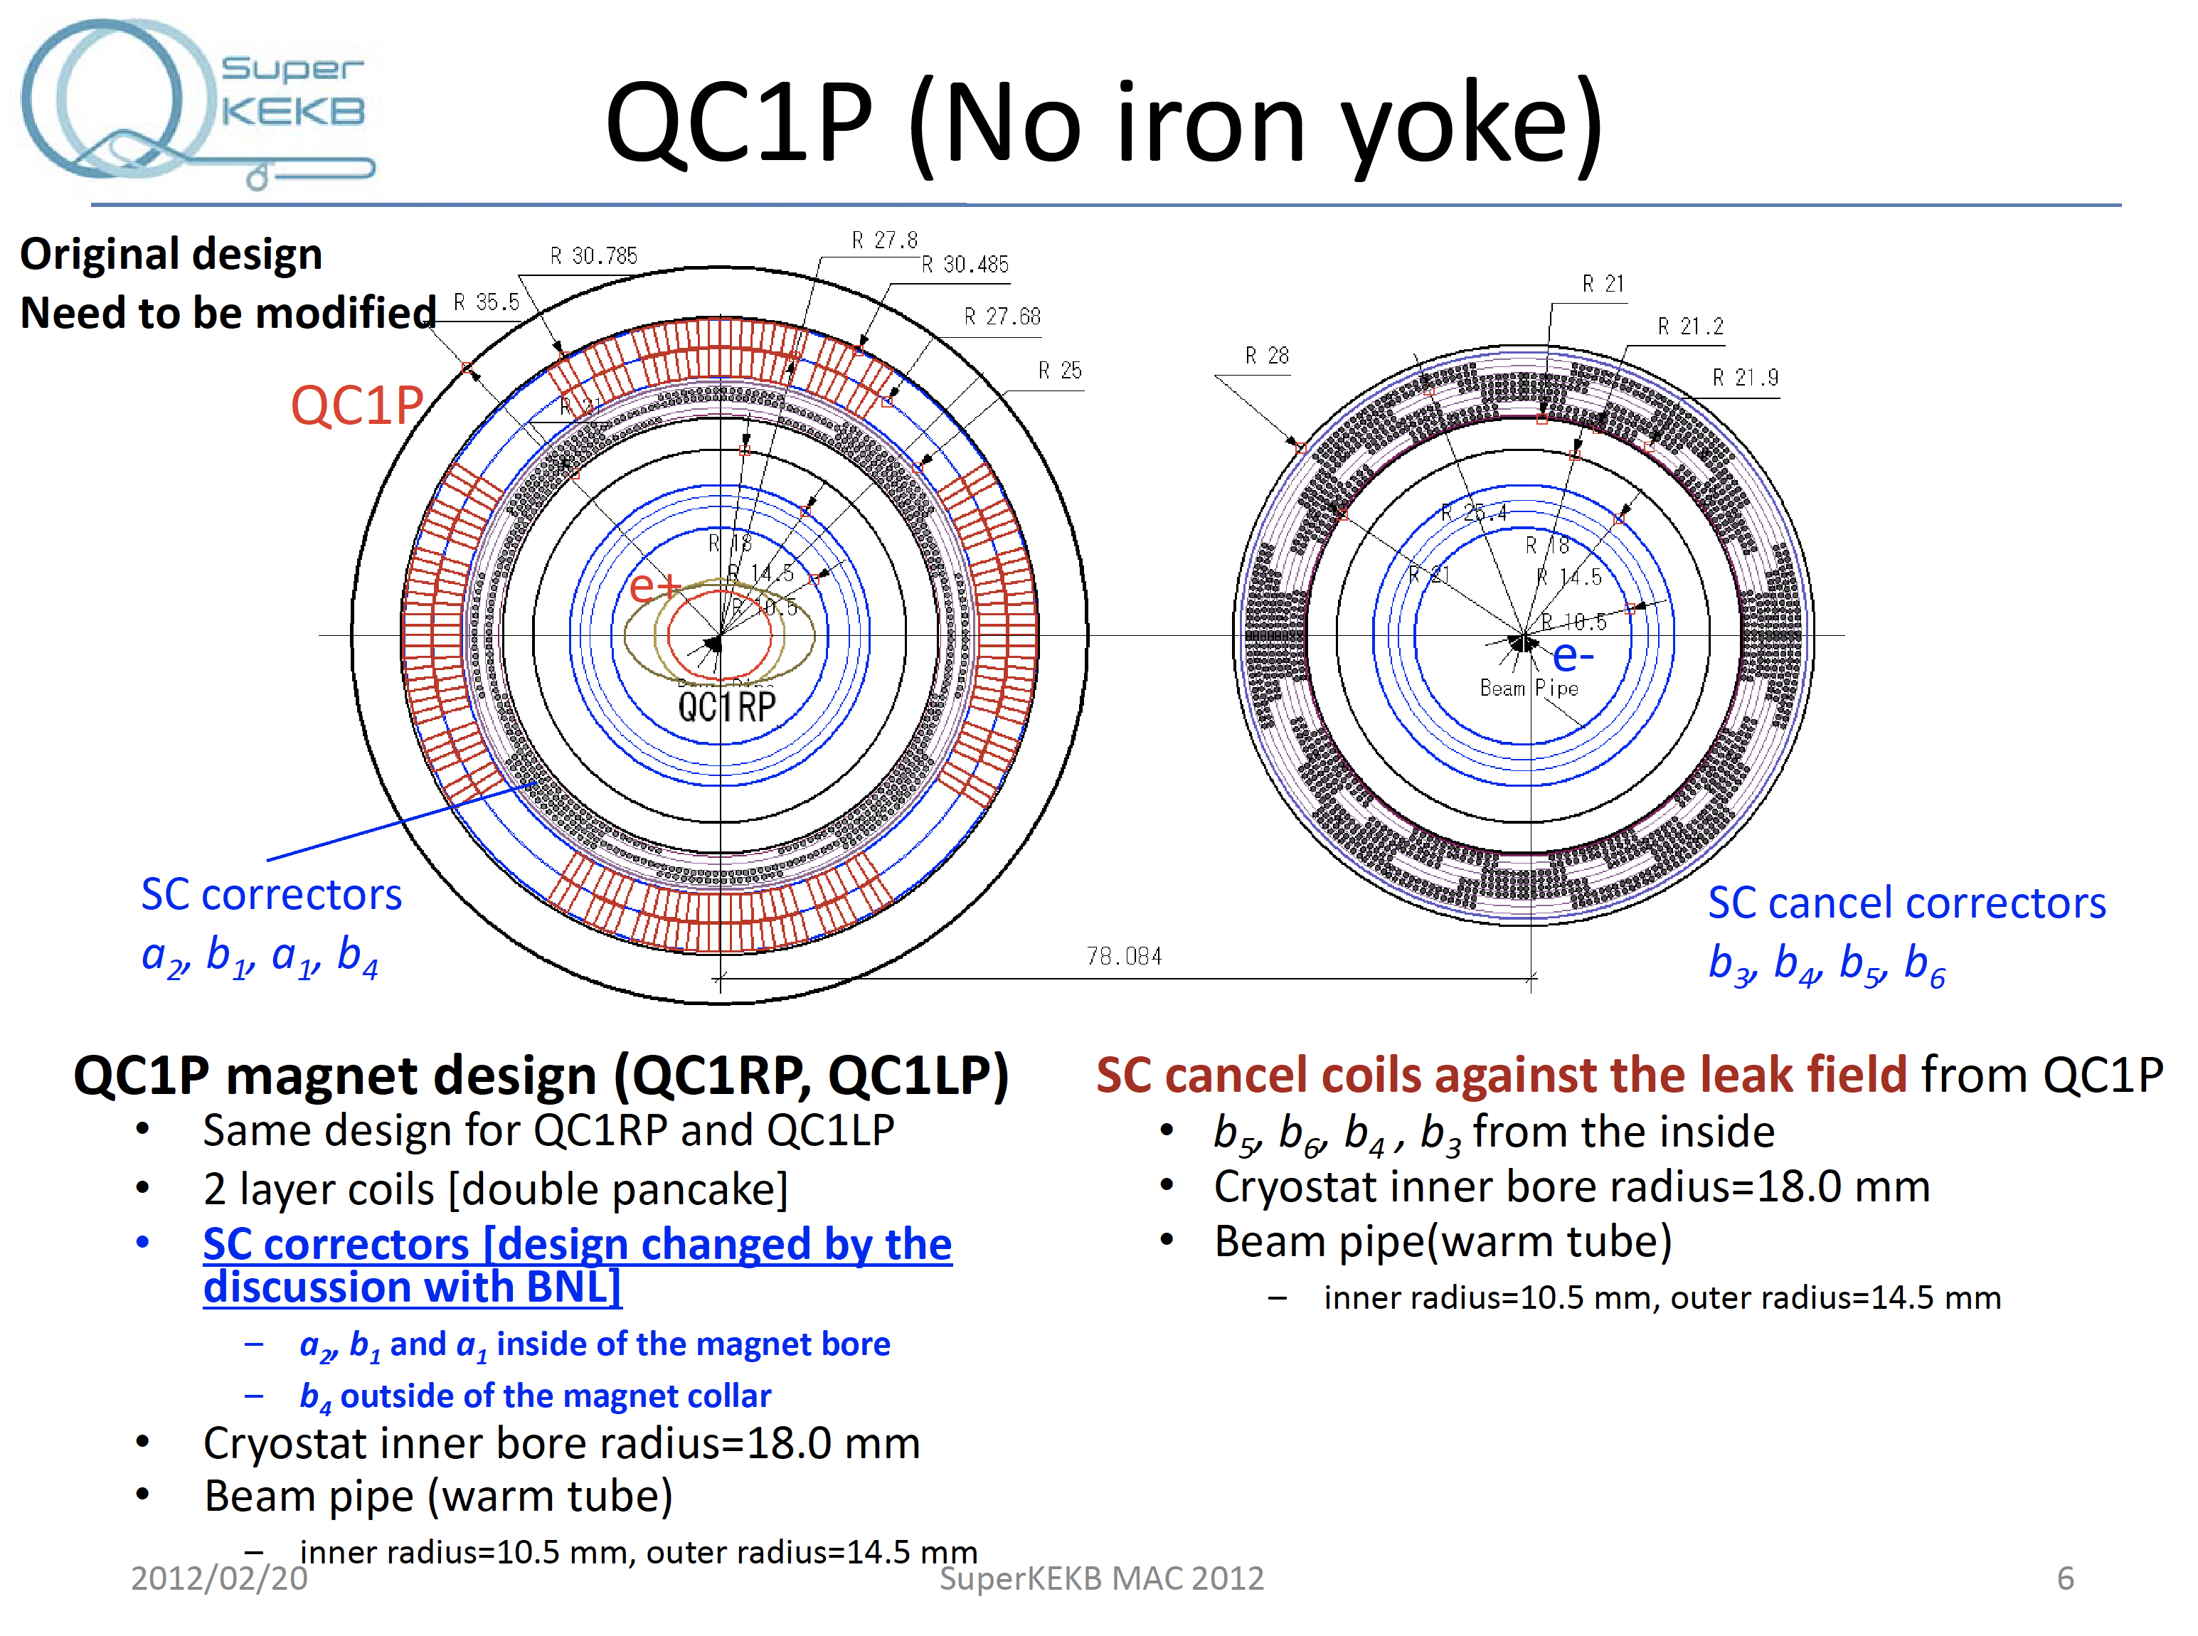

Slide 20
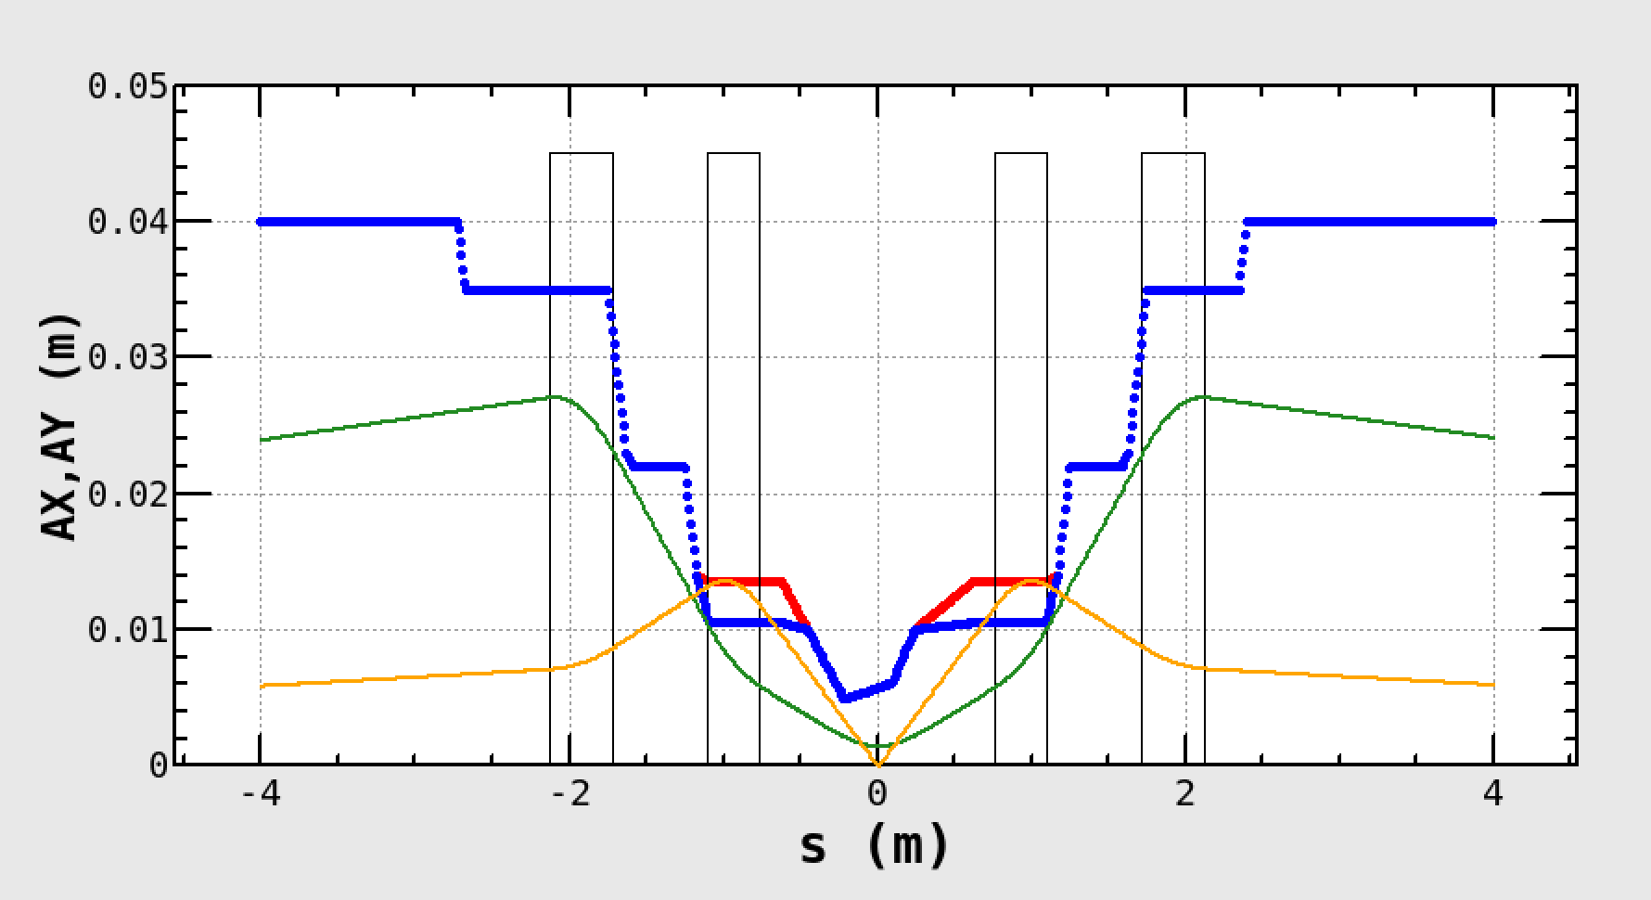
LER beam envelop
β_{x}* = 100mm, β_{y}* = 4mm
b2 coils
e+
horizontal : 80 σ_{x}
W shield
collectors
vertical: 105 σ_{y}
_{(5% coupling)}
Quenches of downstream of IP: induced by horizontal oscillation?
Quenches of upstream of IP: induced by vertical oscillation?

Slide 21
High beam current issues issues

Slide 22
Coupled bunch instability in LER
The LER beam current was limited by the longitudinal coupled bunch instability.
It turned out that the source of the instability was not RF cavities.
It seemed that the one of the collimator was related to the instability.
The nature of the instability should be investigated in more details in Phase 3.
In LER, we have a feedback system to suppress the instability. But we didn’t have a time to tune the feedback system.
A task force which deal with the high beam current issues has been established.

Slide 23
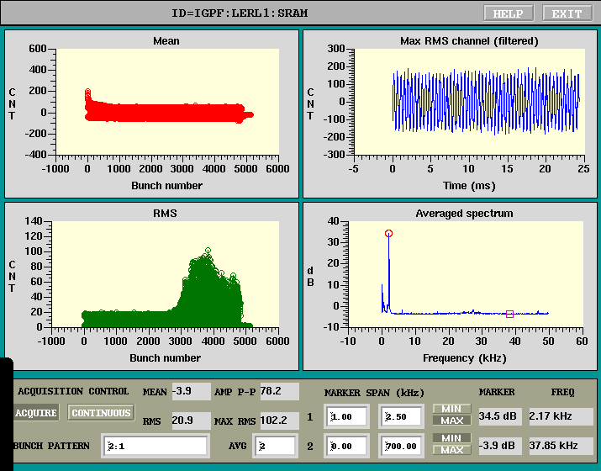
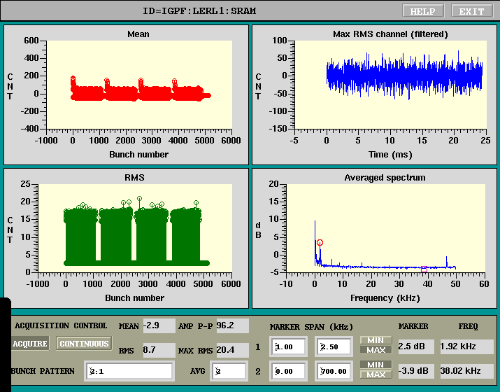
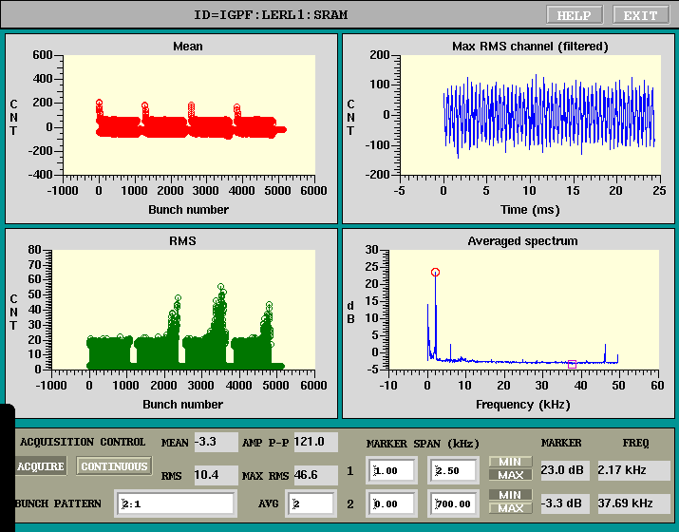
1576 bunch
1372 bunch
850 mA
740 mA
When LER beam current exceeded 830mA, a longitudinal coupled bunch instability started to be observed.
With 4trains the instability was not observed with the same bunch current. But with a higher (total) beam current, the instability is induced again.
With changing D2H4 collimator setting, the instability became stronger.
780 mA

Slide 24
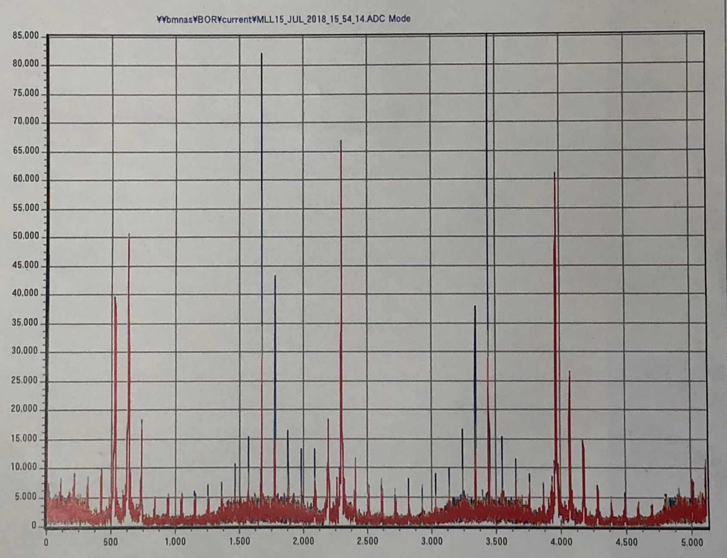
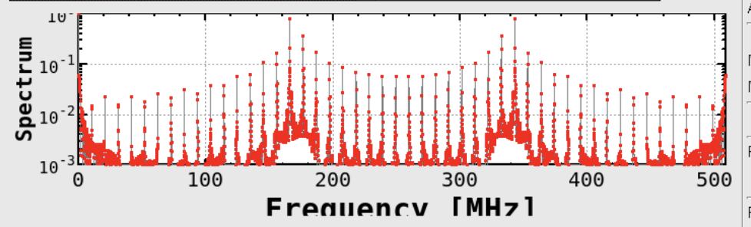
Spectrum when longitudinal instability occurred
Mode number = ~ 2300
This is not due to RF cavity.

Slide 25
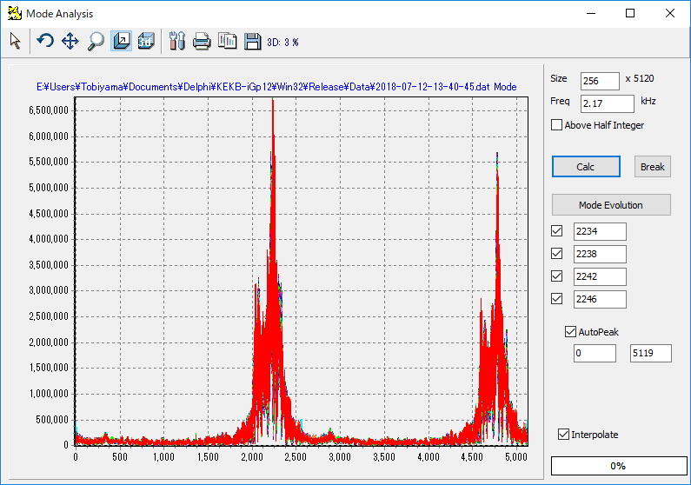
Longitudinal Mode (2 bucket spacing)

Slide 26
Detector BG issues

Slide 27
Detector beam background issues
Iida-san gives a talk in BEAST session in the afternoon.
A task force the detector beam background was established during Phase 2 operation.
Injection BG
The task force members did intensive injection tuning during Phase 2. The BG was lowered effectively, although a stably good condition did not last for a long time.
BG by storage beam
βy* dependence seemed strong.
Scraping BG
It is unlikely that the “scraping” background is caused by the beam tail.
It may be caused by the off-momentum particles overfocused by QCS magnets. This seems to be supported by Nakayama’s (Touschek) simulation.
I asked Zhou-san (Beam-Beam) and Dima-san (Intra-beam) to do the beam tail simulations. The tails may give some effects to SR BG.
Other issues
BG storm or spike
High BG for outer layers of CDC, when we sqeezed βy* from 4 to 3mm
SR BG?
Phase 3
New collimators will be installed.
Establishment of top-up (continuous) injection is a key issue at the beginning of Phase 3.

Slide 28
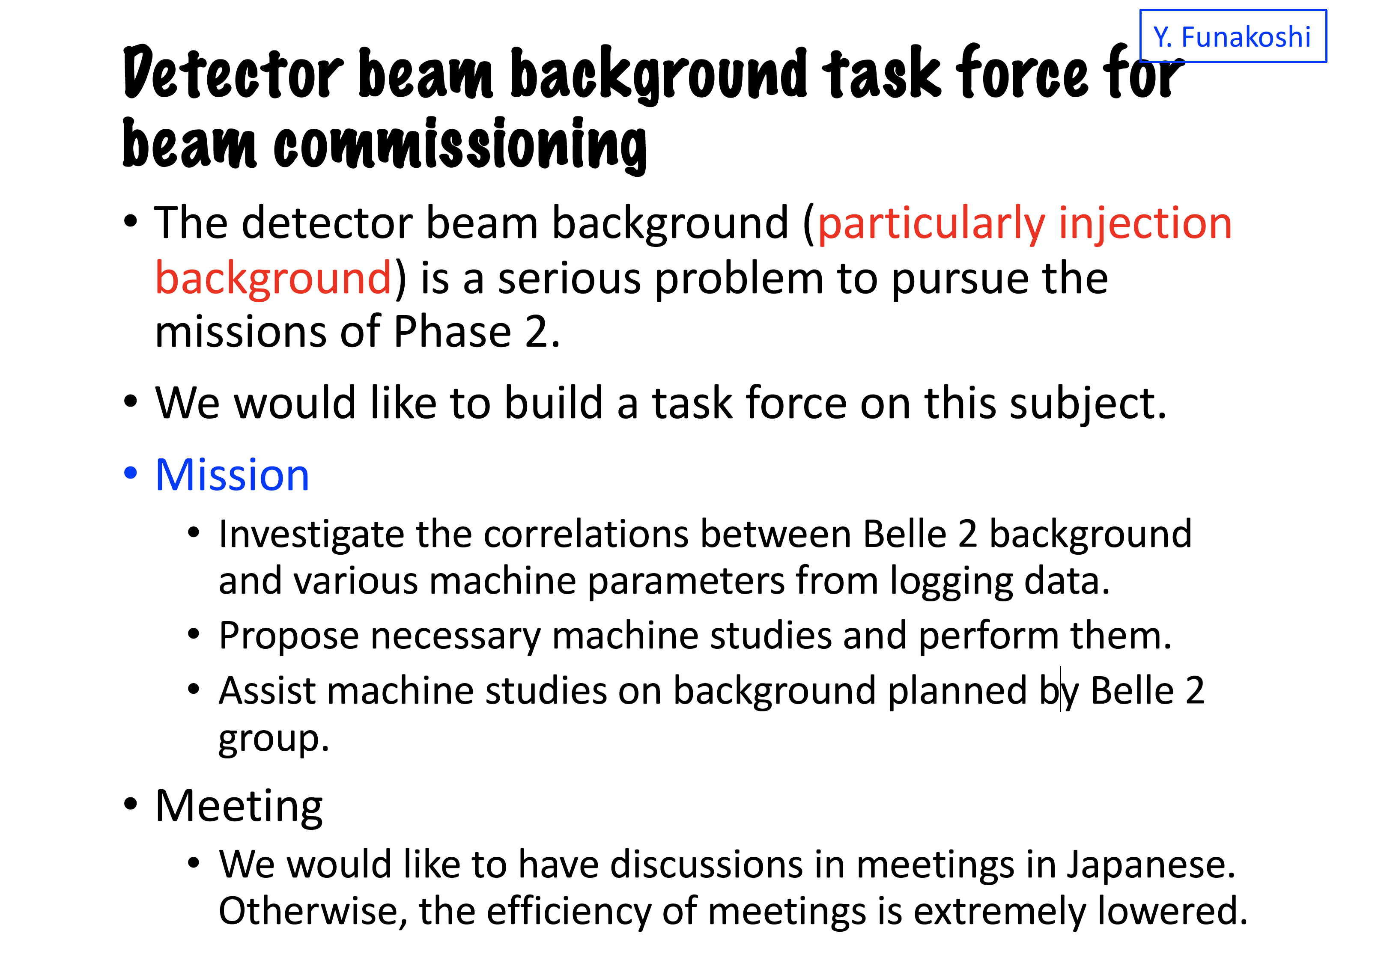

Slide 29
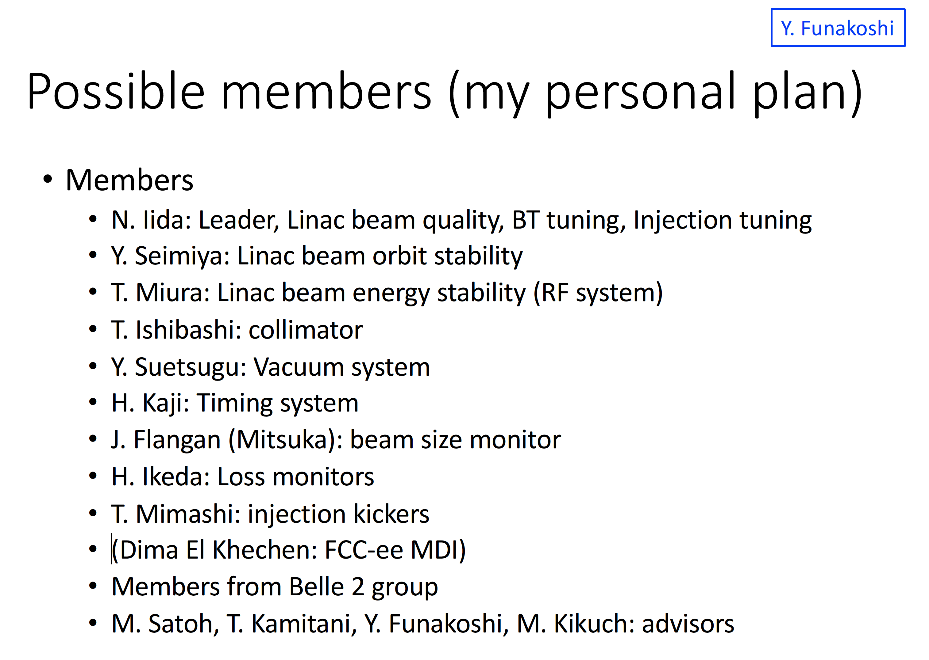

Slide 30
Injection BG
BG was reduced rather effectively by collimator tuning.
BG was also reduced by the injector and injection tuning.
Beam energy
An energy FB was introduced during Phase 2.
Energy spread
LINAC and BT orbit
Optics correction in rings
BG did not decreased drastically by using RF gun, although some BCG member think that it had some effects.
Items to be introduced in Phase 3
LINAC beam orbit FB
Beam monitor for energy spread
Monitor for beam energy (RF phase monitor)
A dedicated study on injection BG was done at the end of Phase 2.
Beast sensors like diamond sensors and CLAWS were essentially important for injection BG tuning.

Slide 31
BG by storage beam
Tuning items when squeezing βy*
Collimators
Optics corrections
Injection tuning
BG depends on tunes
We need more systematic study.
Diamond senser abort
Effective to prevent QCS quench

Slide 32
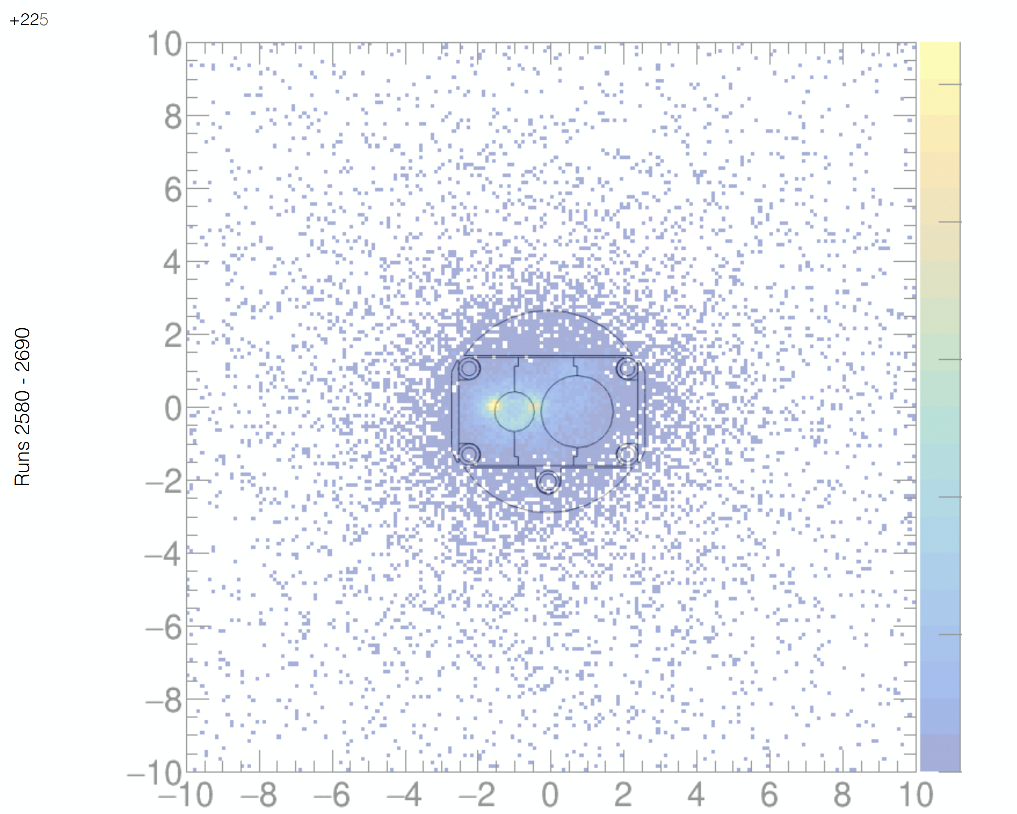
Beam tail?
At the point (+/- 225mm from IP)
β_{x} = 0.453m (β_{x}* = 0.200m at IP)
ε_{x} = 1.73 nm (LER), 4.67 nm (HER)
σ_{x} = 28.0 μm (LER), 46.0 μm (HER)
Aperture = 4.9mm, -> 175 σ_{x} (LER), 107 σ_{x} (HER)
The aperture is too far from the beam!
Collimator Aperture (LER)
D2H3 OUT: 38.7 σ_{x} D2H3 IN : 39.8 σ_{x} D2H4 OUT: 59.3 σ_{x} D2H4 IN : 55.7 σ_{x} D6H3 OUT: 39.0 σ_{x} D6H3 IN : 58.5 σ_{x} D6H4 OUT: 48.7 σ_{x} D6H4 IN : 53.7 σ_{x}
It is unlikely that 100 sigma tails cause the background.

Slide 33
Task forces
Several task forces have been established or are being planned.
Detector beam background issues
Linac BT emittance preservation issues
QCS quench issues
High beam current issues
(Beam-beam issues)

Slide 34
Spare slides

Slide 35
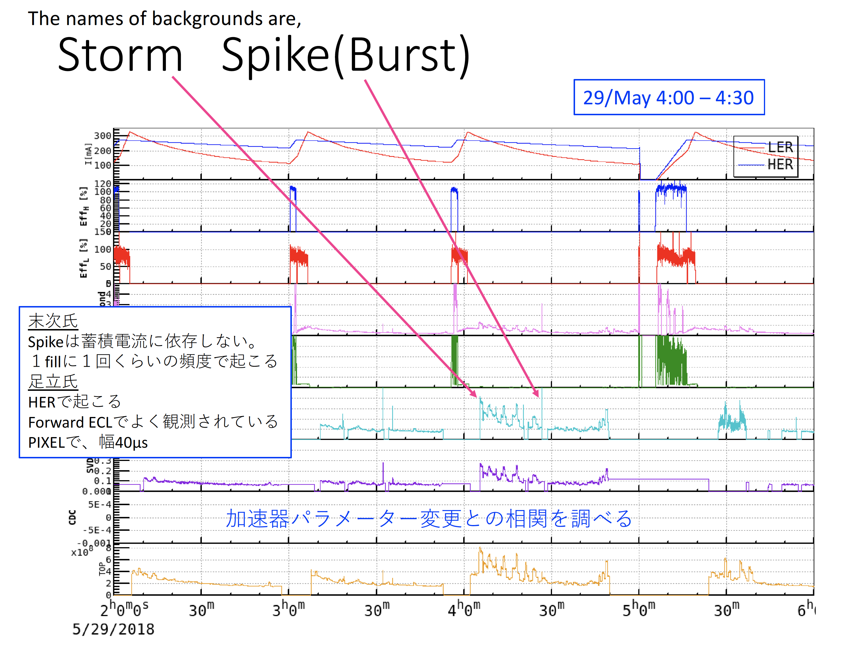

Slide 36
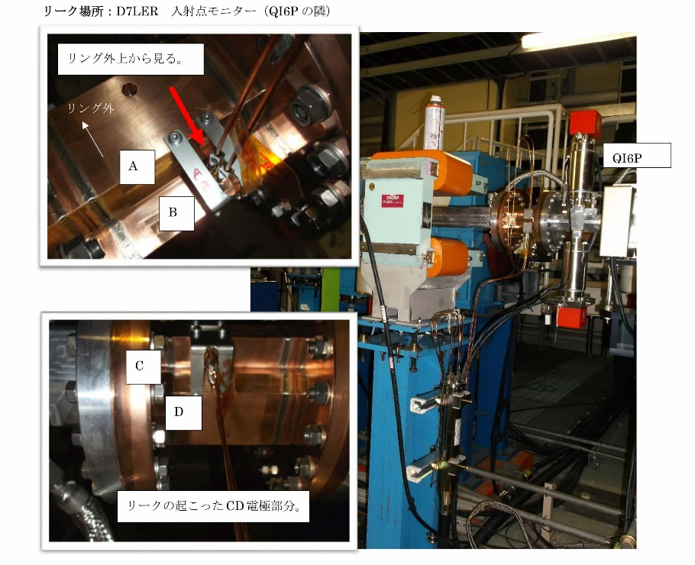
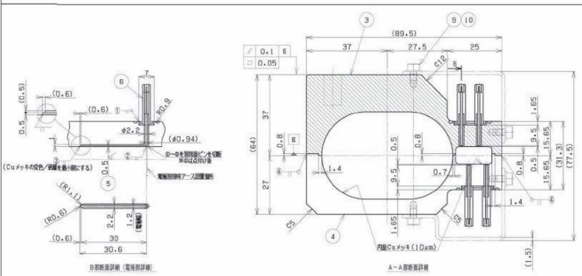
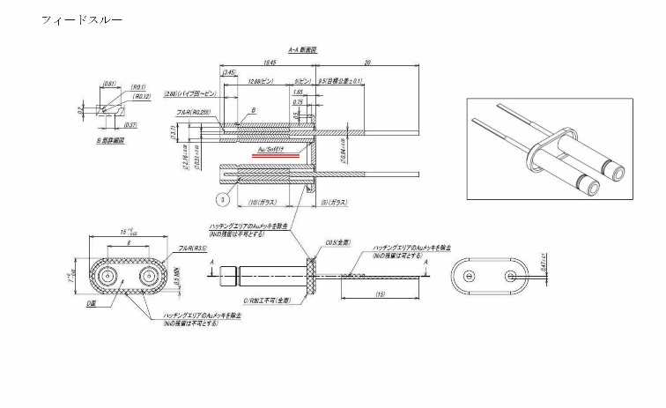
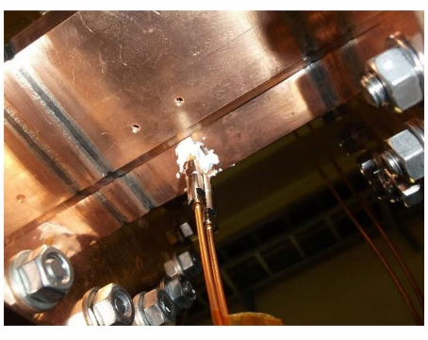
運転中に発生した主な問題 (1)
LER入射部入射点BPMのフィードスルーろう付部からリーク。
3月28日(水)、トールシールで対処した。
入射部入射点BPMの信号はPhase-2後半常時モニターできるようになった(モニターグループ)。
運転(入射調整)に有効そうなので再製作、交換を検討中。フィードスルーの構造は変更する。

Slide 37
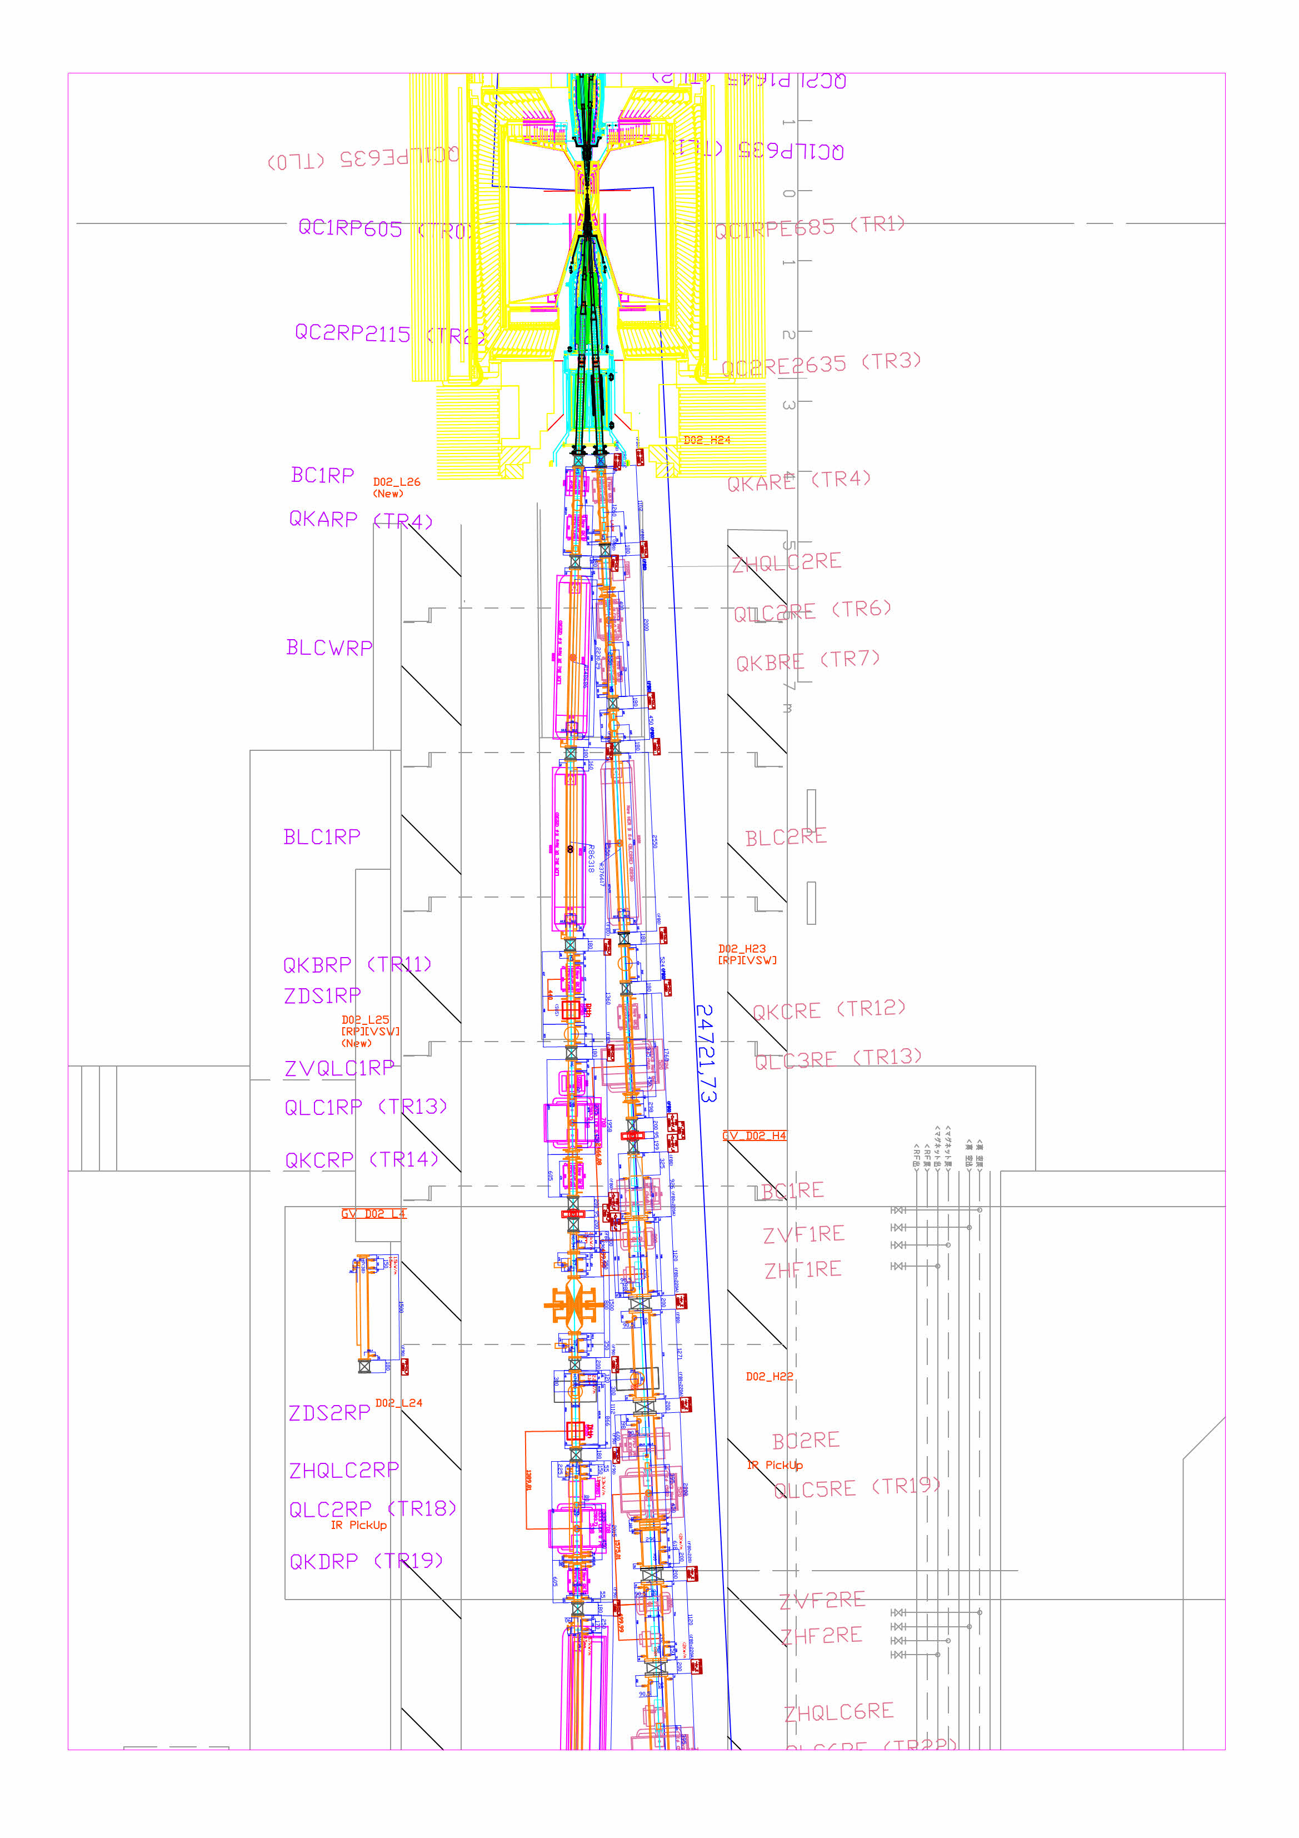
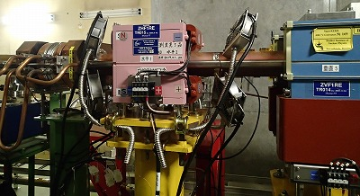
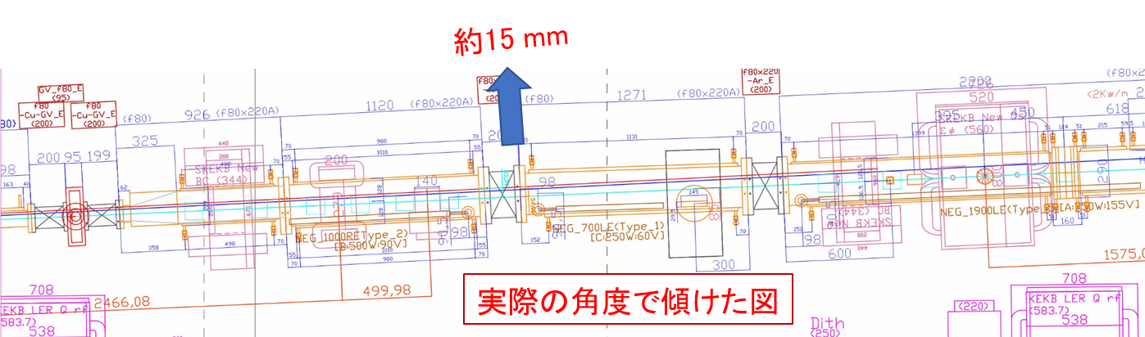
運転中に発生した主な問題 (2)
HER衝突点部下流のステンレス製ビームパイプの発熱、リーク
衝突点部の最終収束超伝導電磁石から発生するシンクロトロン放射光が、下流15～20 mにあるステンレス製ビームパイプに当たり発熱。
ステンレスフランジとクロム銅フランジ接続部で3回大気リーク。
5月11日：上流側SUSチェンバーの下流側フランジからリーク。増し締め＋バックシール。チェンバーをリング外側にシフト。
6月29日：下流側SUSチェンバーの下流側フランジからリーク。増し締め＋バックシール。
7月14日：下流側SUSチェンバーの下流側フランジからリーク。ガスケット交換。
~20 m
~15 m
QCS
衝突点

Slide 38
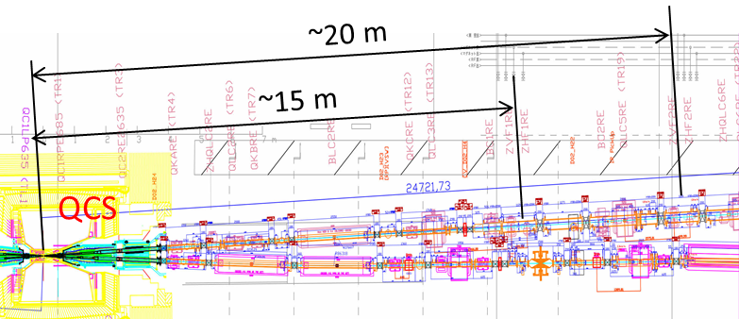
運転中に発生した主な問題 (3)
HER衝突点部下流のステンレス製ビームパイプの発熱、リーク
衝突点部の最終収束超伝導電磁石から発生するシンクロトロン放射光が、下流15～20 mにあるステンレス製ビームパイプに当たり発熱。
ビームが四極電磁石の中心を通っていないため放射光が発生。
1 mmずれた軌道の場合、1mradの角度に照射される放射光パワーは約40 W(@300 mA)。ステンレスパイプを局所的に温めるには十分。
BLC2REの接線よりも外側にある。ビームチャンネル部に照射されている。
測定していた温度はせいぜい50℃程度。材質(線膨張率)が異なるフランジ部での熱サイクルが問題か。
対応策：上流側2か所に放射光マスクを設ける。
フランジをクロム銅にしたビームパイプに変更することも検討中。
衝突点

Slide 39
Comparison of machine parameters between design and Phase2
parameters | Design | Phase 2 | units | factor
I_{beam} (LER/HER) | 3.6/2.6 | 0.8/0.78 (0.27/0.225) | A | 4.5/3.3
ξ_{y} (LER/HER) | 0.0881/0.0807 | 0.03/0.02 |  | 2.9/4.0
β_{y}* | 0.27/0.30 | 3/3 (2/2) | mm | 11/10
# of bunches | 2500 | 1576 (394) |  | 1.6(6.3)
I_{bunch} (LER/HER) | 1.44/1.04 | 0.508/0.495 (0.685/0.571) | mA | 2.8/2.1 2.1/1.8
Luminosity | 8 x 10³⁵ | 5.55 x 10³³ | cm⁻² s⁻¹ | 145

Slide 40
[1] Luminosity of 1 x 10³⁴ cm⁻² s⁻¹
2018/5/11 strategy meeting
Simple scaling
5/9
Luminosity: 4.7 x 10³²
Beam currents: 250mA, 220mA
β_{y}* = 8mm
Beam-beam parameter: ~0.014
Number of bunches: 600
Possible parameter set
Beam currents: 1A, 0.88A (x 4)
β_{y}* = 3mm (x 8/3)
Beam-beam parameters: ~0.03 (x 2)
Luminosity = (4.7 x 10³² ) x 4 x 8/3 x 2 = 1.0 x 10³⁴
Number of bunches: 1576 (for example)
We need
Squeezing β_{y}*
Increasing beam currents
Luminosity tuning to raise the beam-beam parameters

Slide 41
Machine Parameters of SuperKEKB Phase 2 (July 5th 2018)
 | LER | HER
Horizontal Emittance | 1.64 | 4.54 | nm
Beam current @Maximum Luminosity | 788 | 778 | mA
Maximum Beam current in Phase2 | 860 | 800 | mA
Number of bunches | 1576
Averaged bunch spacing | 1.80 |  | m
Total RF voltage V_{c} | 8.8 | 12.8 | MV
Synchrotron tune ν_{s} | -0.0226 | -0.0258
Calculated bunch length σ_{z} @zero current | 4.64 | 5.33 | mm
Betatron tune ν_{x} / ν_{y} | 44.562/46.614 | 45.545/43.612
Beta function at IP β_{x}* / β_{y}* | 200/3 | 100/3 | mm
Measured vertical beam size (XRM) @IP σ_{y}* | 1.48 | 0.610 | μm
Vertical beam-beam parameters ξ_{y} | 0.050 | 0.010
Beam lifetime | 40 | 65 | min.
Luminosity (Belle 2 CsI) | 5.55 |  | 10³³ cm⁻² s⁻¹

Slide 42
Phase 3 (2019 March – June)
Identify what limits the luminosity or machine operation.
What happens with squeezing β_{y}*?
Lifetime decrease?, bad injection efficiency?, QCS quench?
What limits beam-beam parameter?
IP Chromatics coupling…?
What limits beam current?
Longitudinal coupled bunch instability…
Effects of electron cloud…
Understanding Belle 2 beam background and how to suppress it?
With SVD, Pixel detector
Establishment of continuous injection
Collimator tuning
Injector and injection tuning
QCS quench
Mechanism of QCS quench
LER vertical collimator tuning
Physics Run
Next week we will discuss with Belle 2 group a guide line of physics run (how much luminosity the accelerator group assure to them) in the first year of Phase 3.
We need to set target parameters
Beam current：ex.1.5A (LER), 1.2A (HER)
Luminosity: ex. 2 x 10³⁴ cm⁻² s⁻¹

Slide 43
Efforts to prevent QCS quench
Countermeasure meetings were held several times.
Narrower collimator setting from the viewpoint of QCS quench protection (April 11th)
Our feeling is that HER QCS is well protected by collimators but we need more vertical collimators in LER. Vertical collimator setting was not enough, when the quench occurred on May 24th in HER.
Belle 2 diamond sensor beam abort was introduced (May 28th).
Our feeling is that this abort system helps to prevent QCS quenches.
Continuous efforts to improve beam injection (to reduce Belle 2 BG)
Others
Move loss monitors to the place where the betatron phase is same as QC1s and the beta function is large.
A fiber loss monitor was installed in upstream of QCSL in LER.
I ask Belle 2 group that the 40 scintillators on QCS are available for monitoring beam loss at QC1s.
More steps in setting local orbit bumps or luminosity tuning knobs
Synchronized magnet setting system will be introduced shortly.
Careful operation in RF phase scan

Slide 44
Further countermeasures for QCS quench
New collimators before Phase 3
LER: 1 new vertical collimator, 3 new horizontal collimators
HER: 1 new horizontal collimator
Installation of heavy metal (W) shields was proposed by Ohuchi-san.
We are estimating their effectiveness. More realistic beam loss scenario is needed. If needed, we will perform some machine study in Phase 2.
More simulations are needed to simulate effects of ``chip scattering” of collimators.
Are there any alternatives of QC1 dipole corrector coils?
It seems that luminosity performance is degraded, if we use other correctors instead of QC1 dipoles.
Remodeling QC1 magnets?
We should consider it as a part of a long-term upgrade plan of SuperKEKB.
QCS quench due to continuous beam loss?
We started estimation.

Slide 45
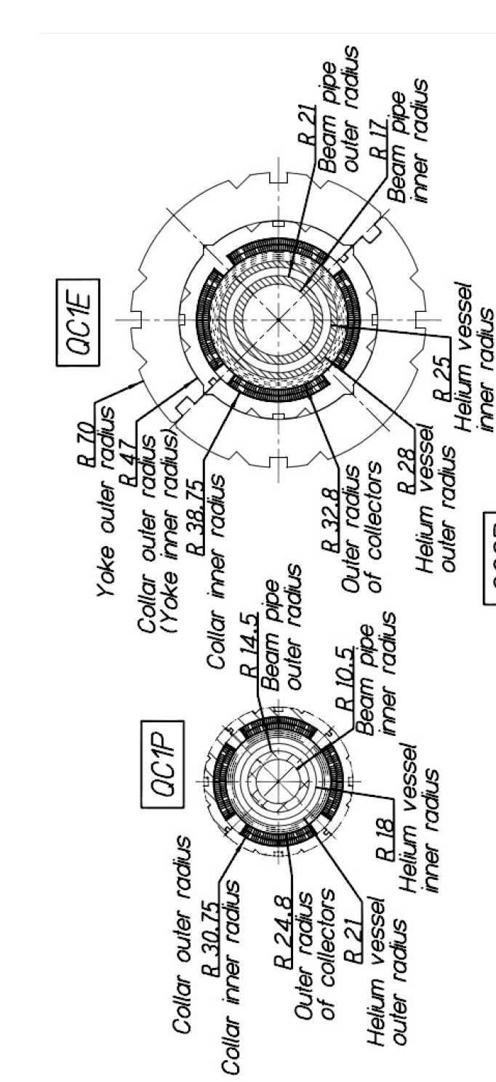

Slide 46
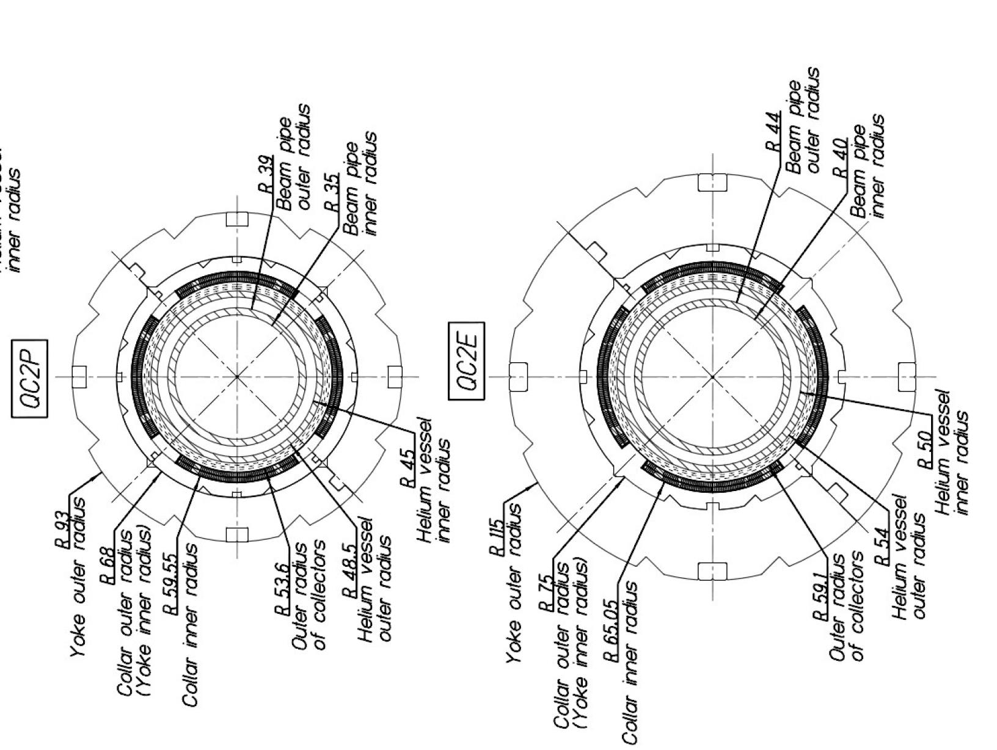

Slide 48
LER beam envelop
β_{x}* = 100mm, β_{y}* = 4mm
QC2RP
QC1RP
QC1LP
QC2LP
b2 coils
e+
horizontal : 80 σ_{x}
W shield
collectors
vertical: 105 σ_{y}
_{(5% coupling)}

Slide 49
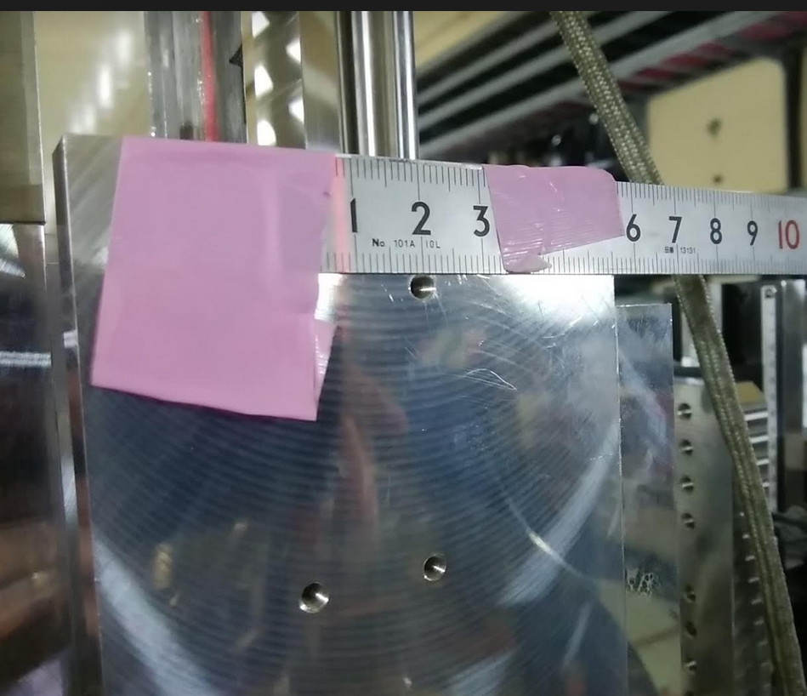
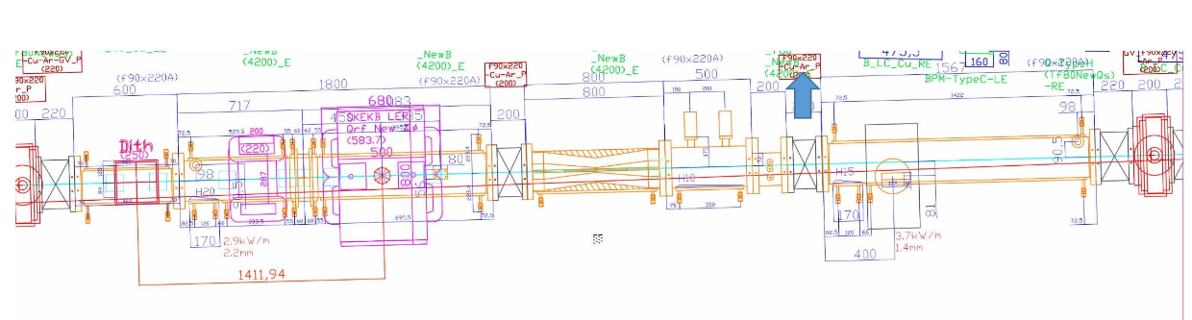
コリメータヘッドが損傷(LER)したためBGが増えた。
レーザーの位置 最初は１ｃｍの位置
２ｍｍ位動かした。
リング外側に２ｍｍ位 コリメータを移動

Slide 50
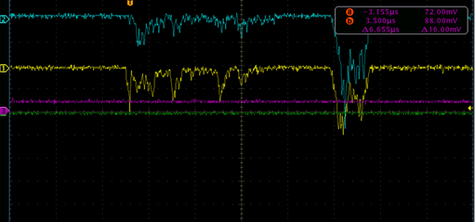
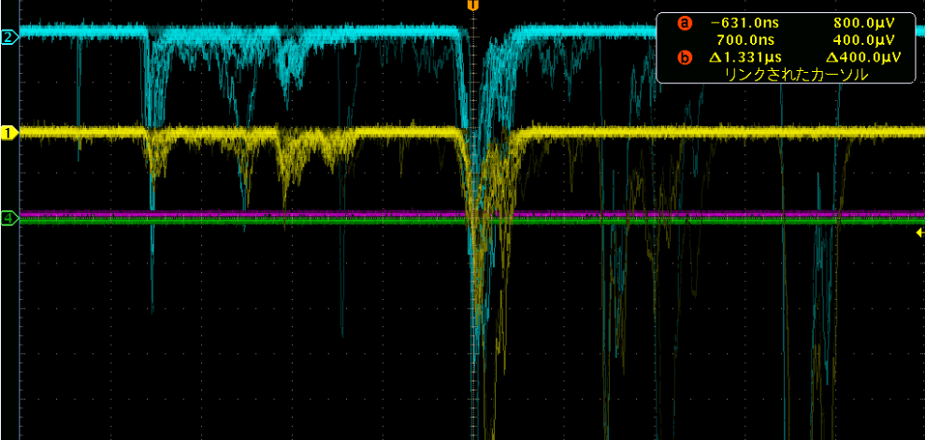
2mmバンプ後
2mmバンプ前
光ファイバーロスモニターでの信号。
矢野さんの協力でQCSの近くに設置

Slide 51
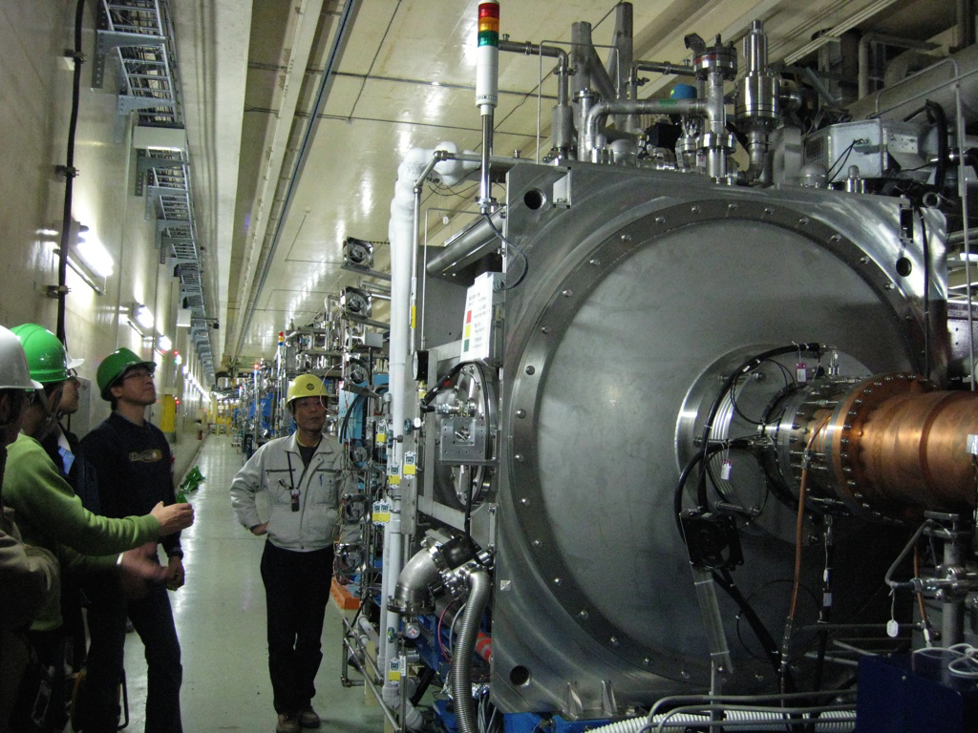
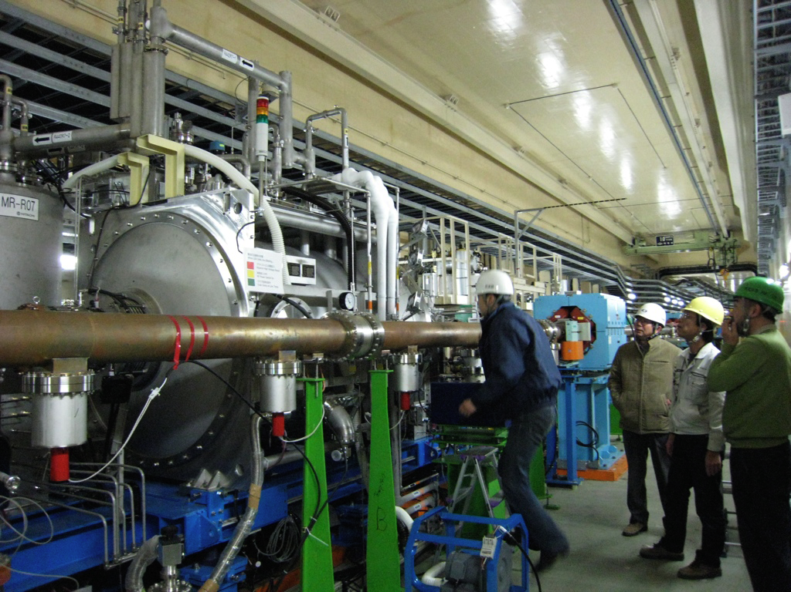
Finally two crab cavities were installed in KEKB, one for each ring in January 2007
HER (e-, 8 GeV)
LER (e+, 3.5 GeV)
…..after 13 years’ R&D from 1994

Slide 52
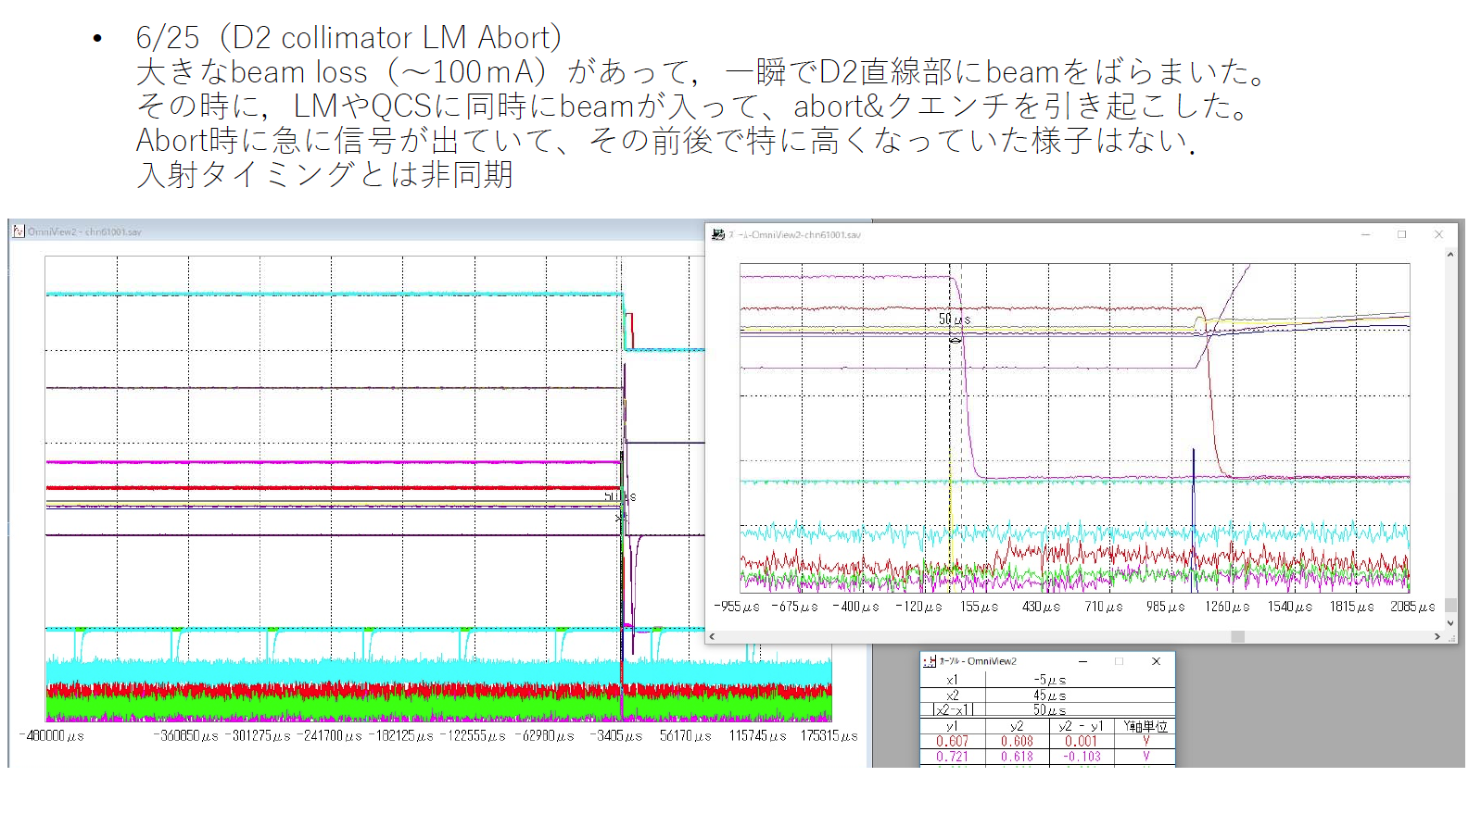

Slide 53
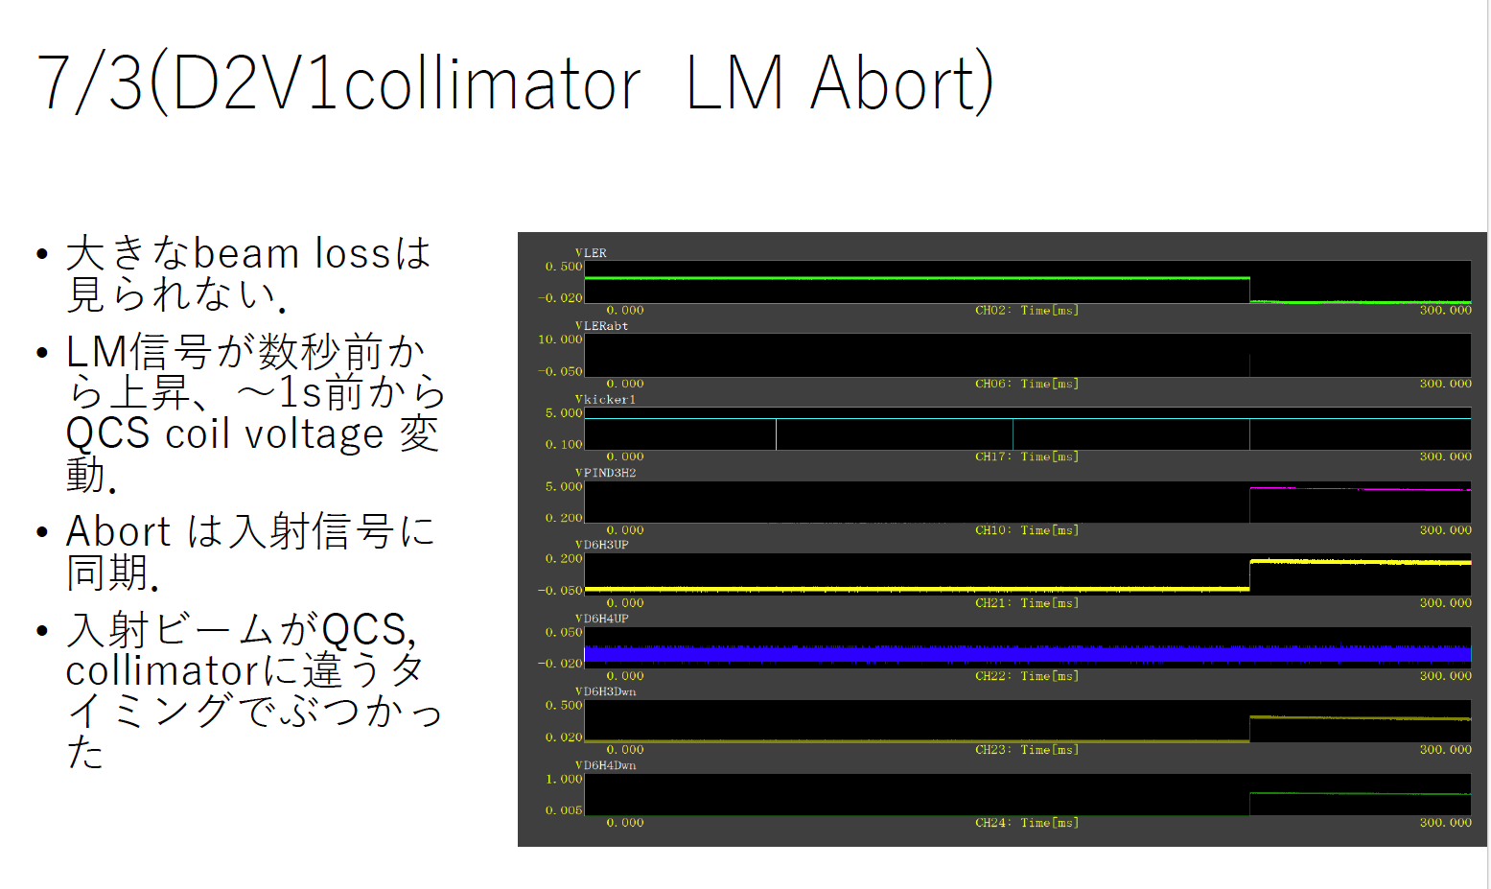

Slide 54
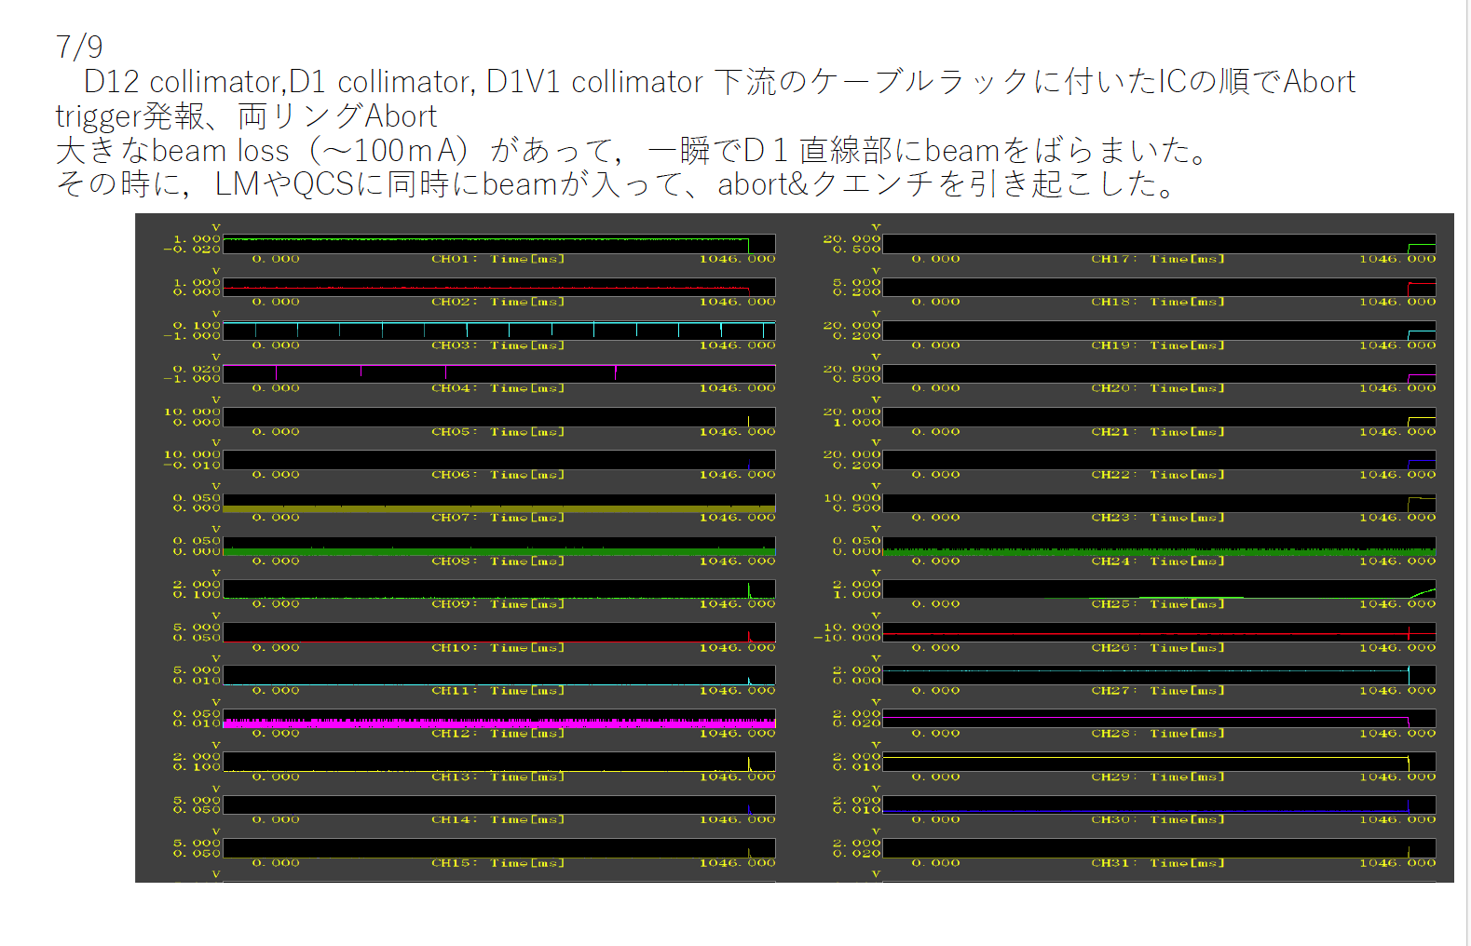

Slide 55
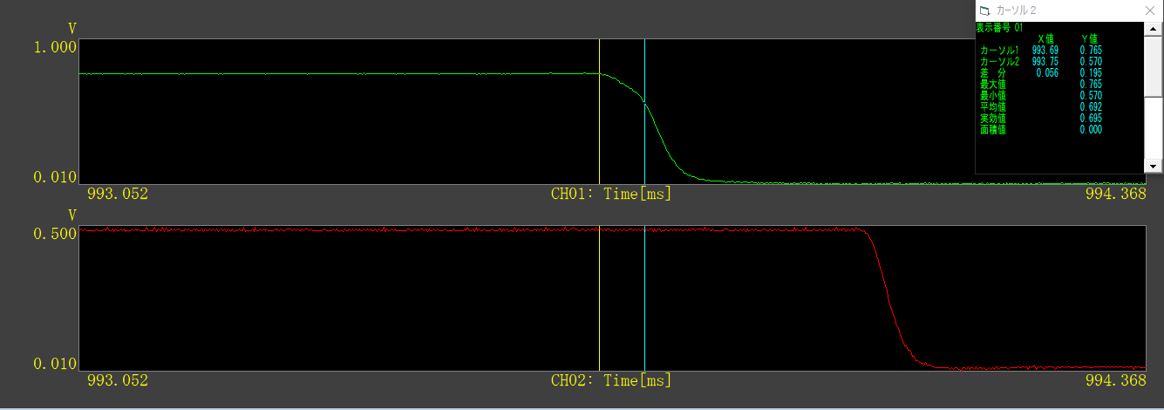
Troubles
11:17:19 HER/LER Abort (766 mA/487 mA)
ビームロスは見えるが数ターンでロスしている。(池田氏)
BORでは振動は見えていない。
HER current (Pinのtriggerでabort)
LER current
Ion chamberのtriggerでabort)
~50 μs

Slide 56
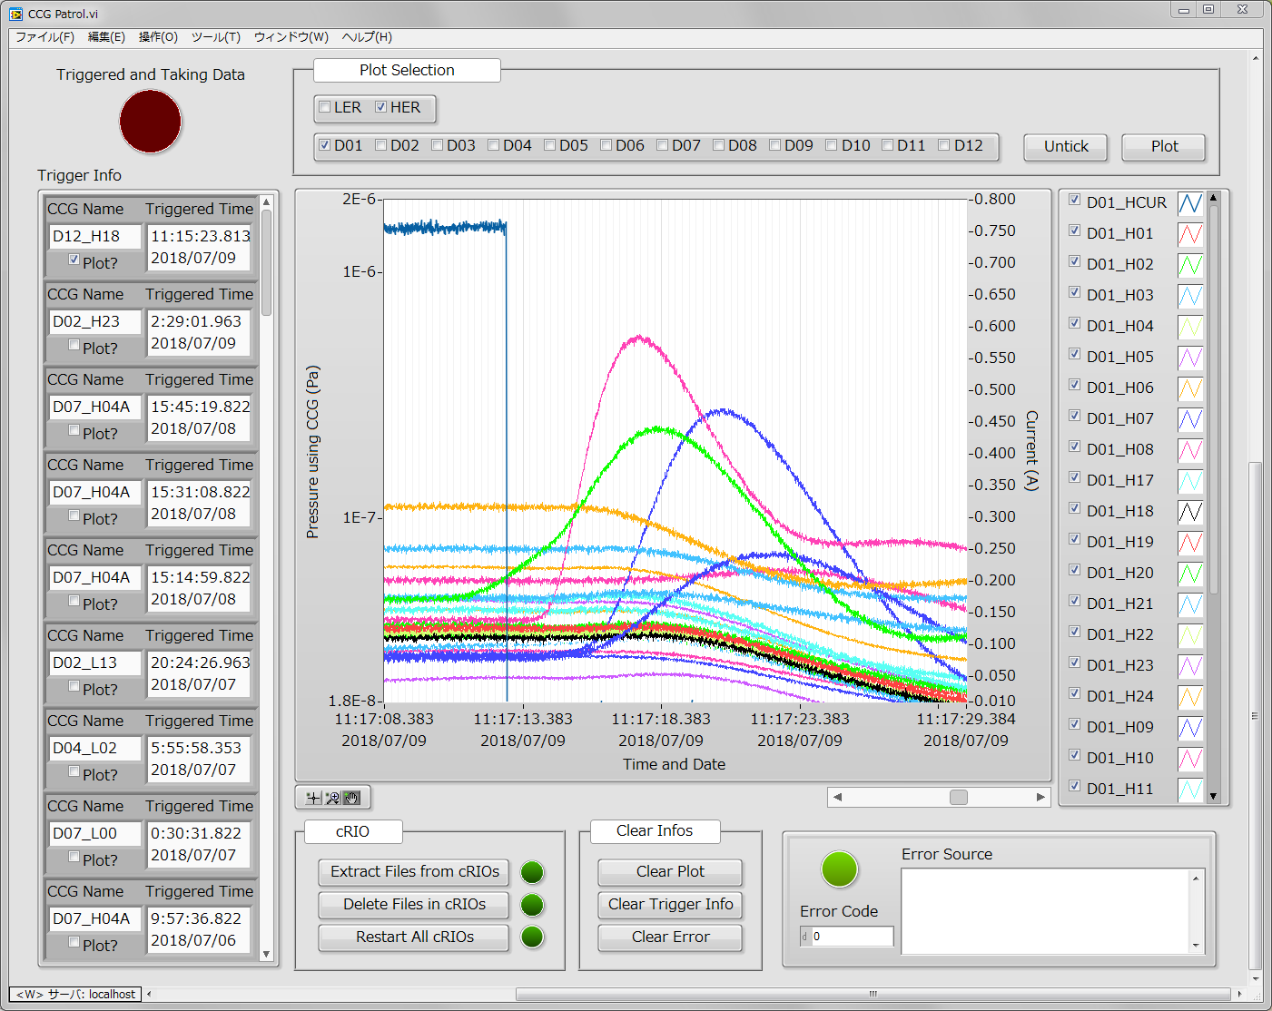
Troubles
11:17:19 HER/LER Abort (766 mA/487 mA)
D01_V1コリメータ部で圧力のバースト(～1E-6 Pa)
下流のD01_H4コリメータ付近のイオンチェンバーも反応している。
ヘッドにビームが衝突したか。

Slide 57
Troubles
11:17:19 HER/LER Abort (766 mA/487 mA)
QCS復帰後、同じヘッド位置で入射は可能だった。効率が少し悪い？
BTの軌道が少し乱れていた。⇒ダンプモードで調整。
原因は不明。
6/25 のアボート+QCSクエンチ時の状況と似ている。。。
参考情報
6/25は月曜日、11:20:30頃
気温が高く、Linac A3ギャラリーの温度が上昇しているタイミング？？(飯田氏)
ただし、入射のタイミングではない。また、前回はLER

Slide 58
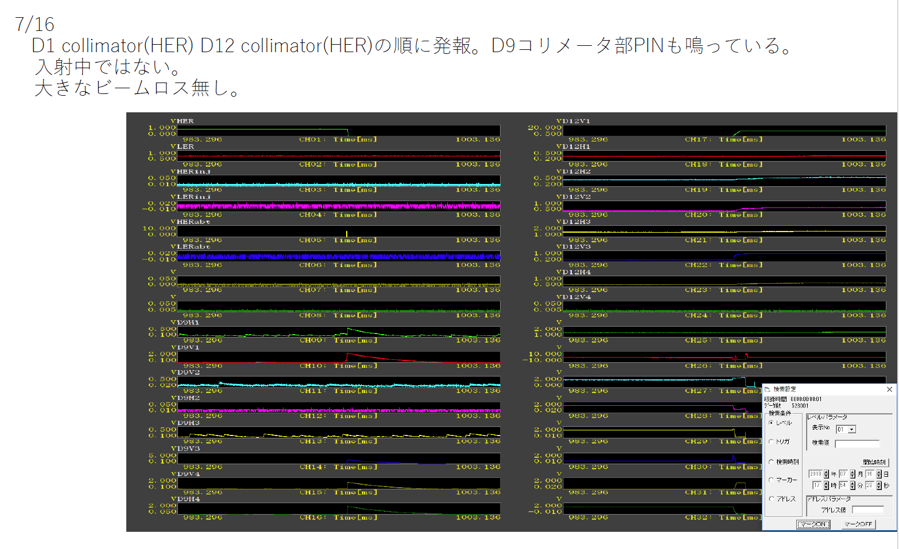

Slide 59
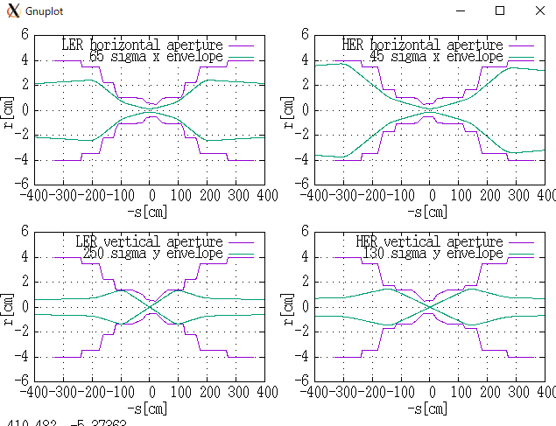
H. Nakayama
Phase2.1
e⁺
e⁻
105σ_{y} w/
5% coupling
βy*=4mm
e⁺
e⁻
For phase3,
nsigma_x(LER) = 25, nsigma_x(HER) = 16,
nsigma_y(LER) = 45, nsigma_y(HER) = 25,
In case of LER vertical, aperture at QC1 is narrowest.
In other cases, edges of vacuum chambers are narrowest.

Slide 60
Ohuchi-san’s estimation
皆様、
QCS補正磁石をクエンチさせるのに必要な7 GeV電子の個数を計算しましたので連絡します。
この計算を行った時の条件は以下の様になります。
補正磁石の超伝導線パラメータ：
外径：0.35�弌∩叛�比Cu：Nb：Ti＝0.5：0.25：0.25
長さ10mmの超伝導線に電子が衝突して電子のエネルギー７GeVが断熱的に超伝導線に与えられるとします。
SCワイヤーの体積＝0.962mm³、SCワイヤー中のCuの重量＝4.31 X 10⁻³ g、NbTiの重量＝3.16 X 10⁻³ g
Cuの比熱＝0.1 J/kg・K、NbTiの比熱＝0.87 J/kg・K @4K
以上より、超伝導線の熱容量＝3.18 X 10⁻⁶ J/K
電子1個のエネルギー７GeV＝7 X 10⁹ X 1.6 X 10⁻¹⁹ Jouleより温度を1度上昇させるのに必要な電子の個数は2696個となります。
実運転では、3度の温度上昇でクエンチすると考えるとその個数は3倍となり8087個です。

