Slide 1
Injector LINAC Status
Kazuro Furukawa for Injector LINAC
<http://www-linac.kek.jp/linac-paper/general/>
Information from all injector group members

Slide 2
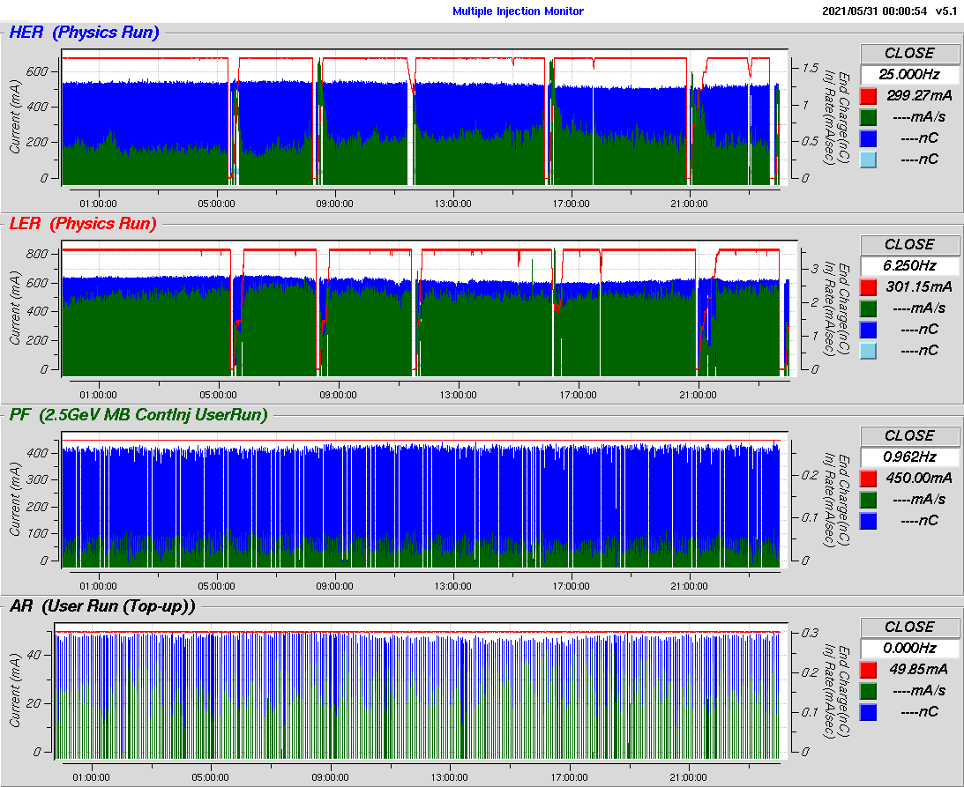
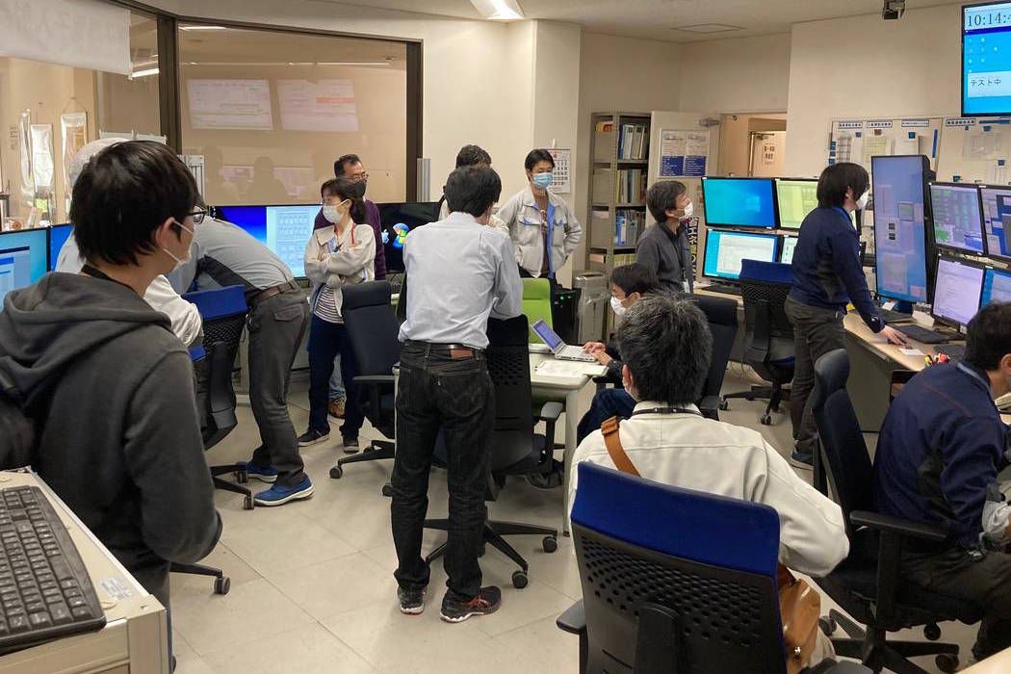
Improved Precision/Flexibility Injections
HER: 800mA, 12.5 – 25 Hz,
1.4 nC, 1 bunch LER: 1000mA, 12.5 – 25 Hz, 3.0 nC, 1-2 bunch
PF ring: 450mA, <1 Hz,
0.25 nC
PF-AR: 50mA, <1 Hz,
0.3 nC
red: Ring current (mA)
blue: Bunch charge (nC)
green: Injection rate (mA/s)
Typical 1-day Injections
Four virtual injectors have enabled high efficiency simultaneous top-up injections
(Achieved 200 thousand hours of operation at the middle of 2020)
The injector provide high availability with advanced high-current and low-emittance injections for SuperKEKB as well as light source rings

Slide 3
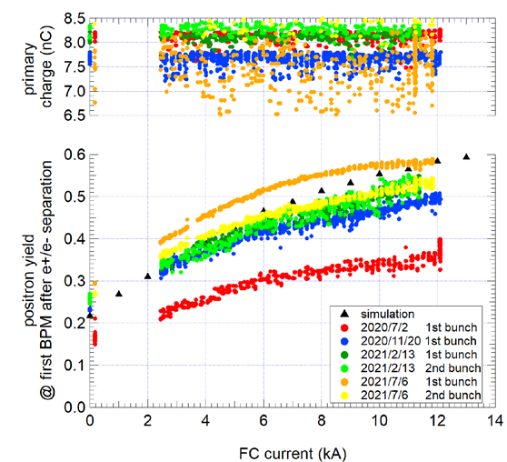
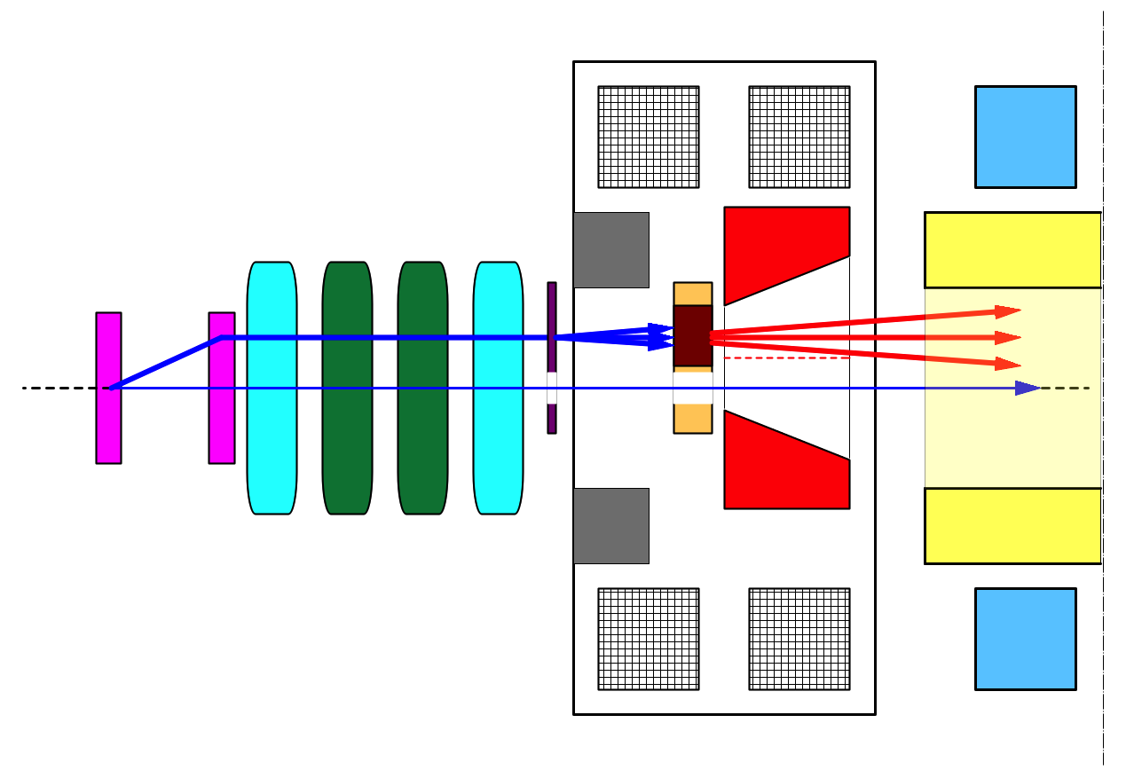
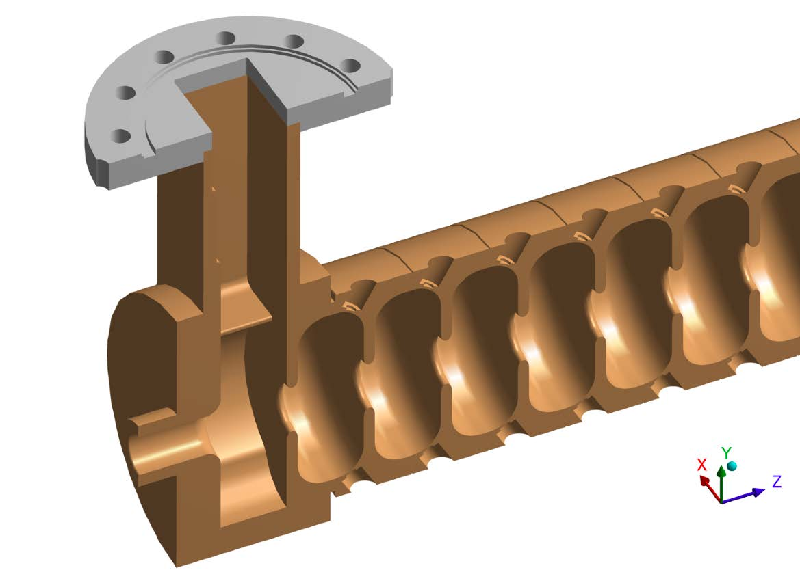
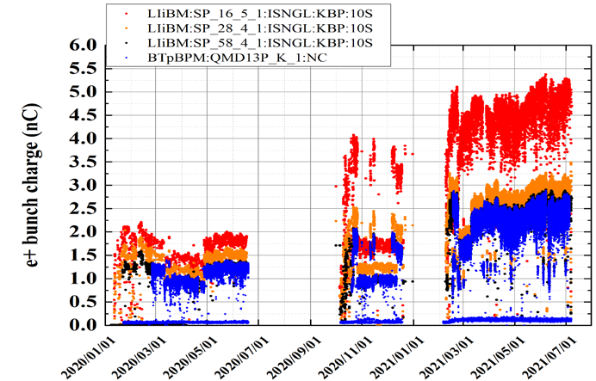
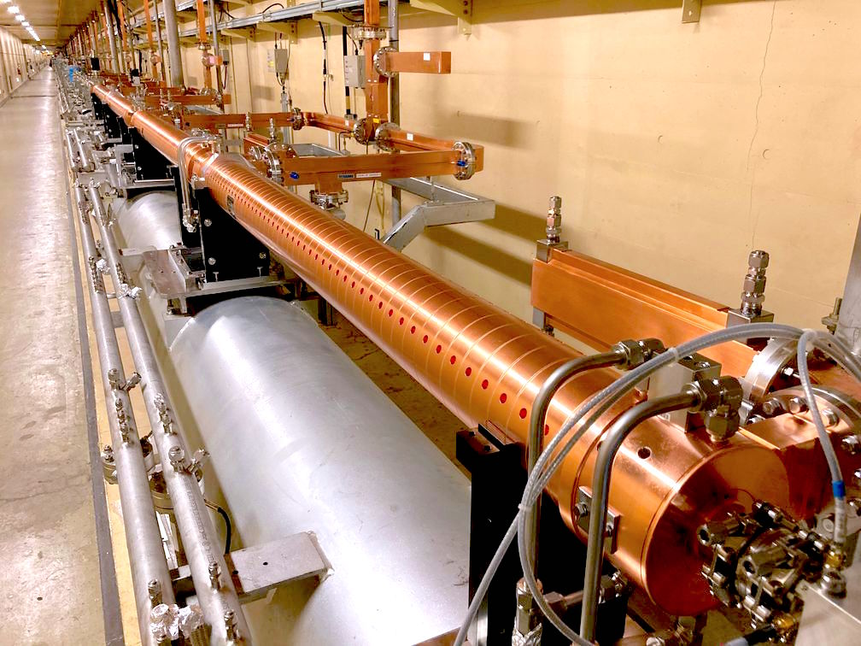
Recent LINAC Development and Progress
Positron production yield reaching designed value
Copper-Nickel alloy was applied to flux-concentrator and resolved the discharge issues
Optimized with newly installed correctors and monitors
3 nC/bunch enough for present SuperKEKB operation
New accelerating structures were designed and are being fabricated
Planning to replace damaged 40 year-old 7% in 230 accelerating structures
Succeeded to achieve high acceleration field and low discharge rate with the first 4 structures
Will install 12 more structures in 2023
Can reach Υ (6S)
top view
bridge coils
solenoid
Present operation
DC quad
Positron yield
10 nC
primary e-
spoiler
target
LAS Accel.
structure
Design to achieve high performance
e+
H. Ego
beam
hole
injection e-
pulsed corr.
Flux
Concentrator
Operation up to the last year
pulsed quad
Y. Enomoto
Flux concentrator
Steady progress of positron beam
4 new structures installed

Slide 4
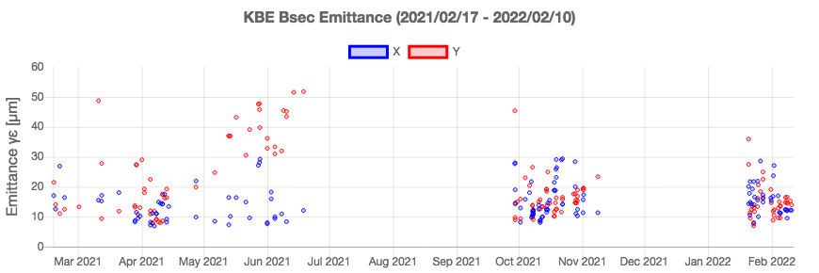
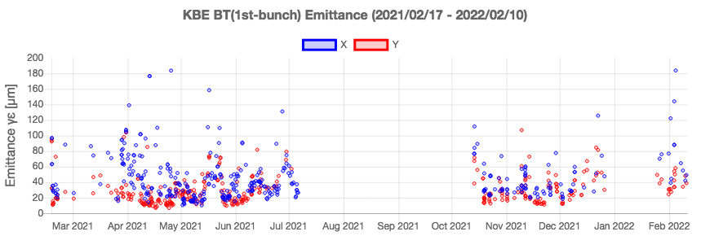
Electron Beam from RF gun
Beam emittance
Present requirement γεx 100 μm, γεy 40 μm
Stability improvements
DOE for 2nd laser
Stabilization closed loops
7 additional pulsed correctors
Emittance blow-up in later part of BT
Needs further studies
CSR is suspected
Vertical blow-up ?
Blow-up behavior with modified optics condition ?
Orbit stability
To avoid sextupole field fluctuation from bends
Mitigation by permanent magnet sextupole correctors
At 1.5 GeV
1st half of BT

Slide 5
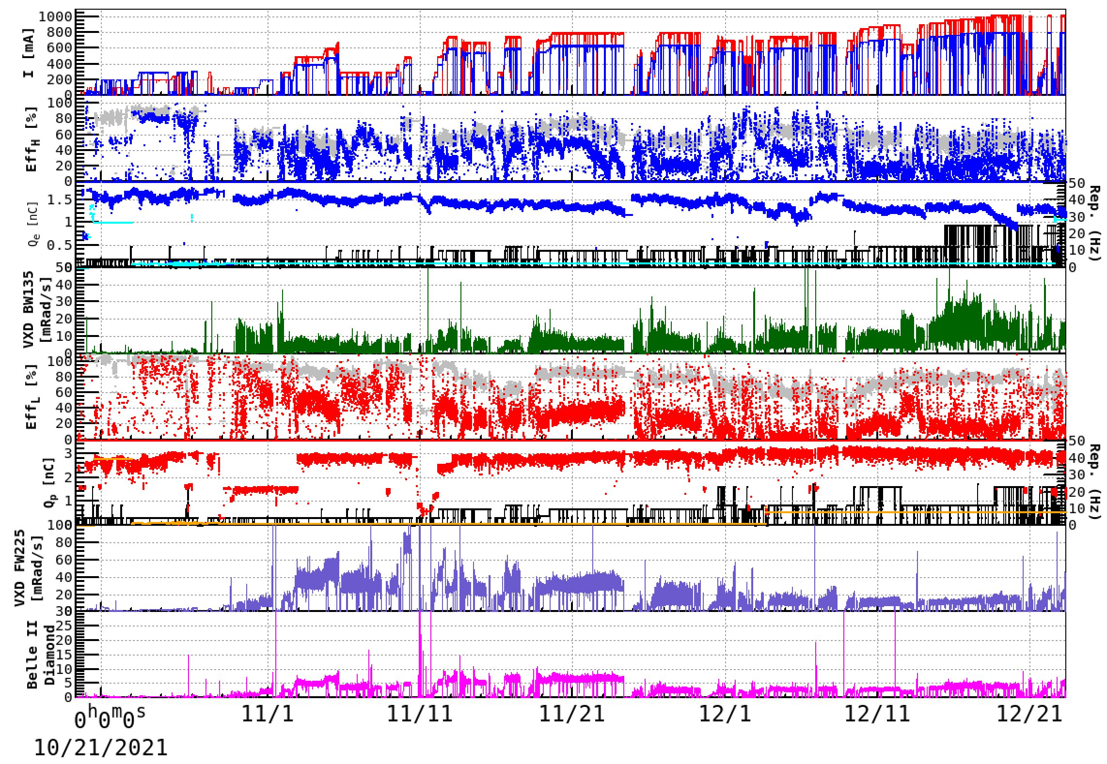
Injection-1. Improvement of HER injection
βy*=8mm
βy*=1mm
Energy scan
HER “raw” injection efficiency reached 80-90 % !
Injection study
N. Iida
①Nov.9 Optics
matching BTe1
②Nov.18, Septum
Angle:2.57→2.68
③Dec.1, Septum
Angle: 2.6→2.5
④Nov.18 Energy adjusted
with TbT-BPM
HER injection for β_{y}*=1mm has improved, achieved from 60% to 80%.

Slide 6
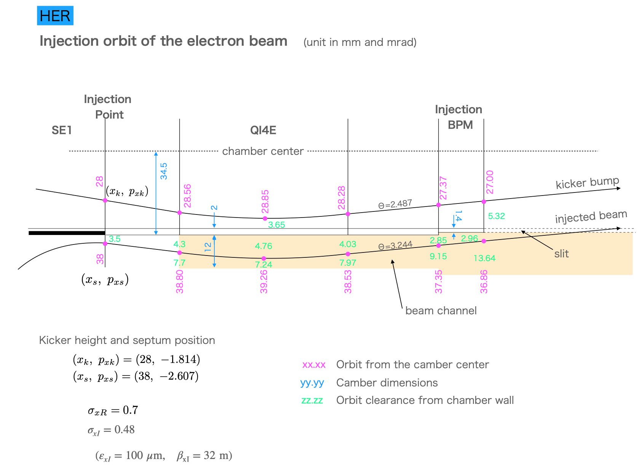
Injection-2. Understanding the injection orbit
M. Kikuchi, Feb.4
3.5
2.85
2.96
The horizontal orbit of the injection beam for HER has little room to the wall of the injection point chamber.
Fairly high residual radioactivity here is observed.
It is planned that this chamber will be replaced with a wider one during LS1.

Slide 7
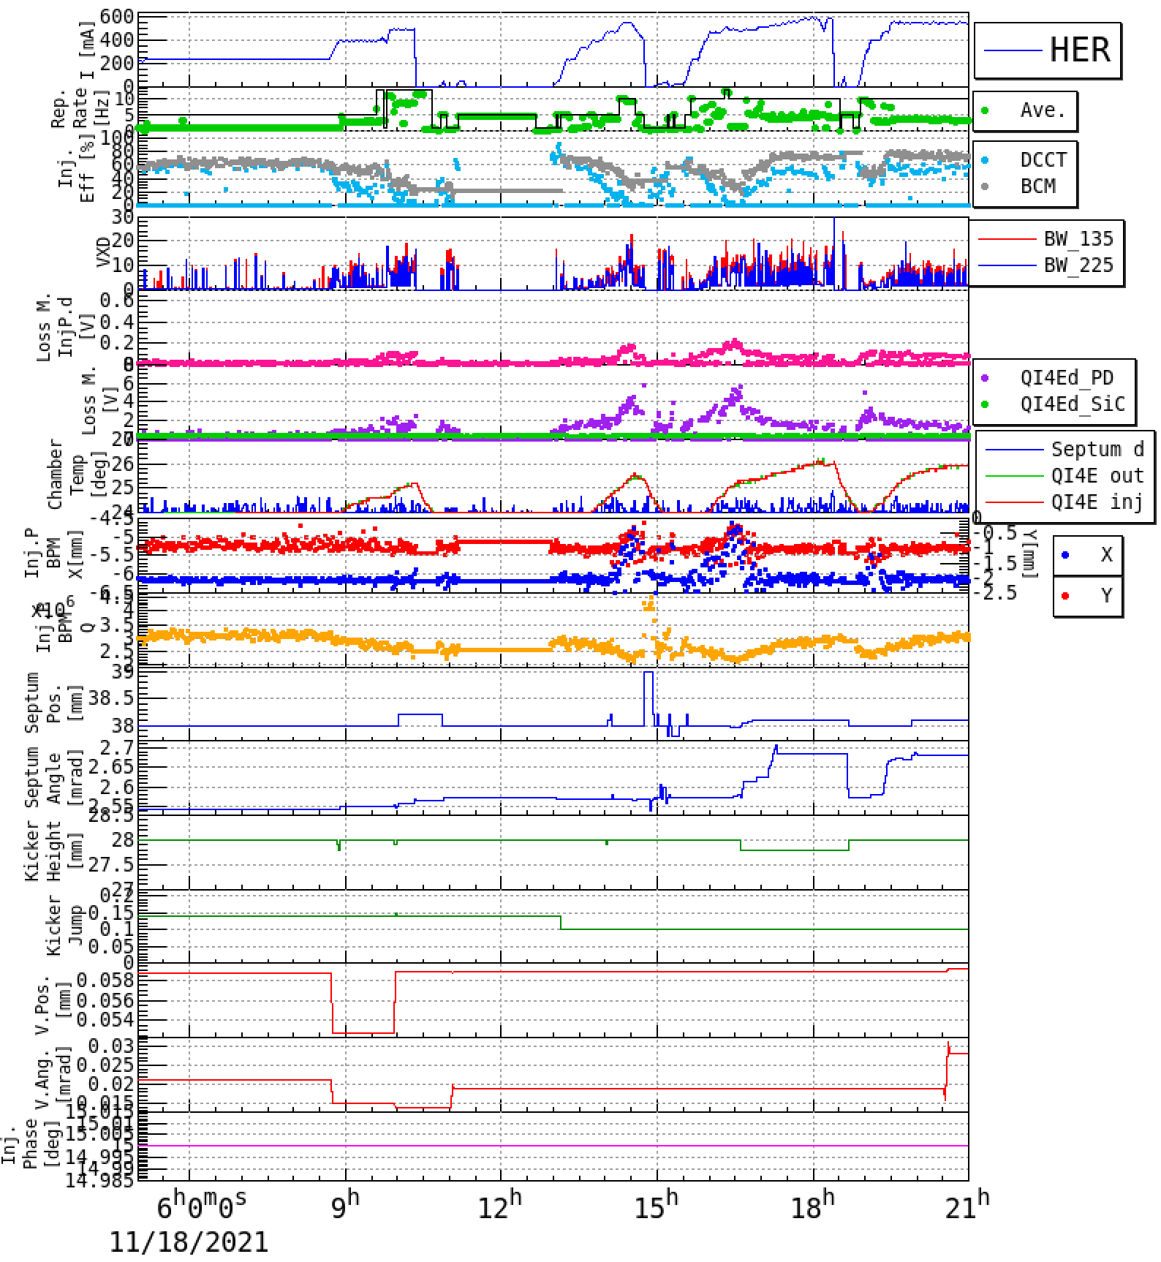
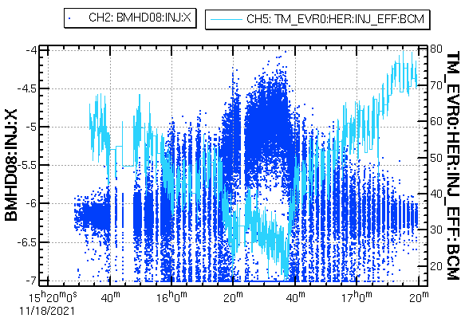
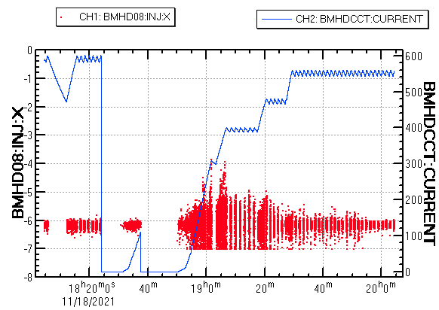
Injection-3. “Injection-BPM” became a good reference
The horizontal position at “Injection-BPM”, so-called “Mitsuka-monitor”, has a correlation with the ”raw” injection efficiency.
HER
“raw” efficiency
X inj-BPM
X inj-BPM
“raw” efficiency
Charge at “Inj-BPM”
Septum angle:
2.55→2.68
Septum angle was tuned so as to increase the charge at “Inj-BPM”.
Nov.18
Smaller fluctuation of the X of the “Inj-BPM” is better.
G. Mitsuka, T. Mori, Y. Ohnishi, S. Ogasawara, N. Iida
The injection tuning panel for the septum magnets has been redesigned considering the design orbit that reduced beam losses at the injection point.
The signal of the special beam position monitor (“Injection-BPM”) for the injected beam became clear, which helped the injection tuning so much.

Slide 8
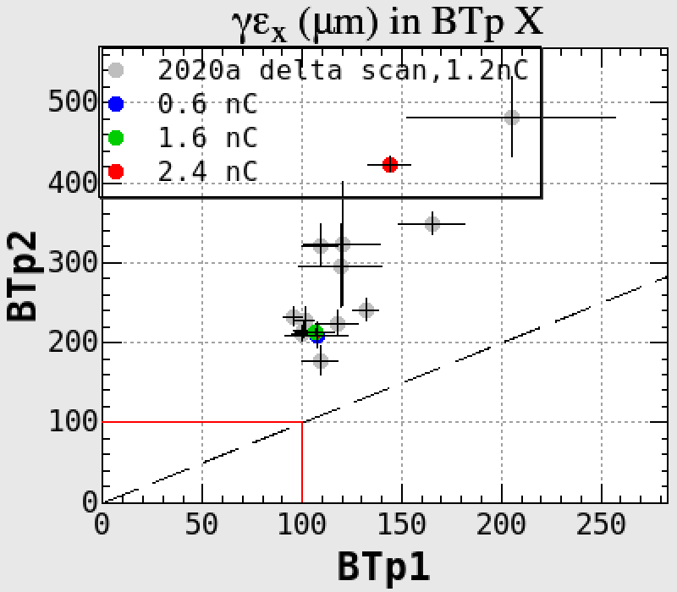
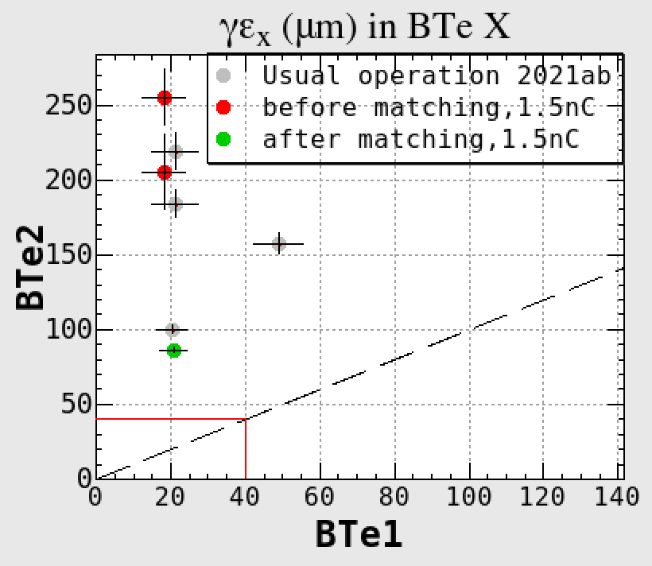
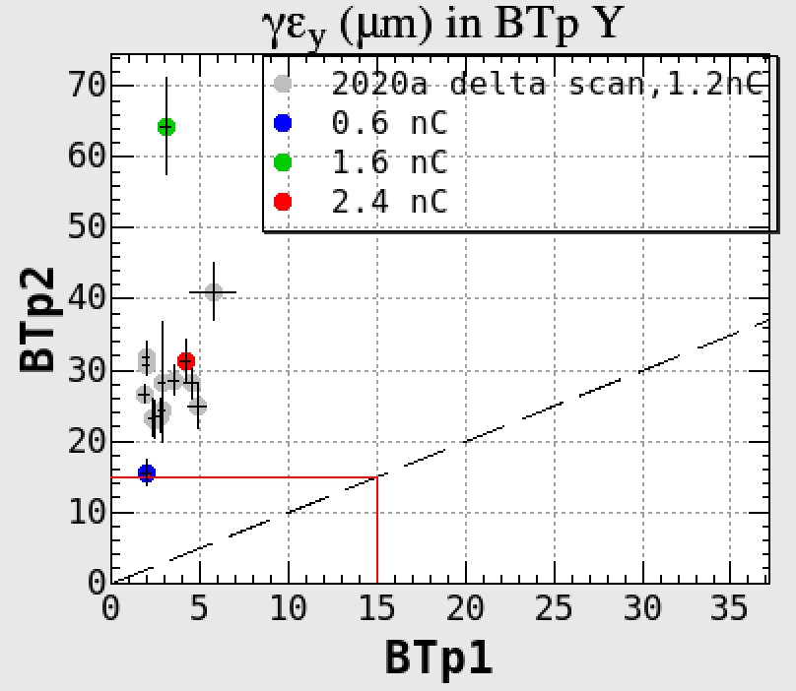
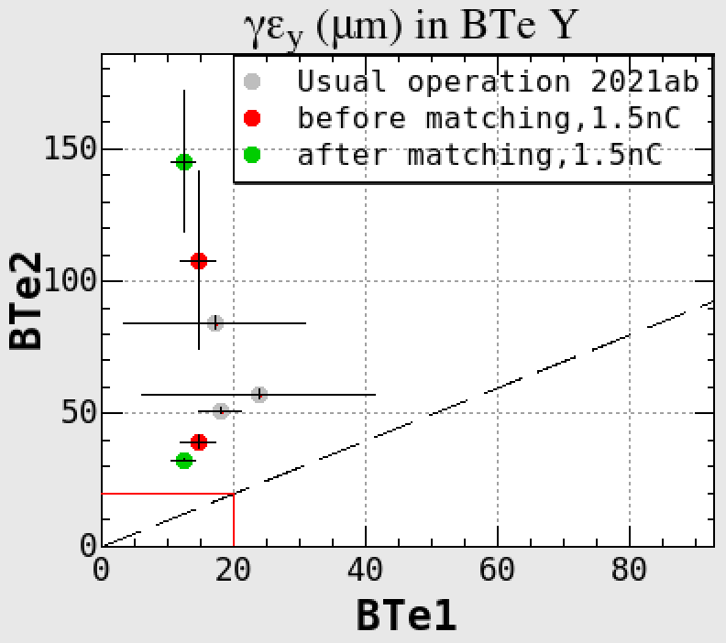
Injection-4. Emittance blowup in the BT lines
N. Iida
OTR
WS
Horizontal
OTR
Positron
Electron
WS
WS
WS measurements may includes beam jitters.
Vertical
OTR
OTR
The emittance blowups between BT1 and BT2 are still unresolved.
The horizontal emittance blowup is now observed not only in e⁻ BT but also in e⁺ BT by increasing beam charge.
A coherent synchrotron radiation (CSR) is now the most suspected.
We are investigating whether the emittance blowup has charge dependence.

Slide 9
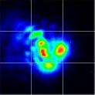
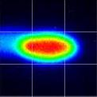
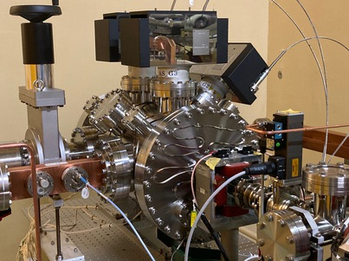
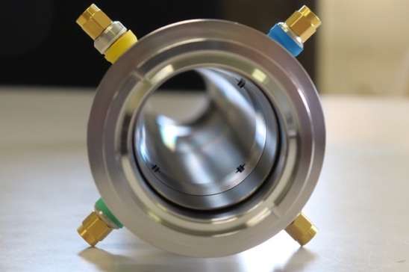
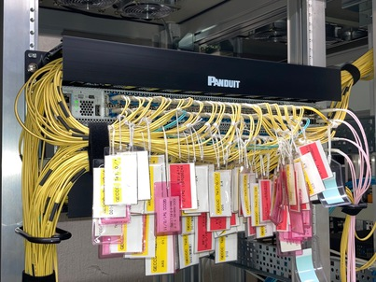
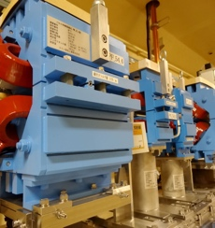
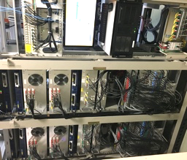
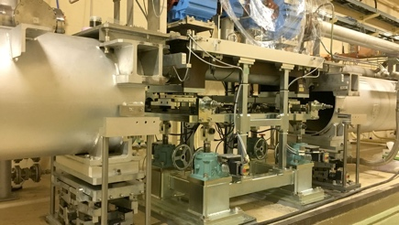
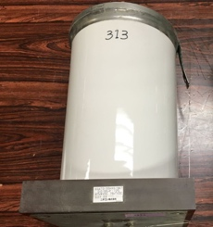
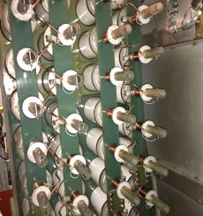
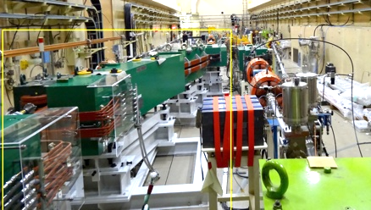
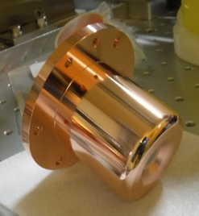
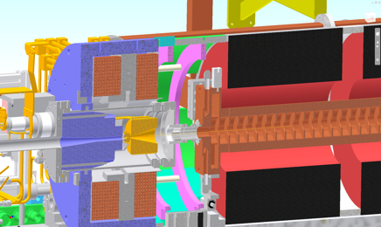

Injector Linac Improvements
Short term：Summer 2021
Optical element and amplifier for 2nd Laser of Rf-gun
Photo cathode and laser window replacement
Core/Edge network switch upgrade
7 pulsed corrector magnet addition
Solid-state amplifiers replacing mid-power klystron
Damaged waveguide renewal
Beam position monitor just after positron target
Improved secondary RF-gun as backup
Improved protection against AC 50Hz fluctuation
Mid-term：up to 2026
Pulsed magnets & kicker
Precision girder mover
Energy compression system
Improved RF-gun
Improved positron generation
Accelerating structure upgrade
PCB capacitor renewal
Laser stabilization with DOE element
Secondary RF-gun
New beam position monitor
Core network switches
Pulsed magnets
High-precision mover
PCB capacitor renewal
Energy compression
RF gun
Positron generation
Accelerating structure

Slide 10
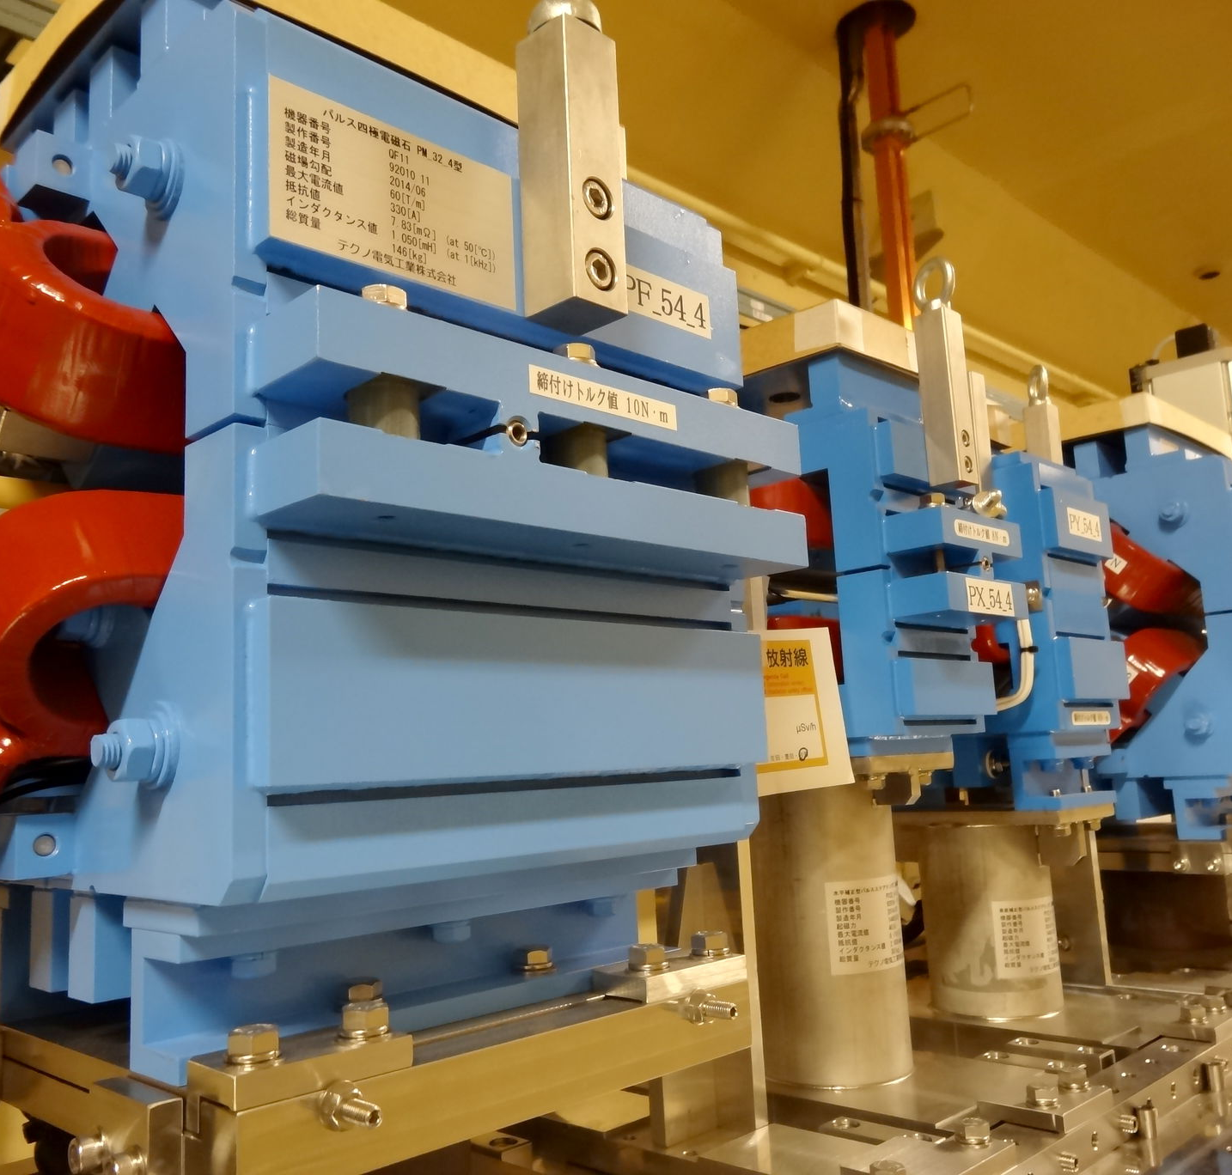
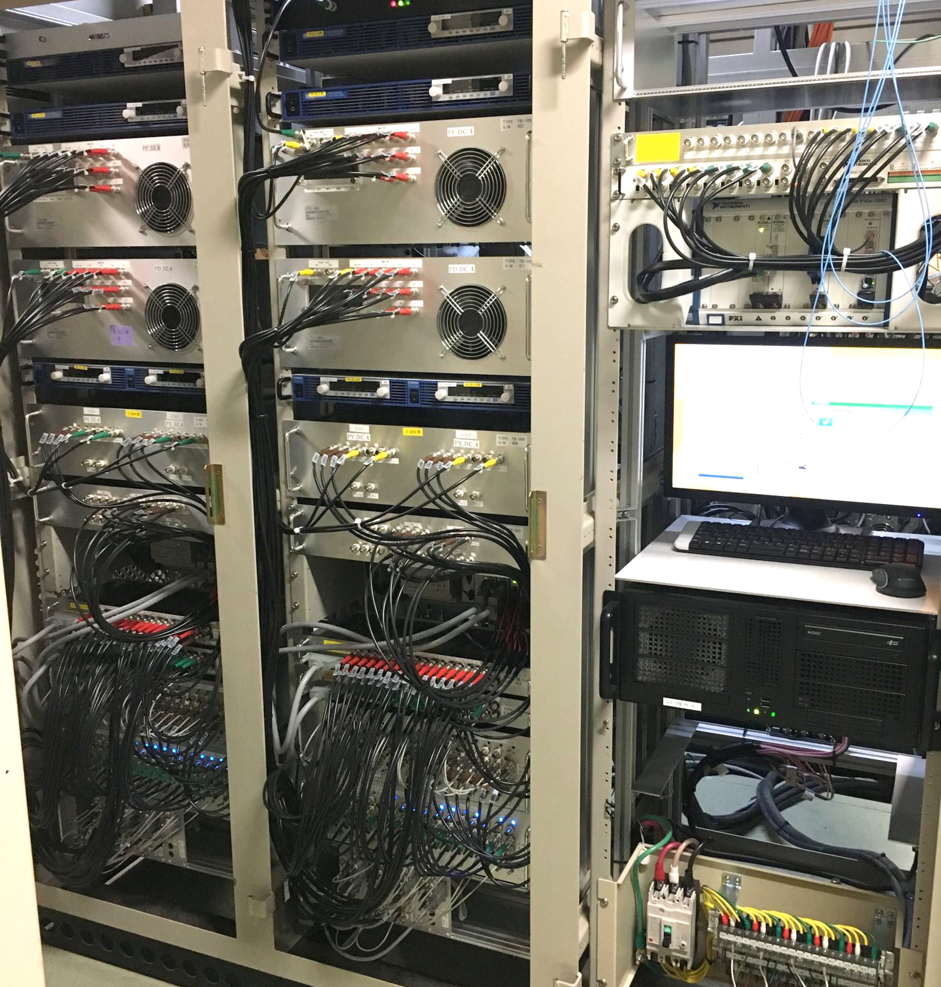
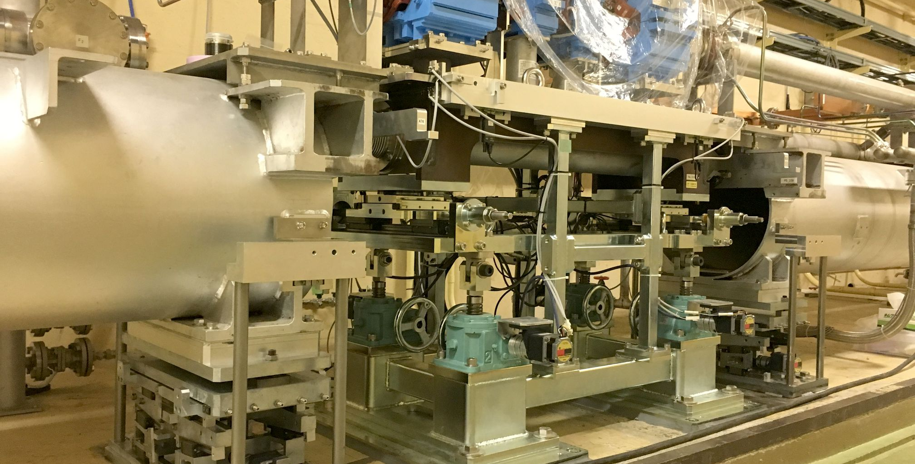
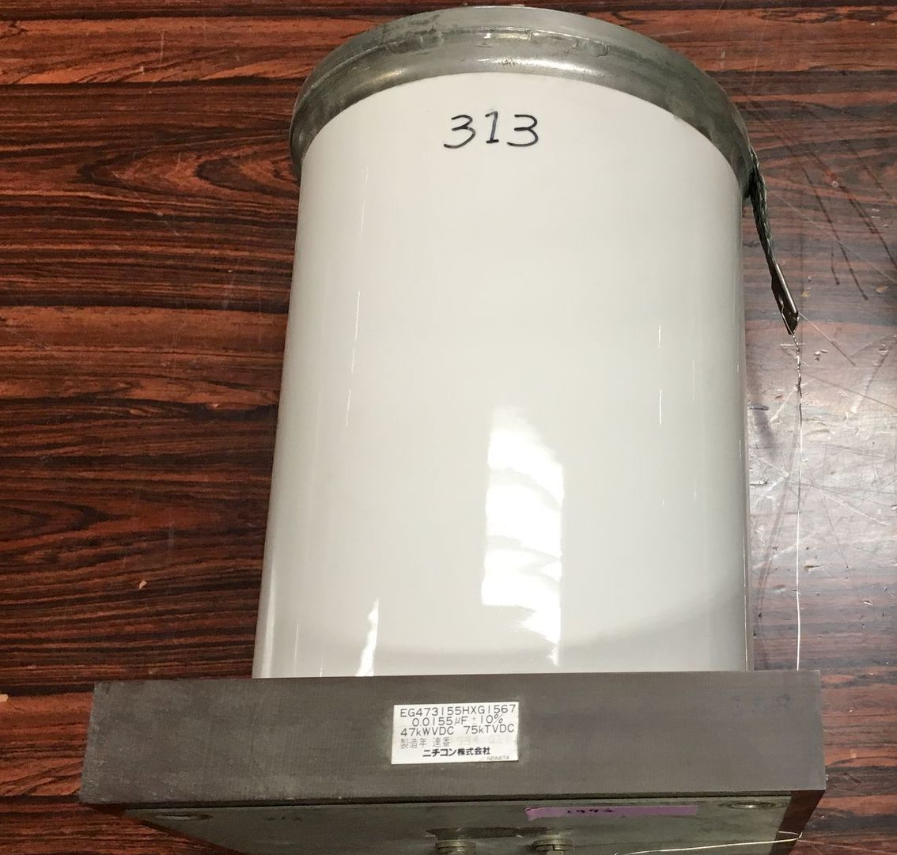
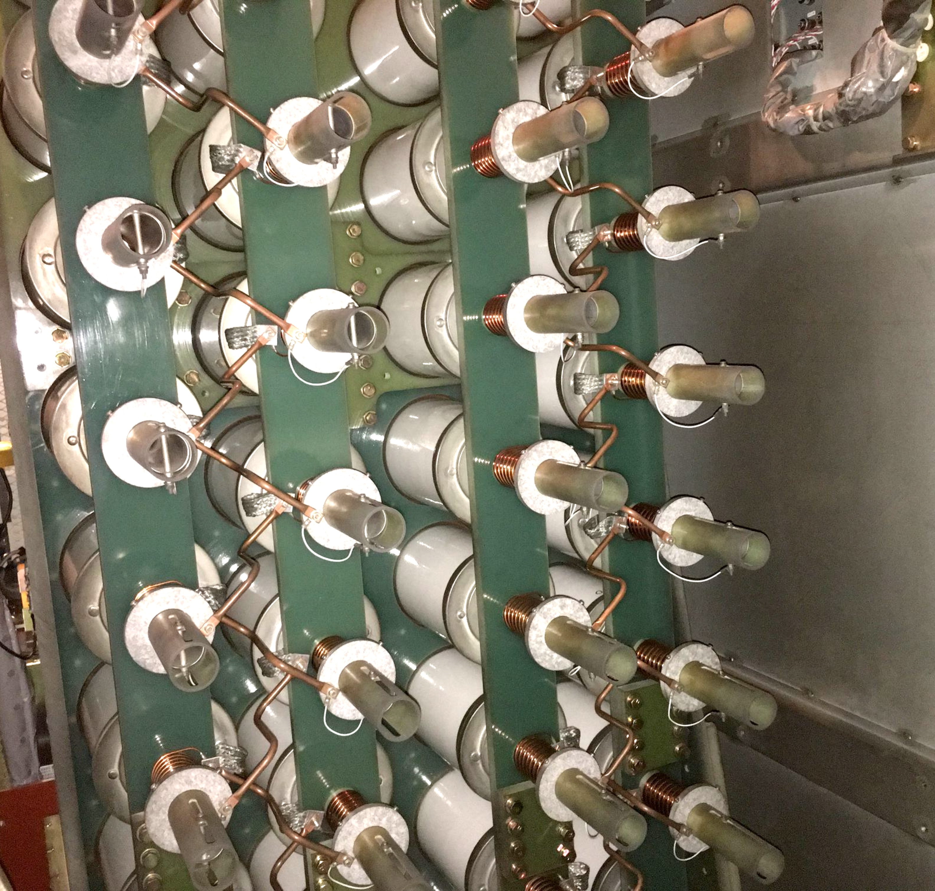
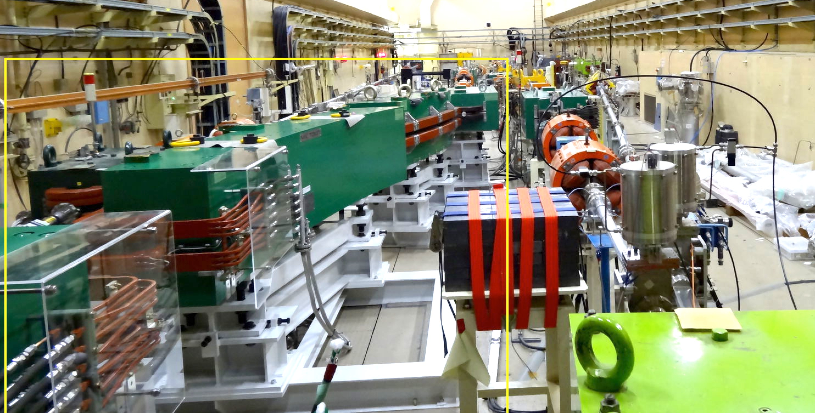
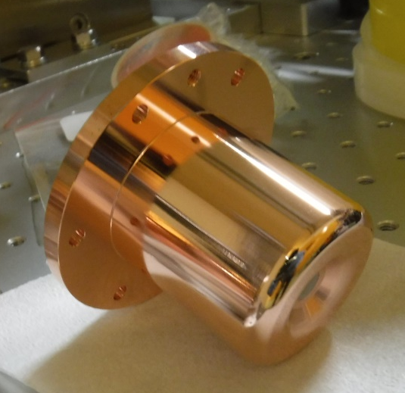

Injector Linac Upgrade Items 2022 - 2026
Thermionic gun with 10 nC
PF ring
2.5 GeV
0.2 nC
B
A
RF gun with 4 nC
1.1 GeV positron damping ring
J-arc
1.5 GeV
3.2 GeV, 10nC x 2
LER positron
4.0 GeV
4 nC x 2
Bunch compression
Energy compression
Energy compression
C
1
Positron generation
2
3
4
5
PF-AR
6.5 GeV
0.2 nC
HER electron
7.0 GeV
4 nC x 2
Pulsed magnets/kickers
High precision movers
PCB capacitor renewal
New energy compressor
RF gun
Positron capture section
Accelerating structure

Slide 11
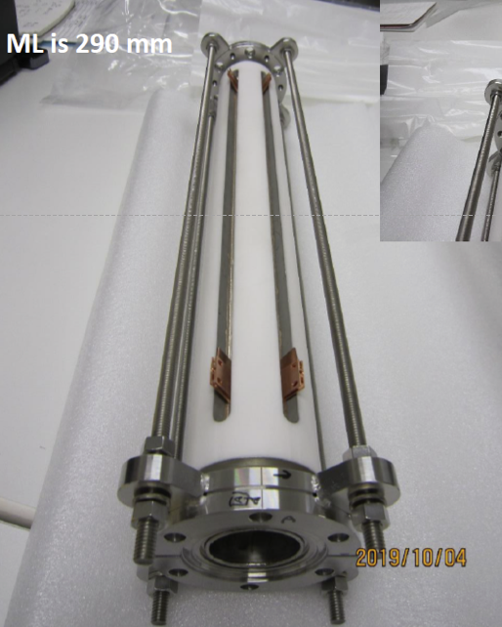
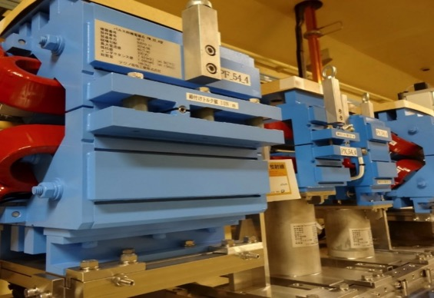
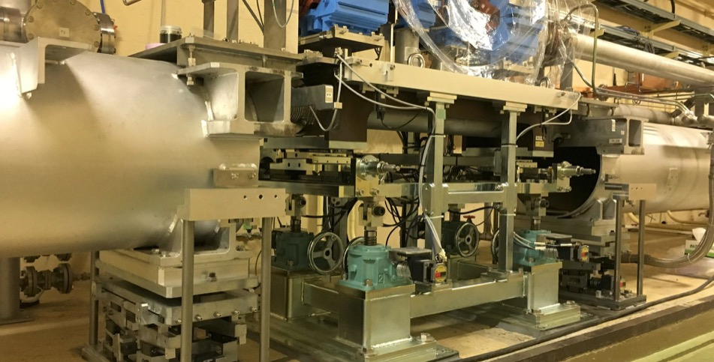

Pulsed Magnet, Kicker and Mover
Injector linac injects beams into SuperKEKB HER, LER as well as light sources PF, PF-AR with adequate beam properties at 50 Hz maximum in simultaneous top-up injection scheme. Pulsed magnets, kicker magnets and girder movers will be installed in order to suppress emittance blow-up caused by wakefield in accelerator structure with 4 nC per bunch. Kicker magnets may correct beam orbits separated by only 96 ns. Girder movers may compensate 2-mm annual floor drift at less than 10 microns.
Ceramics chamber integrated kicker development
Pulsed magnets and power supplies
C. Mitsuda
Y. Enomoto, T. Natsui
High-precision girder movers
Y. Enomoto

Slide 12
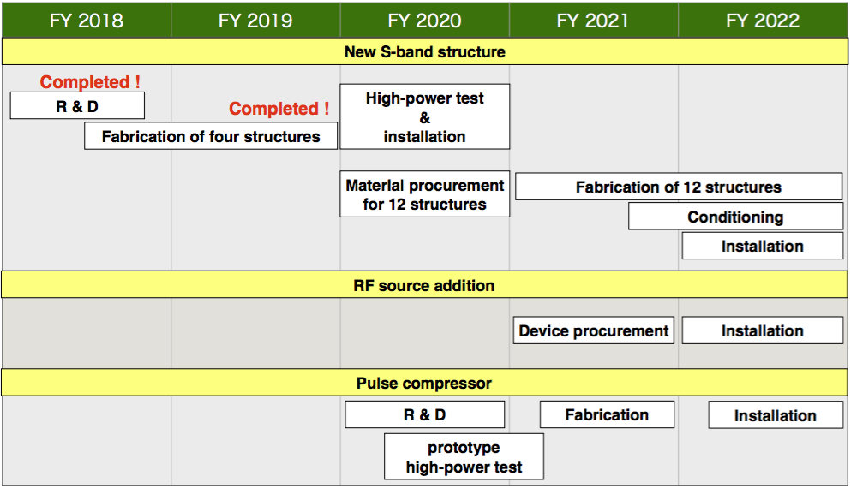
Higher Energy Injection and Collision
Mitigation of accelerator structure issues
Originally designed for 8 MeV/m, but has been used at 20 MeV/m
Degradation that lead to high field emission rate and discharges
Water leaks
Not only Y(6S) but even Y(4S) could be endangered
4-year plan to fabricate and install new accelerator structures
Demands for light source operation may delay the installation until summer 2023

Slide 13
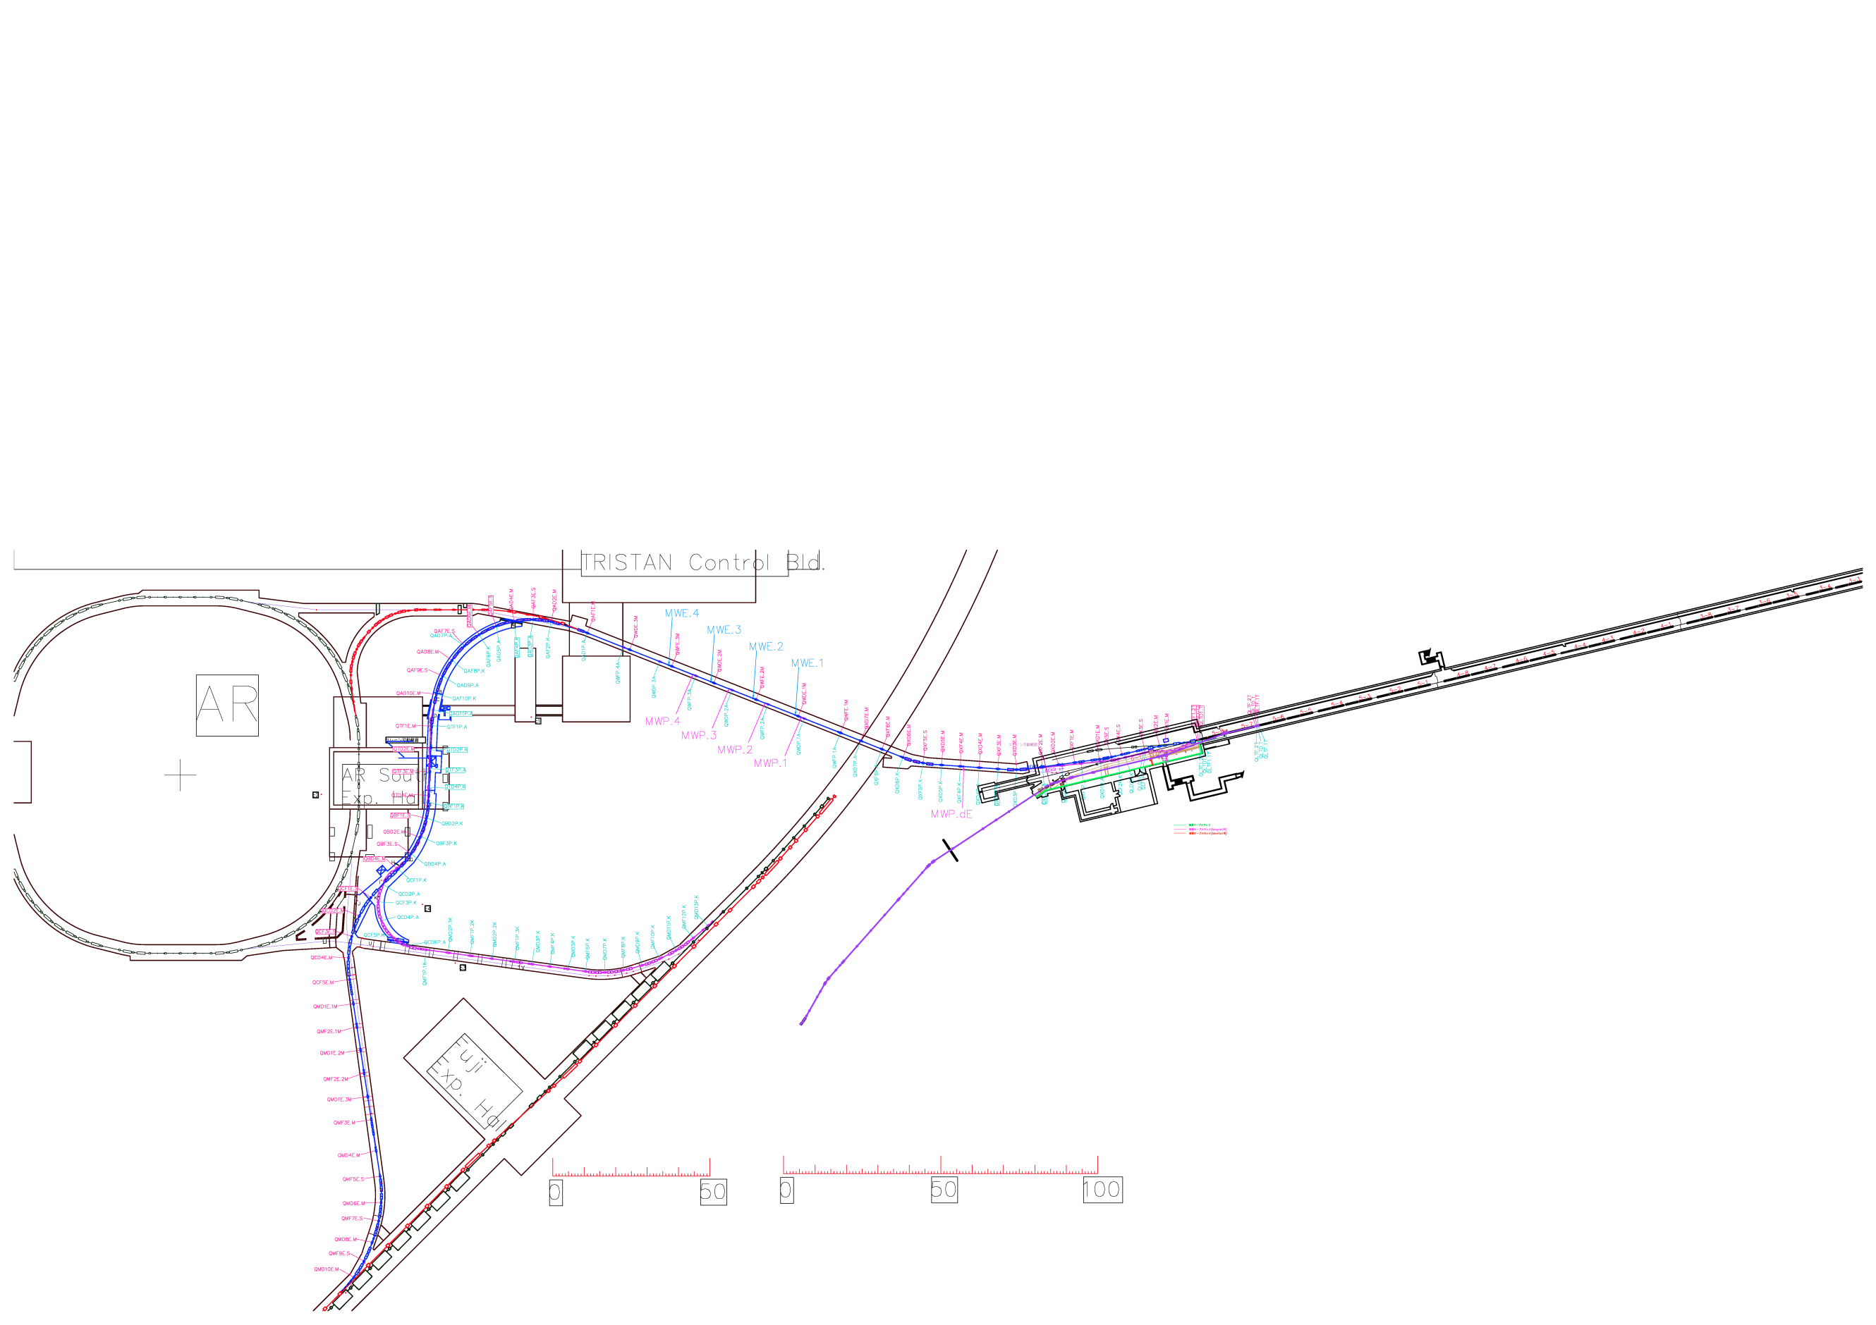
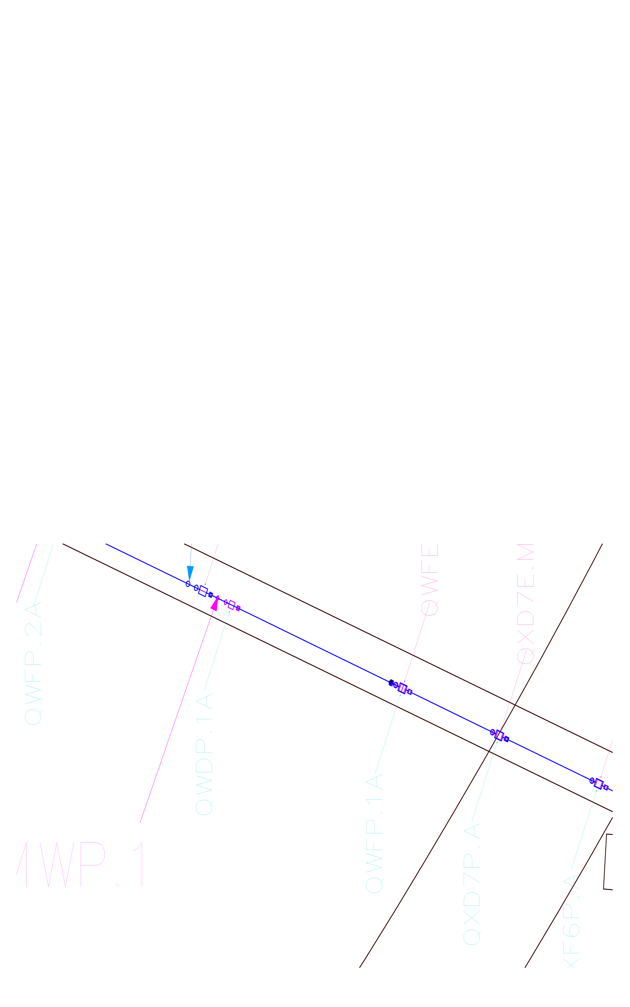
New Accelerating Structures and ECS for Electron Beam
7% of 230 accelerating structures will be replaced for mitigation of 40-years of degradation by discharges and water leaks.
Energy compression system (ECS) for electron beam will be installed at the beginning of the beam transport line.
電子銃空洞と光陰極
回折光学素子による形状補正
E
26m
1000
E
1000
H
E
2000
1000
Additional replace-ment will be necessary in near future.
2000
1000
H
H
E
E
1000
E
10000
1000
H
E
1000
E
1000
H

Slide 14
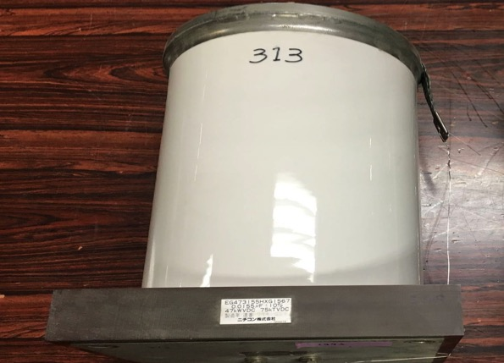
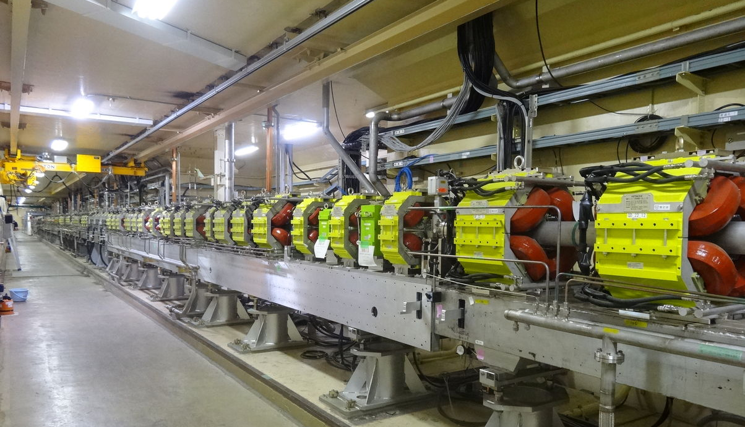
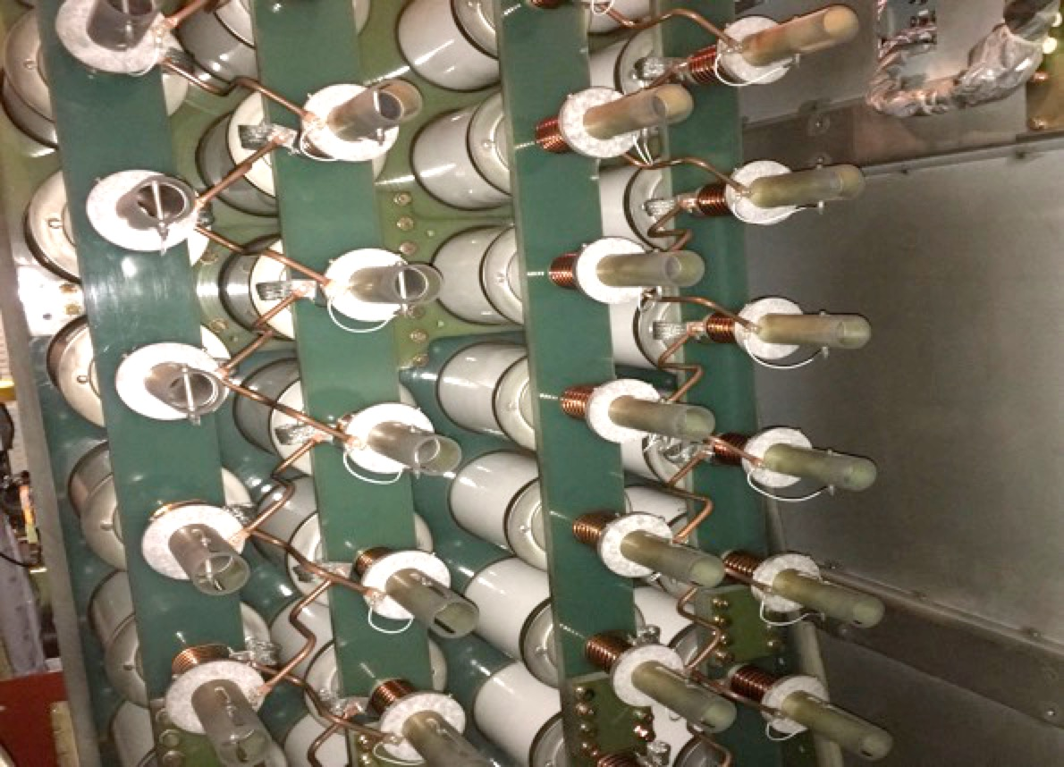
Capacitors with PCB contamination
Capacitors (up to 1200) in power modulators with low-level PCB produced before 1991 will be replaced following the law.
Capacitors in high-power klystron modulators
Injector linac continues to improve with hardware upgrade in 7 category regions from 2022 to 2026.

Slide 15
Further Injector Improvement Possibilities
After injector upgrade in 7 categories
Difficult to foresee now which parameter to improve further
Under consideration
Further increase in positron bunch charge
LER stored current is higher and beam lifetime is shorter
Several possible plans exist
Beam transport line thru the direct tunnel
May relax CSR, etc
May interfere with PF-AR operation
Even higher energy
Not difficult in ring hardware up to 12 GeV with different energy ratio
Collision optics design should be investigated
Quite expensive modification at LINAC and beam transport line
Polarization
Physics demand
R&D for resources, space, meaningful bunch charge
…

Slide 16
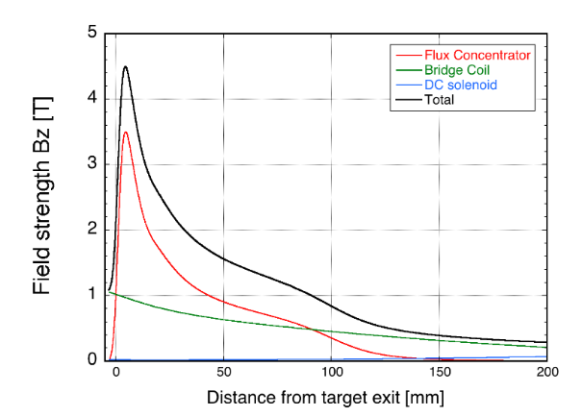

Positron Generation Improvements
bridge coils
Improvement at summer 2020
Cu-Ni alloy for flux concentrator
Routine 12 kA operation
Correctors inside of 15-m solenoid section
Accelerating structure & load
Stable 3 nC positron delivery in 2021
top view
solenoid
10 nC
primary e-
DC quad
spoiler
LAS Accel.
structure
target
e+
beam
hole
4 nC injection e-
Flux
Concentrator
pulsed corr.
pulsed quad

Slide 17
Further Positron Enhancement
Optimization of capturing and bunching
Accelerating voltage gradually increasing
Long-term RF conditioning
Discharge in dummy loads and waveguides being resolved
Several beam monitors and correctors were added
Spiral beam orbit behavior in solenoid with large energy spread
Normal bunching or velocity (decelerating) bunching
New BPM that measures electron and positron separately just after the target before the electron separator. This helps understand positron behavior in solenoidal field.
Signal
Positron
Electron
Monitor head
Time

Slide 18
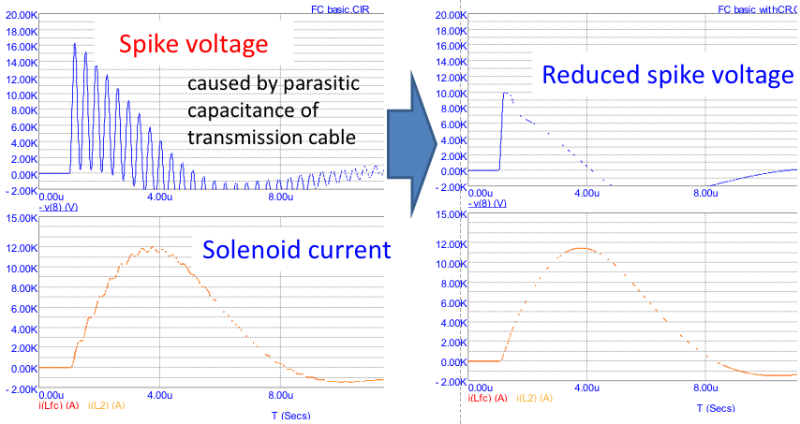
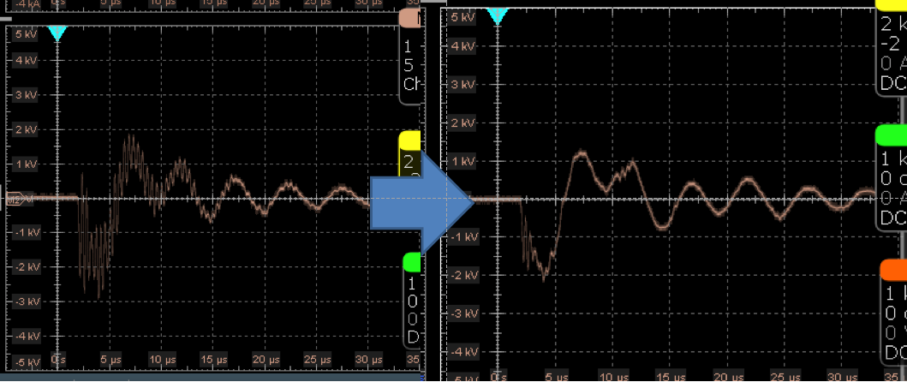
Further Positron Enhancement (II)
Successful resolution of discharge at flux concentrator
Introduction of copper-nickel alloy
Successful mitigation of spike waveform
Simulation of equivalent circuit with detailed stray capacitance
Higher current and higher magnetic field possibility
With power modulator upgrade
T. Natsui
Simulation with improved equivalent circuit and the new design
Actual application of the new design

Slide 19


Further Positron Enhancement (III)
Positron beam not at the center of solenoid / structure
In order to pass electron beam at the center of structure with lower wakefield
The target is 3.5 mm away from the center of structure and 1.5 mm away from the center of flux concentrator, responsible for spiral beam and lower mag field
Solenoidal field gap between flux concentrator and structure
For maintainability at high radiation region
After several years of experience, shorter gap possibility
Both are the sources of positron loss, and new design is underway
Top view
Rear view

Slide 20




Carbon Neutral Activities at Injector LINAC
High Performance Simultaneous Top-up Injections
69% Power Recovery from Pulsed Magnet Coils
High Power Conversion Efficiency at Magnet Power Supplies
High Efficiency RF Power Distribution

Slide 21
Responses to previous BPAC Comments
Although the current injection rate is adequate, improvements will be needed to achieve higher stored beam currents and shorter ring lifetime.
Much improved with a new beam injection monitor. Several possible ideas are being investigated, including physical aperture, optics matching, magnetic field compensation, mitigation of CSR by new beam duct, more synchronized beam instrumentations, etc.
The positron yield is below the design value. The positron yield needs to be improved in order to keep up with the expected short lifetime of the LER as beam currents increase.
Several possible scenarios were presented in this presentation. Presently, it is said to be large enough for the bucket charge quantization.
The HER injection rate also is low and there is still the emittance increase in the BT to the ring.
We are slowly studying the beam behavior between collision operation.
Further studies on the two-bunch injection for the HER is encouraged, most likely requiring dedicated machine time.
Thanks for the recommendation, we will balance it with collision operation and ring study.
The committee encourages expanding the effort to improve the modelling of the current BT in order to understand where the emittance blowup is occurring; e.g. how much a lattice error needs to be increased in order to induce the observed emittance blowup.
We began to understand where the blowup starts, etc. with limited instrumentations.

Slide 22
Summary
Injector LINAC continues reasonable injections in simultaneous top-up injection mode.
Emittance blow-up at the 2nd half of beam transport line is still under investigation, but is partially relaxed recently with finer parameter tuning to make injection and storage beams match.
The injector upgrade was discussed and will be implemented in 7 categories for the final beam parameters with higher bunch charges and lower transverse and longitudinal emittances. Further upgrade is also investigated.

Slide 23
Thank you

Slide 24
Backup

Slide 26





DR Optics Change
H. Sugimoto
(A) Optics using the operation
(B) Low emittance optics
(Failed in Apr.2021)
(C) Half-low-emittance optics
(Feb.2022)

Slide 27
Linac Beam Parameters for KEKB/SuperKEKB
Linac Beam Property Requirements
Stage | KEKB (final) |  | Phase-I (achieved) |  | Phase-II (achieved) |  | Phase-III (interim) |  | Phase-III (final)
Beam | e+ | e– | e+ | e– | e+ | e– | e+ | e– | e+ | e–
Energy | 3.5 GeV | 8.0 GeV | 4.0 GeV | 7.0 GeV | 4.0 GeV | 7.0 GeV | 4.0 GeV | 7.0 GeV | 4.0 GeV | 7.0 GeV
Stored current | 1.6 A | 1.1 A | 1.0 A | 1.0 A | – | – | 1.8 A | 1.3 A | 3.6 A | 2.6 A
Life time (min.) | 150 | 200 | 100 | 100 | – | – | – | – | 6 | 6
 | primary e- 10 |  | primary e- 8 | 1 | 0.5 | 1 | 2 | 2 | primary e- 10 | 4
Bunch charge (nC) | → 1 | 1 | → 0.4 |  |  |  |  |  | → 4
Norm. Emittance | 1400 | 310 | 1000 | 130 | 200/40 | 150 | 150/30 | 100/40 | 100/15 | 40/20
(γβε) (mrad) |  |  |  |  | (Hor./Ver.) |  | (Hor./Ver.) | (Hor./Ver.) | (Hor./Ver.) | (Hor./Ver.)
Energy spread | 0.13% | 0.13% | 0.50% | 0.50% | 0.16% | 0.10% | 0.16% | 0.10% | 0.16% | 0.07%
Bunch / Pulse | 2 | 2 | 2 | 2 | 2 | 2 | 2 | 2 | 2 | 2
Repetition rate | 50 Hz |  | 25 Hz |  | 25 Hz |  | 50 Hz |  | 50 Hz
Simultaneous top-up injection (PPM) | 3 rings (LER, HER, PF) |  | No top-up |  | Partially |  | 4+1 rings (LER, HER, DR, PF, PF-AR) |  | 4+1 rings (LER, HER, DR, PF, PF-AR)
Gradual improvements keeping light source injections

Slide 28


Emittance Preservation
Alignment
Offset injection may solve the issue
Orbit have to be maintained precisely
Mis-alignment should be <0.1mm locally, <0.3mm globally
Mis-alignment leads to Emittance blow-up
Orbit manipulation compensates it
100 samples
Sugimoto et al.

Slide 29

Floor vertical movement in a half year from summer to winter
Alignment
Higo et al.
C3
11
18
28
38
48

