Slide 1
Electron/Positron Injector Phase-2 Status and Phase-3 Plan
Kazuro Furukawa
for Injector Linac, KEK

Slide 2
Overview
Beam Quality Management
Accelerating Structure
Summary

Slide 3
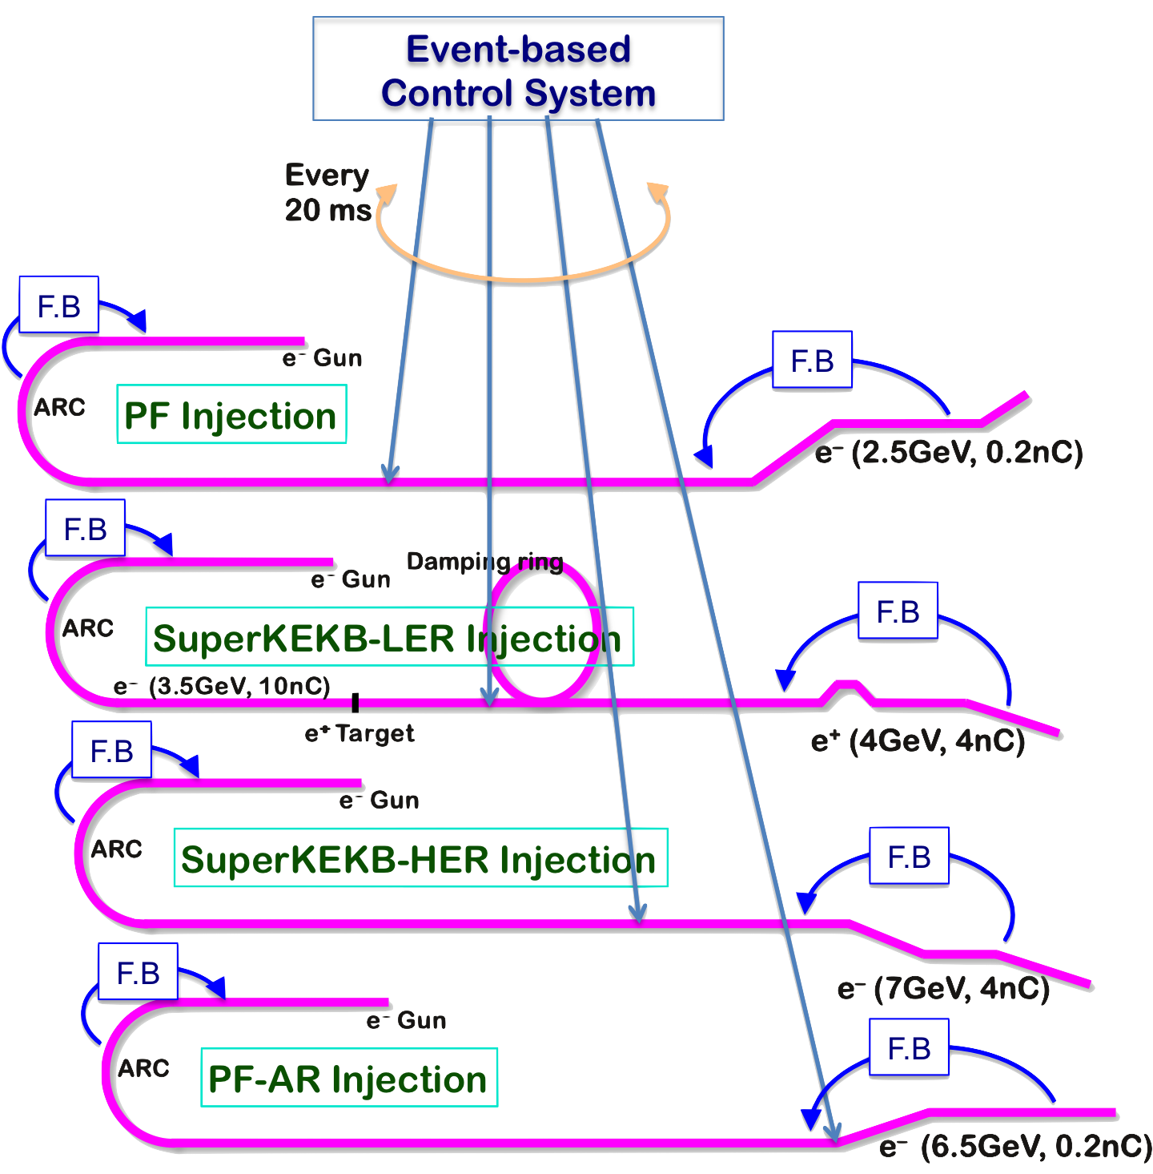
Mission of Electron/positron Injector in SuperKEKB
Injector Linac Mission
For 40-times higher luminosity in SuperKEKB collider
Low emittance & low energy spread injection beams with 4 times higher beam current
New high-current photo-cathode RF gun
New positron capture section
Positron damping ring injection/extraction
Optimized beam optics and correction
Precise beam orbit control with long-baseline alignment
Simultaneous top-up injection to DR/HER/LER/PF/PFAR
Balanced injection for the both photon science and elementary particle physics experiments
The single injector would behave as multiple injectors to multiple storage rings by the concept of virtual accelerator
Notes:
Higher Injection Beam Current
To Meet the larger stored beam current and shorter beam lifetime in the ring
4~8-times larger bunch current for electron and positron
Reconstruction of positron generator, etc
Lower-emittance Injection Beam
To meet nano-beam scheme in the ring
Positron with a damping ring
Electron with a photo-cathode RF gun
Emittance preservation by alignment and beam instrumentation
Quasi-simultaneous injections into 4 storage rings
SuperKEKB e–/e⁺ rings, and light sources of PF and PF-AR
Improvements to beam instrumentation, low-level RF, controls, timing, etc

Slide 4
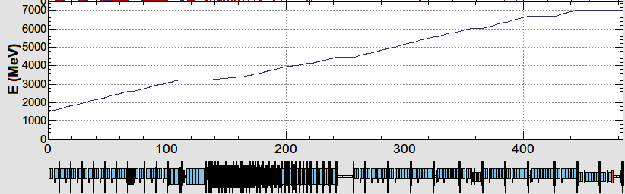
Injector Linac Operation in Phase II - III
10 nC x 2 bunches x 50 Hz (LER)
4 nC x 2 bunches x 50 Hz (HER)
0.3 nC x 1 bunch x 25 Hz (PF-AR)
0.3 nC x 1 bunch x 25 Hz (PF)
B
A
beam bunches from e- gun
beam injection with pulse-to-pulse variable charge and energy
device parameter change at 50 Hz (20 ms)
Pulsed magnet commissioning at 3-5 sectors (2017 autumn), and many more installation (2018-2019)
1.5 GeV e-
1.1 GeV
DR
C
1
2
3
4
5
DC magnets
pulsed magnets
HER: 7 GeV e-
PF-AR: 6.5 GeV e-
4.219 GeV
the same energy
e-
variable energy pulse-to-pulse
LER: 4 GeV e+
1.1 GeV
deceleration
positron target
e+
PF: 2.5 GeV e-
1.5 GeV
C
1
2
3
4
5

Slide 5
Required injector beam parameters
Linac Beam Property Requirements
Stage | KEKB (final) |  | Phase-I |  | Phase-II |  | Phase-III (2019) |  | Phase-III (final)
Beam | e+ | e– | e+ | e– | e+ | e– | e+ | e– | e+ | e–
Energy | 3.5 GeV | 8.0 GeV | 4.0 GeV | 7.0 GeV | 4.0 GeV | 7.0 GeV | 4.0 GeV | 7.0 GeV | 4.0 GeV | 7.0 GeV
Stored current | 1.6 A | 1.1 A | 1.0 A | 1.0 A | – | – | 1.8 A | 1.3 A | 3.6 A | 2.6 A
Life time (min.) | 150 | 200 | 100 | 100 | – | – | – | – | 6 | 6
 | primary e- 10 |  | primary e- 8 | 1 | 0.5 | 1 | → 2 | → 2 | primary e- 10 | 4
Bunch charge (nC) | → 1 | 1 | → 0.4 |  |  |  |  |  | → 4
Norm. Emittance | 1400 | 310 | 1000 | 130 | 200/40 | 150 | 100 | 40 | 100 / 15 | 40 / 20
(γβε) (mrad) |  |  |  |  | (Hor./Ver.) |  |  |  | (Hor./Ver.) | (Hor./Ver.)
Energy spread | 0.13% | 0.13% | 0.50% | 0.50% | 0.16% | 0.10% | 0.16% | 0.10% | 0.16% | 0.07%
Bunch / Pulse | 2 | 2 | 2 | 2 | 2 | 2 | 2 | 2 | 2 | 2
Repetition rate | 50 Hz |  | 25 Hz |  | 25 Hz |  | 50 Hz |  | 50 Hz
Simultaneous top-up injection (PPM) | 3 rings |  | No top-up |  | Partially |  | 4+1 rings |  | 4+1 rings (LER, HER, DR, PF, PF-AR)
 | (LER, HER, PF)

Slide 6
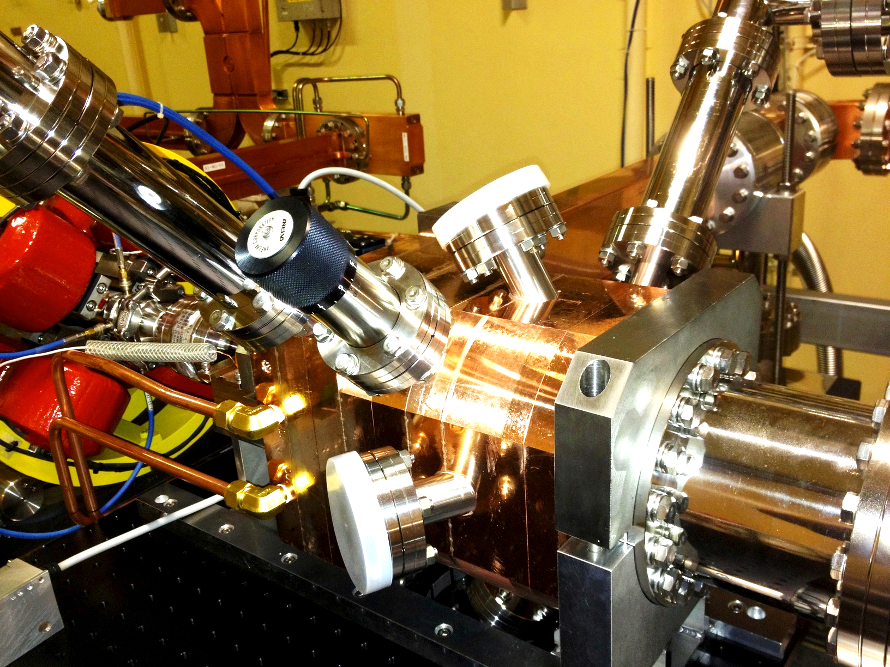
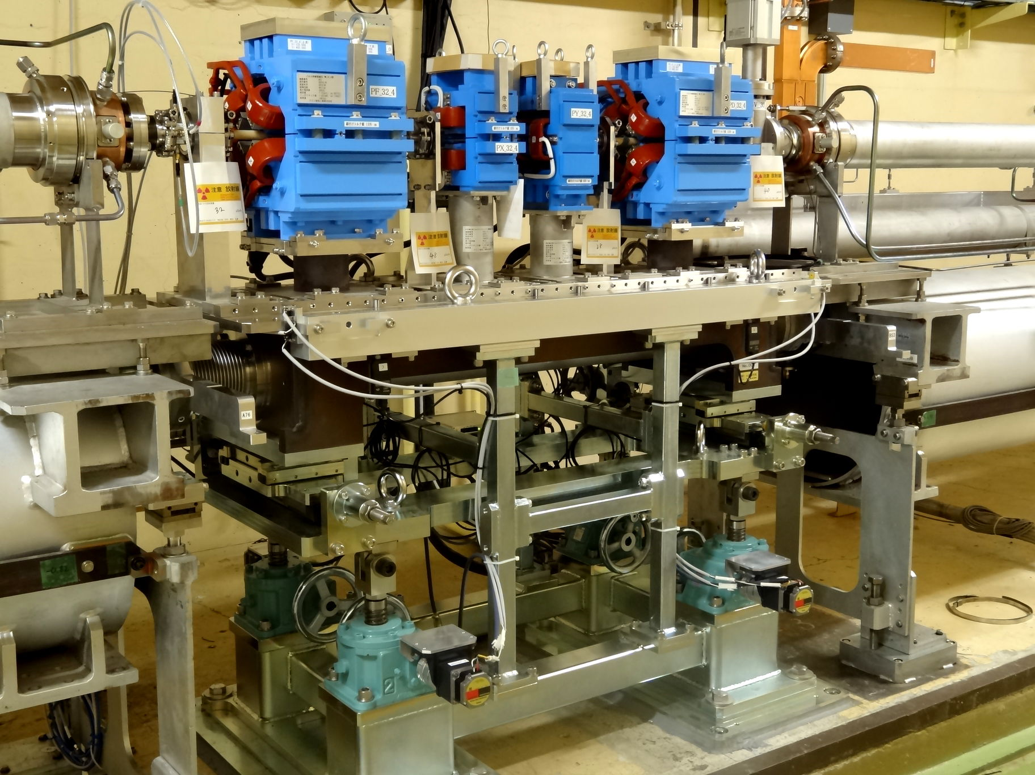
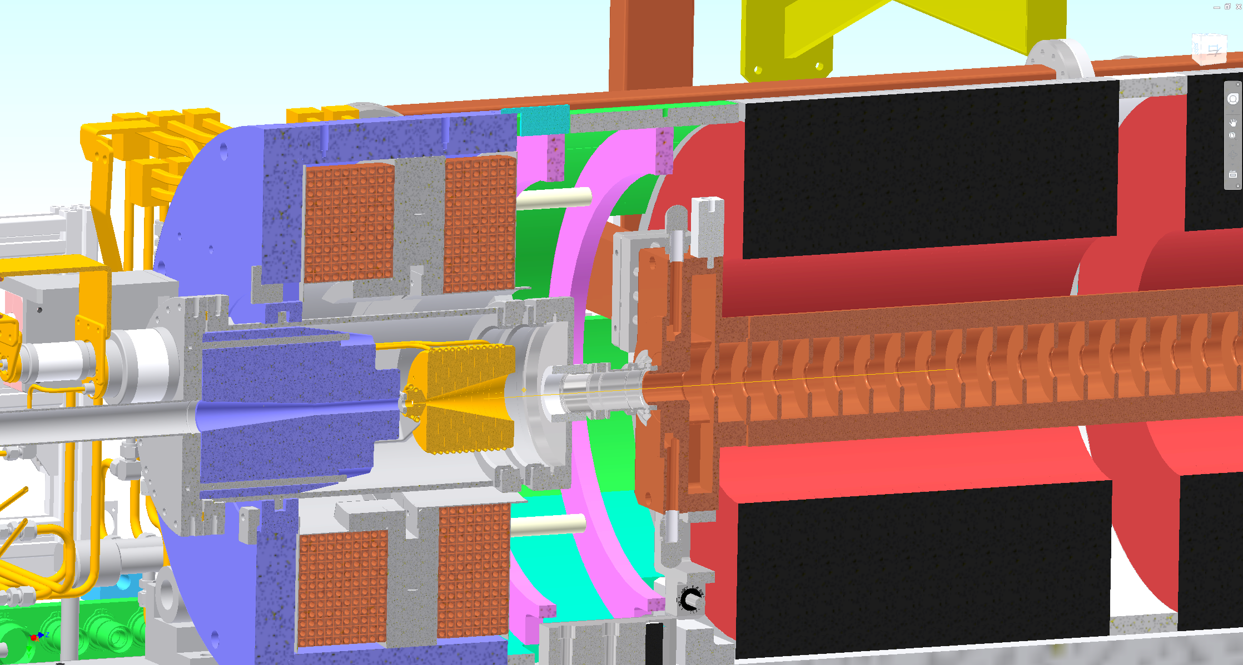
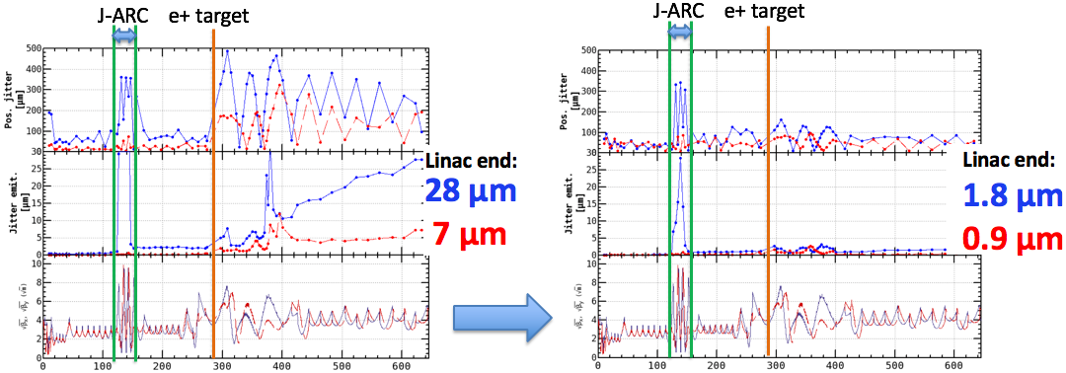
Beam Commissioning Activities
Low emittance electron High efficiency Beam control
from RF gun positron capture with ~70 pulsed magnets
Injection beam for SuperKEKB Emittance optimization
 | KEKB (− 2010) |  | SuperKEKB Phase III
Beam | e+ | e– | e+ | e–
Bunch charge (nC) | 1.0 | 1.0 | 4.0 | 4.0
Normalized Emittance (μm) | 1400 | 310 | 100/15 (Hor./Ver.) | 40/20 (Hor./Ver.)
Energy spread | 0.125% | 0.125% | 0.16% | 0.07%

Slide 7
Injector FY2019 Plan
Realize stable and sufficient beams for the first year of Phase 3 commissioning
Perform 3-year program to recover degradation of accelerating structures
Postpone remaining upgrades until later years, limit backup devices, in order to support longer operation hours even under limited resources in FY2019

Slide 8
Overview
Beam Quality Management
Accelerating Structure
Summary

Slide 9
Injector Operation in Autumn 2018
Top-up injections to light sources, PF/PF-AR
With pulsed magnets at beamline merger of guns
No positron damping ring operation
Opportunity to study beam behavior at target hole
25 Hz mostly, followed by 3-day 50-Hz hardware checks
First intense 50-Hz operation since 2011 earthquake in 2019
Emittance brow-up studies and knowledge acquisition
Beam studies are planned, partially with simultaneous injection
Emittance preservation
Beam orbit, optics controls and mover application
Gradual beam current and gradient improvements
For later injection improvement

Slide 10
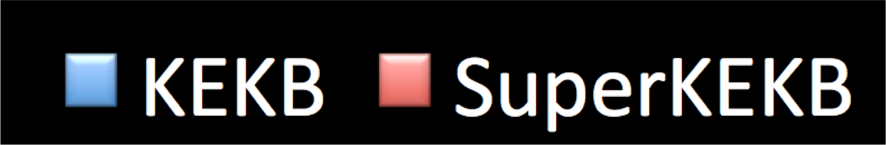














Injection Beam at KEKB and SuperKEKB
Comparison between achievement at KEKB and requirement at SuperKEKB Phase III
Much smaller emittance even with 3-fold higher beam charge
Still a big challenge that is being resolved
5
4
3
2
1
0
3 times
400
300
200
100
0
1/7
400
300
200
100
0
1/15
0.08
0.06
0.04
0.02
0
1.3 times
Norm. Hor.
Emit. (μm)
Norm. Ver.
Emit. (μm)
Charge (nC)
σδ(%)

Slide 11
Beam Quality
Beam emittance
Beam energy spread
Stabilities of beam position, energy, etc
Beam position jitter (painted jitter emittance)
Beam energy jitter (painted energy spread)
Degradation of above beam qualities can be the source of injection background
Hardware components and their monitor systems were much improved

Slide 12


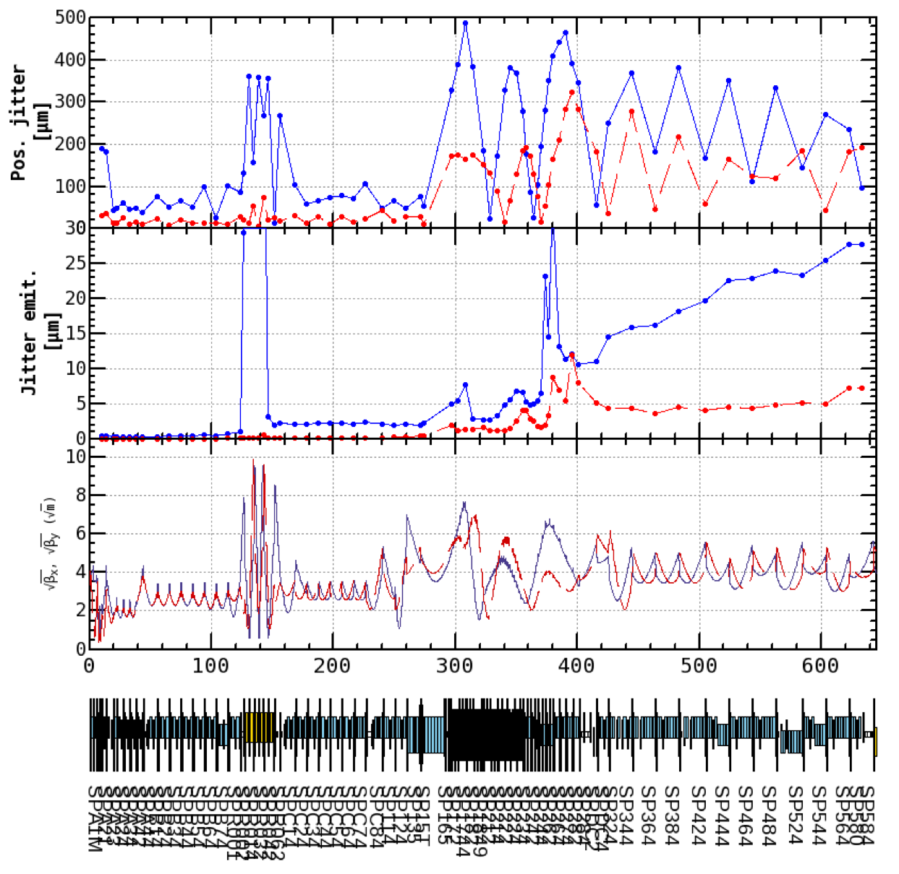
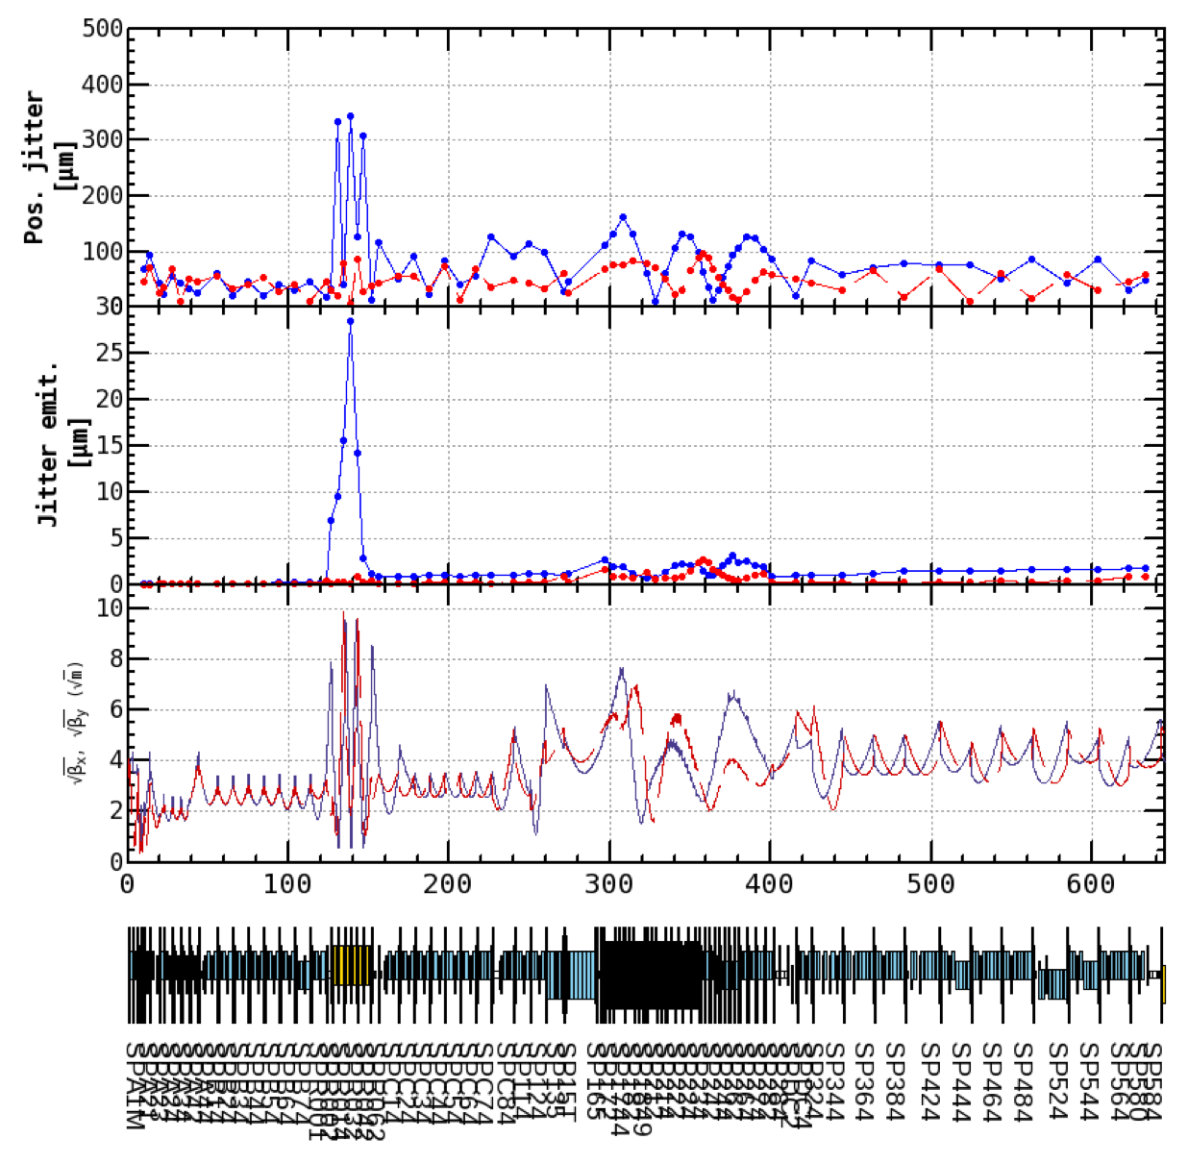


Beam Phase Space Jitter Reduction
Seimiya et al.
Before dispersion correction
After dispersion correction
J-ARC e+ target
J-ARC e+ target
1nC
The top plot shows the standard deviation of beam position. The middle plot shows emittance growth induced by beam jitter.
Linac end:
28 μm
7 μm
Linac end:
1.8 μm
0.9 μm
Beam phase space jitter is reduced by dispersion correction.
Small emittance growth still occurred from after the target after the correction.
We should understand the source of the beam jitter to prepare for the high charged beam (4 nC) and for accidental jitter source which occur at upstream the target.

Slide 13
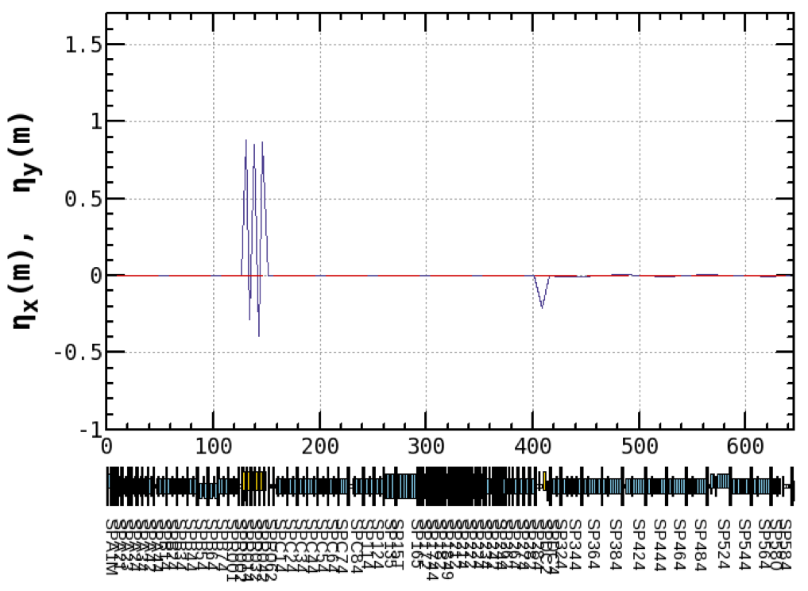
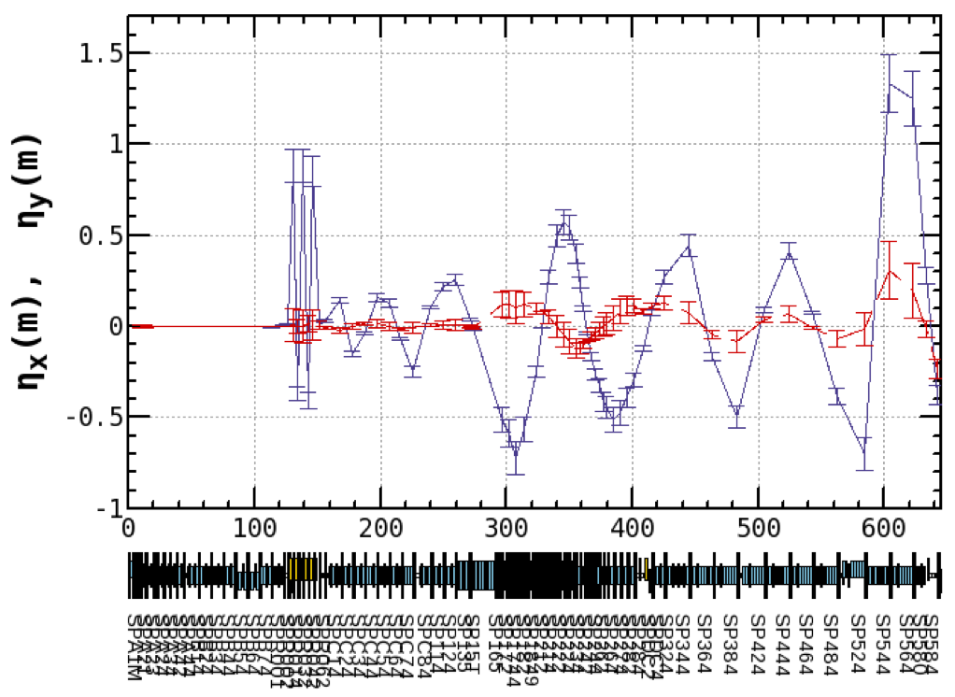
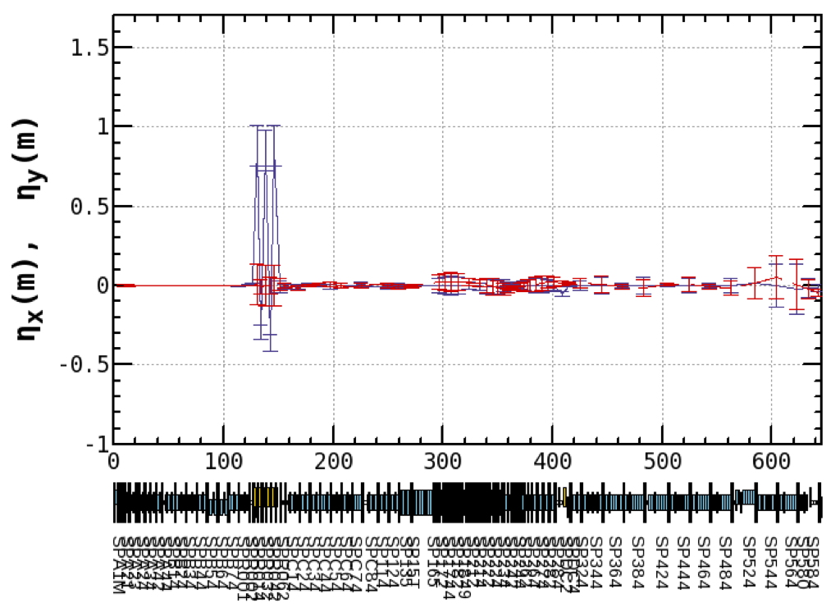

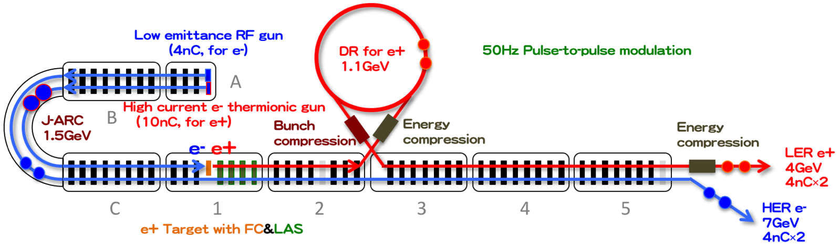
Residual Dispersion Function in Linac
Y. Seimiya et al.
Large residual dispersion was generated from the J–ARC.
With dispersion correction by tuning the magnetic field of quadrupole magnets, residual dispersion became small enough.
Design
Measured
Before
Measured
After
Dispersion correction

Slide 14
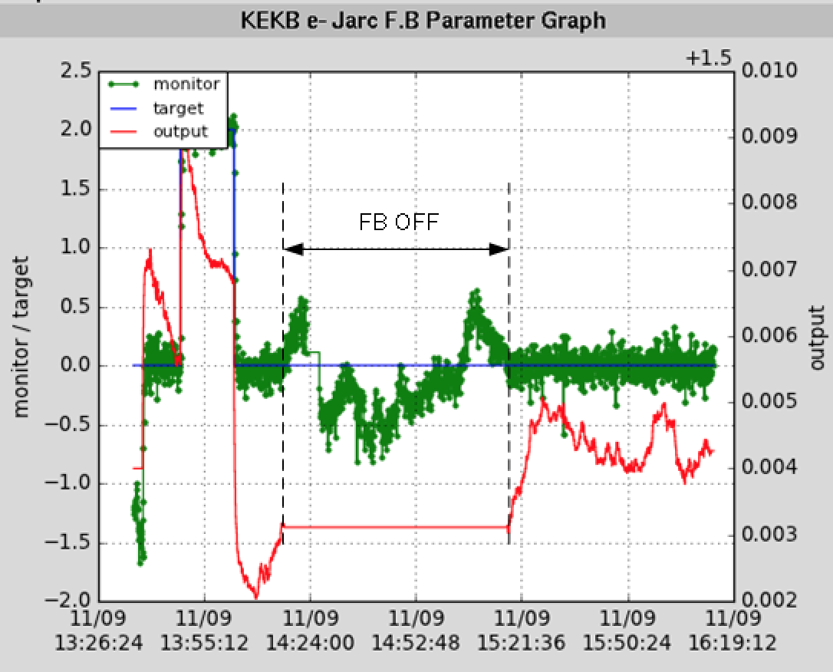
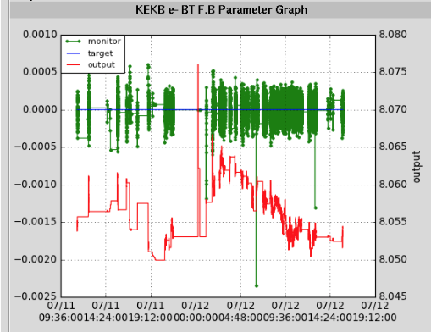
Energy Stabilizer (Energy FB)
Iida et al.
Jarc
BT
FB ON
±0.03%
Target
FB ON
Beam energy
( monitored)
Energy knob
The injection energies have been stabilized within ±0.03% by the energy feedback.

Slide 15
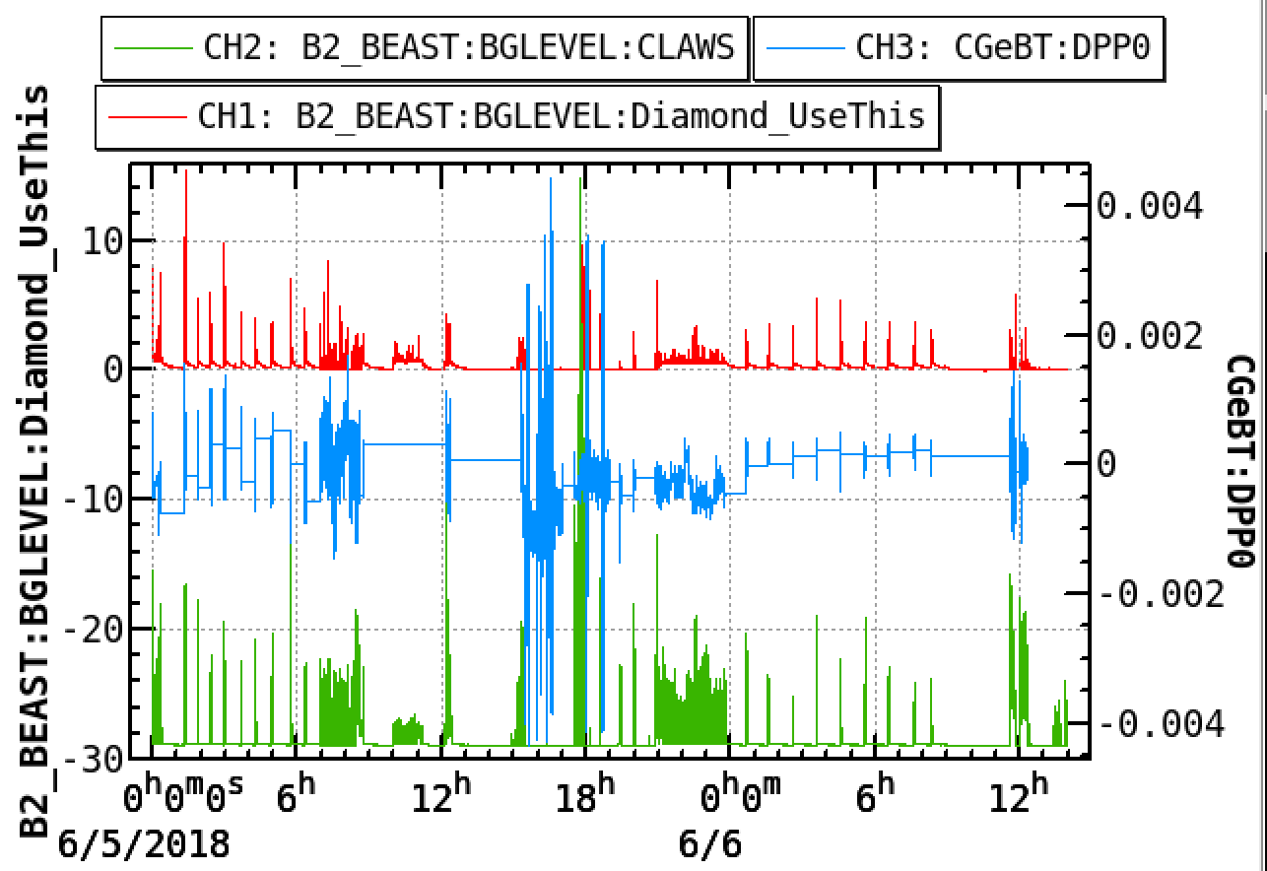
Energy jitter
Iida et al.
After suppressing the energy jitter,
the signal from Diamond detector was reduced.
Diamond became small
±0.1%
Energy Jitter
Energy FB did not work well.
±0.05%
CLAWS
Beam background is sensitive to the energy jitter.

Slide 16









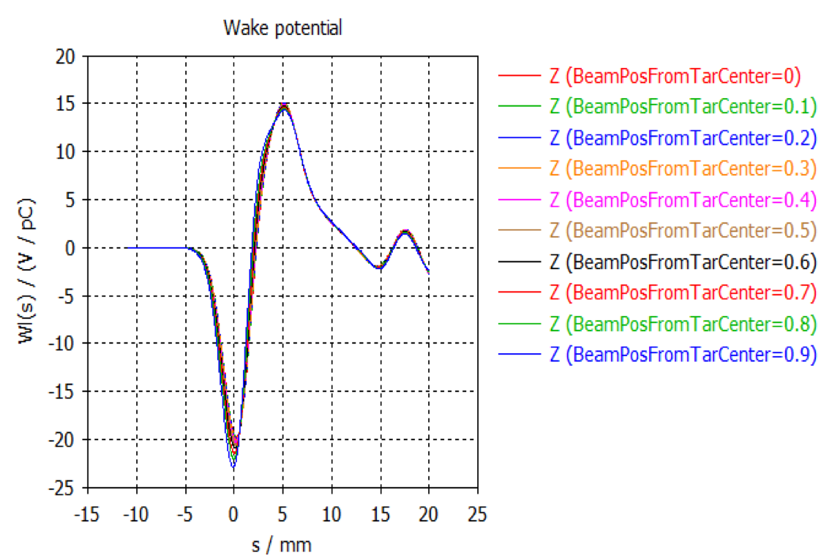
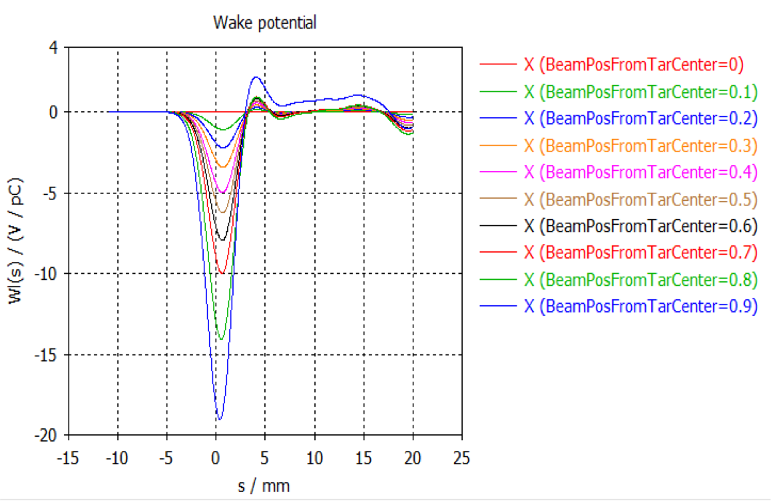

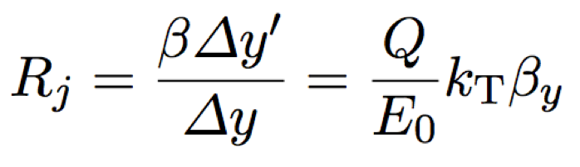
Emittance Growth at Target Hole (?)
Y. Seimiya et al.
e+ e-
e-
φ2 mm
In order to reveal beam jitter problem, simulation analysis of the wakefield in the target hole was performed.
Color variation shows difference of beam position from the center of target hole.
Longitudinal wake
Transverse wake
Wake potential in the target hole.
X = Beam position from the center of target hole.
Enlarged coefficient of beam position jitter:
~ 0.1@1nC << Measured enlarged coefficient

Slide 17

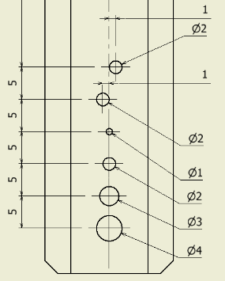
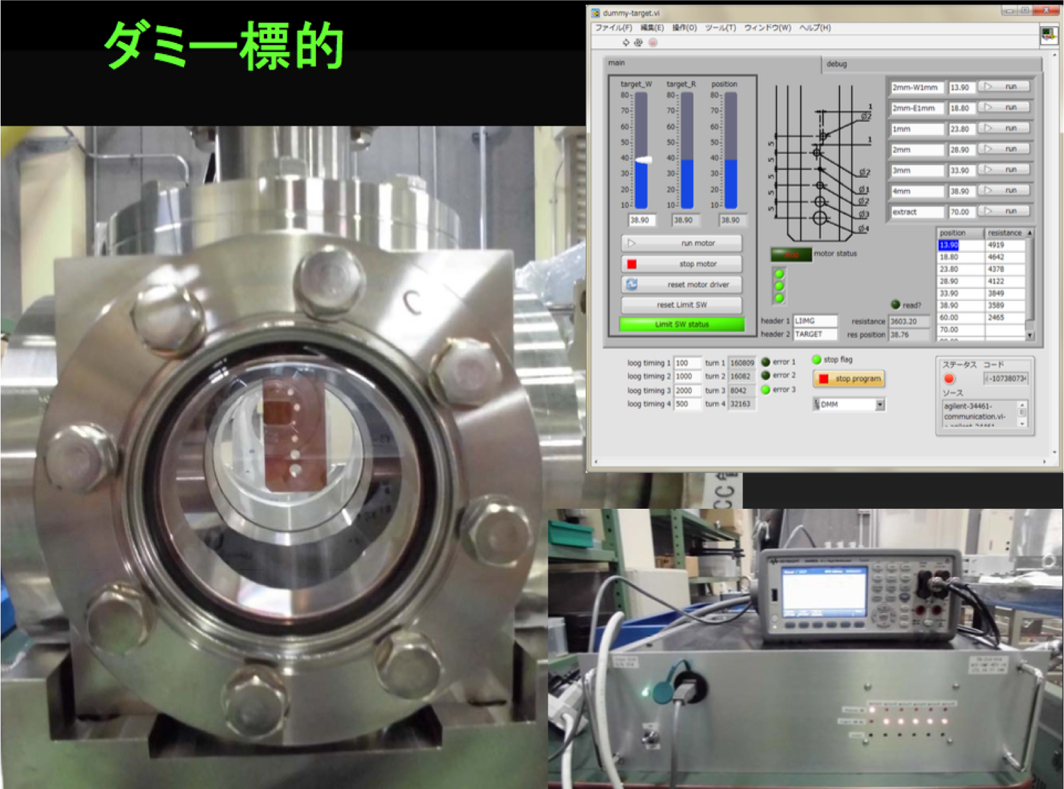
Target Hole Study
Y. Enomoto et al.
To reveal beam jitter source directly, we temporally replace the target to dummy target with several hole, which have different diameter.
In this autumn, we will study the target hole effect on beam jitter.

Slide 18
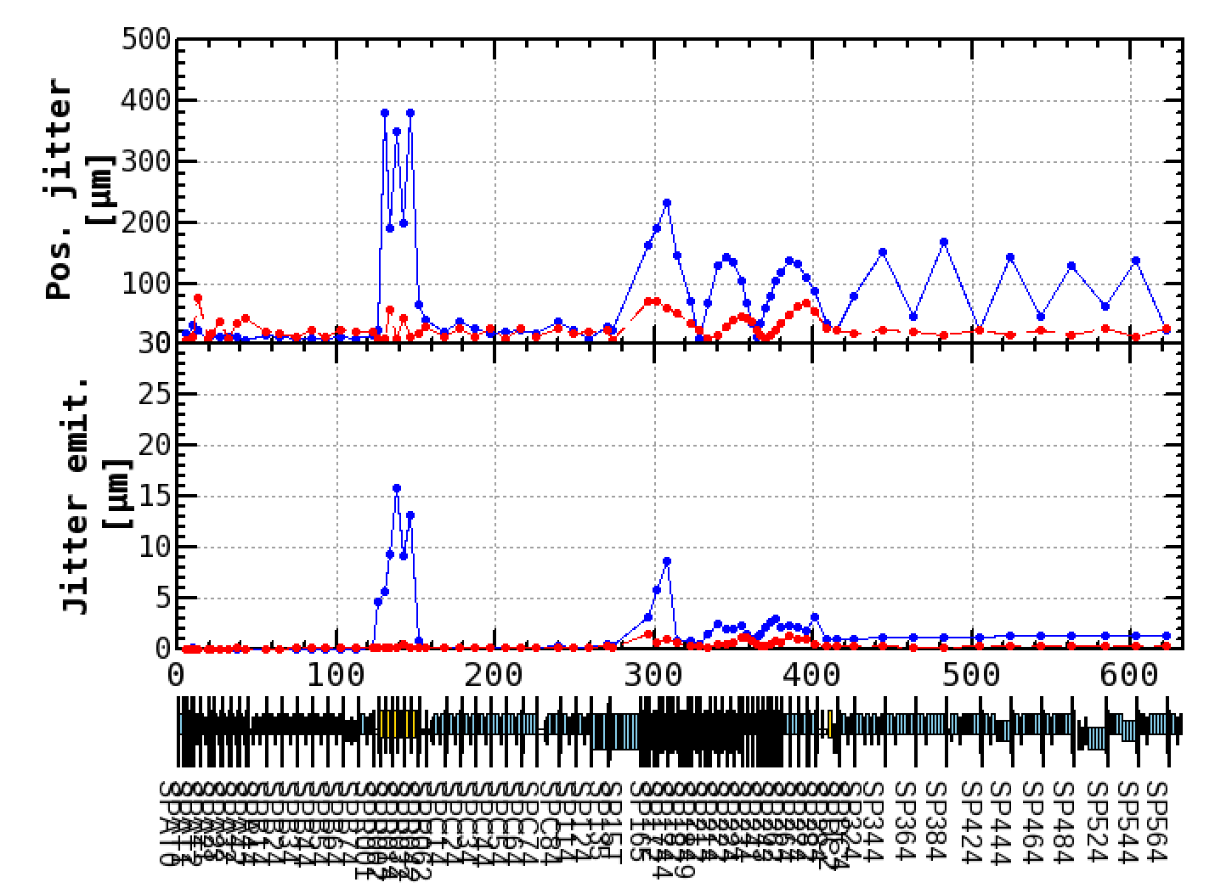
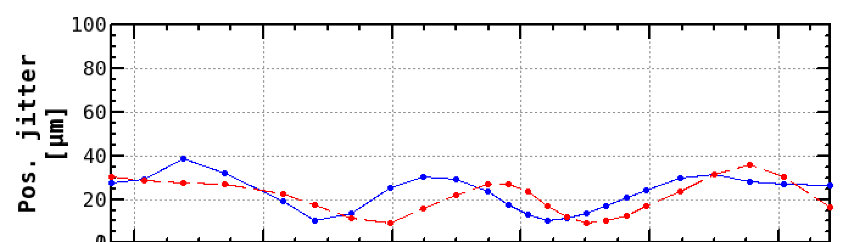
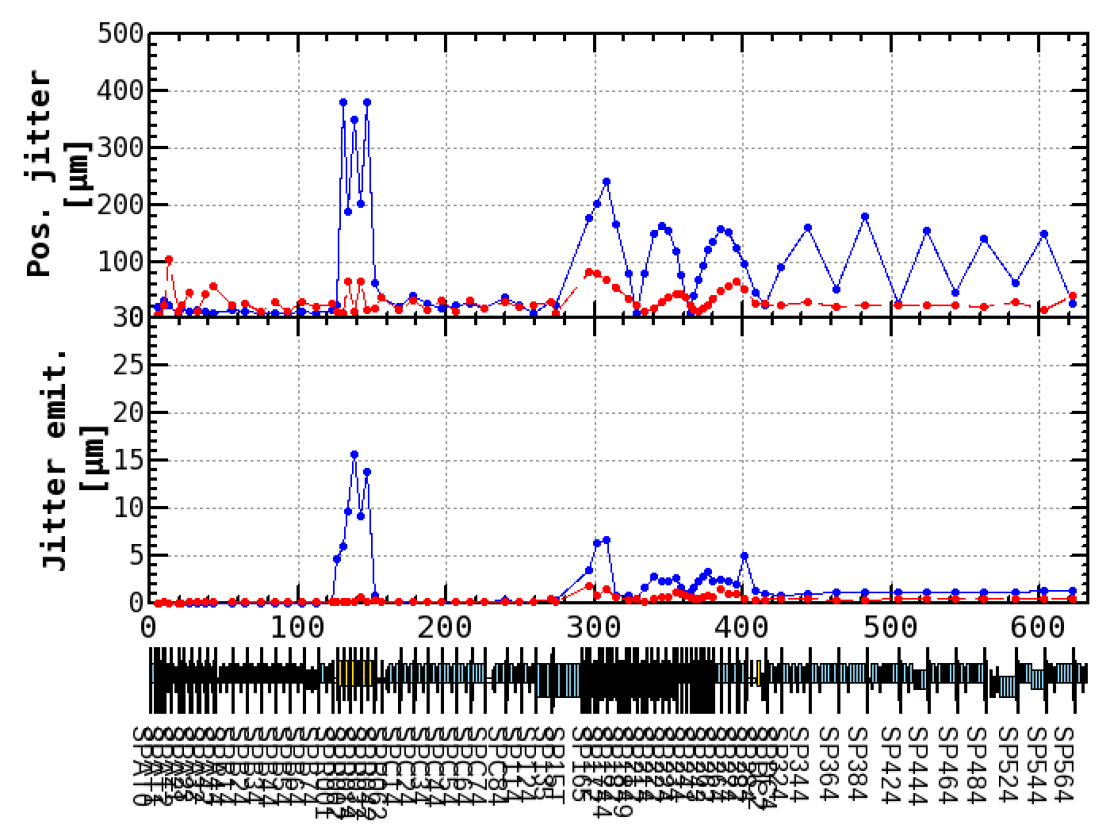
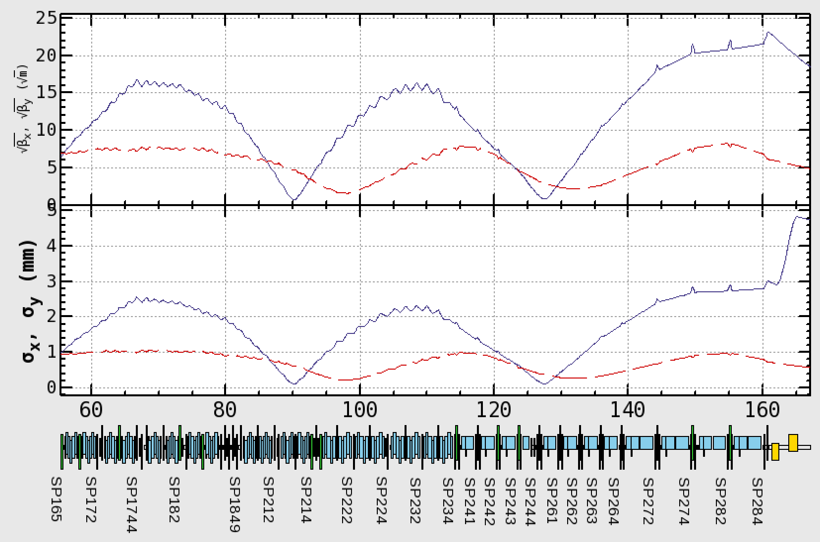
Jitter Emittance after Target
The result is;
The growth of the jitter emittance has been nothing to do with the small hole.
Strong correlation between orbit jitter and beta function.
The beta function after the target is large to squeeze the beam sizes to pass through the hole, which causes the large orbit jitter.
With Target hole(φ2mm)
Although the jitter emittances are still increased as shown in the jitter emittance plots, it is known that this jitter becomes smaller when Jarc's dispersion leakage is reduced.
They are small enough at the end of LINAC.
Position jitters x, y [μm]
√βx, √βy
No Target hole

Slide 19
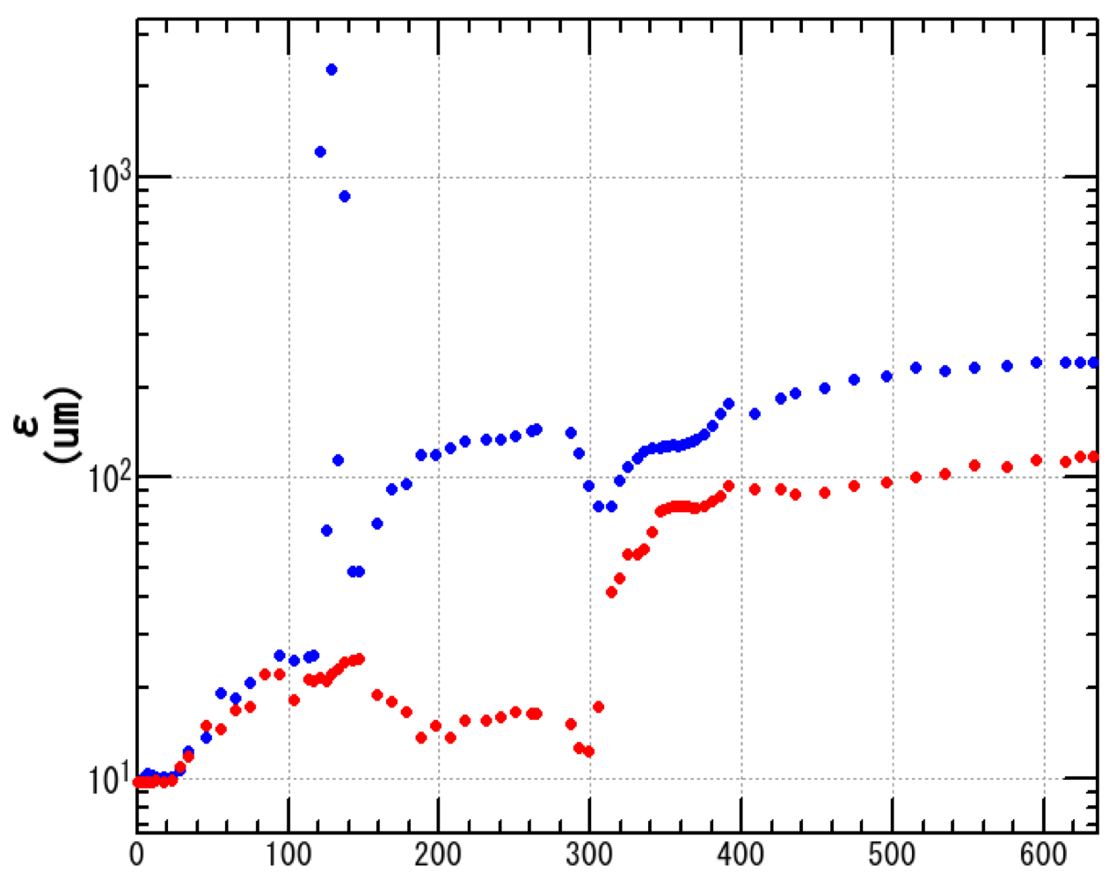
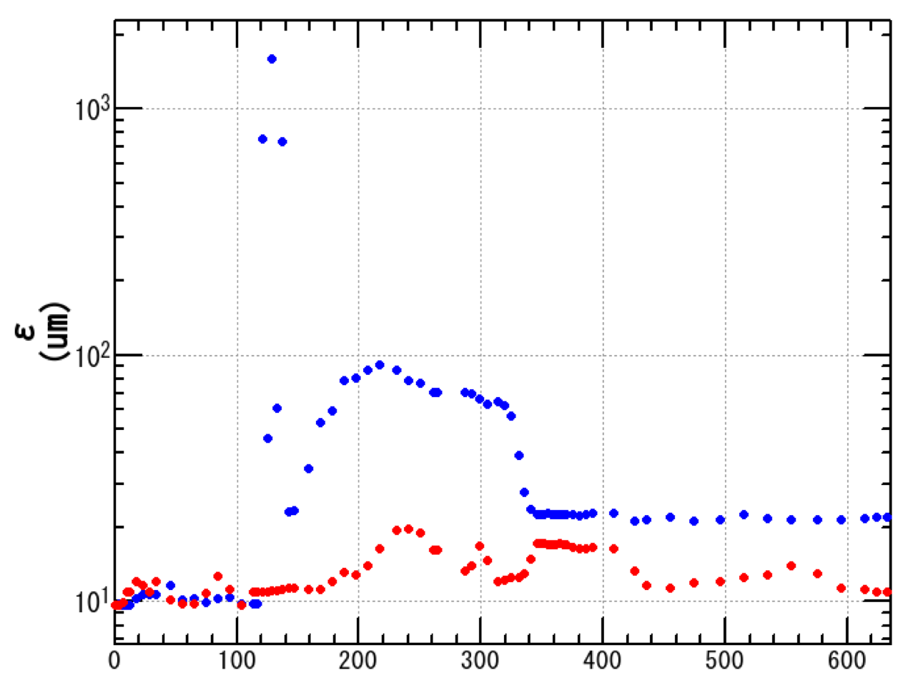
Simulation for Minimizing Emittance Growth Induced by Wakefield in Acceleration Structure
Particle tracking simulation was performed to evaluate this emittance growth.
Simulation conditions:
Phase;III requirement:
• ε_{inj} = 10 μm
• σ_{z} = 1.3 mm
• σ_{δ} = 0.4%
• Q = 5 nC
Horizontal : -
Vertical : -
( <50 μm)
( <20 μm)
Measured misalignments of acc. structure and quadrupole magnet were used.
Iris diameter of acc. structure is about 20 mm.
After emittance is minimized at the end of LINAC
After orbit displacement is minimized
Blue and red dot show horizontal and vertical emittance, respectively.
LINAC end: γβε_{X}:240 μm γβε_{Y}:120 μm
LINAC end: γβε_{X}: 22 μm γβε_{Y}: 11 μm
Blue and red line shows horizontal and vertical requirement of Phase III.
s (m)
End of LINAC
s (m)
By the orbit correction for minimizing emittance growth, requirement of Phase III can be satisfied.

Slide 20
Overview
Beam Quality Management
Accelerating Structure
Summary

Slide 21
Injector Linac Beam Acceleration
10 nC x 2 bunches x 50 Hz (LER)
4 nC x 2 bunches x 50 Hz (HER)
0.3 nC x 1 bunch x 25 Hz (PF-AR)
0.3 nC x 1 bunch x 25 Hz (PF)
60 acceleration units are employed each with 4 acceleration structures.
Beams are accelerated/decelerated as well as energy/bunch-compressed with them.
B
A
beam bunches from e- gun
1.5 GeV e-
1.1 GeV
DR
C
1
2
3
4
5
DC magnets
pulsed magnets
HER: 7 GeV e-
PF-AR: 6.5 GeV e-
4.219 GeV
the same energy
e-
variable energy pulse-to-pulse
LER: 4 GeV e+
1.1 GeV
deceleration
positron target
e+
PF: 2.5 GeV e-
1.5 GeV
C
1
2
3
4
5

Slide 22
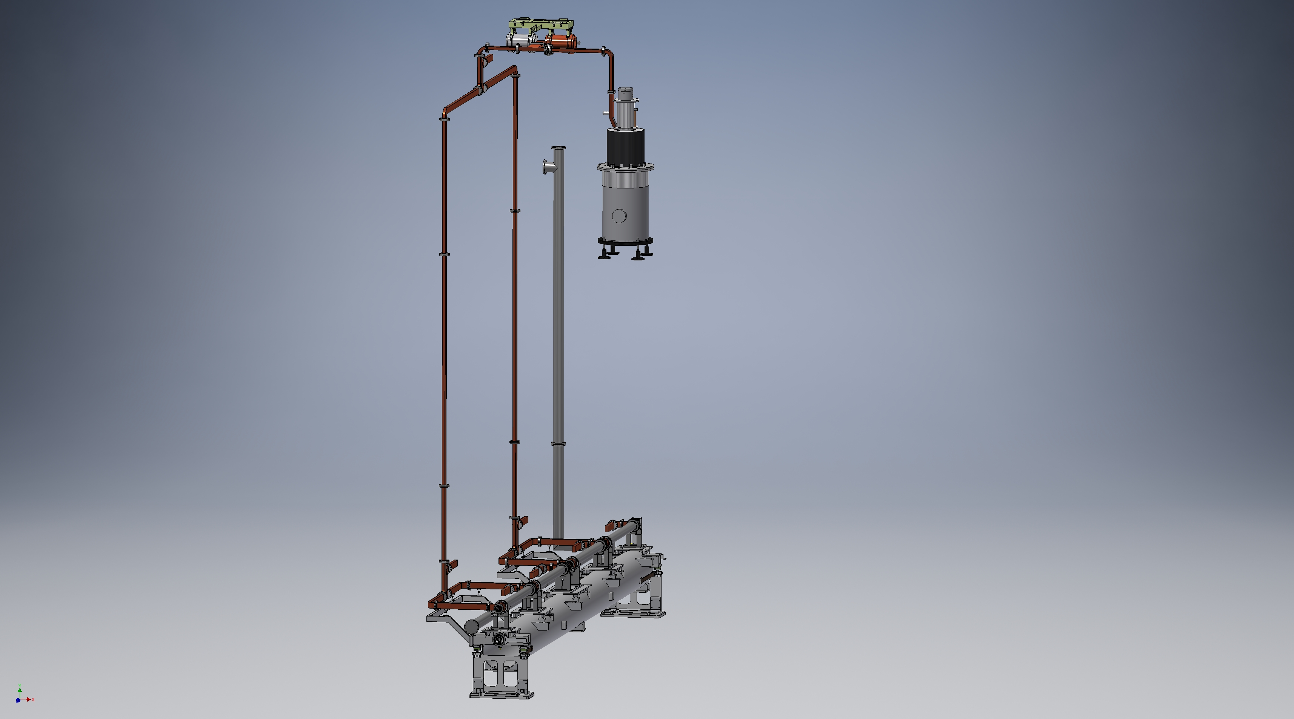
Acceleration Unit Configuration
Designed performance of the accelerating unit
SLED output
140 MW(mean) 0.5 us
Klystron output
40 MW 4 us
Waveguides
~10% power loss
Va = 160 MV (21 MV/m)
by four structures
Notes:
This illustrates an S-band accelerating unit in the linac.
The output RF power of the klystron is compressed to approximately 140 MW through the SLED.
We divide the power into four and feed them into the four accelerating structures by using a vacuum waveguide circuit.
Then the unit generate an accelerating voltage of 160 MV.

Slide 23
Accelerating Structures
Three types of S-band quasi-constant-gradient accelerating structures of 2 m in length are employed
as main accelerators
Type
Number in use
PF-type accelerating structures 142 (19 + 6 units have issues)
KEKB-type accelerating structures 74
Large-aperture accelerating structures (LAS) * 10
* special structure for the positron capture unit

Slide 24
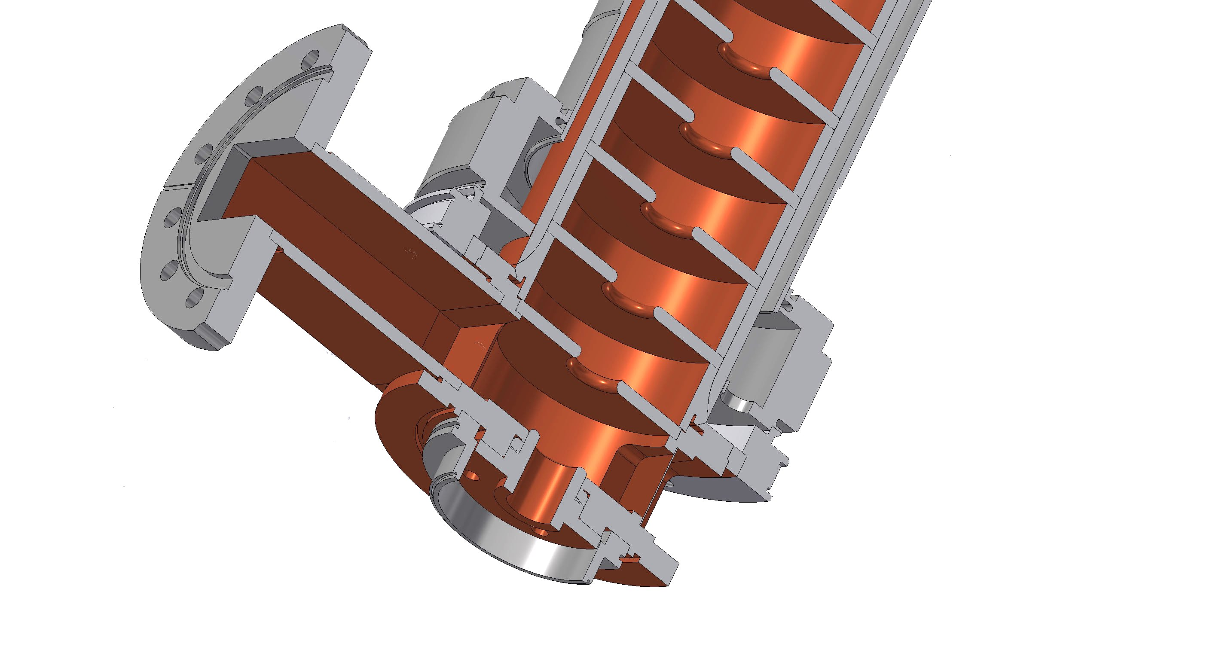
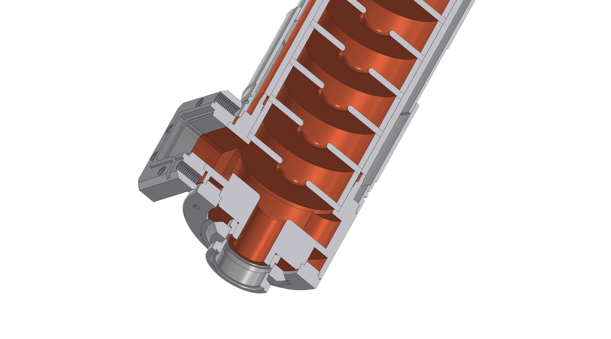
Accelerating Structures
PF-type structure
KEKB-type structure
Not interchangeable
Complicated fabrication
Used at 8 MeV/m since 35 years ago
Later raised to 21 MeV/m
Revised structure
Designed for 21 MeV/m

Slide 25
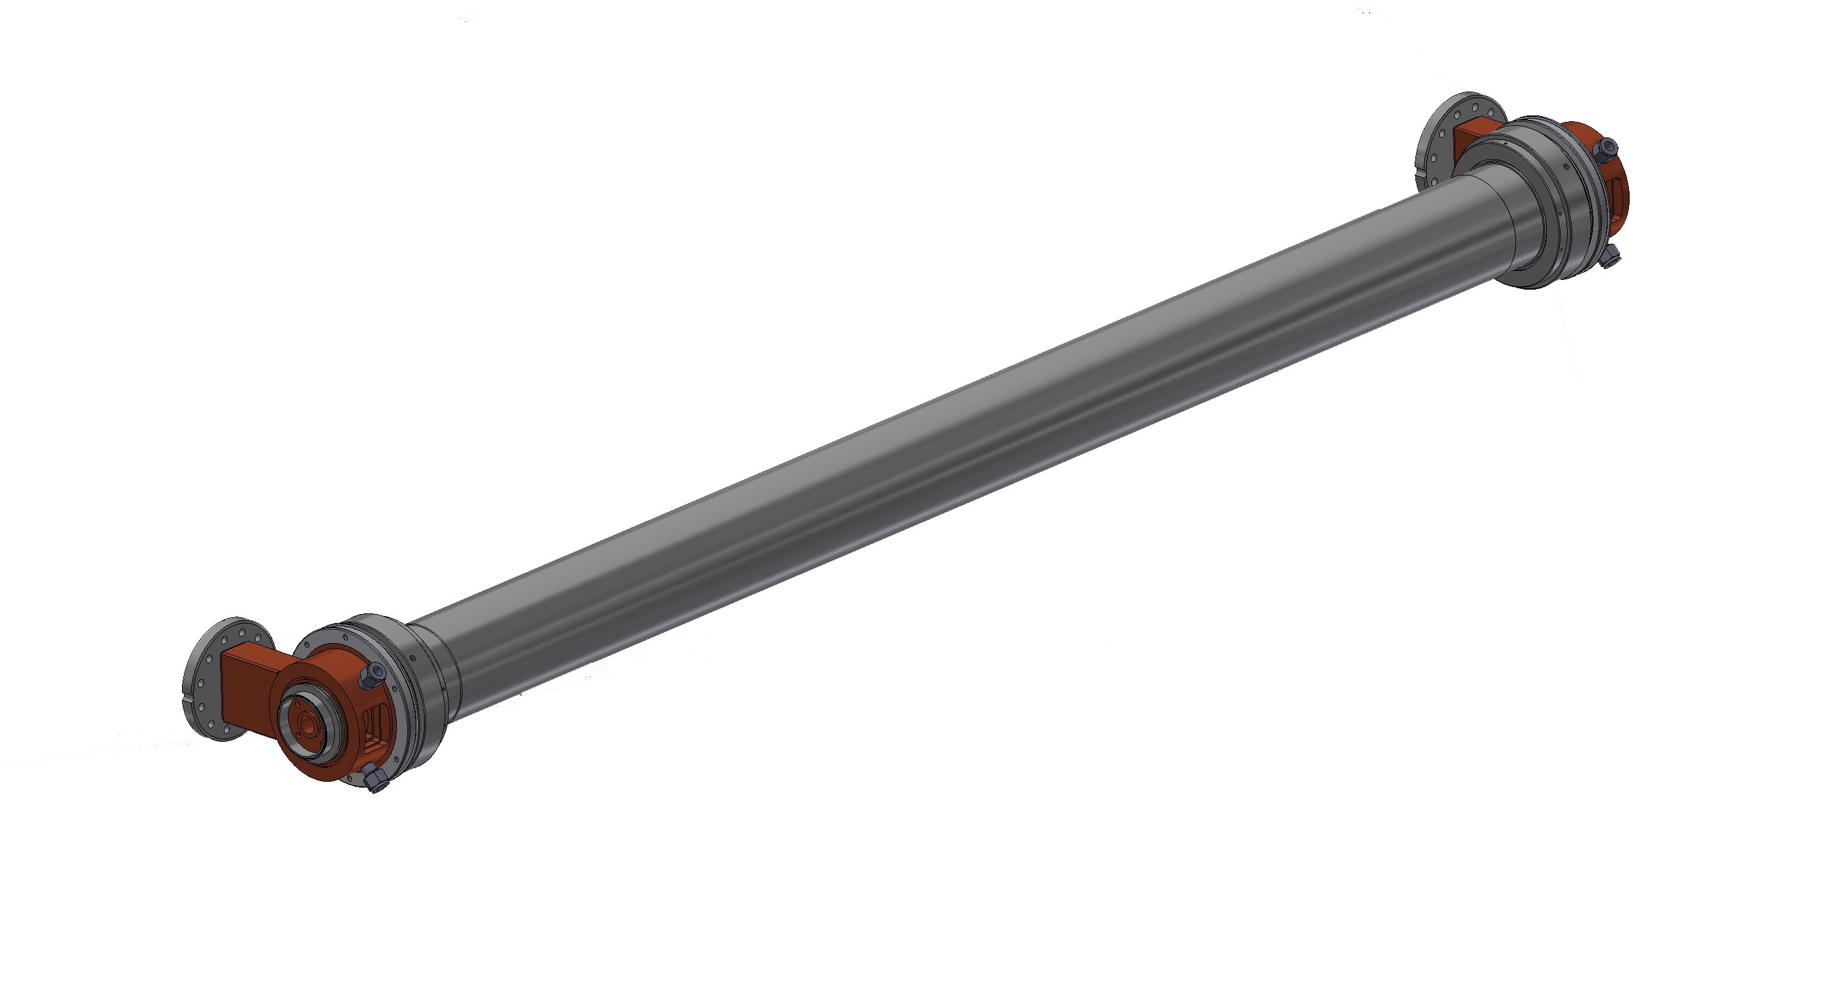
PF-type structures
fabricated about 35 years ago as the injector for the PF ring
don’t work well
Mean RF parameters of five kinds of the PF-type
ra [MΩ/m] | 57.8 (57.3 - 58.3)
τ [neper] | 0.335 (0.302 - 0.368)
Tf [us] | 0.51 (0.462 - 0.558)
Va/P^{1/2} [MV/MW^{1/2}] | 7.29 (7.00 - 7.58)

Slide 26
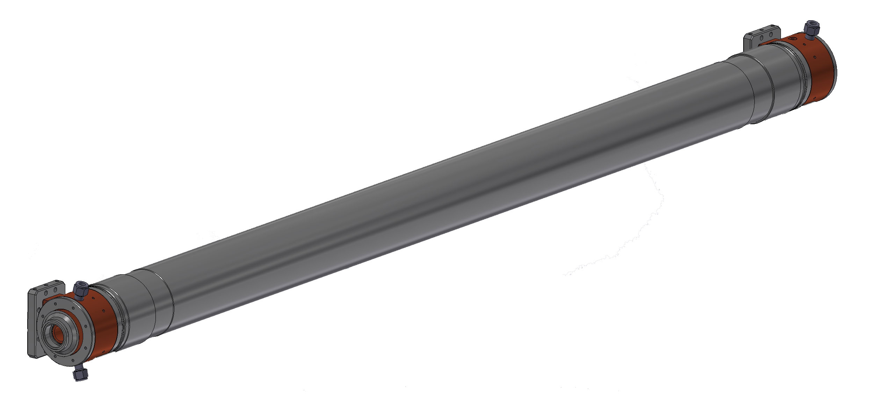
KEKB-type structures
fabricated about 20 years ago for the KEKB injector
work well as designed
Mean RF parameters of five kinds of the KEK-type
ra [MΩ/m] | 57.8 (57.3 - 58.3)
τ [neper] | 0.335 (0.302 - 0.368)
Tf [us] | 0.51 (0.462 - 0.558)
Va/P^{1/2} [MV/MW^{1/2}] | 7.29 (7.00 - 7.58)
the same as those of the PF-type

Slide 27
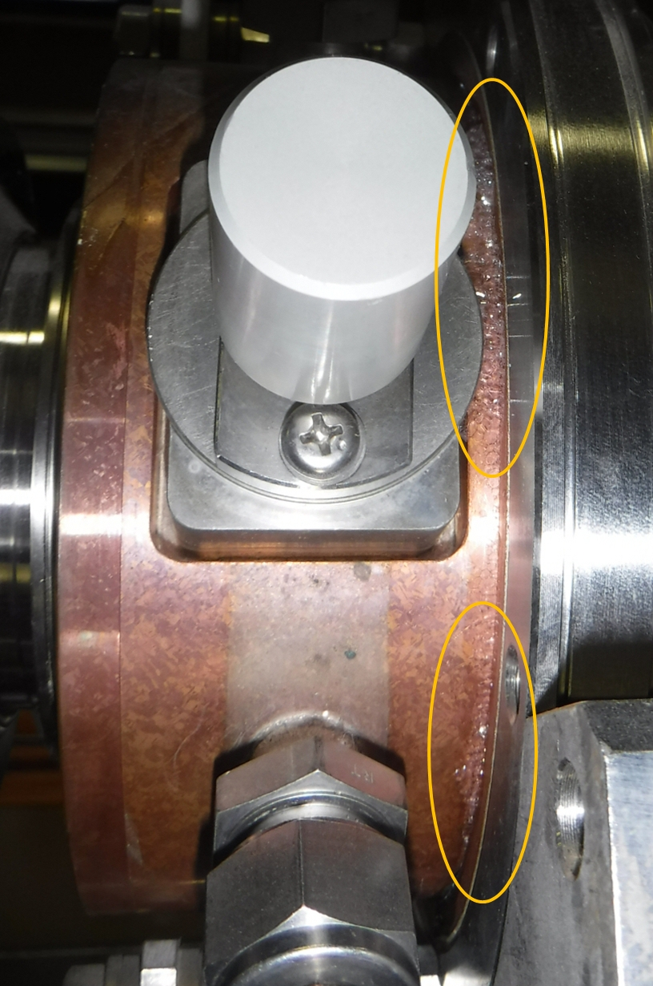
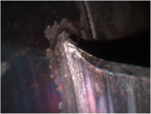
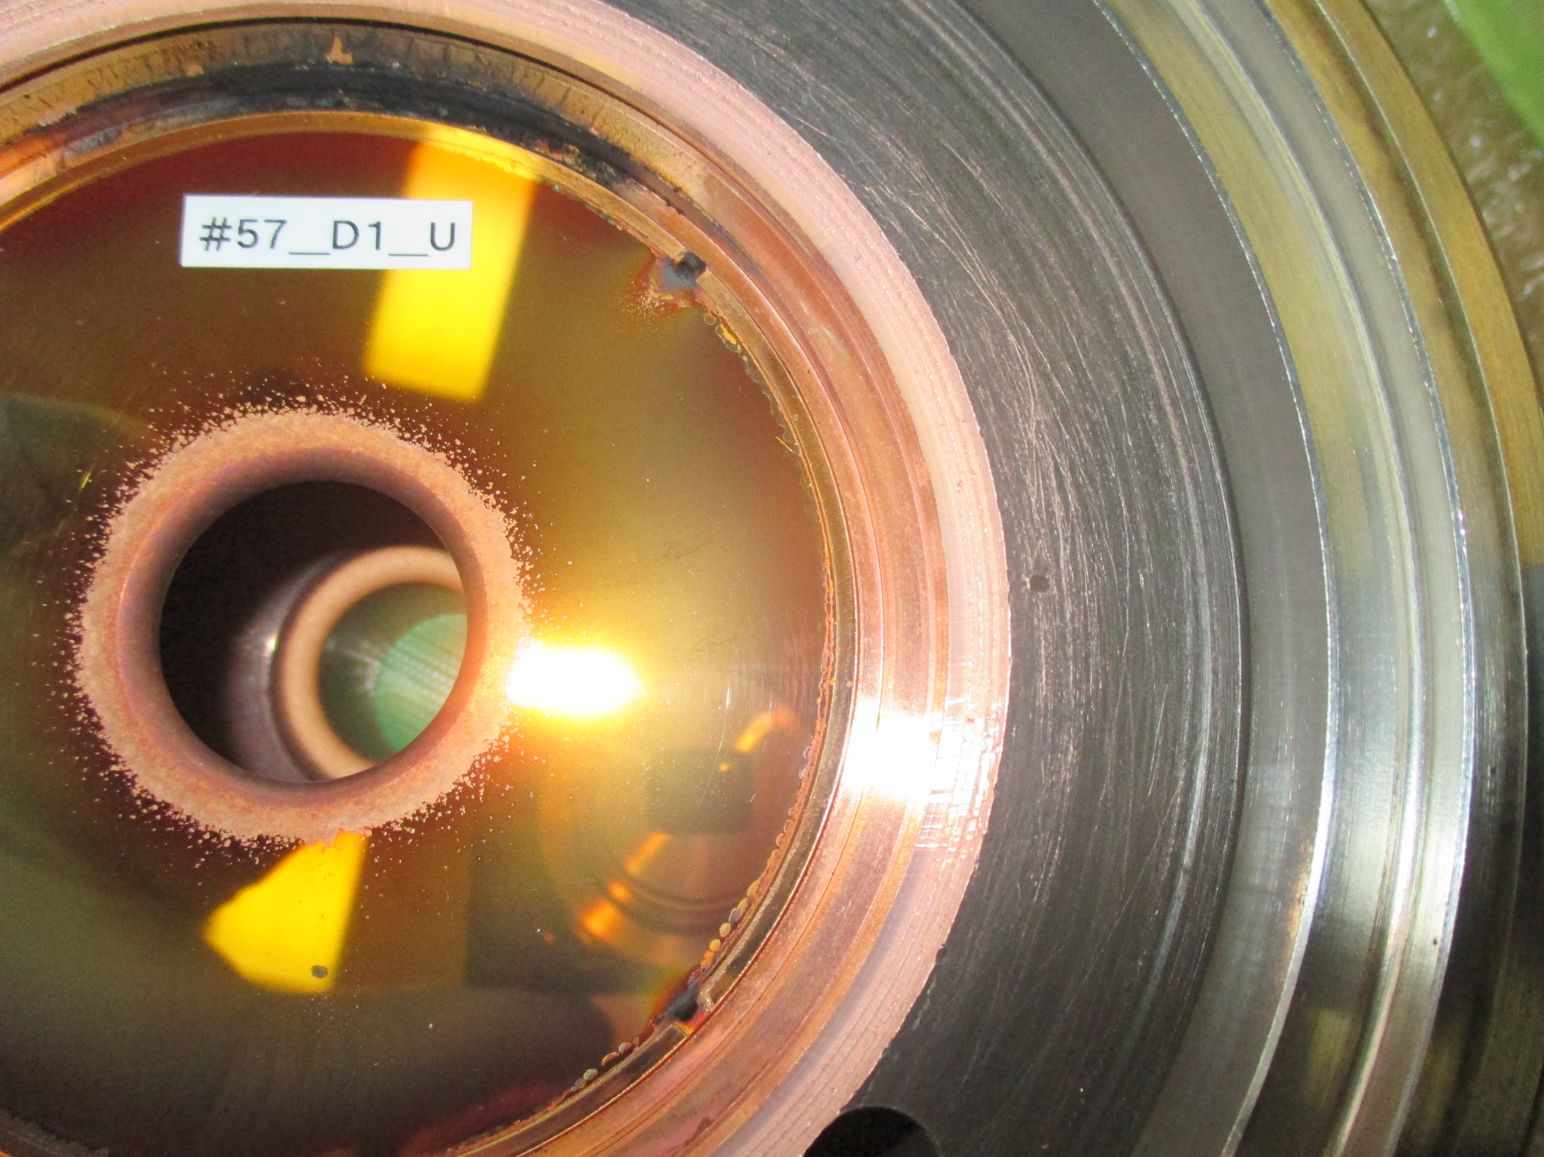
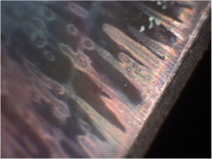
Degradation of Acceleration Units
Field emission, reflection (19)
Cooling water leakage (6)
Lower acceleration
Has to fix
not recoverable
water leak
Need interim fix with sealant
・Some of water leakage are fatal
・Approx. 3 leakages per year, in recent years
・May increase as they are built at a time
・Improving the identification of a damage in four structures
・No more healthy PF-type backup structures
・Have to utilize degraded structures in an emergency

Slide 28
New Structure Production
As a solution, structures are newly designed with lower emission and higher gradient
・4 structures per year
・12 structures for 3 years
・Scheduling from FY2018-9 even under limited budget stopping other improvements
Fabrication schedule
FY20xx
FY20xx + 1
Contract
Design
Materials
M
加工
#1, 2 Structures
C
検査と測定
Coupler
M
C
ST
B
C
ST
表面処理
Structure
M
C
ST
C
B
T
F
C
B
組立
#3, 4 Structures
T
性能調整
F
最終組立
M
C
ST
B
C
M
C
ST
C
B
T
F
C

Slide 29
Overview
Beam Quality Management
Accelerating Structure
Summary

Slide 30
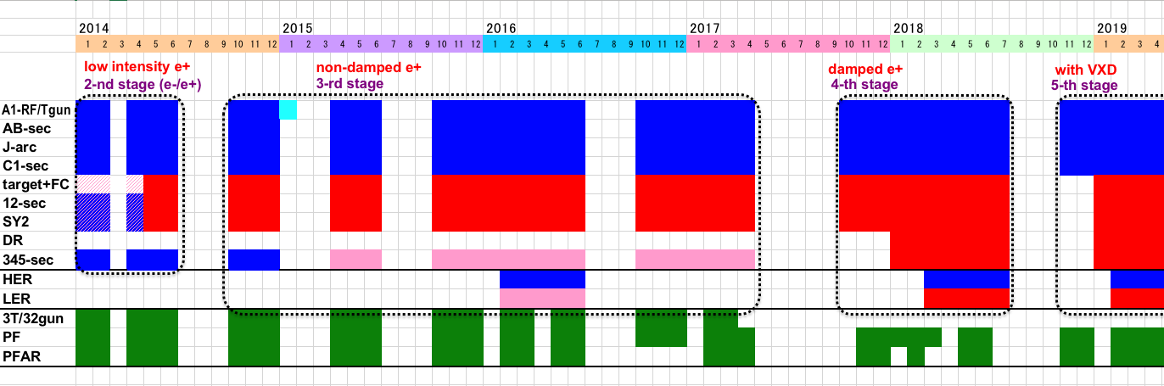
Linac Schedule Overview
Schedule
RF-Gun e- beam
commissioning
at A,B-sector
e- commiss.
at A,B,R,C,1
e+ commiss.
at 1,2 sector (FC, DCS, Qe- 50%)
e- commiss.
at 1,2,3,4,5 sector
Phase1: high emittance beam for vacuum scrub
Phase2,3: low emittance beam for collision
Time →
Location
↓
Beam Licenses in steps
Low Emittance Beams
Low Emittance Injections
4+1 Ring
Injections
DR Commiss.
1 nC
Phase1
1 - 2 nC
Phase2
1 - 4 nC
Phase3
Without Top-up
Direct PF-AR BT
: Electron
non damped e+ commiss.
at 1,2, 3,4,5 sectors
e- commiss. at A→5 sectors
damped e+ commiss.
at 1→5 Qe+ = 1~4nC
e- commiss.
at A→5 Qe- = 1~4nC
Improved RF gun
: Positron
: Low current electron

Slide 31
For Phase 3
Positron target / flux concentrator restoration
50 Hz operation
Simultaneous injections for 4 storage rings with beam stabilization feedback loops
Further instability hunt
Low emittance beam developments
Reliability, reproducibility, automation, etc.

Slide 32
Summary
The injector performed beam improvements after Phase-2 towards Phase-3 commissioning
The facility is believed to be ready for the first year in Phase-3, while it may face challenges to achieve the final beam qualities

Slide 33
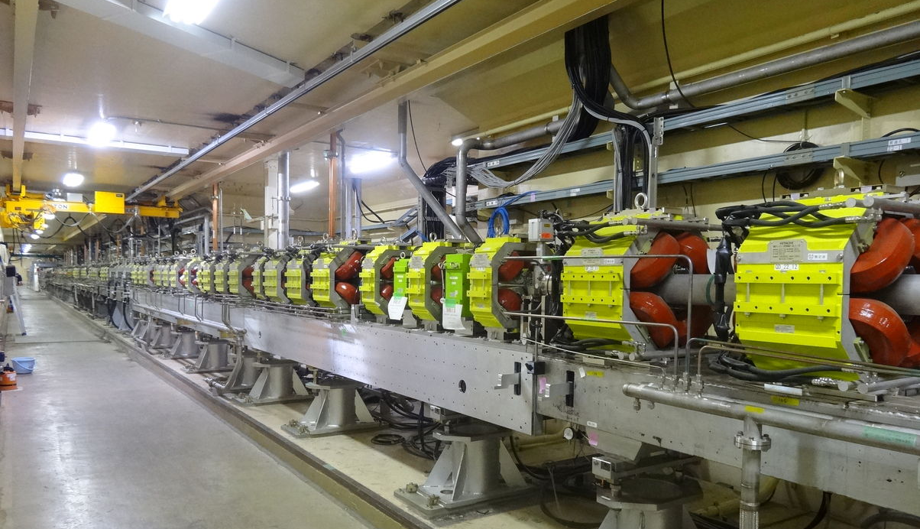
Thank you

Slide 35
Lifetime and injection rate
Example : Phase 3-3ex Parameter
Assumed from the lifetime of Phase 2
 | LER
Life time [sec.] | 600 | N_{b}=1578, I_{tot}=2.0A
Loss Rate [mA/sec] | 3.0
frev=100kHz
Q_{BTend}=1.0nC
f_{rep}=25Hz
n_{bunch}=2
eff_{inj}=70%
Even if such a low charge injection, the total beam current can be kept
with 25Hz injection.

Slide 36
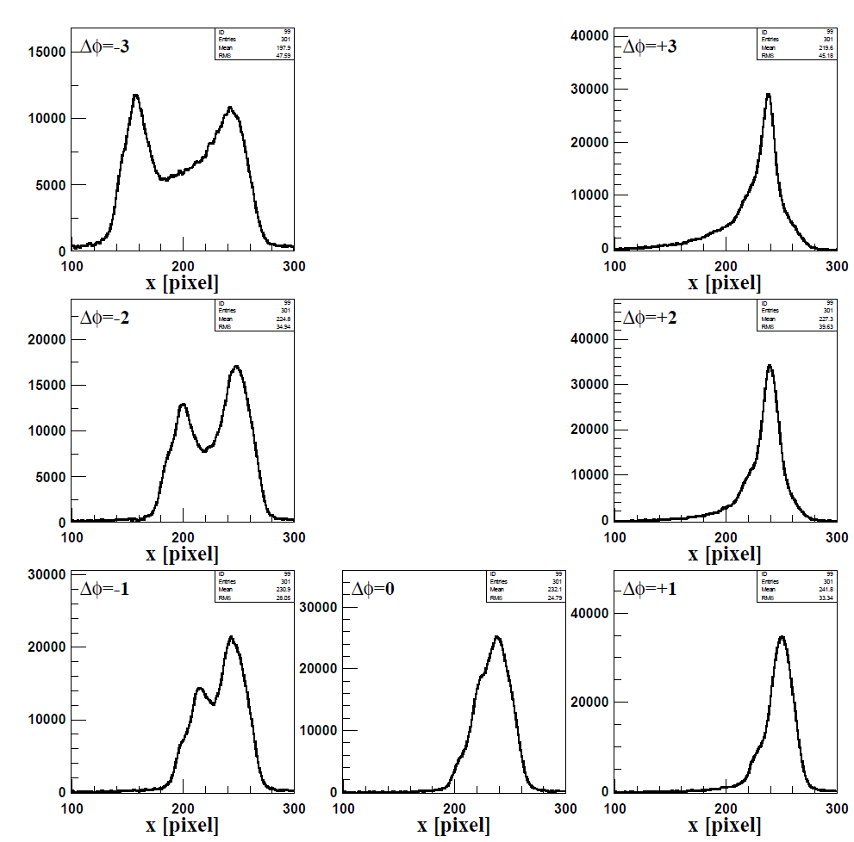
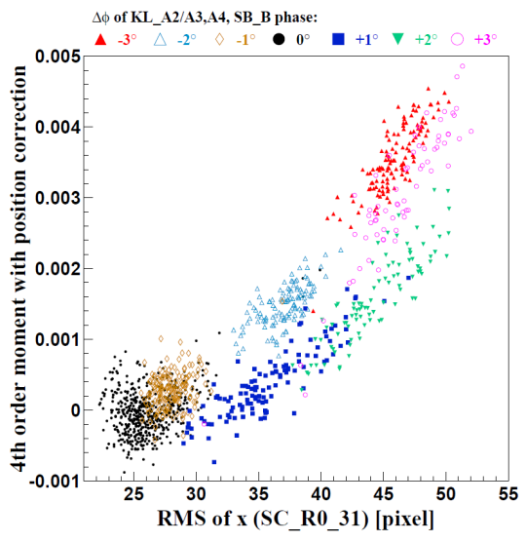
Nondestructive Energy Spread Monitor： eight electrode BPM in Jarc
F. Miyahara
Second moment and horizontal profile
①
⑦
σx monitored with
OctoPos BPM
②
⑥
σx monitored with
screen monitor
③
⑤
④
The beam spread can be measured from the second moment.
Although the profile with two peaks ② can not be recognized from ⑥ only with the second moment, it is important to keep the energy spread to ③ or ④.

Slide 37
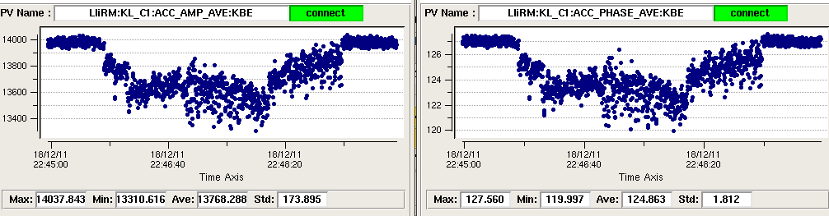
Other voltage fluctuation of klystron power supply
Beam energy stabilization
C1: RF voltage
C1: RF Phase
5%
7deg
RF voltage / phase variation
Sometimes the AC line voltage for klystron power supply drops.
Klystron output power is stabilized by
Induced Voltage Regulator (IVR) at the sudden change of AC line voltage.
In Phase 2, IVR stabilization had been done once an hour.
It is planed to establish the IVR feedback in Phase 3.

Slide 38
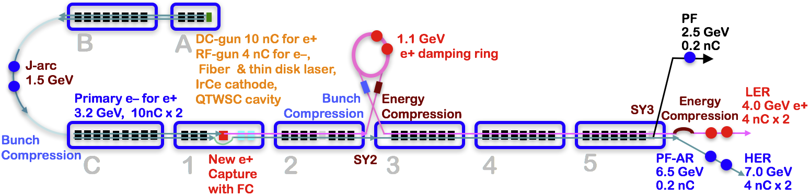
Injector Linac Overview
Injector linac configuration
Major upgrade items
Photo-cathode RF-gun for low-emittance e-
Flux concentrator, LAS structure, solenoids, quads for e+
Pulsed magnets for adequate beam optics for each beam
High-precision beam position monitor
High-precision beamline alignment for low emittance

Slide 39
Required injector beam parameters
Linac Beam Property Requirements
Stage | KEKB (final) |  | Phase-I |  | Phase-II |  | SuperKEKB (final)
Beam | e+ | e– | e+ | e– | e+ | e– | e+ | e–
Energy | 3.5 GeV | 8.0 GeV | 4.0 GeV | 7.0 GeV | 4.0 GeV | 7.0 GeV | 4.0 GeV | 7.0 GeV
Stored current | 1.6 A | 1.1 A | 1 A | 1 A | – | – | 3.6 A | 2.6 A
Life time (min.) | 150 | 200 | 100 | 100 | – | – | 6 | 6
Bunch charge (nC) | primary e- 10 → 1 | 1 | primary e- 8 → 0.4 | 1 | 0.5 | 1 | primary e- 10 → 4 | 4
Norm. Emittance (γβε) (μrad) | 1400 | 310 | 1000 | 130 | 200/40 (Hor./Ver.) | 150 | 100/15 (Hor./Ver.) | 40/20 (Hor./Ver.)
Energy spread | 0.125% | 0.125% | 0.5% | 0.5% | 0.16% | 0.1% | 0.16% | 0.07%
Bunch / Pulse | 2 | 2 | 2 | 2 | 2 | 2 | 2 | 2
Repetition rate | 50 Hz |  | 25 Hz |  | 25 Hz |  | 50 Hz
Simultaneous top-up injection (PPM) | 3 rings (LER, HER, PF) |  | No top-up |  | Eventually |  | 4+1 rings (LER, HER, DR, PF, PF-AR)

Slide 40
A Residual dispersion in the DR extraction line (2)
Y. Seimiya et al.
Emittance improvement by dispersion correction
Emittance was measured by wire scanner.
e+
0.7 [nC]
Horizontal Dispersion at Straight section after the Arcs
DR design emittance
First, we corrected 2nd ARC dispersion. By the correction, emittance was improved from about 300 to 200.
Before Correction
After Correction in 2nd arc
After Correction in 1st arc
Fudge Factor of Quads [%]
<!x²>^{1/2} [m]
0.079
0.019
G 4.5
1.05
0.09
G 8.2
Then, we corrected 1 ARC dispersion. By the correction,
st
Measured Emittance in Sector 3
γβεx [μm]
293+44.5 192+22.4
1.84+0.163 2.01+0.363
126+8.2
64.3
γβεy [μm]
1.5+0.1
emittance was improved to about 130.
Thought the horizontal emittance became less than half, it is still twice as large as that of DR design.
Ms. Iida will talk this issue at the end of this session (TUPAB07).

Slide 41
A) Residual dispersion in BT
Until BT-Wire Scanner (WS) position, dispersion correction was done.
In some ARC, dispersion correction is not finished. → Continue to Phase-III
Y. Seimiya,
N. Iida, M. Kikuchi
e;
<!x²>^{1/2} [m] <!y²>^{1/2} [m]
Fudge Factor of Quadrupole
As a same manner, we corrected dispersion in each ARC of BT.
Correction
Before After Before
0.13 0.11 0.05
0.11 0.02 0.01
0.102 0.038 0.029
0.066 0.029 0.037
0.104 0.091 0.192
- - -
After
[%]
Slope 1
0.01
1.0-5.9
BT-WS placed
Bte 0th ARC
0.02
0-6.7
This table shows residual dispersion before and after
Bte 1st ARC
0.036
2.37
Bte 2nd, 3rd ARC
0.034
2.52
Slope 2
0.116
3.55
Inj. point to MR
correction for e- and Bte 4th ARC
-
-
e+ beam.
Fudge Factor of Quadrupole
e+
<!x²>^{1/2} [m] <!y²>^{1/2} [m]
These ARC names are listed from the upstream of the beam line.
Correction
Before After Before
0.27 0.02 0.01
0.037 0.047 0.126
- - -
- - -
- - -
- - -
After
[%]
BT-WS placed
BTp 0th ARC
0.03
-26-12.9
BTp 1st ARC
0.102
2.5
Slope 1
-
-
BTp 2nd, 3rd ARC
-
-
Slope 2
-
-
Inj. point to MR
BTp 4th ARC
-
-

Slide 42
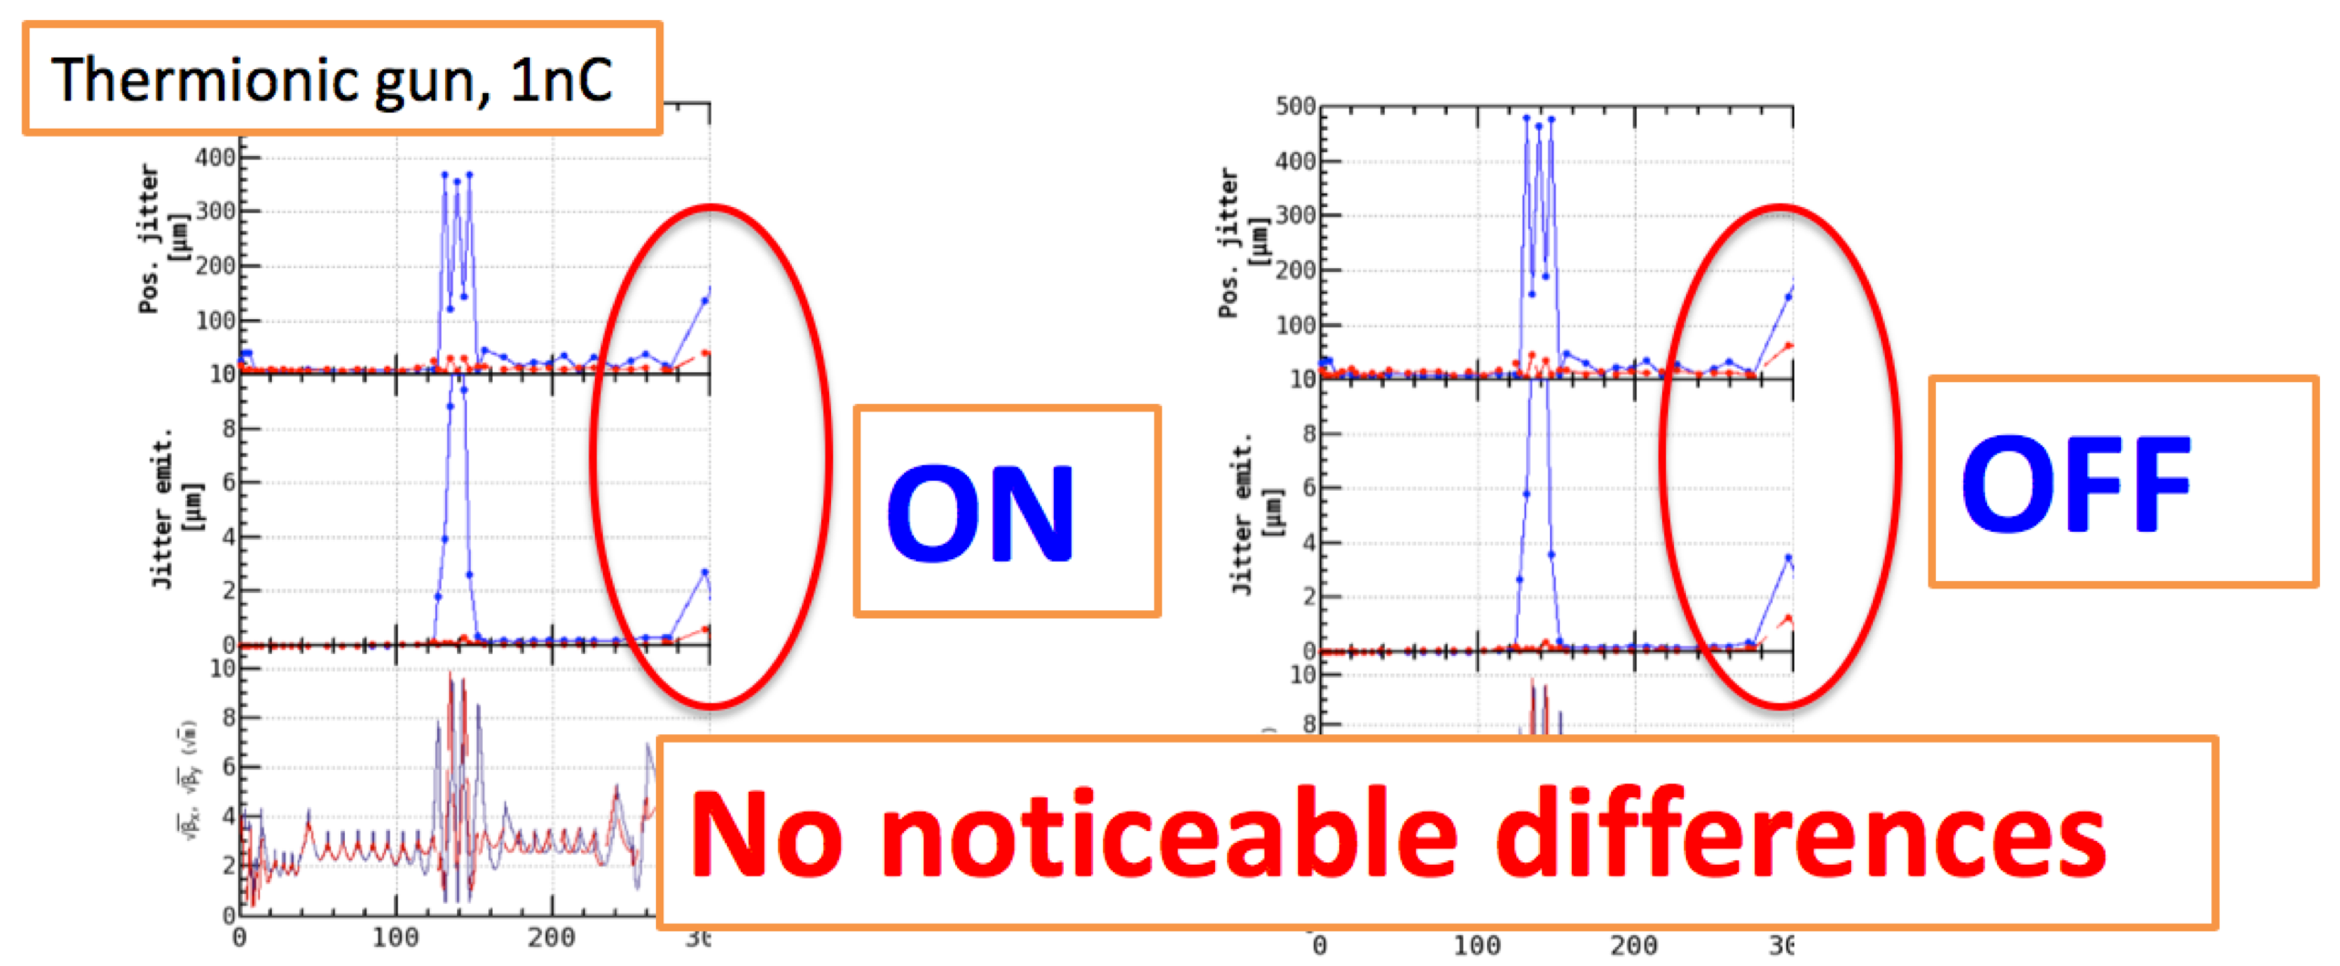
B) Beam Phase Space Jitter (2)
First, we suspected that components around the target made beam jitter.
They are flux concentrator, solenoid, bridge coil, pulsed magnet, chicane, and so on.
We check whether these components are sources of jitter or not by turn off these components.
There is not remarkable differences.
The components are not the beam jitter source.

Slide 43
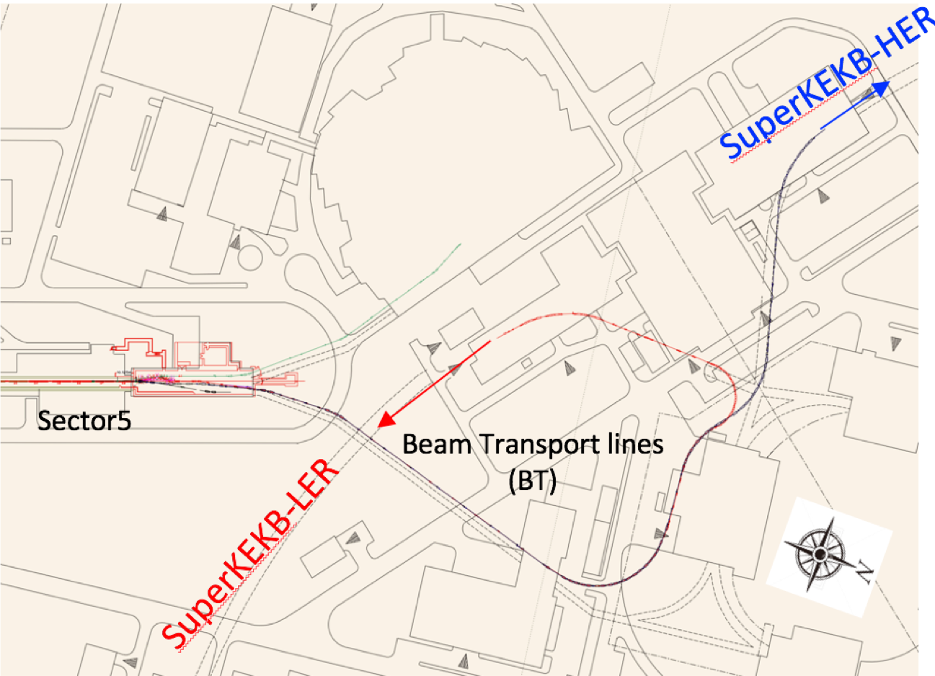
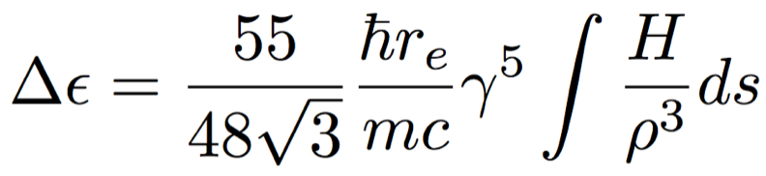
D) Emittance growth induced by radiation excitation in BT
Theoretical emittance growth induced by radiation excitation:
∝ !⁵, 1/∃³
Particle tracking simulation was performed from the end of LINAC to the end of BT.
N. Iida | Initial particles |  | With Radiation | Phase2III3final requirement
 | e8 (7 GeV) !∀ _{x} [∝m] | 20 | 68 | 40
 | e+ (4 GeV) !∀ _{x} [∝m] | 64 | 74 | 100
Initial horizontal emittance of e8 and e+ beam have 20 and 64 ∝m, respectively.
These emittances are increased by radiation excitation and reach 68 and 74 ∝m.
Even if the emittance preservation is perfect in the LINAC, emittance growth by radiation
excitation is larger than Phase8III final requirement for the e8 beam.
We seek a solution of this problem now. One possible way is that other tunnel (AR line) is used as
e8 beam line, which has smaller ρ than that of current beam line.

Slide 44
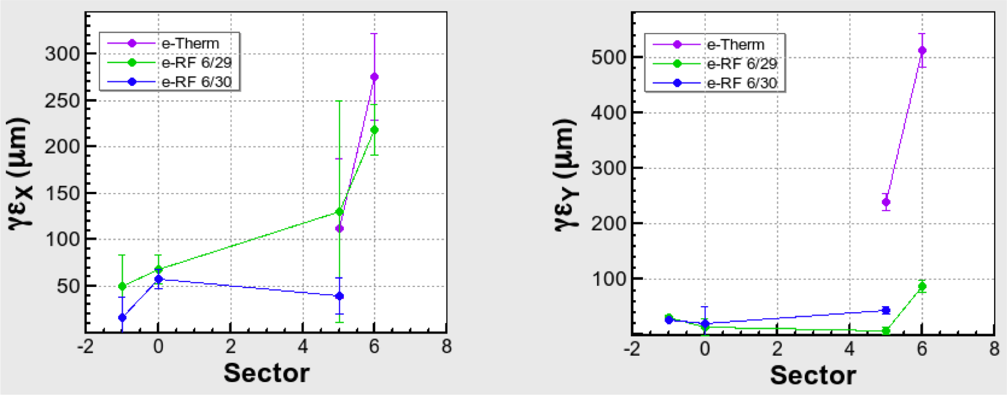




Emittance measurement (e.)
Left and right figure show horizontal and vertical emittance measured at each sector, respectively.
Green and blue plot show emittance of beam generated by RF gun.
Manual orbit correction was done so as to reduce the orbit distortion. By this correction,
emittance was reduced.
In Phase.II, the requirement of e. emittance at the end of LINAC was satisfied.
However, emittance was increased in BT though dispersion correction was done.
This growth is not caused by radiation excitation because BT.WS is placed around the start of BT.
X
1.2nC
Y
N. Iida
Phase.II
reduced by orbit correction
Phase.II
Phase.III
Phase.III
B C
5 BT
B C
5 BT

Slide 45
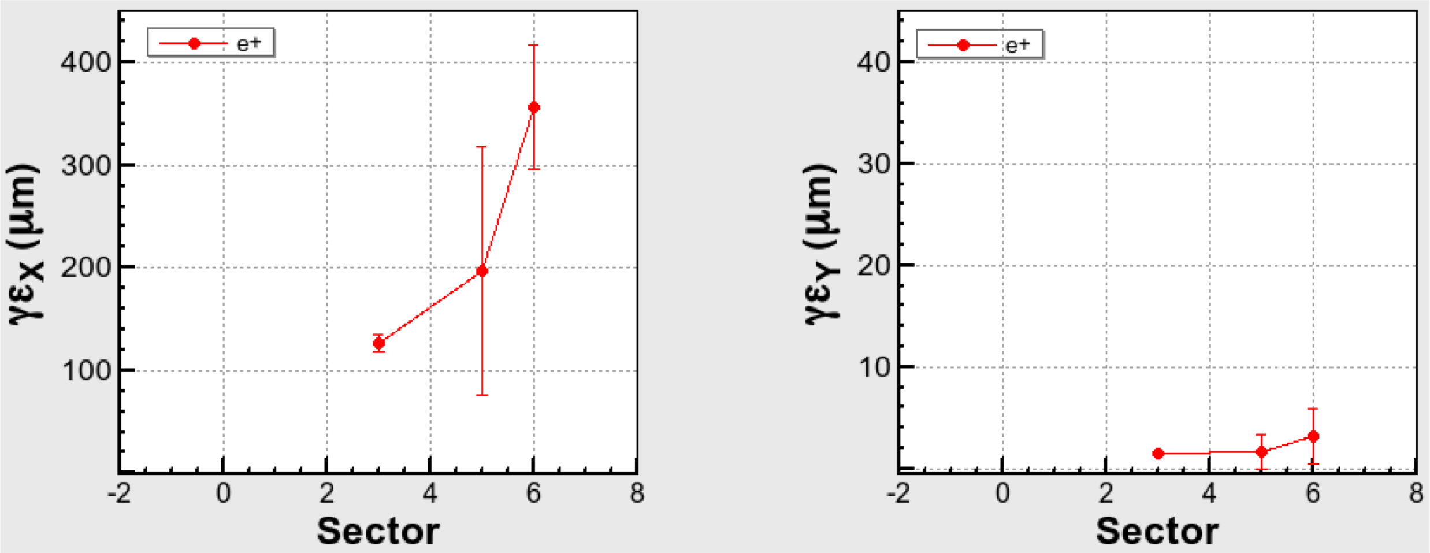
Emittance measurement (e+)
In Phase3II, the requirement of e+ emittance at the end of LINAC was also satisfied.
However, e+ emittance was also increased in BT though dispersion correction was done.
Investigations for this emittance growth source in BT are under going.
X
0.7nC
Y
N. Iida
Phase3II
Phase3II
Phase3III
Phase3III
B C
5 BT
B C
5 BT

Slide 46
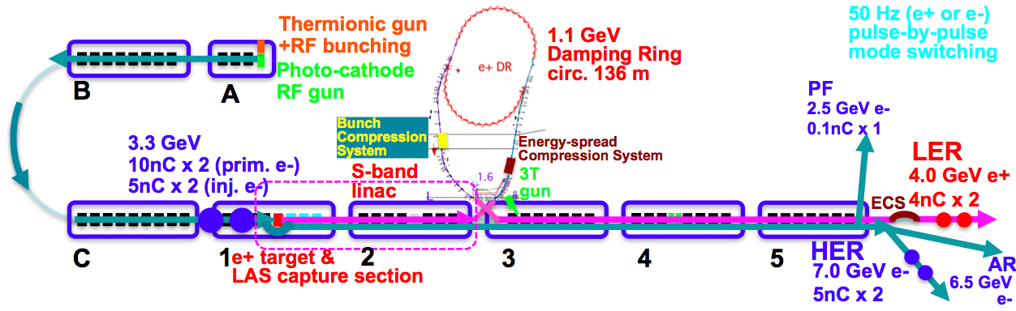
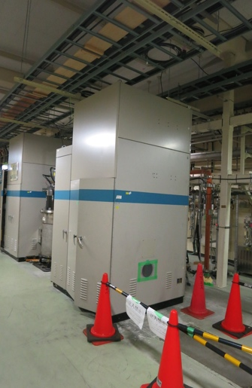
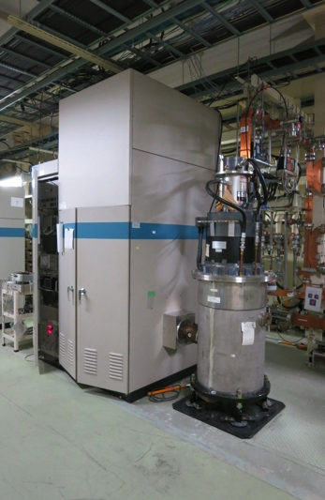

Klystron Modulator Installation and Temporary Gun Removal
Other Improvements
 | ECS | BCS
Voltage required [MV] | 41 | 21.5
# 2m accelerator structure | 2 | 1
Accelerator field [MV/m] | 10.2 | 10.75
Operation power [MW] | 29.0 | 19.0
Pulse width [µs] | 0.8 | 0.8
Rep. rate [Hz] | 50 | 50
KL_DS/BCS
KL_DN/ECS
KL_32

Slide 47
Examples of Other Recent Improvements
Other Improvements
Energy and bunch compressors on the beam transport of DR
Beam lines and power supply rearrangement for DR BT
Thermionic gun and bunchers
Beam position monitors
Wire scanners and streak cameras
LLRF system to co-op with event timing controls
LLRF monitors
Independent RF amplifiers
Alignment
Direct beam transport to PF-AR
Safety system and radiation control licenses
Rejuvenation of old components
Operation software
Operation manuals

