Slide 1
Injector challenges
2020.2.10
M. Satoh (KEK, Acc. Lab.)
for Injector Linac Group
14th annual Belle PAC Review meeting, Feb. 10-12, 2020

Slide 2
Contents
Injector operation status
e- and e+ beam sources
Accelerating structures
Beam controls
  Energy and orbit feedback loops
  Dispersion correction
  Emittance
Summary and plan

Slide 3
Linac Beam Parameters for KEKB/SuperKEKB
Stage | KEKB (final) |  | Phase-I |  | Phase-II |  | Phase-III (interim) |  | Phase-III (final)
Beam | e+ | e– | e+ | e– | e+ | e– | e+ | e– | e+ | e–
Energy | 3.5 GeV | 8.0 GeV | 4.0 GeV | 7.0 GeV | 4.0 GeV | 7.0 GeV | 4.0 GeV | 7.0 GeV | 4.0 GeV | 7.0 GeV
Stored current | 1.6 A | 1.1 A | 1.0 A | 1.0 A | – | – | 1.8 A | 1.3 A | 3.6 A | 2.6 A
Life time (min.) | 150 | 200 | 100 | 100 | – | – | – | – | 6 | 6
 | primary e- 10 |  | primary e- 8 | 1 | 0.5 | 1 | 2 | 2 | primary e- 10 | 4
Bunch charge (nC) | → 1 | 1 | → 0.4 |  |  |  |  |  | → 4
Norm. Emittance | 1400 | 310 | 1000 | 130 | 200/40 | 150 | 150/30 | 100/40 | 100/15 | 40/20
(γβε) (μmrad) |  |  |  |  | (Hor./Ver.) |  | (Hor./Ver.) | (Hor./Ver.) | (Hor./Ver.) | (Hor./Ver.)
Energy spread | 0.13% | 0.13% | 0.50% | 0.50% | 0.16% | 0.10% | 0.16% | 0.10% | 0.16% | 0.07%
Bunch / Pulse | 2 | 2 | 2 | 2 | 2 | 2 | 2 | 2 | 2 | 2
Repetition rate | 50 Hz |  | 25 Hz |  | 25 Hz |  | 50 Hz |  | 50 Hz
Simultaneous top-up injection (PPM) | 3 rings (LER, HER, PF) |  | No top-up |  | Partially |  | 4+1 rings (LER, HER, DR, PF, PF-AR) |  | 4+1 rings (LER, HER, DR, PF, PF-AR)

Slide 4
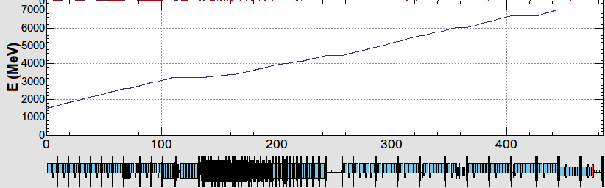
Injector overview
Photocathode RF gun for HER injection
Thermionic gun for LER, PF, PF-AR
B
SectorA
Low emittance RF e- gun
Thermionic DC e- gun
1.1 GeV
1.5 GeV
C
1
2
e+DR
3
4
5
e+ target
e-:Chicane
Pulsed quads, steering magnets
HER: 7 GeV e-
4.219 GeV
PF-AR: 6.5 GeV e-
or 5 GeV
same energy
e-
Decelerate
LER: 4 GeV e+
e+ target
e+
1.1 GeV
PF: 2.5 GeV e-
1.5 GeV
C
1
2
3
4
5
Notes:
RF電子銃でHER入射を，それ以外のリングには熱電子銃が使用されている．
下図は，入射器全景と各ビームモードのエネルギー変化（場所ごとの）を示している．
PFなどの低エネルギービームも前半はなるべく加速し，共通オプティクス部分を確保している．（上流部はDC電磁石が主であるため．）
Jアーク部のエネルギーは，被災により1.5 GeVから1.35 GeVに変更になっている．

Slide 5
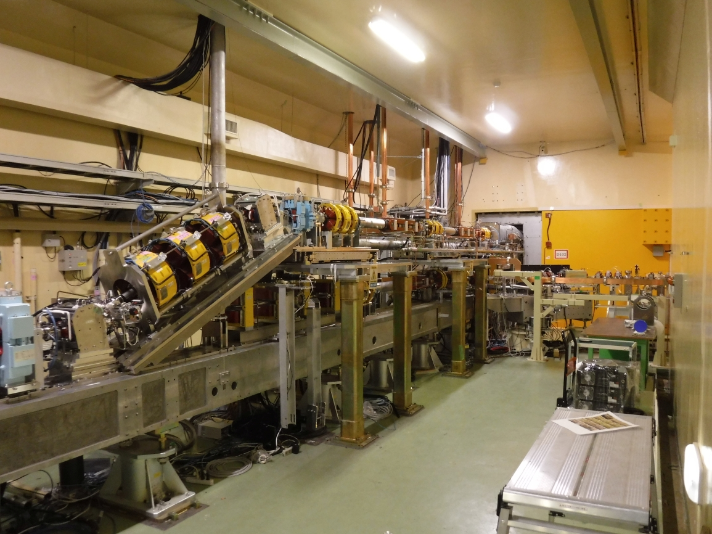
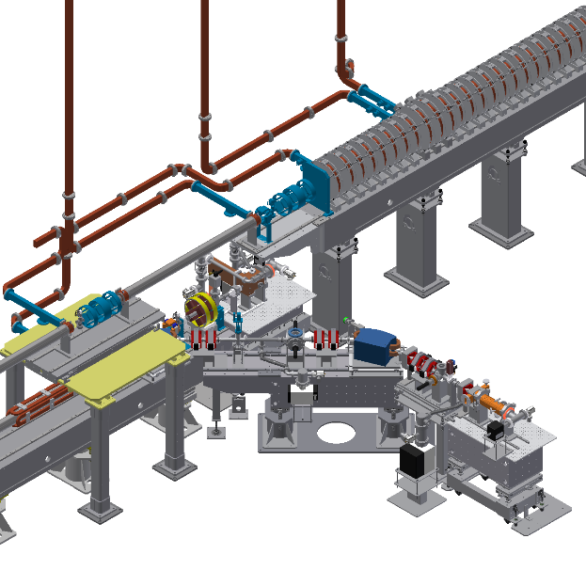
Pulse to pulse switching:
rf e- gun/thermionic e- gun
Thermionic DC e- gun (GU_AT)
w/ 2 subharmonic bunchers and 2 bunchers
・e+ production e-: 10 nC (for LER injection)
・e- study/HER injection: 1 nC
・PF injection: 0.3 nC
・PF-AR injection: 0.3 nC
RF e- gun
（GR_A1 for HER injection）
Pulsed bend rep. up to 25 Hz (LER + PF + PF-AR)
(magnet coil and chamber heating issue)
It will be replaced by new one in summer shutdown 2020.
Notes:
入射部では24度垂直偏向パルスベンドを用いて，熱電子銃，RF電子銃を切り替えて運転している．
熱電子銃は，陽電子生成用10 nC電子ビーム，PF,PF-AR入射用 0.3 nCビームを生成している．
RF電子銃は，HER入射用低エミッタンス電子ビームを生成している．（レーザー両打ち，IrCeカソード）電子銃からは，最大2～3 nC出る．

Slide 6
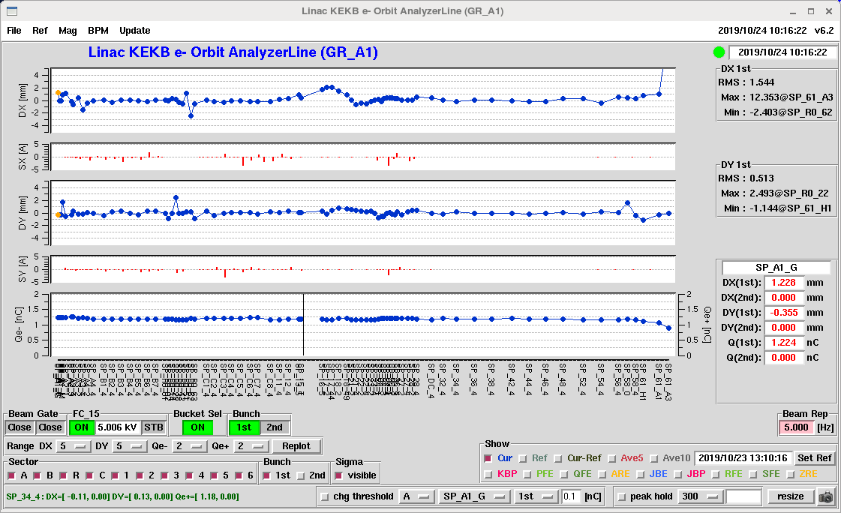
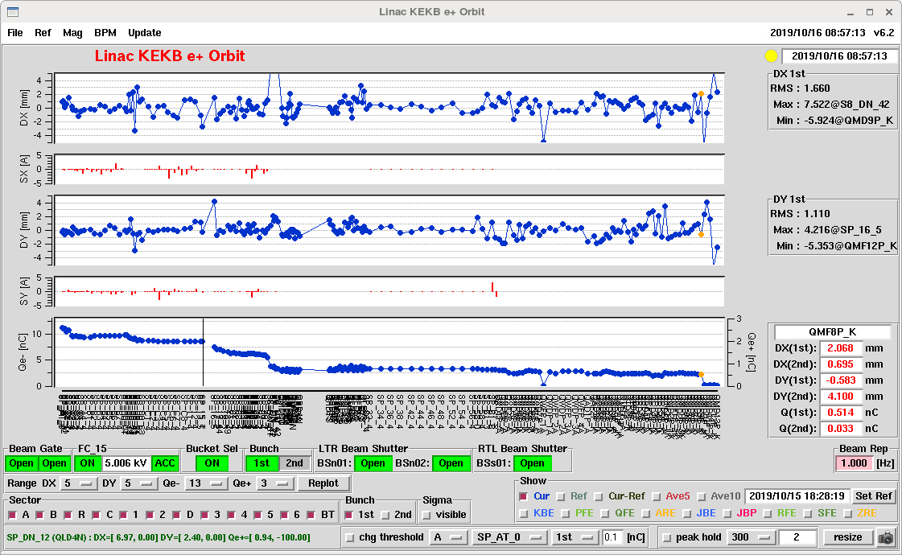
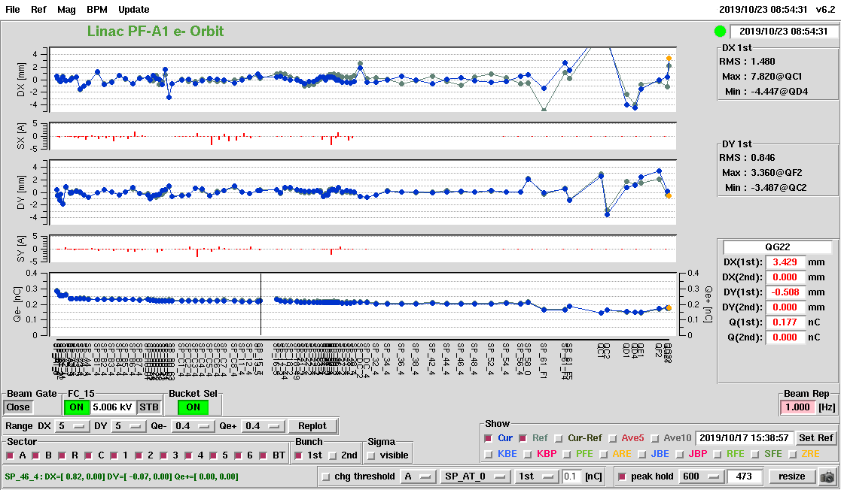
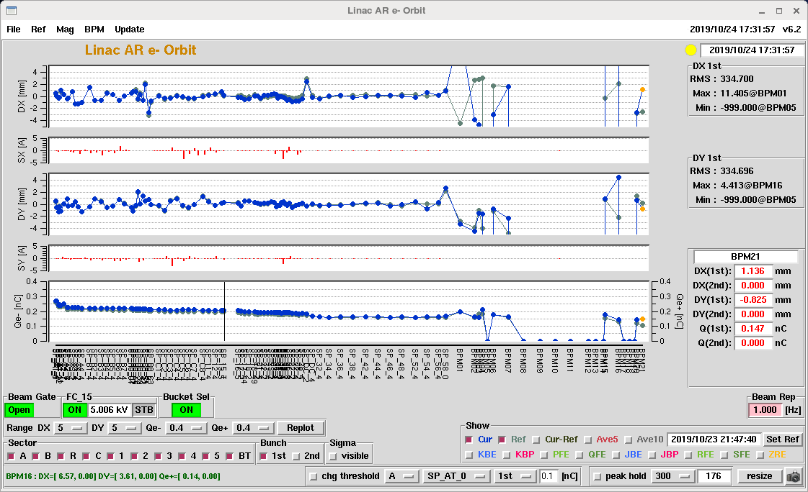
Simultaneous beam operation (w/ thermionic and rf e- gun)
Stable simultaneous top up injection to 4 storage rings (HER, LER, PF, and PF-AR) w/ thermionic gun, rf gun, pulsed magnets.
Hor. orbit
Ver. orbit
Bunch charge
rf gun
Thermionic gun and damping ring
Hor. orbit
Ver. orbit
Bunch charge
Thermionic gun
Thermionic gun

Slide 7
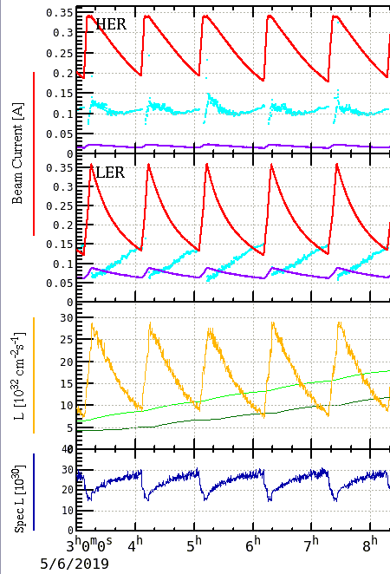
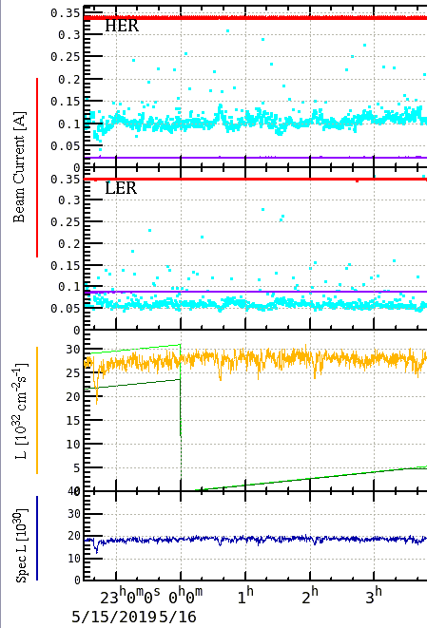
Simultaneous Top-up Injections
SuperKEKB integrated luminosity improvement
17.5 /pb in 5.15 hr
(5 fills)
on May. 6
41.6 /pb in 5.15 hr
(top-up)
on May. 16
237% improvement

Slide 8
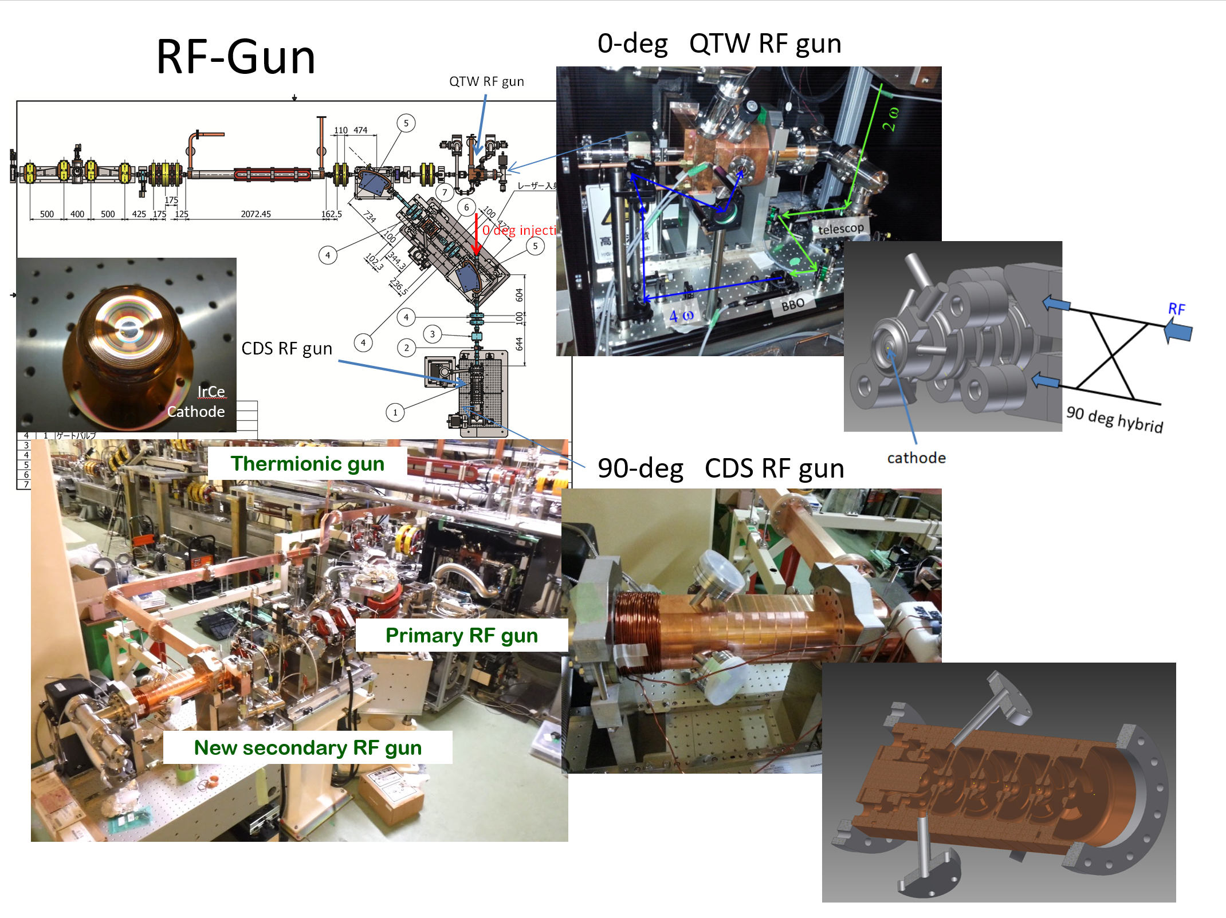
RF e- gun
Low emittance
rf gun
QTW RF gun or operation (0 deg. Line)
Photocathode
(metal composite: IrCe)
CDS RF gun
for backup (90 deg. Line)
Yb-doped-fiber and Nd/Yb:YAG laser
IrCe cathode
QTWSC or cut disk cavities
M. Yoshida, SuperKEKB review, Mar. 14th, 2018

Slide 9
HER injection beam (rf e- gun) status
HER injection has been done w/ only rf gun from PhaseIII day 1. (Mar. 11th , 2019)
Laser system has no significant fault.
In summer shutdown of 2019, photocathode (Ir7Ce2) was replaced by new one (Ir2Ce) for aiming at better quantum efficiency (Qe).
  Discharge, frequent VSWR, gradual decrease of bunch charge
In this winter shutdown,
  Even after applying thermal cleaning of cathode, bunch charge is not stable.
  Finally, photocathode was replaced by previous one (Ir7Ce2) toward next run. Now, under rf conditioning.

Slide 10
Ir7Ce2
2019

Slide 11
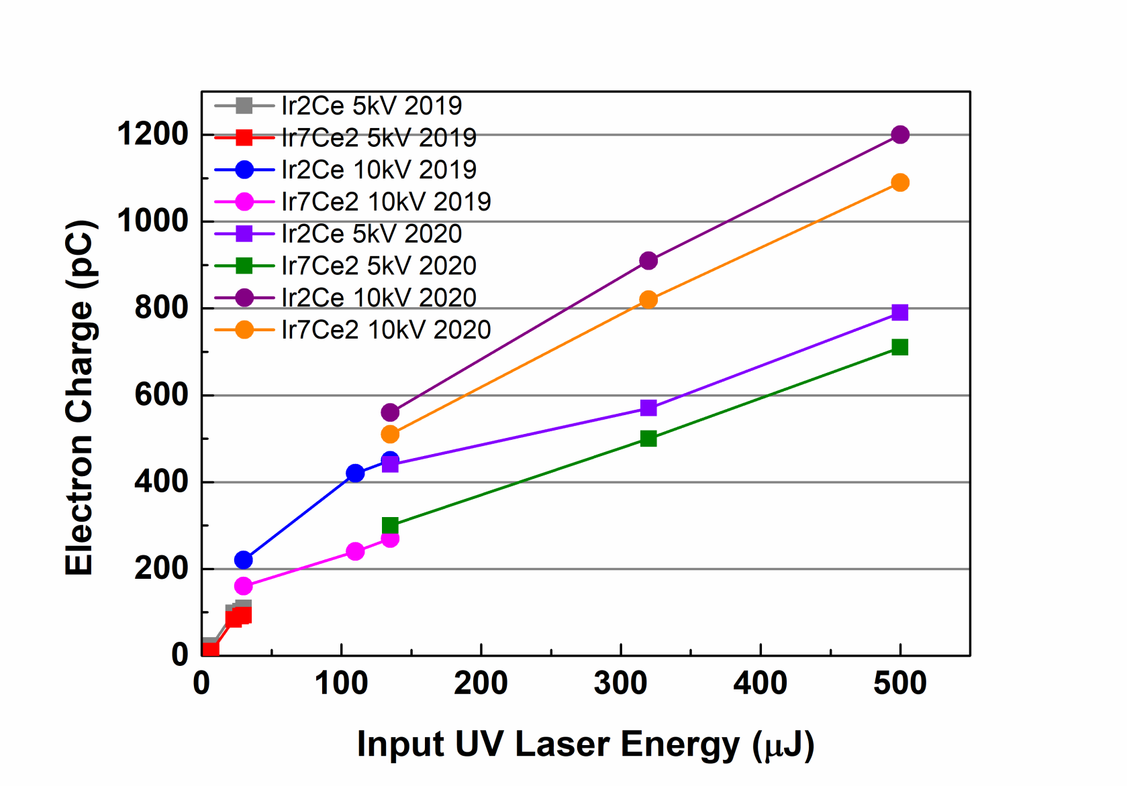
Qe of photocathode (Ir7Ce2, Ir2Ce)
M. Yoshida

Slide 12
Ir2Ce
discharge
VSWR
discharge
VSWR
VSWR
VSWR
VSWR
2019

Slide 13
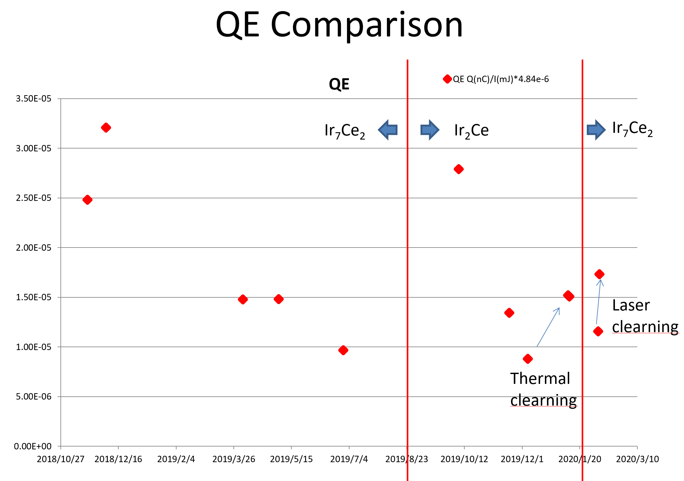
Laser
cleaning
Thermal
cleaning
M. Yoshida, B2GM, Feb. 6th, 2020

Slide 14
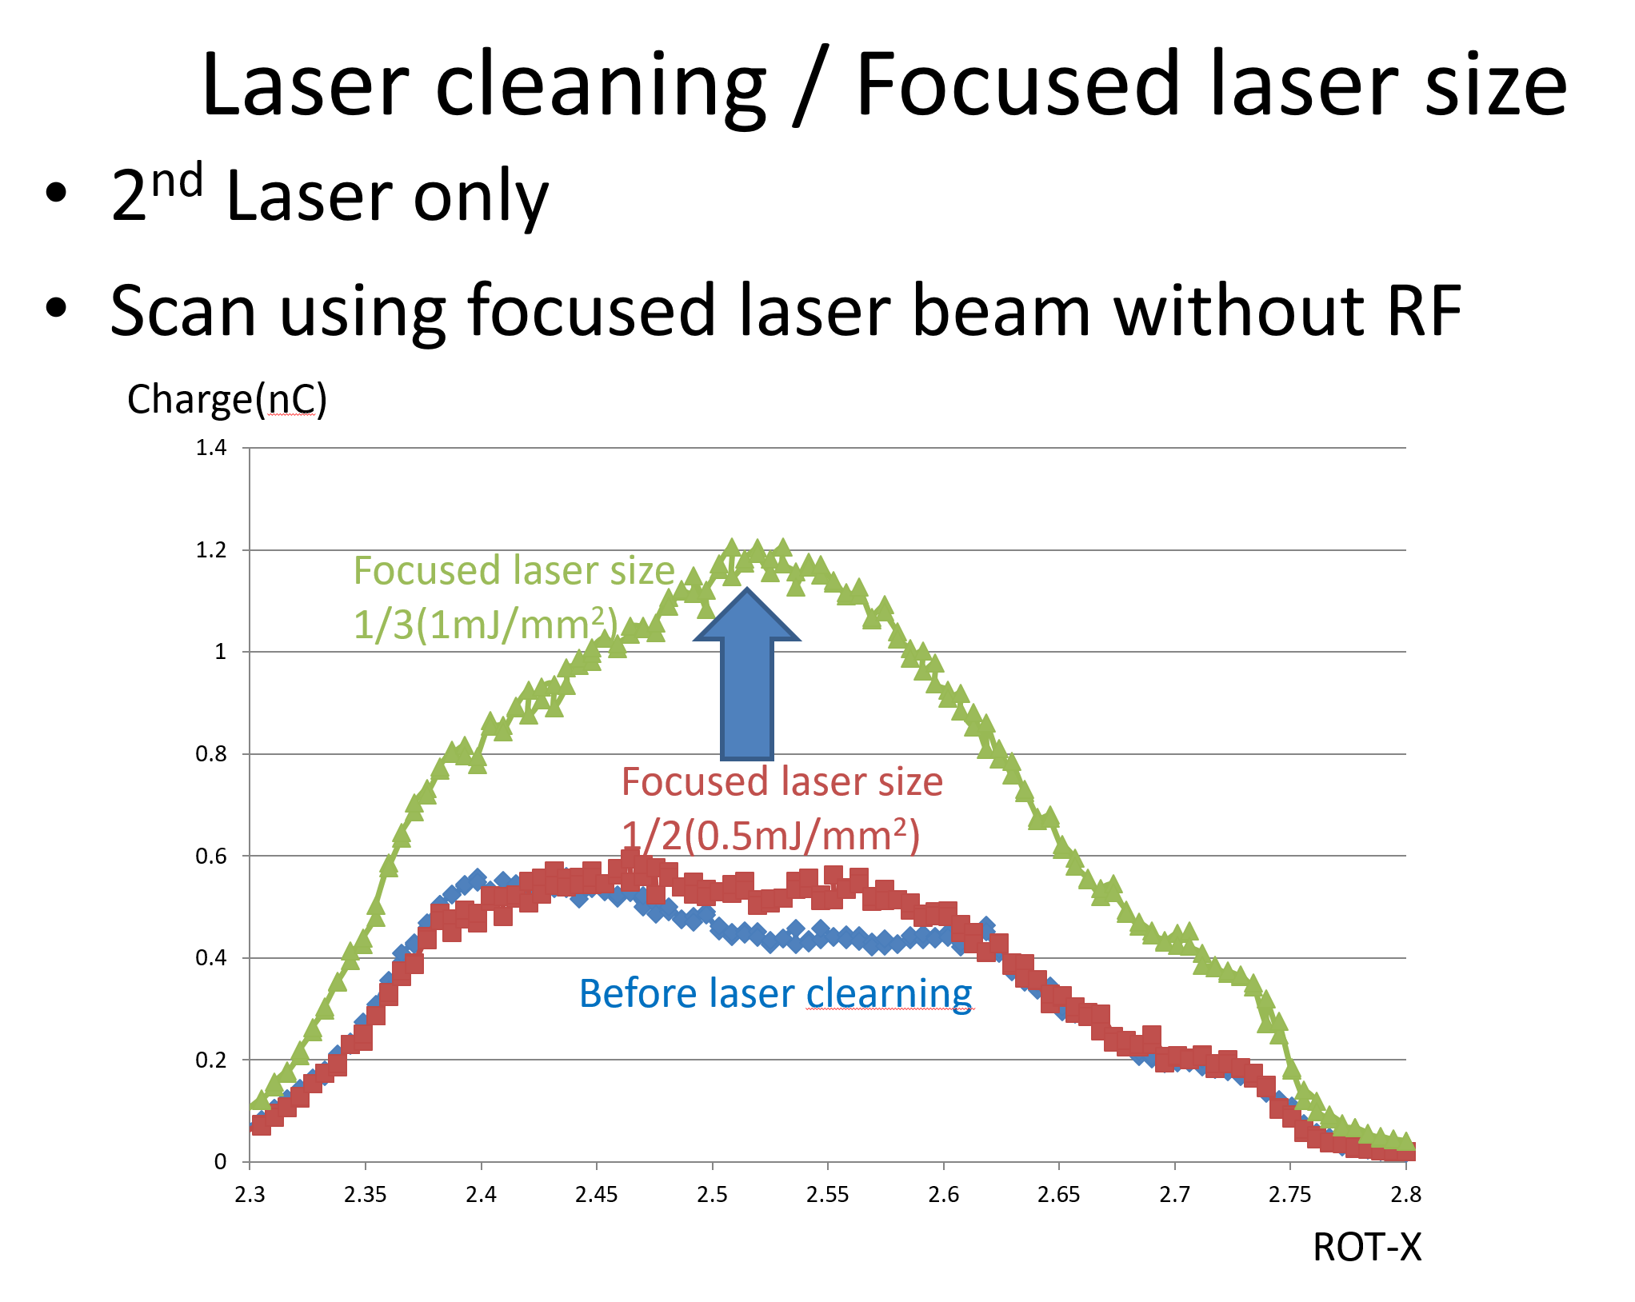
Laser cleaning ～ 30 min.
Before laser cleaning
M. Yoshida, B2GM, Feb. 6th, 2020

Slide 15
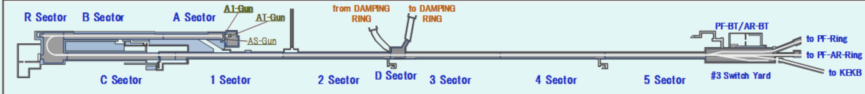
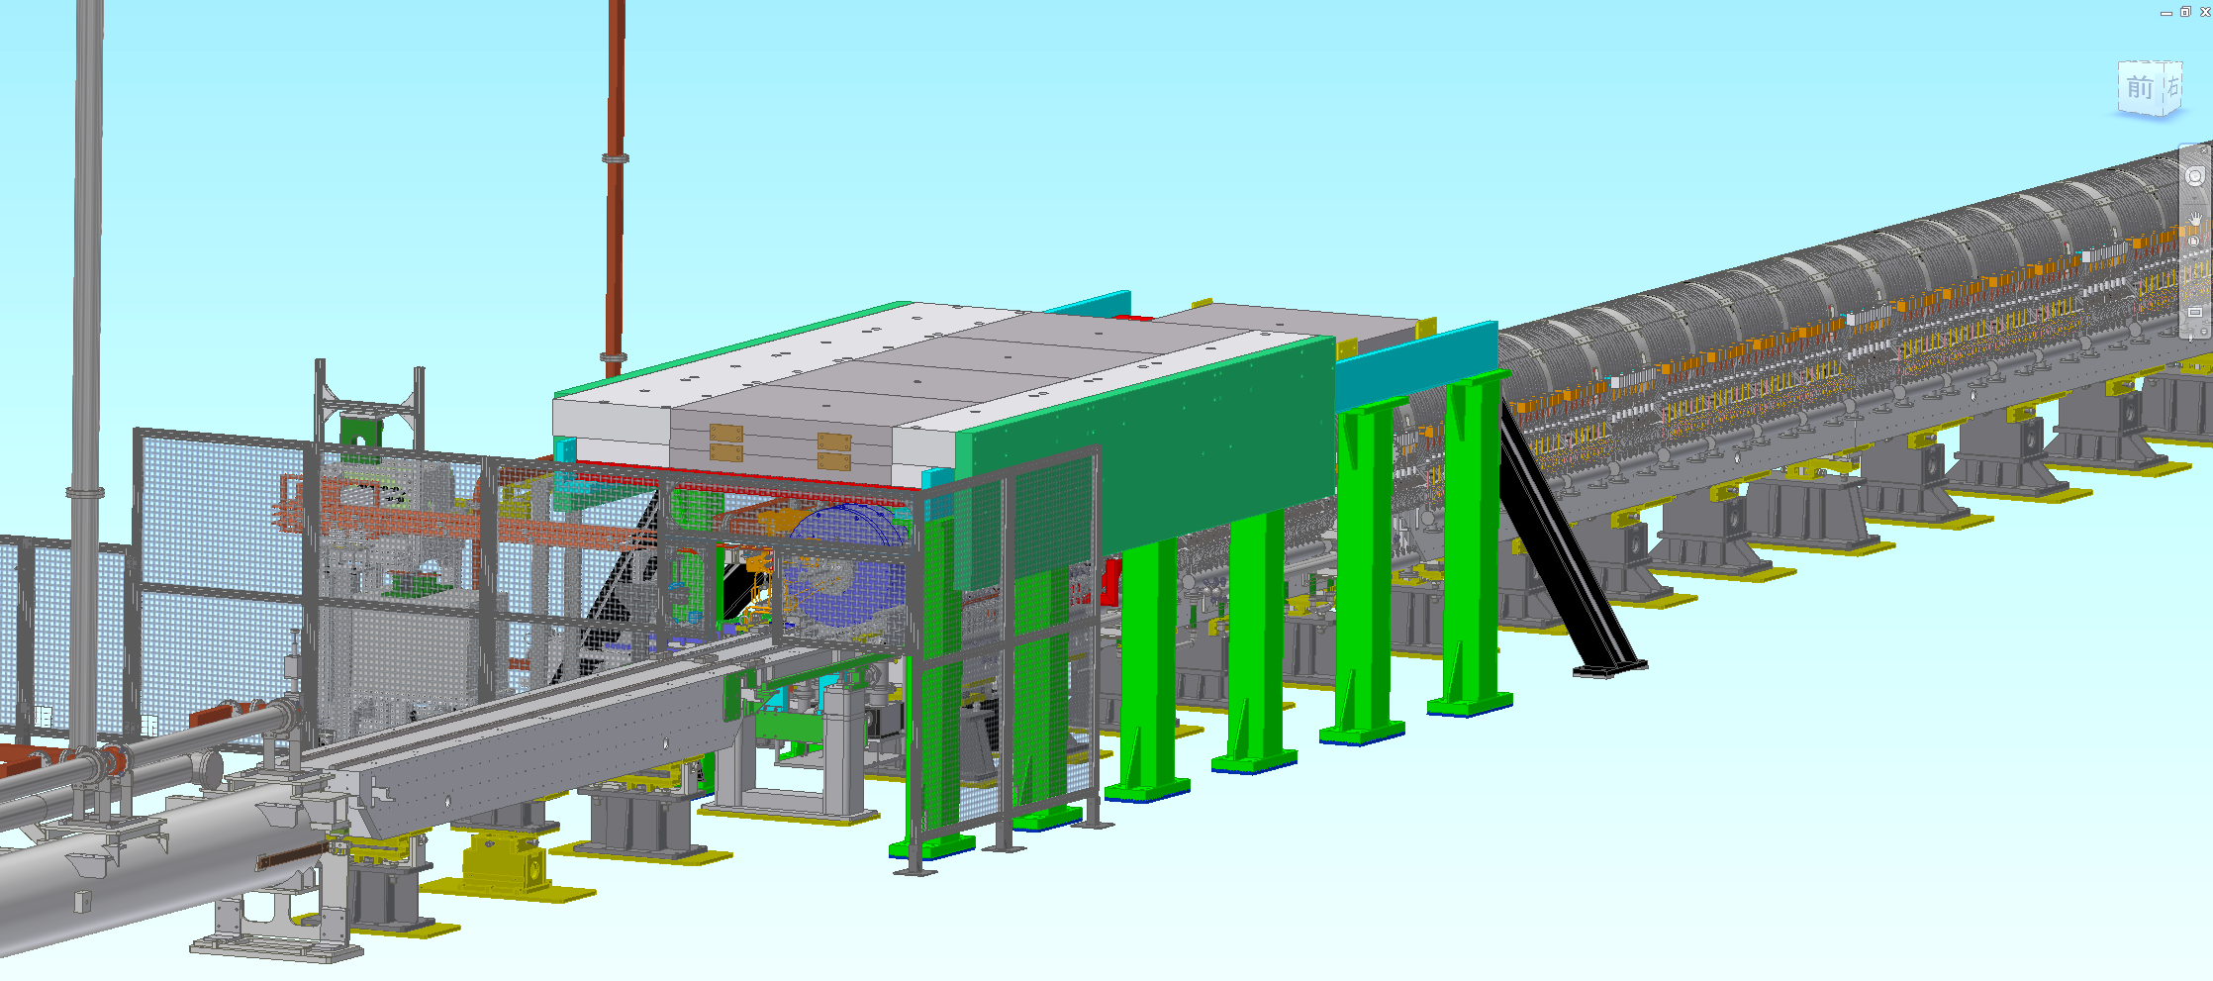
e+ source setup 1
Positron target and capture section
DC solenoid
Large aperture S-band acc. Structures (x10)
W target + flux concentrator (FC)
Y. Enomoto, SuperKEKB review, 2019

Slide 16
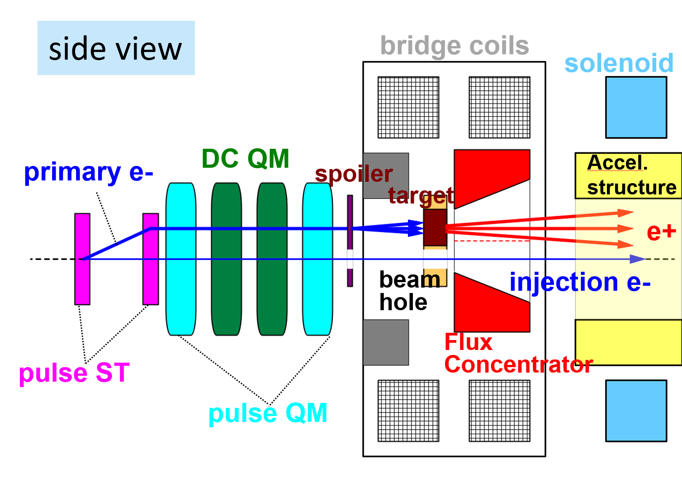
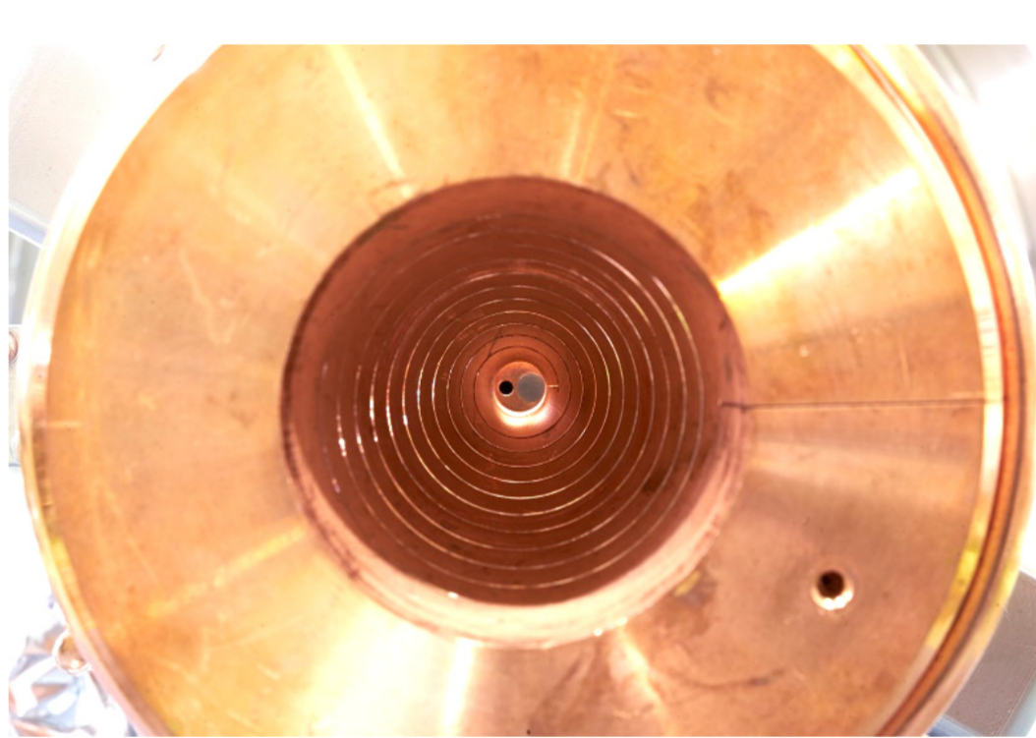
Pulse to pulse e-/e+ beam switching
Pulsed steering magnet control e- beam orbit．
Low emittance e- beam goes through a hole at center of beam line.
W target (Φ4 mm)
hole (Φ2 mm)
for low emittance e- beam

Slide 17
e+ beam history in 2019
Primary
e- beam
e+ beam
2019

Slide 18
LER injection beam status
Bunch charge
  Stable and enough bunch charge in this stage
  Primary e-: 11 nC (from gun), 9 nC (on W target), e+ : 1.2 nC (linac end), 0.8 nC (BT)
Flux concentrator (FC)
  Previous FC was damaged by large discharge during PhaseII. It was removed in Sept. 2018.
  Current FC was installed in Jan. 2019.
  2 ～ 3 kA operation current (design 12 kA) for stable operation. no significant fault.
  New FC made of Cu-alloy (NC50: Cu-Si-Ni) has been tested w/o fault (～ 12 kA).
  New FC will be installed in summer shutdown of 2020 for aiming at design operation current.
Requirements for material of the FC head are
Good brazing characteristic
High yield strength even after brazing
High electric and thermal conductivity

Slide 19
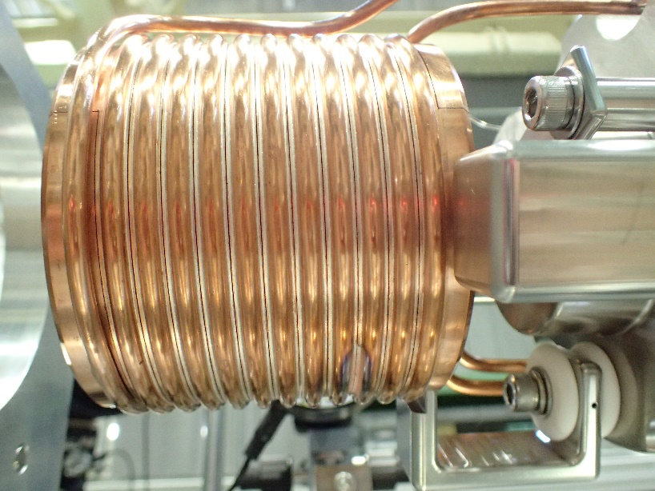
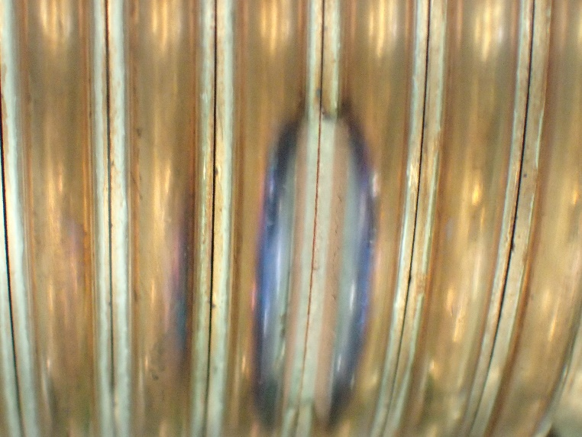
After large discharge…
After large discharge
Slit gap got narrow.
Not possible to apply high voltage unless the gap will be expanded.
Y. Enomoto, SuperKEKB review, 2019

Slide 20
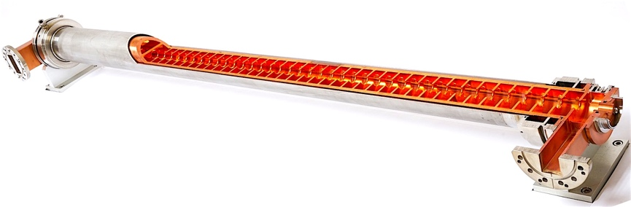
Accelerating structures
Approx. 230 accelerating structures employed
Many aged (40 years-old) structures are degraded
  Risk of 7 GeV / 4 GeV acceleration for Y(4S)
  Cannot reach Y(6S)
As a 4-5 year plan, structures are being fabricated since the last year
First tests will be performed at the assembly room
Possibly, a couple of structures would be installed during summer

Slide 21
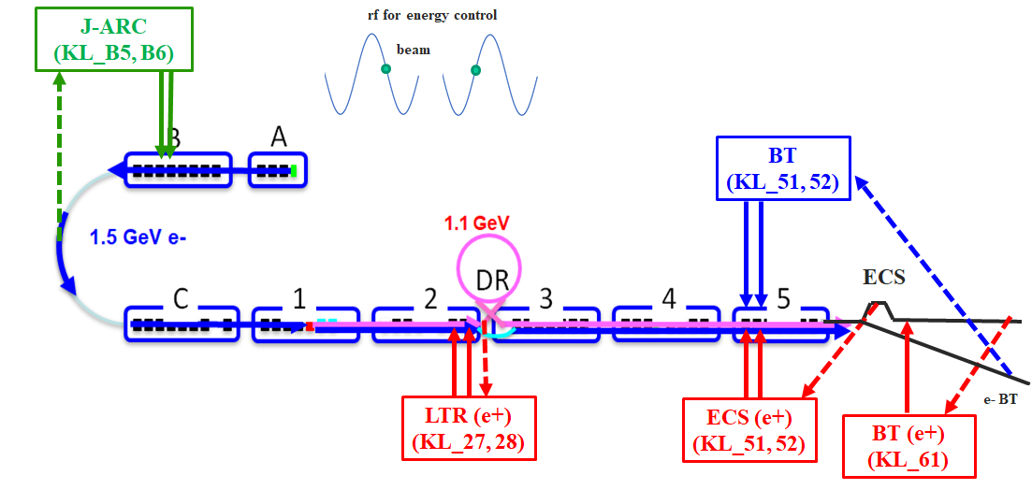
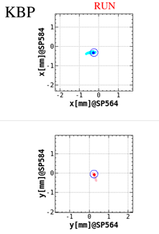
Feedback loops
Energy feedback (J-ARC, LTR, ECS, BT) work fine.
  Energy stability at BT line < 0.025%
Orbit feedback at some locations.
  Large drift (～ 1 mm) can be corrected
  within ~ 0.1 mm w/ feedback.
Energy @ BT
Energy FB
Orbit FB

Slide 22
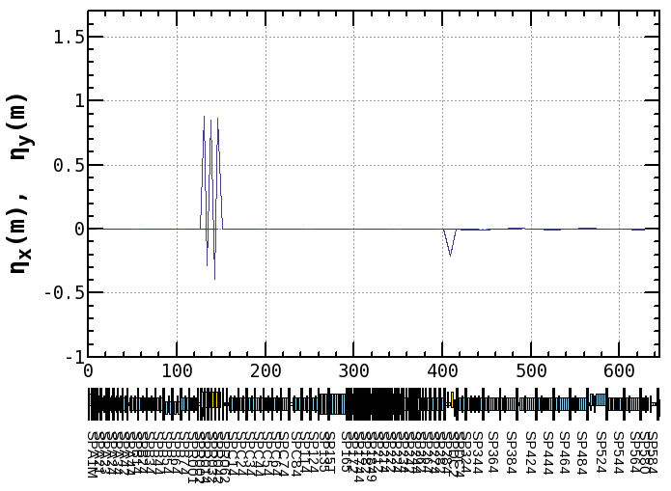
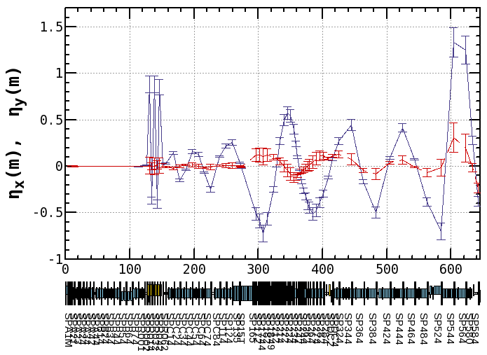
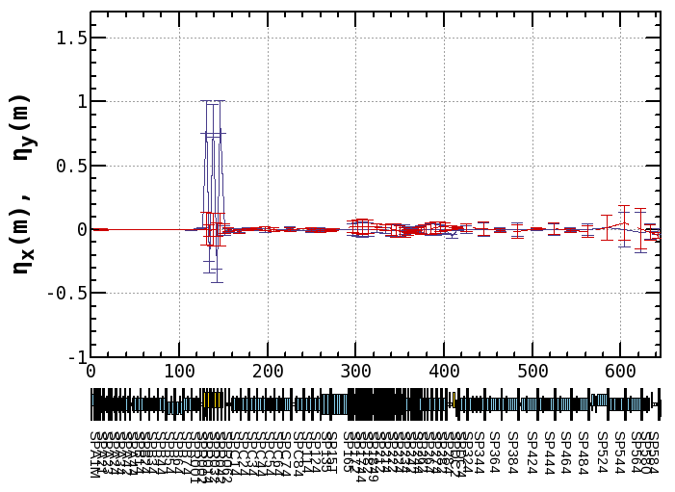
Dispersion measurement and correction
Horizontal dispersion leakage from J-ARC causes the beam position jitter.
Applying fudge factors to quads in J-ARC, dispersion is well corrected.
J-ARC
Design
chicane
Before correction
After correction
Measured
Disp. correction
w/ quads
Y. Seimiya

Slide 23
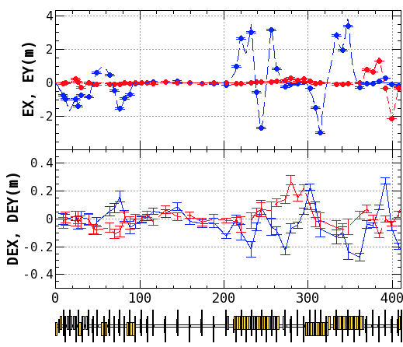
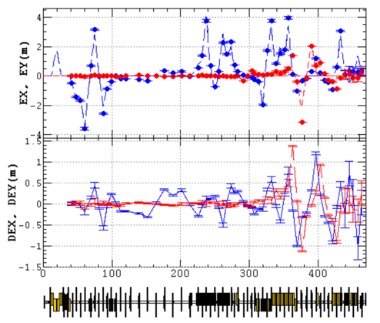
Residual Dispersion in the BT line
The dispersion functions have been corrected for each BT ARC one by one.
Non-negligible residual dispersion is still observed
Straight line
(BT1)
Straight line
(BT2)
Straight line
(BT1)
Straight line
(BT2)
BT for e-
BT for e+
Y. Seimiya

Slide 24
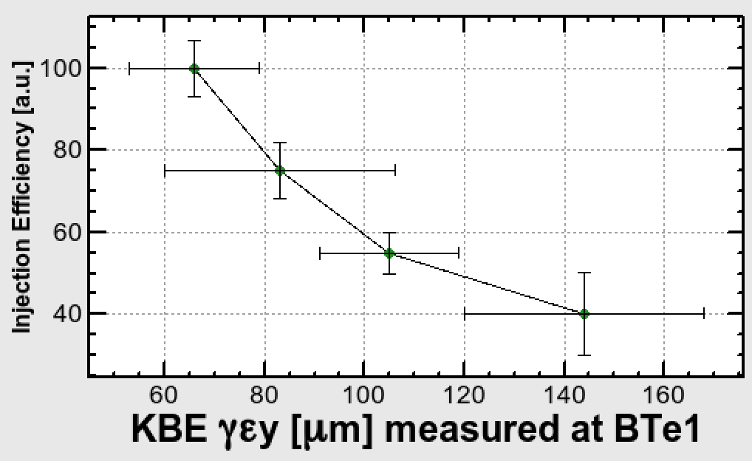
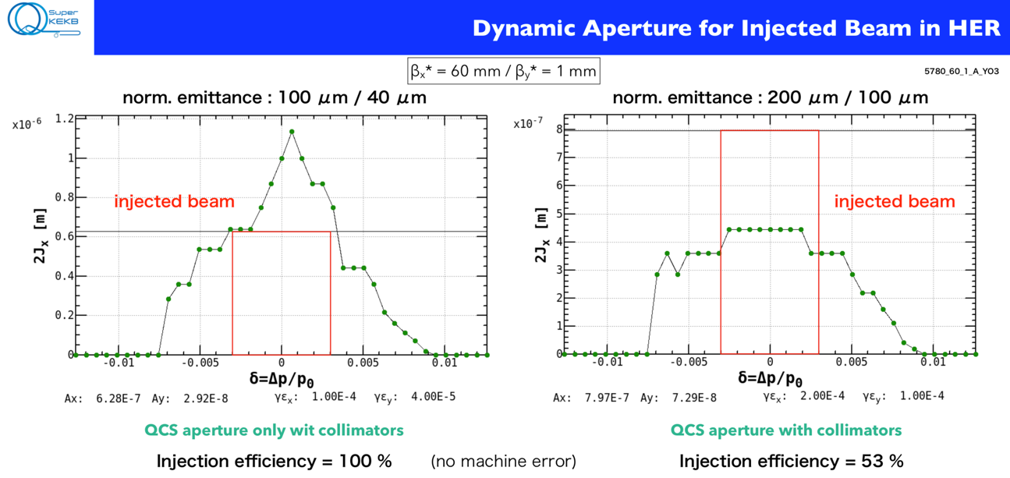
Vertical emittance vs. HER Injection efficiency
Injection efficiency and background
Y. Ohnishi

Slide 25
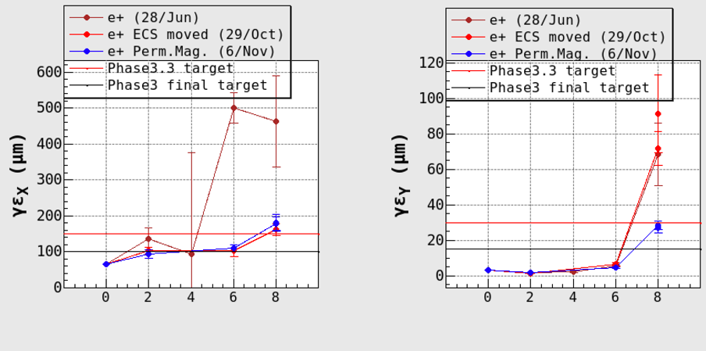
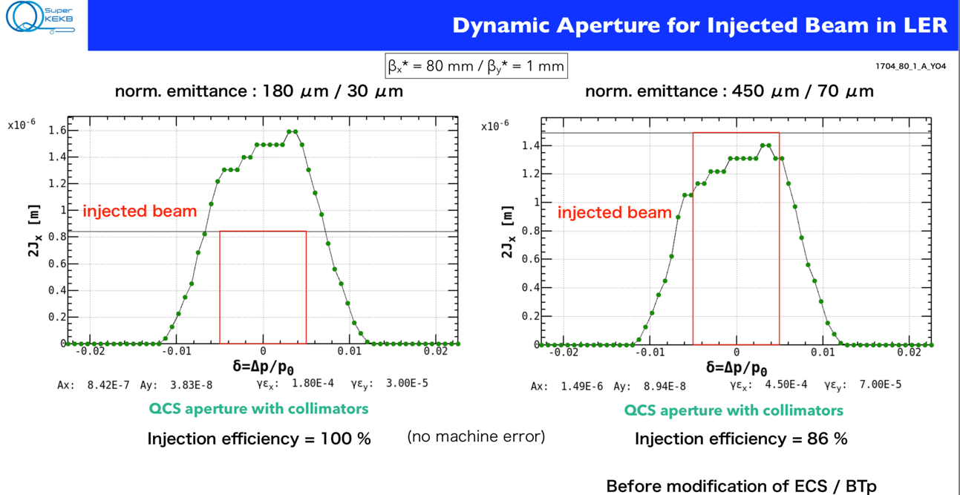
Injection efficiency and background
・LER
γεx
[μm]
γεy
[μm]
DR 3 5 BT1 BT2
DR 3 5 BT1 BT2
e+ horizontal emittance has been improved after ECS bend alignment.
Y. Ohnishi
Reducing emittance is in time for βy*=1mm
(6/Nov/2019)
(28/Jun/2019)

Slide 26
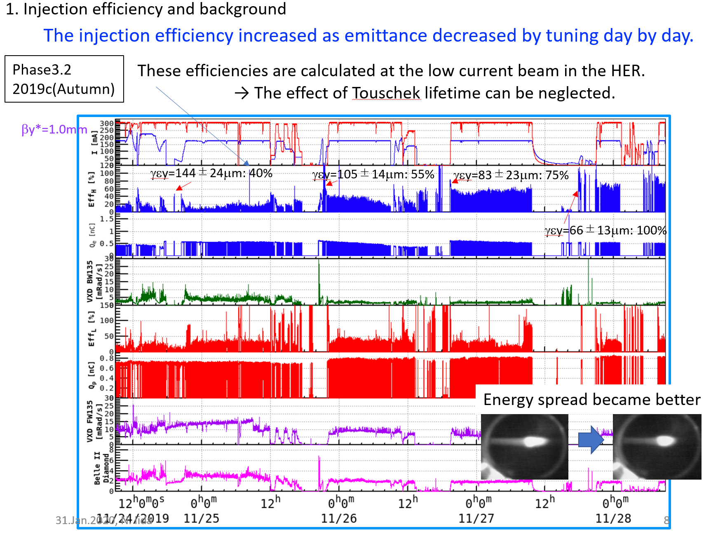
N. Iida, SuperKEKB workshop, 2019

Slide 27

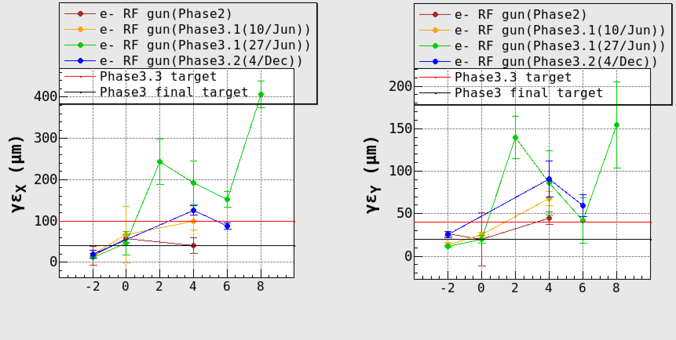
Measured emittance
e+ beam (Phase3.2(6.Nov.2019))
Phase3.3 | e+ | e-
γεx [μm] | 150 | 100
γεy [μm] | 30 | 40
σδ [%] | 0.16(1σ) | 0.1(1σ)
γεx
[μm]
γεy
[μm]
Emittances increase
DR → Sector3
BT1 → BT2
Beam study will be continued
DR 3 5 BT1 BT2
DR 3 5 BT1 BT2
e- beam (Phase3.2(4.Dec.2019))
Emittances increase
C→Sector3
BT1→BT2
Beam study will be continued
γεx
[μm]
γεy
[μm]
B C ３ 5 BT1 BT2
B C ３ 5 BT1 BT2

Slide 28
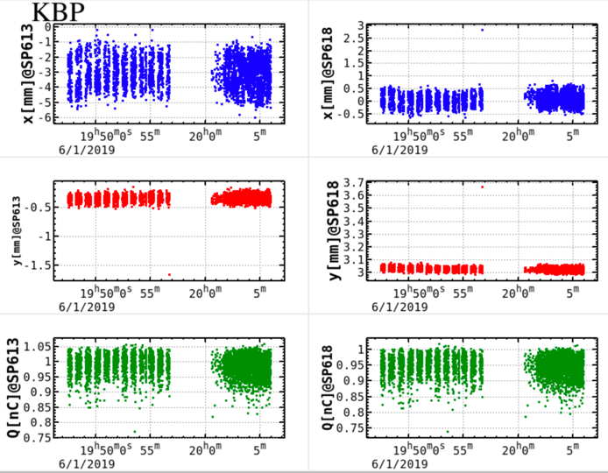
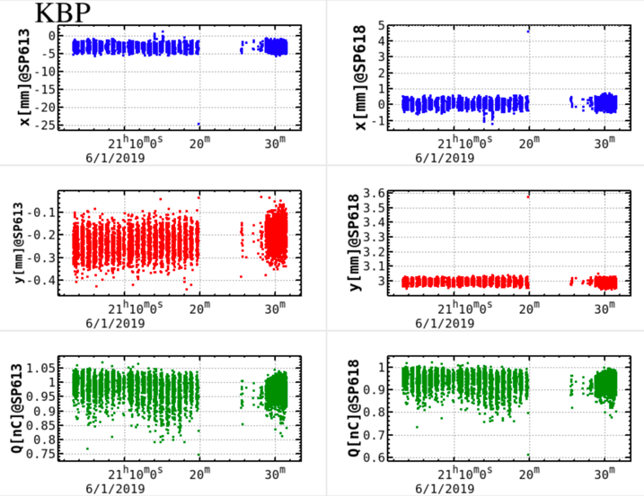
Fast beam position monitor(BPM) in LINAC
Beam abort caused by abnormal injection beam
Y. Seimiya, F. Miyahara, T. Miura, Y. Enomoto, H. Kaji et al.
Injection beam just before abort can be monitored by,
1. Jun., 2019 19:56
  LER D6V2 LM abort
1. Jun., 2019 21:19
  LER D6V2 LM abort
No energy deviation
Beam energy was 50 MeV lower.
Orbit deviation
Dispersive point
Straight line
Dispersive point
Straight line
One station for the power supplies (PS) was set to 0 [A] due to a trigger missing of the PS.
The klystron 51 was down at the time.
The estimation was -46.5 MeV which is consistent with the beam position.

Slide 29
Summary and plan
Stable simultaneous top up injection to 4 storage rings (HER, LER, PF, and PF-AR) w/ thermionic gun, rf gun, pulsed magnets.
HER injection has been done w/ only rf gun from PhaseIII day 1.
  Laser system has no significant fault.
  Photocathode: Ir7Ce2 => Ir2Ce (summer of 2019) for higher Qe, however, bunch charge gradually decreased.
  In this winter shutdown: back to Ir7Ce2 photocathode
  Laser cleaning can cure degradation of Qe
Flux concentrator for e+ beam has no significant fault.
  New flux concentrator will be installed for higher e+ bunch charge for higher e+ bunch charge.

Slide 30
Summary and plan (cont’d)
Smaller emittance, higher injection efficiency, smaller background.
Emittance growth (need more beam study)
  btwn BT1 - BT2 (e-, e+)
  DR – Sector3 (RTL) (e+), SectorC-Sector3 (e-)
  Steering magnets and BPMs will be installed in e+ capture section (solenoid section) at Sector1.
  Movable girder and precise orbit control will help for emittance preservation.
Single shot beam w/ bad quality (energy, orbit) could cause abort.
  Install collimator at ECS (end of linac) in this summer shutdown.
  Reduce failure rate of PS control software

Slide 31
Backup

Slide 32
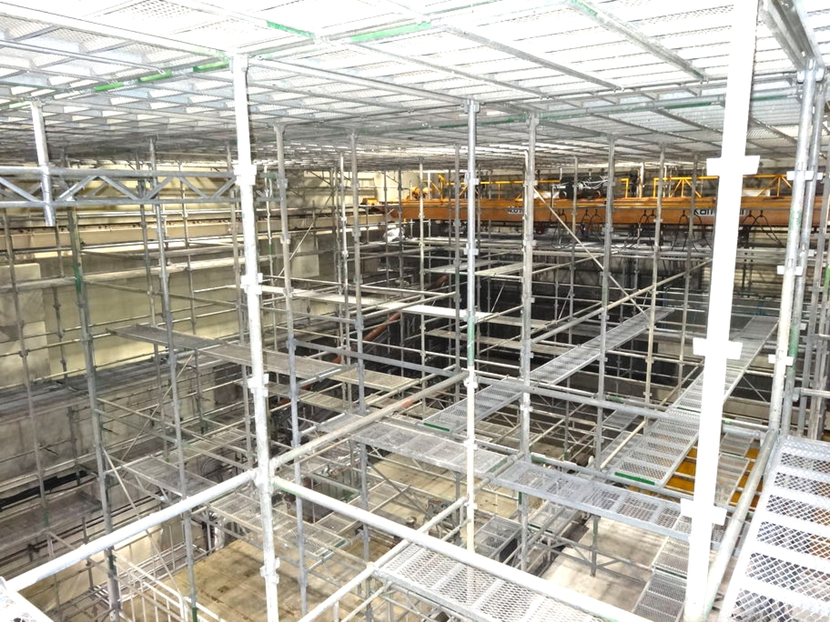
Fire recovery
Fire at acc. structure assembly room on Apr. 3, 2019
  Southern part of the injector was much damaged as well as the assembly room
Interim injector recovery by Apr. 26, 2019
Full injector recovery during summer shutdown
The assembly room
cleaned up
  Restoration in April
  S-band structure tests and
  RF conditioning soon
Scaffold to clean up walls and ceiling
at acc. structure assembly room

Slide 33
Beam emittance example
(~1 nC) w/ multiple wire scanners
Final target (4 nC)
e-: εx/εy 40/20 μm
e+: εx/εy 100/15 μm
e- emittance growth
e+: εx/εy ～100/6 μm
B
A
e+: εx/εy ～100/2 μm
1.5 GeV e-
1.1 GeV
BT
#1 straight
DR
C
1
2
3
4
5
e+: εx,y ～ 2500 μm (before DR)
e-: εx,y ～20 μm
e-: εx,y ～ 50～80 μm
e-: εx,y ～ 50～80 μm
e-: εx,y ～10~20 μm
Notes:
1 nCでのエミッタンス測定の典型的な例（4台のワイヤースキャナで測定）
Phase3の最終目標は，4 nCで中央下にある値．
1nCであるが，陽電子は，概ね最終目標エミッタンスを満たしている．
電子も1nCであるが，入射器内（5セクタ）では水平方向は50 um程度の場合もある．C～5セクタでのエミッタンス増大は，アライメントの改善と加速管架台ムーバーの導入で改善を図る予定である．
Phase2の時には，BTでエミッタンス増大が見られる（入射器5セクタの2～3倍のエミッタンスになる．100 um が300 um以上になる）問題があったが，BTワイヤスキャナのワイヤ径を200 umから60 umに変更し，データ収集系をCAMACから入射器と同じVMEベースのものに変更したところ，そのような増大が見られなくなった．（詳しい原因は不明ですが，測定系に問題があったと思われます．）

Slide 34
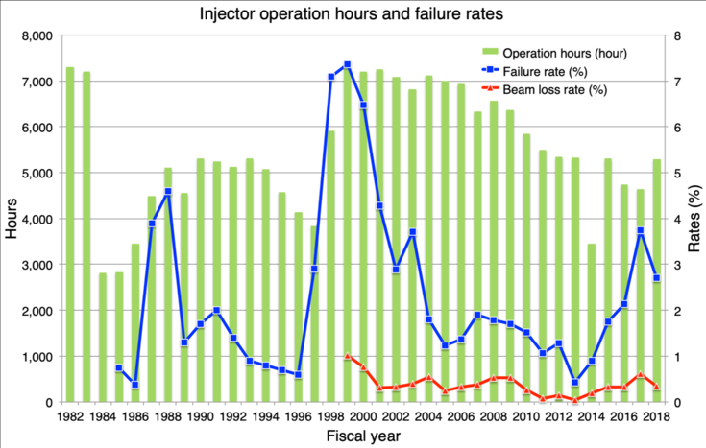
PF injector
KEKB
Tristan
SuperKEKB

Slide 35
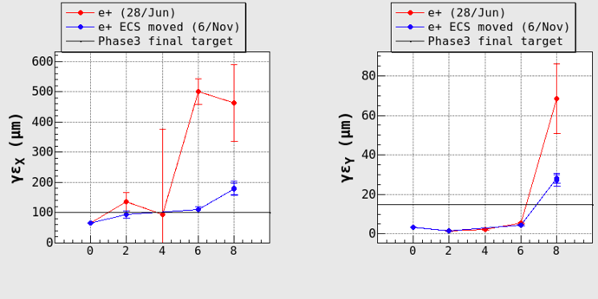
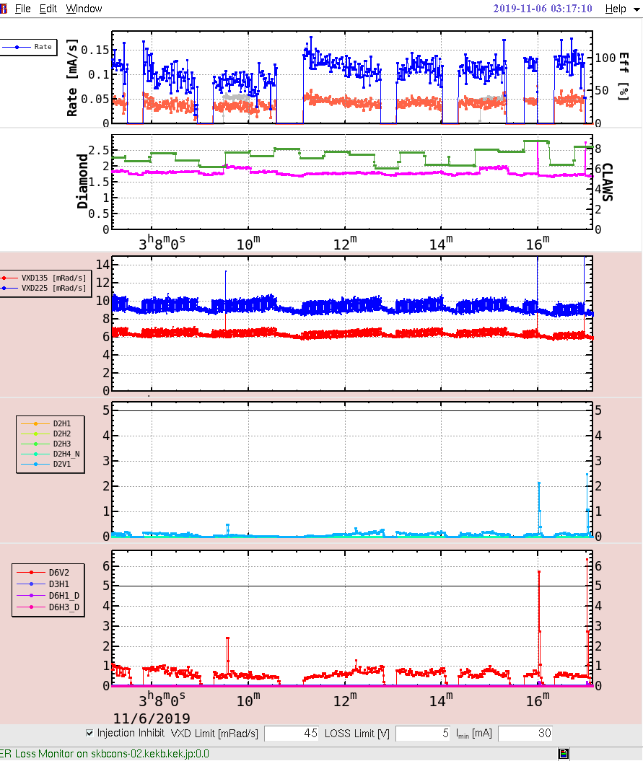
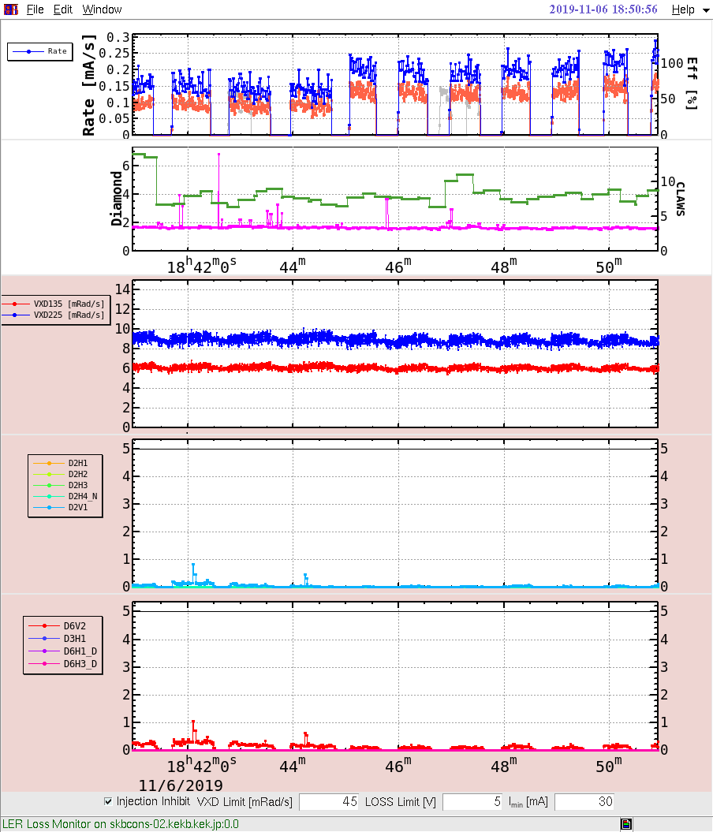
e+ vertical emittance was improved
Injection efficiency and background
LER
γεx
[μm]
γεy
[μm]
DR 3 5 BT1 BT2
DR 3 5 BT1 BT2
6.Nov.2019 3:17
6.Nov.2019 18:50
BGs from Vertex detectors
BG due to injection became smaller.
Signals from Loss monitors in the LER

Slide 36
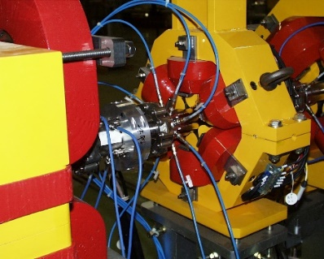
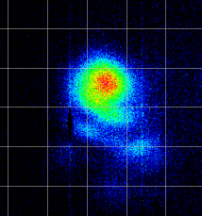
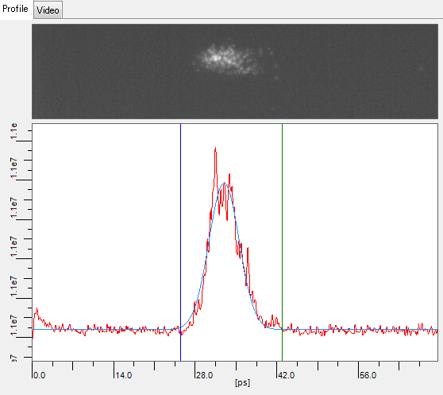
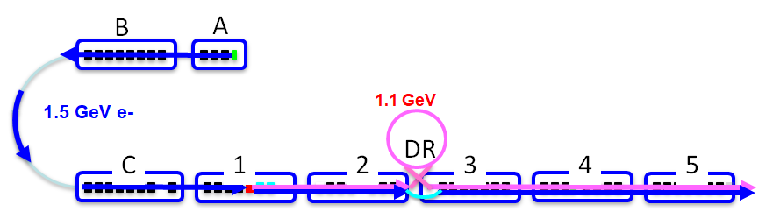
Monitors
Beam position monitor (x 103)
  Four strip line electrodes (x 97)
    Measurement precision ~ 10 μm
  Eight strip line electrodes (x 6) (J-ARC, LTR x2, PF BT, HER BT, LER BT)
Profile monitor (x 104)
  Al2O3/CrO3 (AF995R, Demarquest Co.). (t: 1 mm, 0.1 mm), YAG:Ce (t: 0.1 mm)
Wire scanner (WS) (x 6)
  SectorA, B, C, 2, 3, 5
Streak camera (ST) (x 2)
  SectorA, C, 3
RF monitors for klystron, SLED, acc. structure
ST
WS
WS
WS
WS
WS
WS
ST
ST

Slide 37
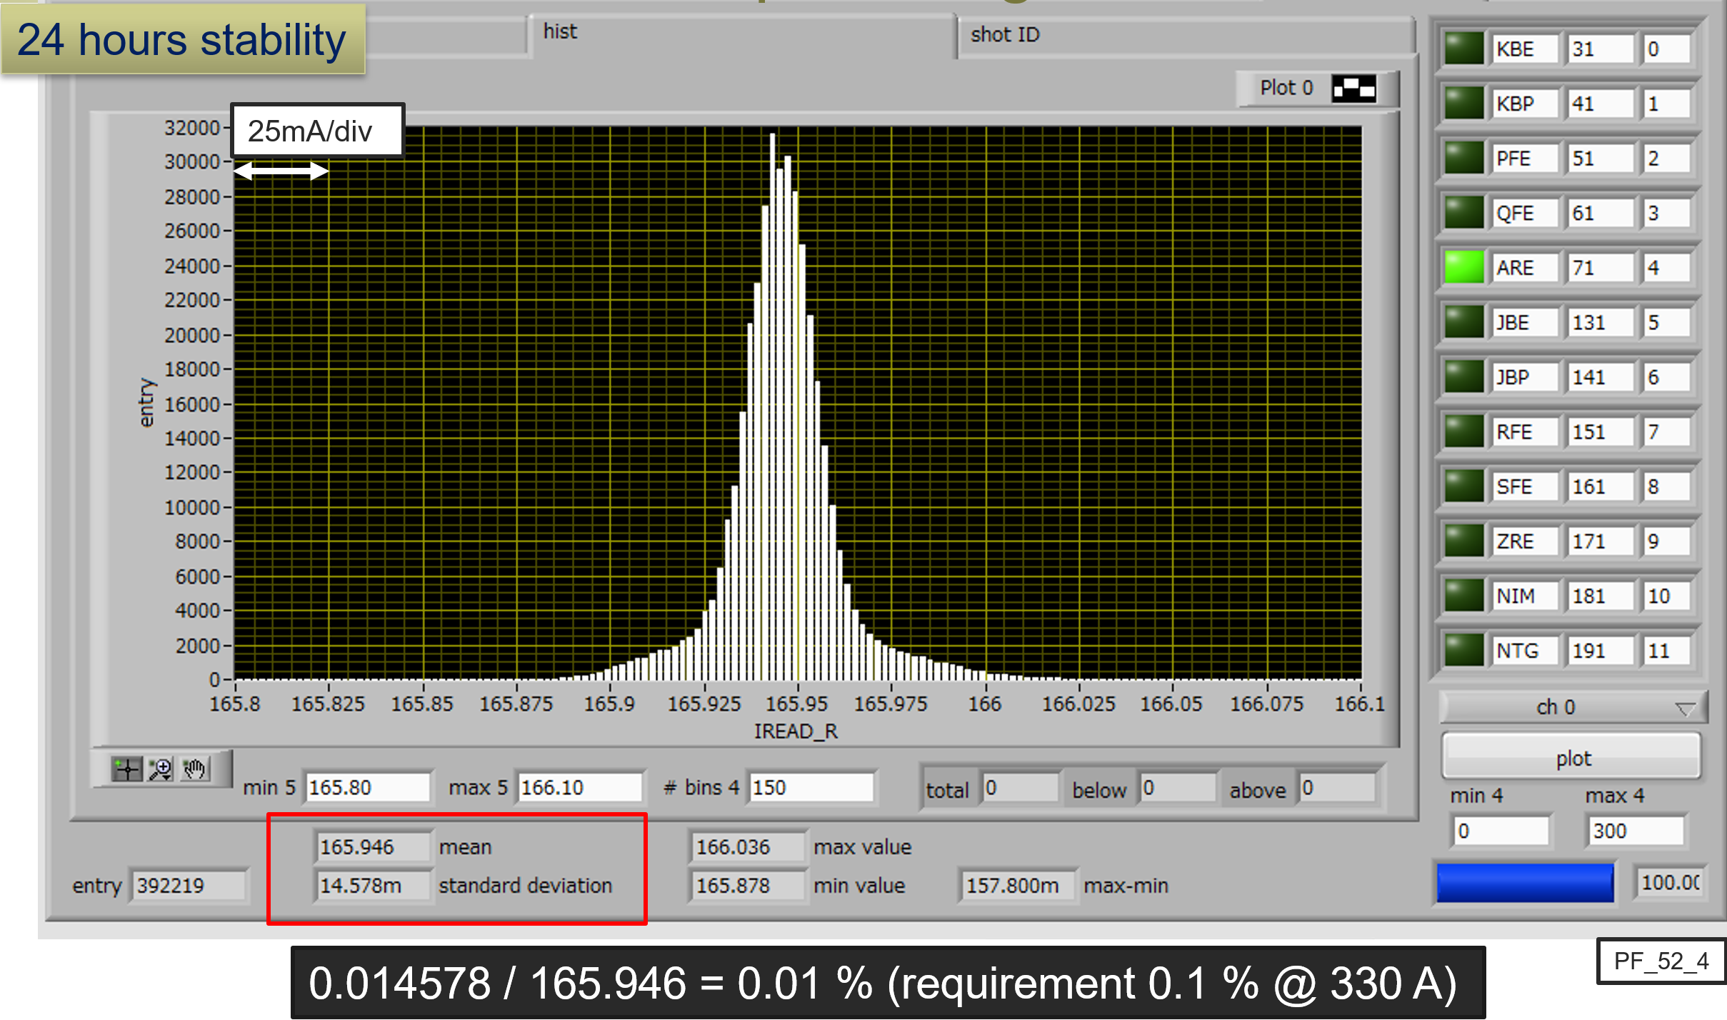
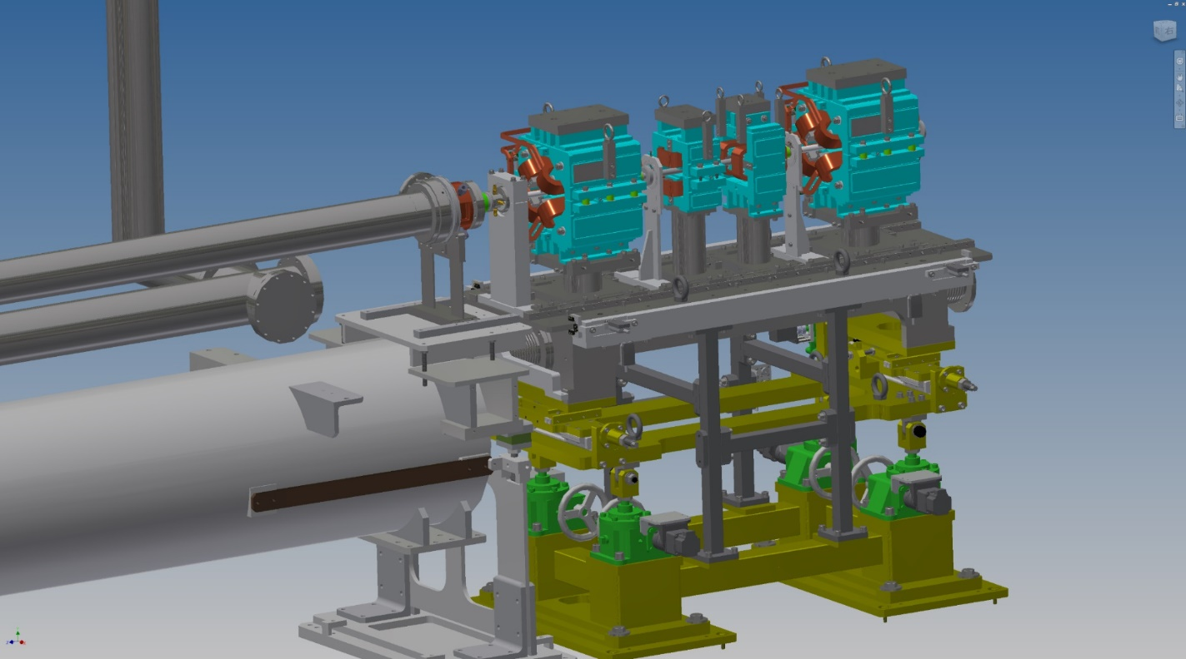
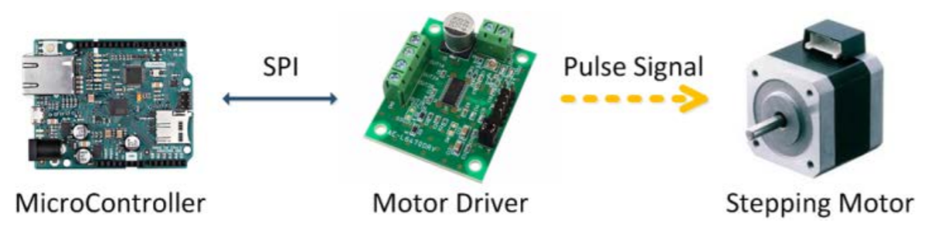
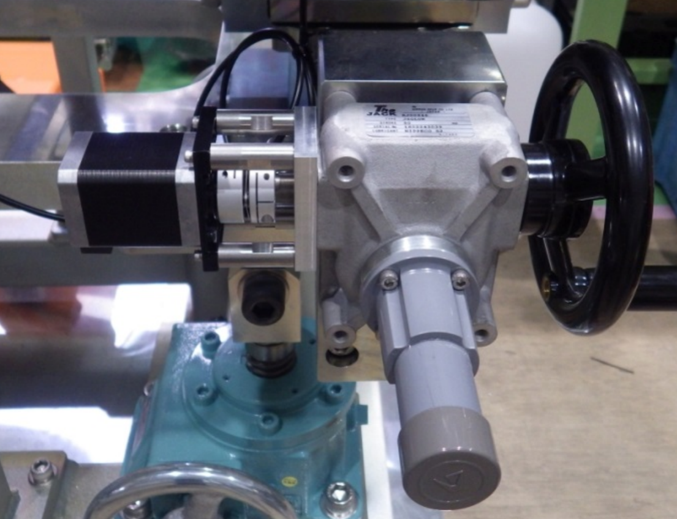
Pulsed magnet system
Pulsed quads (x 28) (w/ ceramic duct) and steering (x 36) were installed at Sector3 to Sector5 in 2017 (on movable girder).
Pulsed bend, additional quad and steering were installed in 2018 summer and winter shutdown.
PXIe based control system (Windows 8.1, LabVIEW, EPICS) have worked fine w/o any serious trouble.
Power supply stability: 0.01% (24 hours)
Pulsed magnet
BPM
Movable girder for pulsed magnet
(remote controllable, 10 μm step)

Slide 38
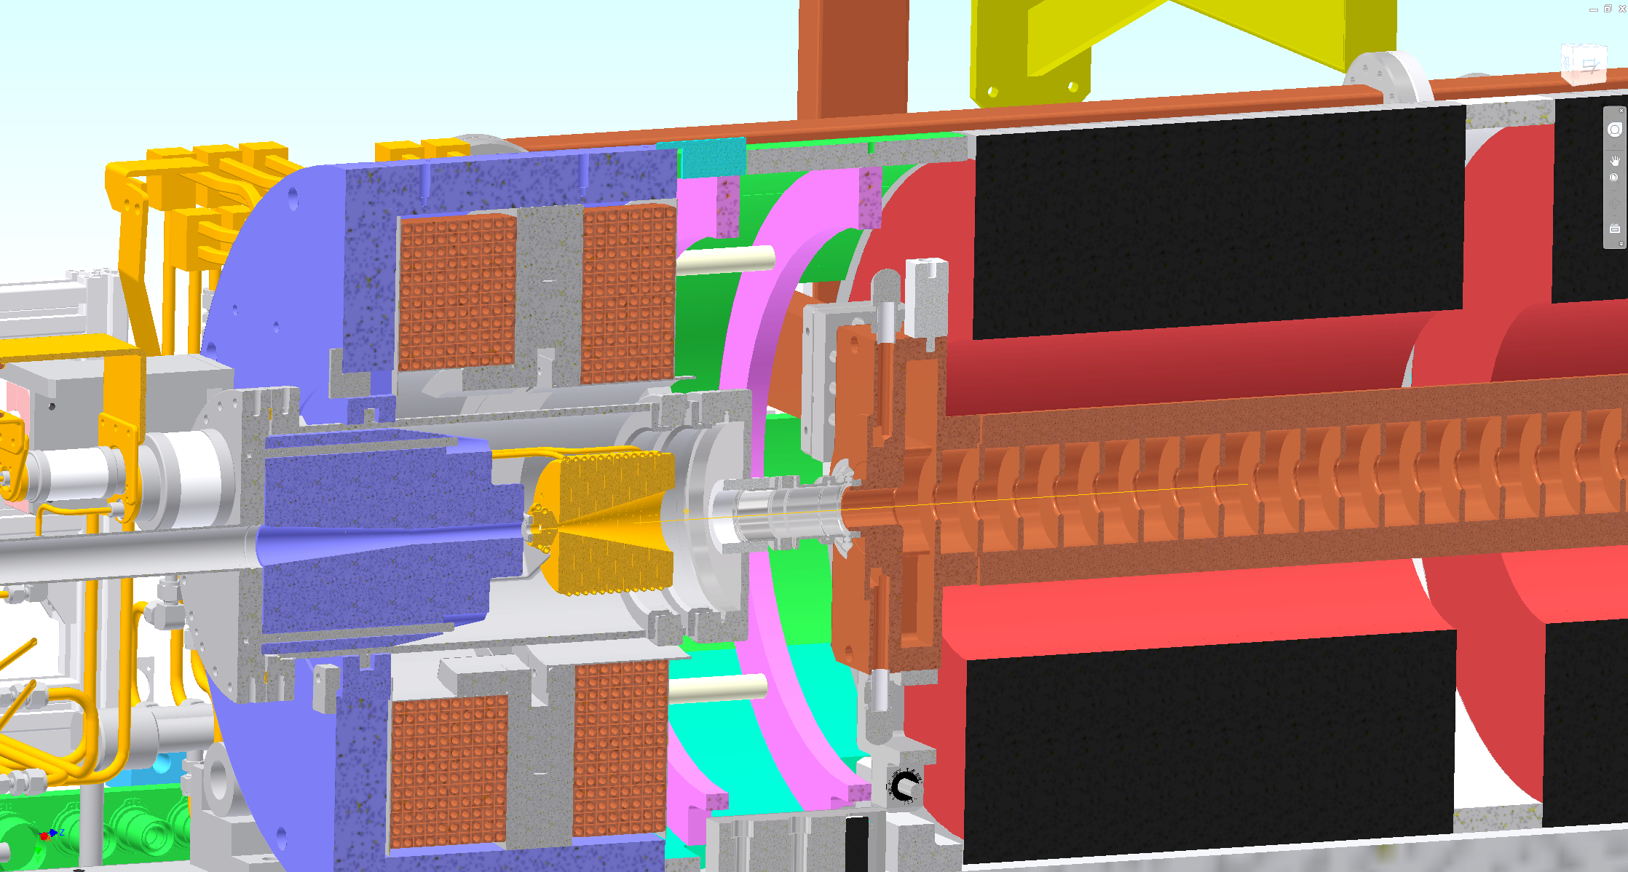
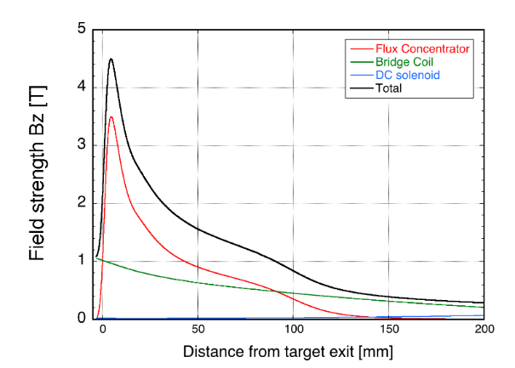
e+ source setup 2
FC head + BC + target = FC assembly
BC (bridge coil)
LAS (large aperture S-band)
target
FC(flux concentrator) head
solenoid
Y. Enomoto, SuperKEKB review, 2019

Slide 39

Movable girder for accelerating structure
Six movable girders have been installed in Sector3 (in summer shutdown of 2019).
  Four 2-m-long accelerating structures are mounted on one girder.
It could help to suppress emittance growth due to misalignment.

Slide 40
Ir2Ce
One day
2020

