Slide 1
Electron / Positron Injector Linac
Kazuro Furukawa
for Injector Linac group

Slide 2
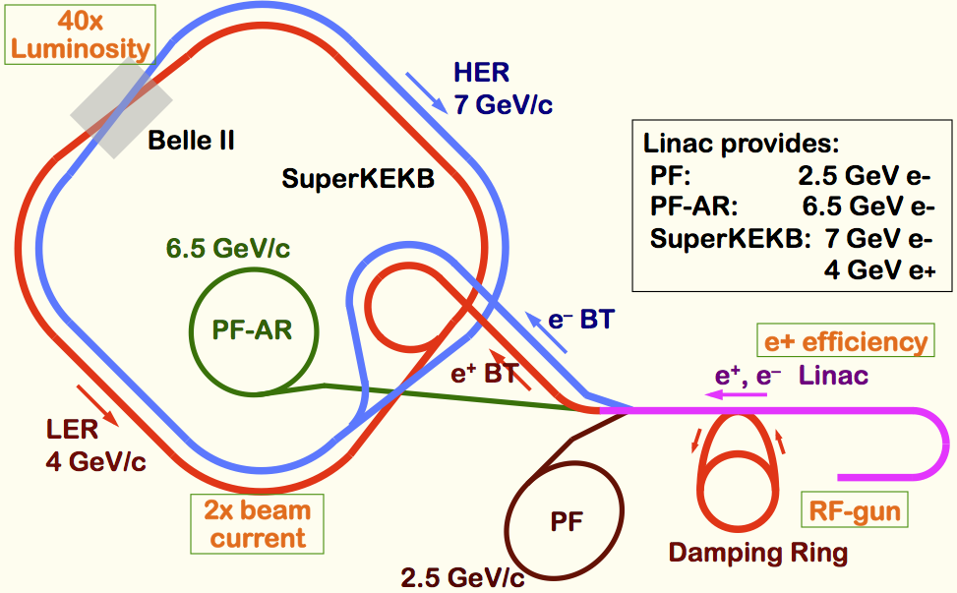
SuperKEKB での Linac の役割
Linac Overview
40-times higher Luminosity
  Twice larger storage beam → Higher Linac beam current
  20-times higher collision rate with nano-beam scheme
    → Low-emittance Linac injection beam
    → Shorter storage lifetime → Higher Linac beam current
Linac challenges
  Low emittance e-
    High-charge RF-gun
  Low emittance e+
    Damping ring
  Higher e+ beam current
    New capture section
  Beam transport
    Emittance preservation
  4+1 ring simul. injection
Notes:
Higher Injection Beam Current
To Meet the larger stored beam current and shorter beam lifetime in the ring
4~8-times larger bunch current for electron and positron
Reconstruction of positron generator, etc
Lower-emittance Injection Beam
To meet nano-beam scheme in the ring
Positron with a damping ring
Electron with a photo-cathode RF gun
Emittance preservation by alignment and beam instrumentation
Quasi-simultaneous injections into 4 storage rings
SuperKEKB e–/e⁺ rings, and light sources of PF and PF-AR
Improvements to beam instrumentation, low-level RF, controls, timing, etc

Slide 3
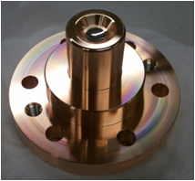
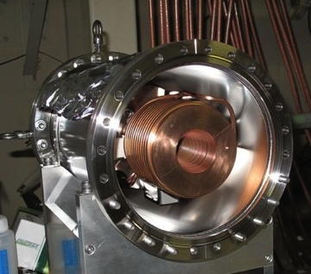
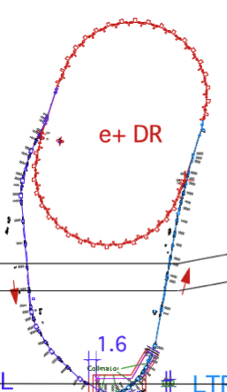
Linac Upgrade for SuperKEKB
Higher Injection Beam Current
  To Meet the larger stored beam current and shorter beam lifetime in the ring
  4~8-times larger bunch current for electron and positron
Lower-emittance Injection Beam
  To meet nano-beam scheme in the ring
  Positron with a damping ring, Electron with a photo-cathode RF gun
  Emittance preservation by alignment and beam instrumentation
Quasi-simultaneous injections into 4 storage rings (PPM)
  SuperKEKB e–/e⁺ rings, and light sources of PF and PF-AR
  Improvements to beam instrumentation, low-level RF, controls, timing, etc
Ir₅Ce
FC
SuperKEKB injector Linac
50 Hz (e+ or e-)
pulse-by-pulse
mode switching
high current
gun
1.1 GeV
Damping Ring
circ. 136 m
PF
low emittance
RF gun
PF-AR
6.5 GeV e-
2.5 GeV e-
0.1nC x 1
Bunch
Compressor
LER
3.5 GeV
10nC x 2 (prim. e-)
5nC x 2 (inj. e-)
Energy-spread
Compression System
S-band
linac
3T
RF gun
4.0 GeV e+ 4nC x 2
ECS
e+ target &
L-band+LAS
capture section
C-band
modules
HER
7.0 GeV e-
5nC x 2

Slide 4
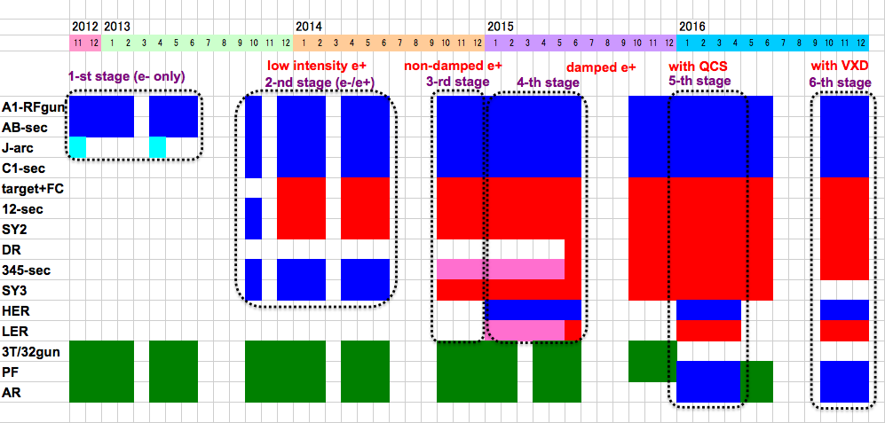
Linac Schedule Overview
RF-Gun e- beam
commissioning
at A,B-sector
Qe- = 5nC
e- commiss.
at A,B,J,C,1
Qe- = 5nC
e+ commiss.
at 1,2 Qe+ = 0.5nC (FC, DCS, Qe- 50%)
e- commiss.
at 1,2,3,4,5 Qe- = 5nC
1 nC
2 nC
4 nC
: Electron
non damped e+ commiss.
at 1,2, 3,4,5 Qe+ = 4nC
e- commiss. pulse-switch
at A→5 Qe- = 5nC
damped e+ commiss.
at 1→5 Qe+ = 4nC
e- commiss.
at A→5 Qe- = 5nC
PF-AR e-
commiss.
: Positron
: Low current electron

Slide 5
概略の予定
Schedule
2013 夏: 多数の機器の設置
2013 秋: e– commissioning (limited)
  後半部: PF 入射, 前半部 日中準夜: ビームコミッショニング
2014 春: Commissioning 継続, 後半部調整, Alignment 等々
  後半部: PF 入射, 前半部 日中: DR 建設, 準夜: ビームコミッショニング
2014 夏: 機器の設置, PFAR-BT (部分)
  冷却水・電力増強, Pulsed magnets 設置, 安全系
2014 秋: Linac (nearly) full commissioning
  PF without daytime top-up? BPM (partially), RF-monitor
2015 冬: MR then (春) DR injection commissioning
  Normal emittance, 1nC, Non-continuous injection, PF Top-up
2016: MR commissioning
  Lower emittance, 2nC, Continuous injection

Slide 6
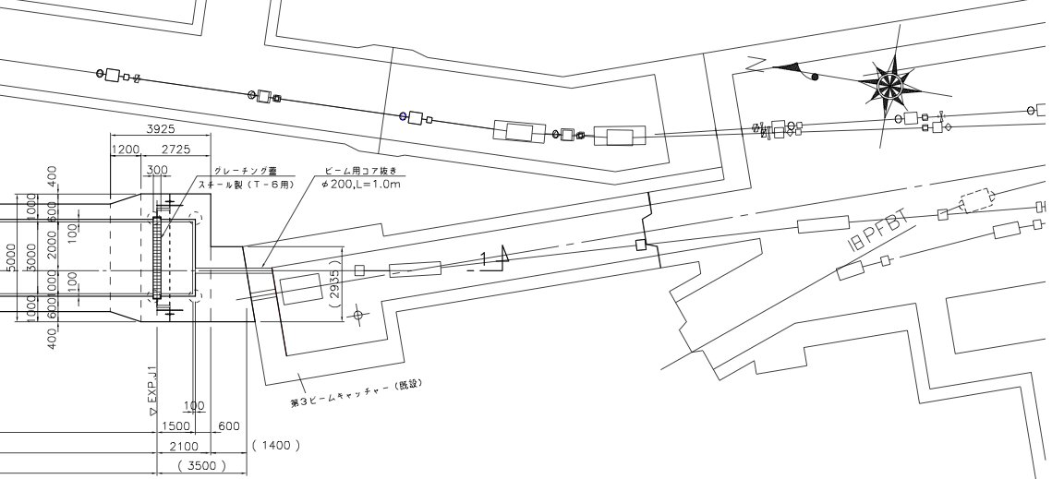
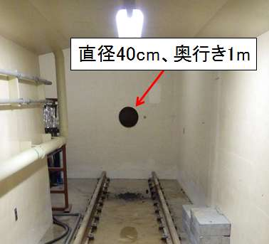
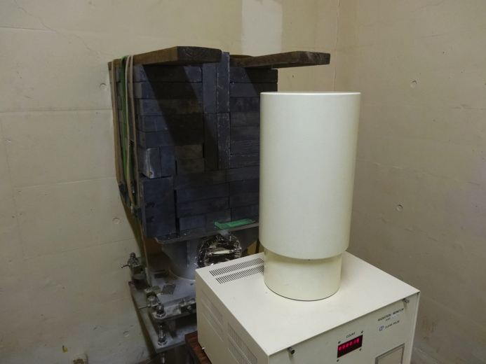
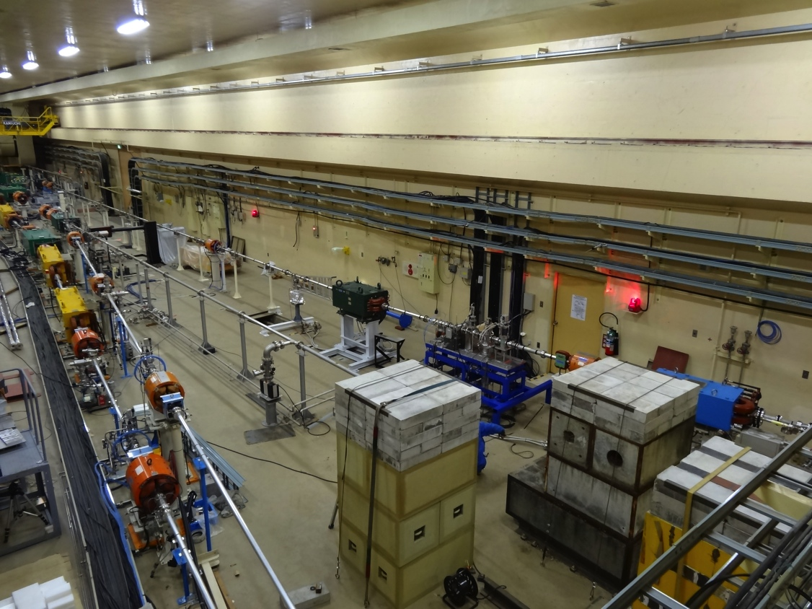
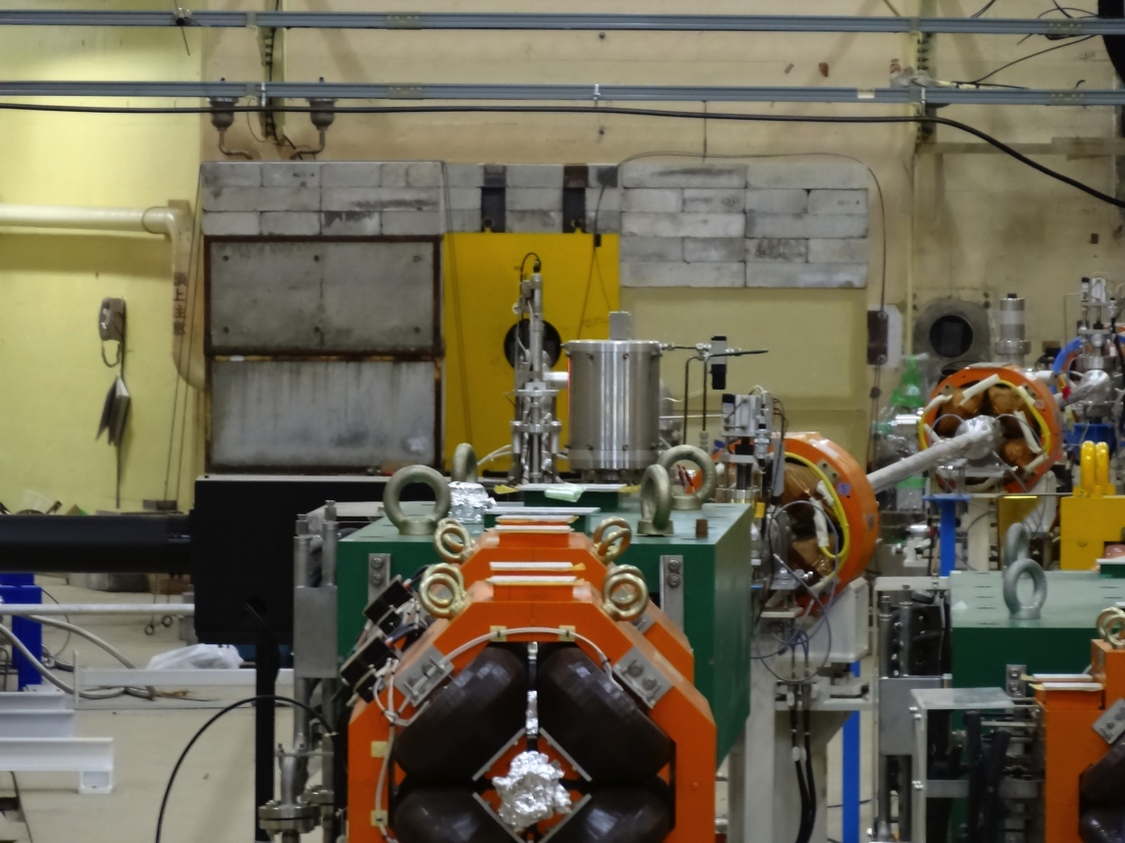
PF-AR 直接入射路工事 追加シールド

Slide 7
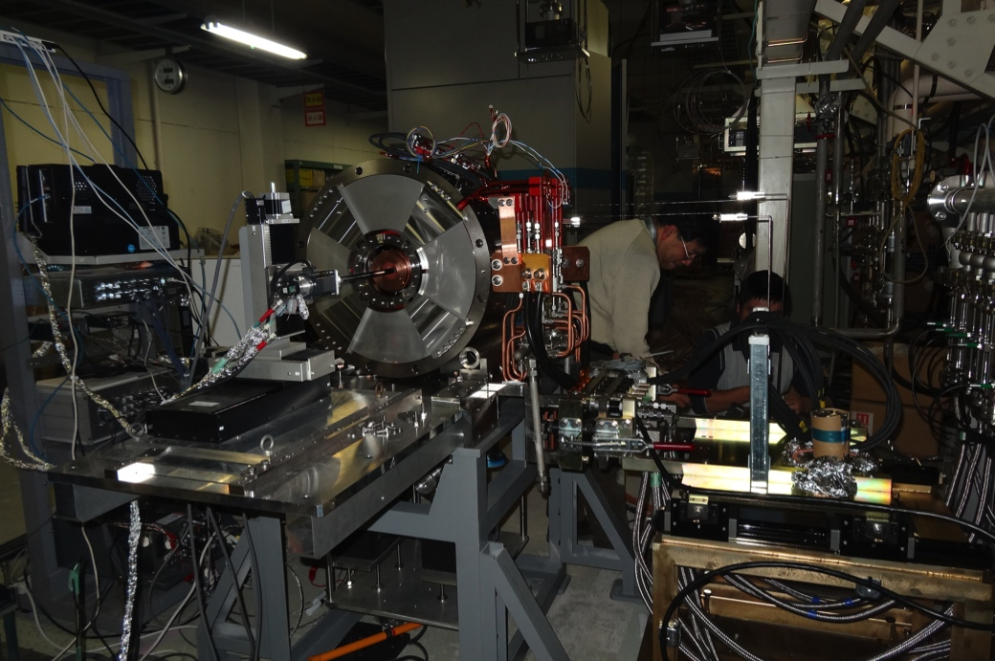
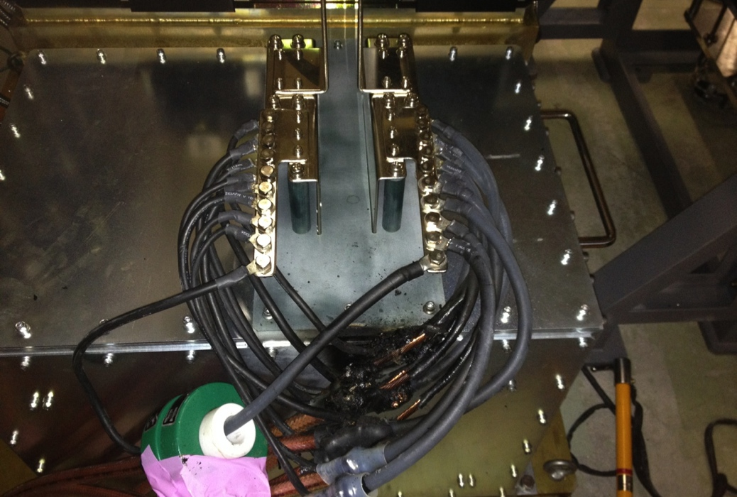
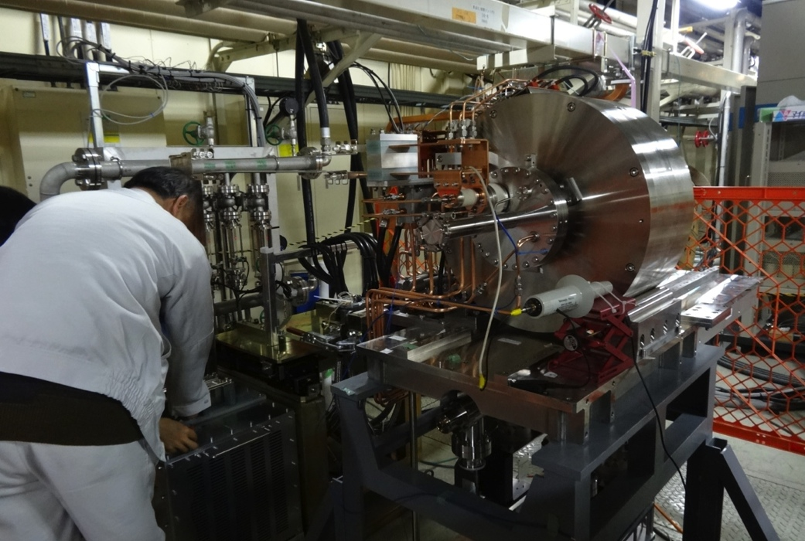
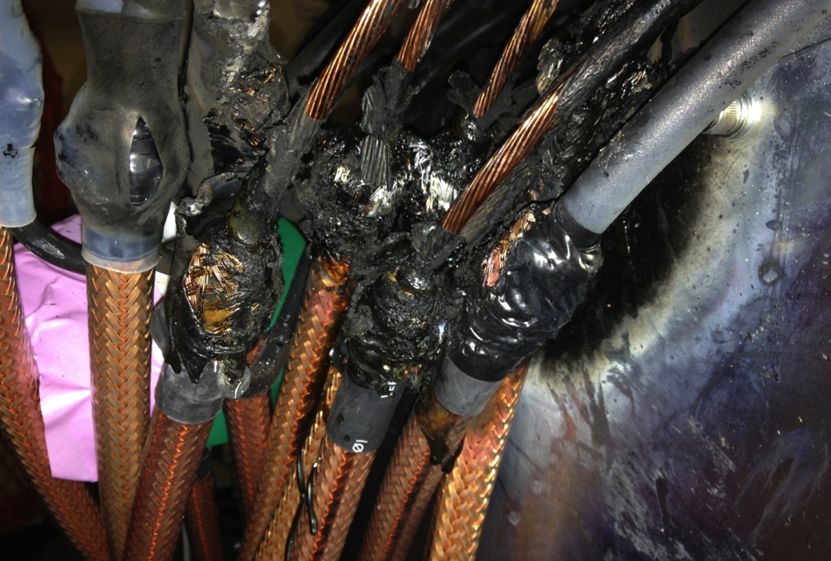
FC 開発 3 号機ぼや Cable 20cm 焼損

Slide 8
SLAC-SuperKEKB Workshop (Injector Linac)
Injector commissioning and issues 30'
  Speaker: Masanori Satoh (KEK)
Photo-cathode RF gun 20'
  Speaker: Takuya Natsui (KEK)
Positron source 30'
  Speaker: Takuya Kamitani (KEK)
Timing synchronization 20'
  Speaker: Hiroshi Kaji (KEK)
Linac alignment 20'
  Speaker: Toshiyasu Higo (KEK)
Beam optics design for simultaneous injection 20'
  Speaker: Takako Miura (KEK)

Slide 9
Questions and Answers
PEDD dependent on beam repetition?
  SLAC study was on single-pulse energy density
    may need further investigation
Fiber loss monitor blackening around target?
  Can be replaced routinely
Diamond loss detector?
  Is worth comparing in the future
Orbit stability tolerance against beam size?
  Pinhole 2mm and beam sigma 0.3mm are possible
  Beam orbit jitter will be studied, as well as for emittance preservation
Rotating target/spoiler?
  Should be studied for the beam current larger
Frequency synchronization btw. linac/ring?
  All SKEKB frequencies are generated from common freq. with ring circumference compensation
Beam charge variation pulse-pulse?
  Can be important
  Technically possible with different event assignment
  Means different injection modes with different orbit stabilization for wakefield
Target quad – pulsed ?
Beam jitter should be small
DR extraction angle jitter
  Offset injection position/angle jitter should be small

Slide 10
BPM 読み出しの技術選択
Beam position monitor (BPM)
  Emittance preservation に重要となる
  ~10μm の要求分解能 (現在の装置は 50~100μm)
Libera と SLAC の技術を基礎とした新規開発
  それぞれ開発・評価中
SLAC の Steve Smith 氏と Andrew Young 氏に Review 依頼
    SLAC – SuperKEKB の協力の枠組み
  Filter 設計、Dual-bunch 信号処理、System 設計に関して詳細な Comment をもらう (may.22-27, jun.15-18.2013.)
  Reviewer は新規開発を選択
詳細設計の改善中
  予算の関係で当初からの全数設置は避けるが、現在のところ、新規開発が性能、価格、運用、保守の全般で有利として、開発中

Slide 11
Laser RF 電子銃 Workshop
ATF, cERL, Linac から計 16 人参加、6+ 件の発表
機構内でも共通技術の交換の可能性がある
低 Emittance はほぼ共通目標であるが、Linac で重要な大電流 + 低エネルギー幅は Unique で、そのための技術交換はあまりなかった
安定度などについて、今後とも情報交換の予定
Web を準備する予定

Slide 12
LAS 加速管 Processing
陽電子捕獲のための大口径加速管
  Large aperture S-band structure (LAS)
Processing に 1 ヶ月以上掛かっていることについて、識者意見を求め、22 人以上の多数の方の参加を得た (Dec.10.2013.)
時間が足りないと思われ、当面の試験運転対策、中期の改善対策について、議論が行われた
  Interlock の改善、Baking は不要・無意味であること、RF monitor 等測定装置が重要であること、等助言を受けた

Slide 13
ビーム光学設計
Pulsed quad の追加 – 同時入射向け
FODO → Doublet – Low emittance
Orbit correction simulation
Emittance preservation
予算の Optimize…

Slide 14
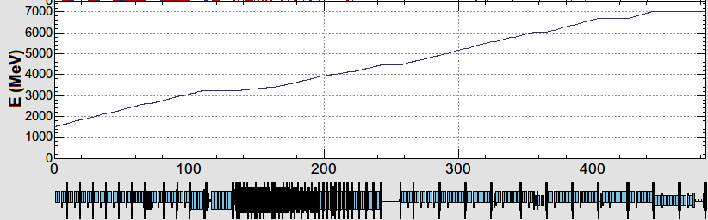
KEK e-/e+ Injector LINAC
B
A
10 nC x 2 (for LER)
5 nC x 2 (for HER)
0.3 nC x 1 (for AR)
0.3 nC x 1 (for PF)
e-/e+ beams are delivered to 4-rings with different current & energy.
Beam acceleration modes must be switched by 50 Hz pulse-by-pulse for top-up injection.
low emittance
RF gun
1.5 GeV e-
1.1 GeV
DR
C
1
2
3
4
5
e+ target
e-:Chicane
HER: 7 GeV e-
5 nC x2
AR: 6.5 GeV e-
4.219 GeV
Decelerate
0.3 nC x1
same energy
e-
LER: 2.5 GeV e+
4 nC x2
e+ target
e+
1.1 GeV
PF: 2.5 GeV e-
0.3 nC x1
1.5 GeV
C
1
2
3
4
5
Beam optics should satisfy the fast beam-mode switching.

Slide 15
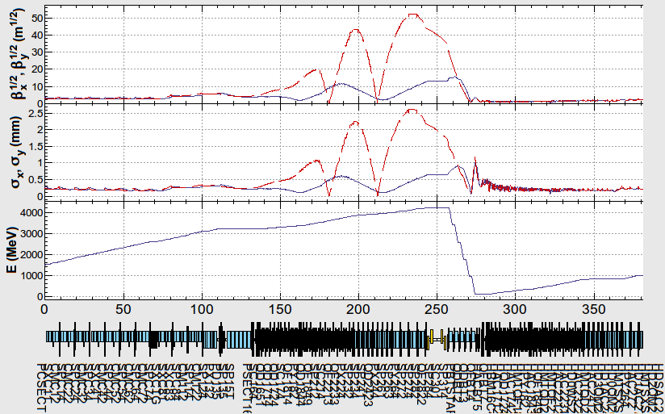
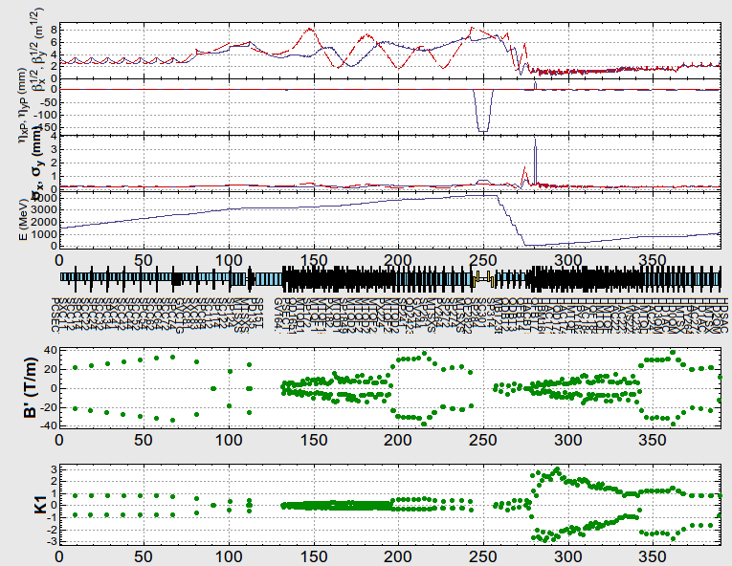
Result of e-p fitting
e-
e+

Slide 16
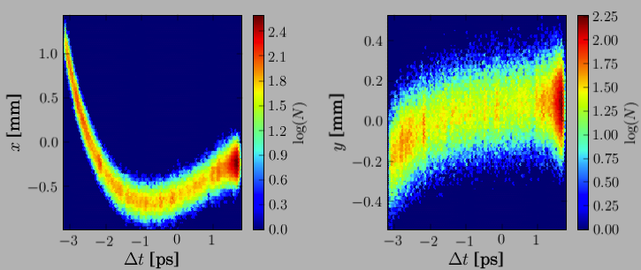
Emittance Preservation
If Device is off center of the beam
  Focusing magnet (quad) kicks the beam bunch
  Accelerating structure (cavity) excites wakefield, to bend the tail
Distorted bunch in banana shape
  Emittance dilution or blow-up
  Depending on the beam optics and the beam charge
Orbit correction is crucial to preserve the emittance
Sugimoto et al.
Beam
Focusing
Magnet
Accelerating
Structure
Transverse distribution in time direction

Slide 17
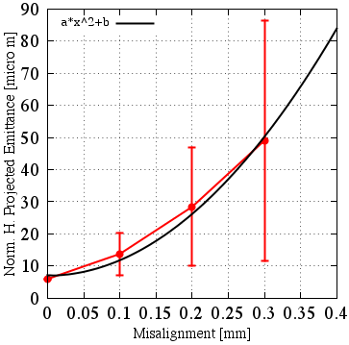
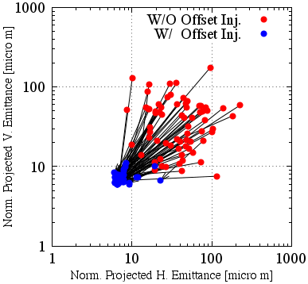
Emittance Dilution
Offset injection may solve the issue
Orbit have to be maintained precisely
Mis-alignment leads to Emittance blow-up
Orbit manipulation compensates it
100 samples
Sugimoto et al.

Slide 18
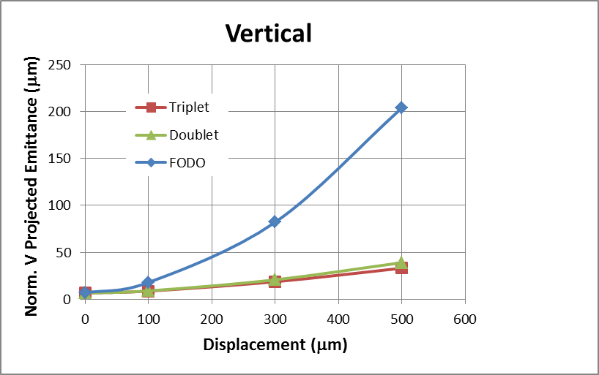
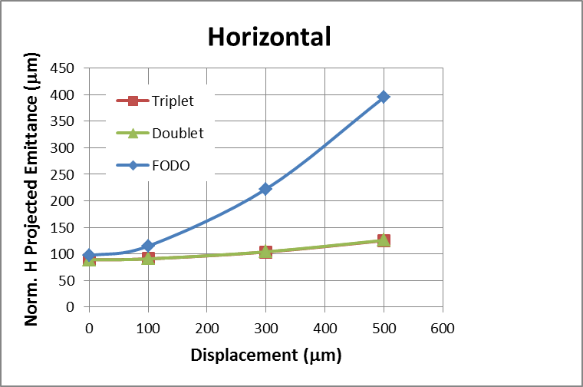
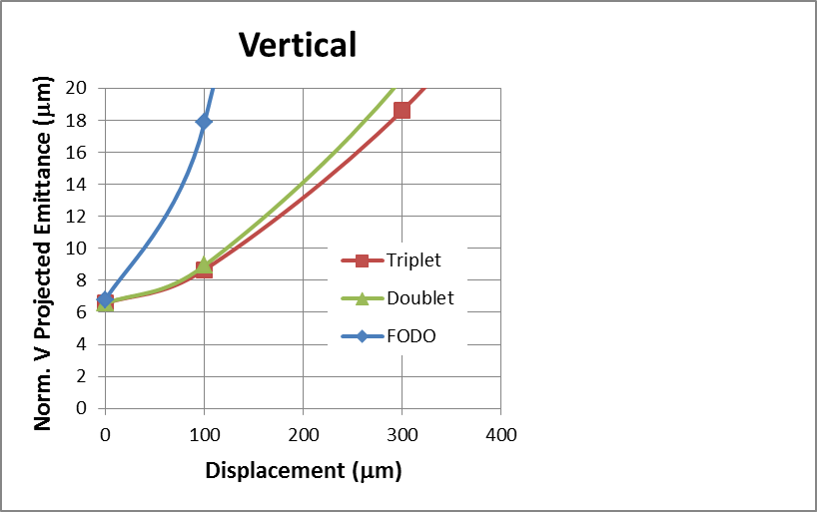
Alignment Error vs. Emittance Growth
<Tracking Condition>
Calculated by H. Sugimoto
Positron is transported from DR outlet to LINAC end.
Alignment error is given in quads and cavities.
The orbit correction is performed by assuming the center of the quads and BPM are exactly the same.
Initial Emittance@Outlet of DR =6.5 μm / 89 μm (Vertical / Horizontal)
Vertical
Horizontal
Zoom
e+ norm. ε at LINAC-end should be less than
20 μm / 100μm ( Ver. / Hor.)
Triplet and doublet give almost same results.
In triplet and doublet, misalignment of 300μm is acceptable.
In FODO lattice, significant emittance growth is seen.

Slide 19
Positron Source
High current positron is required
Positron capturing with flux concentrator (FC) and large aperture s-band structure (LAS)
Deceleration field to reduce satellite bunches
Pinhole beside target for electron beam
Protection system with beam spoilers

Slide 20
陽電子ビームライン建設 – 捕獲部分
SLED
SLED
KLY
1-5
KLY
1-6
target
+FC
LAS : Large Aperture
S-band structure
LAS 14 MV/m
deceleration & phase slip
& acceleration
LAS 10 MV/m
acceleration
Solenoids
primary e- 3.2 GeV, 10 nC x 2 bunch, 50 Hz
tungsten target
AMD system (5.0 T x 200mm + 0.4 T x 15m)
Flux Concentrator DC solenoids
KLY1 2m LAS x 2 (14 MV/m), aperture 2a = 32 -> 30 mm (typical S-band ~20 mm)
KLY2 2m LAS x 4 (10 MV/m), aperture 2a = 32 -> 30 mm
e+ beam energy at capture section exit : 110 MeV
Deceleration capture
e+ yield: N(e+)/N(e-) = 49 % at 1.1 GeV DR

Slide 21
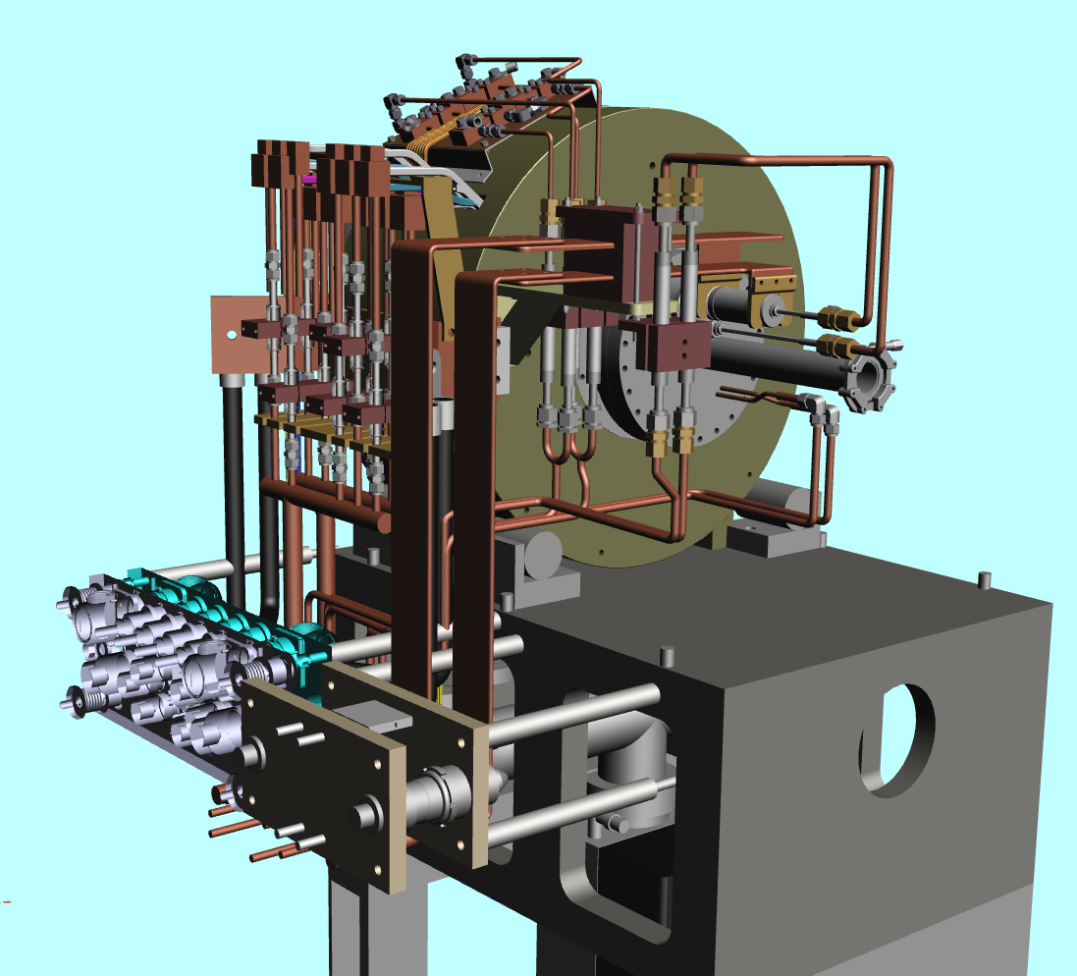
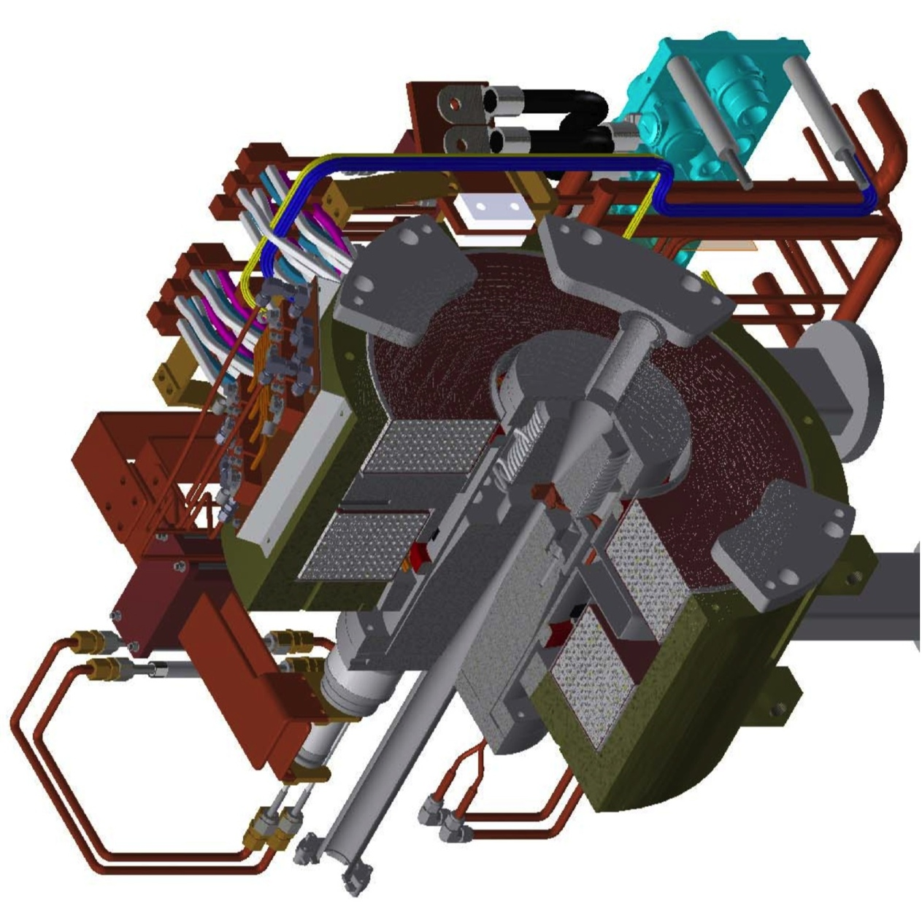
Flux Concentrator Assembly
FC assembly
primary
e- beam
positron
production
Target
quick detachable power & water connection
to minimize worker's radiation dose
Flux
Concentrator
Bridge
Coils
e+ beam

Slide 22
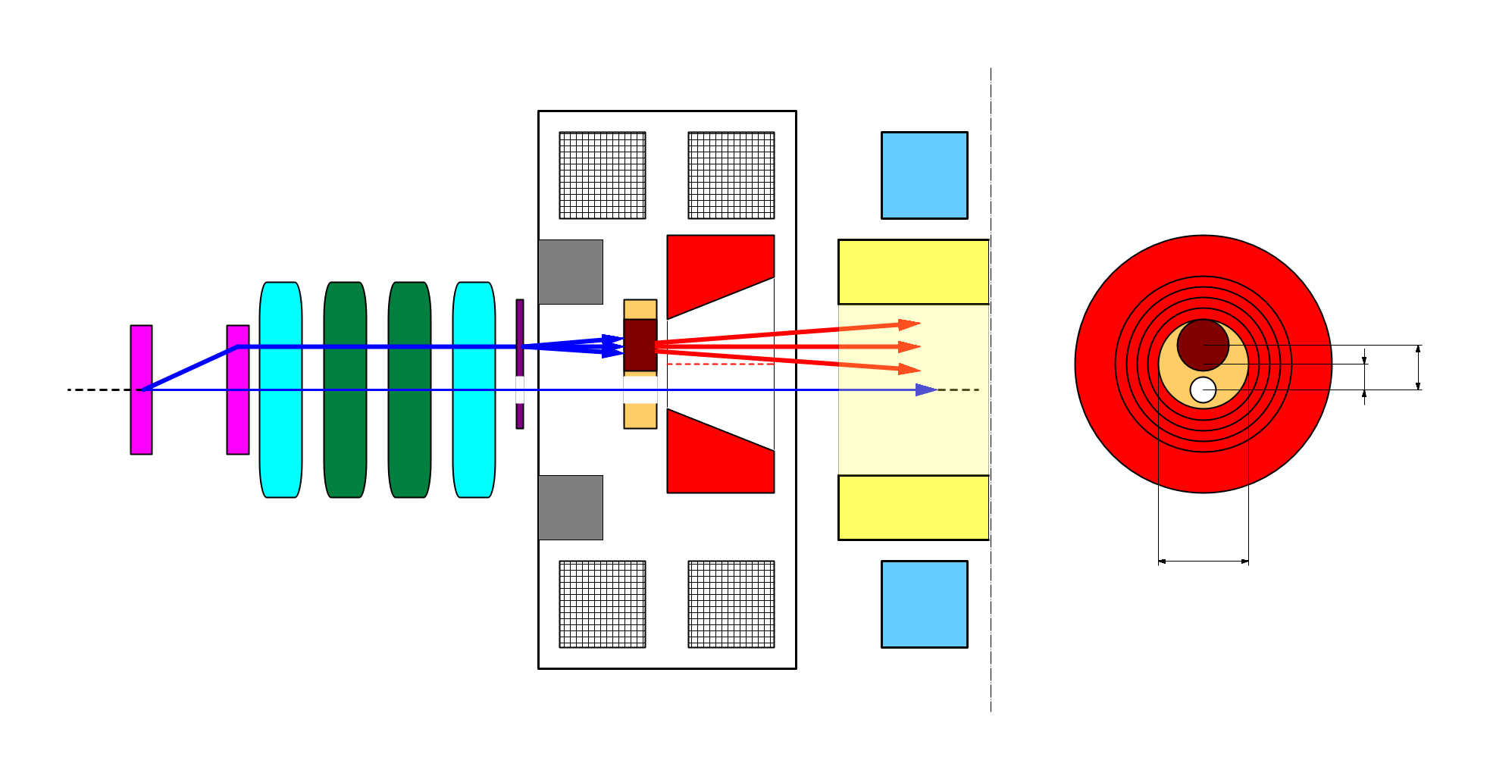
e+/e- beam switching at target
side view
bridge coils
rear view
solenoid
target
diameter
4.0 mm
10 nC
primary e-
DC QM
LAS Accel.
structure
spoiler
target
offset
3.5 mm
target
e+
beam
hole
5 nC injection e-
2.0 mm
FC offset
hole
diameter
2.0 mm
Flux
Concentrator
pulse ST
7.0 mm
FC aperture
pulse QM
Two possible schemes of beam switching by orbit bump
e+ on-axis, e- offset
-> e- emittance growth by solenoid kick induced orbit
e- on-axis, e+ offset
-> e+ yield degradation (50% -> 10%)
we take this scheme.
T.Kamitani

Slide 23
RF 電子銃開発
A1 電子銃 (GR_A1) の試験が進行中
  擬似進行波型空洞や Ir2Ce 陰極、Yb Fiber laser など、今年度の大きな進展
  Energy 幅・安定度制御のための Laser 光時間構造制御を行う必要がある
  その前に Beam 開発用の Beam 供給とその安定化が重要
  陽電子生成用の一次電子も当面 RF 電子銃で生成するが、熱電子銃も捨てず、得失をよく検討する
  新規開発の Component が多いので、経験の積み重ねが重要と思われる

Slide 24
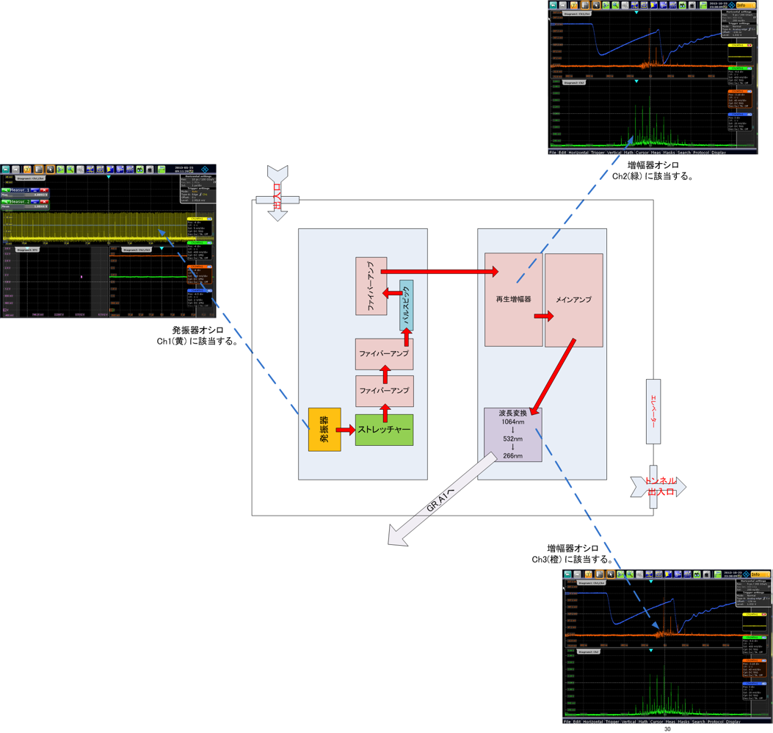
RF Gun GR_A1 Overall Structure
Regenerative Amplifier
Oscillator
Multipass Amplifier

Slide 25
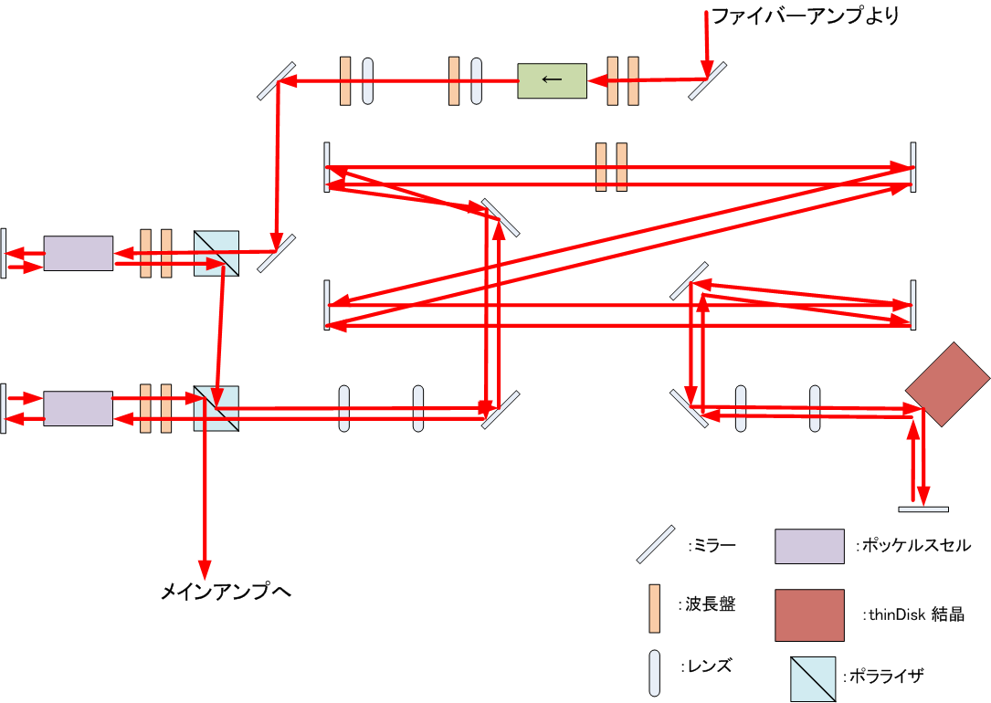
Regenerative Amplifier

Slide 26
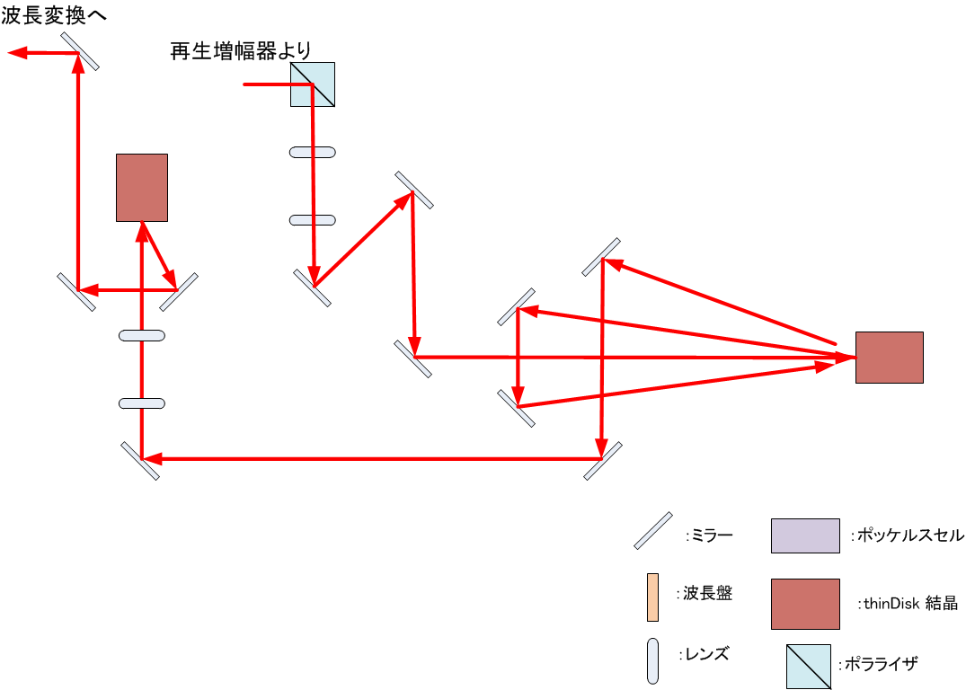
Multipass Amplifier

Slide 27
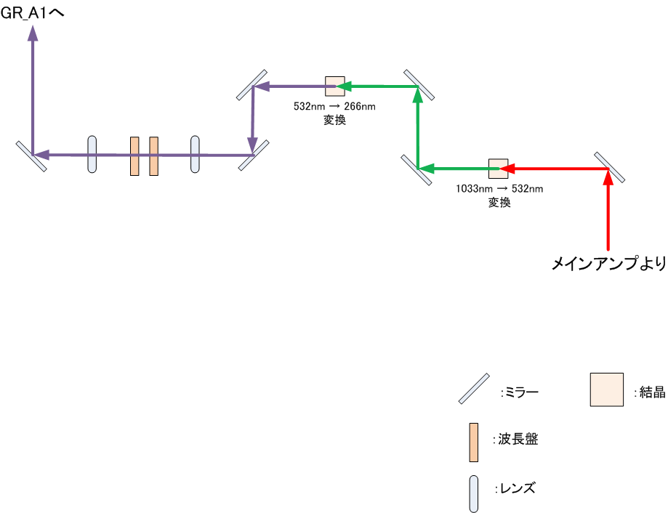
Quadruple Frequency

Slide 28
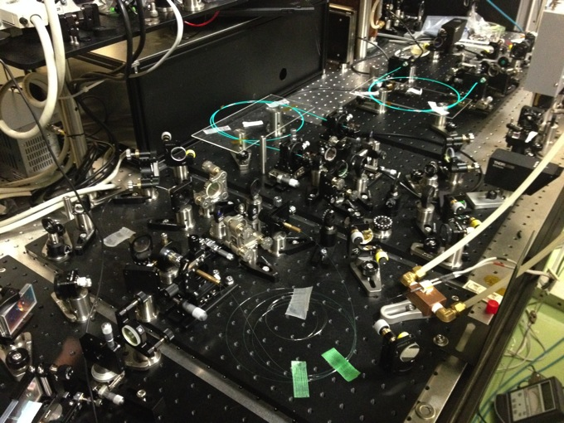
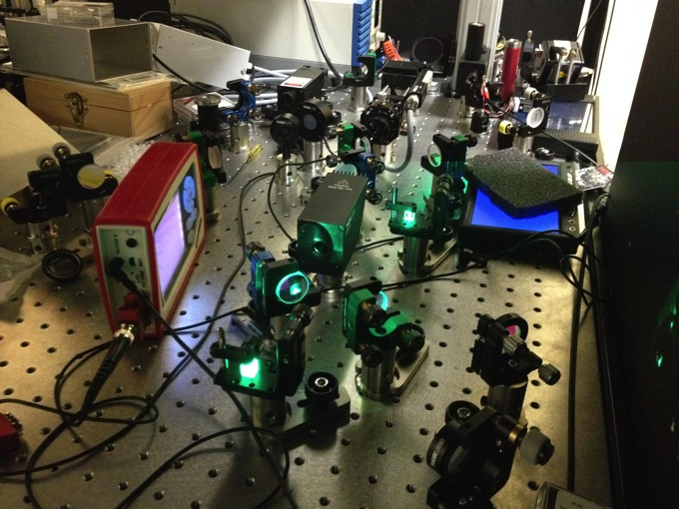
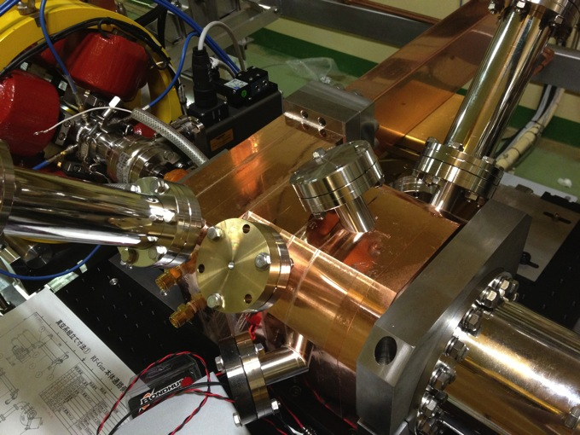
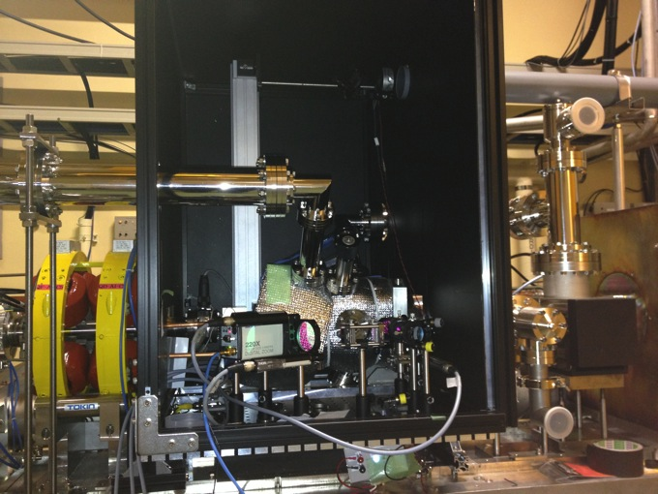

Slide 29
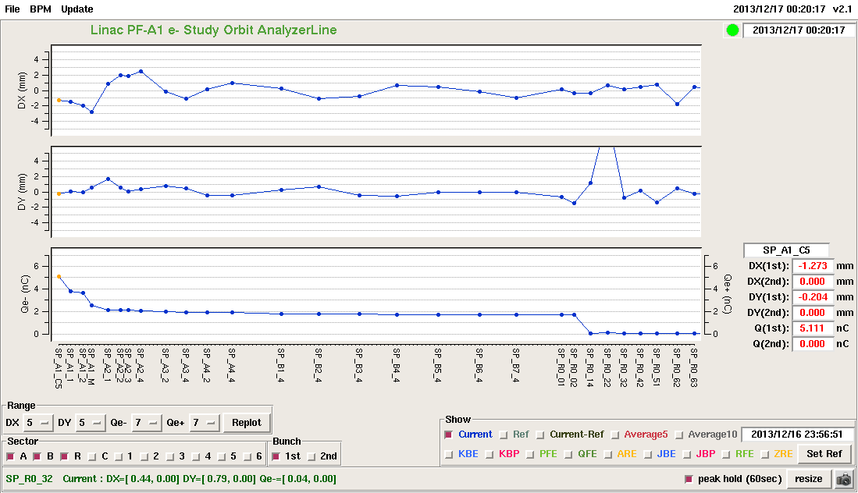
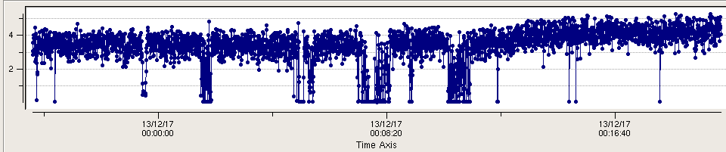
GR_A1 : 5.1 nC / bunch
Vertical position /mm
Charge /nC
Charge Trend / Stability

Slide 30
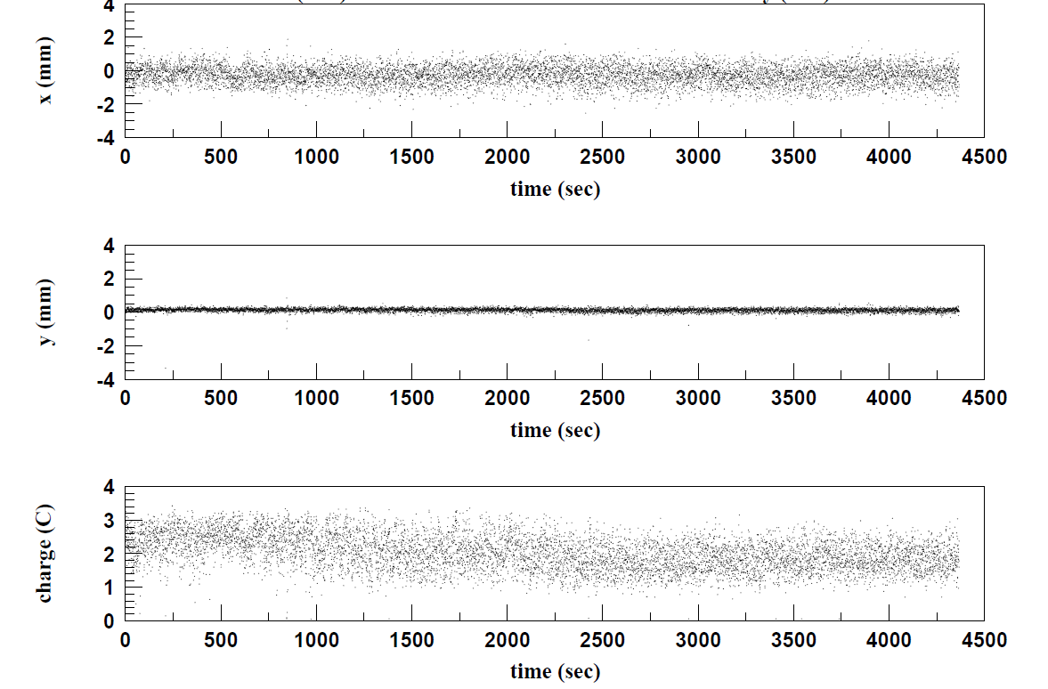
Beam Trend / Stability

Slide 31
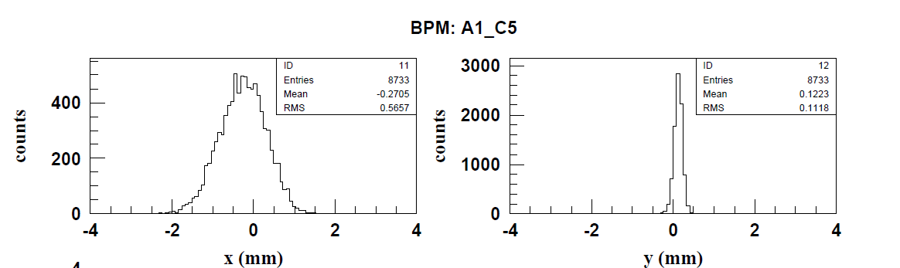
Horizontal / Vertical stability

Slide 32
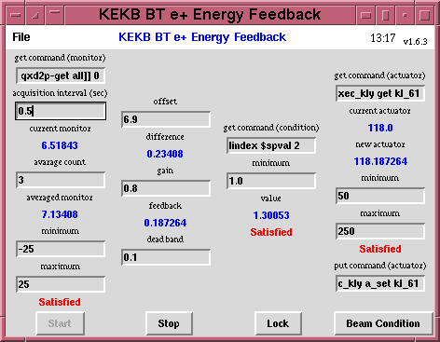
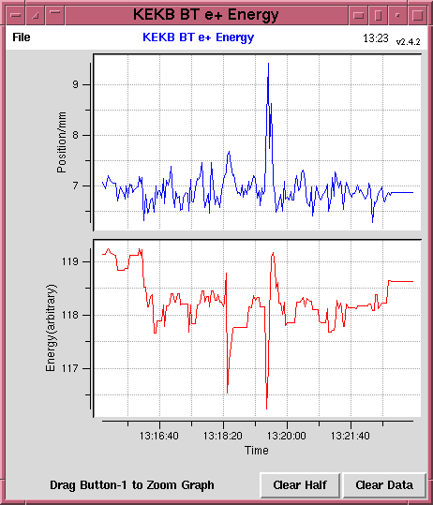
Virtual Accelerator-based Controls
Dual-layer Controls
Multiple closed loops were installed on each PPM VA independently
  Tested at KEKB
e⁻ Gun
e– BT (PF: 2.5GeV, 0.1nC)
ARC
PF Injection
e⁺ Target
Event-based Control System
e⁻ Gun
ARC
KEKB-LER Injection
Primary e– (4GeV, 10nC)
e⁺ BT (KEKB: 3.5GeV, 0.6nC)
e⁺ Target
e⁻ Gun
ARC
KEKB-HER Injection
e⁺ Target
e– BT (KEKB: 8GeV, 1.2nC)

Slide 33
Event-based
Control System
Four PPM VAs at least
for SuperKEKB project
(maybe with
additional PPM VA
for stealth beam)
Every
20 ms
F.B
e⁻ Gun
F.B
ARC
PF Injection
e– (2.5GeV, 0.2nC)
F.B
e⁻ Gun
Damping ring
SuperKEKB-LER Injection
F.B
ARC
e– (3.5GeV, 10nC)
F.B
e⁺ Target
e⁺ (4GeV, 4nC)
e⁻ Gun
ARC
SuperKEKB-HER Injection
F.B
F.B
e– (7GeV, 5nC)
e⁻ Gun
F.B
ARC
PF-AR Injection
e– (6.5GeV, 5nC)

Slide 34
System Construction
Display and Analysis
EPICS Controls
Multiple
Independent PPM Parameters
Common Parameters
Multiple
Multiple
Event Synchronous Controls
PPM
Virtual Accelerators
Simulation
Virtual Accelerators
Real Accelerator

Slide 35
e- beam
Bunch compression @ J-ARC
Offset injection
@ Sector C-5
BNS damping
@ Sector A-B
High precision monitor
20 mm⋅mrad, 0.08% energy spread, 5 nC, two bunch
Component Alignment
& BBA
Uniform longitudinal beam distribution
e- RF gun
(5 nC)

Slide 36
e+ beam
Damping ring operation
Timing system
/Bucket selection
Large aperture
S-band structure
20 mm⋅mrad, 0.07% energy spread, 4 nC, two bunch
Flux concentrator
Component Alignment
& BBA
e- RF gun
(10 nC)

Slide 37
まとめ
(2015 年に目標を達成する) 建設計画からは一部遅れている部分があるが、現在のところ概ね期待どおり
震災復旧も順調 (ただし作業負荷は高くなっている)
昨年は小さな障害が多かったが、今年は少し大きめの障害が少数
最終的に達成すべき目標 Beam quality 達成と、2015 年から運用する当面の Beam の供給を、Balance よく計画する
資源が厳しいので、2015 年までの開発に固執せず、安全に配慮し、最適な選択肢を選び、ひとつずつ開発項目をこなしていく

Slide 38
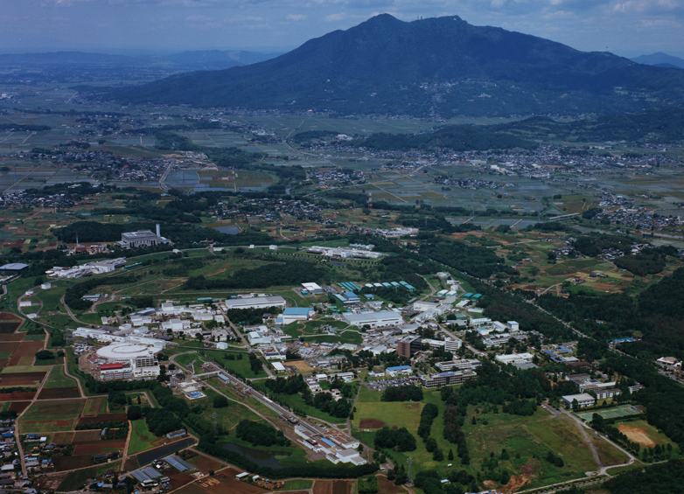
Mt. Tsukuba
Thank you
SuperKEKB
dual rings
PF-AR
PF
Injector
Linac

Slide 39
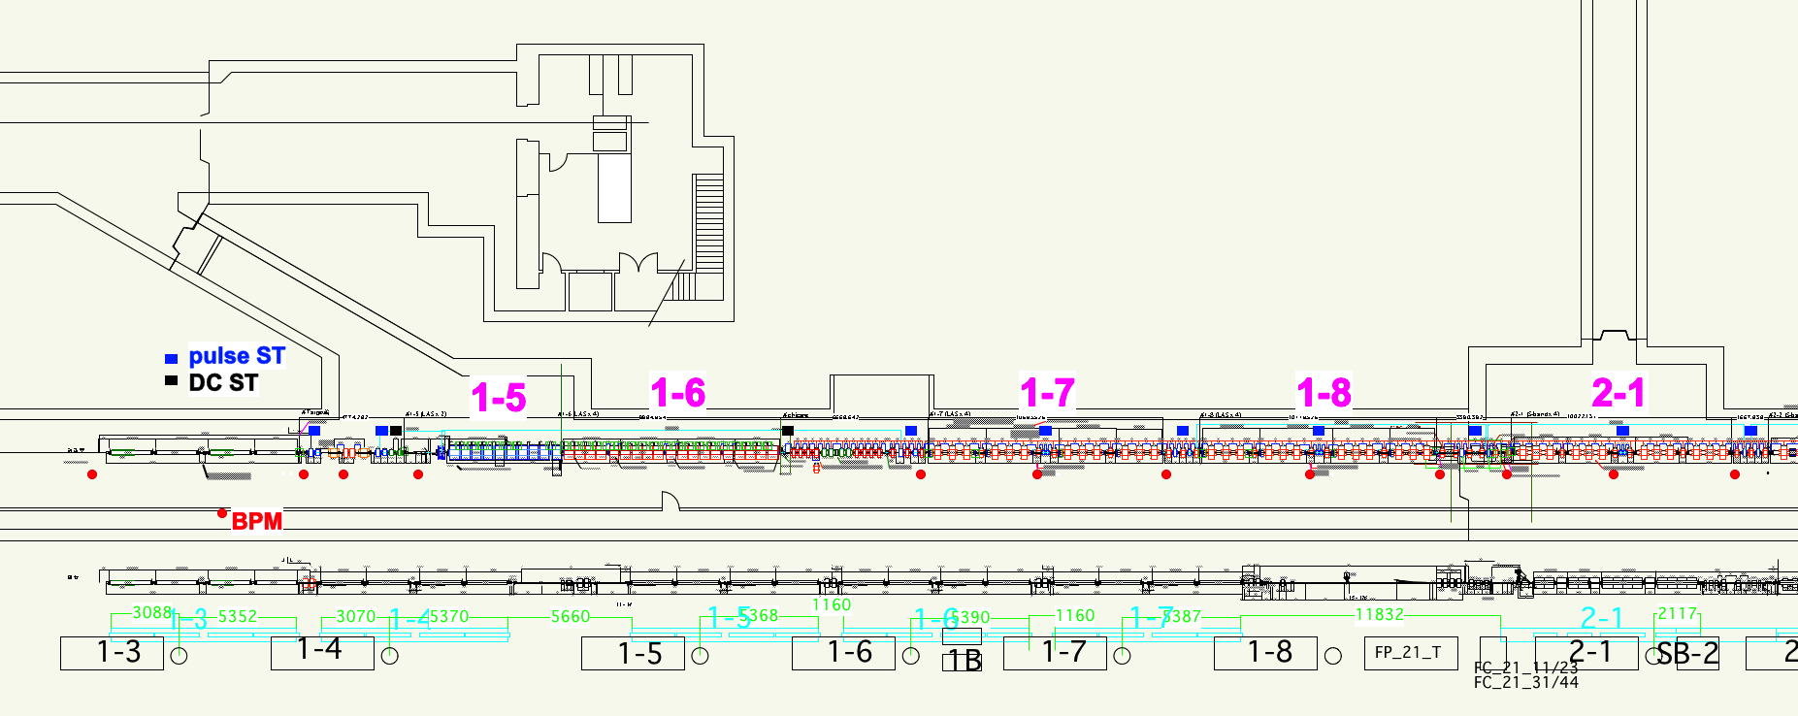
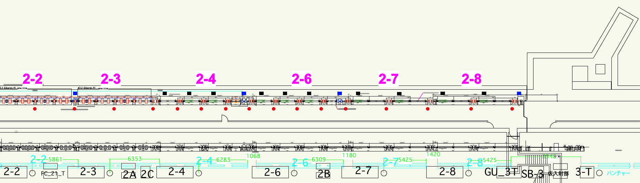
ビームライン詳細
陽電子ター
ゲットから
LTR まで
地下と地上
の摺合わせ
各機器の最
終調整と発
注
matching
section
e+ capture section

Slide 40
まとめ
2 年後の MR 入射コミッショニングに向け、ひとつの Milestone は越えた
震災の影響の懸念をある程度払拭した
SuperKEKB のビーム仕様を満たすための試験の準備が整ってきた
まずは T=0 の 1nC ビームのエミッタンスとエネルギー幅を満足し、さらに大電流ビームのビーム特性達成を目指す
  そのために、機器の安定度向上、ビーム・マイクロ波・タイミング測定、大電流加速、ビーム安定化機構、特にエミッタンス・エネルギー幅制御の確立、などをひとつずつ段階を踏んで進めて行く

