Slide 1
Progress of KEK Electron/Positron Injector Linac
Mitsuhiro Yoshida
Injector Linac, KEK

Slide 2
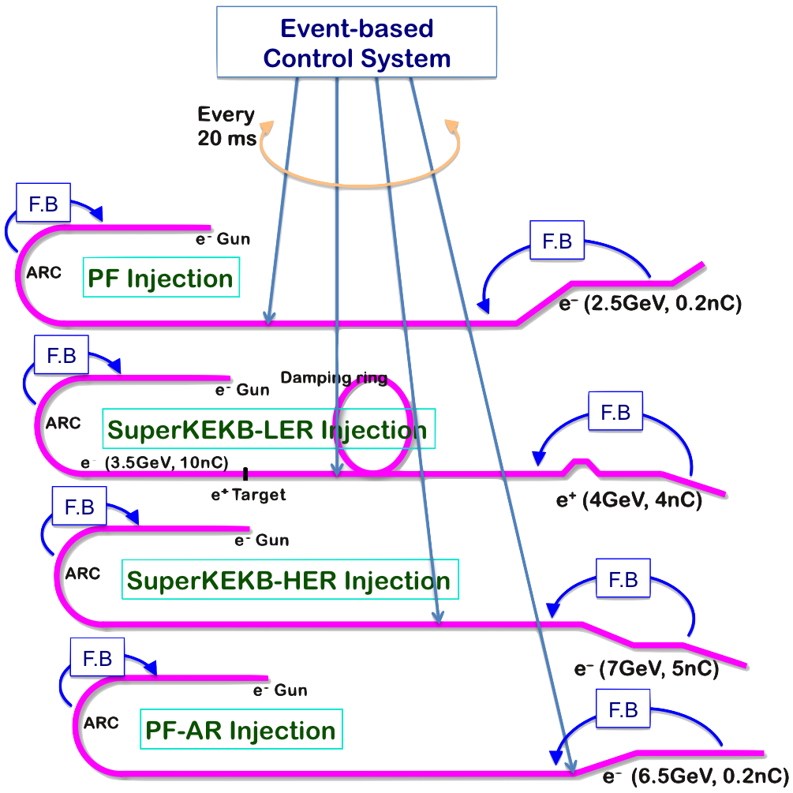
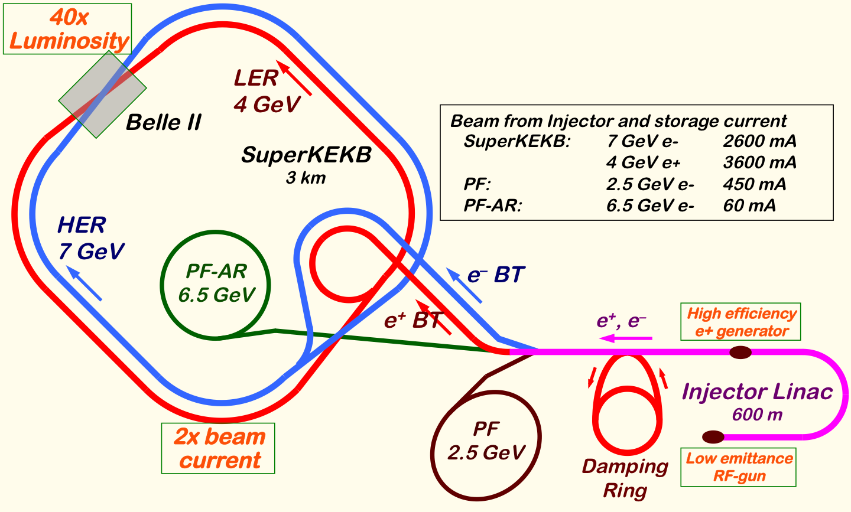
Mission of Electron/positron Injector in SuperKEKB
Injector Linac Mission
For 40-times higher luminosity in SuperKEKB collider
Low emittance & low energy spread injection beam with 4-5 times more beam current
New high-current photo-cathode RF gun
New positron capture section
Damping ring construction
Optimized beam optics and correction
Precise beam orbit control with long-baseline alignment
Simultaneous top-up injection to DR/HER/LER/PF/PFAR
Balanced injection for the both photon science and elementary particle physics experiments
The single injector would behave as multiple injectors to multiple storage rings by the concept of virtual accelerator
Notes:
Higher Injection Beam Current
To Meet the larger stored beam current and shorter beam lifetime in the ring
4~8-times larger bunch current for electron and positron
Reconstruction of positron generator, etc
Lower-emittance Injection Beam
To meet nano-beam scheme in the ring
Positron with a damping ring
Electron with a photo-cathode RF gun
Emittance preservation by alignment and beam instrumentation
Quasi-simultaneous injections into 4 storage rings
SuperKEKB e–/e⁺ rings, and light sources of PF and PF-AR
Improvements to beam instrumentation, low-level RF, controls, timing, etc

Slide 3
Required injector beam parameters
Stage | KEKB (final) |  | Phase-I |  | Phase-II |  | SuperKEKB (final)
Beam | e+ | e– | e+ | e– | e+ | e– | e+ | e–
Energy | 3.5 GeV | 8.0 GeV | 4.0 GeV | 7.0 GeV | 4.0 GeV | 7.0 GeV | 4.0 GeV | 7.0 GeV
Stored current | 1.6 A | 1.1 A | 1 A | 1 A | – | – | 3.6 A | 2.6 A
Life time (min.) | 150 | 200 | 100 | 100 | – | – | 6 | 6
Bunch charge (nC) | primary e- 10 → 1 | 1 | primary e- 8 → 0.4 | 1 | 0.5 | 1 | primary e- 10 → 4 | 4
Norm. Emittance (γβε) (μrad) | 1400 | 310 | 1000 | 130 | 200/40 (Hor./Ver.) | 150 | 100/15 (Hor./Ver.) | 40/20 (Hor./Ver.)
Energy spread | 0.125% | 0.125% | 0.5% | 0.5% | 0.16% | 0.1% | 0.16% | 0.07%
Bunch / Pulse | 2 | 2 | 2 | 2 | 2 | 2 | 2 | 2
Repetition rate | 50 Hz |  | 25 / 50 Hz |  | 25 / 50 Hz |  | 50 Hz
Simultaneous top-up injection (PPM) | 3 rings (LER, HER, PF) |  | No top-up |  | Eventually |  | 4+1 rings (LER, HER, DR, PF, PF-AR)

Slide 4
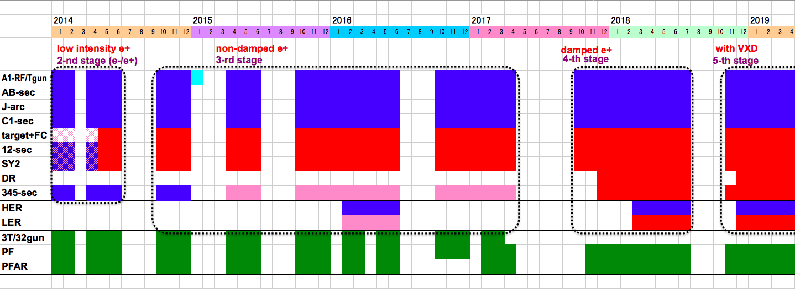
Linac Schedule Overview as of Jun.2017
Schedule
Long (5-month) shutdown for the first time in SuperKEKB project
9-month shutdown in 1997 during KEKB
DR construction, resource availability, etc
Installation of many important components during this shutdown
Time →
Location
↓
Beam Licenses in steps
Low Emittance Beams
4+1 Ring
Injections
DR Commiss.
1 nC
Phase1
2 nC
Phase2
4 nC
Phase3
Without Top-up
Direct PF-AR BT
: Electron
: Positron
: Low current electron

Slide 5
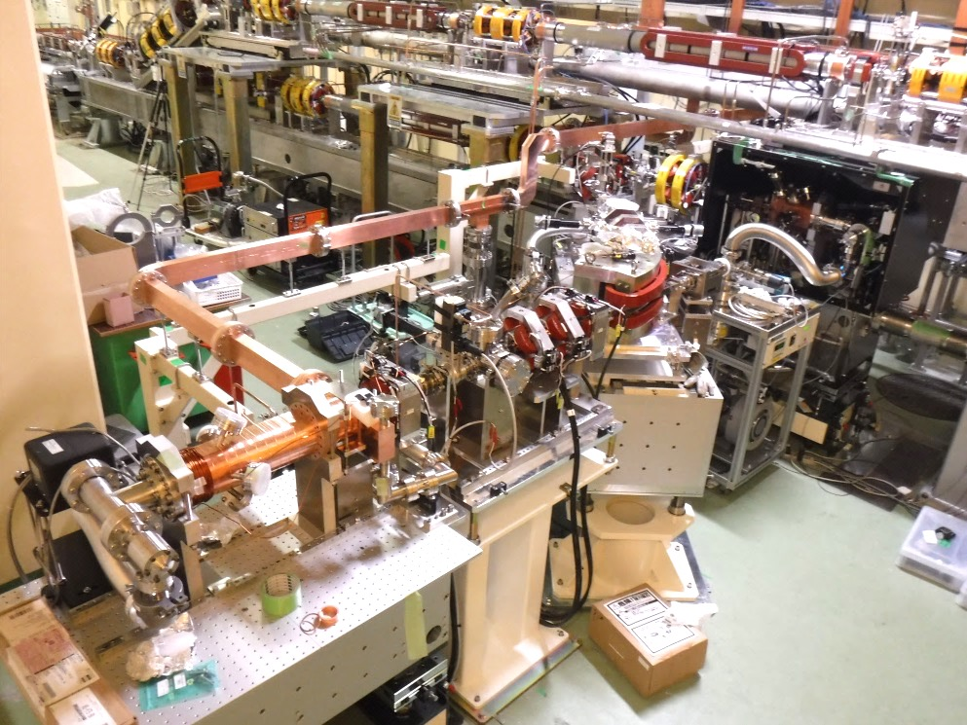
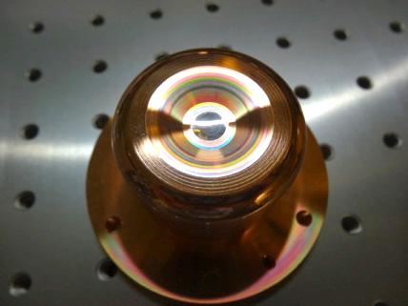
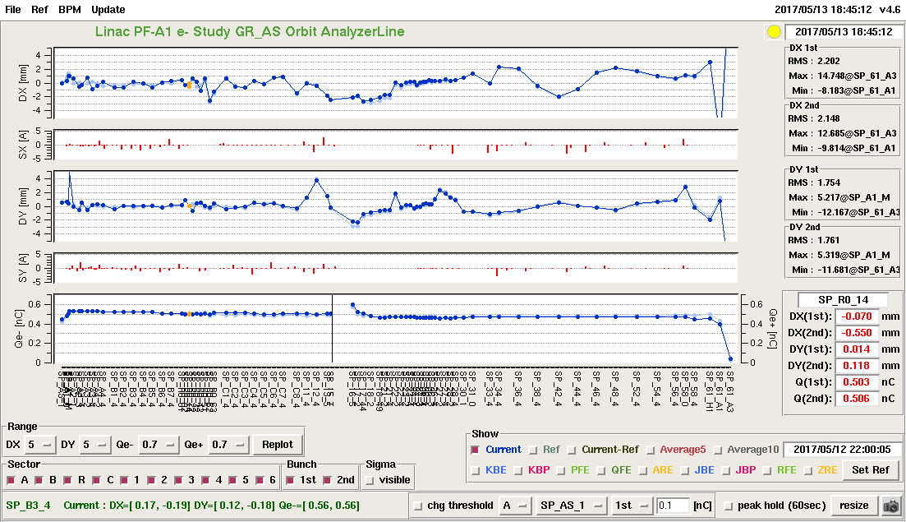
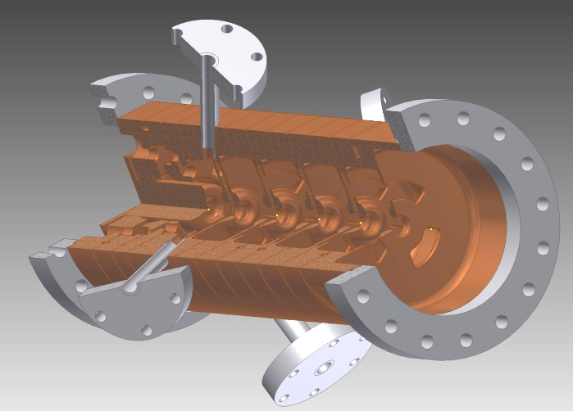
Progress of Photo-cathode RF Gun
Photo-cathode RF Gun
Yoshida et al
Succeeded in injection during SuperKEKB Phase-1 commissioning for 11 days
Employs Yb-doped-fiber and Nd/Yb:YAG laser, Ir5Ce or Ir2Ce cathode, QTWSC or cutdisk structures
Secondary RF gun was constructed for availability with Ir2Ce and cutdisk
Thermionic gun
Primary RF gun
New secondary RF gun
IrCe Cathode
Cutdisk cavity
Beam orbit measurement

Slide 6
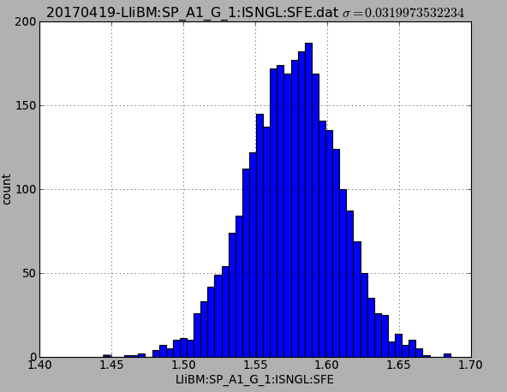
Photo-cathode RF gun: Laser
Yb:Fiber + Nd:YAG multi-pass amplifier
Nd.YAG Φ2mm
×2pass
Nd.YAG Φ4mm
×8pass
1.57 +/-0.032 nC
Fiber Amp
~30 μJ
E.O.
Pockels Cell
Nd.YAG Φ4mm
×4pass
~700 μJ
SHG
FHG
Nd.YAG Φ4mm
2 mJ
1.0 mJ
200 μJ
Beam charge stability
Stable laser system for Phase-II.
2 nC, 2 bunch stable operation will be expected. (2-bunch operation was already demonstrated.)
Two oscilllator (one will be commercial oscillator).
Two amplifier lines.
Spatial filter for one amplifier line.

Slide 7
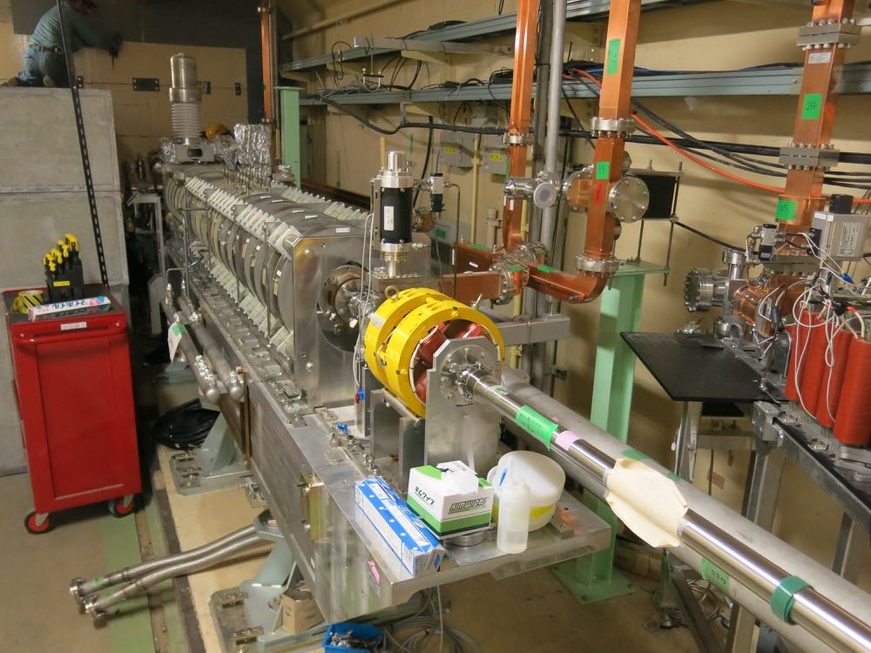
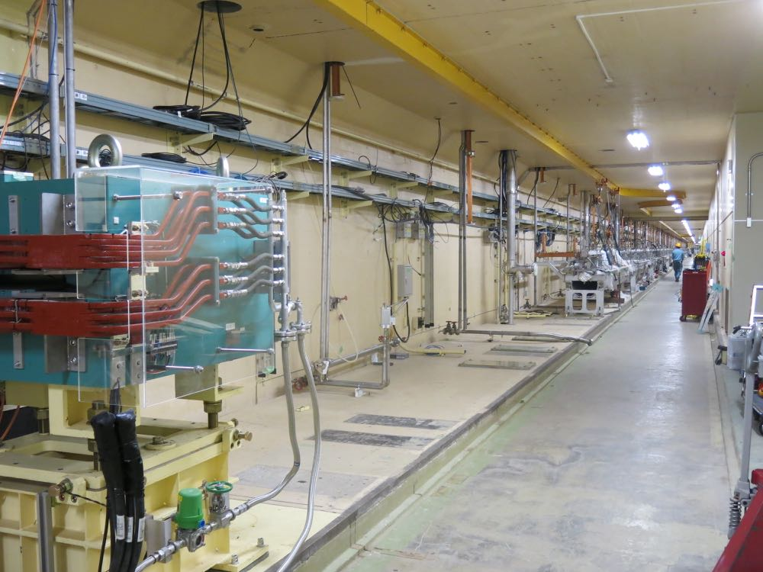
Removal of temporary pre-injector (3T/32RFgun)
KEK e+/e- linac has been divided into two regions by a wall at 3T.
3T/32 pre-injector has been used for PF, AR injection during upgrade construction and initial beam commissioning in linac upstream region.
3T/32 pre-injector is removed in May 2017 for DR commissioning.
a regular accelerator module (3-2) is installed in this region for injection beam energy margin.
AT/A1 pre-injector is used for all the storage rings (HER, LER, PF, AR) after autumn 2017. They share the same fate in case of linac troubles.
PF, AR beam operation from October.
DR commissioning from December 2017.
wall
3T pre-injector
32 pre-injector
After the wall and
3T/32 pre-injector
removal, linac tunnel
is united as one.

Slide 8
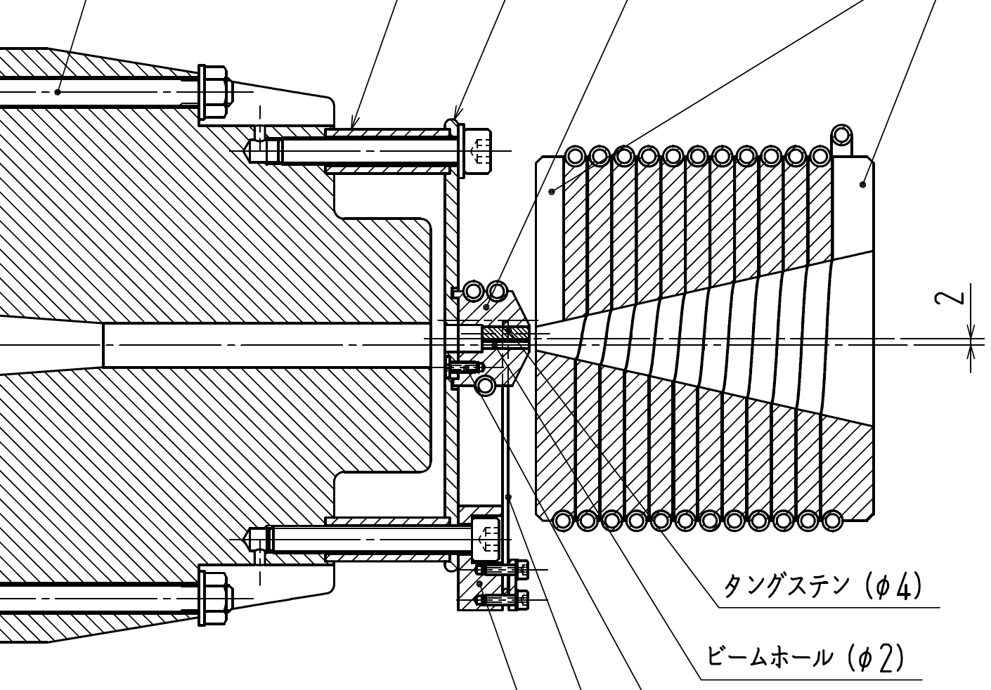
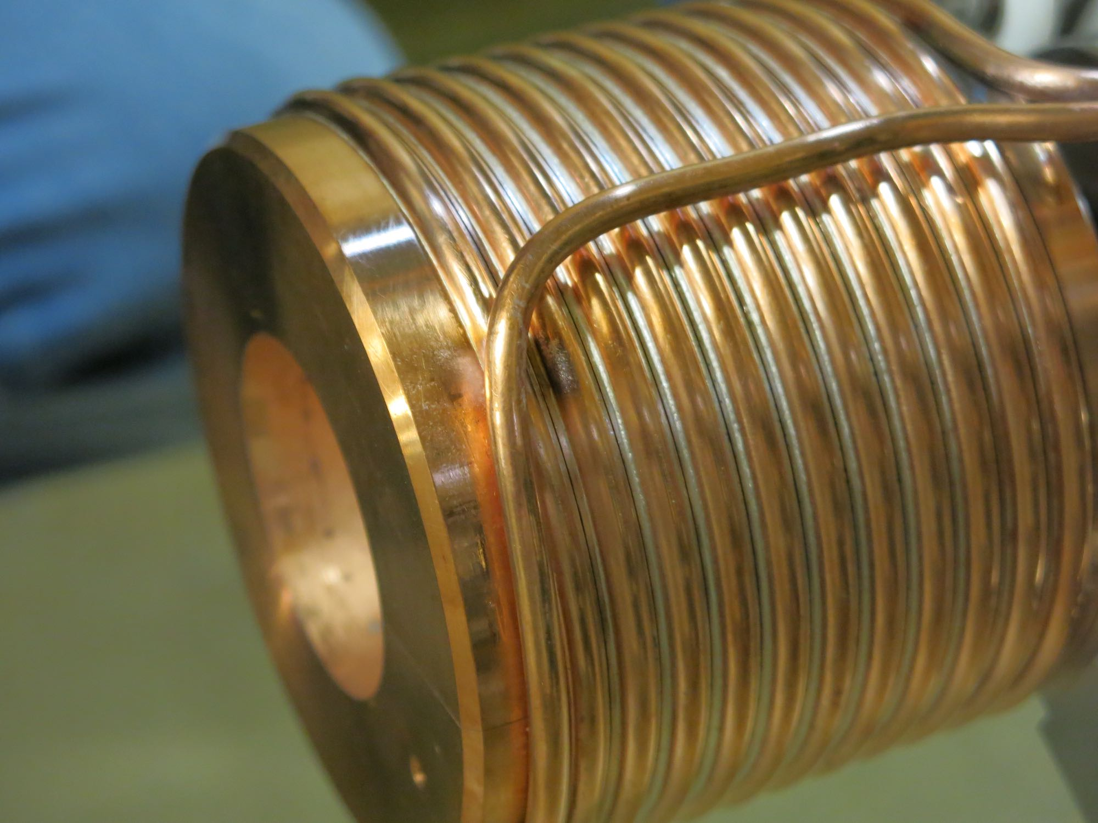
Positron Source status
Breakdown problem in Flux Concentrator during 2017 April operation after beamline installation (Though we had no problem during test-stand operation at full-spec current.)
No e+ beam operation during April-May run.
Inspection of damaged FC
cooling down of residual-radiation since May 15
removal of FC base part from e+ station in June
visual search for damaged part
detailed inspection in August
recovery trial
Re-installation or replacement to spare FC in August for 2017 autumn run & Phase-2 run. (During these period, operation current will be around half of the spec.)
Manufacturing of next FC assembly on-going for stand-alone test and investigation of the breakdown issue for Phase-3 operation.
Target
Flux
Concentrator
return
yoke

Slide 9
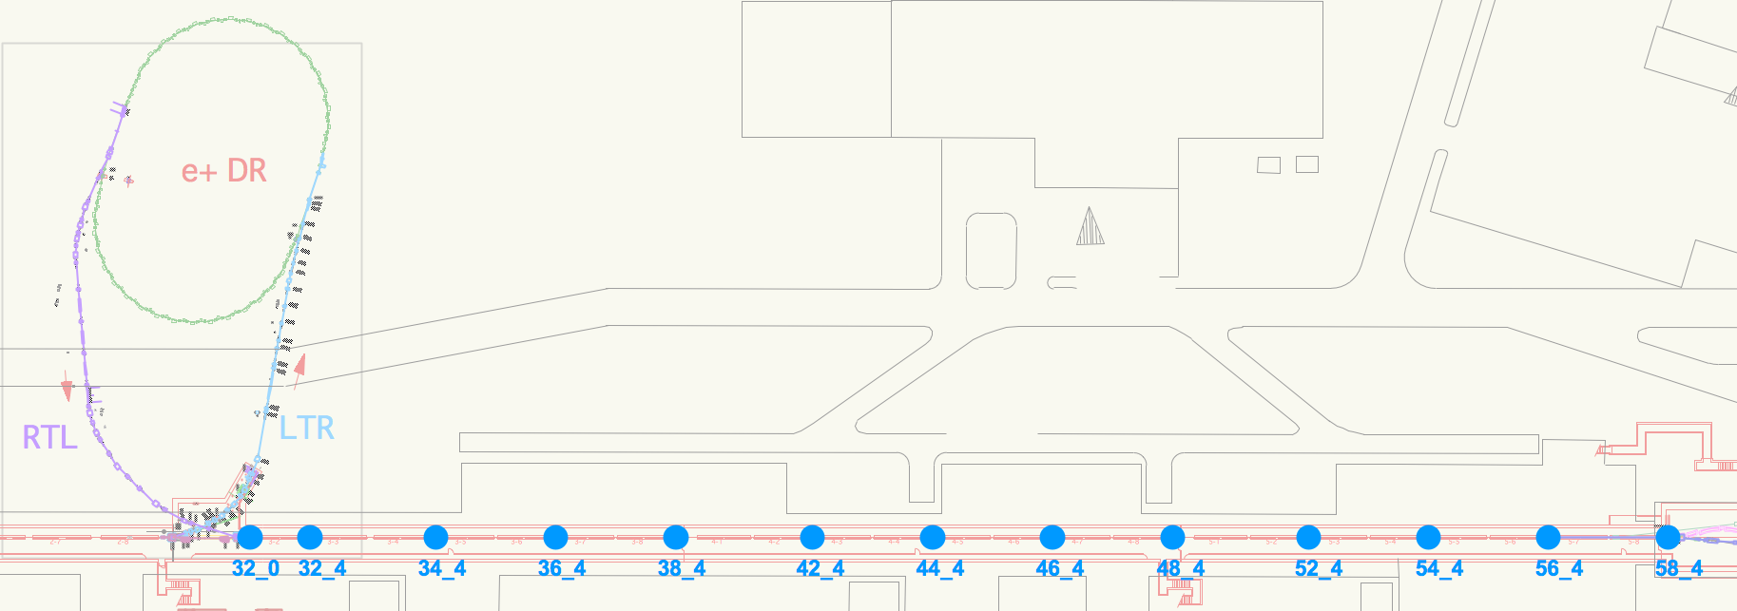
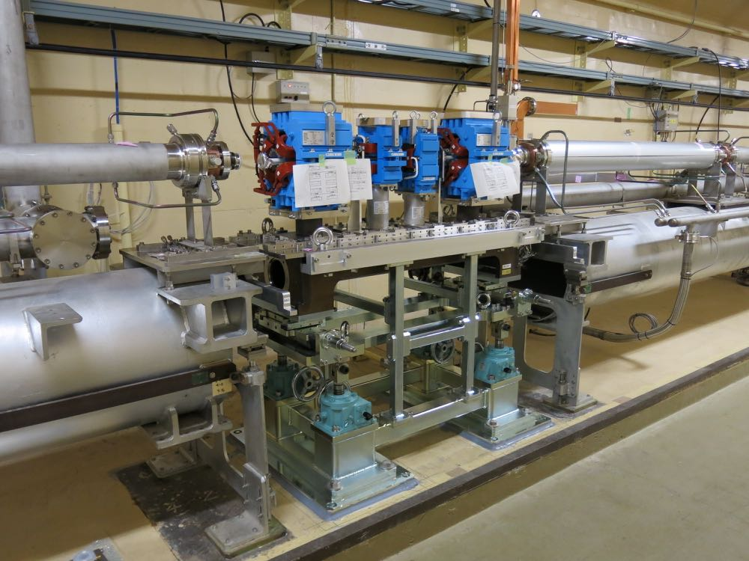
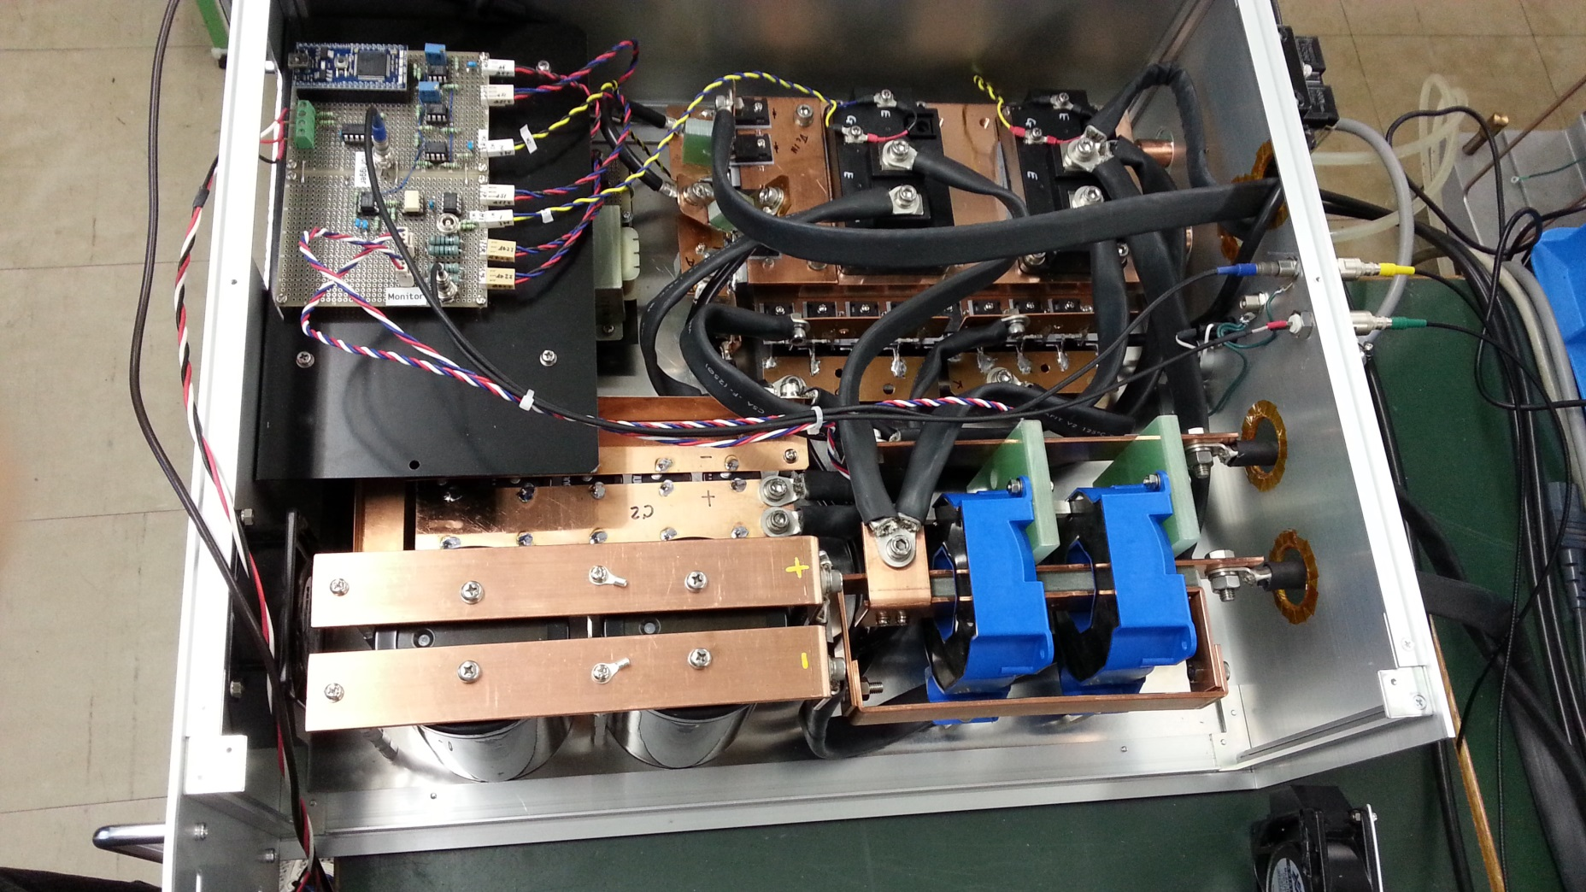
Pulse magnet system
For pulse-by-pulse beam-mode switching and independent optics/orbit tuning, pulse magnet system is introduced.
All the quads in Sector-3, 4, 5 are replaced by pulse-Qs and pulse-steerings are introduced.
AT/A1 pre-injector merger line bends are replaced from DC to pulse magnets.
Pulse magnets installation completed.
Pulse power supply setting-up on-going.
Test operation of pulse magnet system in September.
Beam commissioning with pulse magnet system start in October 2017.
Pulse magnets (Q+ST+ST+Q)
Pulse current driver

Slide 10
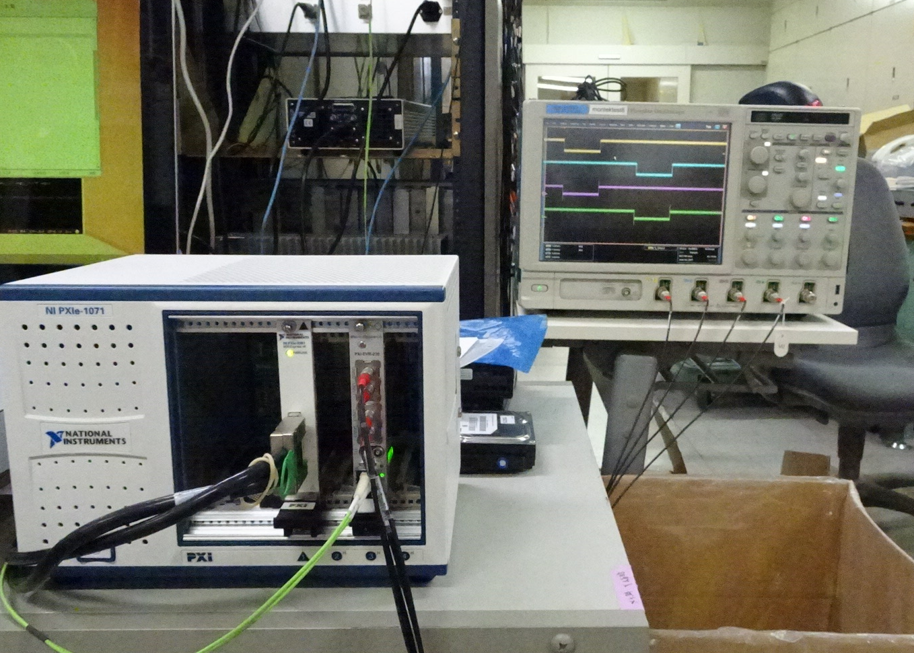
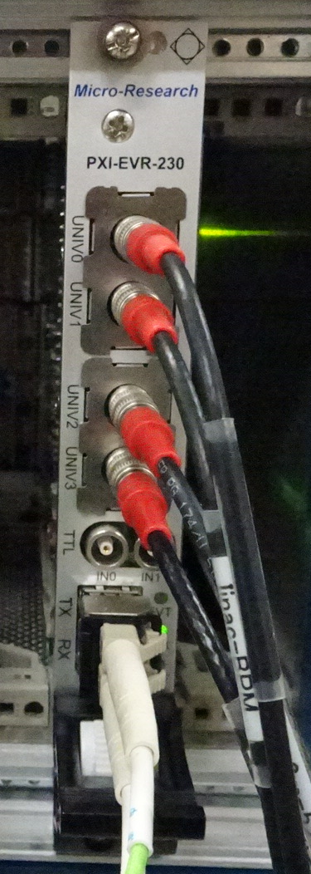
Event timing controls for pulsed quad & steering magnet controls
MRF PXI-EVR-230 was added
Control software is based on:
Windows 8.1 Professional
EPICS base R3.14.12.6 for EVR control
LabView for DAC/ADC control
Satoh, Enomoto et al.
Device driver for cPCI-EVR-300 (Swiss FEL) was modified for our card
Fundamental functions can already work well.
Data buffer functionality is now under implementation.

Slide 11
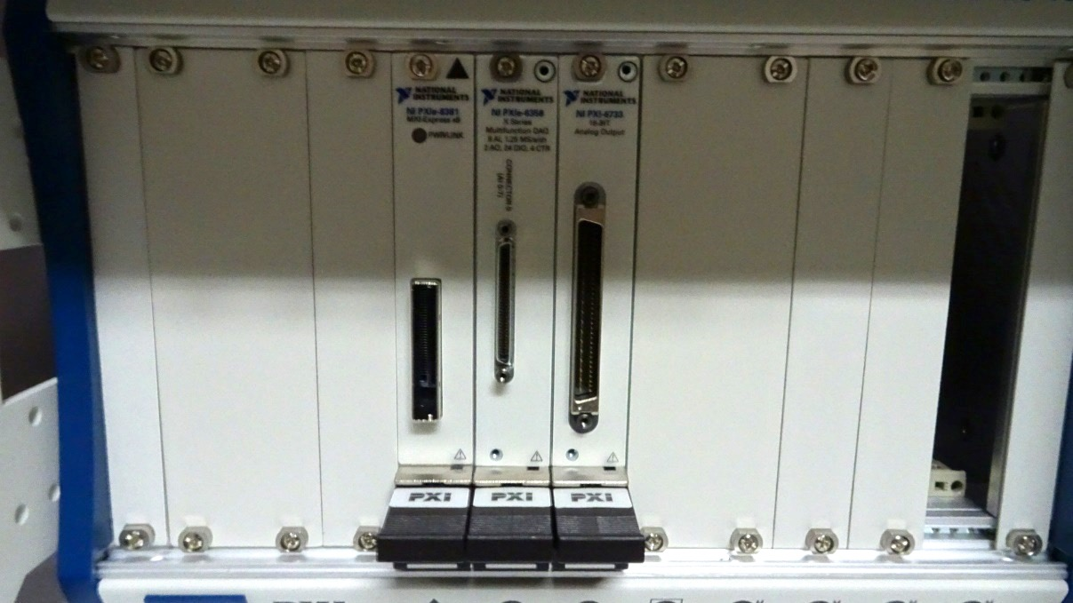
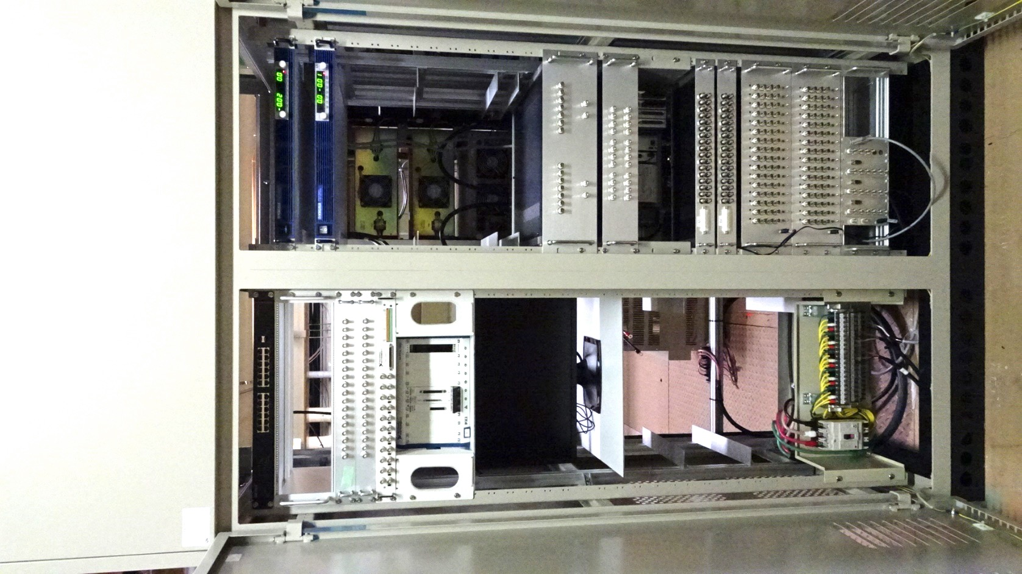
Pulsed magnet rack
Edge switch
DC Power Supplies
Pulsed magnet driver
PXI chassis
(PXIe-1082)
Remote controller
DAC (PXI-6733)
ADC (PXIe-6356)
PXI-EVR-230
Control
PC
13 racks are newly installed
Small form-factor (4U) power supplies are tested more than 2 months at 50Hz
Interlock signal processing
(CompactRIO based system)

Slide 12
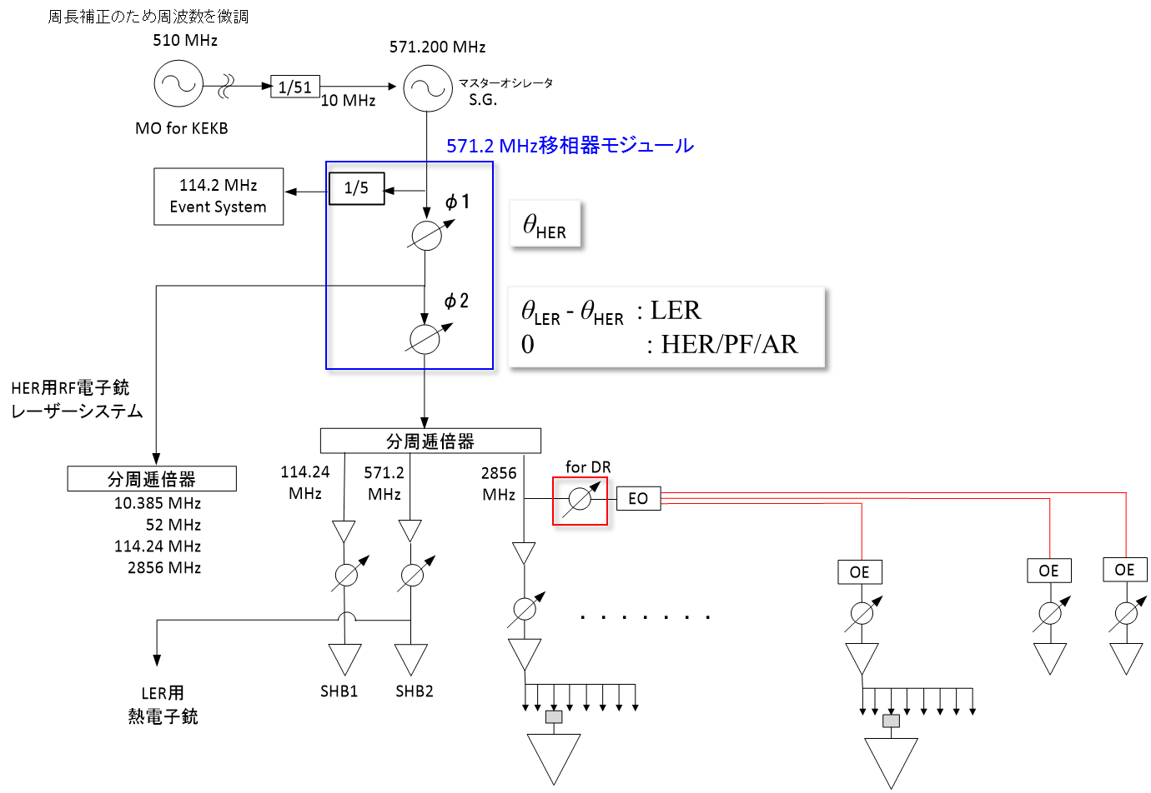
Development of 571.2MHz Master phase shifter
All linac clocks are generated from 571.2 MHz master oscillator
Clock is adjusted every minutes to compensate the ring circumferences, and the phase should be adjusted to meet the lengths of beam transports of electron and positron.
Stabilities of 0.1%rms in amplitude and 0.02 degree rms in phase
φ2 changed at 50 Hz
3,4,5セクター
2856MHz移相器

Slide 13
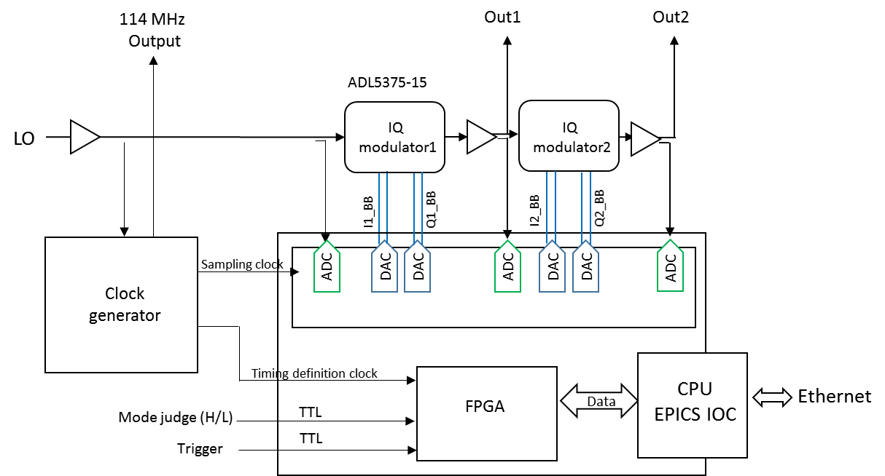
571.2MHz Phase shifter
571.2MHz

Slide 14
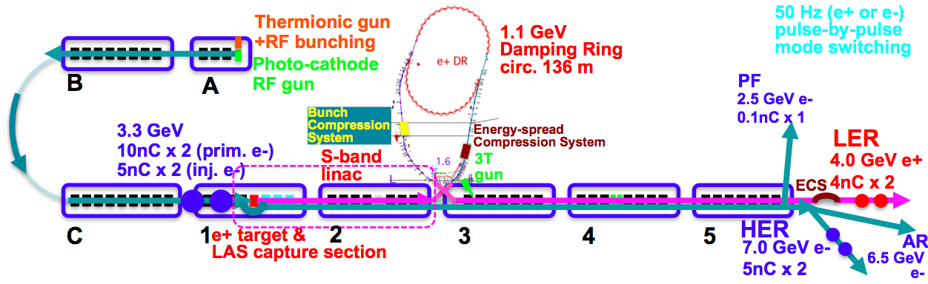
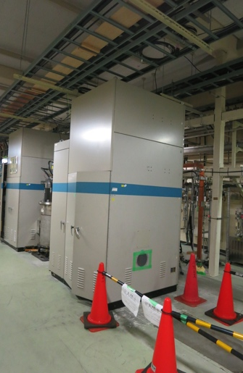
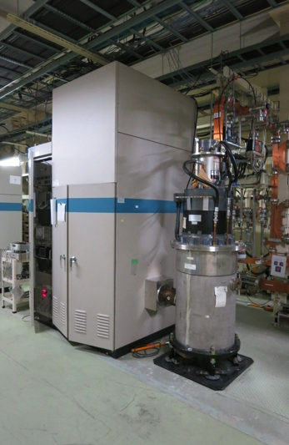
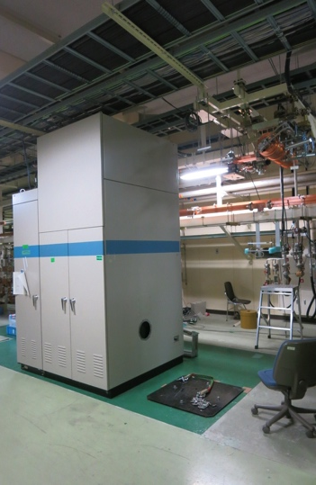
KL_DS, KL_DN , KL_32 Installation
 | ECS | BCS
Voltage required [MV] | 41 | 21.5
# 2m accelerator structure | 2 | 1
Accelerator field [MV/m] | 10.2 | 10.75
Operation power [MW] | 29.0 | 19.0
Pulse width [µs] | 0.8 | 0.8
Rep. rate [Hz] | 50 | 50
KL_DS/BCS
KL_DN/ECS
KL_32

Slide 15
Bucket selection in Phase-2 with DR
Without DR, simply wait up to 5120 x 96 ns ~ 490 μs
96 ns : highest common frequency between linac – ring
With DR, in order to select arbitrary bucket in MR, have to wait up to ~4.5 ms, even if a bucket in DR was carefully selected
Power supply can wait only 2 ms, one of only 2798 buckets in 5120 buckets can be selected, may have to change LLRF condition at latter half of linac every pulse
Can be a big challenge in LLRF precision
e⁻ Gun
KEKB
ARC
Primary e– (3.5GeV, 10nC)
e⁺ BT (3.5GeV, 0.6nC)
e⁺ Target
Kaji et al
96ns
>100ns
e⁺ DR (1.1 GeV, 4nC)
e⁻ Gun
>100ns
SuperKEKB
ARC
96ns
Primary e– (3.5GeV, 10nC)
e⁺ BT (KEKB: 4GeV, 4nC)
e⁺ Target

Slide 16
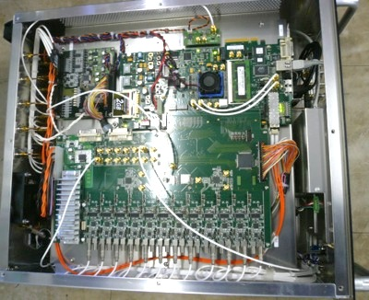
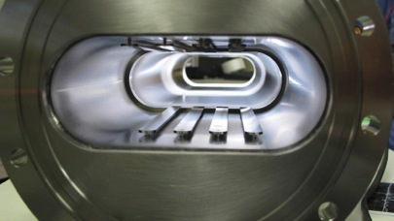
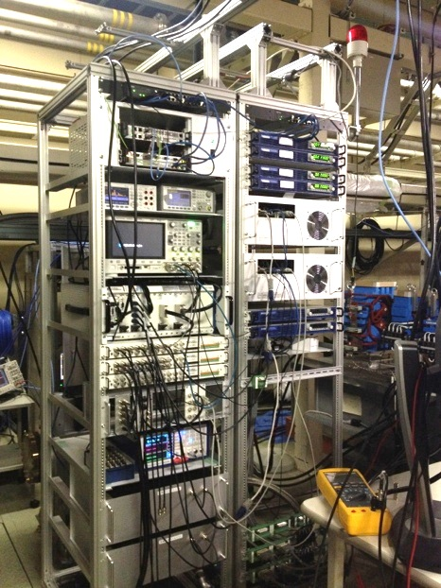
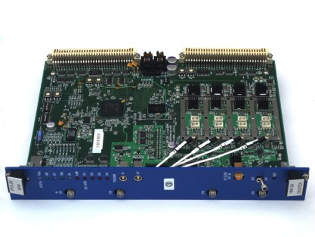
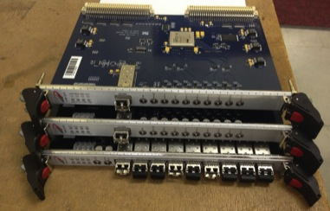
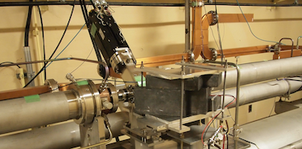
Many other Linac Upgrade Progress
Linac Upgrade Overview
High-power microwave modulator upgrades
Low-level RF controls/monitor upgrades
Pulse-to-pulse modulation (PPM) between 4+1 rings
More spaces for increasing number of devices
Beam instrumentation
Large/small aperture beam position monitors (BPM)
Precise/fast and synchronized BPM readout system
Wire scanners and beam loss monitors
Streak cameras
(Deflectors, etc.)
Alignment to preserve beam emittance
Measurement precision reaching 0.1 ~ 0.3mm
Mover and orbit control development
Event-based control and timing upgrade
Essential for pulse-to-pulse modulation
Precise timing & synchronized controls
Bucket selection at DR and MR
Pulse magnet tests
SINAP event modules
Beam wire scanner

Slide 17
Linac Schedule Overview as of Jun.2017
New Schedule
RF-Gun e- beam
commissioning
at A,B-sector
e- commiss.
at A,B,J,C,1
e+ commiss.
at 1,2 sector (FC, DCS, Qe- 50%)
e- commiss.
at 1,2,3,4,5 sector
Phase1: high emittance beam for vacuum scrub
Phase2,3: low emittance beam for collision
Time →
Location
↓
Beam Licenses in steps
Low Emittance Beams
4+1 Ring
Injections
DR Commiss.
1 nC
Phase1
2 nC
Phase2
4 nC
Phase3
Without Top-up
Direct PF-AR BT
: Electron
non damped e+ commiss.
at 1,2, 3,4,5 sectors
e- commiss. at A→5 sectors
damped e+ commiss.
at 1→5 Qe+ = 1~4nC
e- commiss.
at A→5 Qe- = 1~5nC
Improved RF gun
: Positron
: Low current electron

Slide 18
Summary
Summary
We learned a lot during KEKB operation
Phase-2 injection into SuperKEKB is another challenge with higher beam current and lower transverse and longitudinal emittance
Steady progress towards designed injection beam in steps
Alignment: almost confident on the measurement precision (0.1-mm local, 0.3-mm global), may need mover to maintain it for longer term
Positron generator: need discharge analysis
Thermionic gun: stably operated for primary electron for positron generation
RF gun: following recommendations at review meetings
Pulsed devices: global and synchronized operation
New modulators for energy and bunch compressors on DR beamlines
Will balance between final beam quality and progressive operation
Will select optimized route depending on available resources
Balance with injection operation for light sources, commissioing and development in parallel

Slide 19
Injection Energy Margin Recovery (even while dropping Energy 8 GeV → 7 GeV)
No backup/stand-by before J-Arc in KEKB operation
Optimized for SuperKEKB ring injection reliability with larger beam currents and smaller emittance
Temporary removal of units for construction
Should be recovered before phase-3
A unit was removed to make a room for DR BT
Positron deceleration capturing
Lower acceleration in large aperture structures in the positron capture section
An unit before J-Arc was converted into a stand-by for availability
C-band structures were converted into S-band to help emittance preservation
Degraded accelerating structures after 35 years of operation
Should be refurbished in the long run
Larger beam current with larger beam loading
Kamitani et al

