Slide 1
eeFACT2025 Hardware-related working group summary
Kazuro Furukawa

Slide 2
Hardware-related working groups & conveners
WG6 - Injector, Injection (partially)
Paolo Craievich (PSI)
Kazuro Furukawa (KEK)
WG7 - Beam Instrumentation
Hitomi Ikeda (KEK)
Stefano Mazzoni (CERN)
WG9 - Vacuum
Kyo Shibata (KEK)
Oleg Malyshev (ASTeC, Daresbury)
WG10 - Magnets, IR, Alignment
Mika Masuzawa (KEK)
Helene Mainaud Durand (CERN)
Brett Parker (BNL)
WG11 - RF
Alessandro Gallo (INFN)
Tetsuo Abe (KEK)
WG12 - Cryogenics, Infrastructures
Gao Jie (IHEP)
Hirotaka Nakai (KEK)

Slide 3
Paolo Craievich (PSI) Kazuro Furukawa (KEK)
WG6 Injector, Injection
WG6
Injector, Injection

Slide 4
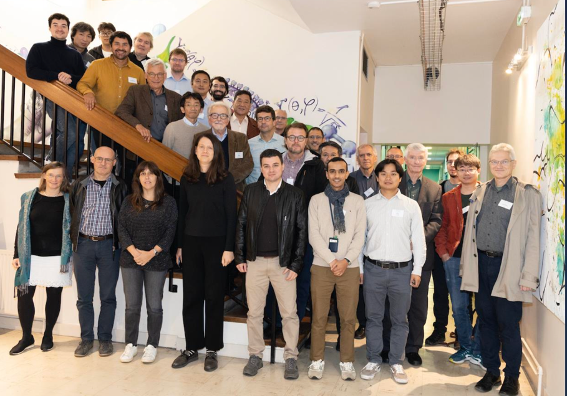

WG6 Injector, Injection
Summary of the hardware-related working groups: WG6 Injector and injection - 1/3
Summary of the workshop on Advances in High-Intensity Positron Source Physics and Technologies (AHIPS-2024) – Iryna Chaikovska
The workshop brought together 49 participants from leading institutions across the USA (SLAC, JLab), Japan (KEK, University of Tokyo, AIST), China (IHEP, Hefei), CERN, Germany (DESY, University of Hamburg, University of Mainz, HZDR), UK (University of Liverpool, RAL, Queen's University Belfast), Italy (INFN, Sapienza University of Rome), Switzerland (PSI) and France (IJCLab/CNRS, CEA/IRFU/DPhP , LOA, SOLEIL).
It served as an excellent meeting point for the international community working on positron sources and beams.
Explore the possibility of establishing a workshop series (every 2 years?) to maintain momentum and foster collaboration and exchanges in this field.

Slide 5
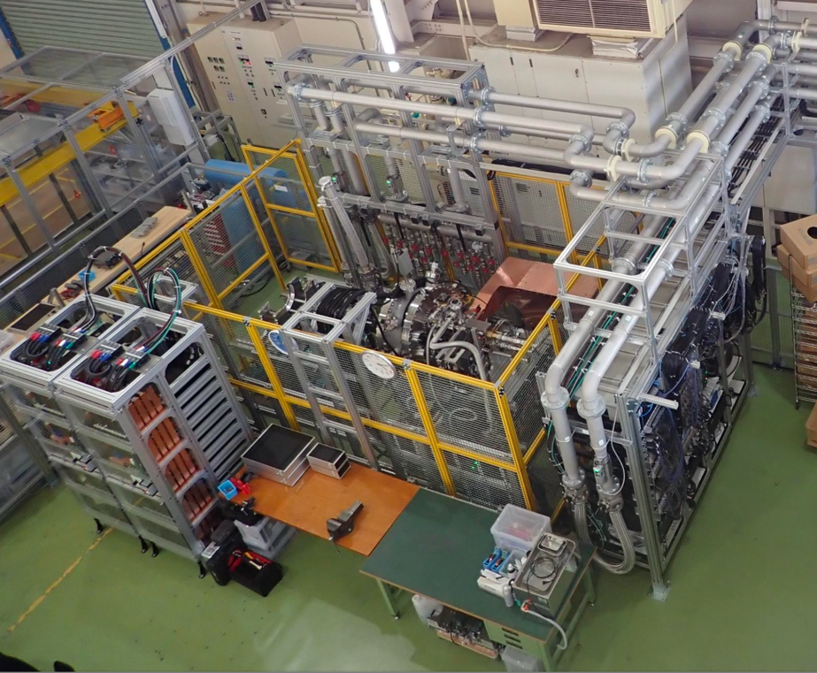
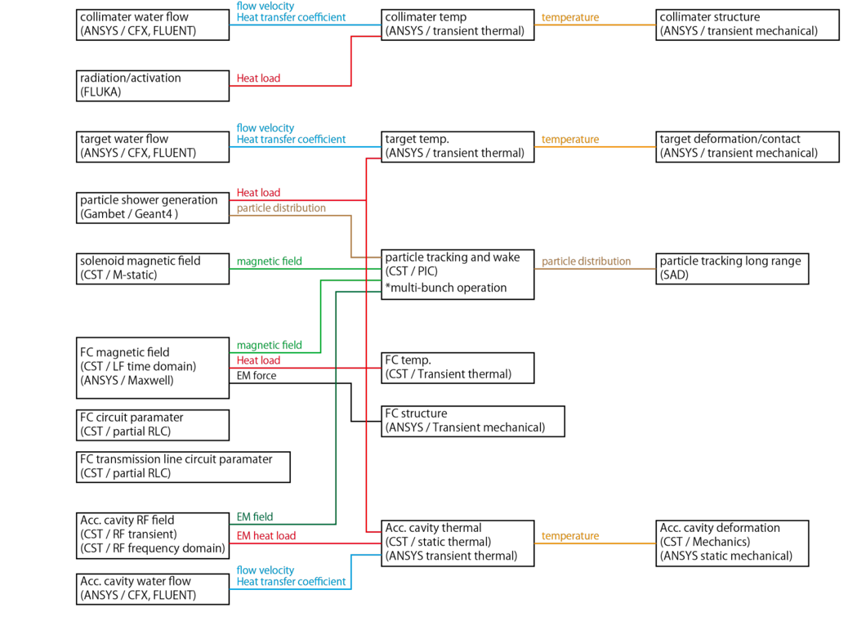
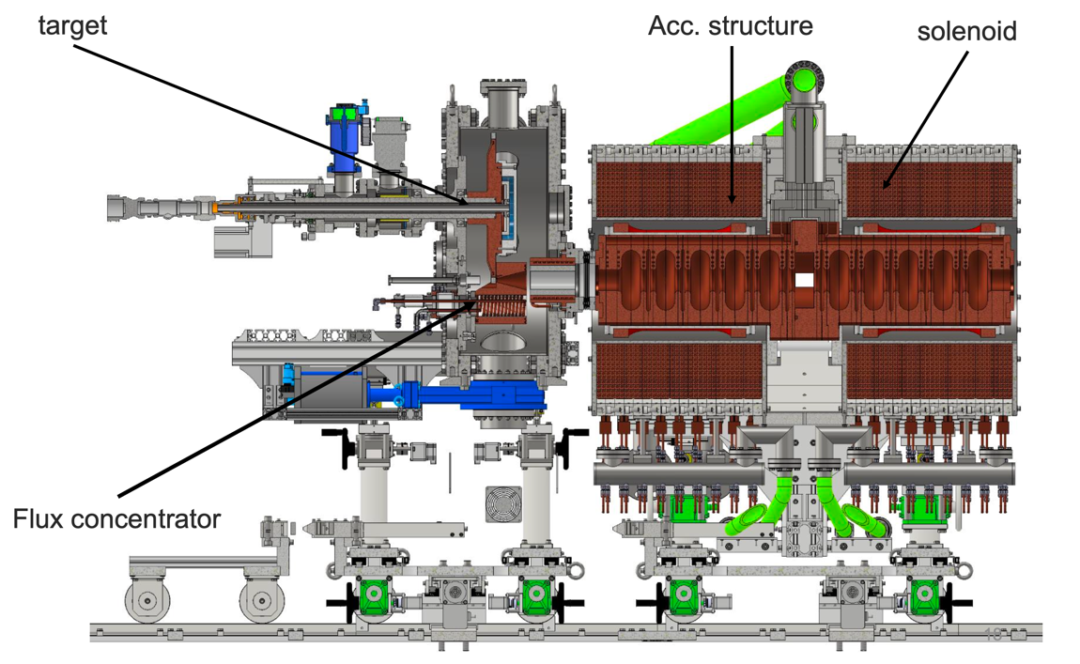
WG6 Injector, Injection
Summary of the hardware-related working groups: WG6 Injector and injection - 2/3
Overview of positron sources and development for ILC – Yoshinori Enomoto
KEK has been developing and operating positron source since 1980s.
Enomoto says: “Although reliability is important for sources, it is time to proceed to the next step”
New concepts (JLab: Polarized CW positron source, e- driven+QWT, SLAC: LXe target) and new technologies (for FCC-ee, CEPC, ILC) are ongoing
Experience in SuperKEKB: It took long times (2-3 years) to reach design performance for positron production
Collaboration is important to maximize limited opportunities, resources and knowledge transfer
Prototype positron source for ILC is under construction and ready by JFY2027
Simulation flow for the ILC positron source
ILC the positron source
Prototype of the ILC the positron rotating target

Slide 6
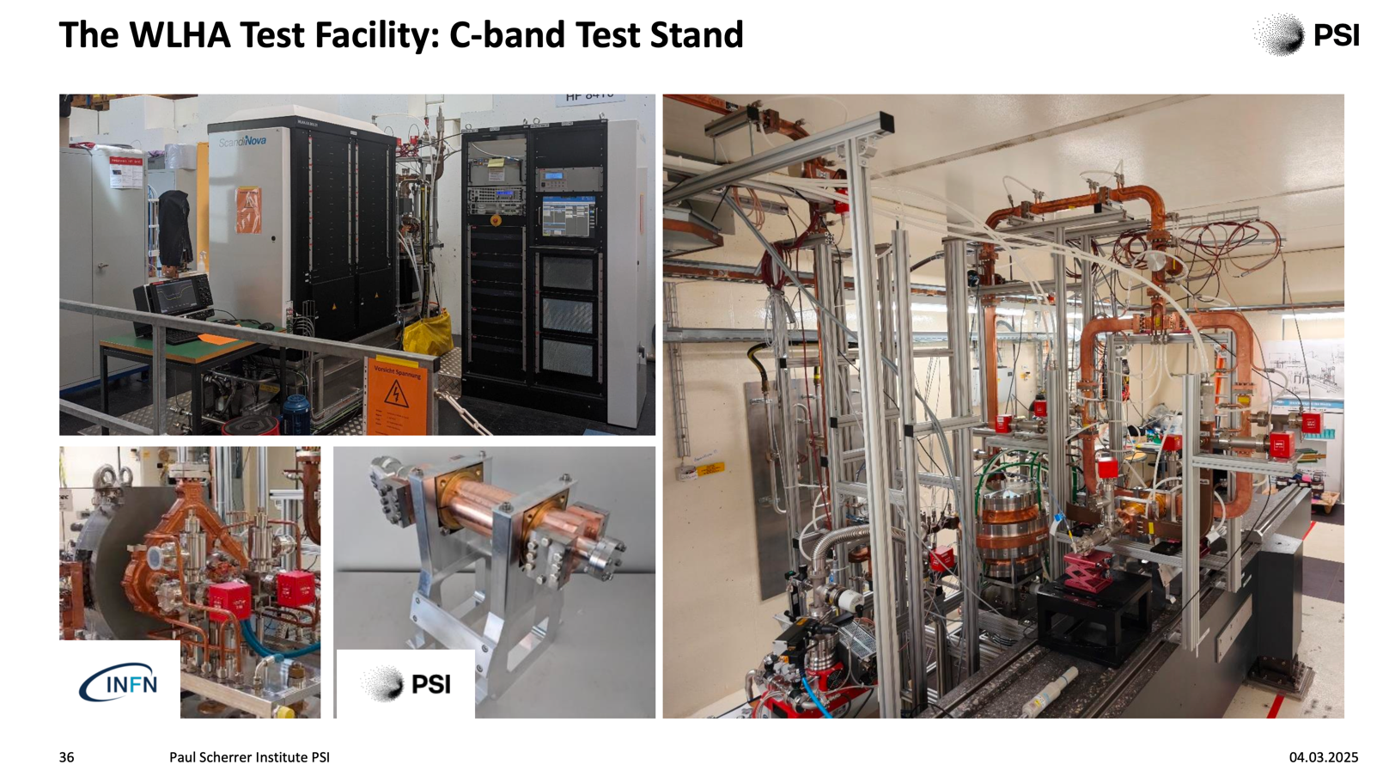
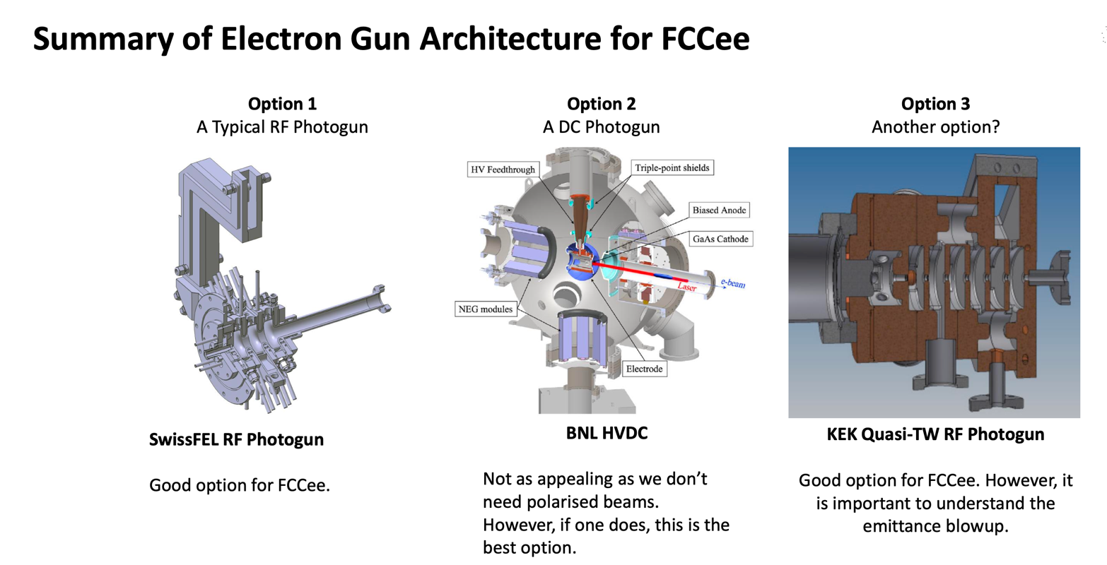
WG6 Injector, Injection
Summary of the hardware-related working groups: WG6 Injector and injection - 3/3
Requirements for electron sources for lepton colliders: Case Study for FCCee – Tom Lucas
Electron sources requirements for lepton colliders are largely driven by the machine layout and the presence of damping rings.
Taking the FCCee machine as a case study, photocathode S-band RF gun meets the machine requirements (for electron beam and positron production).
For this device, semi-conductor cathodes give the best QE in the order of >1e-3. However, a test to understand their viability at high charges must be performed! A strong alternative is the metallic cathode Ir7Ce2 which has QE values of >1e-4. It has been well established at SuperKEKB at the bunch charges required.
DC Photo-emission guns and DC Thermionic remain a possibility and will be investigated in a further study for FCCee.
We will investigate the use of the SwissFEL gun as the electron source for FCCee in a dedicated test at PSI over the next couple of years.
C-band (and future S-band) test stand at PSI

Slide 7
Hitomi Ikeda (KEK) Stefano Mazzoni (CERN)
WG7 Beam Instrumentation
WG7
Beam Instrumentation

Slide 8
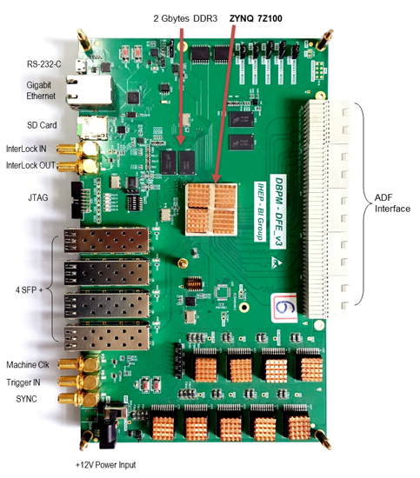
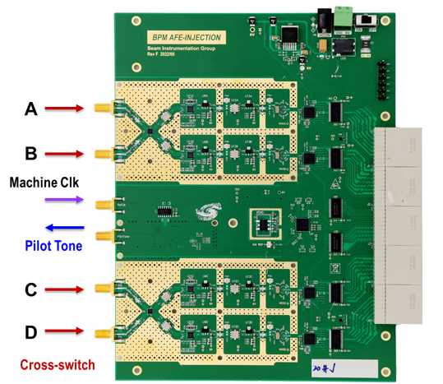
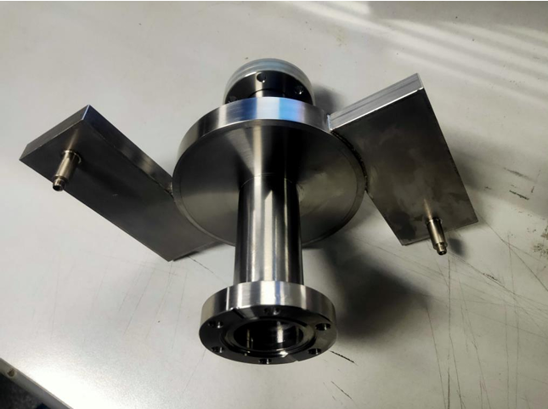
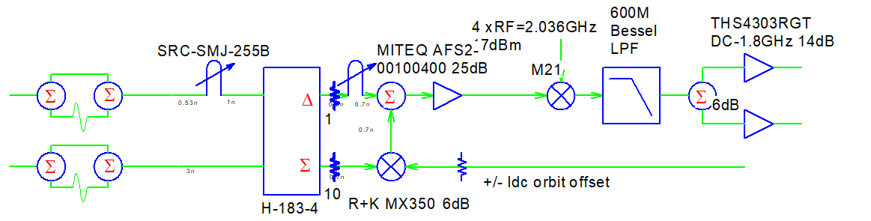
Beam Instrumentation (WG7:S.Mazzoni,H.Ikeda)
WG7 Beam Instrumentation
The CEPC beam position monitoring system –Yanfeng Sui (IHEP)
The CEPC BPM system have been designed and going on calibration of pickups and testing the electronics by automated test system. The electronics are self-developed and fully meet CEPC's requirements.
Cavity based beam diagnostics for the STCF injector – Qian Wang (USTC)
A complete prototype cavity monitor was designed and tested.
Online experimental results demonstrate that the cavity monitor measures bunch charge (0.75% @ 300 pC) and length (~ 0.3 ps @ 300 pC, 5ps) with very high resolutions.
Effect of Bunch Feedback system to the luminosity of e+e- collider – Makoto Tobiyama (KEK)
Bunch by bunch feedback systems for SuperKEKB rings are working well to suppress the CBI and to store more than 1A with by-2 filling pattern.
In order to reduce the luminosity drop with vertical
FB gain in LER, tuning the FIR phase/phase shift to
suppress excitation, reducing the V-FB gain and
hunting noise source were done.
Prototype Cavity

Slide 9
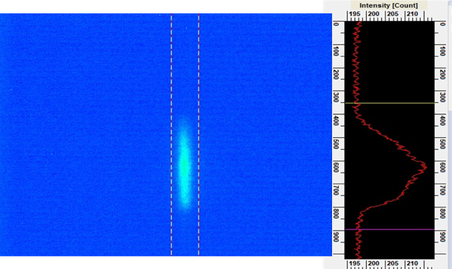
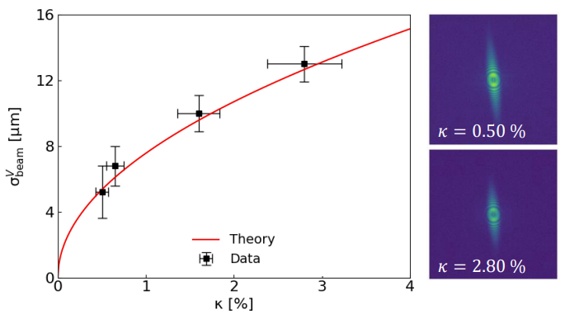
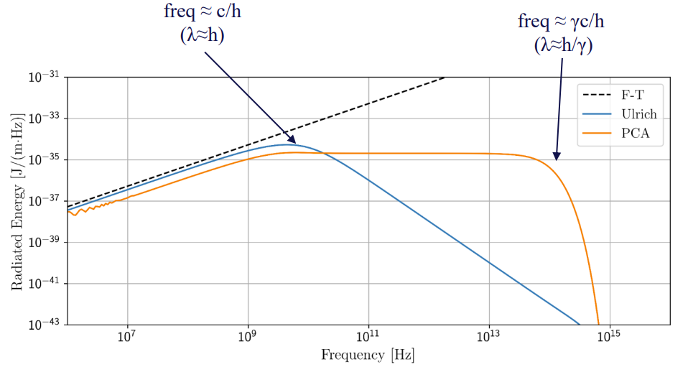
WG7 Beam Instrumentation
Nine Years of Optical beam diagnostic system development at SuperKEKB – Toshiyuki Mitsuhashi (KEK)
Review of materials and methods for optical transverse and longitudinal monitoring based on Synchrotron radiation at SuperKEKB.
Beam halo observed via long-range coronagraph. Gated and streak camera allow observation of last turn beam blow-up in SBL events
Status and outlook of FCCee transverse diagnostic systems – Daniele Butti (CERN)
As part of FCC Feasibility study, concepts and optical placement of transverse beam monitoring are presented
For a Synchrotron radiation spectrum in the 10-100 keV range, combination of pinhole and interferometry is proposed with complementary functions: OP 'quick 'tool vs high small beam size accuracy
Cherenkov diffraction radiation studies for longitudinal diagnostics – Kacper Lasocha (CERN)
Incoherent Cherenkov diffracted radiation studied as potential source for non-invasive longitudinal diagnostics for FCC and linear colliders
R&D tests in ATF2 at KEK (ongoing) and IOTA @ FNAL (planned) for verification of properties (yield, angular distribution)
Beam halo
SBL events
Interferometry tests with 12 KeV beam
ChDR yield predictions for FCC (Z )
Notes:
Toshiyuki, Daniele, Kacper

Slide 10
Kyo Shibata (KEK) Oleg Malyshev (ASTeC, Daresbury)
WG9 Vacuum
WG9
Vacuum

Slide 11
WG9 Vacuum
Convener : O. Malyshev (ASTeC) & K. Shibata (KEK)

Slide 12
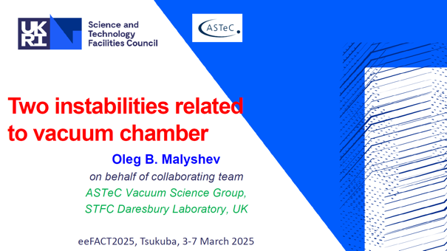
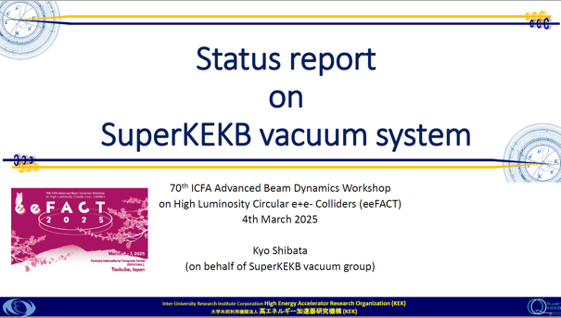

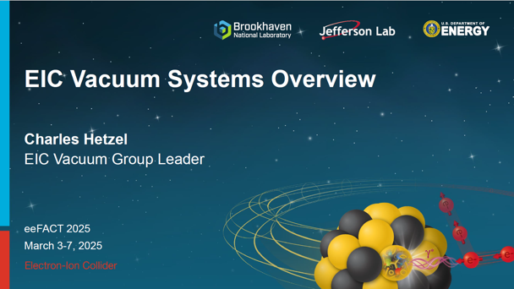
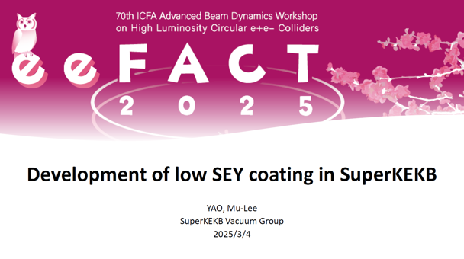
WG9 Vacuum
WG9(Vacuum) was a very useful session in linking our experience to future accelerators.
WG9 had five talks about;
Learning from past and present accelerators
“Two instabilities related to vacuum chamber” by O. Malyshev (ASTeC)
“Status report on SuperKEKB vacuum system” by K. Shibata (KEK)
R&Ds and design for the vacuum system of future colliders
“CEPC Vacuum system development progress” by Y. Ma (IHEP)
“EIC Vacuum Systems Overview” by C. Hetzel (BNL)
“Development of low SEY coating in SuperKEKB” by M.L. Yao (KEK)
Notes:
Oleg, Kyo, Yongsheng, Charles, Mu-Lee

Slide 13
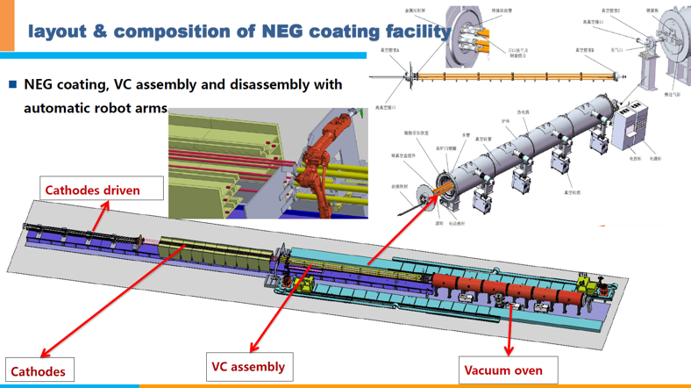
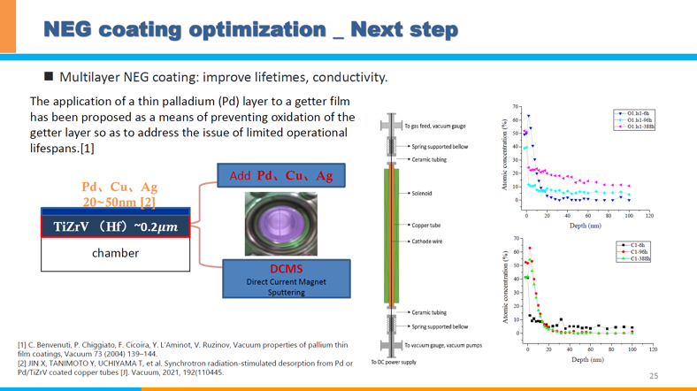
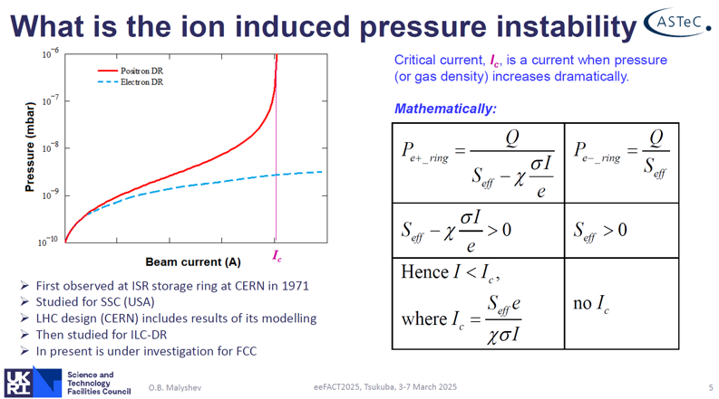
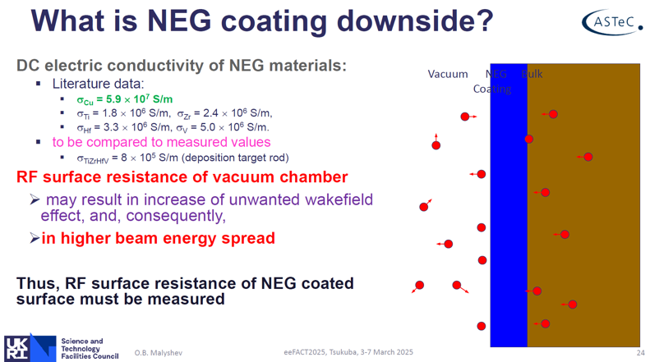
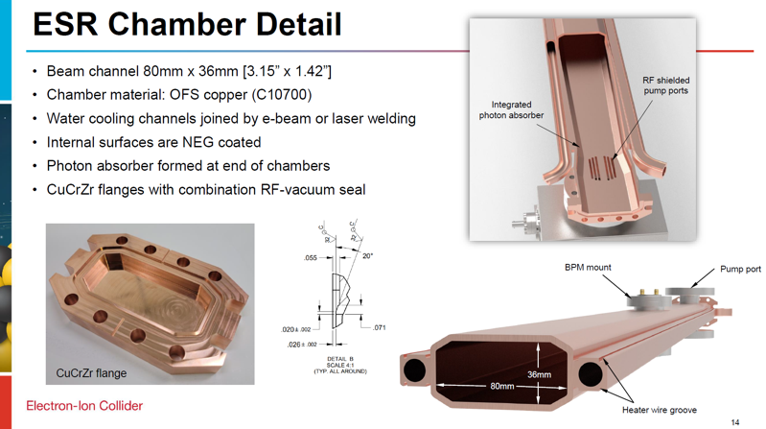
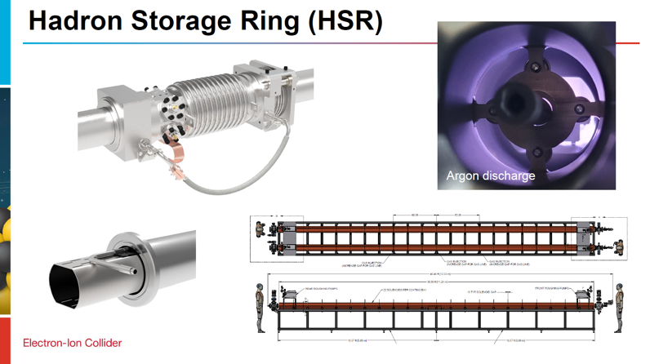
WG9 Vacuum
Highlight from WG9;
“CEPC Vacuum system development progress” by Yongsheng Ma (IHEP)
R&D of vacuum chambers NEG coating and spray heating are actively progressing to establish automatic production lines for 200,000 m beam pipes in near future.
“Two instabilities related to vacuum chamber” by Oleg Malyshev (ASTeC)
Two issues related to the vacuum system that can adversely affect the beam operation, “Ion induced pressure instability” and “RF surface resistance of NEG coated beam chamber” were explained in detail.
“EIC Vacuum Systems Overview” by Charles Hetzel (BNL)
Design and R&Ds of various components for the four accelerators (Electron LINAC, RCS, ESR, HSR), which have different requirements for the vacuum system, are being carried out energetically.
Notes:
Yongsheng, Oleg, Charles

Slide 14
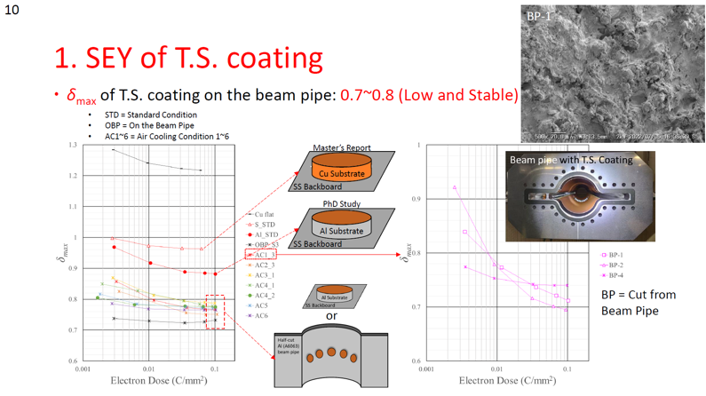
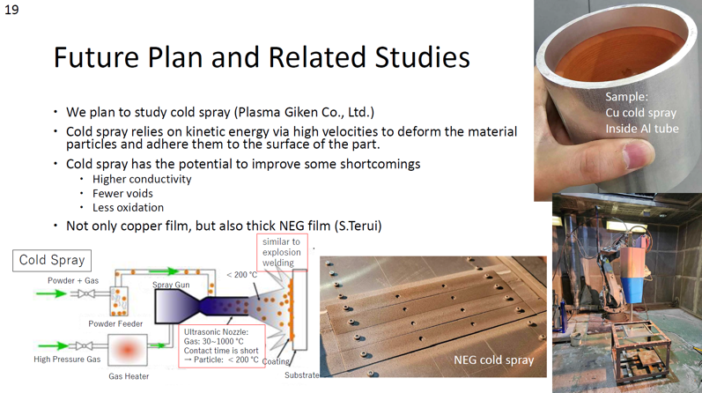
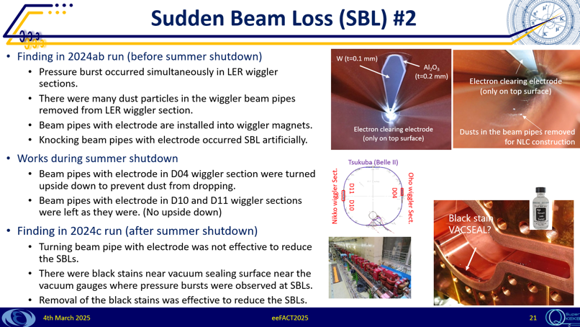
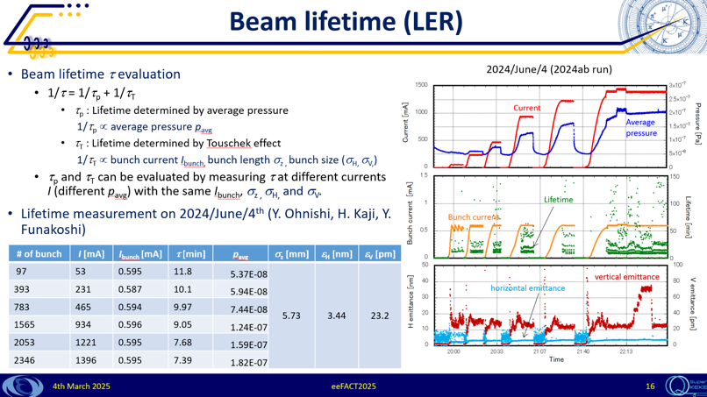
WG9 Vacuum
Highlight from WG9;
“Development of low SEY coating in SuperKEKB” by Mu-Lee Yao (KEK)
A feasibility study on the thermal sprayed copper surface to mitigate electron cloud density in beam pipes was reported, and R&D plan on the cold spray coating instead of thermal spray was shown.
“Status report on SuperKEKB vacuum system” by Kyo Shibata (KEK)
During the 2024 beam operation, it was found that the cause of the beam sudden loss was likely the VACSEAL, and that the pressure in the LER had a large effect on the beam lifetime.
Speakers toured the SuperKEKB accelerator (Tsukuba and Oho straight sections) and Oho Experimental Hall (TiN coating facility) on 3rd March.
Notes:
Mu-Lee, Kyo

Slide 15
Mika Masuzawa (KEK) Helene Mainaud Durand (CERN) Brett Parker (BNL)
WG10 Magnets, IR, Alignment
WG10
Magnets, IR, Alignment

Slide 16
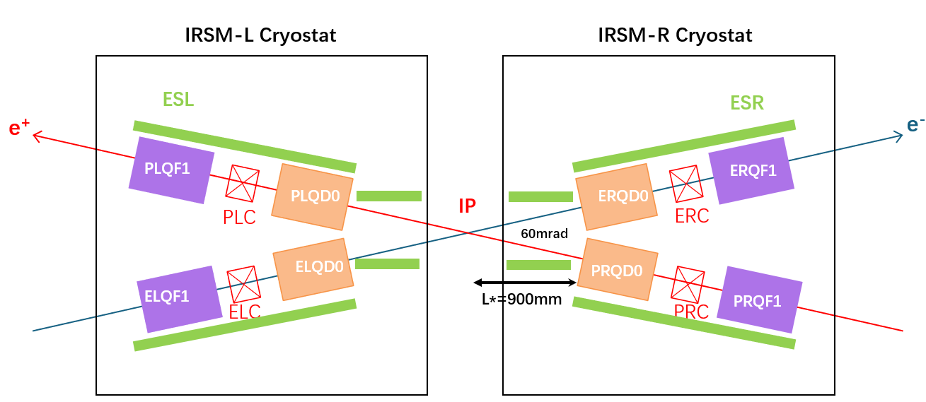
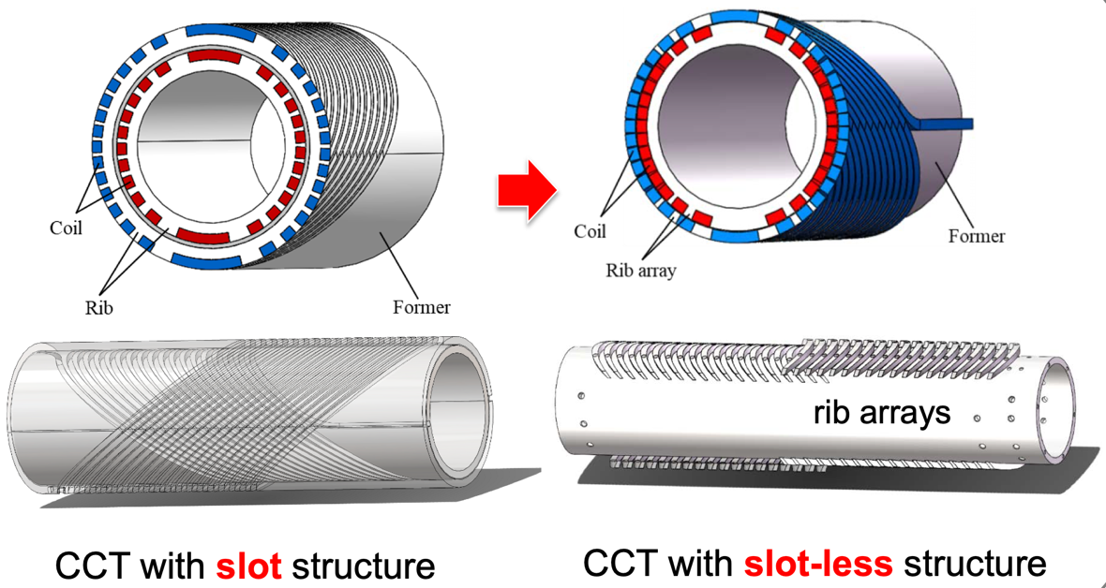
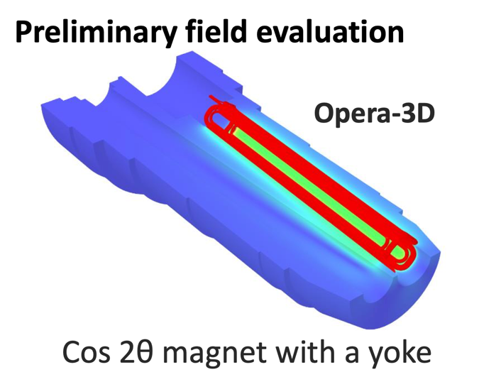
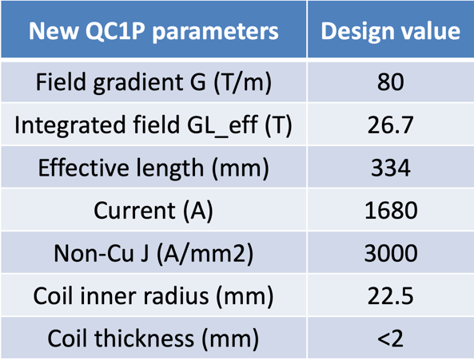
SCTF IR magnet
eeFACT2025 WG10 Session 1
Two talks from STCF on IR magnets
Progress of IR Superconducting Magnet (Wenbin Ma)
CCT QD0 prototype magnet work is presented along with the challenges.
International collaboration is necessary and welcome.
Development of the CCT superconducting magnets for the STCF IR (Shaoqing Wei)
Design and Harmonic optimization process is presented.
Copper coil winding is shown.
A novel design of CCT with slot-less coil is introduced.
SuperKEKB IR Upgrade Idea (Xudong Wang)
Design concept for the new IR is presented.
Technical issues with Nb3Sn QC1 magnet discussed.
QC1 development schedule shown.
SuperKEKB New IR magnet

Slide 17
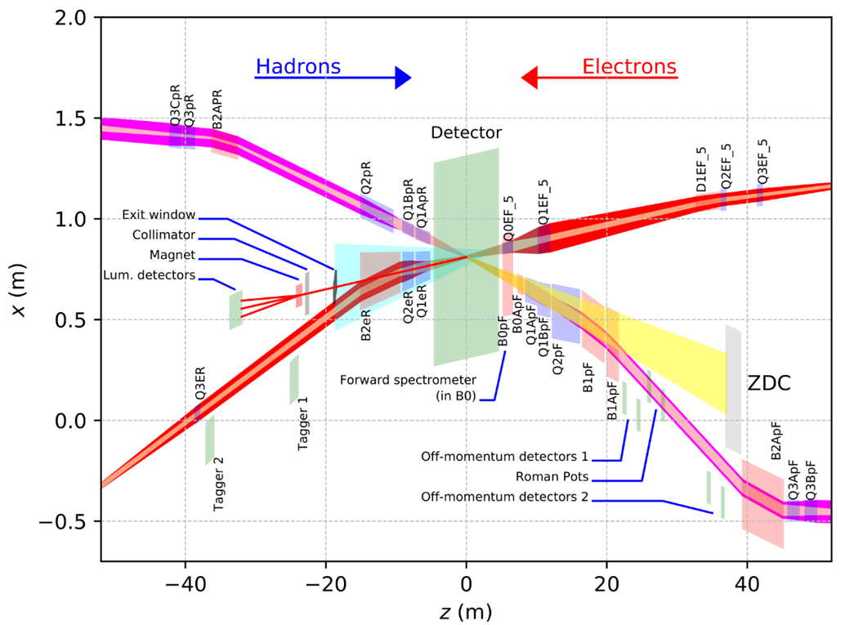
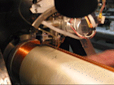
WG10 Magnets, IR, Alignment
eeFACT2025 WG10 Session 2
EIC magnet overview
Three talks on Interaction Region
EIC IR Design & magnets (Christoph Montag, BNL)
A lot of challenges for EIC IR layout: high luminosity, +-5 m machine element free zone around the IP, etc.).
Presentation of EIC magnet overview, first solutions and prototypes.
25 mrad crossing to be compensated by crab cavities, under design & prototyping.
A novel spin rotator concept for longitudinally polarized beam for Chiral Belle at SuperKEKB (Brett Parker, BNL)
Proposal of a spin rotator as a drop-in replacement for an existing HER dipole, with no impact on the ring geometry.
Application of BNL’s direct wind superconducting magnet fabrication.
R&D plan to design & fabricate 1 prototype and then 4 full-length units.
Direct wind corrector
Experiences with SuperKEKB IR installation & alignment (Mika Masuzawa, KEK)
Return of experience on QCS cryostat, located in the detector via a cantilever support.
Important floor motion when the detector rolls-in (up to 0.35 mm); detection of a daily effect and correlation with outside air temperature (due to design of infrastructure and building).
Cryostat motion during beam operation, aborts, earthquakes, quenches.
Important floor and cryostat motion over a long period.

Slide 18
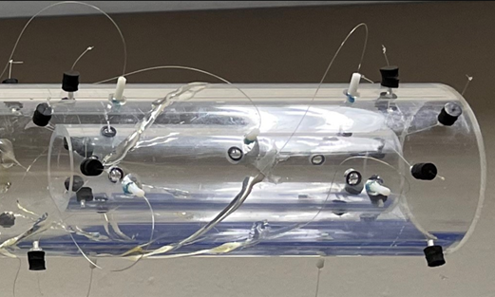
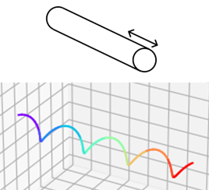
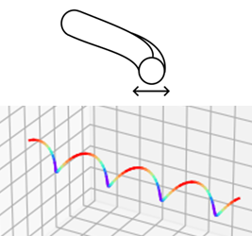
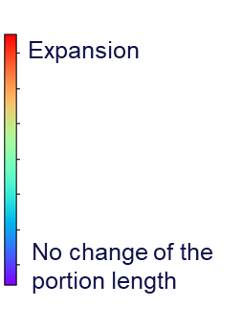
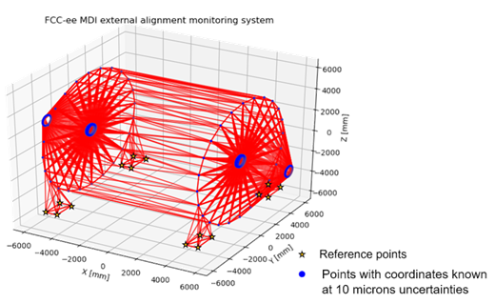
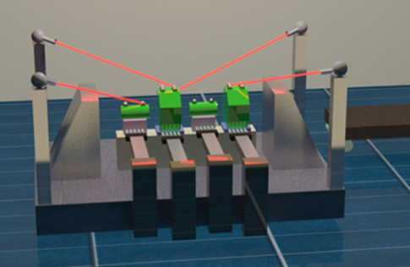
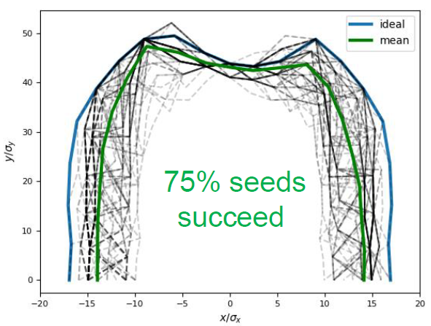
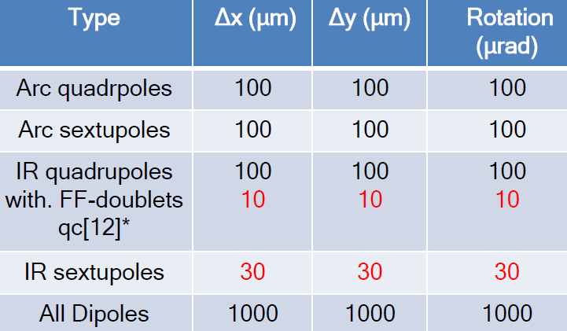
WG10 Magnets, IR, Alignment
eeFACT2025 WG10 Session 3
Frequency Scanning Interferometry (FSI)
Fiber FSI Monitoring Example
Motion A
Motion B
Two talks: CERN/ESRF on Alignment/IR Tolerances
Alignment plans for FCC (Hélène Durand)
Alignment Topics: Absolute, Relative & Maintenance
Get IR magnet info’ via FSI with a fiber network.
Use fibers with semi-reflective mirrors and FSI.
Can be external / internal to IR magnet cryostat.
Get detector info’ via a dense network in IR hall.
Also developing concepts for fiducialisation and alignment for BDS / arc regions in tunnel.
First view at alignment tolerances in the FCCee Interaction Region (Satya Jagabathuni)
Perform optics tuning and alignment studies.
Focus mainly on Z since it is most sensitive.
Python version of Accelerator Toolbox (pyAT) used for “commissioning like simulations.”
Generate/invert response matrix to find changes.
FF motion sensitivity leads to reduced DA; thus, we can use DA as figure of merit for IR studies.
Result is smaller tolerances for FF-doublets and the IR sextupoles (10 & 30 μm Vs. 100 μm elsewhere.
Spiraling
Fibers!
A Dense Laser
Based Detector Monitoring
Network
Component / Girder Fiducialisation
Dynamic Aperture Figure of Merit
Final Associated Tolerances Table

Slide 19
Alessandro Gallo (INFN) Tetsuo Abe (KEK)
WG11 RF
WG11
RF

Slide 20

WG11 RF
T. Abe & A. Gallo: WG11 Summary
WG11 (RF) SUMMARY
1 Dr. Tetsuya Kobayashi (KEK - High Energy Accelerator Research Organization, JPN):
"High current-related issues in KEKB/SuperKEKB RF operation"
2 Dr. Walid Kaabi (Université Paris-Saclay, CNRS/IN2P3, IJCLab): "Challenges in RF systems for Energy Recovering Linacs"
3 Dr. Rama Calaga (CERN European Organization for Nuclear Research): "Status and perspectives of RF systems for Hi-Lumi LHC"
4 Dr. Feng Qiu (IMP Institute of Modern Physics, Chinese Academy of Sciences):
"Improving Beam Quality and Reliability through Low-Level RF Control in Superconducting Accelerators"
5 Dr. Yelong Wei (USTC University of Science and Technology of China, CHN):
"Design and prototyping of a HOM-damping TM020-mode RF cavity for the STCF collider rings"
6 Dr. Mathieu Omet (KEK - High Energy Accelerator Research Organization, JPN):
"ILC RF system challenges and status of high-gradient SC cavities"
7 Dr. Jiyuan Zhai (IHEP, CHN): "RF systems for circular Higgs factory projects"
8 Dr. Dario Giove (INFN Milan, ITA): "RF systems for a future Muon collider"
9 Dr. Jiyuan Zhai on behalf of Dr. Zusheng Zhou (IHEP, CHN): "High Efficiency klystrons for future colliders"
20
20
eeFACT2025 Workshop – Tsukuba (JP), March 3-7 2025

Slide 21
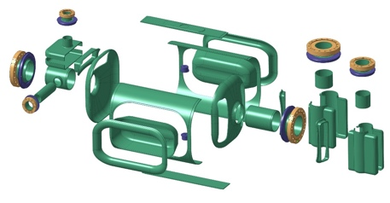
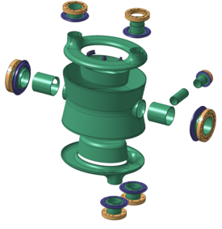
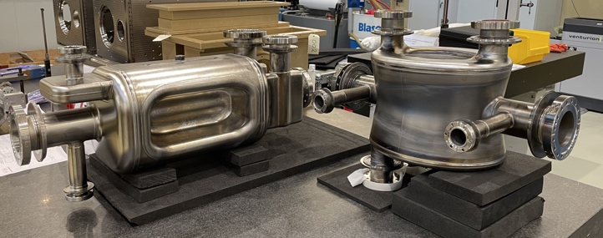
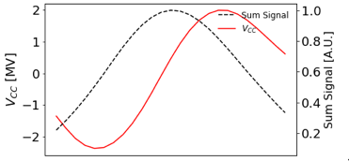
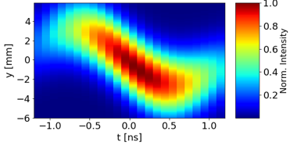




WG11 RF
T. Abe & A. Gallo: WG11 Summary
SuperKEKB (in operation), HL-LHC (in preparation), ILC (mature technology)
Talk #1
High current issues in SuperKEKB RF operation:
Beam Power Sharing among Cavities (Acc. Phase Optimization)
Coupled Bunch Instability (CBI) due to both Fund Mode and HOMs
Coherent Bunch Oscillation Issue (Static Robinson Instability)
Transient Beam Loading (Bunch Gap Transient)
Instability due to interaction btw crab cavities and beam-beam force
Mostly cured or mitigated, but beam currents still lower than nominal by a factor ≈2
Model of crab-cav RF system+ beam-beam force
Unexpected! Mitigated by experimentally changing the RF parameters
Talk #6
Talk #3
A complete prototype cryomodule is being built by the ILC Technology Network (by 2027)
Two-step baking procedure of SC cavities demonstrated high gradient – high Q in excess of the ILC baseline (31,5 MV/m – 1e10)
Developments on-going on many other items:
Implementation of SC crab cavities HL-LHC of 2 types (8 x DQW @ CMS, 8 x RFD @ ATLAS) is the most challenging RF upgrade respect to the present LHC.
Way more complicated respect to LHC accelerating cavities (complex shaping, 30+ welding, …), surface fields in excess of 50 MV/m & 100 mT.
DQW successfully tested for 5 years in the SPS. RFD installed in SPS in 2025, ready for extensive tests.
Wide international collaboration
Double Quarter Wave
DQW
RFD - RF Dipole
Cryomodule
RF input coupler
Magnetic shield
Frequency tuners
Clean assembly/automation (in view of large mass production of ≈8000 cav, 1000 CMs …)
SPS Test
21
21
eeFACT2025 Workshop – Tsukuba (JP), March 3-7 2025

Slide 22
WG11 RF
T. Abe & A. Gallo: WG11 Summary
RF x future colliders (FCCee/CEPC, STCF, μ-coll)
Talk #7
Z, W ,H, ttbar factory projects FCCee/CEPC show similar basic RF system design.
Equal or similar beam currents, max synchrotron radiated power (50 MW), total gap voltage, common cavities for the 2 beams at H/ttbar.
Different technologies and frequencies: bulk Nb (CEPC) vs. Nb film on Cu (FCC), 650 MHz (CEPC) vs. 400/880 MHz (FCC). In the booster 1300 (CEPC) vs. 800 (FCC) MHz.
Different operation sequence: H first or increasing energy order, reflecting in possibly different implementation plans.
The scale, complexity, and challenges of the RF system for the future circular e+e- factories are unprecedented.
More severe beam dynamics issues @ Z: Transient beam loading, fundamental mode driven instabilities.
Critical R&D, engineering design or demonstration of SRF components and cryomodule (high Q, high gradient, high power) are underway
Collaborative efforts and synergies in R&D and industrialization with other related projects are crucial
CEPC
FCC
Talk #5
Talk #8
An optimized 499.7 MHz NC TM020-mode cavity with strong HOM damping suitable for a 2A operation of the Super Tau-Charm Factory STCF has been fully designed.
The prototype fabrication is ongoing and expected to be completed by the end of 2025
Muon ionization cooling is the most challenging process to be demonstrated for the future muon collider MAP baseline.
Accelerating fields in of the order of ≈ 30 MV/m in a ≈700 MHz NC cavity immersed in a multi-tesla solenoidal B-field are required. Breakdown in these conditions is expected to be severe, experimental R&D is crucial.
A vast experimental program of testing high E-field in multi-tesla solenoidal magnetic field at various frequencies (pulsed DC, 3, 5.7 and 12 GHz) has been proposed at INFN LASA (Mi) and Frascati Labs, together with the realization of a couple of prototypes of single cells and power couplers running at 704 MHz and 1 GHz.
22
22
eeFACT2025 Workshop – Tsukuba (JP), March 3-7 2025

Slide 23
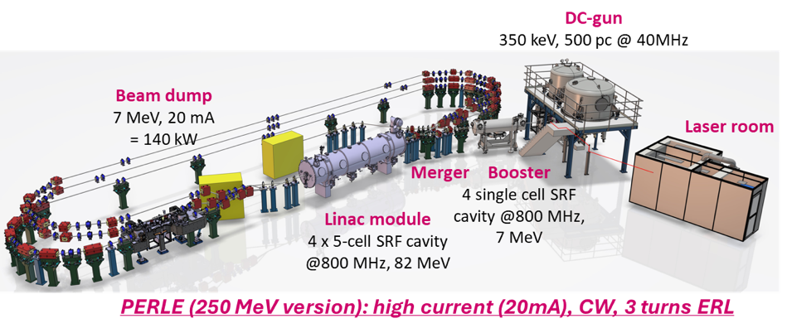
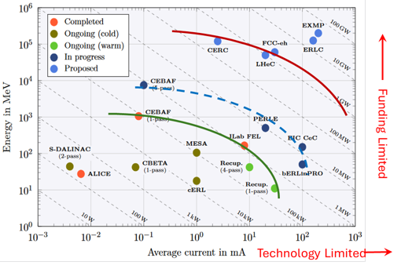
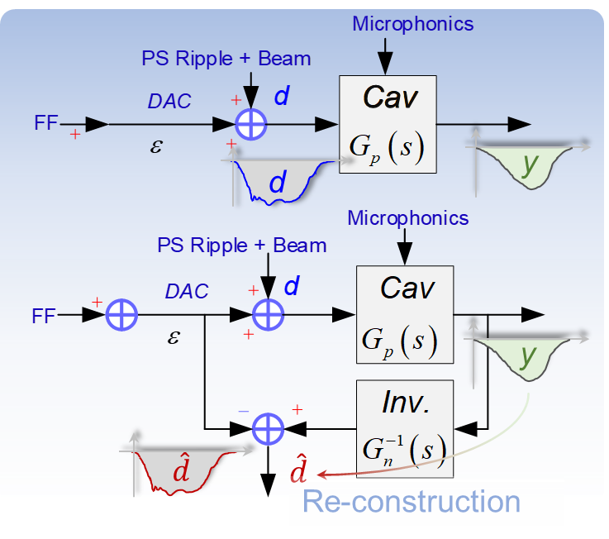
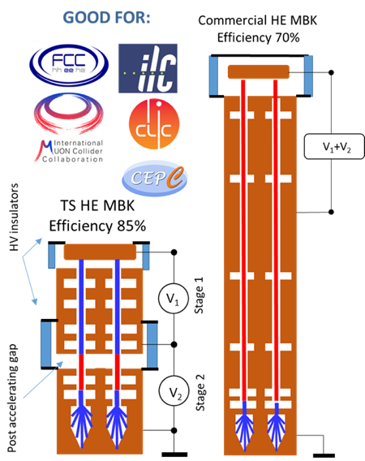


WG11 RF
T. Abe & A. Gallo: WG11 Summary
RF x ERLs, HE-klystrons, Advanced LLRF (Sustainability, ML&AI )
Talk #2
Energy Recovery Linacs (ERLs) were recognized as one of the five main axis of accelerators R&D in support of the ESPP.
Two projects: PERLE & bERLinPro were recognized as "essential pillars of the ERL development," with milestones to be achieved by the next ESPP in 2026.
5 main challenges for RF systems have been identified and addressed:
High Q₀ cavity
Efficient HOMs extraction
The highest BBU threshold
Fast tuning, prevent external vibrations
Fast feedback and perfect phase synchronisation
Cavity treatment with optimised recipe (EP, Doping, infusion, Mid T-baking…)
Act on cavity design + optimized HOM couplers and BLA
Optimized Filling pattern and HOM extraction & damping scheme
Development of FE-FRT
Development of a digital AI-assisted field and detuning control, smart amplifier control
Talk #5
Talk #9
RF stability and beam energy spread of cERL have been improved using DOB (Disturbance Observer Control) method: it reconstructs disturbance estimation then cancel it from the LLRF control loop
High Efficiency (HE) Klystrons are generally needed for all future projects and an intense R&D and activity is worldwide ongoing.
Power efficiency increase is mandatory to reduce operational cost and increase the sustainability of the present and future facility.
The status of the development of dedicated tubes for all major accelerator projects (FCC ,LHC, ${\text{C}}^{3}$,CLIC, MuCol, CEPC) has been presented. The trend is extremely positive.
The tube efficiency is raising from 40-50% (typical values in today catalogues) to 60-80% in recent prototypes and first industrial units, while there are ideas and experimental activities to go further up to ≈90%.
Synergies and industry involvement are essential.
Managing transient loading of the 10 mA beam with new Iterative Learning Control (ILC) strategies
Achieving AI-based automated SRF fault classification
Mitigating SRF faults using flexible LLRF algorithms
FCC Two-stage MBK (multi-beam klystron): CW, 400MHz, 1.28MW
23
23
eeFACT2025 Workshop – Tsukuba (JP), March 3-7 2025

Slide 24
Gao Jie (IHEP) Hirotaka Nakai (KEK)
WG12 Cryogenics, Infrastructures
WG12
Cryogenics, Infrastructures

Slide 25
Summary of WG12 (Cryogenics, Infrastructures)
WG12 Cryogenics, Infrastructures
Cryogenics
1. Accelerator cryogenics in China (Rui Ge)
Various superconducting accelerators are in operation or under construction in China
Cryogenic systems meet the demands for superconducting accelerator operations, after experiencing long-term developments of cryogenic engineering and technology
2. ILC cryogenic systems (Kota Nakanishi)
ILC cryogenic system has been updated as needed
All amount of helium inventory of ILC will be stored in gas phase during long-term shut-down or power outage

Slide 26
WG12 Cryogenics, Infrastructures
Infrastructures
1. CEPC conventional facilities (Jinshu Huang)
Works of all CEPC systems are in progress, and the plannings and designs of conventional facilities need to be updated
Energy conservation and green design are key focuses of CEPC
2. Accelerator facility life cycle (Masakazu Yoshioka)
We are not free from carbon neutrality and low carbon emission even for construction and operation of large-scale accelerators
Further efforts should be made to improve energy-saving technologies for construction and operation of large-scale accelerators like ILC
3. Sustainability assessment of European LDG Working Group (Maxim Titov)
The European Laboratory Directors Group (LDG) took recently the decision to establish a working group on complex sustainability assessment of future large-scale accelerators
The working group includes representatives of the projects of future accelerators and experts on sustainability of large research infrastructures

Slide 27
We hope that you have enjoyed eefact2025
Thank you

