Slide 1
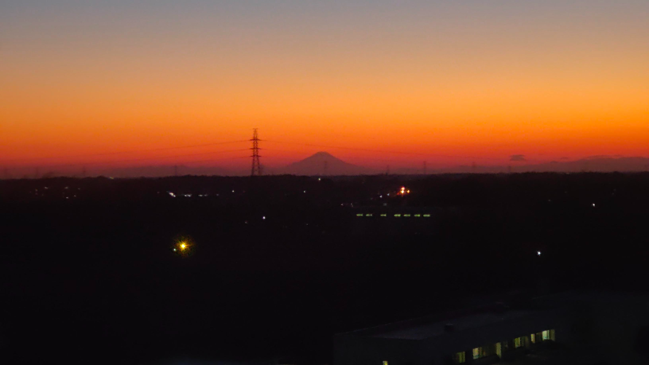
What is »JACoW« The »Joint Accelerator Conferences Website«
Volker RW Schaa Darmstadt, Germany
KEK, Tsukuba, Japan — 2024
view from 6th floor San Go Kan building 2024-01-18

Slide 2
Before I start…
… with my talk about JACoW, I want to explain
who I am,
and what I’m doing at KEK,
and also that JACoW has nothing at all to do with cows (and is not pronounced as such).

Slide 3
Before I start…
… with my talk about JACoW, I want to explain
who I am,
and what I’m doing at KEK,
and also that JACoW has nothing at all to do with cows (and is not pronounced as such).
My name is Volker RW Schaa,
I’m from GSI/FAIR, Darmstadt, Germany
And to get an impression here are some (way too many) items from my CV:

Slide 4
who I am…
1971 Technical University of Darmstadt (TUD) enrolled for Physics, Electrical Engineering, and Technical Informatics
1974 Student Employee (½ FTE) of GSI
1976 Thesis at TUD/GSI "Heavy Ion Beam Emittance Measurements using Profile Harps"
1975–2020 full employee of GSI/FAIR
1975 Software development for operation of the linear accelerator (UNILAC)
1977–1982 Group Leader »Main Control Room Software« (Operations Department)
1982–2012 Group Leader »Main Control Room Software« (Controls System Department)
1988–2005 Deputy Leader: Controls System Department
2001 »JACoW« started for me (from 2007 as full FTE)
2012 Senior Scientific Advisor for the »Controls System Department«
2017 Retired
2017–2020 employed as »Senior Scientific Advisor for Open Access Publication« and »JACoW« 2021–2024 working for MSU/USA, LNLS/Brasil, KEK/Japan, et al.
>2024-05 GSI/FAIR employee (¼ FTE)

Slide 5
what I do at KEK…
Kazuro Furukawa — a constant supporter of JACoW — wanted some old accelerator conference proceedings to be scanned and re-published with all the features of “modern” technology, such as DOIs, bibliographic records, entries into InspireHEP, and searchable by e.g. GoogleScholar, etc.
He asked me and I happily accepted the invitation for 2022 and 2023.
This was done first (after 33 years) for »ICALEPCS 1991« which was organized by KEK in Tsukuba and took place in this building.
ICALEPCS 1987, 1995, and 1997 will follow.

Slide 6


Slide 7
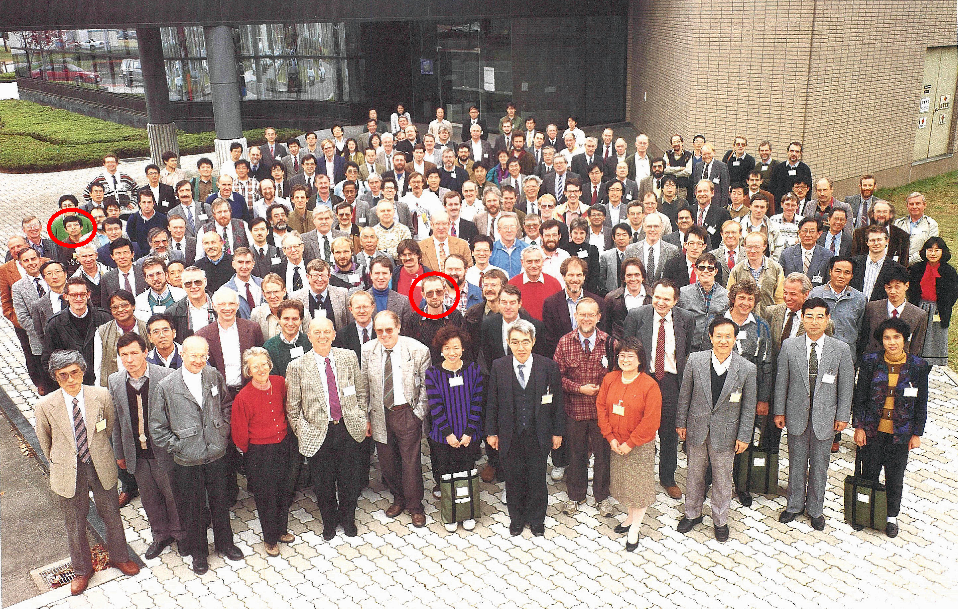

Slide 8
JACoW — Activity for Accelerator Community
The topics I will try to cover
A bit of pre-JACoW history (hmm, actually a lot)
How JACoW came into existence
JACoW’s goals — Main Purpose of JACoW
JACoW Milestones
What else is JACoW? Requirements, Charter, Community, …
Where do we stand today, current activities and future

Slide 9
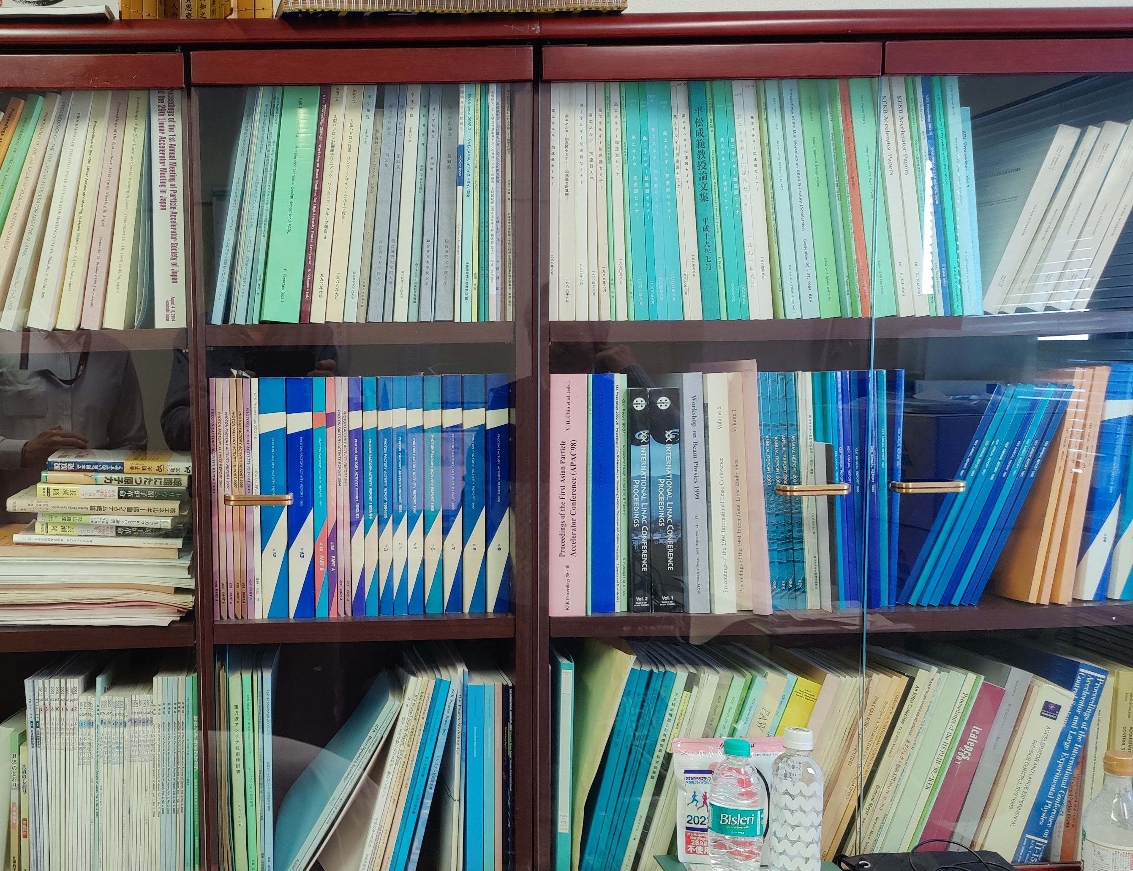
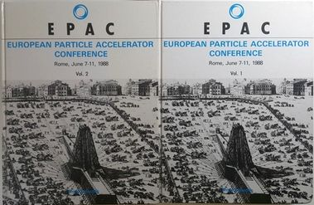

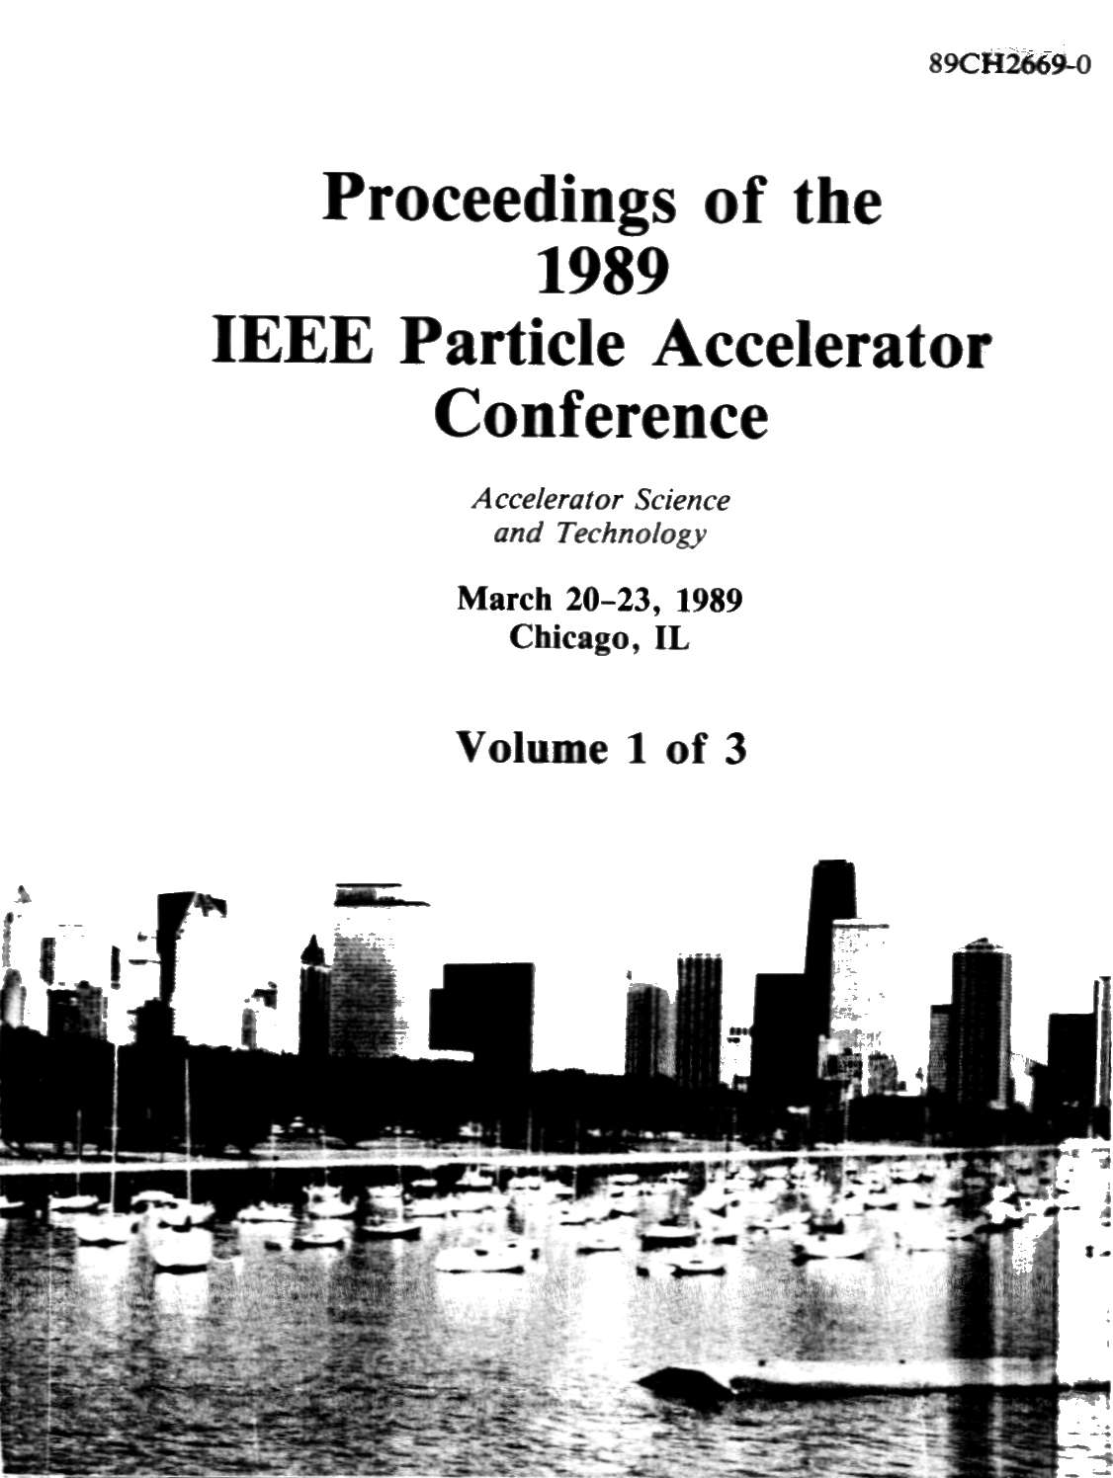

pre-JACoW history
I remember from my early days that proceedings were books

Slide 10
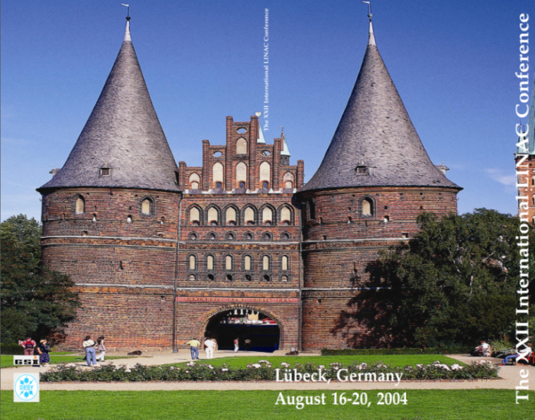
… history
Conferences once printed all their proceedings
As delegates you got a printed, shipped copy (when requested/payed). I remember getting my proceedings volume of ICALEPCS’89 delivered 3 weeks before ICALEPCS’91!
Institutes send people to conferences to get printed proceedings
Printing and shipping was a big part of the conference budget
Even in JACoW’s early years printed books were requested: ★ I produced for LINAC’04 printed proceedings: 2 volumes, full-color, with hard-cover, 914 pages, 48 €

Slide 11
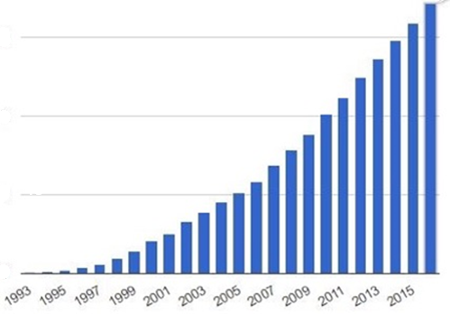
… history
Conferences once printed all their proceedings
This became more complicated and expensive with the number of papers (e.g. for PAC’95 more than 3,000 pages were expected)
Technical development set the path:
1990: World Wide Web (CERN)
1993: PDF and Acroread made free (Adobe)
1994: 100 MHz PC processors (Intel)
1995-2000: Dot Com Boom Internet usage/access grows 25×: 15 M to 350 M
PAC’95 decision: Electronic Publication
EPAC’96 and PAC’97 joined the editorial team to learn how it might be feasible (see documentation)

Slide 12
… history
only a short detour: prices for printed proceedings You can still buy the proceedings of EPAC’96 on Amazon and Ebay

Slide 13
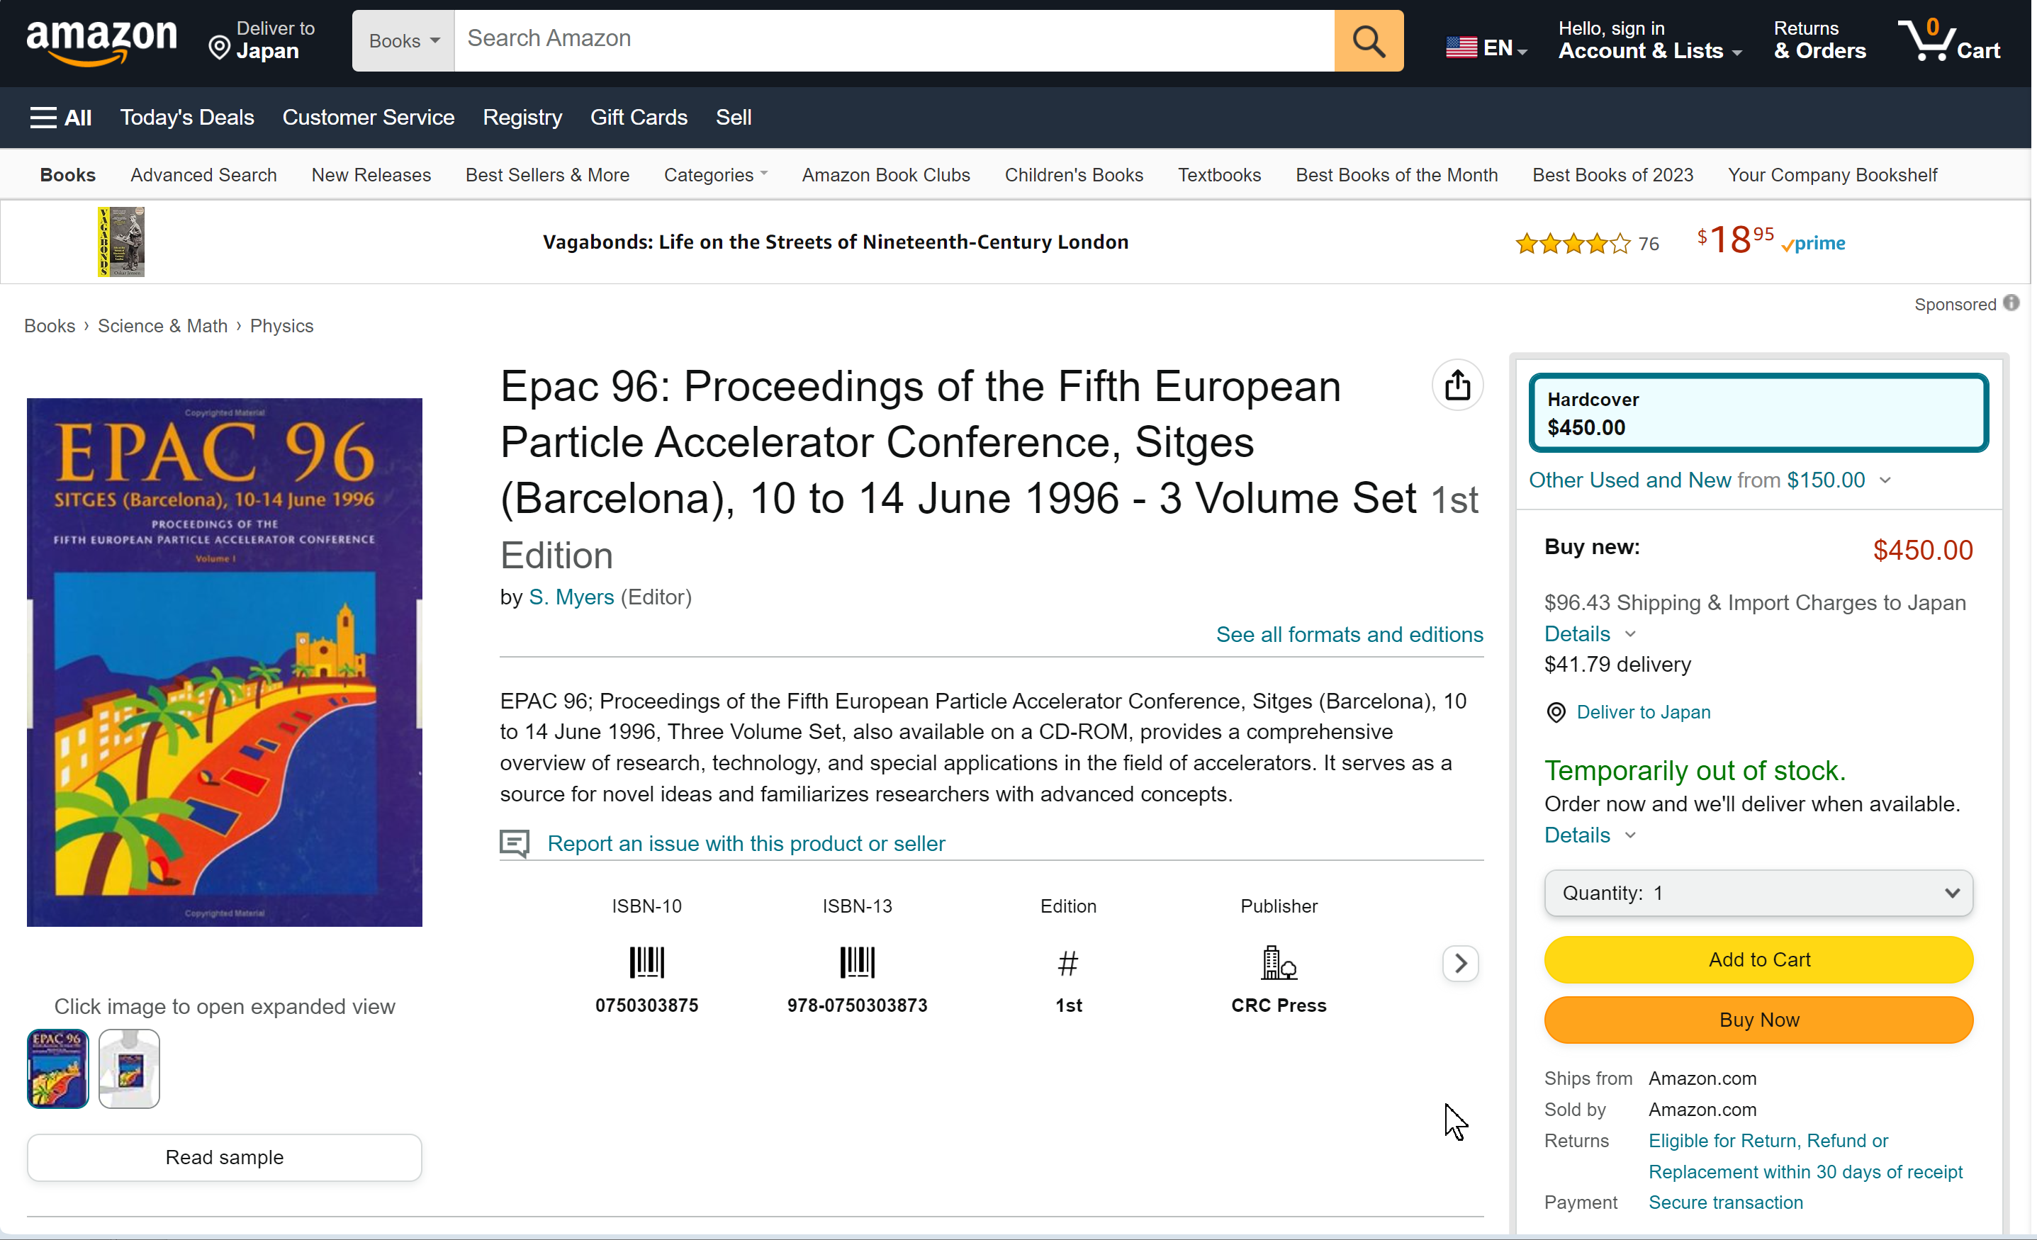
… history
only a short detour: prices for printed proceedings You can still buy the proceedings of EPAC’96 on Amazon and Ebay

Slide 14
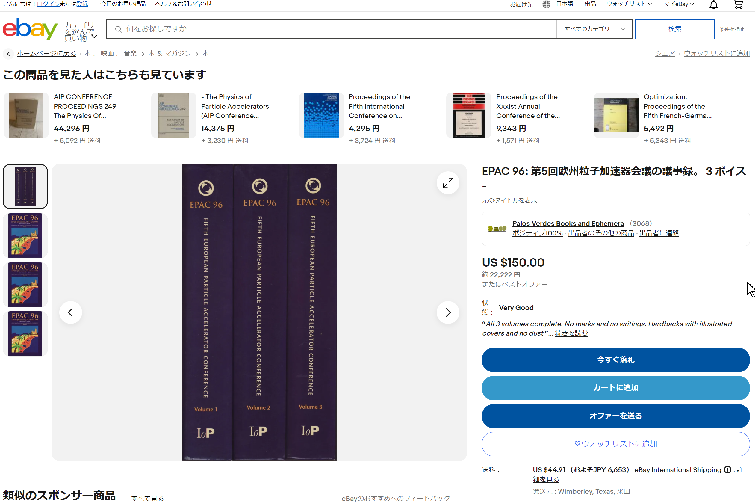
… history
only a short detour: prices for printed proceedings You can still buy the proceedings of EPAC’96 on Amazon and Ebay

Slide 15
… history
Prices for printed proceedings:
Large portion of the registration fee was spent in the “old days” when all delegates received a printed copy
Btw.EPAC’96 is still available for US$ 150–450 or ¥ 22,222
Proceeding copies are now sold through e.g. Curran Associates for libraries (in the past JACoW got a small amount of royalties)
Other hardcopies US$ 100-300 (or less) for recent IPACs

Slide 16
… history
Who were the people who wanted to try their hands at publishing proceedings themselves?
John Poole EPAC’96
PAC’99
PAC’97
Leif Liljeby
PAC’95
EPAC’98
Leif Liljeby
EPAC’98

Slide 17
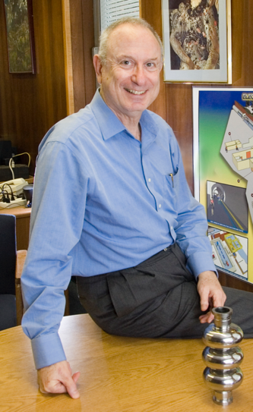
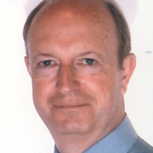
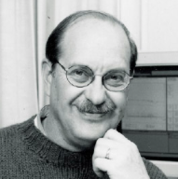
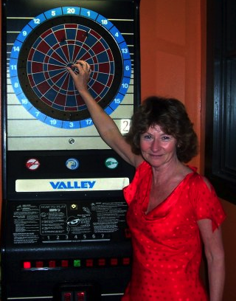
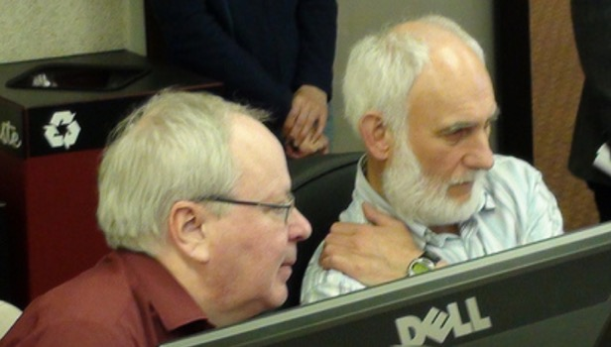
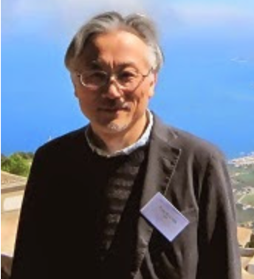
The people to try their hands at publishing proceedings themselves
PAC’95
John Poole EPAC’96
Bob Siemann
Ilan Ben-Zvi
The birth of JACoW:
PAC’99
Christine Petit-Jean-Genaz
EPAC’96...
It was Ilan Ben-Zvi of BNL, the PAC’99 Programme Committee Chairman, who suggested that it would be useful for sister conferences in the APAC, EPAC & PAC series to publish their proceedings at the same site.
Martin Comyn
Martin
Comyn
PAC’97
PAC’97
Leif Liljeby
PAC’95
Leif Liljeby
Leif Liljeby
EPAC’98
APAC’98
EPAC’98
EPAC’98
Yong-Ho Chin

Slide 18


How JACoW came into existence
The birth of JACoW
came with Ilan Ben-Zvi’s idea to publish the electronic proceedings at the same site.
The website for publication was decided to be at CERN and when
EPAC’96 appeared,
soon PAC’95 and PAC’97 proceedings were added, followed by
EPAC’98, APAC’98, and PAC’99,
Finally the JACoW.org was established for the conferences website

Slide 19
JACoW’s goals
What are the goals of JACoW?
Publish high-quality sets of proceedings with access through the custom interface which allows searching the proceedings with boolean searches on keywords, title, authors and in the full text.
Provide long-term archival storage to ensure longevity and access to publication data.
Publish conference metadata for the Open Archives Initiative (OAI).
Provide and maintain a repository of user profiles and affiliation for accelerator conferences.
Provide support for conference organizers.

Slide 20
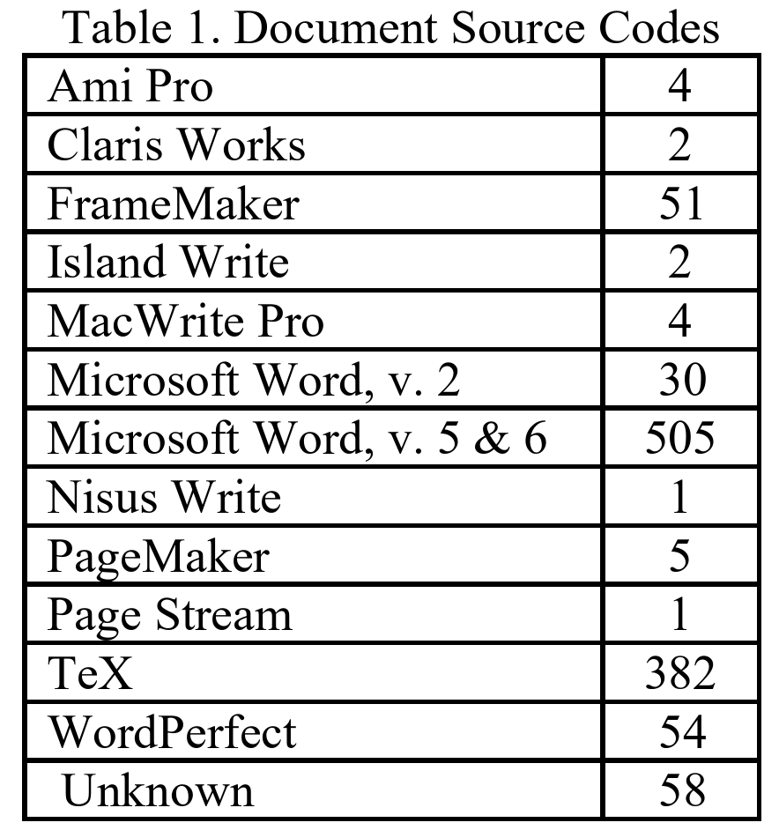
JACoW’s goal: … high-quality proceedings
Publish high-quality sets of proceedings from what authors provided in the early days turned out to be quite an undertaking (quotes from PAC’95 and EPAC’96):
Multitude of operating systems sources and applications (most unknown today), different types of fonts, 7 or 8-Bit ASCII, different character encodings, etc.

Slide 21
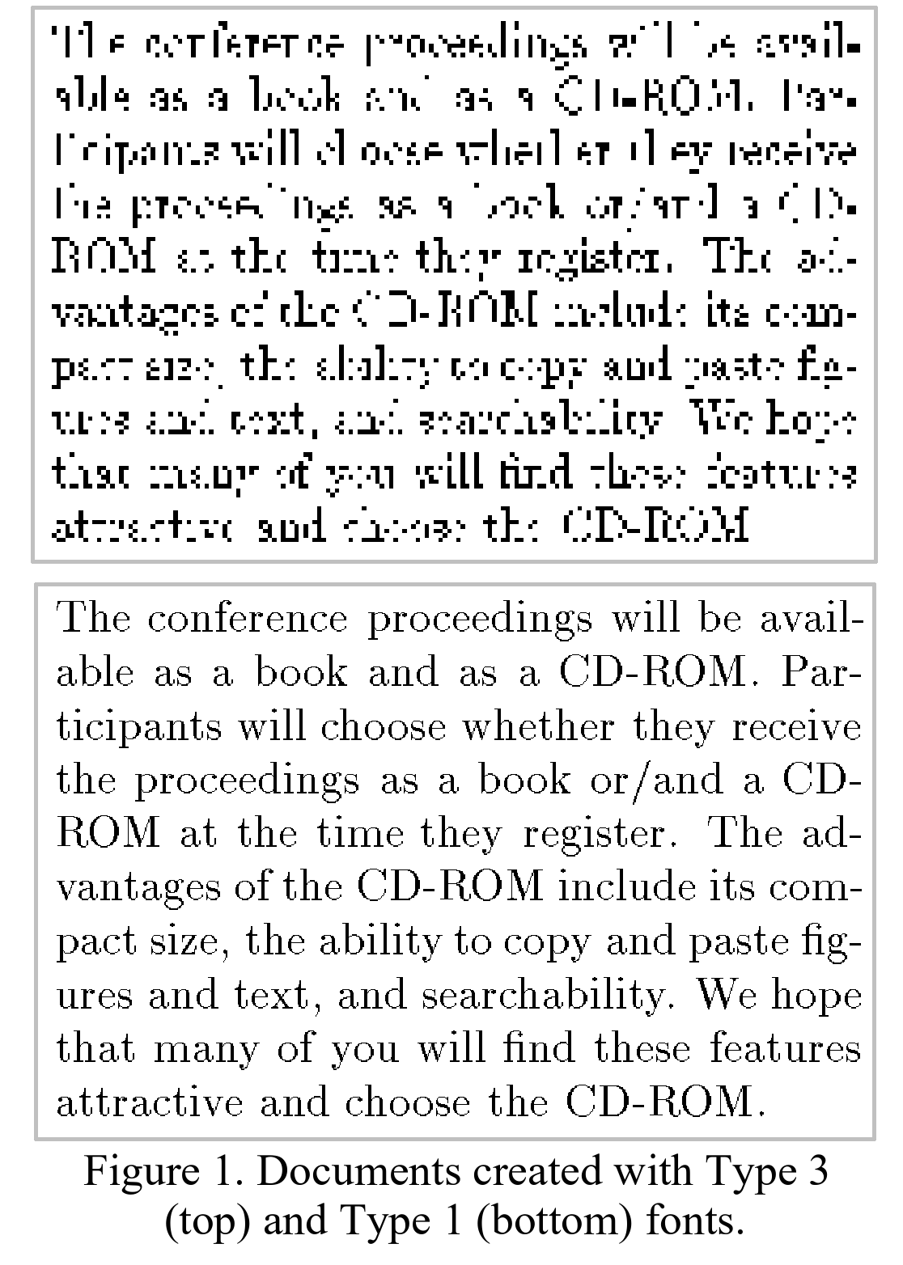
… high-quality proceedings
Problem:
Multitude of operating systems source
Problems with Type 3 fonts (LaTeX)

Slide 22
… high-quality proceedings
Problem:
Requested media types for source and PDF delivery:
1 diskette containing the complete printable paper as PostScript/PDF (could be zipped)
1…n diskettes containing the native format (WORD, TeX, etc.)
1…n diskettes containing the native format (Illustrator, Excel, etc.) source code for the figures and charts.
A printed copy of the paper for comparison
FTP server in addition if above too restrictive

Slide 23
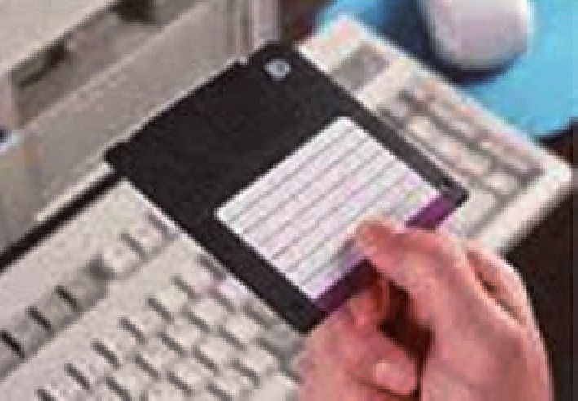
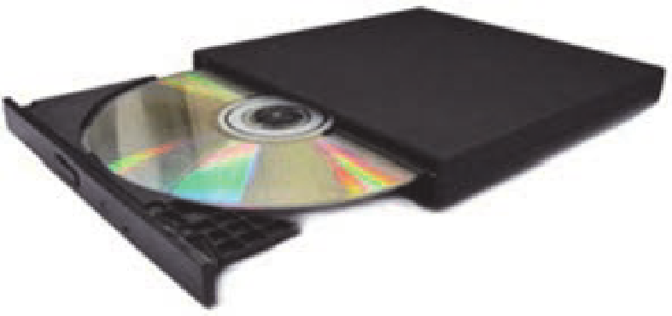
… high-quality proceedings
Problem:
Requested media types for source and PDF delivery:
1 diskette containing the complete printable paper as PostScript/PDF (could be zipped)
1…n diskettes containing the native format (WORD, TeX, etc.)
1…n diskettes containing the native format (Illustrator, Excel, etc.) source code for the figures and charts.
A printed copy of the paper for comparision
FTP server in addition if above too restrictive
Some pictures for those who do not remember these times (maximum of a SD/DS floppy 1.4 MB)

Slide 24
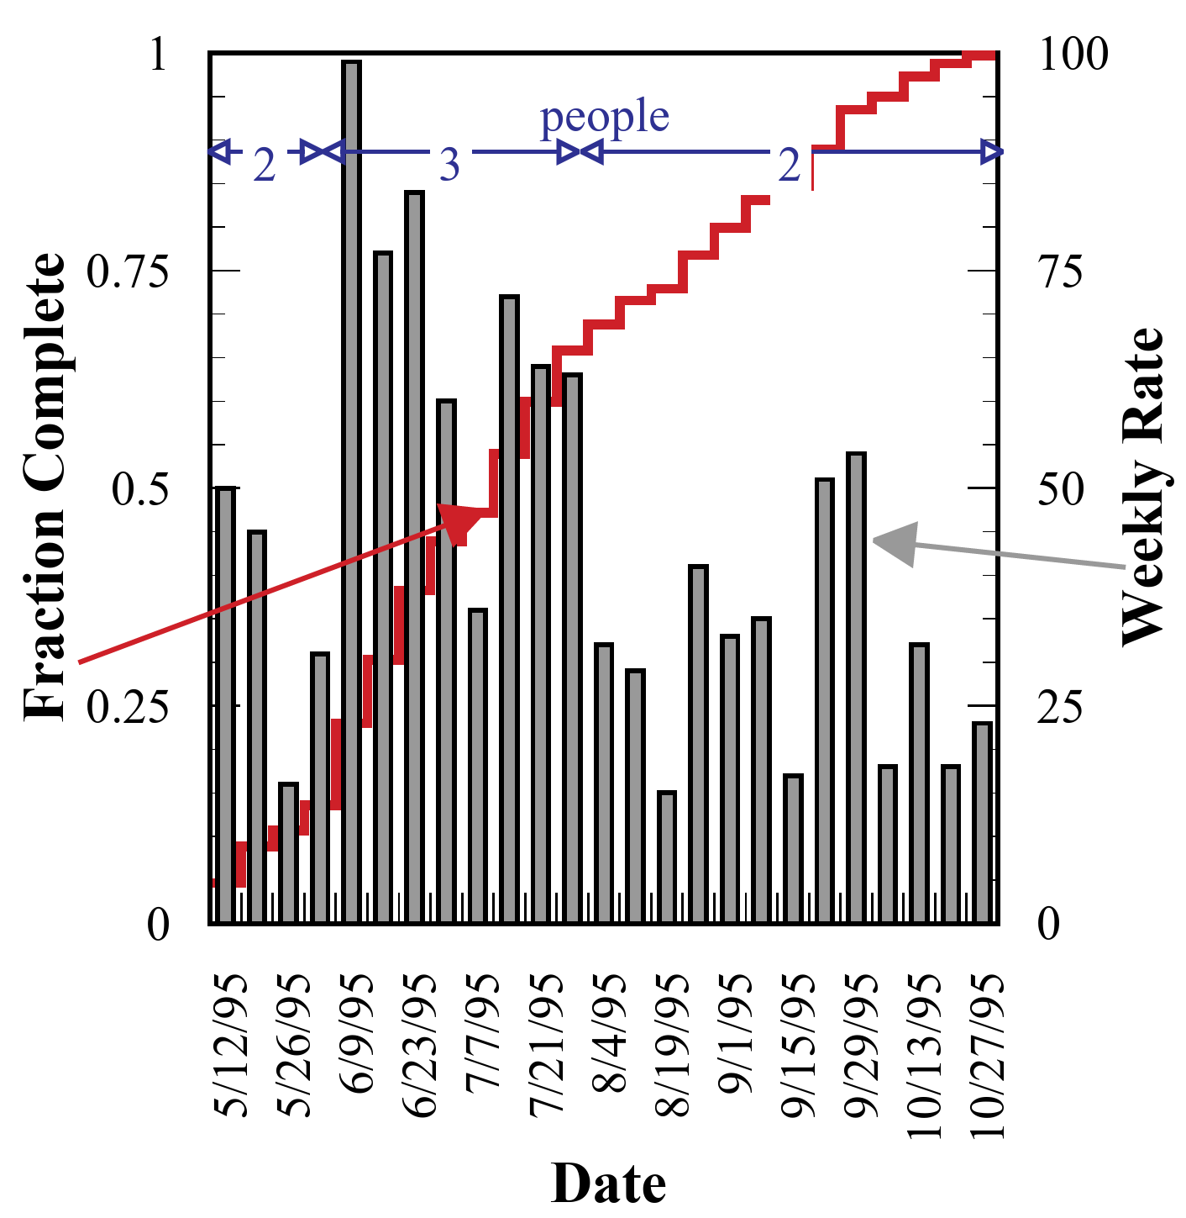
… high-quality proceedings
Problem:
Multitude of operating systems source
Problems with Type 1 fonts (LaTeX)
Amount of work finishing papers: time from 1995-05-08 to 1995-10-27 with the given people (5 days/week, 8 hours/day) gives ~2,600 hours.
Final publication after 5½ months for 1099 papers totaling 3429 pages
For EPAC’96 Chris made the suggestion to do the editing during the conference

Slide 25
… high-quality proceedings
Problem:
: …
Final publication for 1099 papers totaling 3429 pages after 5½ months
For EPAC’96 Chris made the suggestion to process the papers during the conference to be able to share the experience made while editing.
Therefore at EPAC’96 in Sitges, Barcelona the following people met in the Proceedings Office: Chris Petit-Jean-Genaz, John Poole, a CERN technical student, Leif Liljeby, MSL (editor EPAC’98), Yong Ho Chin, KEK (APAC’98), Martin Comyn, TRIUMF (PAC’99), and a few local people from Barcelona
This “JACoW model” brought together the people responsible for the electronic publication of the conference proceedings within the different regional series, to work and learn together.
It has been so successful that since 1996 all conferences have adopted it.

Slide 26
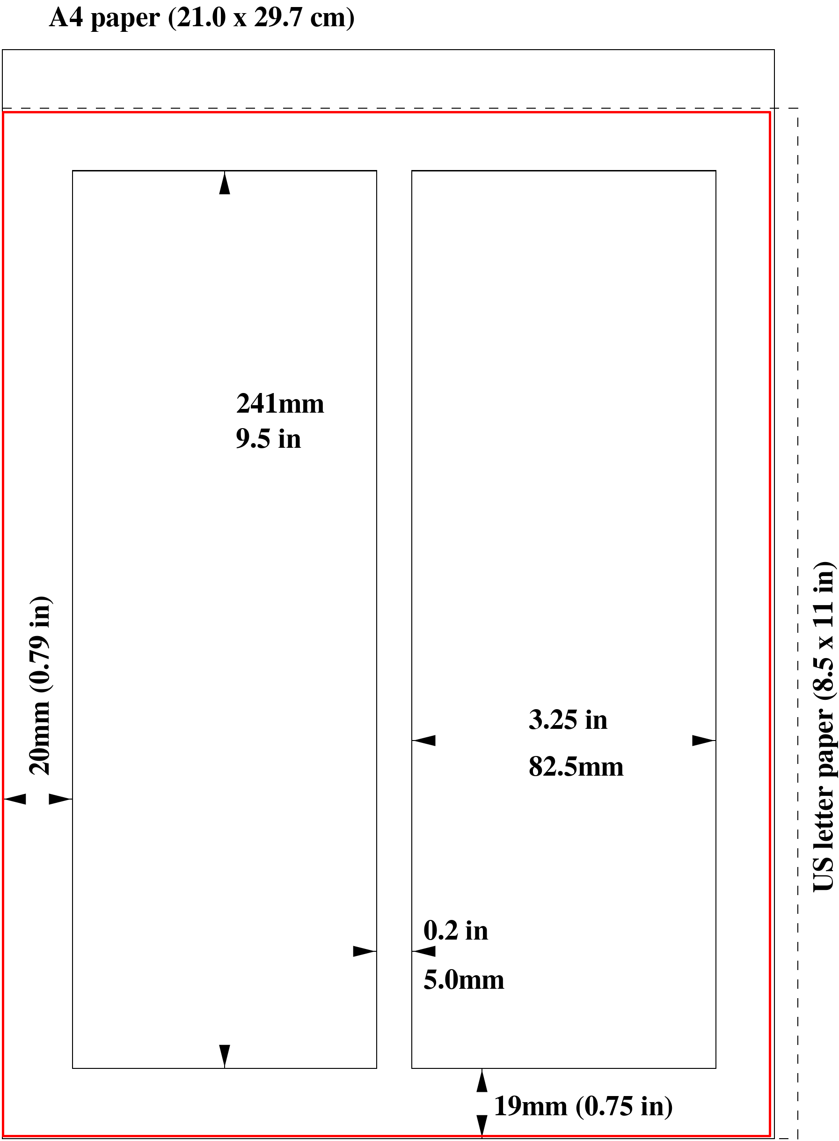
… high-quality proceedings
Problem: (quotes from PAC’97):
Working with A4 and Letter sized paper did not cause problems per se, only when it came to printing
Leif Liljeby of Manne Siegbahn Laboratory (MSL) came up with the idea of creating a JACoW paper size by cropping the PDF file to the minimum dimensions of A4 width and US Letter height.
Since then JACoW uses this special paper size in its provided templates.

Slide 27
… high-quality proceedings
Problem:
Experiencing the amount of different source formats from a multitude of different applications, it was decided to provide templates for the most used ones
MSWord for Windows and Mac, LaTeX, and OpenOffice from Sun/Oracle/Apache
These templates came in two versions: A4 and Letter
So dependent on what you prefer, you will find:

Slide 28
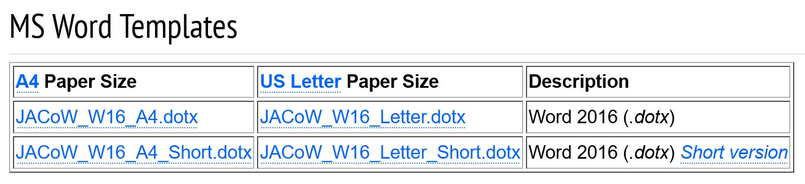
… high-quality proceedings
Problem:
Experiencing the amount of different source formats from a multitude of different applications, it was decided to provide templates for the most used ones
MSWord for Windows and Mac, LaTeX, and OpenOffice from Sun/Oracle/Apache
These templates came in two versions: A4 and Letter
So dependent on what you prefer, you will find today just these two: (in earlier years we had to maintain 3-4 versions of Word in MS and Mac flavor)

Slide 29
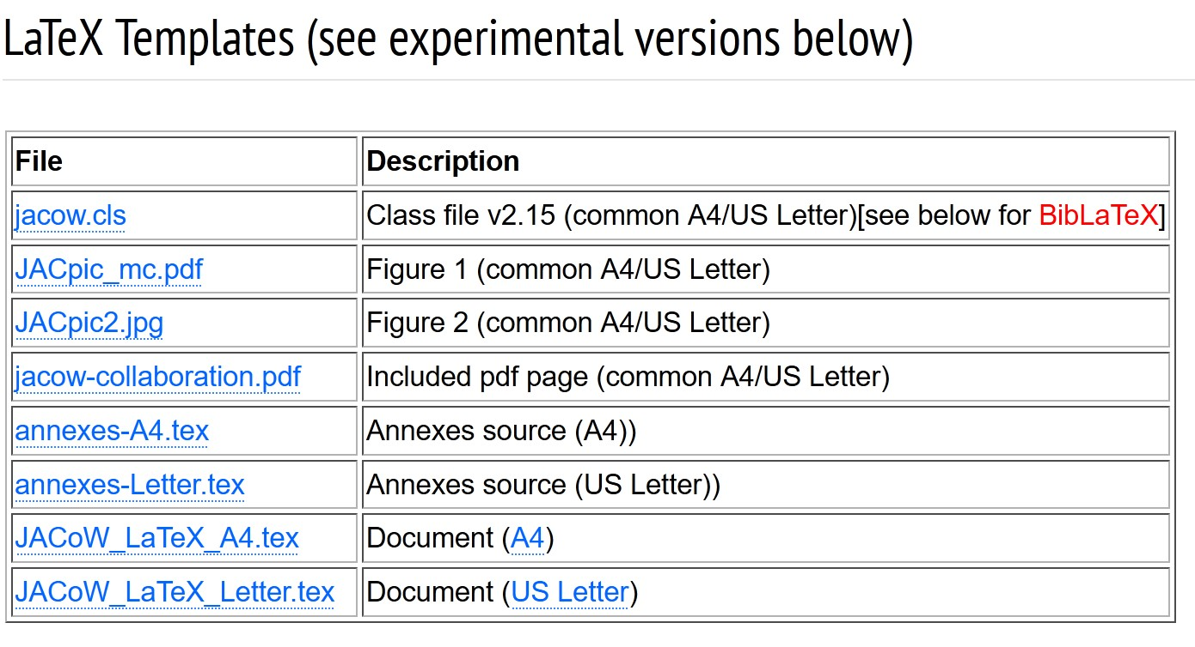
… high-quality proceedings
Problem:
Experiencing the amount of different source formats from a multitude of different applications, it was decided to provide templates for the most used ones
MSWord for Windows and Mac, LaTeX, and OpenOffice from Sun/Oracle/Apache
These templates came in two versions: A4 and Letter
So dependent on what you prefer, you will find:

Slide 30
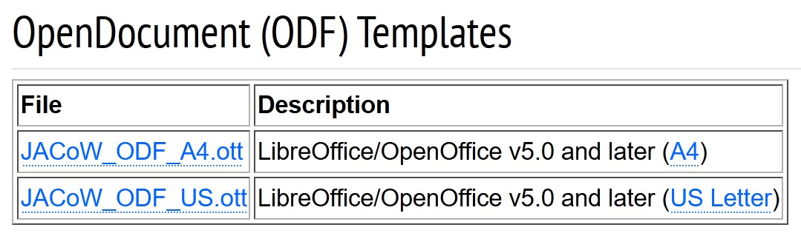
… high-quality proceedings
Problem:
Experiencing the amount of different source formats from a multitude of different applications, it was decided to provide templates for the most used ones
MSWord for Windows and Mac, LaTeX, and OpenOffice from Sun/Oracle/Apache
These templates came in two versions: A4 and Letter
So dependent on what you prefer, you will find:

Slide 31
… high-quality proceedings
Problem:
Experiencing the amount of different source formats from a multitude of different applications, it was decided to provide templates for the most used ones
MSWord for Windows and Mac, LaTeX, and OpenOffice from Sun/Oracle/Apache
These templates came in two versions: A4 and Letter
So dependent on what you prefer, you will find.
In the future there will only be one LaTeX template as LaTeX crops the page size automatically to the JACoW paper size.

Slide 32
JACoW Milestones
Now I want to highlight some mile stones in the years 2004 to 2023.
Be assured that much more happened in the JACoW community then I’m going to list in the coming slides but I wanted to show important events that are still in my mind as memorable (and are therefore just a personal view).

Slide 33
JACoW Milestones
2004 Award for JACoW: Christine Petit-Jean-Genaz and John Poole
2004 First use of a production version of the Scientific Programme Management System (SPMS)
2004 First use official use of JACoW Proceedings Software Package (JPSP)
2010 Award for JACoW: Christine Petit-Jean-Genaz and Volker RW Schaa
2012 ISBN numbers for JACoW conferences
2015 DOI registration for all JACoW papers
2019 RefScan: Reference Search in all of JACoW’s proceedings
2019 CatScan: Word DOCX Validator to examine JACoW papers ahead of submission
2020 ISSN numbers for all conferences
2023 Scopus indexes LINAC and IBIC conferences
2023 First use of a production version of the new JACoW-Indico Conference System

Slide 34
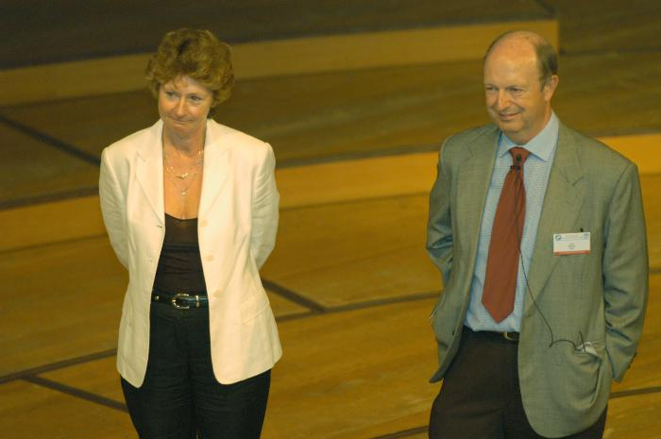
JACoW Milestones
https://vrws.de/EPAC2004-Award-Session.mp4
2004 Award for JACoW: Christine Petit-Jean-Genaz and John Poole
The following are extracts from the citation the award carried:
“From tiny acorns mighty oak trees grow. An idea from Ilan Ben-Zvi in 1996, nurtured by others, has finally spread its branches as the JACoW collaboration reaches maturity in 2004.”
“While many individuals have played a part, none would begrudge recognition to the two people whose foresight and enthusiasm have served to blend so many varied ideas together: John Poole, the Chairman of JACoW, and Christine Petit-Jean-Genaz, the EPAC Conferences Coordinator.”

Slide 35
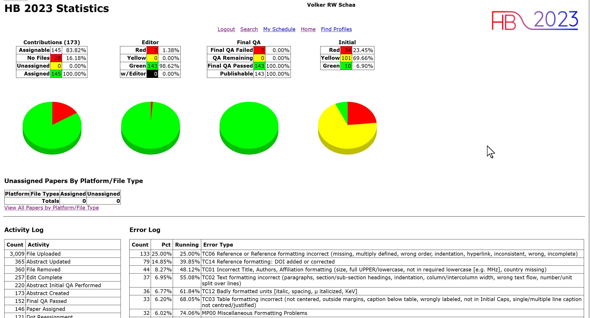
JACoW Milestones
2004 The Scientific Programme Management System (SPMS)
At EPAC’04 the SPMS developed by Matt Arena is use for the first time for abstract submission, paper upload and in the editorial office for paper editing. It is now available for all future conferences providing access to the Central Repository containing author profiles and affiliation.
I could not find a picture from 2004 therefore I present an actual one. The important display for editors is the one to the left showing every-thing about the status.

Slide 36
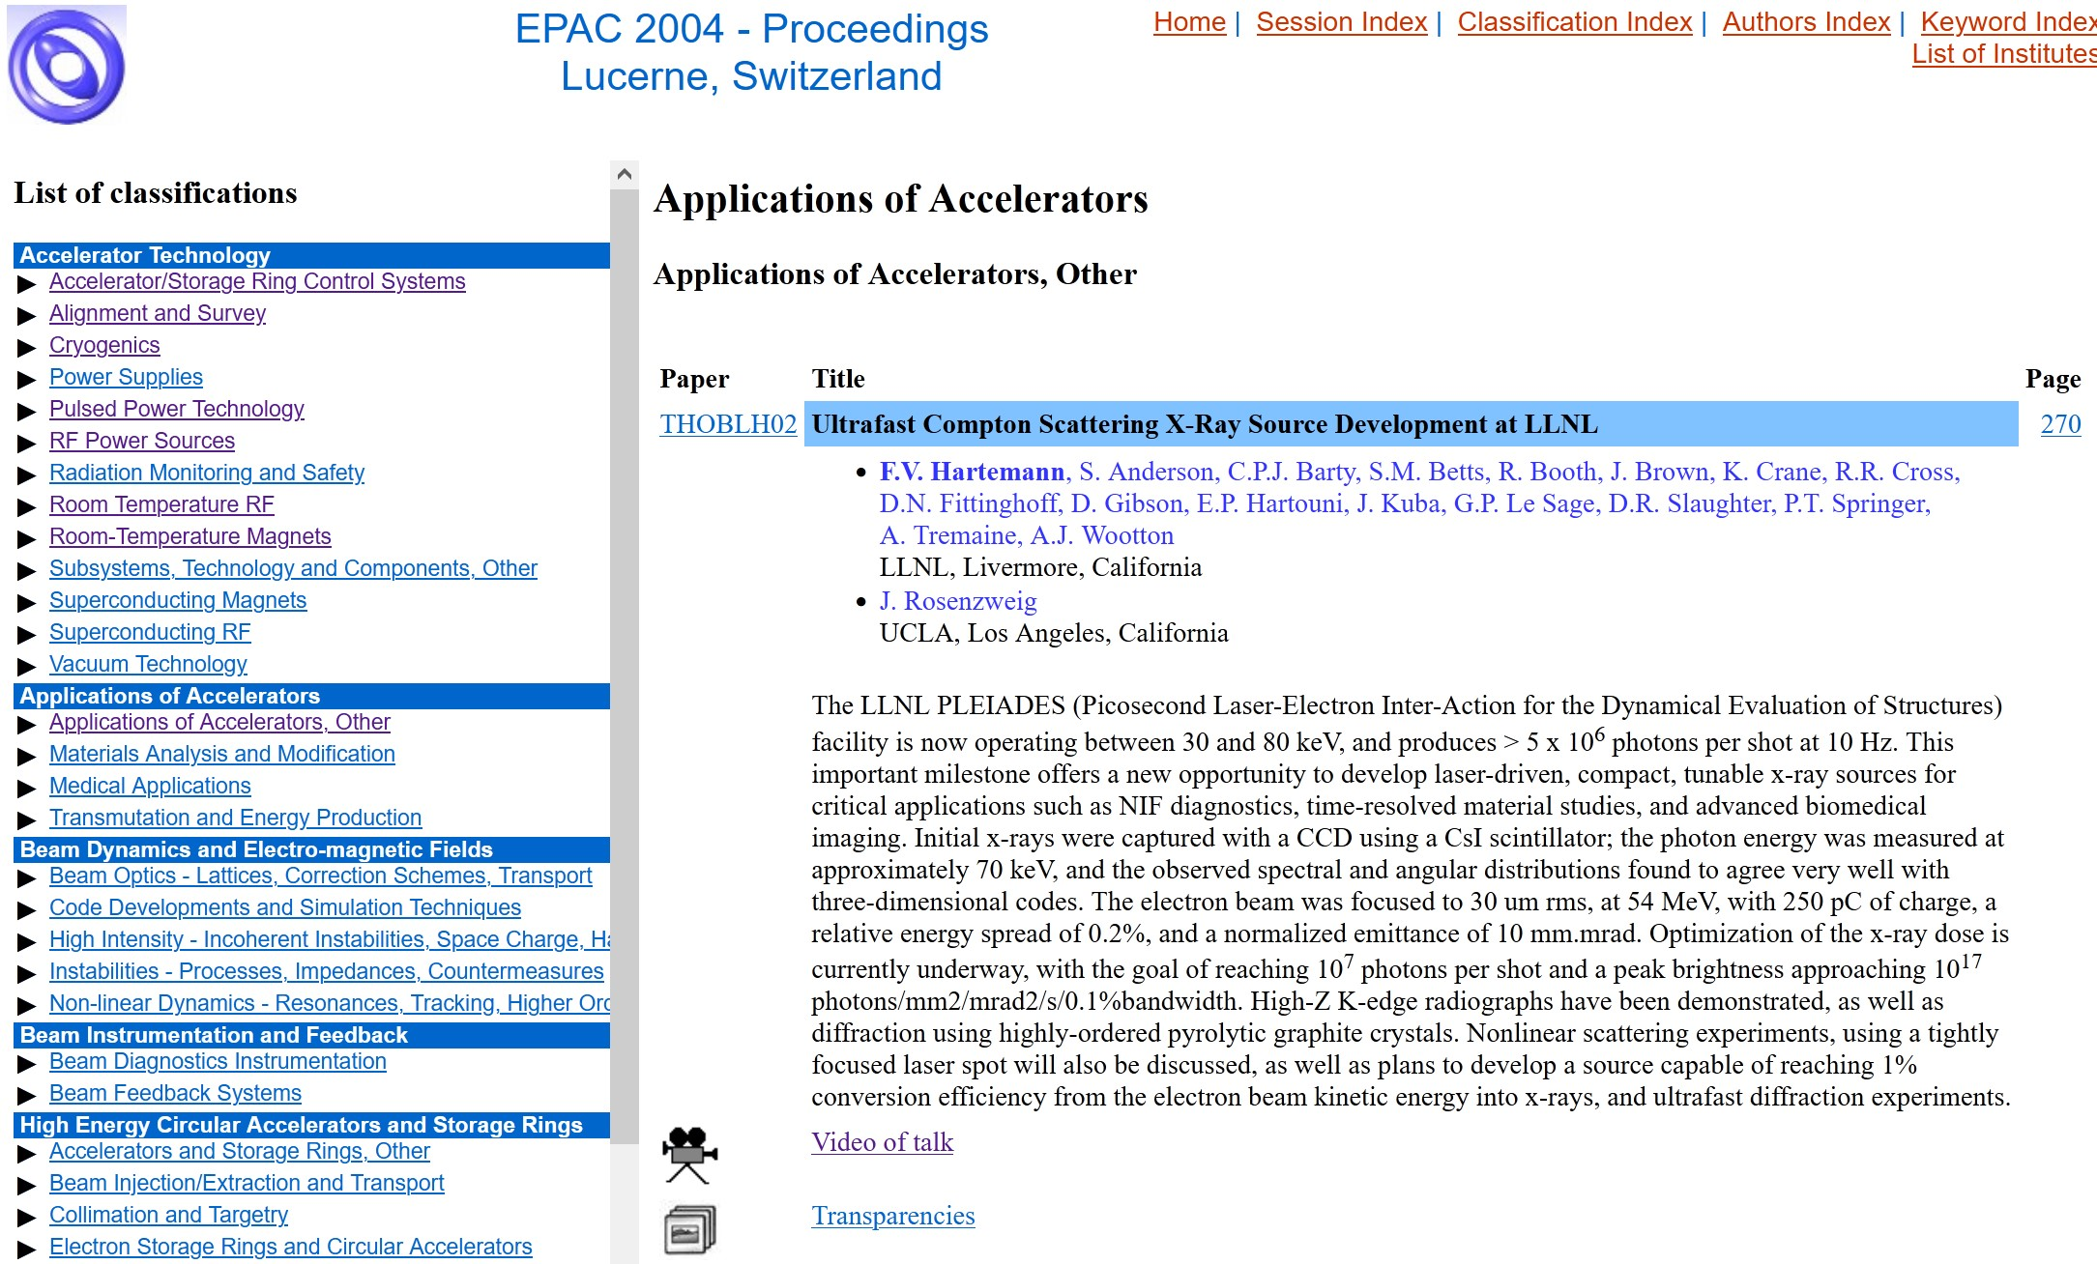
JACoW Milestones
2004 First use official use of JACoW Proceedings Software Package (JPSP)
At EPAC’04 my script package was used for the first time using XML data export from SPMS.

Slide 37
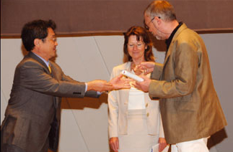
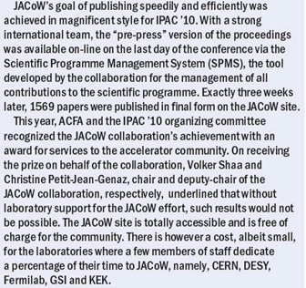

JACoW Milestones
2010 Award for JACoW: Christine Petit-Jean-Genaz and Volker RW Schaa

Slide 38
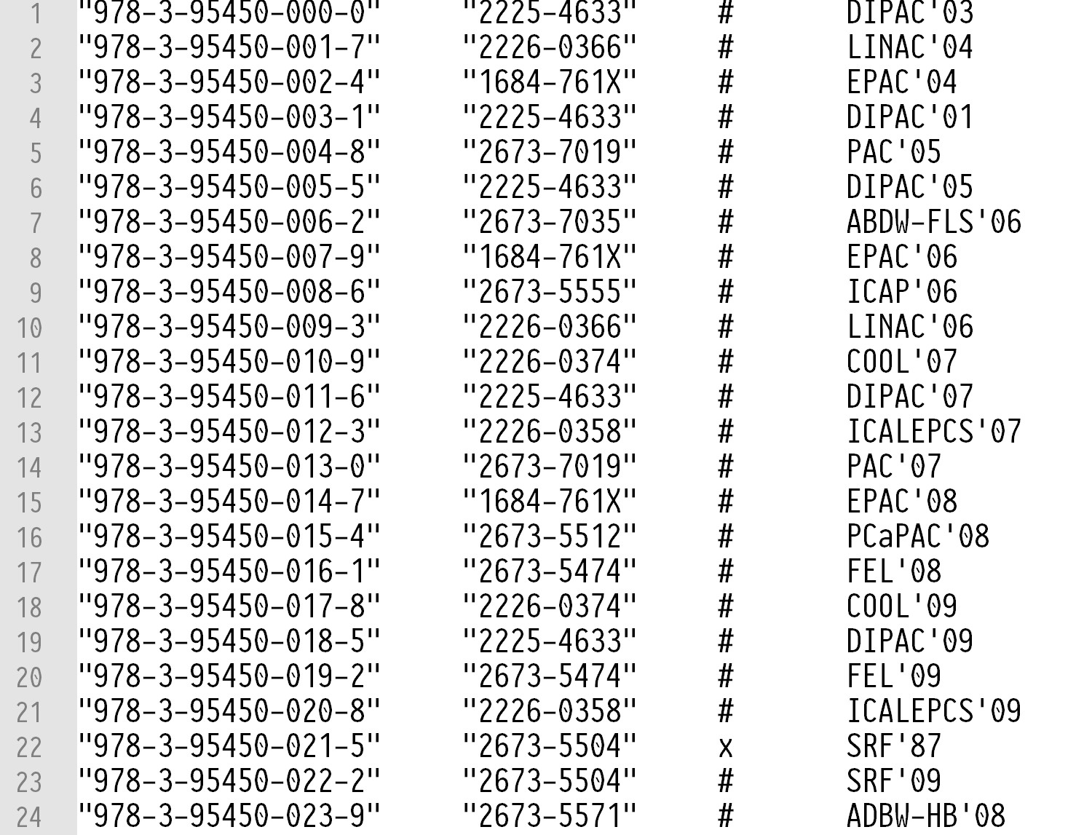
JACoW Milestones
2012 ISBN numbers for JACoW conferences This shows the block of ISBNs provided by the German Registrar. JACoW got the 1,000 ISBN block 978-3-95450-xxx-x This block is under own supervision and we decide which conference gets which ISBN number. In this list the ISSN number is listed too as these go hand-in-hand with the conference series (see ISSN).

Slide 39
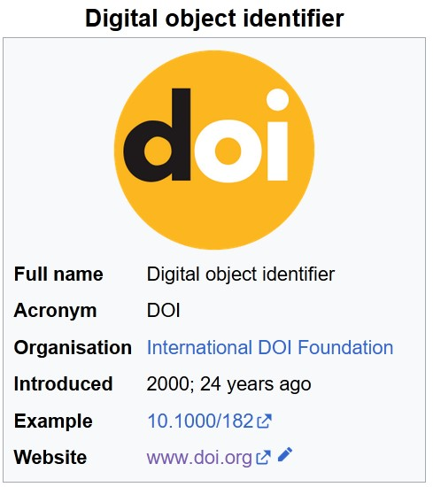
JACoW Milestones
2015 DOI registration for all JACoW papers
After several years of trying to acquire low-cost DOIs for JACoW's papers (2-10 € in 2013), Germany was able to provide free DOIs for research institutes in 2014, but the metadata had to be hosted in Germany. This would have meant doubling some of the data (PDFs + landing page + metadata). In 2015, Switzerland also made it possible for universities and research institutes to register DOIs free of charge. As our data are stored at CERN, this was the start of JACoW's DOI registration.
JACoW got the DOI basic URI 10.18429 which is a CERN subdomain as format I defined JACoW-<conference-acronym+year>-<paper_code> a valid DOI for a JACoW paper might be 10.18429/JACoW-IBIC2027-TU7MO4I
A DOI is a persistent identifier or handle used to uniquely identify various objects, standardized by the International Organization for Standardization (ISO). DOIs are an implementation of the Handle System;[ they also fit within the URI system (Uniform Resource Identifier). They are widely used to identify academic, professional, and government information, such as journal articles, research reports, data sets, and official publications.

Slide 40
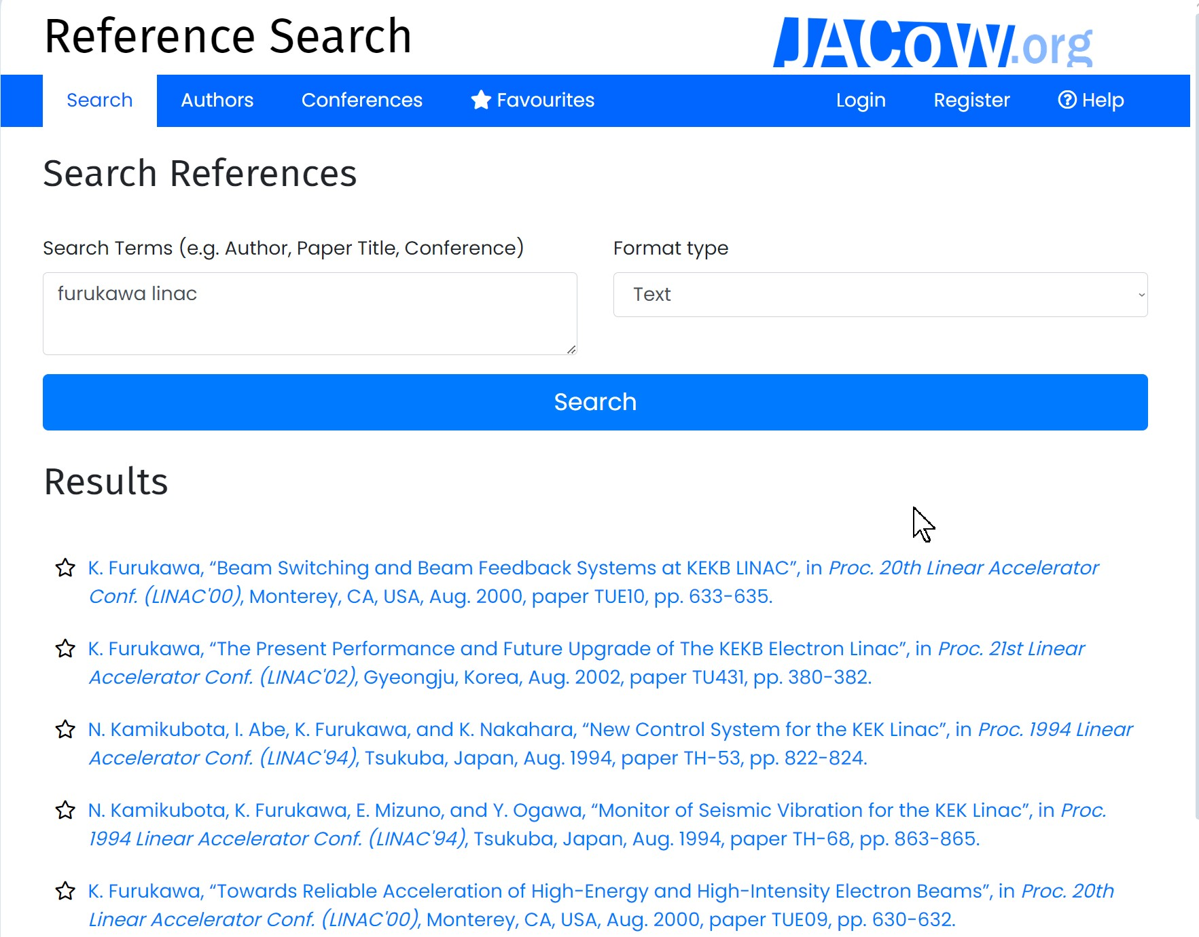
JACoW Milestones
2019 RefScan: Reference Search in all of JACoW’s proceedings
In 2019 for the IPAC in Australia ANSTO developed two tools which are enormously important for every author trying to provide correct references to JACoW proceedings papers. Josh Peters of ANSTO refined the tool so that all relevant papers published on JACoW can now be found with just a few entries. The references can then be output as bibliographic data in various formats.

Slide 41
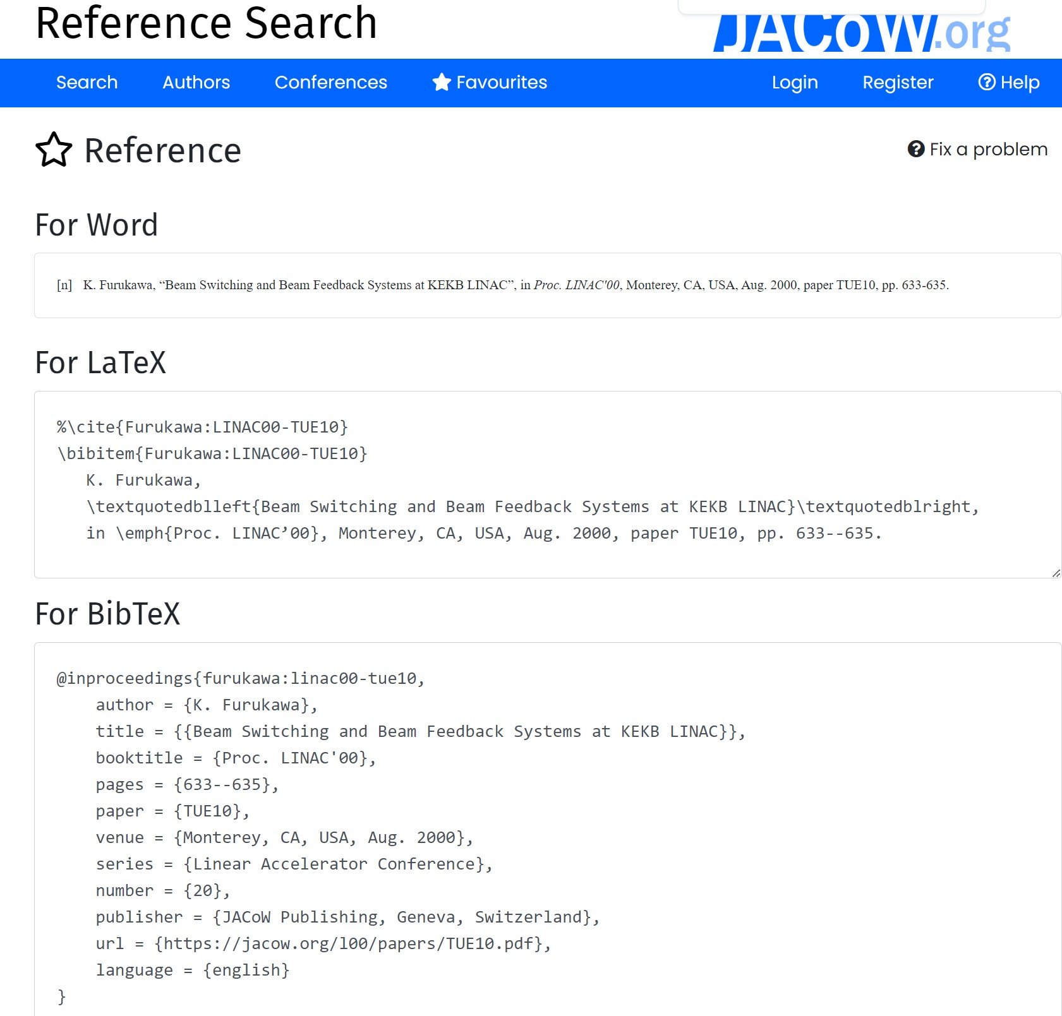
JACoW Milestones
2019 RefScan: Reference Search in all of JACoW’s proceedings
RefScan can provide formatted output for Word, LaTeX and BibTeX as can be seen to the right

Slide 42
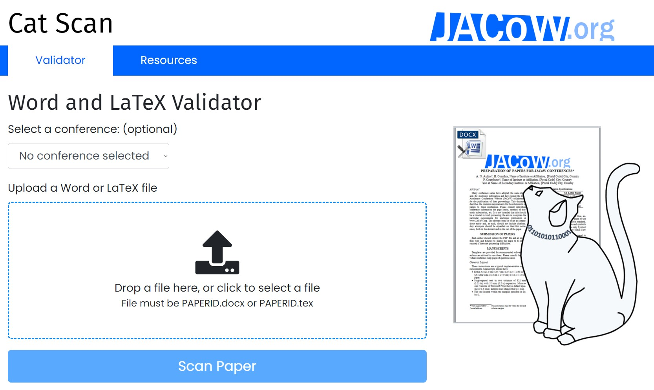
JACoW Milestones
2019 CatScan: Word DOCX Validator to examine JACoW papers ahead of submission
The second tool developed at ANSTO by Rosemary Waghorn in 2019 for the IPAC in Australia is named »Cat Scan«. It is a Word DOCX (and LaTeX) validator which detects wrong settings, material out of margins, checks sequence of citations, references, and pictures, and much more…

Slide 43
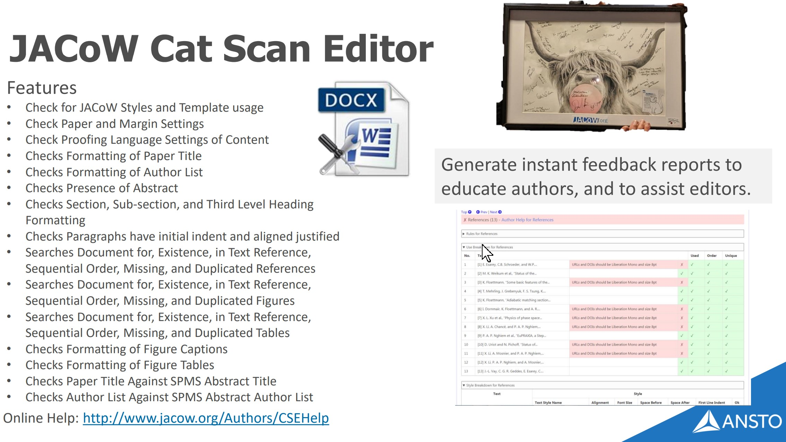
JACoW Milestones
2019 CatScan: Word DOCX Validator to examine JACoW papers ahead of submission
The second tool developed at ANSTO (by Rosemary Waghorn) in 2019 for the IPAC in Australia is named
»Cat Scan«. It is a Word DOCX (and LaTeX) validator which detects wrong settings, material out of margins, checks sequence of citations, references, and pictures, and much more…

Slide 44
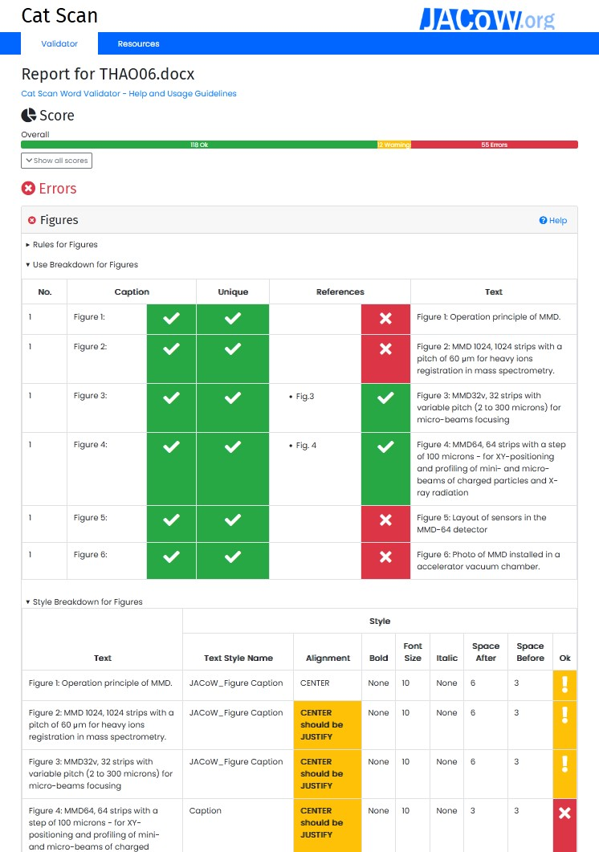
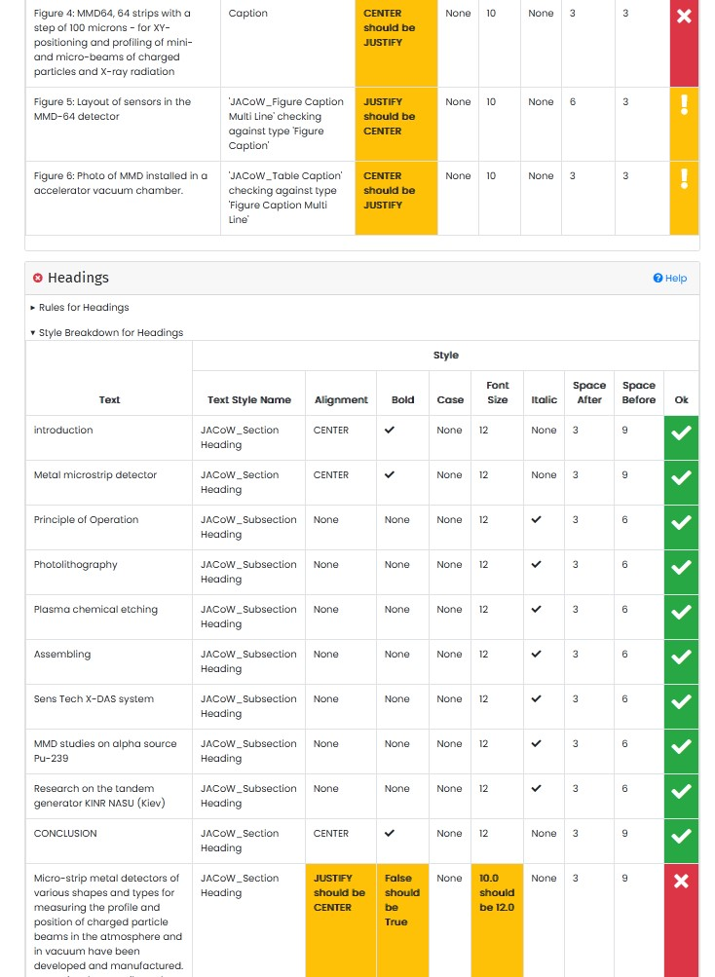
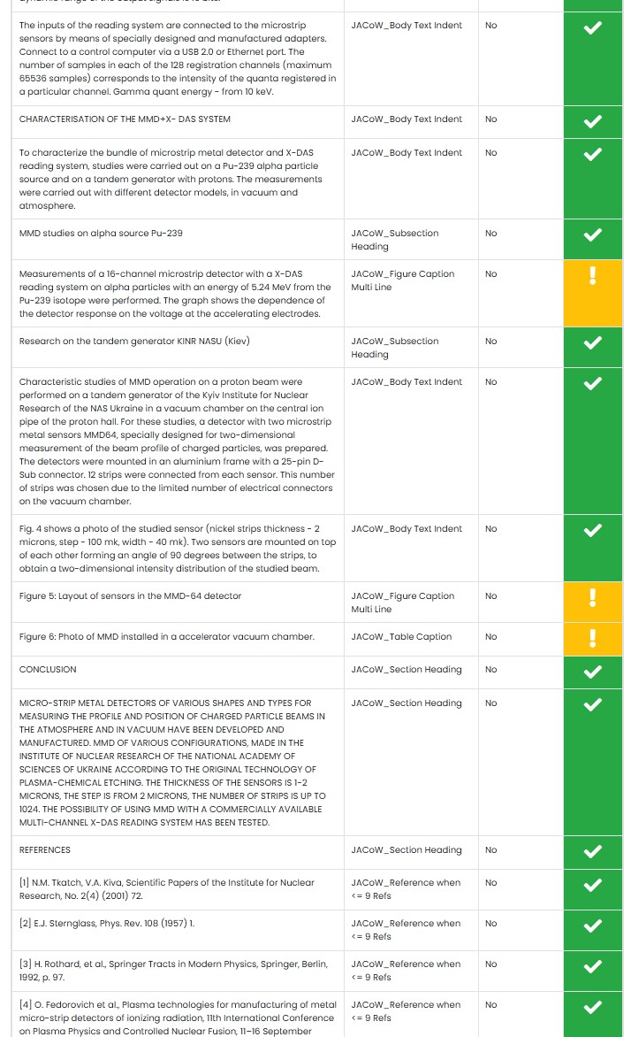
JACoW Milestones
2019 CatScan: Word DOCX Validator to examine JACoW papers ahead of submission

Slide 45
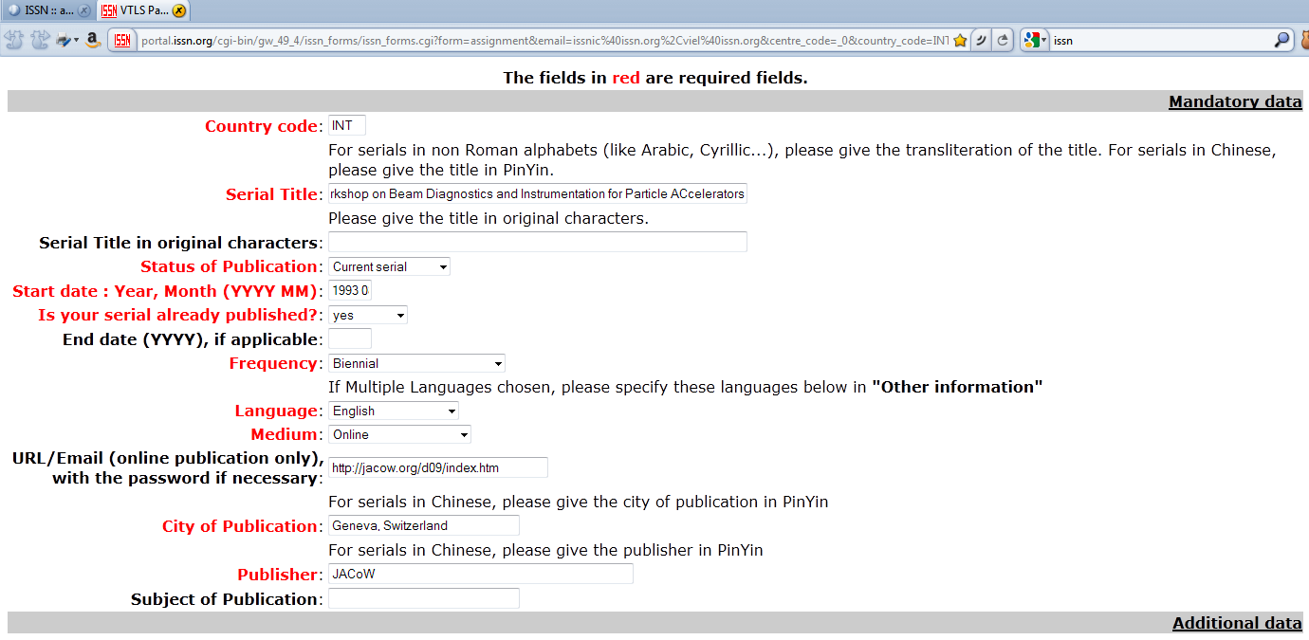
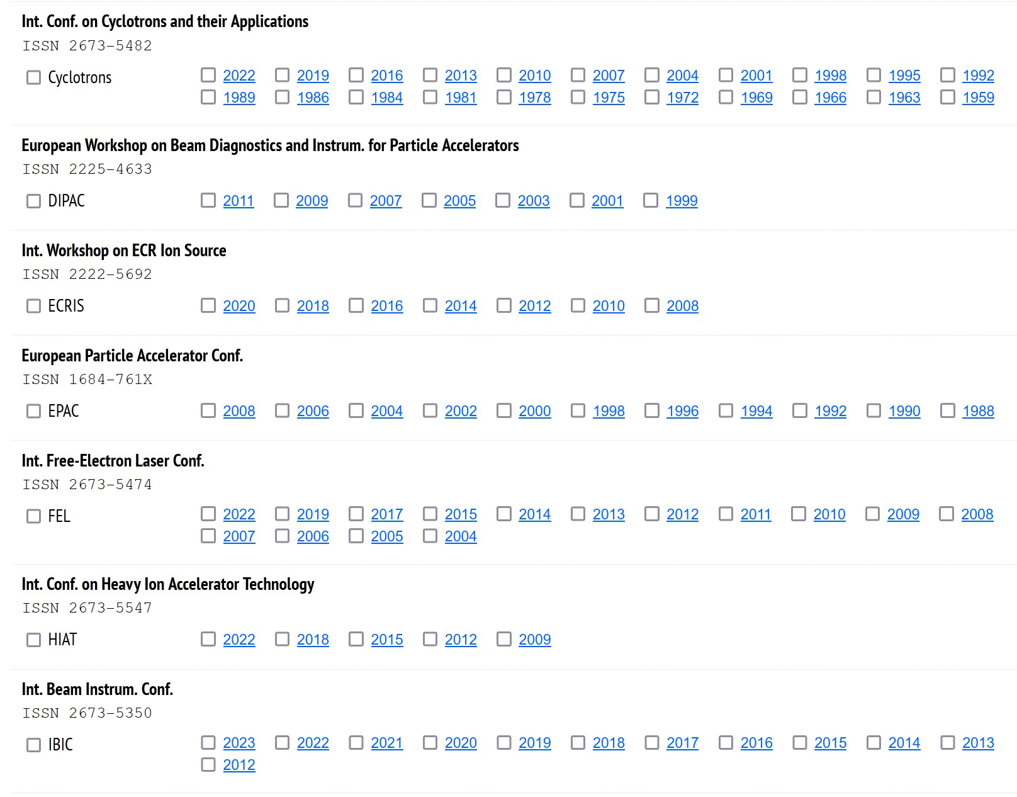
JACoW Milestones
2020 ISSN numbers for JACoW conferences Now you see the ISSNs (which are necessary for being recognized as a periodical and journal — and a need for being indexed by Scopus) on the JACoW Proceedings page: the first ISSN numbers were provided in 2011 for 4 conference series by the International ISSN Board in Paris — after this changed it took a long time before JACoW was granted ISSNs for all current conference series (2020 by the Swiss Registrar).

Slide 46
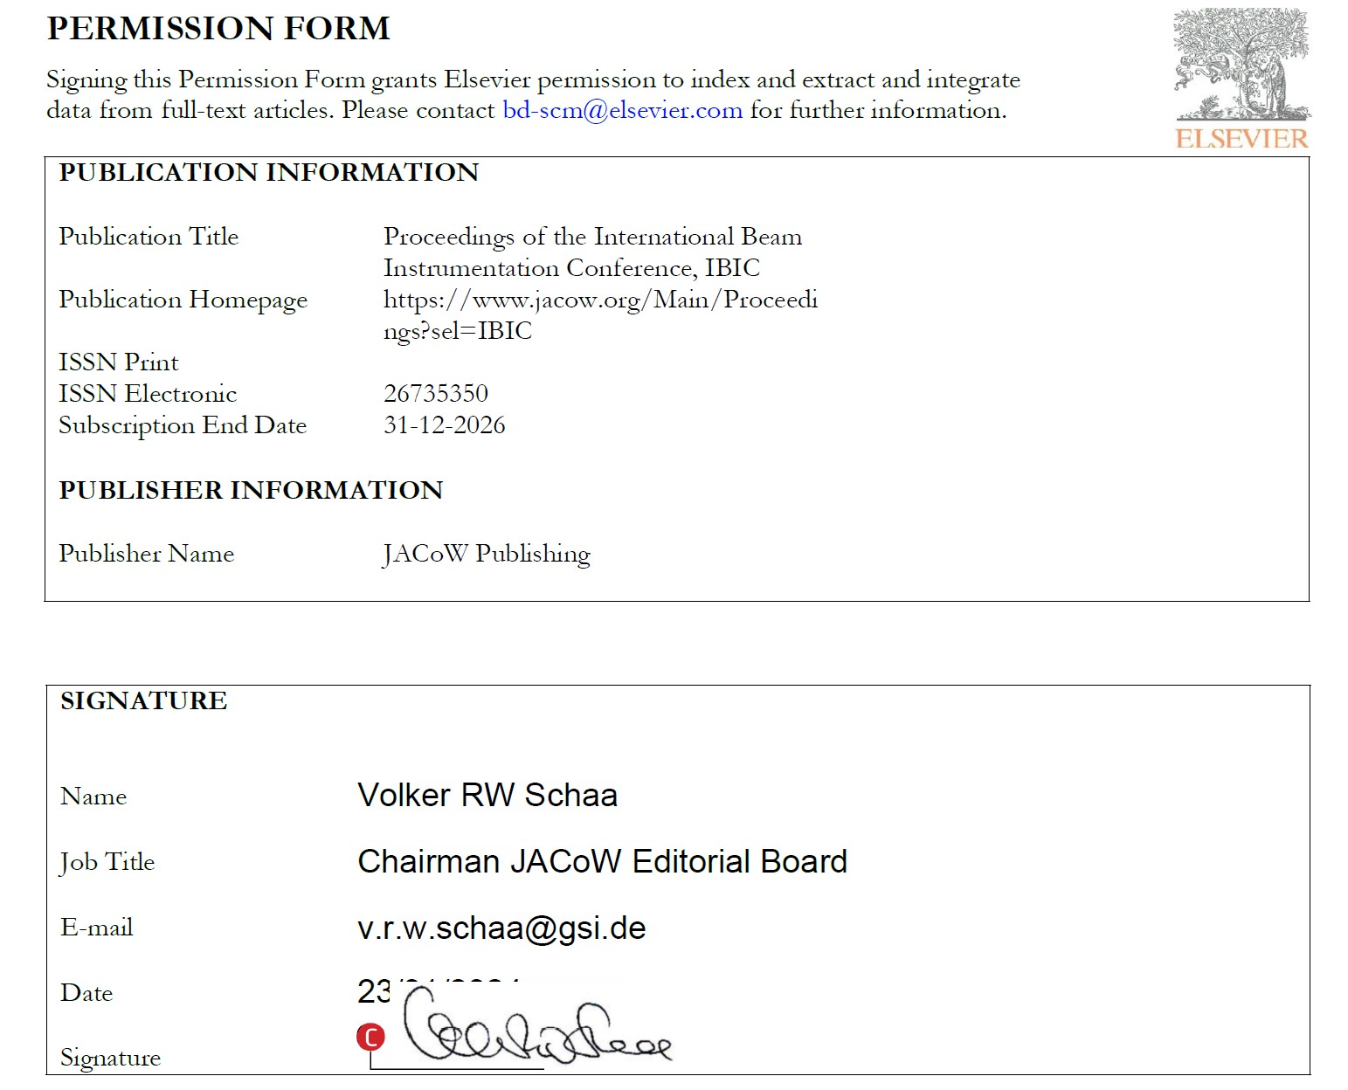
JACoW Milestones
2004 Scopus indexes LINAC and IBIC conferences
After many years of trials in 2023 we finally succeeded in getting two of our series indexed by Scopus/Elsevier. This will improve the visibility of our authors and JACoW’s rôle as publisher of quality scientific papers. My hope is that we manage to get all conference series indexed in Scopus in the near future.

Slide 47
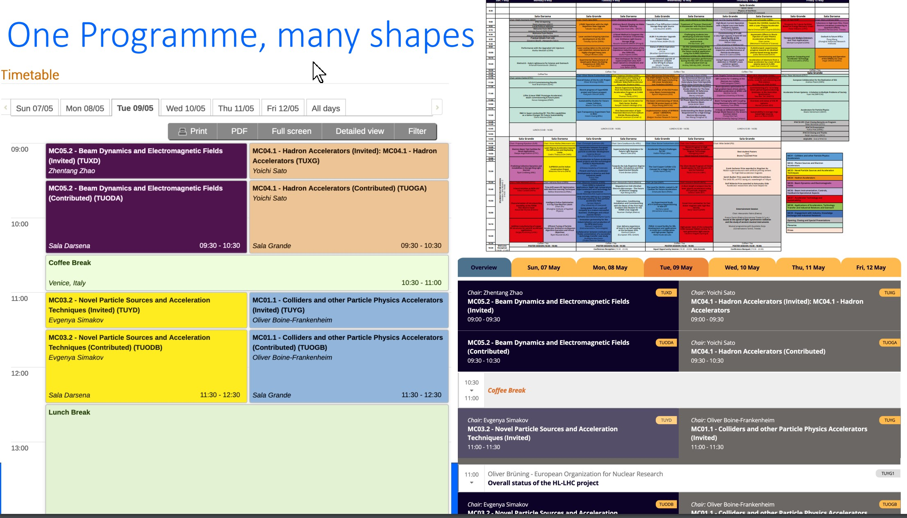
JACoW Milestones
2023 First use of a production version of the new JACoW-Indico Conference System
The SPMS Conference System on Oracle was not maintainable anymore as the sole developer Matt Arena was not available to deal with security issues which threatened the operation of conferences more and more.
Since 2016 the Indico team was involved to add functionality to the standard Indico system to make it usable for JACoW’s needs. IPAC’23 in Venice was the first time the new JACoW-Indico conference System was used in production.
More will be reported in the future about the Indico system.

Slide 48
What else is JACoW?
First place where you find excellent proceedings
A Community with requirements and rules
What are the requirements of JACoW?
What is the JACoW Charter?
What does it mean “Community”?
A Website with…

Slide 49
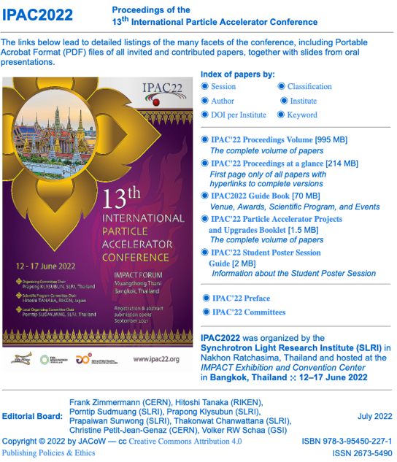
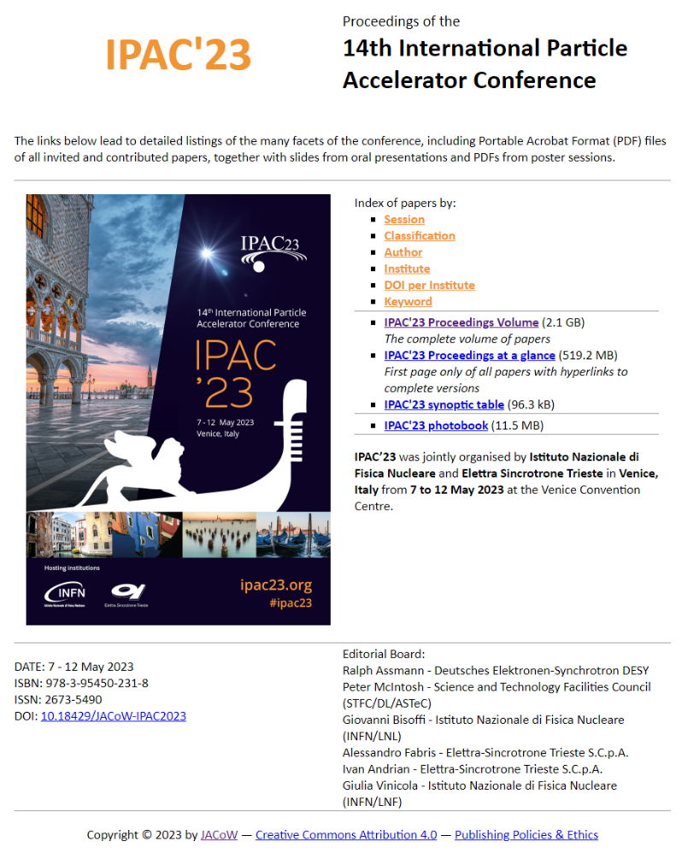
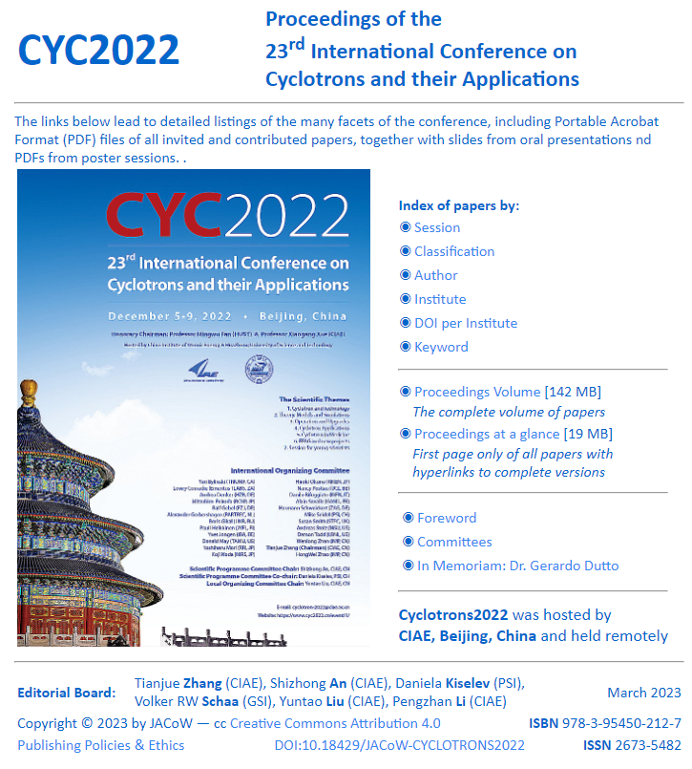

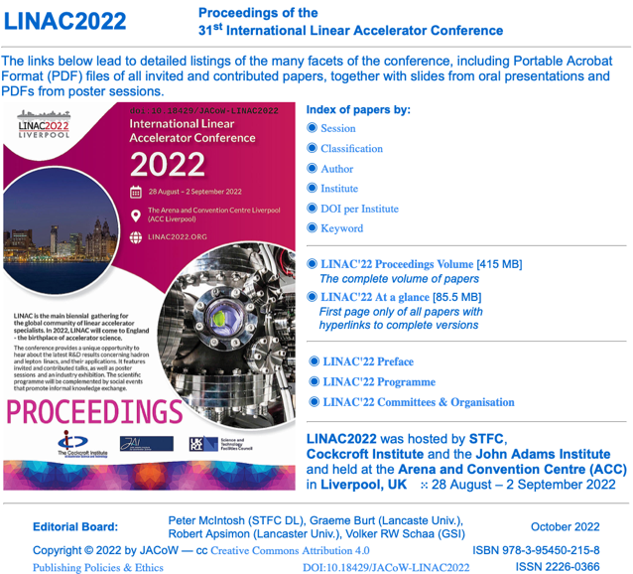
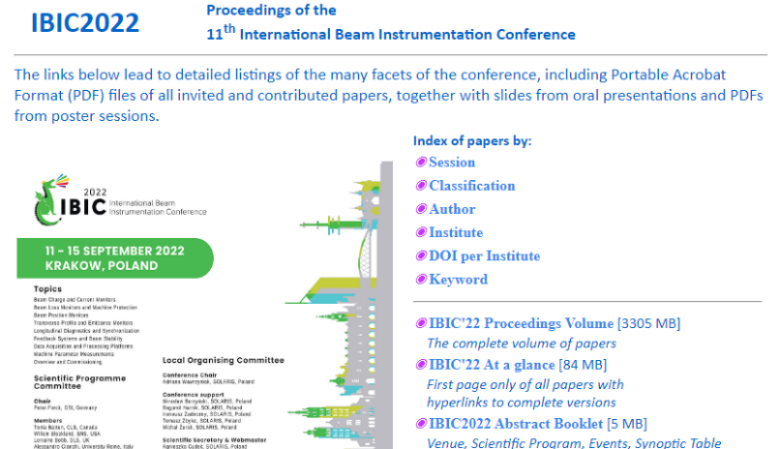
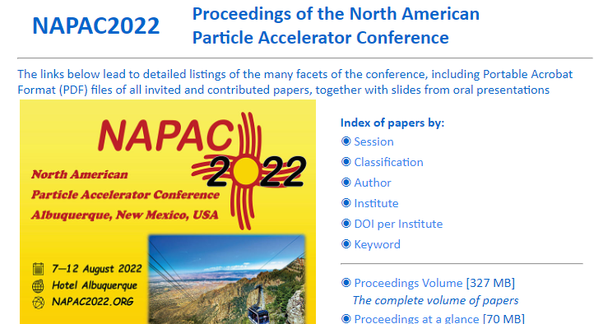
JACoW: Producing Excellent Proceedings

Slide 50
What are the Requirements of JACoW?
http://www.jacow.org/About/PoliciesRequirementsForPublishingOnJACoW
CC-BY 4.0: https://creativecommons.org/licenses/by/4.0/
Editor/IT participation in Team Meetings
Technical paper requirements
PDFs: proper metadata, margins, paper size, font embedding, version compatibility
Indico use not required
Use of Indico and repository requires agreement on repository privacy, quality, integrity
Indico new model still evolving

Slide 51
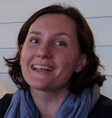
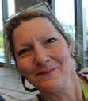
The JACoW Charter
http://www.jacow.org/About/Charter
JACoW operates according to the rules and policies of the JACoW Charter, documented on jacow.org
The charter defines less what JACoW does, more how JACoW operates.
Board of Directors composition, elections, responsibility and authority
Annual Team Meeting
Annual Stakeholder’s Meeting
(Nearly) always at IPAC to attract broadest audience
Main contacts
Chairperson Coordinator
Meghan McAteer Jana Thomson
“The existence of the JACoW site does not detract from the rights of individual conference organisers to publish their proceedings on other web sites, storage media or hard copies of their choice.”

Slide 52
What is JACoW? A Collaboration
http://www.jacow.org/About/TheCollaboration
JACoW is an international collaboration
Dedicated to prompt high-quality publication of accelerator science conference proceedings
Many stakeholders
Users of JACoW proceedings/papers
Institute representatives (Institutional “stakeholders”)
Conference representatives/organizers
JACoW Team and Board of Directors
There is often much overlap among all classes of stakeholders
:
http://www.jacow.org/StakeHolders/ListOfStakeholders

Slide 53
What is JACoW? A Website (or more)…
Joint Accelerator Conferences on the Web(sites)
Proceedings hosted by CERN and KEK
JACoW wiki/website hosted by Elettra
Proceedings scripts (Volker for SPMS, now Ivan@github for Indico)
SPMS servers hosted by CERN and KEK (Indico: CERN)
Upload/download servers hosted by PSI, Jefferson Lab, CERN
Legacy SPMS code (formerly supported by FNAL)
Source code, request tracking hosted by sourceforge
With investment in a functionality merge with Indico
We cannot hope to achieve our goals without the resources (hardware and time) provided by the support of national labs and conference series

Slide 54
JACoW: Producing Excellent Proceedings
Back to the production of proceedings and a big problem we face: the paper delivered to JACoW conferences shifted from MSWord to LaTeX
and we do not have enough LaTeX editors: WE NEED YOU!

Slide 55


JACoW: Producing Excellent Proceedings
Back to the production of proceedings and a big problem we face: the paper delivered to JACoW conferences shifted from MSWord to LaTeX
and we do not have enough LaTeX editors: WE NEED YOU!

Slide 56

JACoW: Producing Excellent Proceedings
This is the actual count of proceedings on JACoW on 2024-02-28 with 2024 adding three “new” proceedings with ICALEPCS’91, FLS’23, and ICALEPCS’23. This brings it to a total of 253 proceedings.
Actions and updates to conferences can be seen on https://accelconf.web.cern.ch/JACoW/Website-Updates.html

Slide 57

JACoW: Producing Excellent Proceedings
Updates to JACoW.org can be seen in this table showing also the number and size of file groups (PDFs of papers, talk slides, posters, photo albums, and the total size of the conference).
Currently we are at Paper PDFs: 74,642 Talk PDFs: 84,197
Poster PDFs: 88,715 Photos [MB]: 102,411
Total size [MB]: 300,253

Slide 58
JACoW: An Accelerator Community
This finishes my overview on JACoW

Slide 59
JACoW: An Accelerator Community
This finishes my overview on JACoW
It was fun to work and live here on the campus — Thank you for that!

Slide 60
JACoW: An Accelerator Community
This finishes my overview on JACoW
It was fun to work and live here on the campus — Thank you for that!
KEKの皆さんの親切な対応に感謝します。

Slide 61
JACoW: An Accelerator Community
This finishes my overview on JACoW
It was fun to work and live here on the campus — Thank you for that!
KEKの皆さんの親切な対応に感謝します。
I hope that we will meet in the near future again

Slide 62
JACoW: An Accelerator Community
This finishes my overview on JACoW
It was fun to work and live here on the campus — Thank you for that!
KEKの皆さんの親切な対応に感謝します。
I hope that we will meet in the near future again
Maybe here on the campus for a JACoW Team Meeting?

Slide 63
JACoW: An Accelerator Community
This finishes my overview on JACoW
It was fun to work and live here on the campus — Thank you for that!
KEKの皆さんの親切な対応に感謝します。
I hope that we will meet in the near future again
Maybe here on the campus for a JACoW Team Meeting? Like 2008?

Slide 64

JACoW: An Accelerator Community
Maybe here on the campus for a JACoW Team Meeting? Like 2008?

Slide 65
JACoW: An Accelerator Community
Maybe here on the campus for a JACoW Team Meeting? Like 2008?
Finally a special thank you to Kazuro for everything he did for me!

